Slide 1

Digital Only Insurance Company
PalSurance

Slide 2
Supervised by : Dr. Ahmad Shraideh.
Team members:
Aman Hout.
Rahaf Banna.
Nour Khouri.
Owais Suleibi.

Slide 3
Goals of the project:
-Pandemic contingency response.
- Bureaucratic business process wastes massive amount of resources.
-Adapt with the international shape of organizations.

Slide 4
Digital only Insurance in the palestinan industry
Based on the web without the need for physical buildings or managers
It takes advantage of a global pandemic and unfulfilled demand in the Palestinian Market
Local companies fail to meet certain embassies standards.
Data Mining and detection fraud

Slide 5
Co-Founding the company
We understood the legal procedures for co-founding the company.
Visited local companies to understand the business process for obtaining an insurance policy
Analysed which customer segmentations should be targeted.

Slide 6
What is PalSurance?
PalSurance is a digital- only insurance company that is based on the web and clouding services it allows customers to obtain travel insurance policy in minutes. The service is available for locals in Palestine and Internationals from all around the globe.

Slide 7
Why PalSurance?
-PalSurance provides digital, fast, reliable, and authenticated policy.
-It saves you from unnecessary bureaucracy that costs money and time in traditional organizations.
- Insurance claims can also be processed through our digitized service.

Slide 8
PalSurance Vs. Insurance Companies
-Estimated time (Signing up -> Claiming the insurance) 15-20 mins
While traditional insurance companies takes up to two days.
-Availability of all the information needed.
-Accessibility
-Costs
Notes:
Free license because we will get it from Austria
Less costs on the customer on the insurance
Less costs on us also because we have no buildings and no customers

Slide 9
Goals of PalSurance.
-To create a safe environment for customers to be able to receive their travel insurance policy from home , taken advantage of World Pandemics like (Covid-19).
-To be the first mover in this digital industry.
-To cultivate digitization and expand our company to provide all types of insurance.

Slide 10
Programming languages
-Html , CSS
-Php
-Java Script
-JQuery
-MySql
Notes:
UI/UX , The colors we used

Slide 11
Tools/ Apps we used:
-Xamp.
-Php MyAdmin .
-Visual Studio Code.

Slide 12
The buying journey:
Awareness
Consideration:
Decision

Slide 13
Story of PalSurance

Slide 14
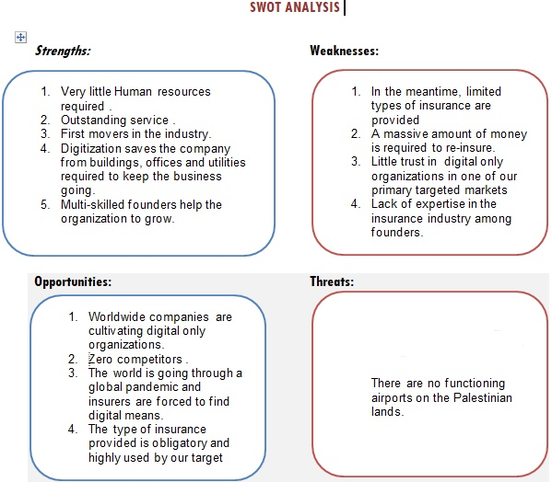

Slide 15
Marketing Objectives:
-Increase our travel insurance market share
-High rate of customer retention.
-Cultivate digital only insurance in Palestine to create future opportunities for PalSurance.
-Recruiting local travel agencies.

Slide 16
Problems we faced:
-Low knowledge in Coding.
-Time wasted on limited account on Wix.
-Hard times gathering information from insurance companies.

Slide 17
THANK YOU!
Any questions?

