Slide 1
A Study on Labor Market For Graduates Of Management Information Systems In Palestine
Done by Students:
Sana’a Sharea and Maysam Nassar
Supervisor: Dr. Safa’a AbuJarour

Slide 2
Content :
Introduction and purpose
Research Question
literature review
Methodology of study
Participants
Instrument
Results
Discussion
Referance

Slide 3
Introduction and purpose
The main reason for doing this research is to study the status of MIS graduates in the labor market
Because of the lack of awareness and knowledge of the management information systems specialization in Palestinian companies and the problems that students face in practical training

Slide 4
Research Question
1. What are the difficulties facing graduates of management information systems in the labor market?
2. From students’ point of view, what do Palestinian companies know about the management information systems specialization and what are the job opportunities could they provide to MIS graduates?
3. What are the recommendations to connect MIS graduates and University?

Slide 5
Literature Review
Management Information system
The major in Management Information Systems is one of the specializations of the College of Information Technology. It includes several fields and several branches, including technology, marketing, accounting, finance, quality assurance, and human resources.( O'brien, J. A., & Marakas, G. M. (2006)

Slide 6
Literature Review
Labor Market for Mis graduates
The MIS employee plays an important role in developing business strategies and policies, and specialization occupies a large place in education in many governments
Palestinian decision makers face unusual challenges to provide job opportunities especially in light of the low investment and lack of job opportunities in the Palestinian territories (Salas-Velasco, M. (2021)

Slide 7
Literature Review
Graduates
There is a decrease in the opportunities of graduates to enter the labor market due to several factors, the problem of unemployment among graduates, and the requirements of education and education with the requirements of the labor market. (Laudon, K. C., & Laudon, J. P. (2015))

Slide 8
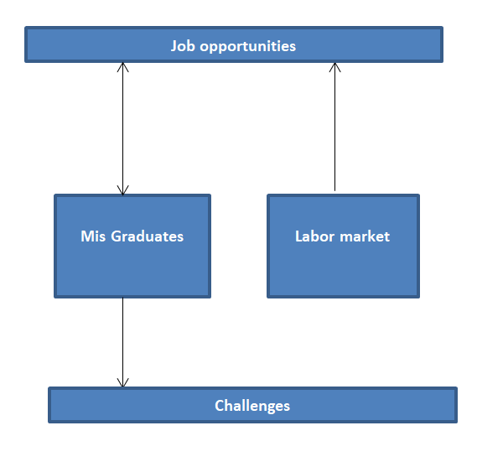
Model of research

Slide 9
Methodology of study
This study is conducted in the May 2022
We used quantitative research method. The study was directed to graduates of management information systems.
We used a questionnaire to collect data from graduated

Slide 10
Participants
The participants of this study were 110 graduates of management information systems from different universities.
The Questionnaire was published in groups on social media
(Facebook , What'sup , Instagram , Email) .
108 responses are valid and were considered in our analysis

Slide 11
Instrument
In order to gather the needed data for this study the researcher prepared a questionnaire.
. The questionnaire consisted of two parts
the first part included the Demographic of the graduates such as gender ,Age ,and Graduation Year ?
. the second part includes 12 statements which examine Position of graduates in the labor market and job search.

Slide 12
Results
The aim of this research is to explore the status of MIS graduates in the labor market. In this section, we analyze the results we collected from the questionnaire. Below we present the results we collected .
Tools: Spss , Google Form Analytic.

Slide 13
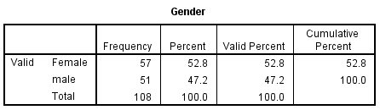
Part 1: Demographic
Gender

Slide 14
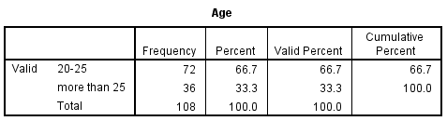
Age

Slide 15
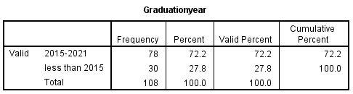
Graduation Year

Slide 16
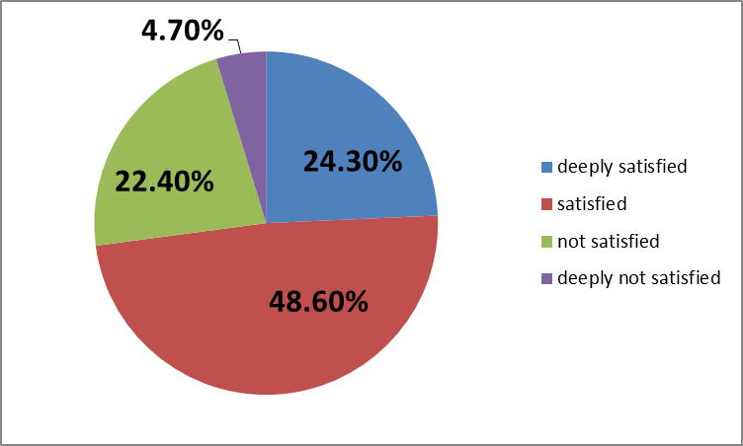
Are you satisfied with entering the specialty?

Slide 17
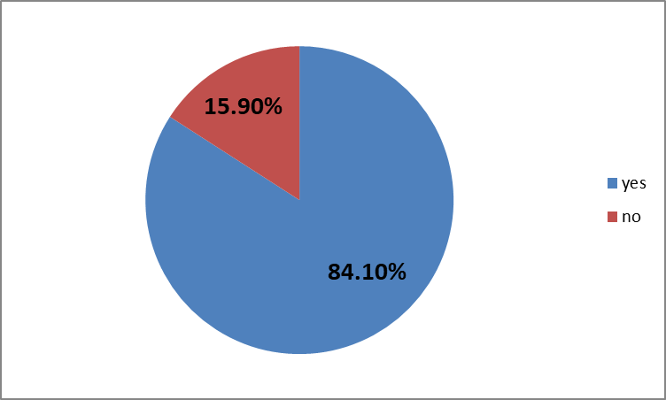
have you ever applied for a job in the field of specialization?

Slide 18
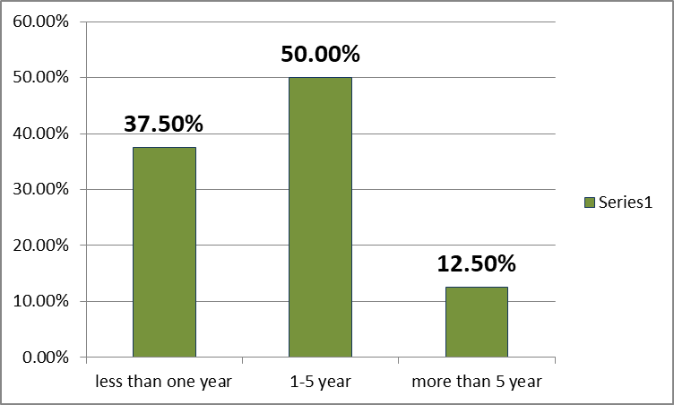
The number of years work

Slide 19
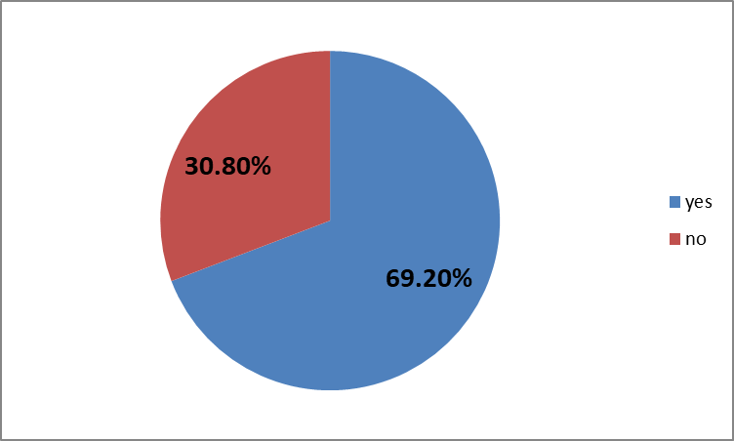
Did you benefit from studying the specialization in the labor market?

Slide 20
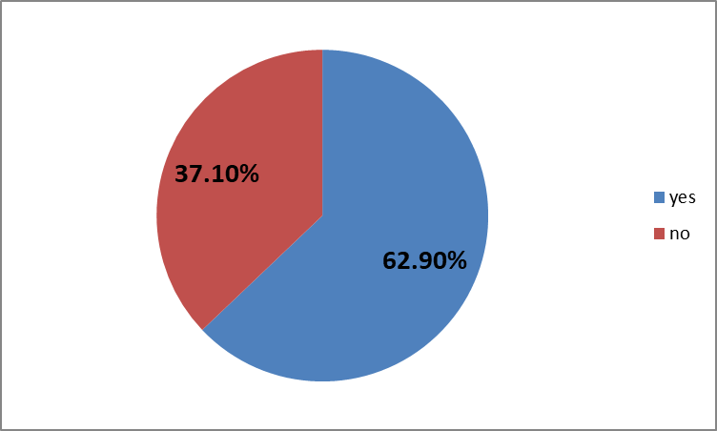
Did you find it difficult to find a job?

Slide 21
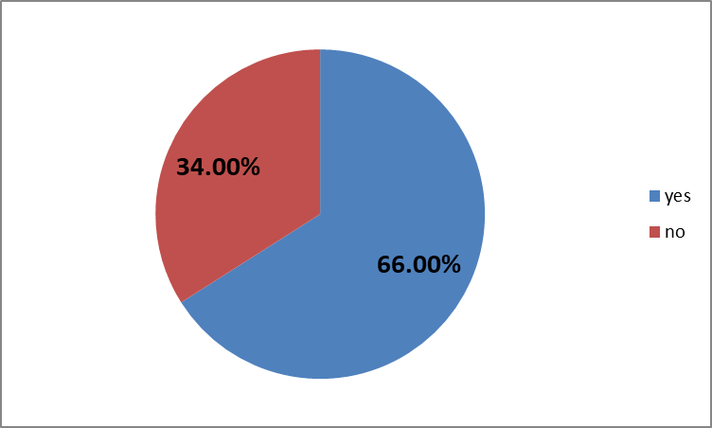
Is there discrimination between males and females in the labor market?

Slide 22
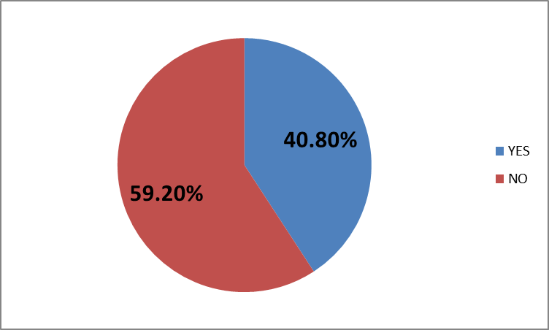
Were the companies you applied to work with understanding the nature of your work as a Mis graduate?

Slide 23
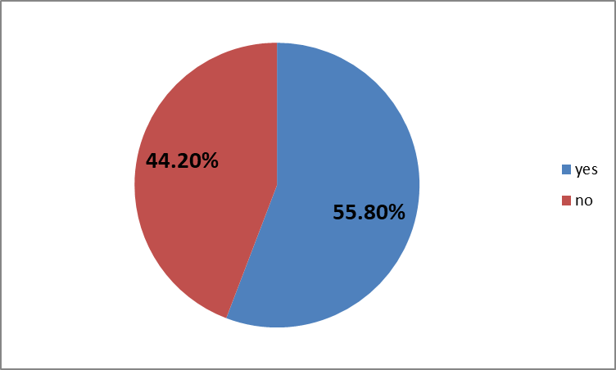
Have you noticed a require for management information systems specialization in the labor market

Slide 24

Did you need to take courses to be able to enter the labor market

Slide 25

Did you face a problem in the labor market as a graduate (Mis) compared to similar specialties?

Slide 26
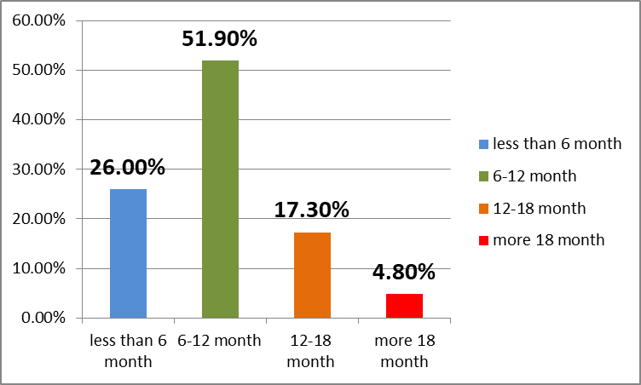
How long does it take to search for a job?

Slide 27
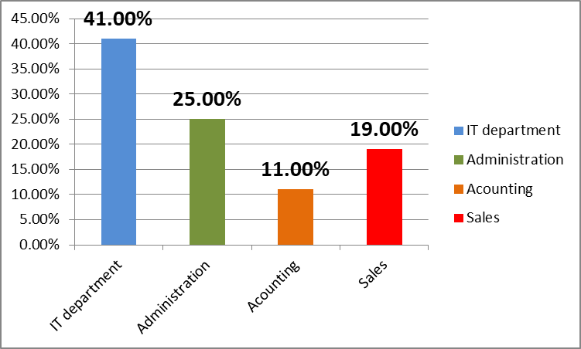
in which department of the company have you been hired?

Slide 28
Discussion
What are the difficulties facing graduates of management information systems in the labor market?
Difficulty finding a job
Discrimination between males and females in the labor market
Lack of companies' knowledge of the specialty and the nature of its work

Slide 29
2. From students’ point of view, what do Palestinian companies know about the management information systems specialization and what are the job opportunities could they provide to MIS graduates?
Through the results, it became clear to us that many companies have a lack of knowledge regarding the management information systems specialization. In job interviews, the graduate needs to explain more about the specialization than to introduce himself and his skills.

Slide 30
3. What are the recommendations to connect MIS graduates and Palestinian companies in the labor market?

Slide 31
For University:
Focus on what the labor market needs
Focus on a specific part of the specialization
Introducing the practical course in companies since the beginning of the third year at least, so that we can start directly in the labor market with experience
Introducing Palestinian companies to the importance and important role played by a graduate of management information systems within the company and assisting them in improving and developing their business

Slide 32
For Graduates:
Graduates are ambassadors of the specialization and they are responsible for introducing companies to their specialization by proving their worth in the jobs they obtain and proving themselves in the labor market .

Slide 33
Reference
O'brien, J. A., & Marakas, G. M. (2006). Management information systems (Vol. 6). McGraw-Hill Irwin.‏
Salas-Velasco, M. (2021). Mapping the (mis) match of university degrees in the graduate labor market. Journal for Labour Market Research, 55(1), 1-23.‏
Laudon, K. C., & Laudon, J. P. (2015). Management information system. Pearson Education India.‏

