Slide 1
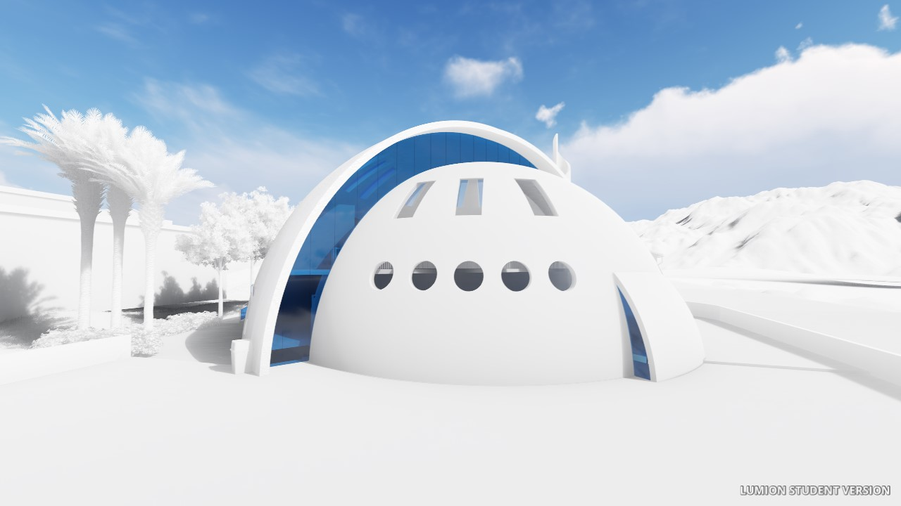

Integrated design of masjed
An-Najah National University
Presented by:
Sharaf Khalefa
Hussam Alaker
Saeed Abo Shamleh
Supervisor : Eng. Ala’a Shaheen
21/12/2017

Slide 2
outline
Introduction
Site analysis
Architectural design
Environmental design
Structural design
Electrical design
Mechanical design
Safety
Quantity Survey

Slide 3
Introduction
The masjed is a house of worship for Muslims . The masjed typically consists of a large lounge building and services places

Slide 4
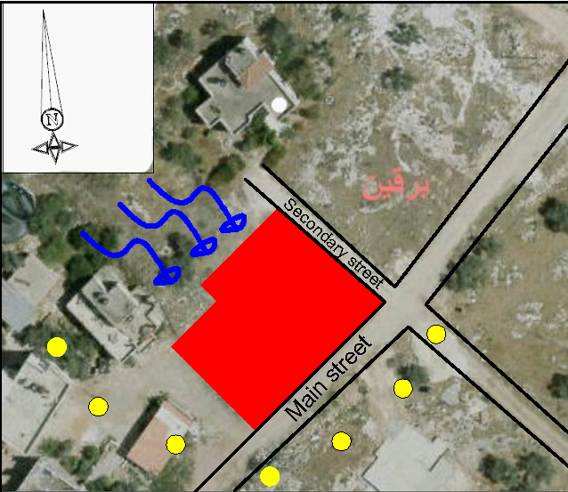
Site Analysis
Land area = 1223 m²
Building area = 834m²
The topography of the land : two level with 3 meter difference between them

Slide 5
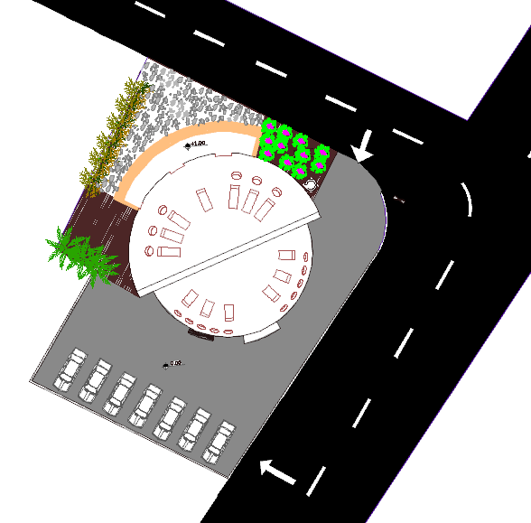
Architectural design
Site plan

Slide 6
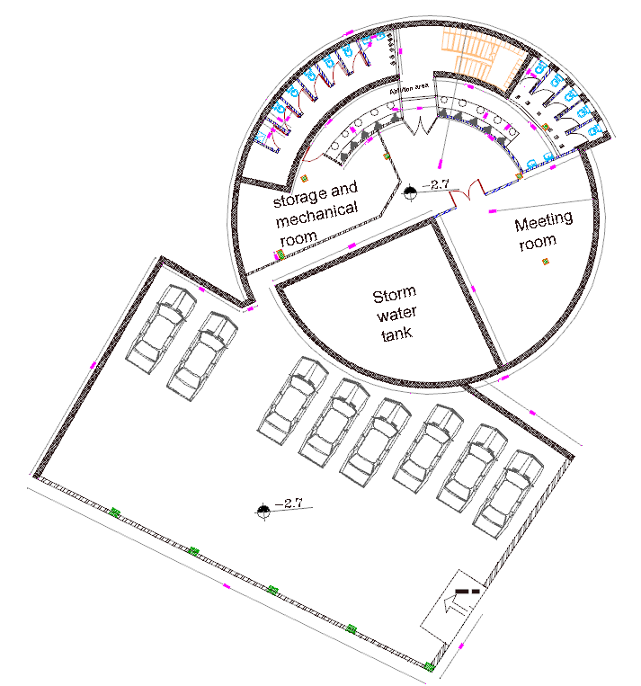
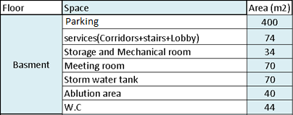
Architectural design
Basement

Slide 7
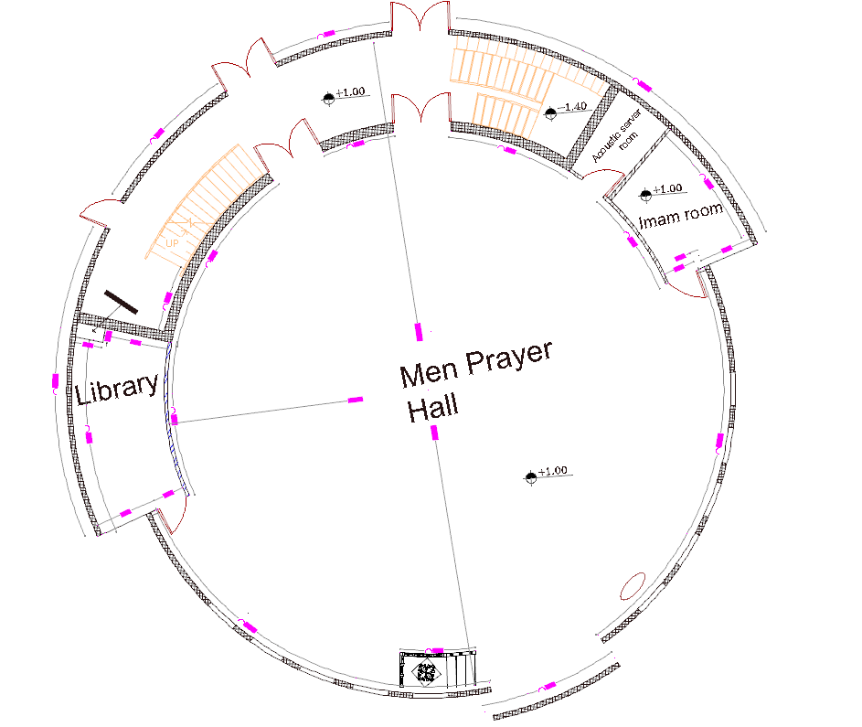
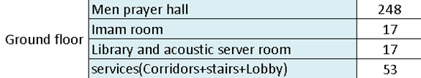
Architectural design
Ground floor

Slide 8
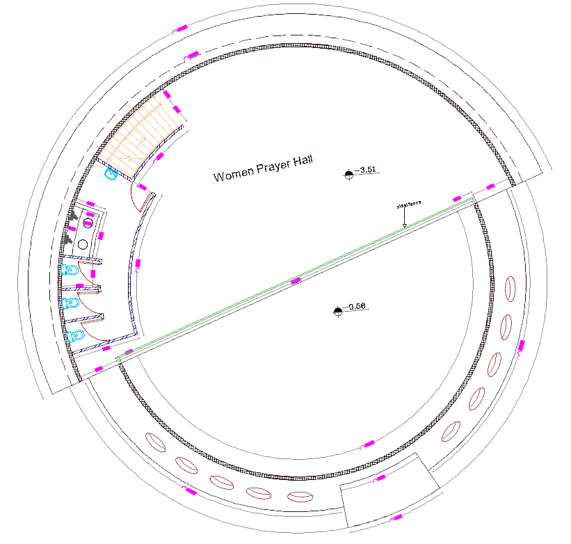

Architectural design
First floor

Slide 9
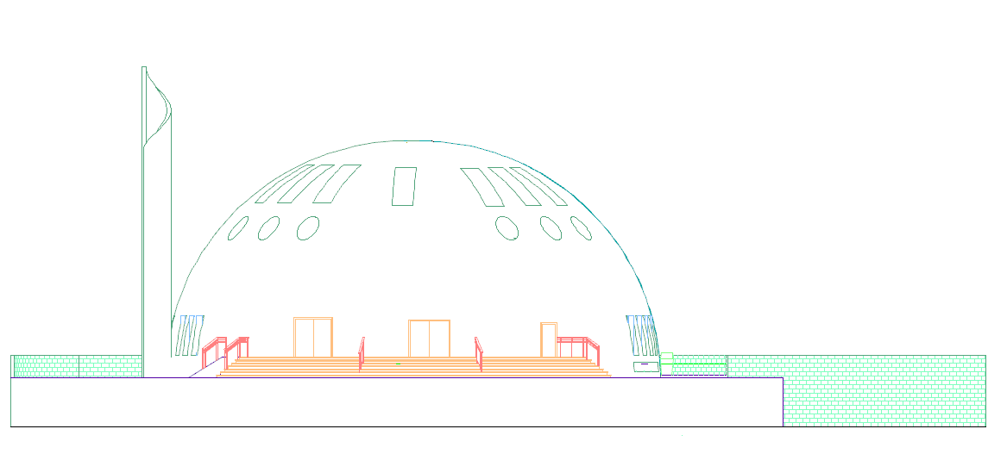
Architectural design
Northern
elevation

Slide 10
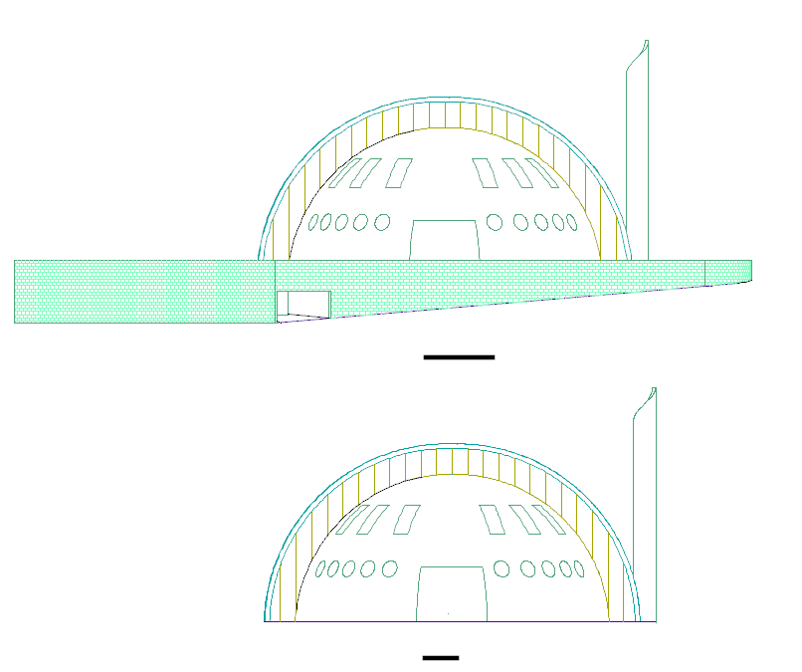
Architectural design
Southern
elevation

Slide 11
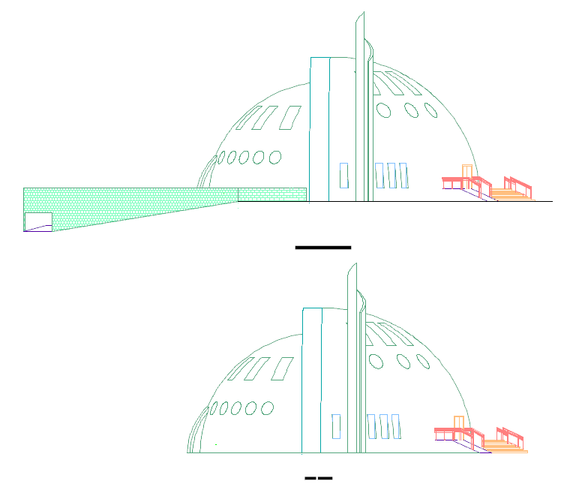
Architectural design
Eastern elevation

Slide 12
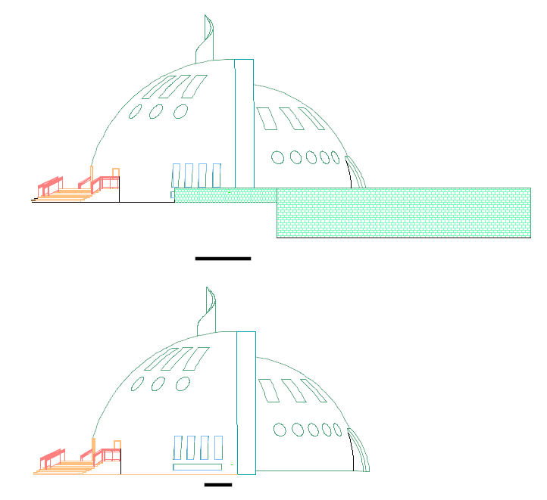
Architectural design
Western
elevation

Slide 13
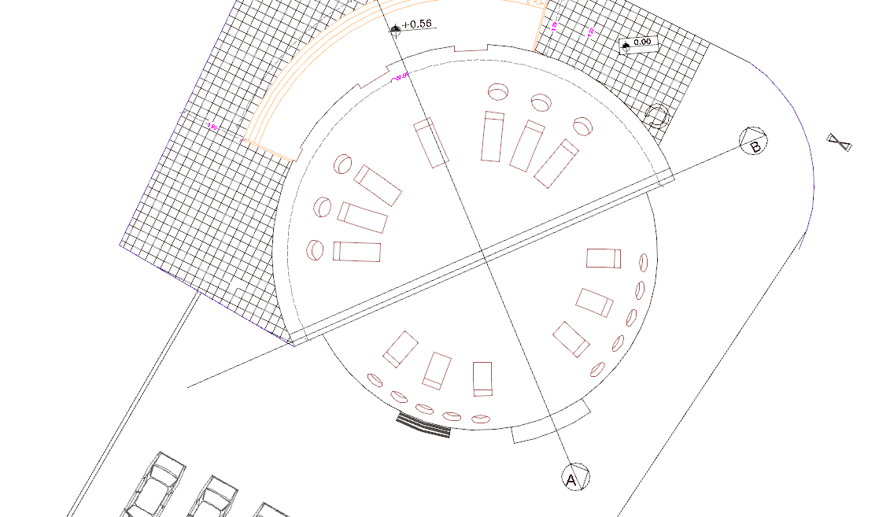
Architectural design
Sections

Slide 14
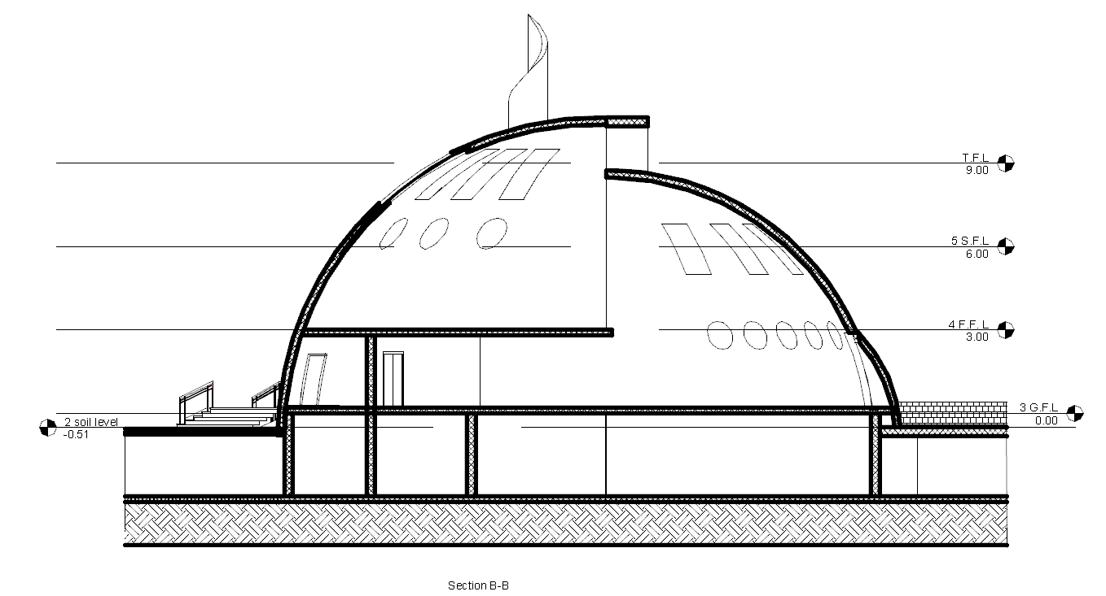
Architectural design
Section A-A

Slide 15
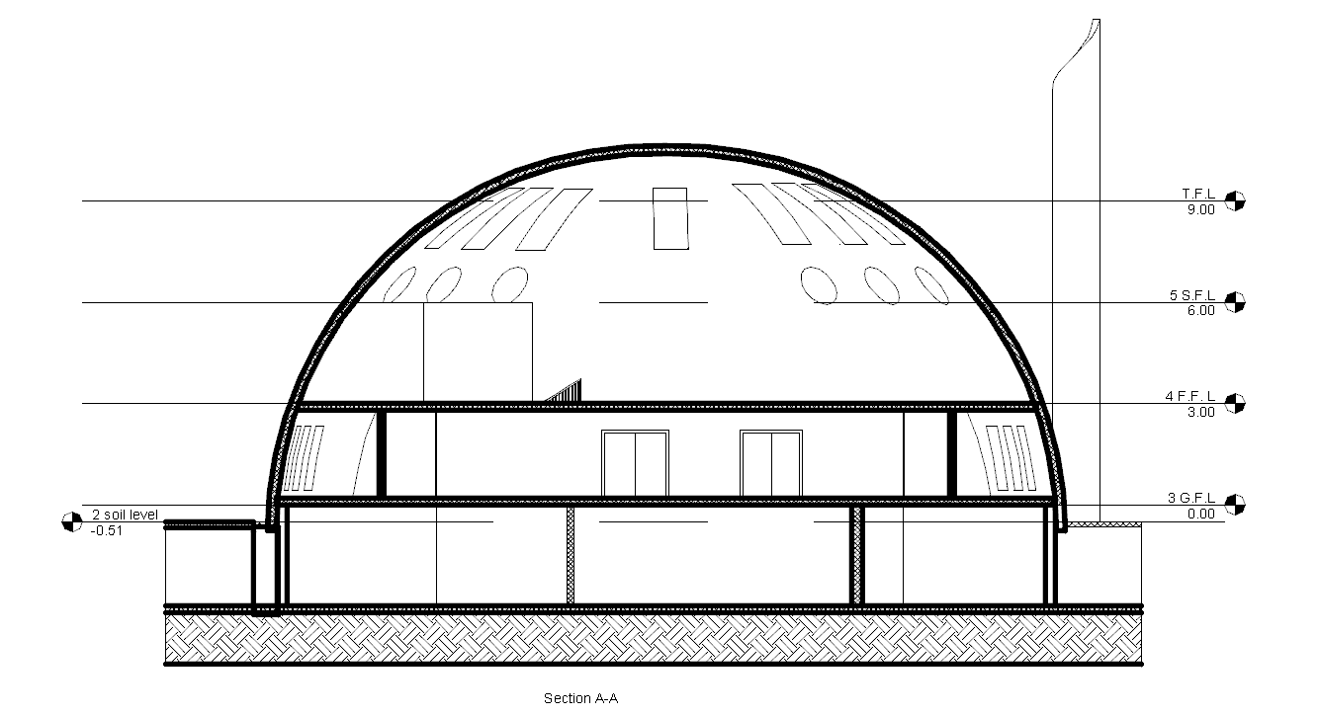
Architectural design
Section B-B

Slide 16
Architectural design
3D-view

Slide 17
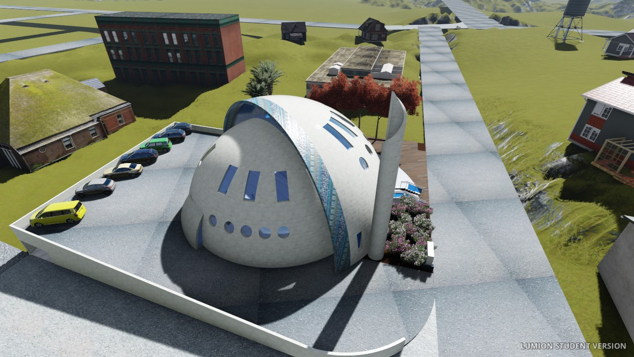
Architectural design
3D-view

Slide 18
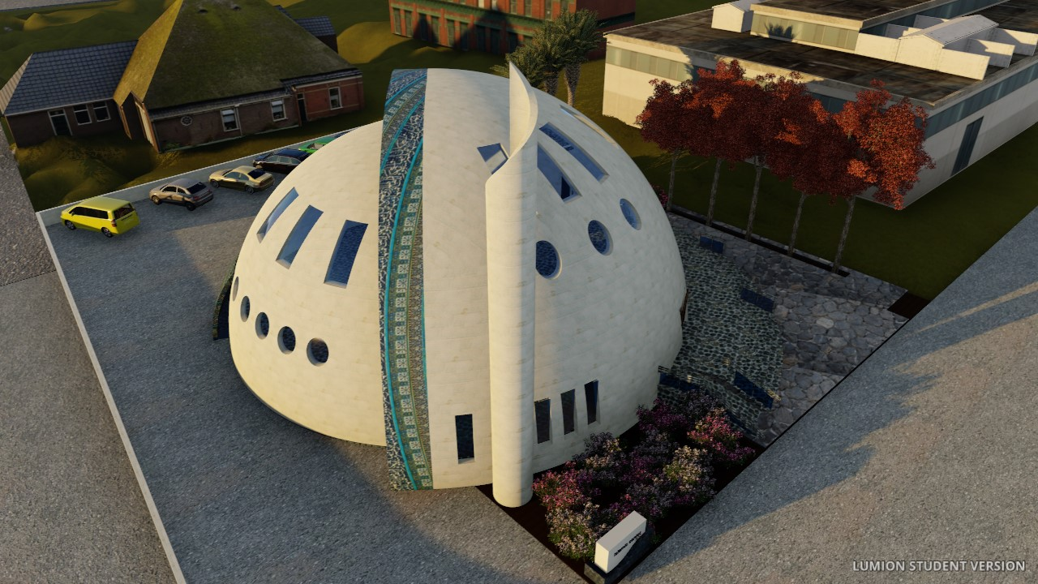
Architectural design
3D-view

Slide 19
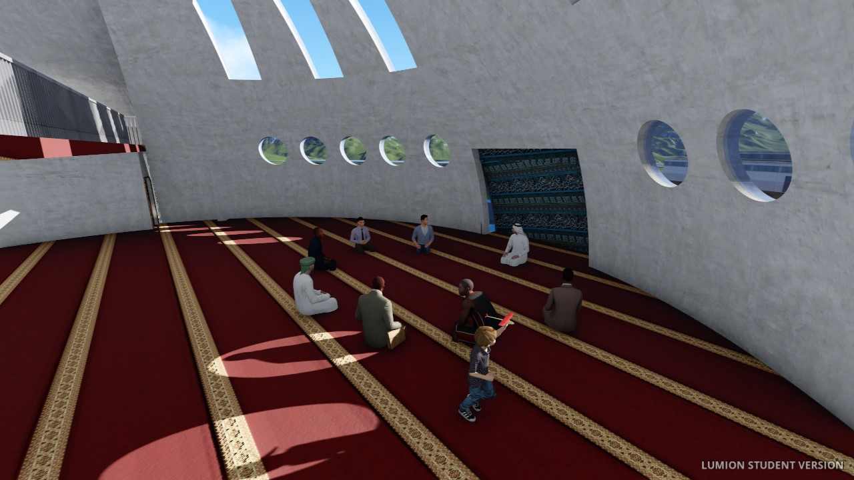
Architectural design
3D-view

Slide 20
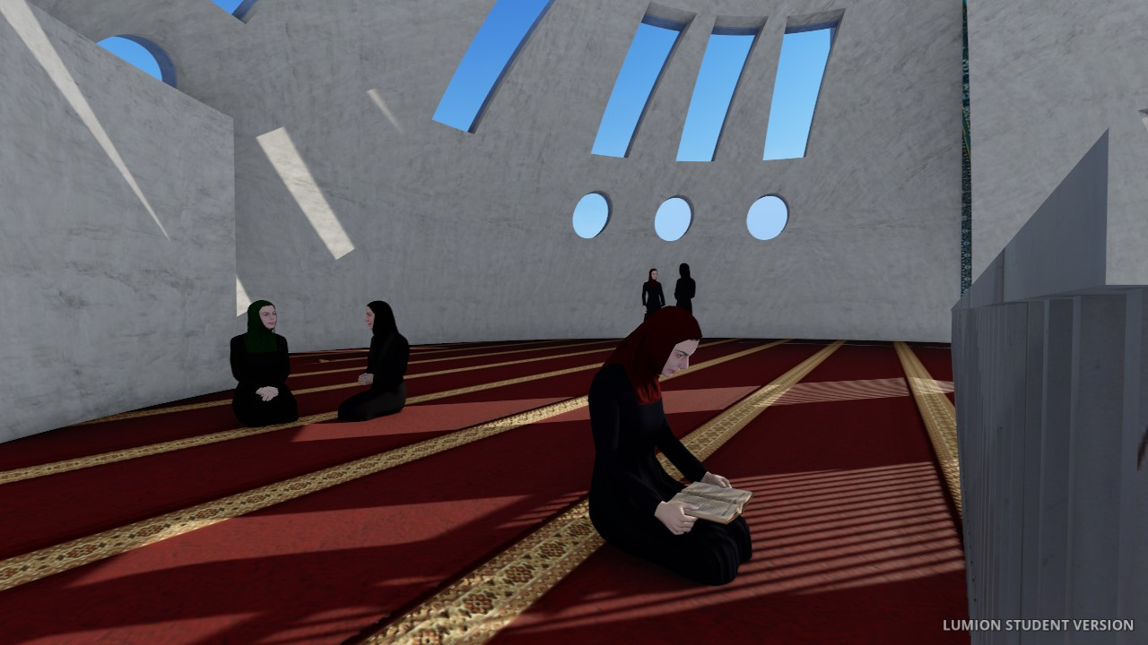
Architectural design
3D-view

Slide 21
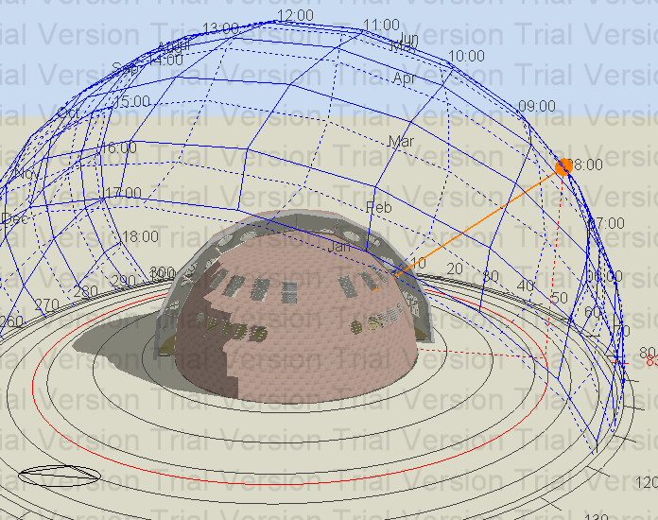
Environmental Design
Building Shadow at 8:00 am on 21th Jun..

Slide 22
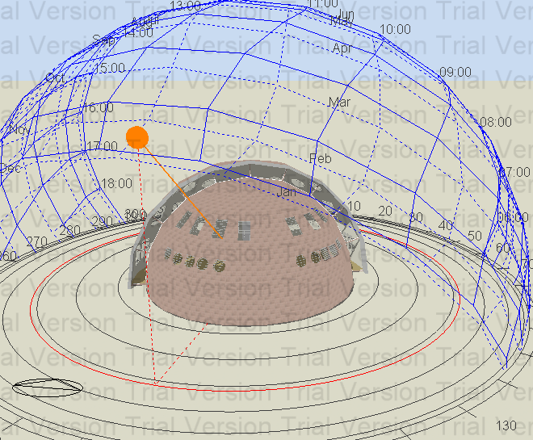
Environmental Design
Building Shadow at 12:00 am on 21th Jan..

Slide 23
Environmental Design
Materials
Elements | U-value (W/m2-k)
External walls | 0.628
Internals walls | 1.616
Ground slab | 0.58
Glass | 1.686

Slide 24
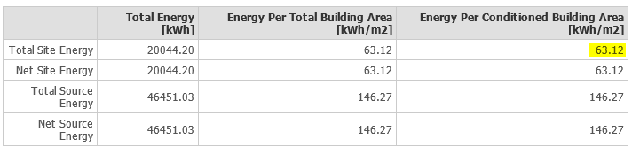
Environmental Design
Thermal analysis.

Slide 25
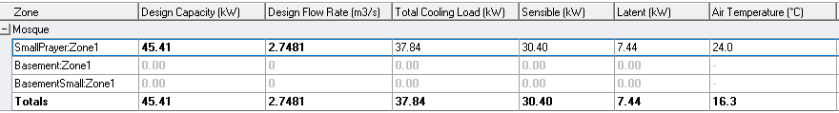
Environmental Design
Design capacity= 45.41 KWh for masjed

Slide 26
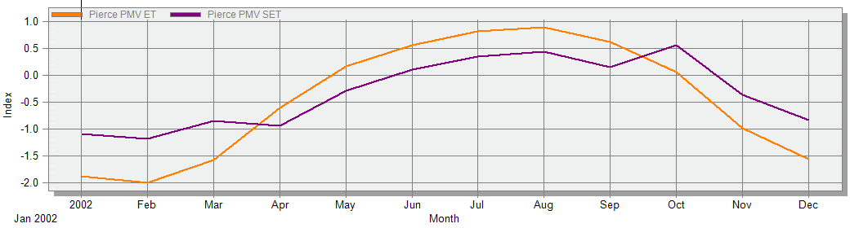
Environmental Design
Thermal comfort

Slide 27
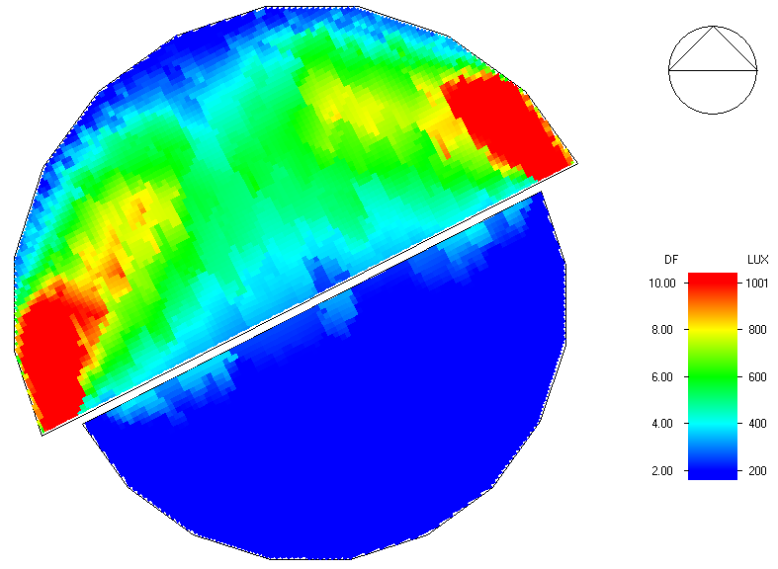
Environmental Design
Daylight factor , Avg DF=4.87%

Slide 28
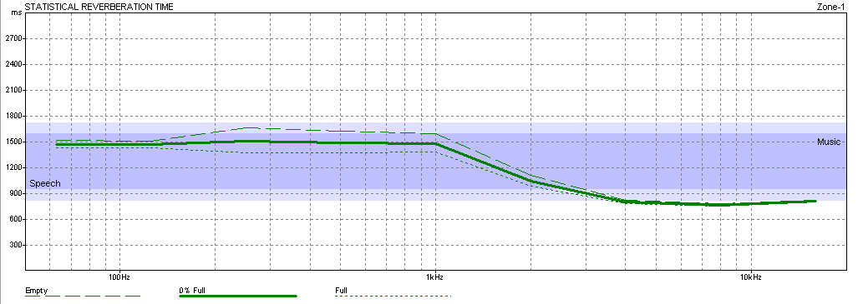
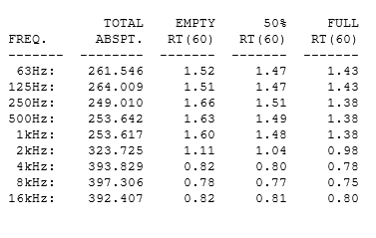
Acoustical design

Slide 29
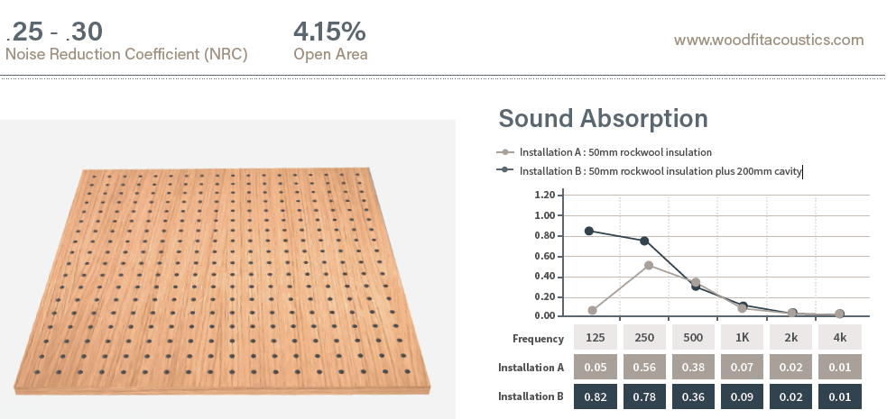
Acoustical design
Acoustic improving
Perforated acoustic panels.
Plaster Joists .
Wood decoration.
Books shelves .

Slide 30
Acoustical design
STC and IIC
Elements
External wall with glass | STC=45dB
Ceiling (mezzanine floor) | STC= 65dB
Ground Slab | IIC=78dB

Slide 31
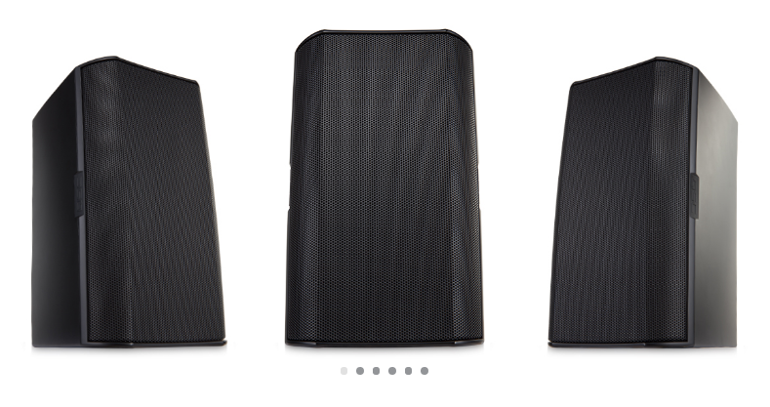
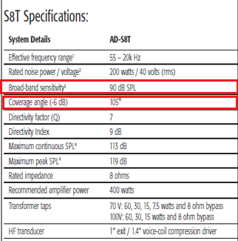
Acoustical design
AD-S8T Type (wall mounted)
Specifications
Dimensions: 254 mm width
440 mm height

Slide 32
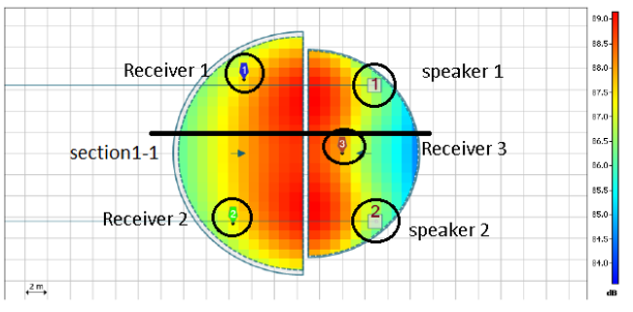
Acoustical design
By Ease Focus program

Slide 33
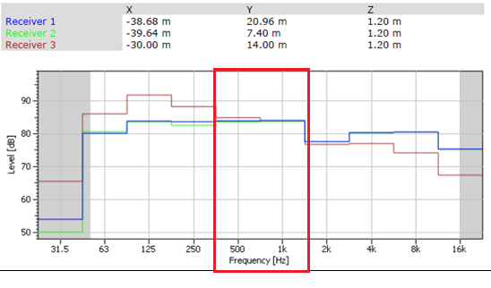
Acoustical design
By Ease Focus program

Slide 34
Acoustical design
AL% | S/N (dB) | SpL (dB) | Distance (m)
12 | 50.2 | 85.2 | 0.5
12 | 44.6 | 79.6 | 1
12 | 39.9 | 74.9 | 2
12 | 38 | 73 | 3
12 | 37 | 72 | 4
12 | 36.5 | 71.5 | 5
12 | 36.2 | 71.2 | 6
12 | 36 | 71 | 7
12 | 35.9 | 70.9 | 8
12 | 35.8 | 70.8 | 9
12 | 35.7 | 70.7 | 10
12 | 35.7 | 70.7 | 11
12 | 35.6 | 70.6 | 12
12 | 35.6 | 70.6 | 13
12 | 35.6 | 70.6 | 14
12 | 35.6 | 70.6 | 15
12 | 35.6 | 70.6 | 16
12 | 35.5 | 70.5 | 17
12 | 35.5 | 70.5 | 18
When the absorption factor
is taken into account
SPL around 70db .
Al% =12 .
Which is acceptable.

Slide 35
Structure design
Codes and Standards:
(ACI 318) for RC Structures Design
(UBC 97) for Earthquake Loads
(ASCE 7 2010) for loads computations

Slide 36
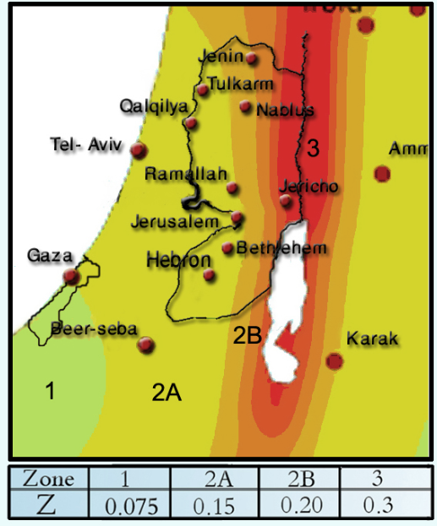
Structure design
Loads
Live Load = 5 KN/m2
SID= 5.65 KN/m2
Lateral loads:
Jenin city.
The seismic zone factor Z=0.2.
The soil profile is type Sc.
The Acceleration seismic coefficient Ca=0.24
The Velocity seismic coefficient Cv=0.32.
The Seismic importance factor is 1.25.
The structural design type is intermediate, R=5.5

Slide 37
Structure design
Material
Compressive strength of Concrete f′c=28 MPa
Yielding strength of steel Fy = 420 MPa.

Slide 38
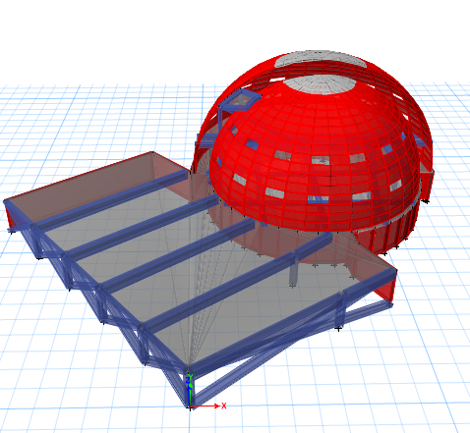
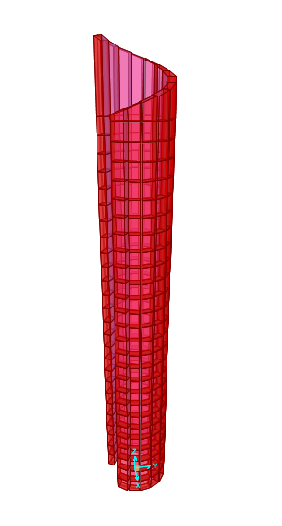
Structure design
3D Modeling For Masjid & Minaret .

Slide 39
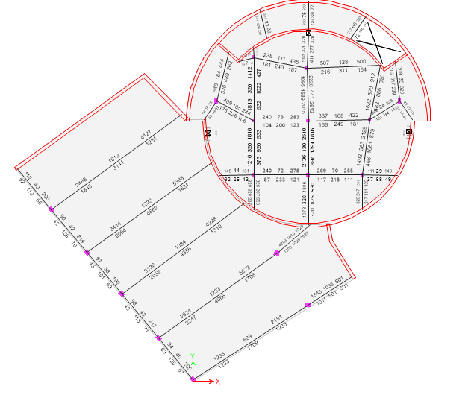
Structure design
Beam Distribution For Ground Floor .

Slide 40
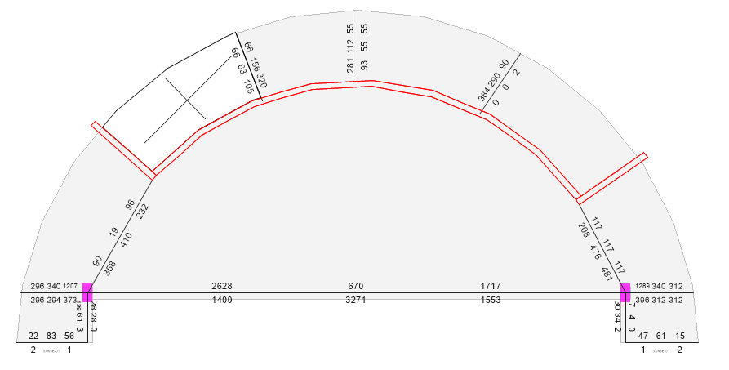
Structure design
Beam Distribution For First Floor .

Slide 41
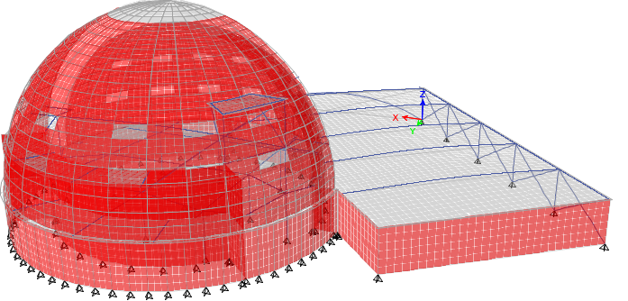
Structure design
Checks:
1.Compatibility Check

Slide 42
Structure design
2.Equilibrium Check
Load | manual calculation(KN) | Etabs calculation(KN) | %Error
Dead | 9306.81 | 9523.011 | 2.27
Live | 4809.7 | 4784.479 | 0.53
SID | 3794 | 3770.052 | 0.64
Element | Manual calculation(KN.m) | Etabs calculation(KN.m) | %Error
Slab1 | 37.66 | 36 | 4.61
beam2 | 120 | 111.3 | 7.82
column7 | 797.52 | 769 | 3.71
3.Internal Forces Check

Slide 43
Structure design
4.Deflection check.
5.Drift check.
6.Period check.
7.Model participating mass ratio check.

Slide 44
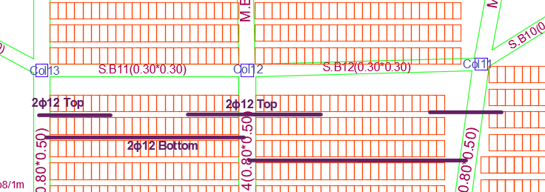
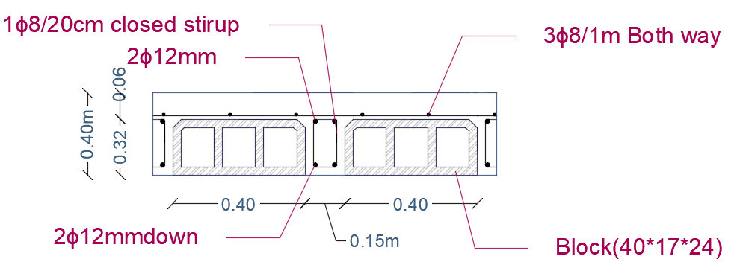
Structure design
Slab:
One-Way Ribbed Slab

Slide 45
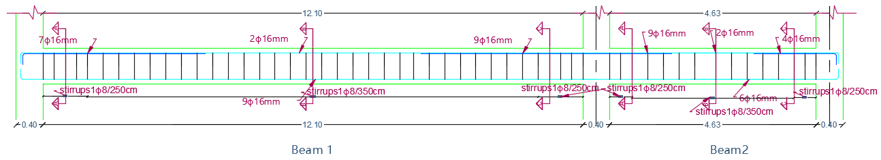
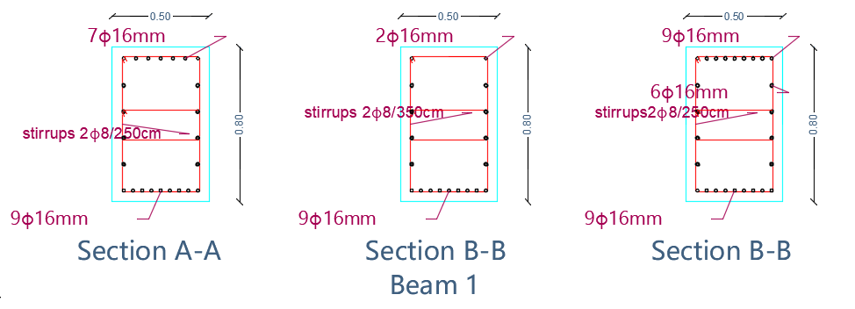
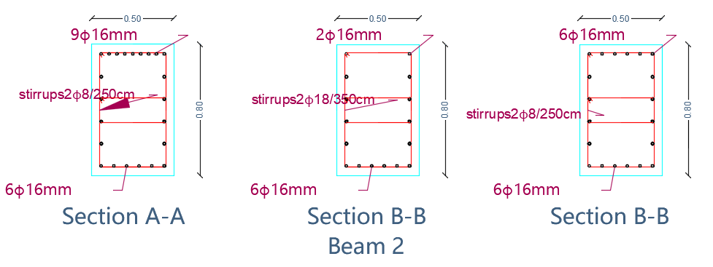
Structure design
Beam Design

Slide 46
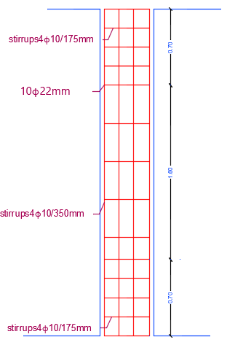
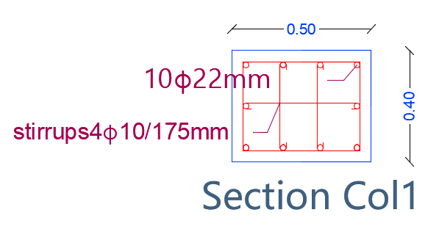
Structure design
Column Design

Slide 47
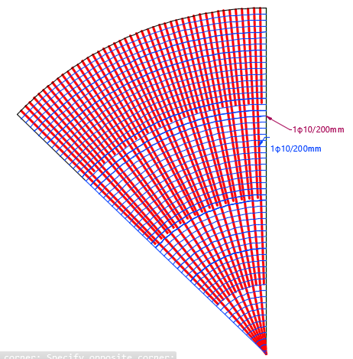
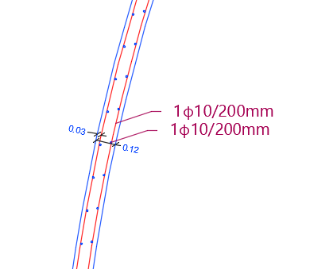
Structure design
Dome Design

Slide 48
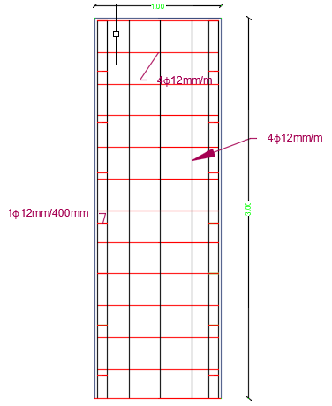
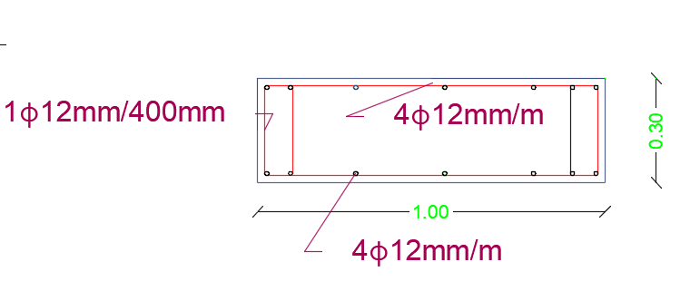
Structure design
Shear Wall Design

Slide 49
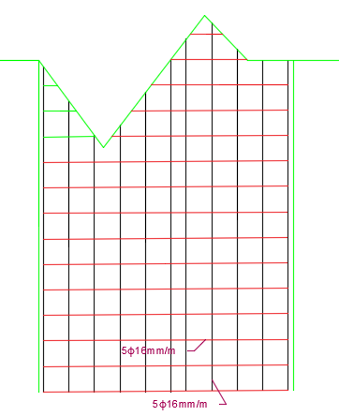

Structure design
Minaret Design

Slide 50

Structure design
Footing plan

Slide 51


Structure design
Single Footing Design

Slide 52

Structure design
Wall Footing Design

Slide 53




Electrical Design
Lighting design

Slide 54


Electrical Design
Lighting design

Slide 55



Electrical Design
Result

Slide 56


Electrical Design

Slide 57

Electrical Design

Slide 58
Electrical Design
Space name | Number of socket | Number of special loads
Pray hall | 10 | 3
Imam room | 2 | 0
Library | 2 | 0
Women pray hall | 3 | 0
W.C+abultion area for men | 4 | 2
W.C+abultion area for women | 1 | 1
Entrance & stairs | 4 | 0
Basement | 6 | 0
Storage and mechanical room | 2 | 2
Total | 34 | 8
Type | Current(Amp) | Type | Area(mm2)
Lighting breaker | 10 | Lighting | 1.5
Power breaker | 16 | Power | 2.5
Main breaker | 30 | Main | 10

Slide 59
Mechanical design
Water Supply System.
Drainage System.
HVAC System.

Slide 60

Mechanical design
Water Supply System.

Slide 61

Mechanical design
Water Supply System.

Slide 62

Mechanical design
Drainage System.

Slide 63

Mechanical design
Rain water discharge.

Slide 64


Mechanical design
HVAC Design:
VRF system used.
4 indoor unit with 5 out door unit.

Slide 65

Mechanical design
HVAC System.

Slide 66

Mechanical design
HVAC System.

Slide 67

Mechanical design
HVAC System.

Slide 68

Mechanical design
Basement ventilation layout

Slide 69

Safety design
Low fire hazard
Dry powder Fire Extinguisher.

Slide 70

Safety design

Slide 71
Quantity survey
Item | Total cost ($) | Unit cost ($/m²)
Excavation work | 61580 | 86
Civil and finishing work | 275420 | 385
Mechanical work | 54638 | 76.5
Electrical work | 14493 | 20
Total | 344204 | 481

Slide 72


Slide 73


Thank you

