Slide 1

An-Najah National University
Faculty of Engineering
Civil Engineering Department
Graduation Project (2)
Structural analysis and design of
Balata health center
By Kareem Kamal
Under supervision of Dr. Imad Al-Qasem

Slide 2
Outlines
Introduction
Architectural view
Structural system
Preliminary design
3D structural analysis and design
Design of columns
Design of footings
Drawings

Slide 3
Introduction

Slide 4
Project description
BALATA HEALTH CENTRE is one of the projects that are recently constructed in the east area in Nablus. This building consists of ground floor, top four floors, reservoir floor, electrical room and staircase.
Floor | Area (m²) | Height (m) | Use of floor
Ground | 609.6 | 3.70 | Receptions and Medical multi-uses
First | 592.1 | 3.64 | Medical multi-uses
Second | 593 | 3.64 | Medical multi-uses
Third | 610 | 3.64 | Medical multi-uses
Fourth (roof) | 274.7 | 3.9 | Meetings, Training and storing
Total | 2679.4 | 18.52 | -

Slide 5
Structural materials
Concrete
Property | Value
Compressive strength of concrete, (f’c) | 25 Mpa
Modulus of elasticity, (Ec) | 23.5*10³ Mpa
Unit weight of plain concrete, (γ) | 23 KN/m³
Unit weight of reinforced concrete, (γ) | 25 KN/m³
Reinforcement steel
Property | Value
Yield strength (fy) | 420 Mpa
Modulus of elasticity, (Ec) | 2.04*10⁵ Mpa
Non-structural elements: Aggregates, Block, Masonry stone, Tiles, Plaster, Concrete mortar

Slide 6
Soil properties
The soil in the site area is mainly composed of layers of marlstone and clay where footings shall be laid on natural excavated ground.
The allowable bearing capacity of the soil based on the nature of the soil in the site is 200 KN/m².

Slide 7
Gravity loads
Dead load
The own weight of structural members
Live load
Floor | Live load (KN/m²)
Ground | 4.79
First | 4.79
Second | 4.79
Third | 4.79
Fourth | 4.79
Roof | 6

Slide 8
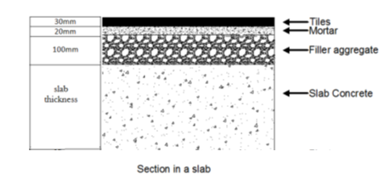
Superimposed dead load
𝑊𝑆𝐷 = 𝑊 𝑡𝑖𝑙𝑒 + 𝑊 𝑚𝑜𝑟𝑡𝑎𝑟 + 𝑊𝑓𝑖𝑙𝑙 +𝑊 𝑝𝑙𝑎𝑠𝑡𝑒𝑟𝑖𝑛𝑔+𝑊𝑝𝑎𝑟𝑡𝑖𝑡𝑖𝑜𝑛𝑠
For partitions, Reinforced block of 10 cm thickness and 25 KN/m3 in addition to plaster will be used.
WSD = 6.23 KN/m2

Slide 9
Codes and standards
ACI 318-11
Building code requirements of structural concrete and commentary.
IBC2012
For seismic design.

Slide 10
Architectural view
( Post modern style)

Slide 11
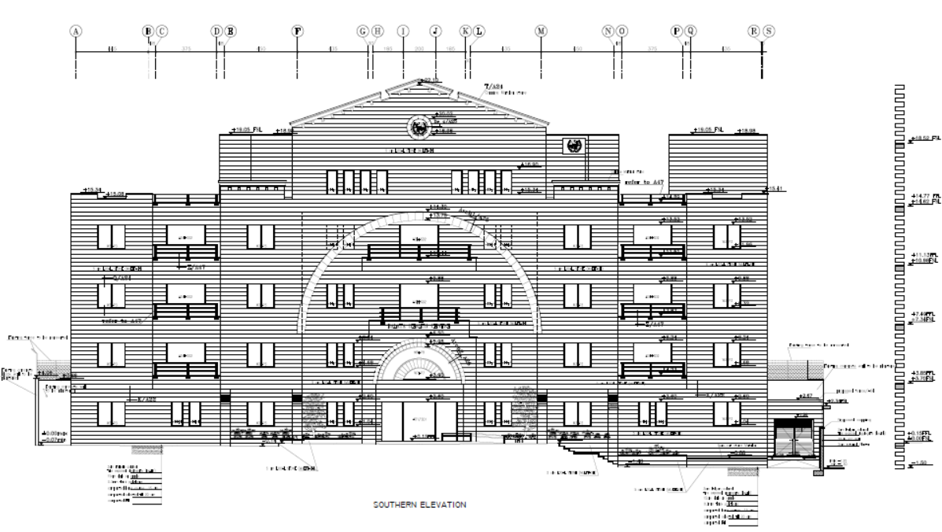
Southern elevation

Slide 12
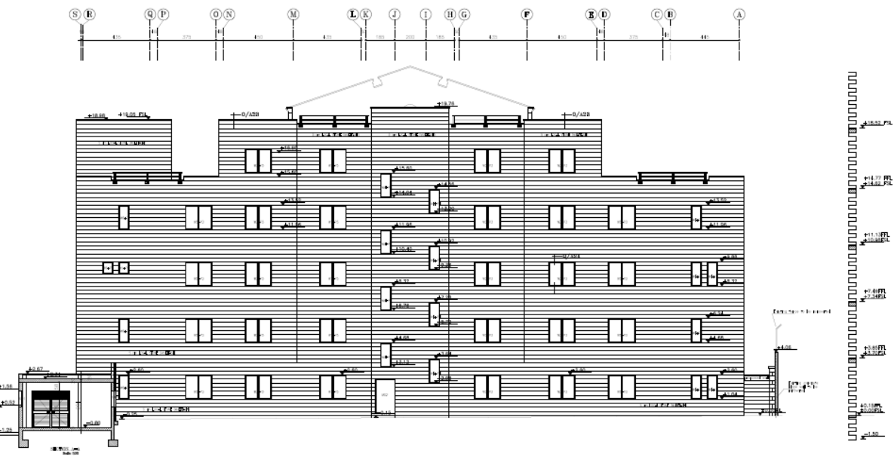
Northern elevation

Slide 13
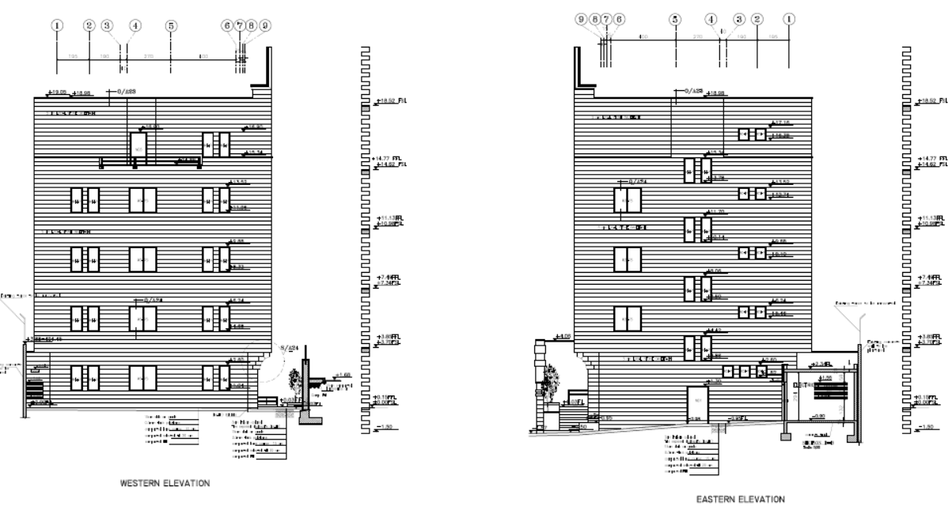
Eastern and western elevations

Slide 14
Structural system

Slide 15
Solid VS Ribbed
Solid slab is better for seismic design later and has thinner thickness.
Moreover.
One way VS Two way
Two way has larger beams significantly so one way is better
The choice is One-way Solid slab

Slide 16
Preliminary design

Slide 17
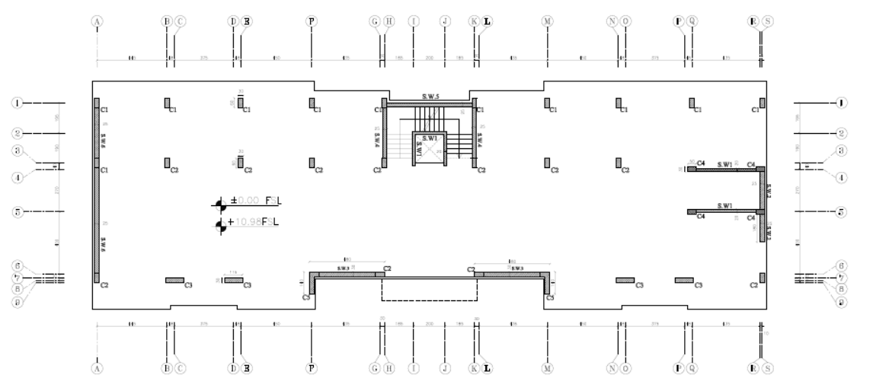
Plan view

Slide 18
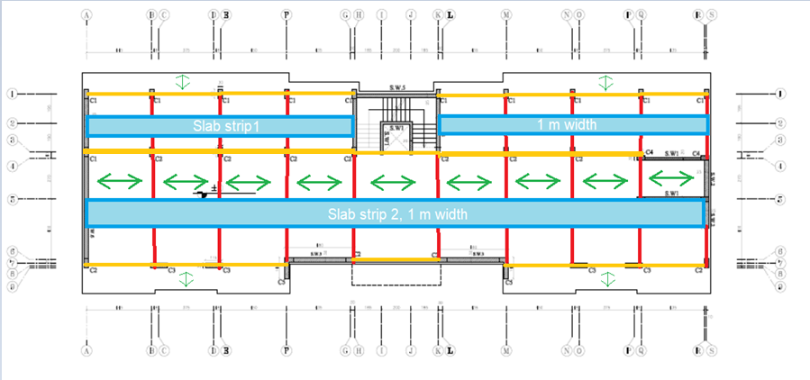
Slab strips and beams distribution
For floors

Slide 19
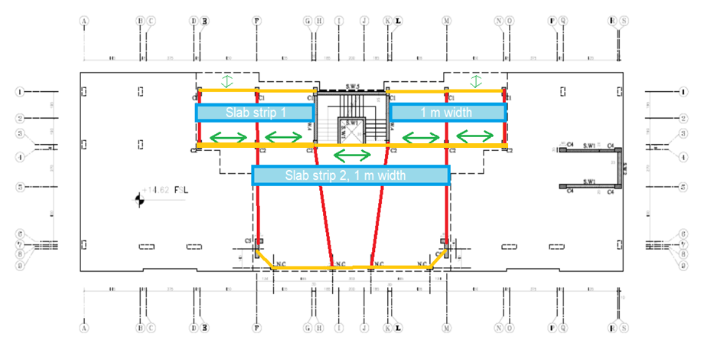
For roof

Slide 20
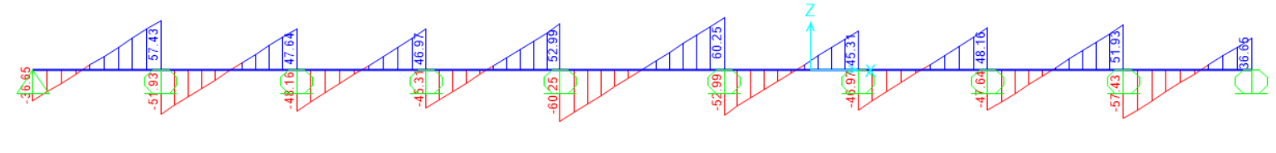
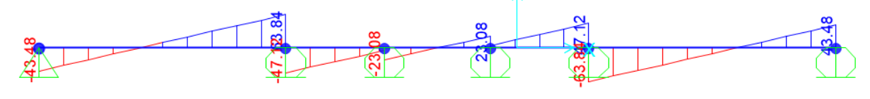
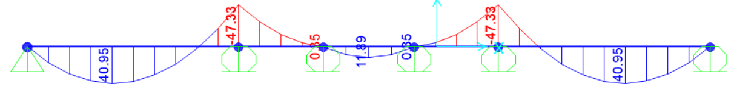
Slab
Floors
Roof

Slide 21
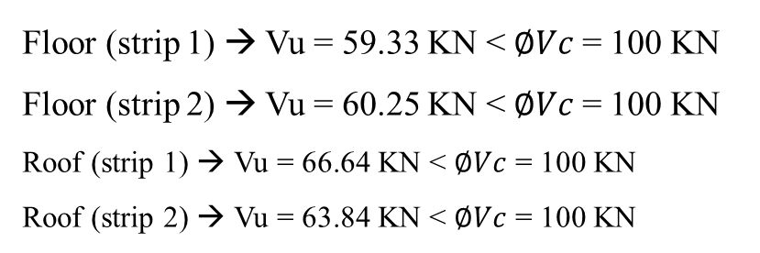
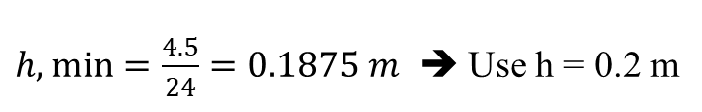
$h,\min{=\frac{4.5}{24}}=0.1875 m$ ➔ Use h = 0.2 m
WD = 5 KN/m²
Wu (floor) = 21.14 KN/m²
Wu (roof) = 23.08 KN/m²
Shear check
Floor (strip 1) → Vu = 59.33 KN < $∅Vc$ = 100 KN
Floor (strip 2) → Vu = 60.25 KN < $∅Vc$ = 100 KN
Roof (strip 1) → Vu = 66.64 KN < $∅Vc$ = 100 KN
Roof (strip 2) → Vu = 63.84 KN < $∅Vc$ = 100 KN
No need for shear reinforcement

Slide 22




Flexural design
For floors (by take strip 2 as critical)
Mu+ = 34.55 KN → $ρ$ = 0.0037 → As = 592 mm² > As_{min}
Mu- = 51.3 KN → $ρ$ = 0.0056 → As = 896 mm² > As_{min}
use 6Ø12/m bottom steel and 5Ø16/m top steel
For roof (by take strip 2 as critical)
Mu+ = 40.95 KN → $ρ$ = 0.00442 → As = 707 mm² > As_{min}
Mu- = 47.33 KN → $ρ$ = 0.0051 → As = 816 mm² > As_{min}
use 5Ø16/m bottom steel and 6Ø16/m top steel

Slide 23
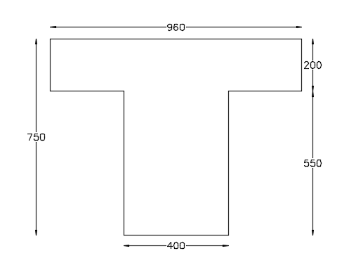
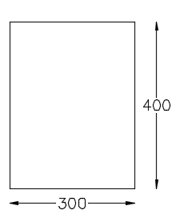
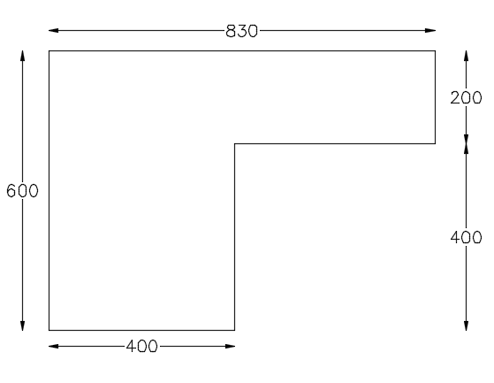
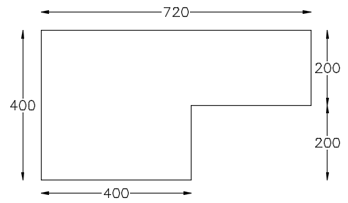
Interior beams
Beams
Secondary beams
Dimensions
(mm)
Exterior beams of floors
Exterior beams of roof

Slide 24
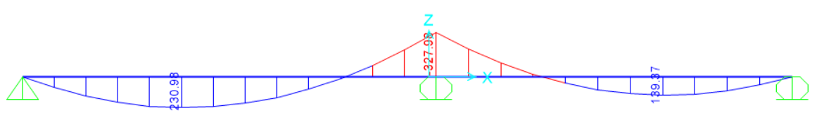
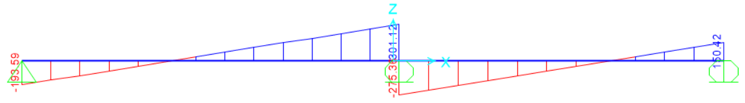
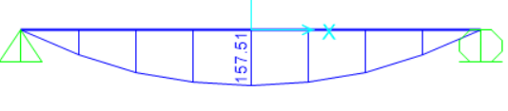
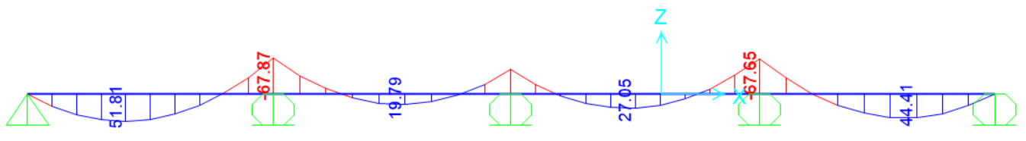
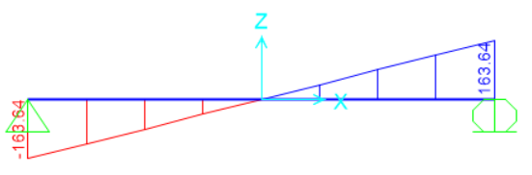
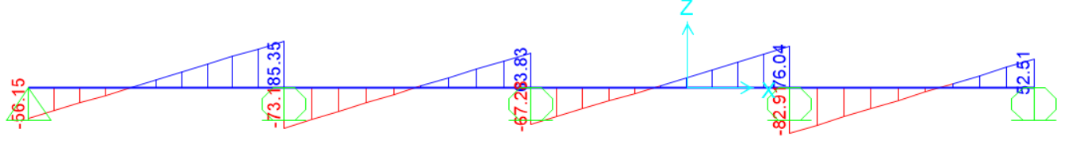
Floor’s
Interior
Roof’s
Exterior
Floor’s
Secondary

Slide 25
Flexural design for floors
Floor | Interior | Exterior | Secondary
Mu+ (KN) | 497.26 | 230.98 | 51.81
p | 0.00296 | 0.00259 | 0.00365
As (mm2) | 1961 | 1343 | 373
As > As min | No | No | yes
As used (mm2) | 2160 | 1728 | 373
Bottom steel | 7Ø20mm | 6Ø20mm | 5Ø10mm
Mu- (KN) | 515.52 | 327.98 | 67.87
p | 0.00833 | 0.0081 | 0.00546
As (mm2) | 2300 | 1750 | 557
As > As min | yes | yes | yes
As used (mm2) | 2300 | 1750 | 557
Top steel | 8Ø20mm | 6Ø20mm | 5Ø12mm

Slide 26
Flexural design for roof
Roof | Interior | Exterior | Secondary
Mu+ (KN) | 575.14 | 157.51 | 49.51
p | 0.00344 | 0.00375 | 0.00348
As (mm2) | 2279 | 1224 | 355
As > As min | yes | yes | No
As used (mm2) | 2279 | 1224 | 360
Bottom steel | 8Ø20mm | 6Ø16mm | 5Ø10mm
Mu- (KN) | 638.08 | - | 83.02
p | 0.0098 | - | 0.00678
As (mm2) | 2705 | - | 692
As > As min | yes | - | yes
As used (mm2) | 2705 | - | 692
Top steel | 9Ø20mm | - | 7Ø12mm

Slide 27
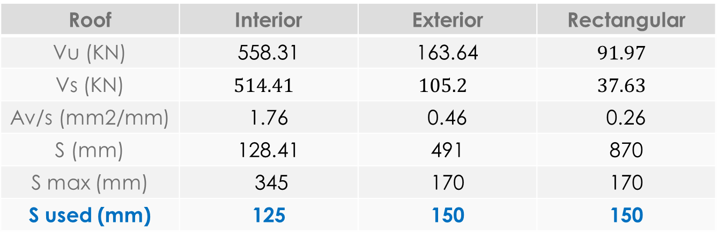
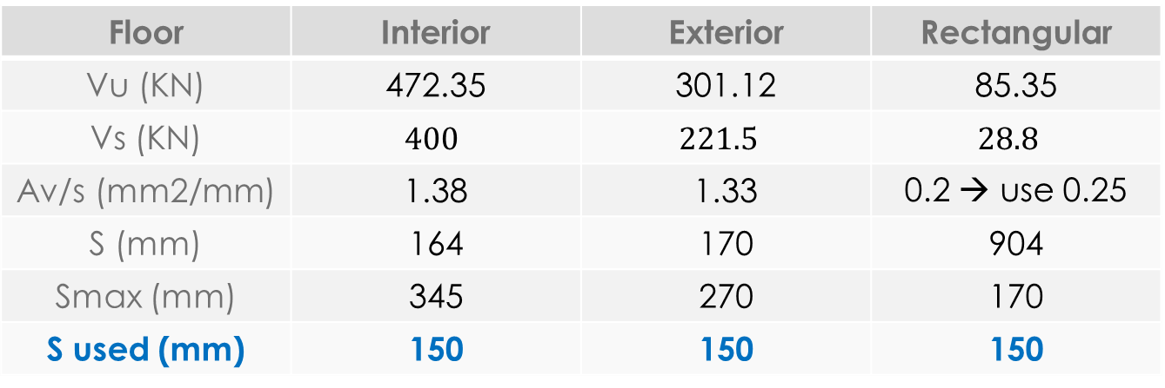

Vc = 230 KN
$Av/s\left(min.\right)$ = 0.33
Vs max = 920 KN
Floor | Interior | Exterior | Rectangular
Vu (KN) | 472.35 | 301.12 | 85.35
Vs (KN) | $$400$$ | $$221.5$$ | $$28.8$$
Av/s (mm2/mm) | 1.38 | 1.33 | 0.2 → use 0.25
S (mm) | 164 | 170 | 904
Smax (mm) | 345 | 270 | 170
S used (mm) | 150 | 150 | 150
Shear design
Øs = 10 mm
Roof | Interior | Exterior | Rectangular
Vu (KN) | 558.31 | 163.64 | $$91.97$$
Vs (KN) | $$514.41$$ | $$105.2$$ | $$37.63$$
Av/s (mm2/mm) | 1.76 | 0.46 | 0.26
S (mm) | 128.41 | 491 | 870
S max (mm) | 345 | 170 | 170
S used (mm) | 125 | 150 | 150

Slide 28
3D Structural analysis and design

Slide 29
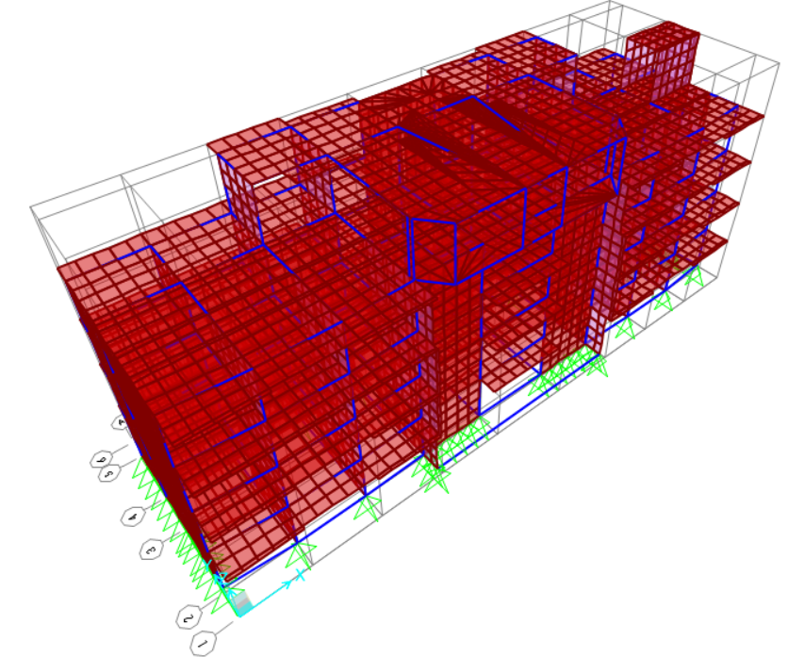
3D model

Slide 30
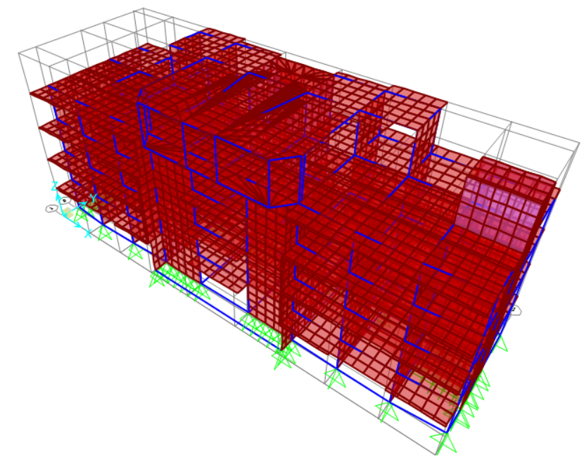

Slide 31
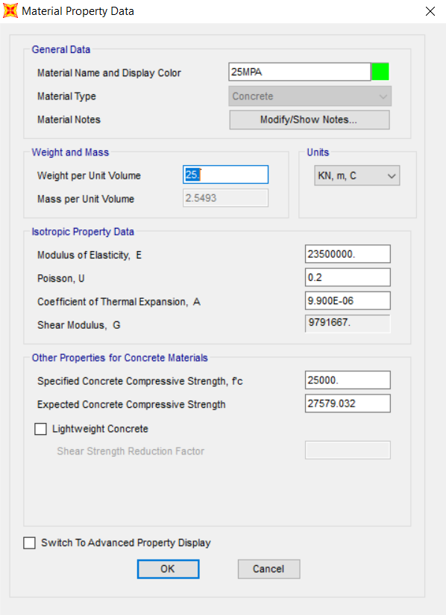
Material

Slide 32
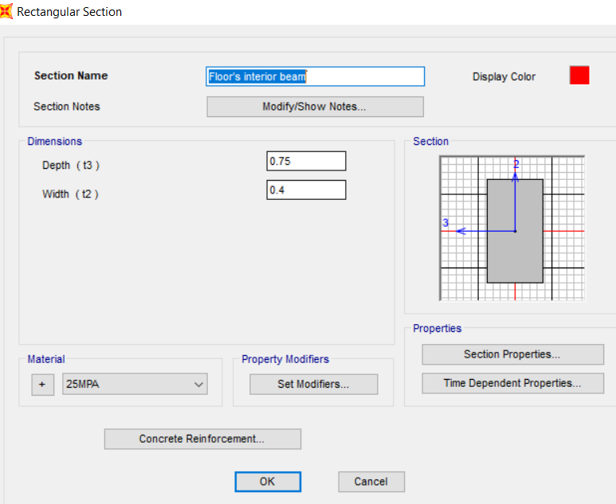
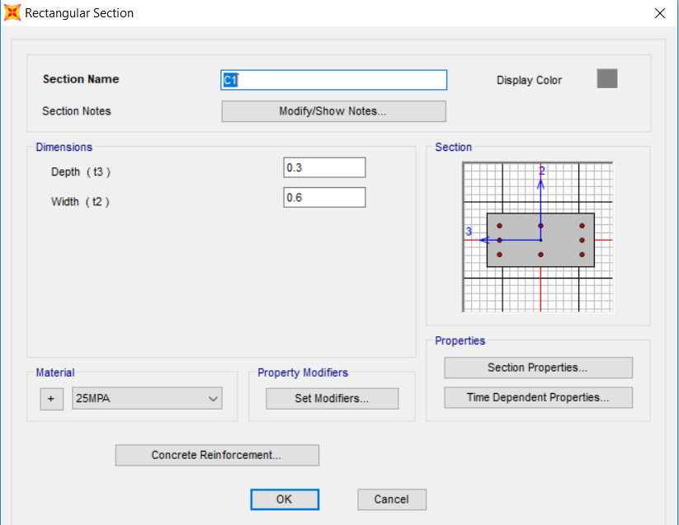
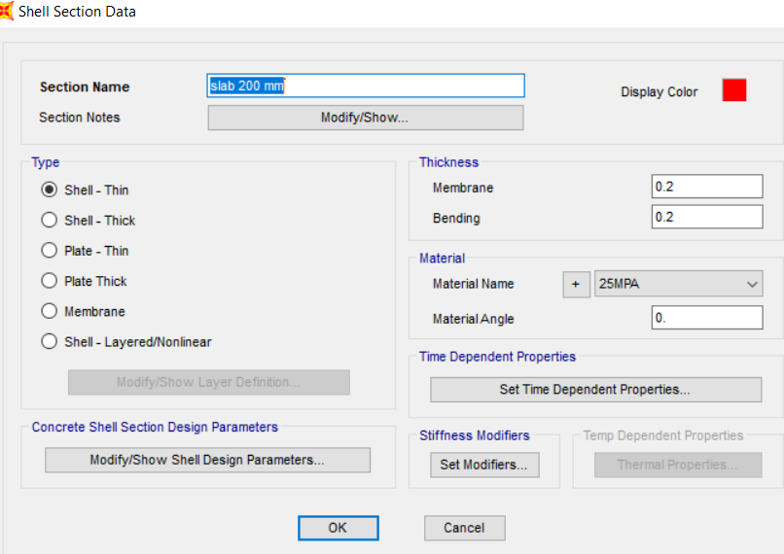
Sections

Slide 33
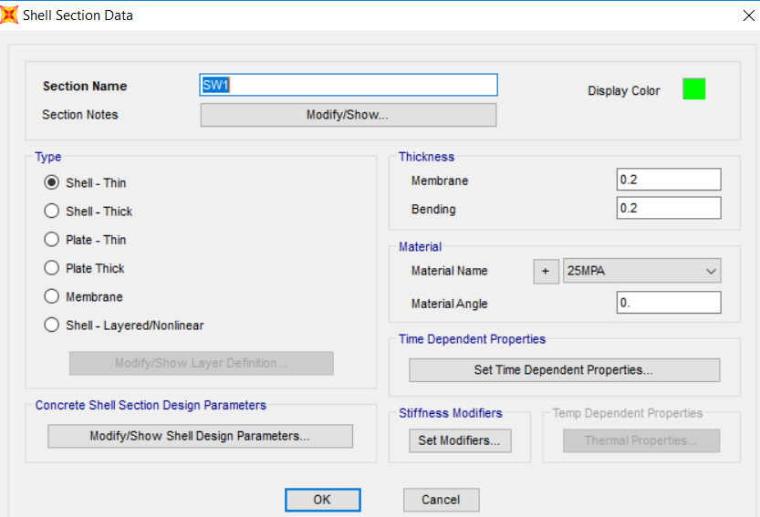
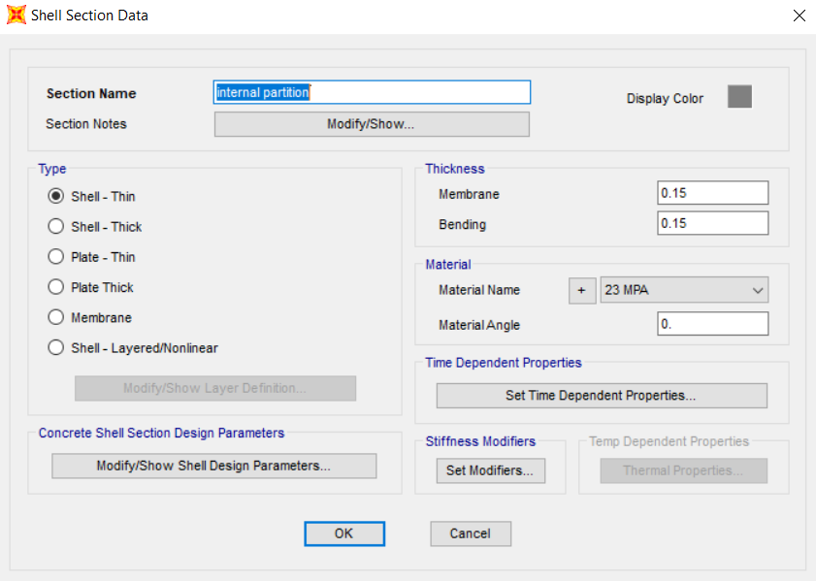

Slide 34
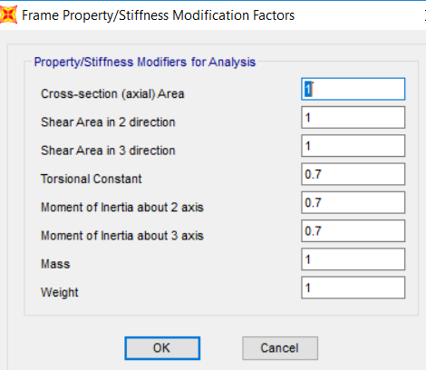
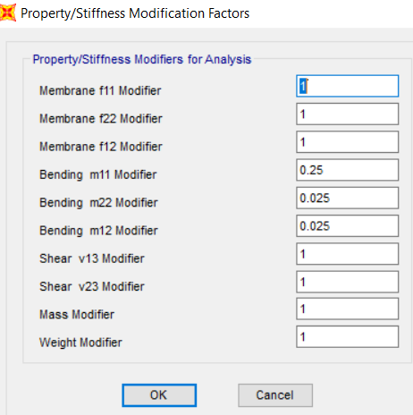
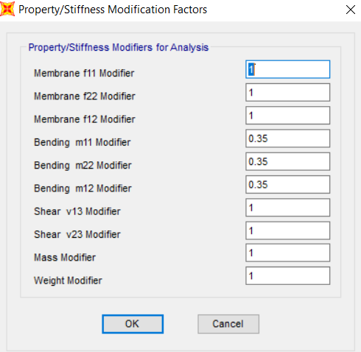
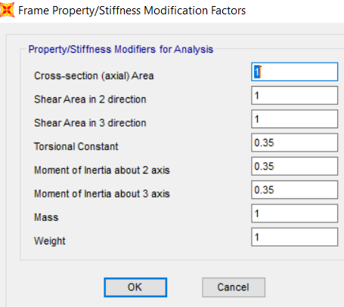
Column
Modifiers
Slab
Shear wall
Beam

Slide 35
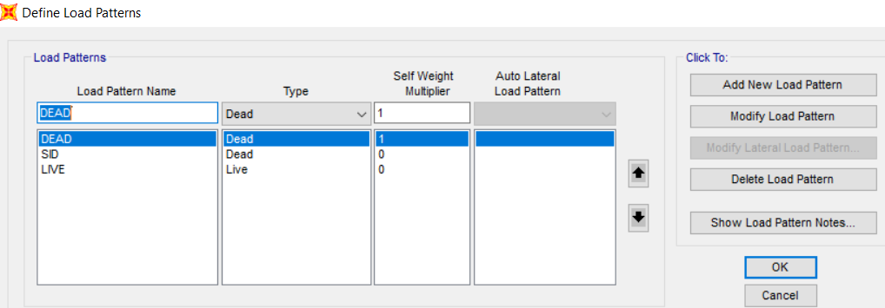
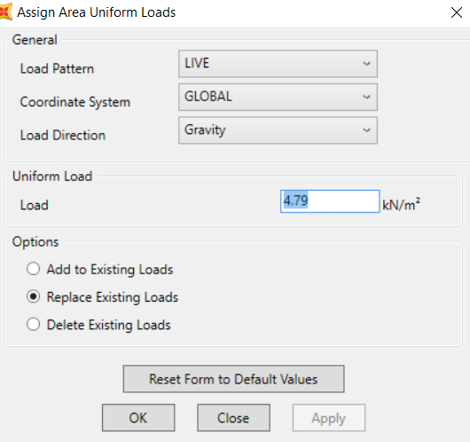
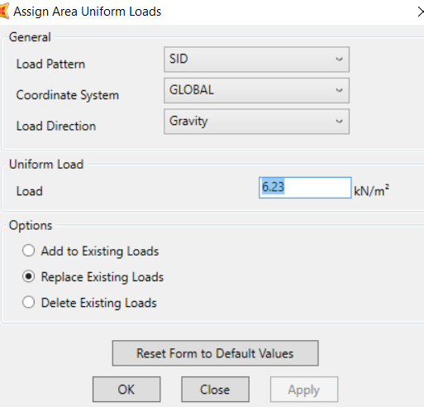
Gravity loads

Slide 36
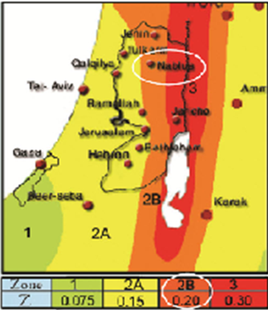
Seismic loads
Ss = 2.5*Z = 0.5
S1 = 1.25*Z = 0.25

Slide 37
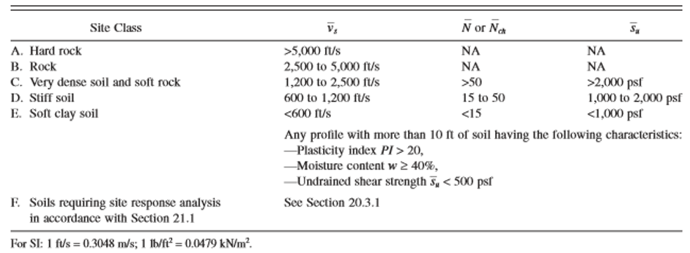
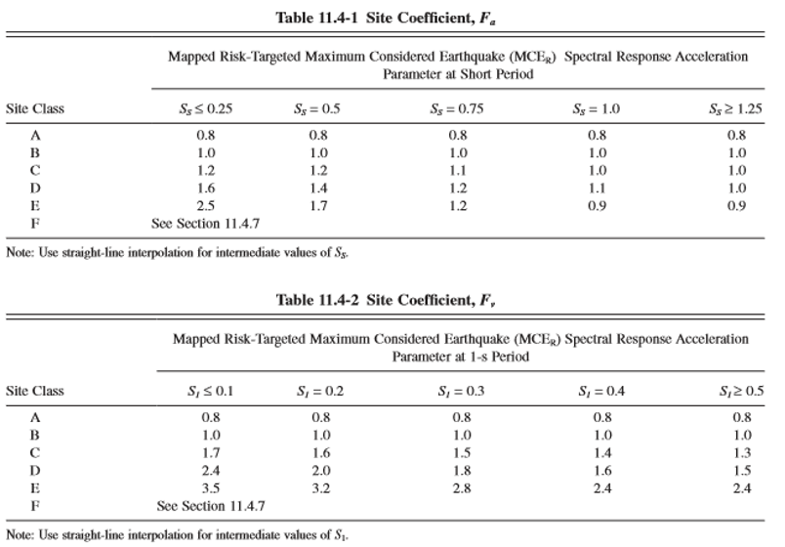
The site soil classification is D
Fa = 1.4
Fv = 1.9
SMS = Fa * Ss = 0.7
SM1 = Fv * S1 = 0.475
SDS = SMS = 0.7
SD1 = SM1 = 0.475

Slide 38
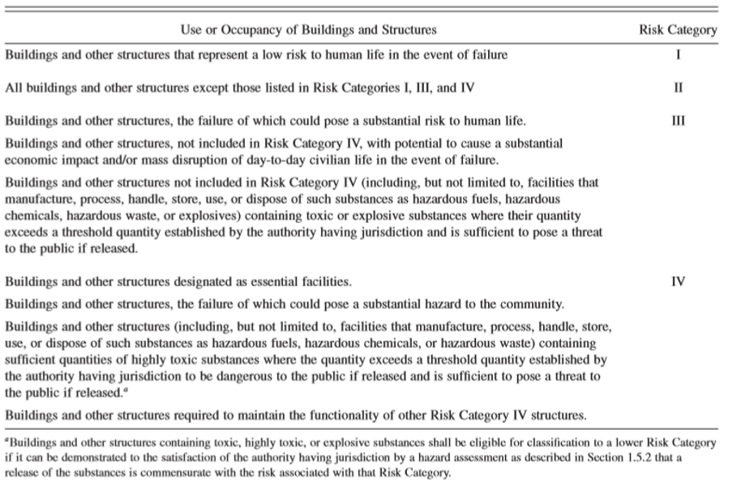
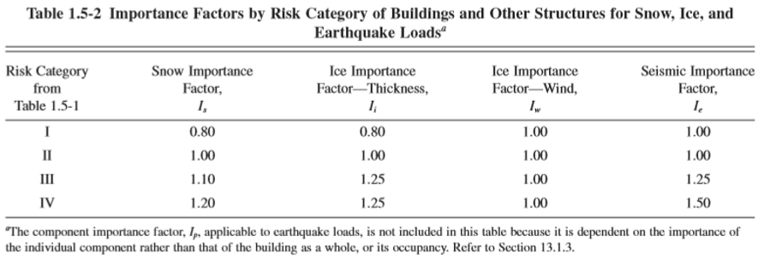
The risk category = III
I = 1.25

Slide 39
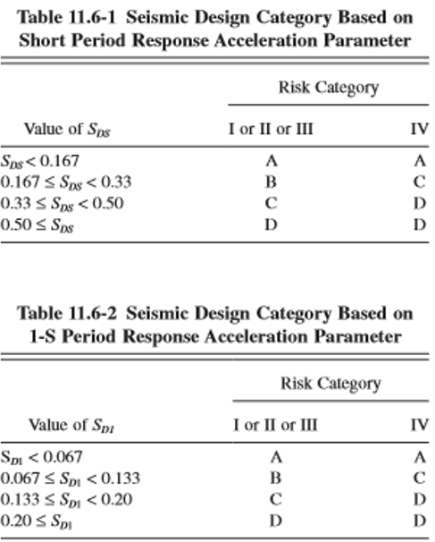
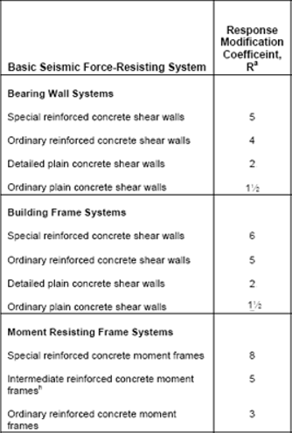
Seismic design category is D.
Reduction factor = 3
( ordinary reinforced concrete moment frames)

Slide 40
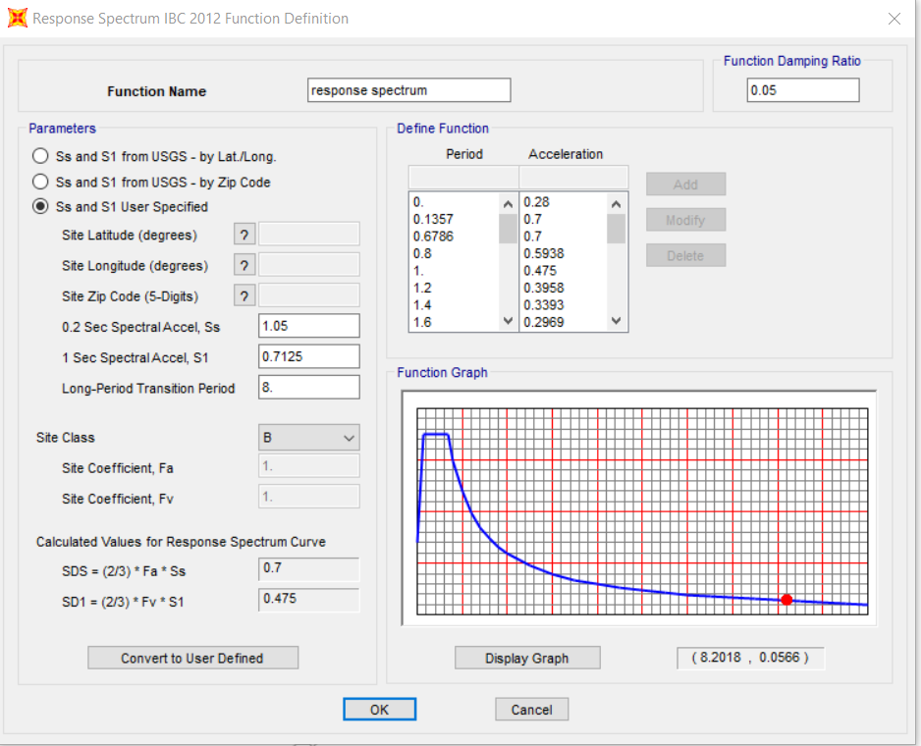
Response spectrum

Slide 41
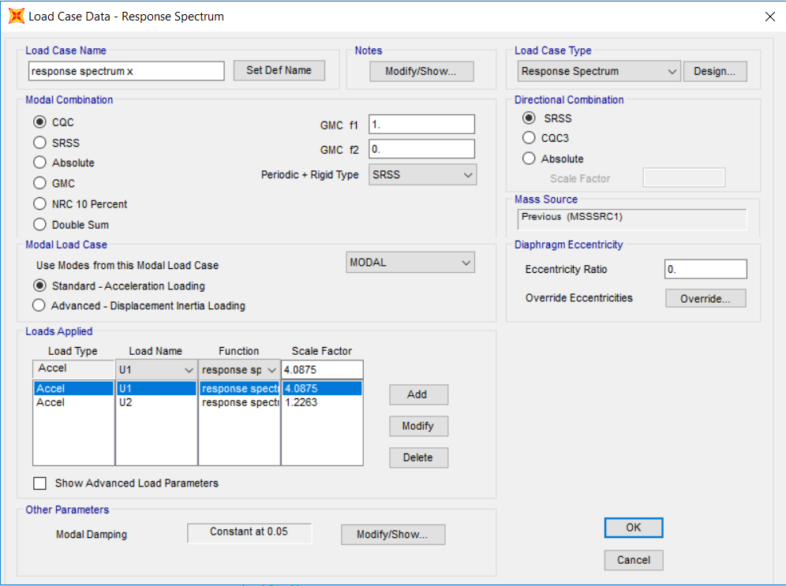
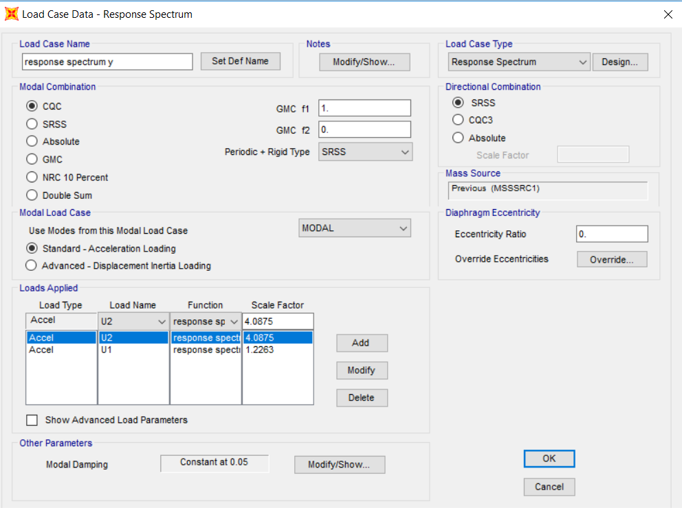
Scale factor = (I/R) * g
= (1.25/3)*9.81 → 4.0875

Slide 42
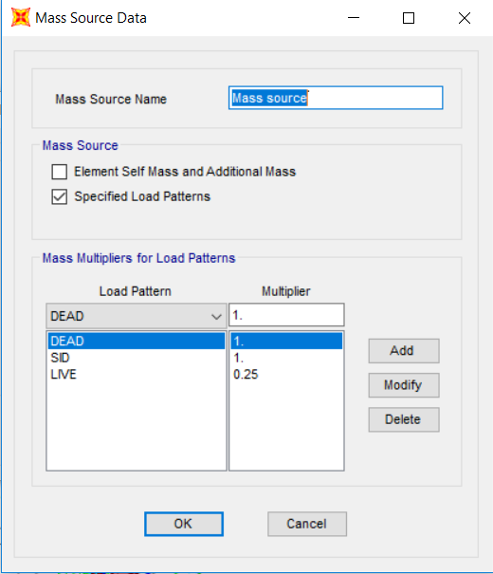

Slide 43
Design load combination and strength check
New dimensions were used. So, there were no red elements and all rebar percentages were within the allowable ranges.
1.4D
1.2D+1.6L
1.3D+L+Ex
1.3D+L+Ey
0.8D+Ex
0.8D+Ey
Element | Width (m) | Depth (m)
Floor’s secondary beam | 0.4 | 0.7
Roof’s secondary beam | 0.4 | 0.7
Roof’s interior beam | 0.4 | 1

Slide 44

Checks
Compatibility
( T= 0.23724 )

Slide 45

Equilibrium
W_{dead} = Wslab + Wbeam + Wcolumn + Wshear wall
= 12758 + 6673 + 2656 + 5880
= 27967 KN
W_{live} = 12529 KN
W_{SD} = 14244 KN
Load type | Hand result (KN) | SAP result (KN) | Differences%
Dead | 27967 | 29010 | 3.73%
SID | 14244 | 13964 | 1.97%
Live | 12529 | 12307 | 1.77%

Slide 46

Stress-strain relationship
For slab
M 3D = 33.87
M 1D = 34.55
Difference = 1.97% < 10%

Slide 47




For beam
M avg 3D = 565.5
M avg 1D = 524.39
Difference = 7.84% < 10%

Slide 48


Deflection (serviceability)
Δ (total dead) = 5.47 mm
Δ (live load) = 2.18 mm

Slide 49



No compression steel (ρ_{compression} = 0)
Assume 50% sustained live load
$λ\left(tz\right)∗ Δ long term= Δ live+ λ∞∗ Δ total dead+ Δsustained live$
$λ∞= λt$, since we assumed that the live load will sustained.
$λ=\frac{T}{1+50ρ′}$ (such that ρ’ is the compression steel ratio, T is a multiplier for long term deflection)
From the figure at time 5 years (60 months), T = 2
→ $λ$ = 2
Δ long-term = (1.5*2.18) + (2*5.47) = 14.21 mm
Length of largest span of slab = 4.65 m
The allowable deflection for all sustained load = L/240 = 4650/240 = 19.38 mm
19.38 > 14.21

Slide 50



Modal mass participation ratio check
At 100 modes, the X and Y arrived nearly equal percent (67%) which less than 90% and the value of 90% is reached at 500 modes. Moreover, the structure has a lot of shear walls around and internal reinforced partitions so it will not be able to move in X or Y and it is not required to get 90% so I will use 12 modes only. The fundamental mode will be in Z direction.

Slide 51
Design of Columns

Slide 52

Columns grouping
columns were classified as groups according to the suggestions of architectural engineer.
Group ID | Max, Pu (KN) | Columns ID
C1 | 1732 | 1,2,3,4,5,6,7,8,9,10,11
C2 | 2032 | 12,13,14,15,16,17,18,23,27,28,32
C3 | 2615 | 24,25,30,31
C4 | 664 | 19,20,21,22

Slide 53


Slenderness check → $\frac{KL}{r}≤34−12\frac{M1}{M2}$
Column design
K= 0.8 (from tables) , L= 3.4 m , r = 0.09 , M1 = 0.4 , M2= 6.7
30.22 < 33.28
so it is short column and neglect slenderness.
Steel ratio ρ = 1% (minimum)
As_{min}= 1% * Ag
$\left.∅Pn= ∅ λ (0.85f^{′}c\left(Ag−As\right)+fyAs\right)$ , $∅=0.65 , λ$ = 0.8
Required stirrups spacing according to ACI318-08 is the minimum of:
S≤ 16 db
S≤ 48 ds
Lest dimension of column

Slide 54
concrete cover = 4cm stirrups of Ø10mm
Group ID | Critical column # | Pu (KN) | Dimension (mm) | Ag (mm²) | As (mm²) | Reinforcement | Ties
1 | 9 | 1732 | 300*600 | 180000 | 1800 | 8Ø18mm | 2Ø10/250mm
2 | 17 | 2032 | 300*600 | 180000 | 1800 | 8Ø18mm | 2Ø10/250mm
3 | 24 | 2615 | 300*1150 | 345000 | 3450 | 18Ø16mm | 3Ø10/250mm
4 | 20 | 664 | 300*500 | 150000 | 1500 | 8Ø16mm | 2Ø10/250mm

Slide 55



Group 4
Group 1+2
Group 3

Slide 56

Interaction diagram check
The interaction diagram of column (C24) was drawn (taking the values of M33 vs Pu from SAP)
Moment and axial load on the column are 6.7 KN.m and 2615 KN respectively.
Interaction diagram of column shows that the column section was not economic and that because of large concrete section and restriction on the dimensions from A/E and owner as mentioned before.

Slide 57
Design of Footings

Slide 58

Single footings area needed < 50%*Total area of ground floor
→ No need for full mat foundation

Slide 59


Single footings F1&F2
Af = Pservice / q_{all}
h = d + cover
Wide-beam shear (one-way shear)
Vu = ØVc
$$qu∗\left(l1−d\right)= Ø∗λ∗\frac{1}{6}∗ \sqrt{f^{′}c}∗bw∗d$$
$$∅Vc,p=∅Vc,p=\left\{\begin{aligned}&∅Vc,p1=Ø×0.17×\left(1+\frac{2}{ꞵ}\right)×\sqrt{f′c}×b0×d \\ &∅Vc,p2=Ø×0.83×\left(\frac{αs∗d}{b0}+2\right)×\sqrt{f′c}×b0×d \\ &∅Vc,p3= Ø×0.33×\sqrt{f′c}×b0×d\end{aligned}\right.$$
B₀ = 2(C1+d) + 2(C2+d)
ꞵ = long column side / short column side
α_{s}= 40 (interior)

Slide 60


$$Mu=\frac{qu∗{l1}^{2}}{2}$$
Steel percentage (ꝭ) =$\frac{0.85×fc}{fy}×\left(1−\sqrt{1−\frac{Moment ×2.61}{1000∗fc∗d^{2}}}\right)$
As = ρ * b * d
As,shrinkage(min) = ρ_{shrinkage} * b * d
Group ID | Critical column # | Ps (KN) | Pu (KN) | Dimensions (m) | thickness (m) | Reinforcement
1 | 17 | 1495 | 2032 | 2.75*2.75 | 0.55 | 1Ø16mm/150mm
2 | 24 | 2012 | 2615 | 3.2*3.2 | 0.6 | 1Ø18mm/150mm

Slide 61



F2 and column 24 were taken as critical in SAP design
9.97 mm < 10 mm
Maximum soil pressure = 200 KN/m²
Qu = reaction / mesh area
= 12/0.0625 = 192 KN/m²

Slide 62




Vu = 866/3.2 = 271 KN/1m
$$ØVc= 0.75∗1∗\frac{1}{6}∗ \sqrt{25}∗1000∗500/1000$$
= 312.5 KN
Vu < ØVc
Vu,p = 686/3.2 = 215 KN/1m
$$∅Vc,p3= 0.75×0.33×\sqrt{25}×4.9×0.5×1000=3032 KN>V_{u,p}$$

Slide 63


Mu = {(830+696)/2}/3.2 = 238.44 KN.m/m
Steel percentage (ꝭ) = $\frac{0.85×25}{420}×\left(1−\sqrt{1−\frac{238.44∗{10}^{6} ×2.61}{1000∗25∗{500}^{2}}}\right)$ = 0.00258
As = ρ * b * d
= 0.00258 * 1000 * 500 = 1290 mm²/m
As,shrinkage(min) = ρ_{shrinkage} * b * d
= 0.0018 * 1000 * 500 = 900 mm²/m
As_{total} = 1290 * 3.2 = 5031 m²
Use As = 20Ø18 mm (bottom steel)

Slide 64


Slide 65


Longitudinal mat foundation 1&2
Sum (Px*x) = Sum (Px) * X → X
L = 2(X+b1/2)
Af = P/qall
B = Af/L
$$ØVc= Ø∗λ∗\frac{1}{6}∗ \sqrt{f^{′}c}∗bw∗d$$
Vu = ØVc
Vu,p = Pu – q_{u}*A1
$$∅Vc,p=∅Vc,p=\left\{\begin{aligned}&∅Vc,p1=Ø×0.17×\left(1+\frac{2}{ꞵ}\right)×\sqrt{f′c}×b0×d \\ &∅Vc,p2=Ø×0.83×\left(\frac{αs∗d}{b0}+2\right)×\sqrt{f′c}×b0×d \\ &∅Vc,p3= Ø×0.33×\sqrt{f′c}×b0\end{aligned}\right.$$
B₀ = 2(C1+d) + 2(C2+d)
ꞵ = long column side / short column side
h = d + cover

Slide 66


Mu = from SAP
Steel percentage (ꝭ) =$\frac{0.85×fc}{fy}×\left(1−\sqrt{1−\frac{Moment ×2.61}{1000∗fc∗d^{2}}}\right)$
As = ρ * b * d
$$Mu(transverse)=qu∗\frac{{(l)}^{2}}{2}$$
 | B | L | d | h | Bottom steel | Top steel | Transverse steel
LMF1 | 4.75 m | 12 m | 0.3 m | 0.35 m | 1Ø25mm /100mm | 1Ø25mm /100mm | 1Ø12mm /250mm
LMF2 | 7 m | 5.5 m | 0.3 m | 0.35 m | 1Ø16mm /200mm | 1Ø32mm /125mm | 1Ø25mm /100mm

Slide 67



Slide 68



Mat foundation 1&2
$$q=\frac{−P}{A}±\frac{Mx}{Ix}y±\frac{My}{Iy}x$$
Check compression < allowable bearing capacity
Check No tension
P = Sum (p)
$$Assume A=L∗L$$
$$I=\frac{L^{4}}{12}$$
Sum (Px*x) = Sum (Px) * X → X
Eccentricity in X direction (Ex) = X –{(c/c)/2}
Sum (Py*y) = Sum (Py) * Y → Y
Eccentricity in Y direction (Ey) = Y –{(c/c)/2}
Mx = P * Ey
My = P * Ex

Slide 69

Assume d
Vu,p = Pu*load factor
B₀ = 2(C1+d) + 2(C2+d)
ꞵ = long column side / short column side
$$∅Vc,p=∅Vc,p=\left\{\begin{aligned}&∅Vc,p1=Ø×0.17×\left(1+\frac{2}{ꞵ}\right)×\sqrt{f′c}×b0×d \\ &∅Vc,p2=Ø×0.83×\left(\frac{αs∗d}{b0}+2\right)×\sqrt{f′c}×b0×d \\ &∅Vc,p3= Ø×0.33×\sqrt{f′c}×b0×d\end{aligned}\right.$$
h = d + cover

Slide 70




Deflection = 9.75 mm < 10 mm
Wide-beam shear check
qu=195 KN/m < 200 KN/m
Vu= 3330 KN
$ØVc= 0.75∗1∗\frac{1}{6}∗ \sqrt{25}∗12000∗0.52$ = 3900 KN > Vu

Slide 71



Values of M11 and M22 are near to each other so, Mu = 1.4(8460/12) = 987 KN.m will be used for X and Y directions design.
Steel percentage (ꝭ) =$\frac{0.85×fc}{fy}×\left(1−\sqrt{1−\frac{Moment ×2.61}{1000∗fc∗d^{2}}}\right)$
As = ρ * b * d
Same procedure for Mat2

Slide 72
 | B | L | d | h | Reinforcement
MF1 | 12 m | 12 m | 0.52 m | 0.6 m | 1Ø32mm/125mm For Top and Bottom in X and Y directions
MF2 | 12 m | 8.4 m | 0.32 m | 0.4 m (Use 0.6 m) | 1Ø32mm/75mm For Top and Bottom in X and Y directions

Slide 73



Slide 74



Slide 75
Drawings samples

Slide 76


Main beam 8
Connection between column group 1 and main beam 3

Slide 77

Slab of ground, first and second floors

Slide 78


Shear walls
Stairs

Slide 79


THANK YOU

