Slide 1

An- Najah National University
Faculty of Engineering
Electrical Engineering Department
Graduation project 2
Building Management System(BMS)
Prepared by : Sara Zaid
Sabah Daraghmeh
Bayan Snouber
Supervised by: Dr.Jamal Kharusheh

Slide 2
contents
Overview
Graduation project 1
BMS
System design
Lighting system
Water pumping system
Cooling system
summery
The controller

Slide 3
overview
Our project is about the building management system (BMS), by this technological development we will control the building of BURJ QASER AL-THAKAFA IN RAMALLAH, and The controlling will consist of many systems: lighting system, cooling system and water pumping system.

Slide 4
Graduation project 1 (stage 1)
Load estimation for Lighting ,HVAC, water pump and Socket.
Choose the electrical equipment.
Draw the AutoCAD planes including lighting, HVAC, socket distribution boards and risers.
Choose sensor type and the controller for the system.
Distribute the sensors and the controllers in the AutoCAD planes.
Draw and design the BMS risers.
Make an Economical study.

Slide 5



Building management system (BMS)
  A micro-processor based system which centralizes and simplifies…
    controlling
    monitoring
    operation
    management
  …of pumping, air-conditioning, lighting & other building services to achieve the next benefits…..
        safe and comfortable working environment
        energy saving & efficient operation
        at reduced time & cost

Slide 6

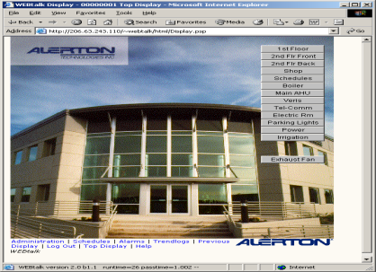
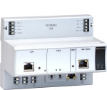
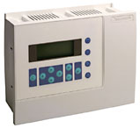
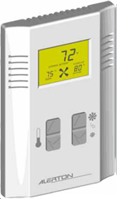

Components of BMS
  Centralized Computer Station
    With powerful user-friendly software.
    Used for everyday building operation.
  Controllers
    Micro-processor based
    Fully programmable
    Control all systems in the building
  Field devices
    Temperature, Pressure sensors
    Water level sensors
    Motion sensors
    Light level sensor

Slide 7
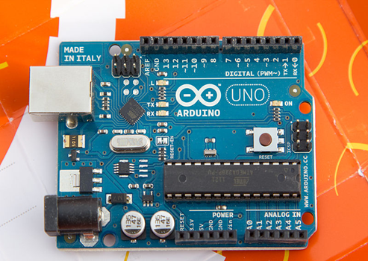
The controller
We use Arduino UNO to be the controller in our project, through this controller we can control the lighting, cooling systems and water pumping system.
The Arduino responsible for both capturing the input of the sensors and sending an action to the output.
Software: for writing the code we use the next programs:
  Arduino 1.0.4, downloaded from http://arduino.cc/en/
  And for simulation: simulator for Arduino v0.98

Slide 8
System design
The system design consists of two parts: Hardware and software
  The hardware consists of the sensors : motion sensor, LDR sensor, water level sensor and temperature sensor connected to the inputs of the controller board, the controller is a standalone Arduino UNO, and the output is a controlled device and we use in the project the electrical relay, which is responsible to open or close the lighting system, water pumping system and cooling system.
  The software is split into the programs running on the Arduino and the interfacing running.
      The Arduino was responsible for both capturing the input of the sensors and sending an action to the output.
      The interfacing part was responsible for reading the packets from the Arduino, converting the raw data into current/power information, and presenting it to the user in a clear fashion on the screen.

Slide 9
the lighting system contains:
The sensors
The controller (software)
the output from the controller (relay)
The lamps installation

Slide 10
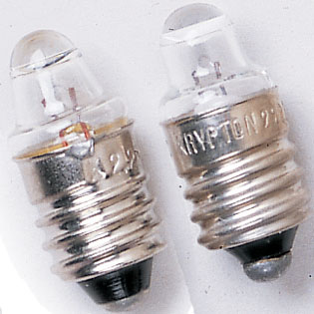
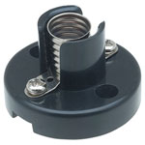
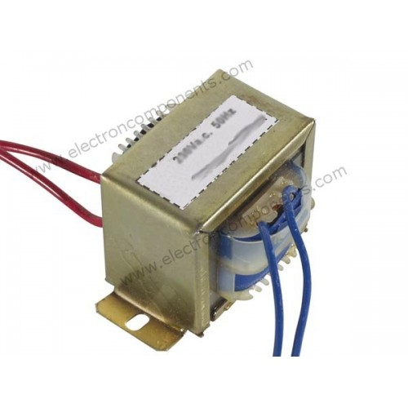
Installation the lamps:
Using lumen method we need 9 lamps for the model, the lamp specifications:
  2.5 volt
  0.3 Ampere
  luminous flux for the lamp is 6 (lumen)
Every 3 lamps are connected series together as group , and each single group connected with transformer.
Transformer specifications:
  Single phase
  The output :12V*2/1.2A , we can use 12 V or 24 V.
  The input: 230V/50Hz

Slide 11
Installation the lamps:
The wire trench in the model
The trench after connected the wires
The lamps group

Slide 12
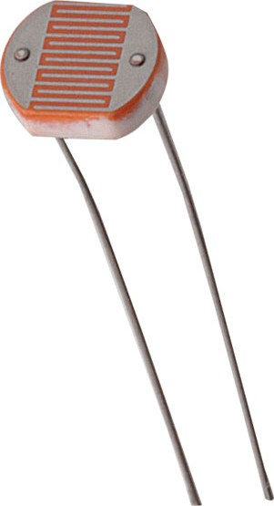
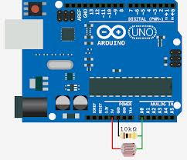
The sensors
LDR detector: It allows to control the system automatically dim the lights when the available daylight is low in order to maintain a specific light level in the space.
Its connection with Arduino

Slide 13
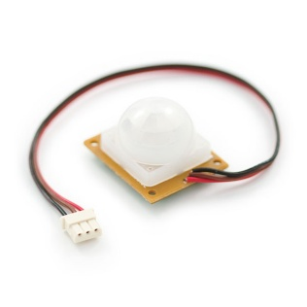
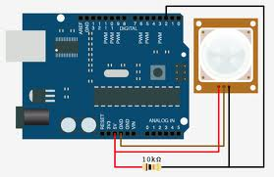
The sensors
Motion sensor: often used in indoor spaces to control electric lighting. If no motion is detected, it is assumed that the space is empty, and thus does not need to light the lamps.
The connection with Arduino:

Slide 14
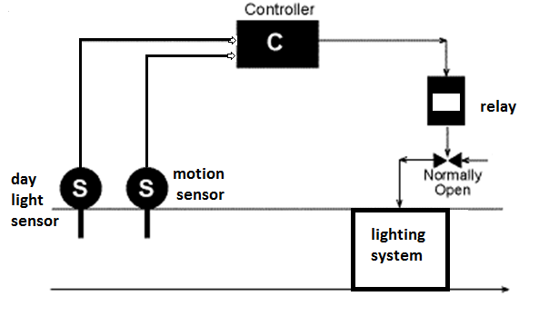
The controller
depend on the lighting level in the room the controller will decide the number of lighting that must be lighted so to reach the wanted illumination level in the room.

Slide 15
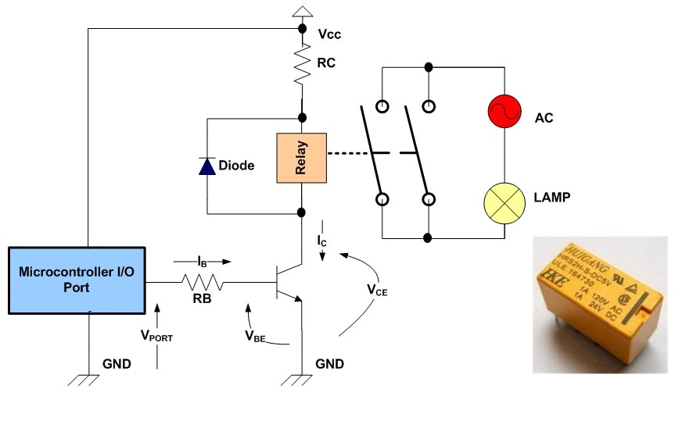
The output from controller (relay)

Slide 16
the water pumping system contains:
Water level sensor
The controller (software)
the output from the controller (relay)
Water pump

Slide 17
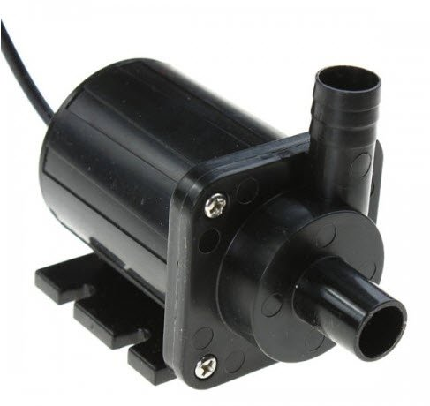
Water pump
This is a 12 VDC water pump which we used in our project in order to deliver water to the tank, then water spread through pipes to the whole house.
The pump’s job is to push water from the low tank into the top tank.

Slide 18
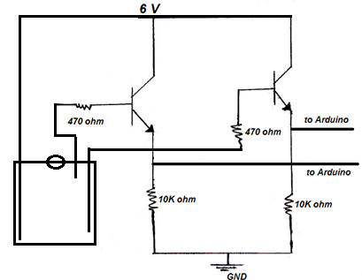
Water level sensor
For our project we design the sensor and built it using transistor BC337and resistors 10k and 470 ohm.
When there is water, the 470ohm will connected to the Vc so there will be a current therefor the signal which goes to Arduino will be HIGH.

Slide 19
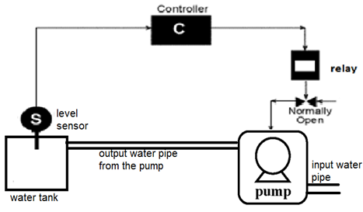
The controller

Slide 20
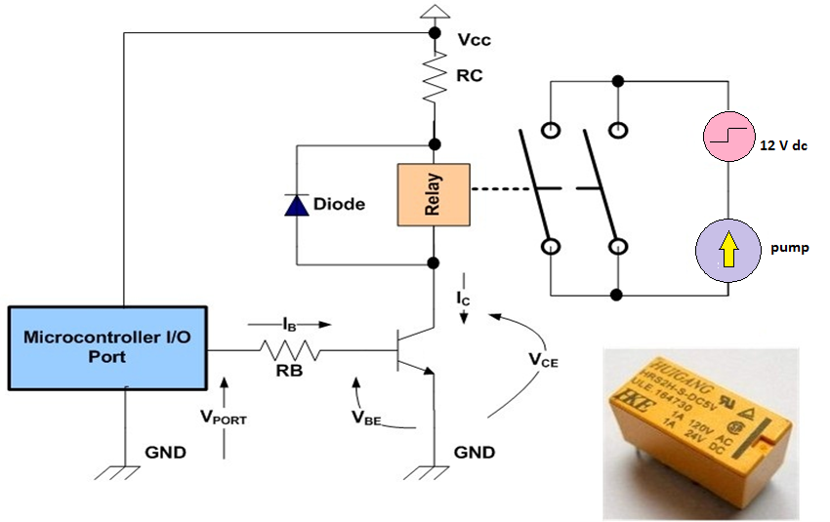
The output from controller (relay)

Slide 21
The cooling system contains:
Temperature sensor
The controller (software)
the output from the controller (relay)

Slide 22
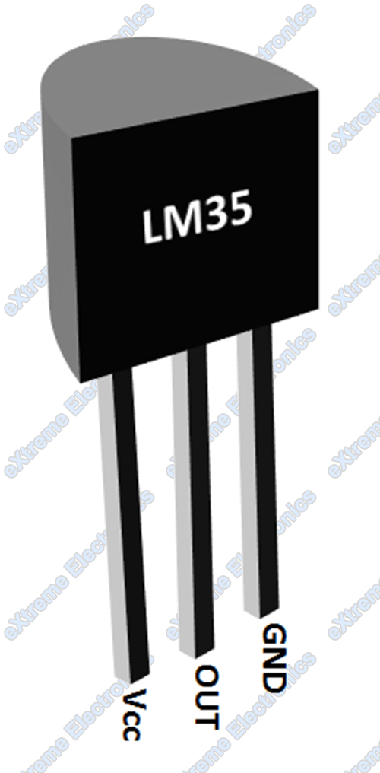
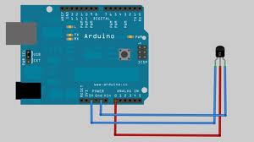
Temperature sensor
We use LM35 temperature sensor :
  It has an output voltage that is proportional to the Celsius temperature.
  The scale factor is 10 mV/C
  -55 to +150°C temperature range

Slide 23
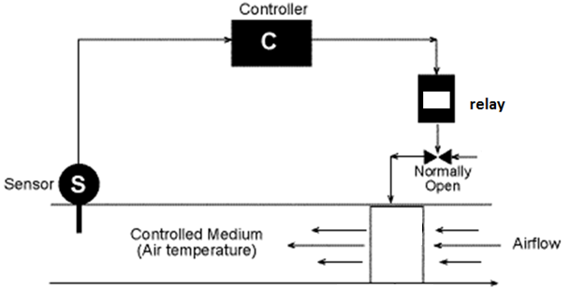
The controller

Slide 24
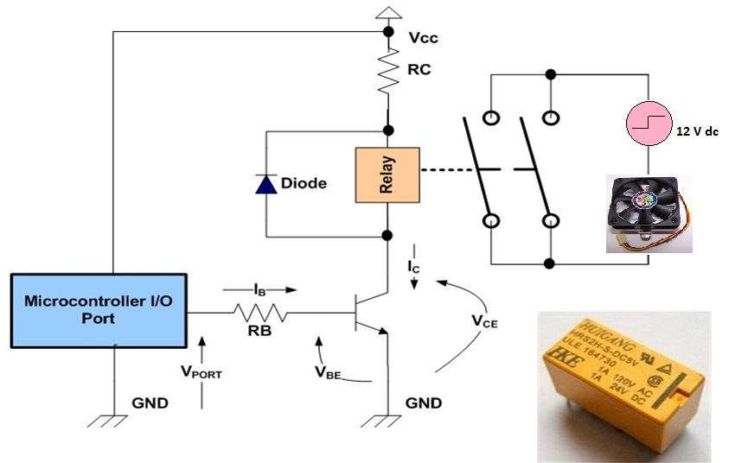
The output from controller (relay)

