Slide 1

Mobile access to fixed-line system
Presented by:
Mostafa Basheer & Diaa Badawi
Supervised by:
Dr. Ahmed Masri

Slide 2


Existing Problem
Some people have a problem of receiving too many calls at work

Slide 3
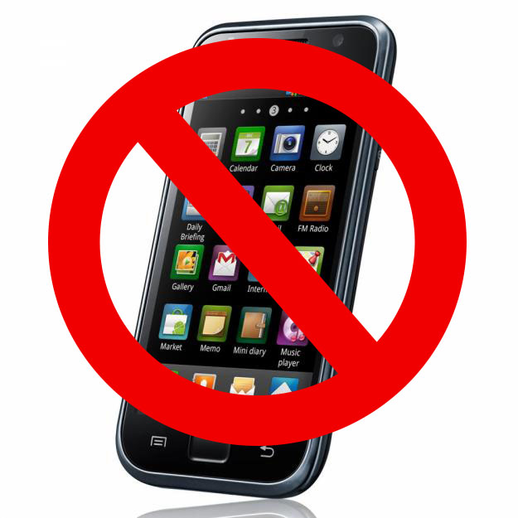
Existing Problem
Two options:
shut down your mobile.

Slide 4

Existing Problem
The other option is to:
Control your calls traffic
How can we control calls traffic?

Slide 5
Solution
Our solution is to enable mobile access to fixed-line system.
Two aspects of the system:
User’s utility (Mopho).
Switching system.

Slide 6
Solution
This system offers users two options:
Selecting calls you want to directly receive on mobile.
Otherwise, offload other calls to your fixed-line telephone.

Slide 7
What is offloading?
Offloading is re-directing data from one network to another one.
Can be for calls or data.

Slide 8
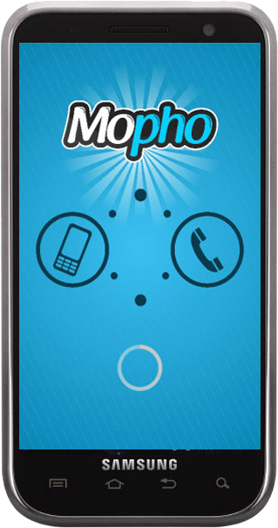
Mopho
The name comes from the two words: Mobile & phone
Mopho is an android-based application.
Functionalities:
Activation/deactivation of the service.
Enabling user to set traffic control configuration.
Sending user’s configuration to switching system.

Slide 9
Switching system
Consists of two sub-systems:
Database sub-system
Call switching subsystem
  Mobile Operator Switching System
  Unified Communication Open Source Network

Slide 10


Mobile Operator
Unified Communication Source network
Switching carried out by MSC & GMSC
Pros:
Using conventional calling process
More natural to users
Cons:
Additional billing for the service
Needs mobile operator adoption
Switching carried out by Asterisk PBX
Pros:
Independent of mobile operator
More freedom for developers
Voice over IP ( no billing)
Cons:
Needs VoIP utility (ZoiPer)

Slide 11

Area of interest
Real-life scenarios:
Doctors at clinics
People at offices
People At formal meetings

Slide 12
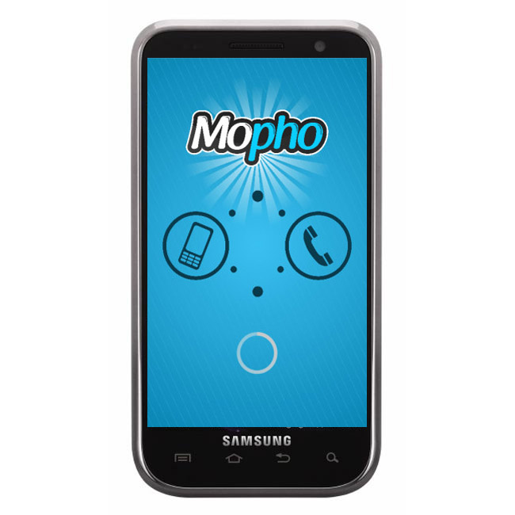
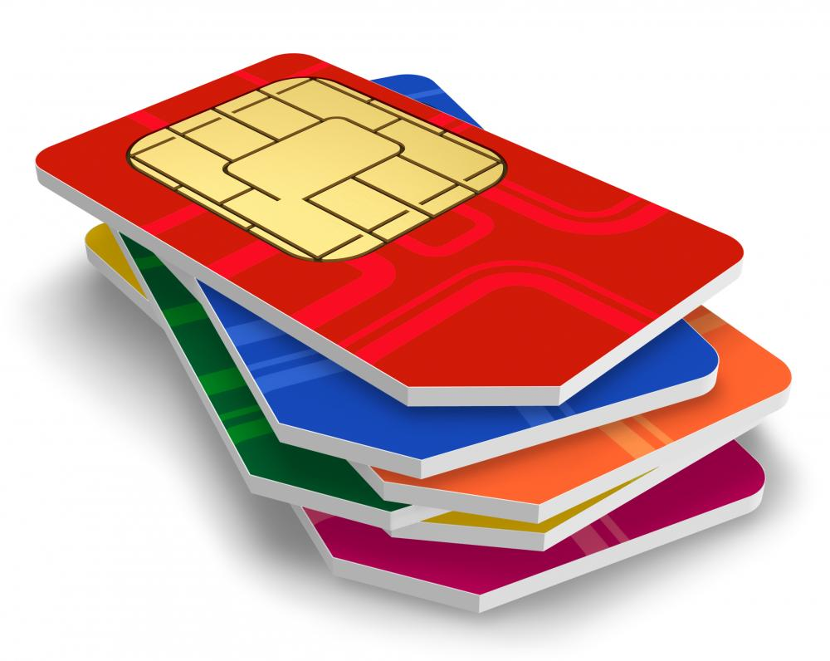
Service requirements
Mopho
Valid subscription.
Smartphone.
Internet Access.
ZoiPer utility.

Slide 13
How does it work ?
Calls conversion has three stages:
User enquiry stage.
Database stage.
Offloading stage.
} user’s utility
} switching system

Slide 14
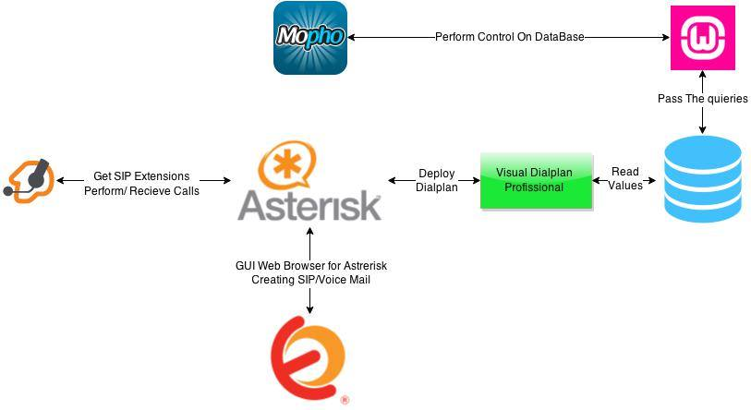

Slide 15
Demo.

Slide 16
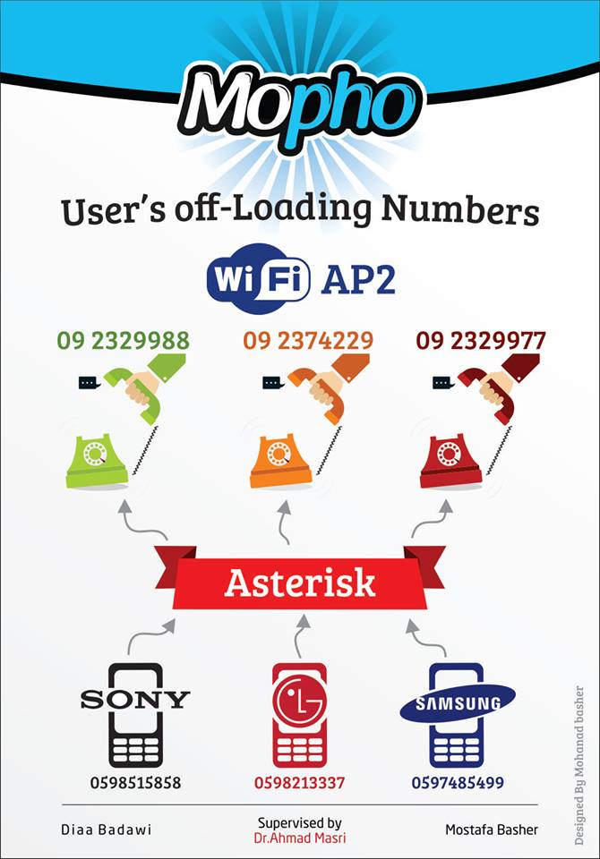
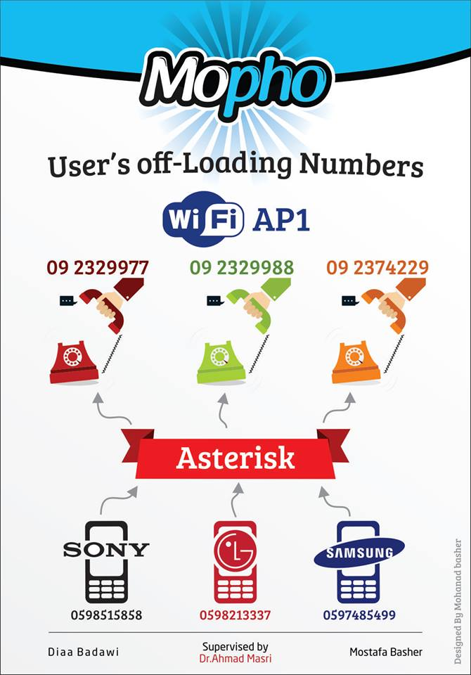

Slide 17
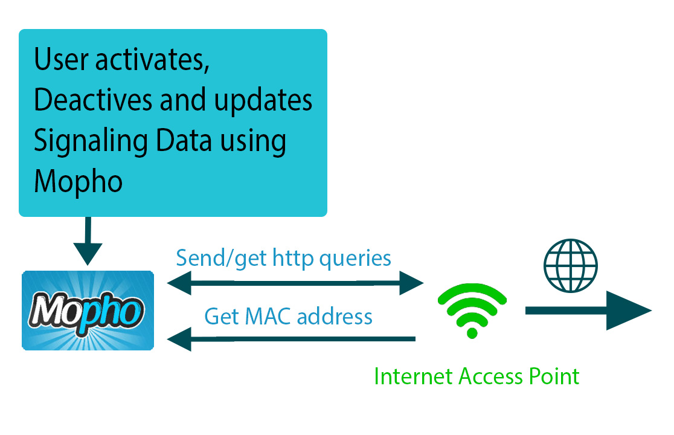

Slide 18
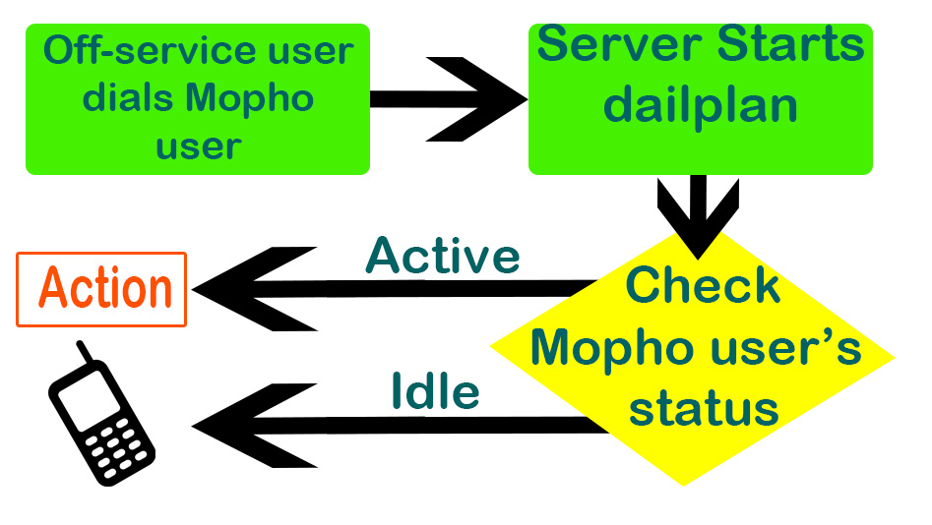

Slide 19
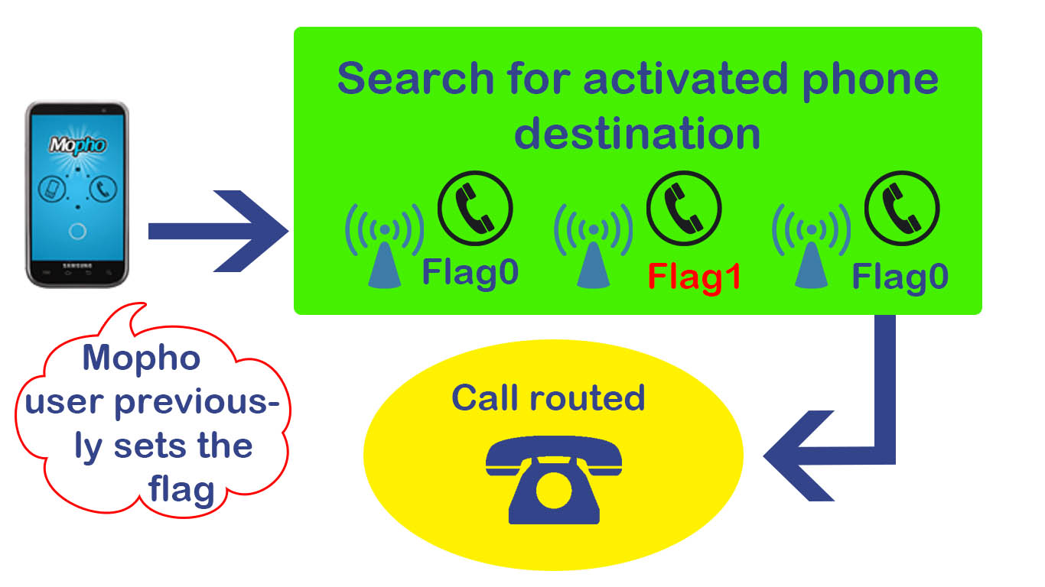

Slide 20
Future work
Technical issues:
Destination Authentication
Enforcing termination

Slide 21
Questions?

Slide 22
Thank You

