Slide 1

AN-NAJAH NATIONAL UNIVERSITY
INDUSTRIAL ENGINEERING DEPARTMENT
GRADUATION PROJECT
DEVELOPING SAFETY SYSTEM AT ARAB SPECIALIST HOSPITAL
Supervised By: Eng. Suleiman Daifi
Samya Abu Haibah | Sana’a Abd AL -Razzaq
Safwan Khair Allah | Reem Hmeidan

Slide 2
Contents
Problem statement
Recommended Solution
Explain the problem
Explain the solution
Benefits and result
Deliverable of project
Conclusion and Recommendations

Slide 3
Problem Statement
Lack of effective safety management systems.
Employees, patients and visitors are exposed to danger.
Large number of accidents lead to higher degree of danger in danger situation

Slide 4
Recommended Solution
Develop safety system
Construction for safety committee
Training course for employee
Create Palestinian code specialist for safety hospital

Slide 5

Explain The Problem
No implemented safety system
Absence of fire and emergency plan
No documented, programmed, and Followed system in the hospital
Not dealing with the medical waste and disposed it properly

Slide 6
Explain The Solution
Safety guide
Safety equipment
Fire and emergency plan
Development of medical waste management system
Access safety system.

Slide 7
Benefits and Result
Decrease expected risks to its lower level
More efficient, more productive
Ensure employees, visitors and patient’s safety

Slide 8
Benefits and Result
.
.
.
Costs of injuries and occupational illnesses should be significantly reduced.
Improve safety system in all hospital sectors
Improved employee performance

Slide 9
Project Implementation Methodology
Contact
Contact with the administration of the hospital.
Approval
take the approval from the administration.
Data collection
​​several visits to the hospital
Data analysis
Contact with the Eng . Adham Al Jallad .
Contact with civil defense
using online resources and textbooks
Analysis of the risks and the factors affecting the safety

Slide 10
Literature Review
Safety is the state of being "safe" ,the condition of being protected against all types of consequences failure, damage, accidents and harms .
Difference between safety & health
Safety deals with a cute effects of hazards ,whereas health deals with chronic effects of hazards

Slide 11
The Improvement Cycle
Plan
Do
Check
Act

Slide 12
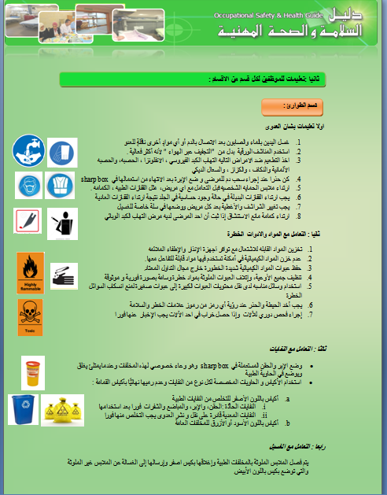
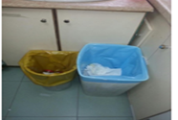
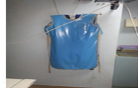
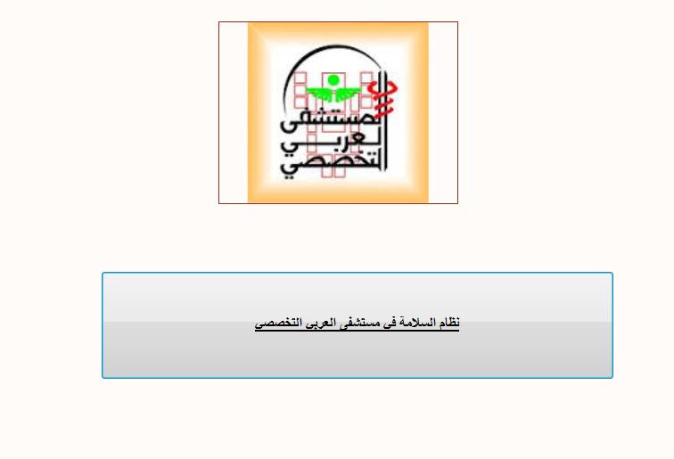
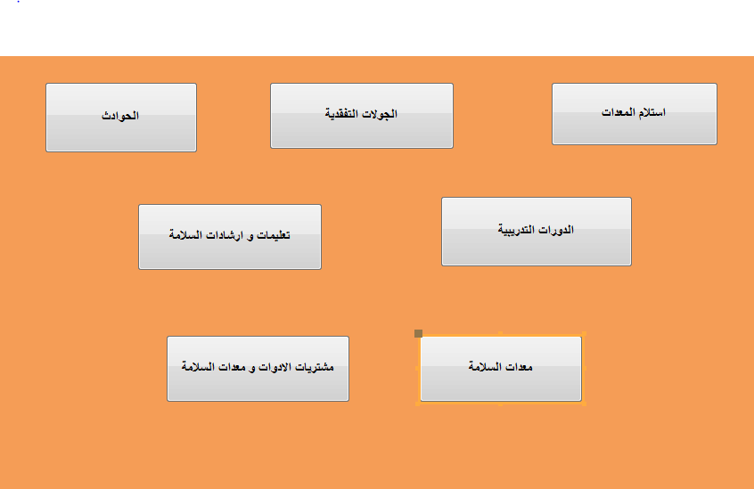
Deliverables of projects
Safety Guide
Safety equipment
Medical Waste system
Access system software

Slide 13
Safety Guide

Slide 14
Safety guide
Identify And Analyze The Risks Of each department
Divide them into 2 types
Visit the departments
Medical risk
Non Medical risks

Slide 15
Stakeholders
patient
visitor
employee

Slide 16
Medical Risks
Hospital infections
Pollution
Wastes
Chemical risk
Sharp objects

Slide 17
Non-Medical Risks
Fires
Natural disasters
Seek Supply
Accidents and work-related injuries
Bad lighting
Poor ventilation
Risks caused by fatigue and stress

Slide 18
The Instructions
How to Deal with fire
How to dispose waste
Instructions on infection
Dealing with hazardous materials and tools
Dealing with contaminated clothing.
Things that must follow when you enter the hospital

Slide 19
Departments Of The Hospital
Emergency department
Radiology department
Maternity ward Department
ICU &
Cardiology Departments
Operations department
Pharmacy Department

Slide 20
Departments Of The Hospital
Department of women & men sleeping place
Laundry Department
Laboratory Department
Kitchen ,Lecture Hall Department
Clinics Department

Slide 21
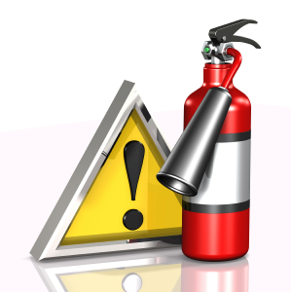

Safety Equipments

Slide 22
Safety Equipments
A checklist was prepared
Differentiate between the medical safety tools and personal safety tools
Listed safety equipment with appropriate specifications.

Slide 23
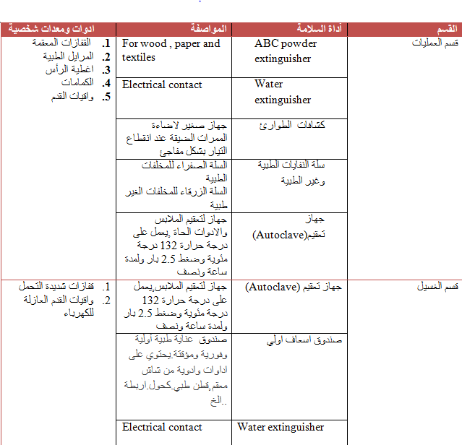

Slide 24
To clarify this plan we have set a list of safety requirements and fire protection in hospitals, this plan was include:
Fire Plan
Location
Sector of fire
Survival Means Requirements

Slide 25
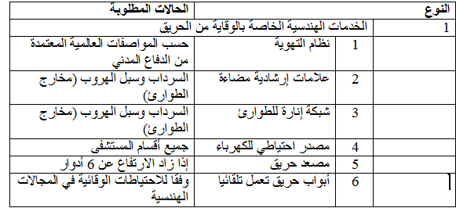
The engineering services

Slide 26
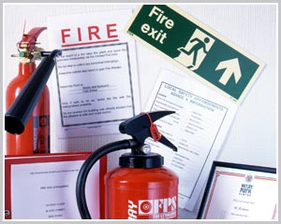
Fire management plan

Slide 27
Emergency plan
Secure transportation of patients
Secure supplies and medicines
Insurance to protect workers and ensure they continue to provide service
Good management of the incident
Secure deaths and save the deceased
Insurance reception and treatment of patients
ensure continuity of provision of medical services
The goal of this plan

Slide 28
This plan contains three strategies/ phase
Phase 1
Before the incident (standby) and include:
Phase 2
During the incident the response and include
Phase 3
After the incident revaluation, it is include the following:
Awareness
Training
Reporting scenario
Transfer patient
Blogging the full process
Collect reports

Slide 29
Medical Waste

Slide 30
The Medical Waste System
The responsibilities
Color coding and labelling
Reducing medical waste
The medical waste operations series
The Protective measures
Irregularities System

Slide 31
Reducing Medical Waste

Slide 32
The Medical Waste Operations Series
Generation
On-site transportation
Segregation

Slide 33
The Medical Waste Operations Series
Treatment & disposal
Off-site transportation
Storing

Slide 34
      Protective Measures
Primary prevention
Eliminating hazards
Collective and technical prevention
Secondary prevention
Measures in the event of an accident (accidental exposure to blood, spills).
Organizational prevention
Individual prevention

Slide 35

    Software Safety System
This Software system for easy access to information for all people entering the hospital whether they are employees, visitors or patients.

Slide 37
The Objectives Of Access System
Easy access to the instructions and safety guidelines
Easy access to previously recorded accidents and new registration accidents.
Easy access to the tools and safety equipment used in the department
Knowledge of safety-related training courses

Slide 38
The Constraints
Cancel the agreement with An - Najah hospital after two months
Difficult to communicate with the supervisor engineer on the project
Difficulty to communicate with the administration of the hospital
Had to learn using the Microsoft Office program (access)
Difficulty in collecting accurate information on some departments

Slide 39
Conclusions and Recommendations

Slide 40
Conclusions and Recommendations
The hospital is recommended to implement this system to achieve all safety requirements and reduce injuries, accidents and infection.
Training is very essential, to increase the employees awareness for safety in their work areas.
The workers should commit the safety management procedures.

Slide 41
Conclusions and Recommendations
The administration should invest more time and money in order to improve the implementation of the safety system.
The hospital should form a safety committee. To ensure applying the safety rules in all the hospital departments.
Continuous improvement for this system to implement the modern techniques
Design an automatic alarm Network at the hospital

Slide 42


