Slide 1
Techno-Economic Assessment Of grid connected Photovoltaic System in Sohar university in Oman
To:
Dr. Mohammad Othman
Dr. Tamer Khatib.
By:
Ahmad Saad AlDin
Salma Omari

Slide 2
Content
Introduction
Problem Statement
Objectives
Literature Review
Methodology
Results
Conclusion

Slide 3
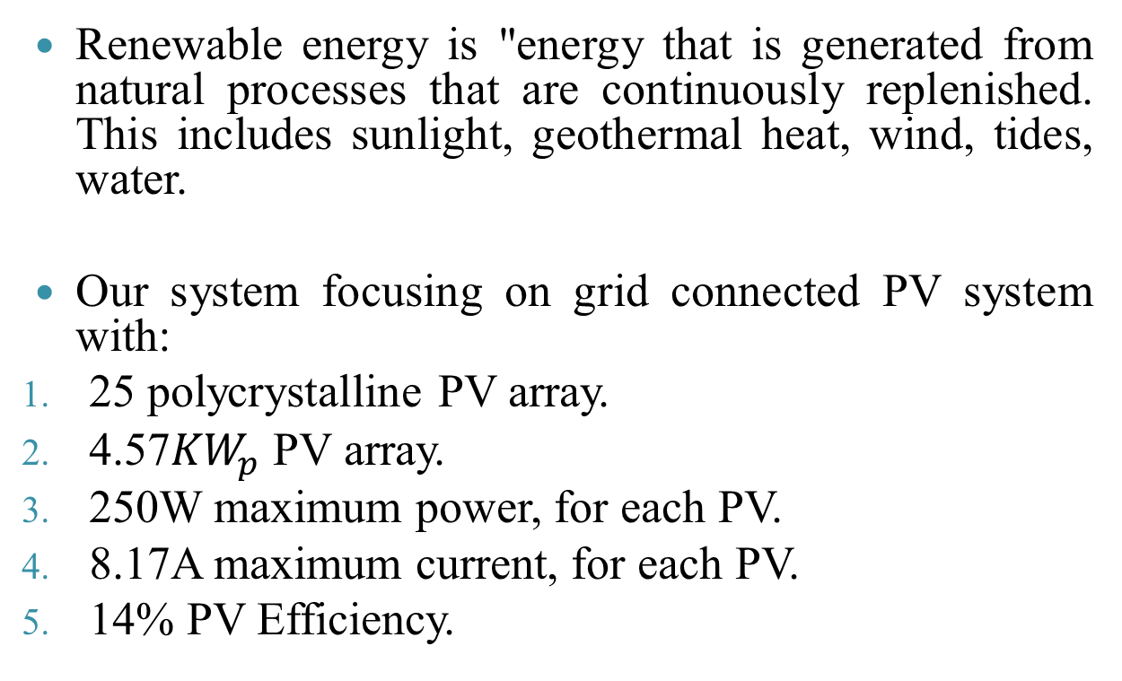
Introduction
Renewable energy is "energy that is generated from natural processes that are continuously replenished. This includes sunlight, geothermal heat, wind, tides, water.
Our system focusing on grid connected PV system with:
25 polycrystalline PV array.
4.57${KW}_{p}$ PV array.
250W maximum power, for each PV.
8.17A maximum current, for each PV.
14% PV Efficiency.

Slide 4
Problem statement
world is facing a serious environmental problems related to the traditional energy sources in addition to an increase in energy demand. And from all different modes of renewable energy technologies, solar PV is under study.
Photovoltaic
η: 5-20%
High cost

Slide 5
For the future of PV technology.
Figure 1: The global solar PV cumulative installed capacity.

Slide 6
Objectives
Evaluate the performance of the system in combination with the feasibility of the system
Research on whether or not a solar PV system is economically viable under certain circumstances
Identify the efficiency and productivity of the system.
Design a cost-effective energy system with a good reliability.

Slide 7
Methodology
Economical criteria:
To evaluate the economic potential (all costs of installing, operating and all related costs) the PV system and to use parametric simulation:
Life cycle cost
2.Annualized Life cycle cost
3.Unit cost of electricity
4.Parametric simulation

Slide 8
Technical criteria:
To evaluate the productivity of the system some indices were calculated
1. Photovoltaic efficiency.
4. Capacity factor.
2. Inverter efficiency.
5. Solar radiation profile.
3. Yield factor.
6. Ambient temperature profile.

Slide 9
Results
Technical criterion
PV efficiency.
PV efficiency | Month
15.78% | January
16.64% | March (Max.)
13.77% | April
13.72% | May
7.97% | June
10.23% | July
7.57% | August
5.46% | September (Min.)
10.45% | October
9.25% | November
9.41% | December

Slide 10
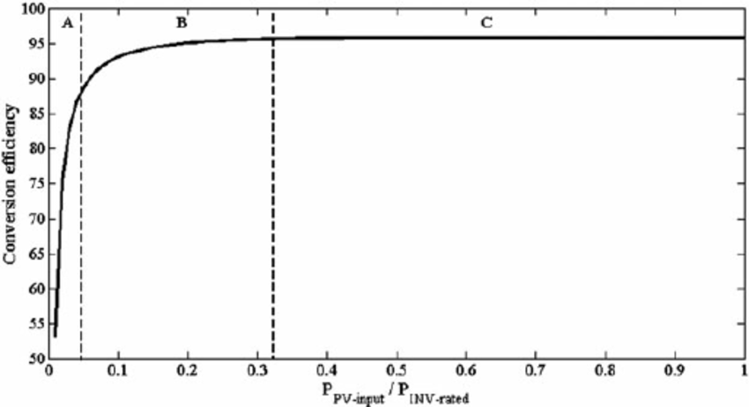
Inverter efficiency
Inverter efficiency | Month
92.37% | January
92.20% | March
92.60% | April
92.62% | May
92.50% | June
92.66% | July (Max.)
92.48% | August
92.11% | September (Min.)
92.53% | October
92.55% | November
92.17% | December
Typical efficiency curve of an inverter.

Slide 11
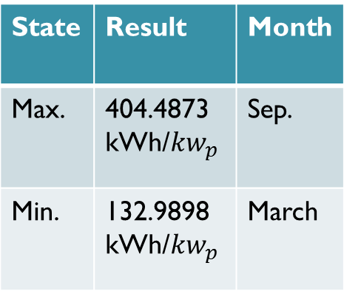

3. Yield factor
Month | Result | State
Sep. | 404.4873 kWh/${kw}_{p}$ | Max.
March | 132.9898 kWh/${kw}_{p}$ | Min.
the monthly average yield factor was 225.1614 kWh/${kw}_{p}$.

Slide 12
4. Capacity factor
Month | Result | State
Aug. | 0.5618 56.18% | Max.
July. | 0.1069 10.69% | Min.
the monthly average capacity factor was 0.2854 (28.45%).

Slide 13
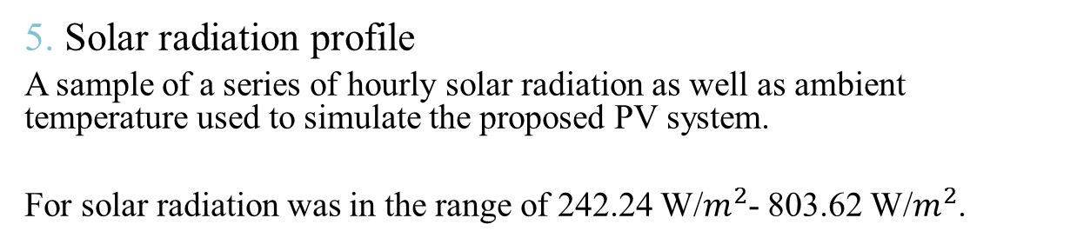
5. Solar radiation profile
A sample of a series of hourly solar radiation as well as ambient temperature used to simulate the proposed PV system.
For solar radiation was in the range of 242.24 W/$m^{2}$- 803.62 W/$m^{2}$.
For March

Slide 14
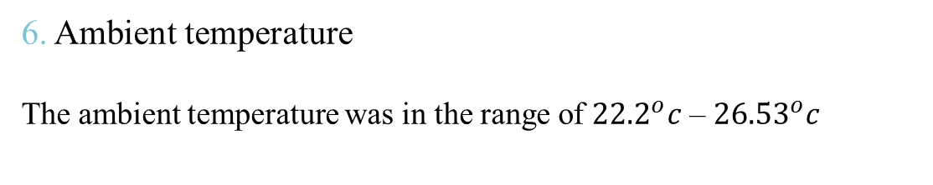
6. Ambient temperature
The ambient temperature was in the range of ${22.2}_{}^{o}c$ – ${26.53}_{}^{o}c$

Slide 15
Operating curve [experimental I-V characteristic curve].
The characteristic of a PV cell is expressed by its relationship between current and voltage (I–V) as called The I–V characteristic of a solar cell.

Slide 16
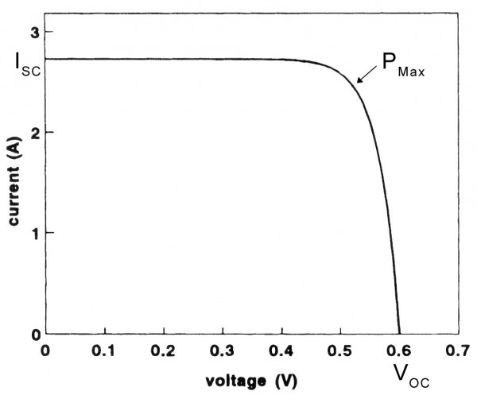
I-V characteristic curve.

Slide 17
b. Economical criterion
The life cycle cost with respect to system life time:
N | LCC
5 | 10918.14
10 | 15711.28
15 | 19874.68
20 | 23491.07
25 | 26632.32

Slide 18
The maintenance cost with respect to system life time:
N | Cm
5 | 5518.137
10 | 10311.28
15 | 14474.68
20 | 18091.07
25 | 21232.32

Slide 19
The effect of changing inflation rate in life cycle cost and unit cost of electricity:
i | LCC | UCE
0.04 | 24455.09 | 0.771446
0.045 | 25505.3 | 0.766214
0.05 | 26632.32 | 0.761228
0.055 | 27842.45 | 0.75649
0.06 | 29142.52 | 0.752004

Slide 20
i | LCC | UCE
0.04 | 24455.09 | 0.771446
0.045 | 25505.3 | 0.766214
0.05 | 26632.32 | 0.761228
0.055 | 27842.45 | 0.75649
0.06 | 29142.52 | 0.752004

Slide 21
The effect of changing discount rate in life cycle cost and unit cost of electricity:
d | LCC | UCE
0.07 | 29092.21 | 0.752167
0.075 | 27813.32 | 0.756598
0.08 | 26632.32 | 0.761228
0.085 | 25540.43 | 0.766049
0.09 | 24529.69 | 0.771053

Slide 22
d | LCC | UCE
0.07 | 29092.21 | 0.752167
0.075 | 27813.32 | 0.756598
0.08 | 26632.32 | 0.761228
0.085 | 25540.43 | 0.766049
0.09 | 24529.69 | 0.771053

Slide 23
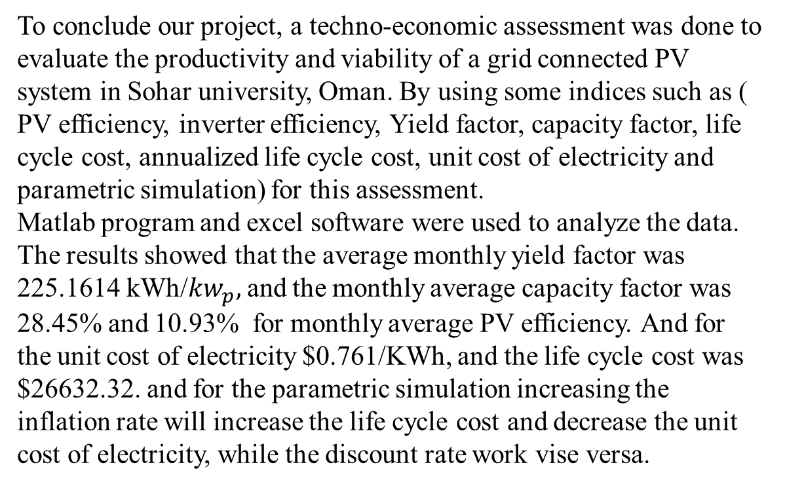
Conclusion
To conclude our project, a techno-economic assessment was done to evaluate the productivity and viability of a grid connected PV system in Sohar university, Oman. By using some indices such as ( PV efficiency, inverter efficiency, Yield factor, capacity factor, life cycle cost, annualized life cycle cost, unit cost of electricity and parametric simulation) for this assessment.
Matlab program and excel software were used to analyze the data.
The results showed that the average monthly yield factor was 225.1614 kWh/${kw}_{p},$and the monthly average capacity factor was 28.45% and 10.93% for monthly average PV efficiency. And for the unit cost of electricity $0.761/KWh, and the life cycle cost was $26632.32. and for the parametric simulation increasing the inflation rate will increase the life cycle cost and decrease the unit cost of electricity, while the discount rate work vise versa.

Slide 24


