Slide 1

An-NajahNationalUniversity
Faculty of Engineering
Civil Engineering Department
Graduation project (11) for:-
”Mr. Amer Alhaj Qasem”
Done by:-
Hani Awwad
Majde Ghazal
Ammar Al-barri
Submitted to :
Dr. Riyad Abdel-Karim Awad

Slide 2
Out line :-
1- Introduction
2- Materials
3-Codes
4- Loads
5- Design of slabs and beams
6- Checks for the model
7- Dynamic analyses
8-design for footing ,column and shear wall

Slide 3
Introduction:-
An earthquake is the shaking of the surface of the Earth, resulting from the sudden release of energy in the Earth's lithosphere that creates waves, Earthquakes can range in size from those that are so weak that they cannot be felt to those violent enough to toss people around and destroy whole cities.
The seismicity or seismic activity of an area refers to the frequency, type and size of earthquakes experienced over a period of time , No body predicted the earth quake , but what we can do design for it and protect our self and our buildings .

Slide 4
In this project we will design for a building which located in Ramallah city , worth to mention that this city is very active city related to building , so it should have a good strong building .
The objective of this project is to practice the concept of the concrete design , to design strong and economical construction against the earth quake forces , which means an optimal solution.
The building that we have is contained from (5) floors also we have one the basement floor.

Slide 5
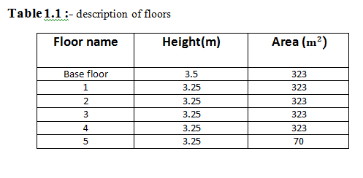

Slide 6
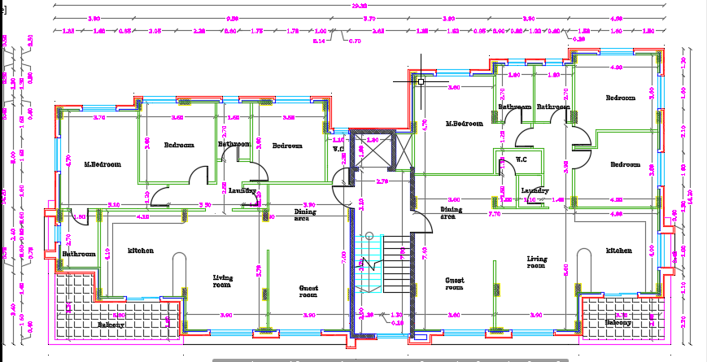

Slide 7
Geotechnical Investigation:-
Geotechnical investigation is a very important process to assess the soil under the structure and obtaining its bearing capacity which is used in the design of the foundations.
But in this project, there are no geotechnical investigation reports, so the bearing capacity of the soil is assumed to equal 300 kN/m² with unit weight of 18.5 kN/m³ and soil class B (Rock) for seismic design

Slide 8
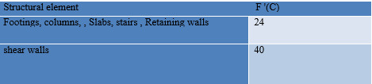
Materials:-
Structural Materials:-
Concrete:-It is the binding material that has an ability to resist the compression forces effectively. Also it provides a very good protection to other structural material such as steel. The concrete compressive strength is measured after 28 days of pouring and curing the samples. This strength will differ according to the importance of the structural element.
In this project, the concrete type for the structural elements is B300

Slide 9
steel : -it is used with concrete to give the enough strength to resist the tensile stresses, which will make the structure more flexible in addition to reduce the growing cracks in the structural elements.
ASTM A955 Grade 60, and this type has yield strength of 420 MPa.

Slide 10
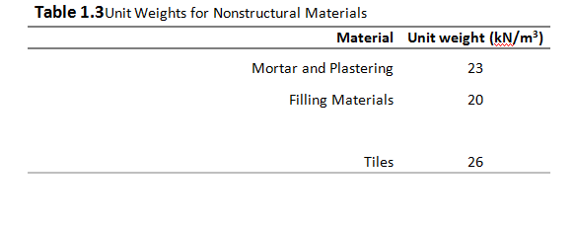
Nonstructural Materials :These materials in general have directly relationship to the finishing process. These materials include tiles, filling materials, mortar and plastering.

Slide 11
Codes:-
UBC 97 ( Uniform Building Code)
ACI 318M-14 ( American Concrete Institute)
IBC 2012 ( International Building Code)

Slide 12
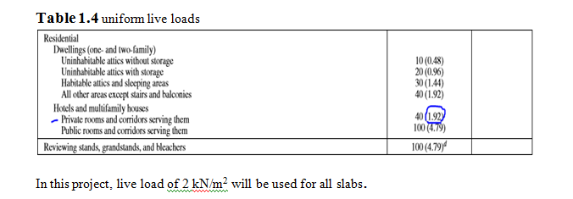
Loads:-
1-live load: which can be defined as the loads that are variable by time progressing. However, it is mainly caused by people, furniture, or any other movable objects.
To find the live load using IBC-2015 , our building is a residential , private rooms and corridors

Slide 13
2- Superimposed dead load:- this load is mainly caused by the nonstructural elements of the building , such as tiles , stones , partitions , filling materials , and plastering.
3-Dead Load:- it is mainly the own weight of the structural elements , which can be defined as the load that does not change with time progressing , in addition to the superimposed dead load.

Slide 14
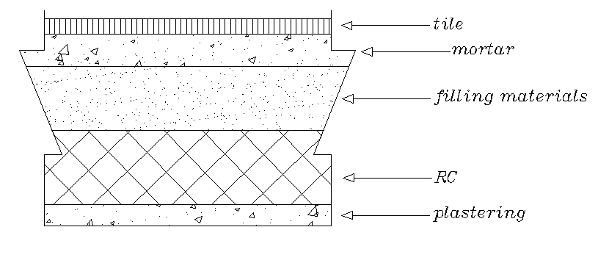
SD= (0.01 * 23 ) + ( 0.1 * 20 ) + (0.02 * 23 ) +
( 0.03 * 26 ) = 3.5 KN/
Because we have a partitions we add 1 KN/ to SI load
Superimposed dead load = 3.5+1 = 4.5 KN/

Slide 15
3- wall load :-
load = 21 kN/m
4- basement wall :-
load = Y soil * H * K
K= 1-sin30/1+sin30 = 0.5/1.5 = 0.333
The load is = 18**3.5*0.333* = 20 kN/m

Slide 16
5- Lateral Loads:-
Lateral loads are mainly caused by earthquakes and wind forces or any other similar effect such as explosions that causes one single destroyed shock. In this project, we will design the building for seismic loads .
Seismic Load: it is a result of earthquakes, and it happens at contact surfaces of a structure with the ground.
The design for seismic loads is according to UBC 97
6- Load Combinations:-
For the ultimate load we have 6 combination then we will take the envelope .

Slide 17
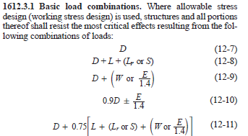
Figure :basic load combinations

Slide 18
U= 1.4D
U= 1.2D+1.6L
U= 1.275D+1L+1Ex
U= 1.275D+1L+1Ey
U=0.825D+1Ex
U=0.825D+1Ey

Slide 19
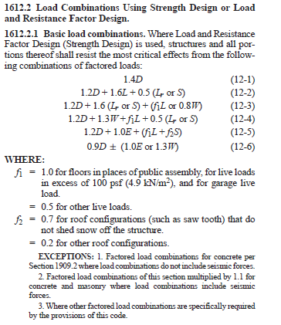
For the services load combination it will be
Figure: load combinations using strength design or load and resistance factor design.

Slide 20
U=1D+1L
U=0.9D+0.71Ex+0.214EY
U=0.9D-0.71Ex-0.214Ex
U=0.9D+0.214Ex+0.71Ex
U=0.9D-0.214Ex-0.71Ex
U=1D+0.75L+0.54Ex+0.162Ey
U=1D+0.75L-0.54Ex-0.162Ey
U=1D+0.75L+0.162Ex+0.54Ey
U=1D+0.75L-0.162Ex-0.54Ey
Then we will take the envelope between this values.

Slide 21
Programs:-
1- SAP 2000
2-Autocad
3-Excel

Slide 22
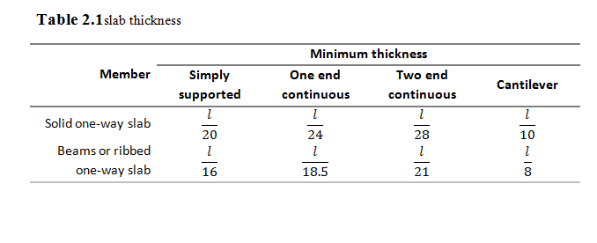
Design of slabs and beams:-
Slab thickness for one end continues h = 4/18.5 =21.6 cm ( which is max values ) so , we will use h =25 cm

Slide 23
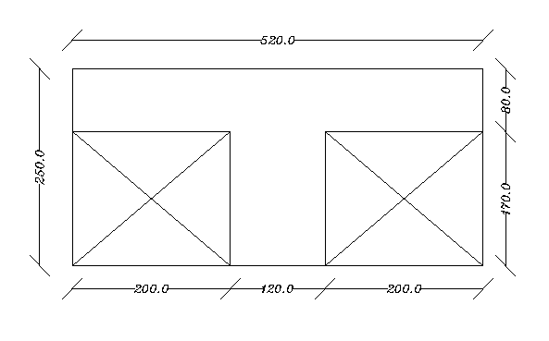
Figure: section of ribbed slab

Slide 24
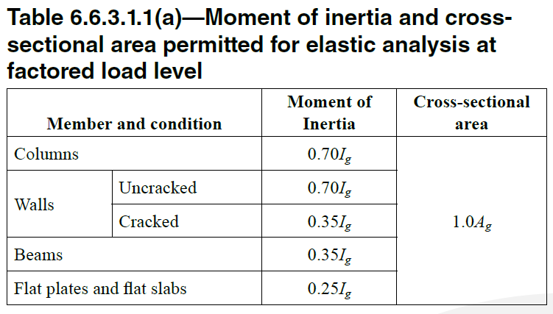

Slide 25
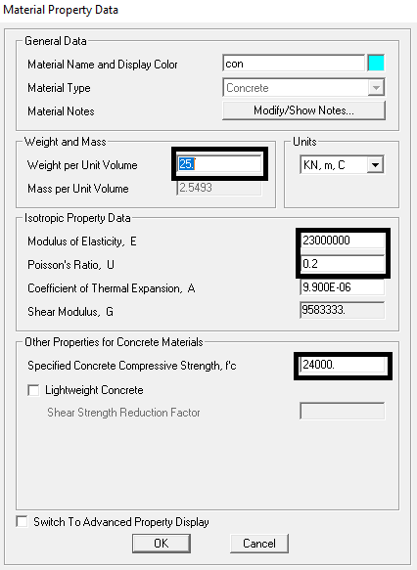
Sections:-

Slide 26
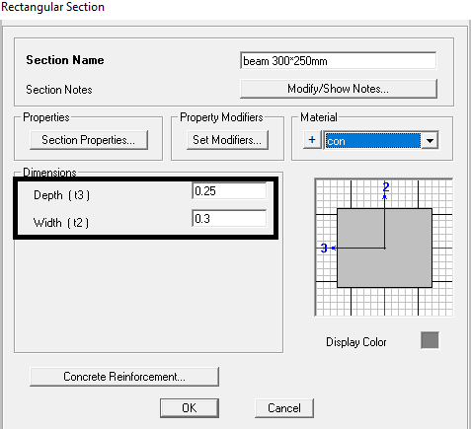
Beams:-

Slide 27
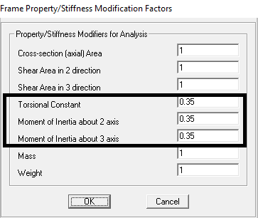

Slide 28
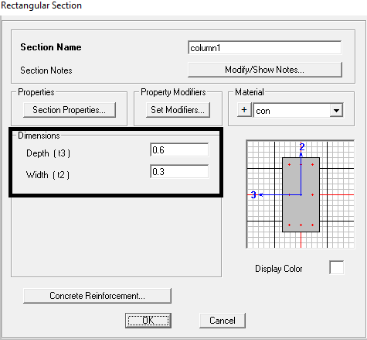
Columns:-

Slide 29
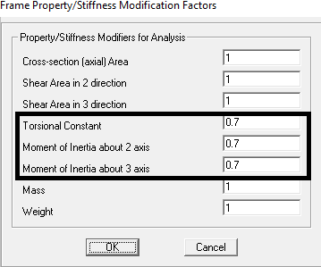

Slide 30
Equivalent section:-
I ribbed = I solid
0.52*h^3/12 = 2.852*10^-4
(from section was made on sap)
H= 0.1874 m

Slide 31
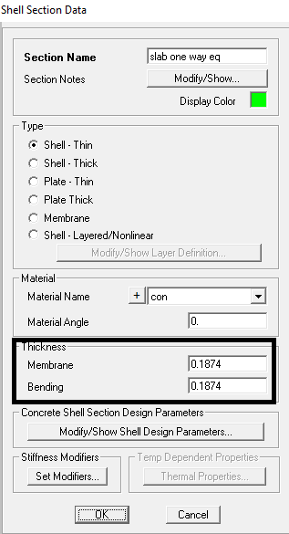

Slide 32
Modifier for one way part:-
Modifier:-
F22= Area actual / Area sap = 0.08*.52/0.1874*0.52
= 0.427
F11= 0.62/0.52*0.1874
F12= the smallest = 0.427
M22 = (.08/0.1874)^3 * 0.025 = 0.00194
M11 = 0.25
M12 = 0.00194

Slide 33
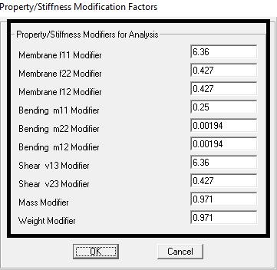

Slide 34
Modifier for two way part:-
f11= f12=f22=v13=v23 =0.062/0.097= .0639
m11= I ribbed / I SOILD *.25
m11=m12=m22 = 0.25

Slide 35
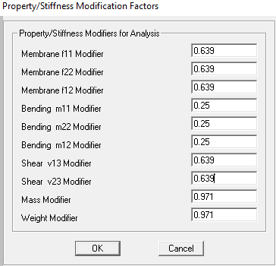

Slide 36
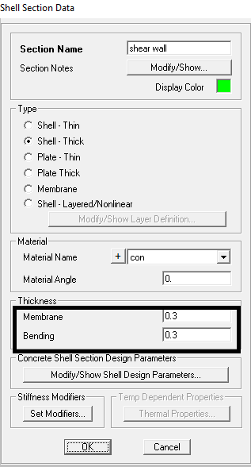
Shear wall:-

Slide 37
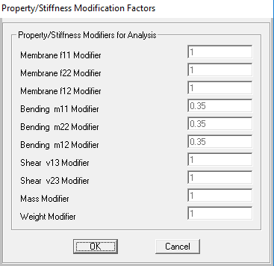

Slide 38
checks for the model:-
We have three checks :-
1-compatibility check : the aim of this check is to see if the building act as one unit , It have the same direction of movement, also we should notice that every mesh In the same point with other one.
.

Slide 39
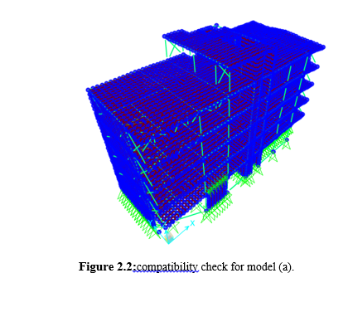
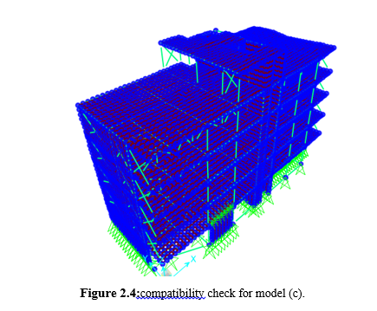
Compatibility:-

Slide 40
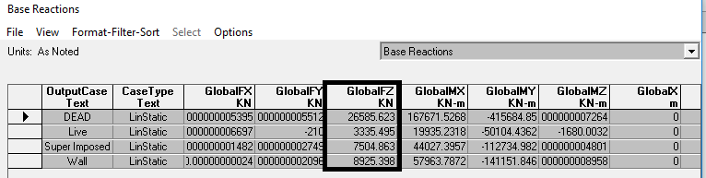
2-equilibrium check : -Here we should prove that sum of all loads equal all reaction for every type of load with % difference max = 5%
% of difference acceptable

Slide 41
Live load = area * load = 322.75* 2 *5+70*2 = 3362kn
SI load = area * load = 322.75* 4.5*5+70*4.5 =7576.5 KN
Wall load = 21* (7+29*2+13*2) *5 = 9555kN
Total dead load( Slab + Columns + shear wall + basement wall + beams ) =
(7903+2834+10880+79+2848+1000 )
= 25544 KN
(26585-25544 ) / 26585 = 3.9%
% of difference acceptable

Slide 42
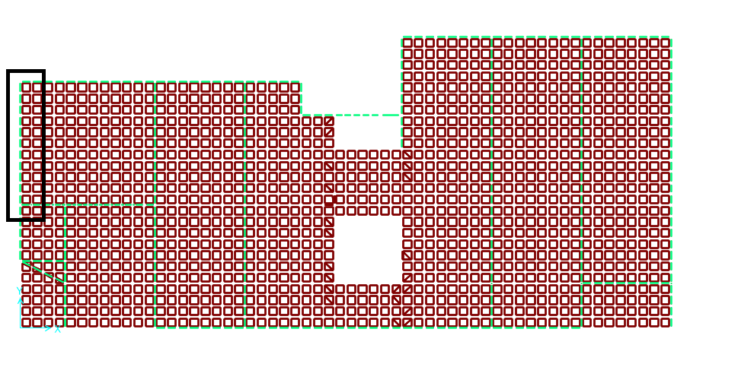
3-stress-strain check :-
The moment is W*L2*/8 and its applied for pin or fixed support (from live load ).
Lets take this beam.

Slide 43



Wl^2/8= 2*(5.5)^2/8 = 7.56
(4+4) /2 + 2.3 = 6.3

Slide 44
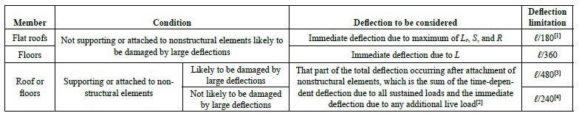
4-Deflection checks:-should notice that when we design to deflection we should use service
According to ACI-code the limitations for max deflection that is allowed

Slide 45
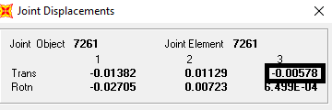
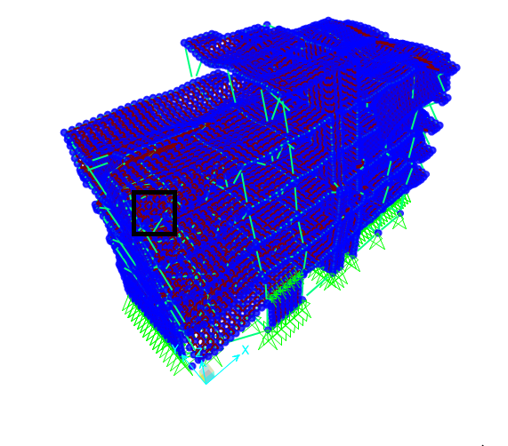
Some critical point in the building
Point 1

Slide 46
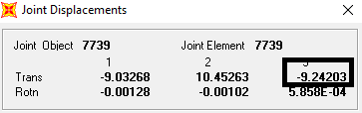
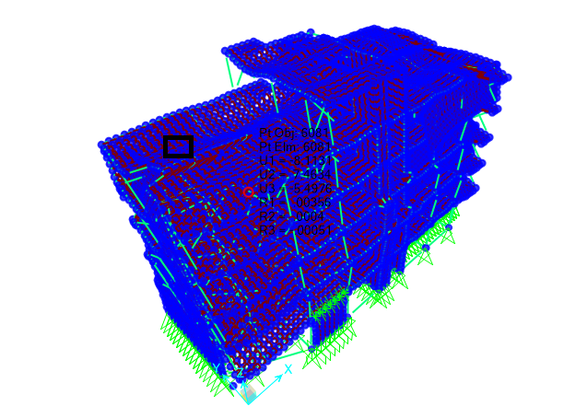
Ponit 2

Slide 47
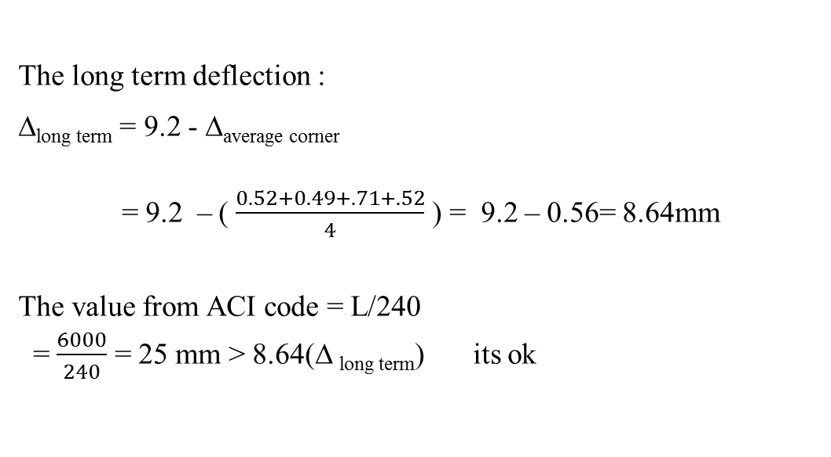

Slide 48
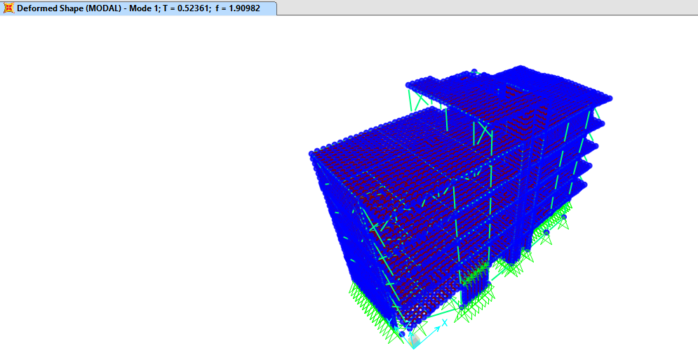
5-Period check:-

Slide 49
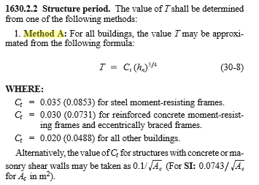
From Section 1630.2.2 in UBC 97:-

Slide 50
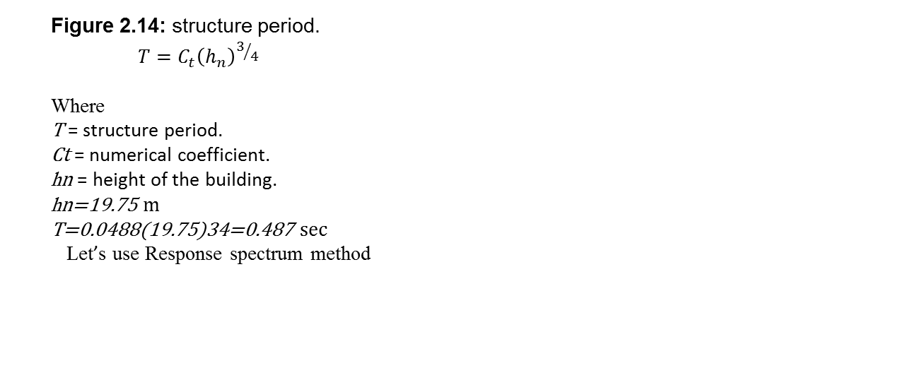
T = 0.5236 sec
In method the fundamental period of the first mode was equal to 0.487 sec.
The difference = 0.52-0.487/0.52 = 6.3%

Slide 51
Dynamic analyses:-
Equivalent static force
Response spectrum functions
Time history

Slide 52

Response spectrum functions

Slide 53
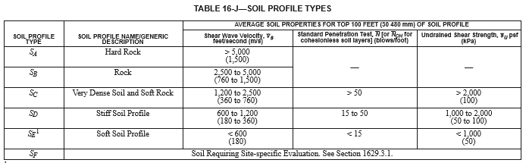
for Ramalla , City, seismic zone is 2A.
Figure : soil profile types.
from soil test we defined the allowable bearing capacity as 300 KN/m2, and the soil is classified as Rock, then from ASCE, Chapter 20. (Table 20.3-1):
Soil profile type is assumed to be SB.

Slide 54
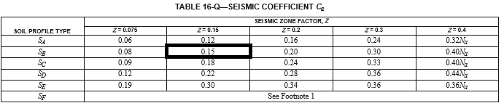
From Table 16-I in UBC 97, seismic zone factor, Z=0.15
Figure seismic zone factor Z.
From Table 16-Q in UBC 97, seismic coefficient, Ca=0.15
Figure : acceleration seismic coefficient. Ca

Slide 55
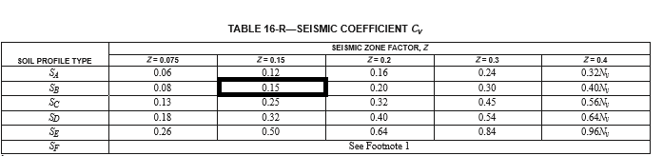
Figure : velocity seismic coefficient Cv
From Section 1630.2.2 in UBC 97, numerical coefficient, Ct=0.0488
From Table 16-R in UBC 97, seismic coefficient, Cv=0.15

Slide 56
From Table 16-K in UBC 97, importance factor, I=1
Figure : factor I.
From section 1630.1 in UBC 97, redundancy/reliability factor, ρ=1

Slide 57
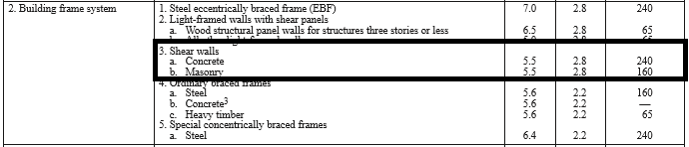
Figure : structural system.
From Table 16-N in UBC 97, response modification factor R=5.5

Slide 58
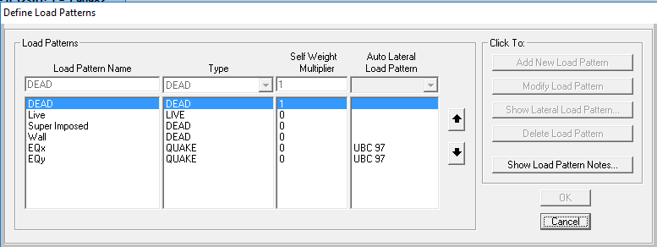
SAP design:-
Figure : define load patterns.

Slide 59
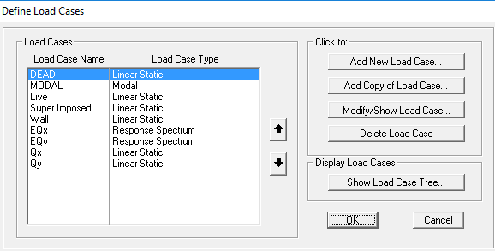
Figure : define load cases.

Slide 60
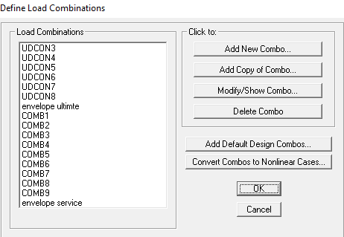
Figure : define load combinations.

Slide 61
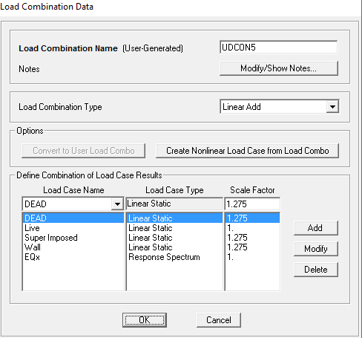
Figure : load combinations data.

Slide 62
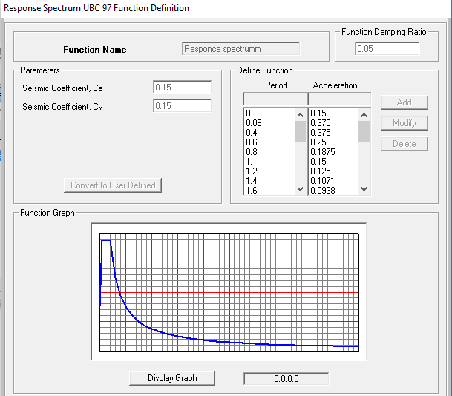
Figure : response spectrum UBC 97 function definition and graph.

Slide 63
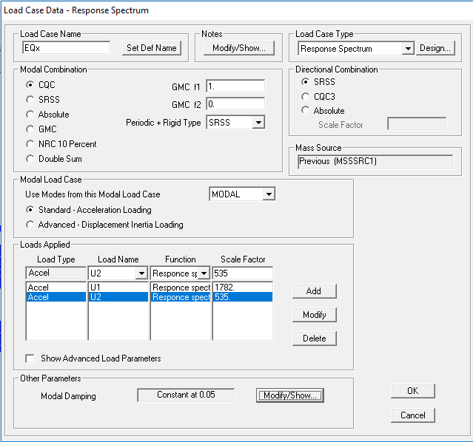
Figure : load case data –response spectrum in X-direction.

Slide 64
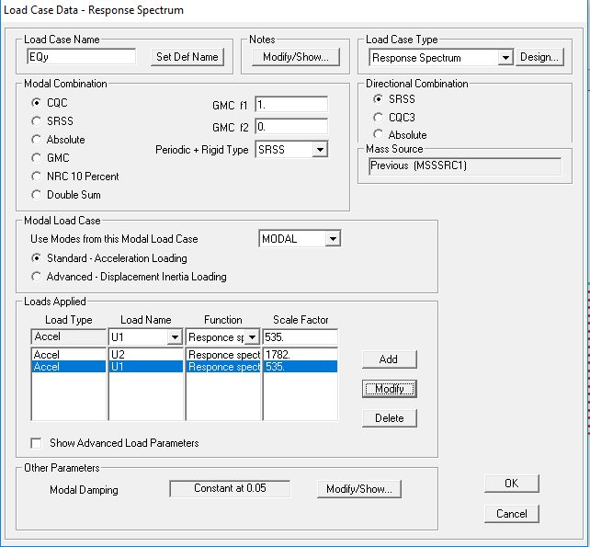
Figure :load case data –response spectrum in y-direction.
Where scale factor = I*g /R = 1*9810/5.5 =1782 in y.
And scale factor for x-direction = 0.3(I*g /R)=535

Slide 65
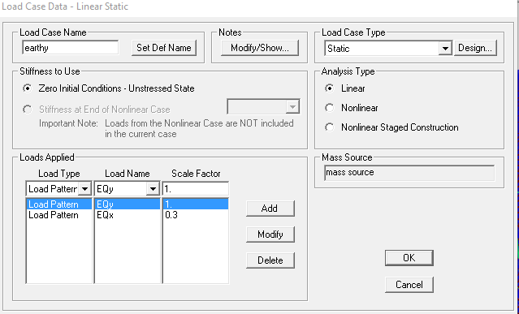
Figure : load case data –linear static (Ey).

Slide 66
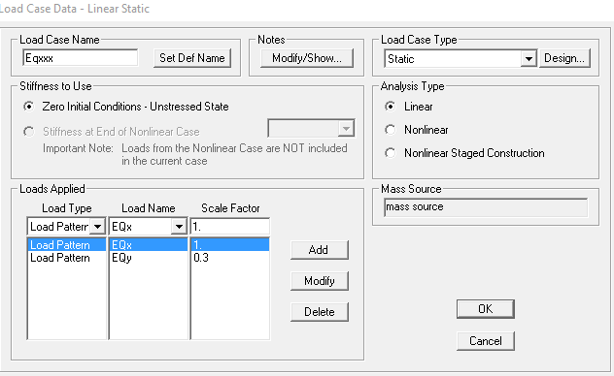
Figure 4.17: load case data –linear static (Eqx).

Slide 67
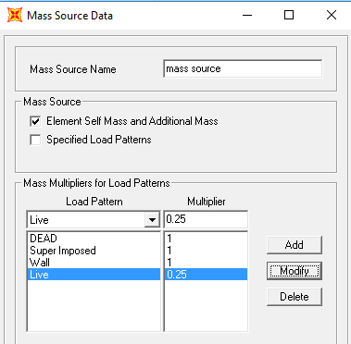
From Section 1630.2.1, the following equations are obtained for the base shear:-
And then put the mass source
Figure : mass source data.

Slide 68


Where
V = design base shear.
W = the total seismic dead load.
_{V≤2.5CaI/RW max}
_{V≥0.11CaI/W min}
.
W= Wd+Wwall+Wsuper imposed +0.25Wlive = 34962.94875
V = 1957.977
34962.94875
= 576

Slide 69
Since V < Vmax
Take V=1957.977
base shear from response spectrum cases >= base shear from equivalent static method through modifying scale factor.
Since base shear from response spectrum cases (8118 KN) is greater than that of equivalent static method ,there is no need to modify scale factor .

Slide 70
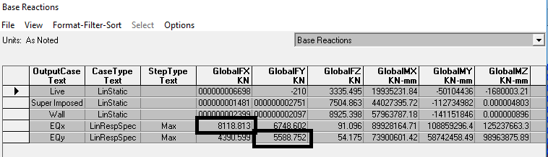
Figure : base shear from response spectrum.
8118.813 >1958

Slide 71
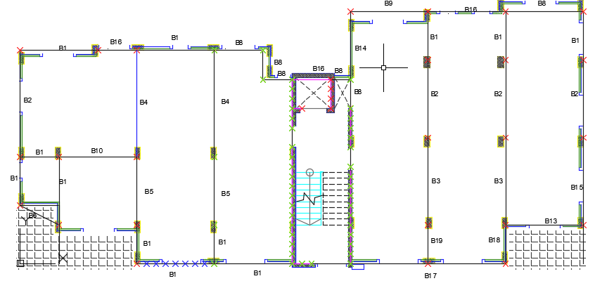
To make less beams , make the groups of beams as
B1= B6,B7,B4,B12,B13,B17,B22,B24,B23
B8=B9,B20,B21
Figure : beams distributions.

Slide 72

Designing of beams :-

Slide 73


Slide 74


Slide 75


Slide 76


Figure: Longitudinal Section in beam (10 ).
Figure: cross Section in beam and stirrups (10 ).

Slide 77

Design of slab:-
One way slab:-
For bottom steel:-
Figure : bottom steel (one way slab).
.

Slide 78
The area of steel for one way part:-
As = 1280.326 mm^2 /m
So , use 4Φ16 / rib in bottom steel

Slide 79

For top steel in slab :-
Figure : top steel (one way slab).
The area of steel in top face = 1243mm^2 / m
So use , use 4Φ16 / rib in top face.
As shrinkage = .0018*1000*250 = 450 mm2 …… 4Φ12 / rib

Slide 80

For two way part :-
Figure : top steel in x direction (two way slab).
The area of steel in top face in x direction = 2211 mm^2 / m
So use , use 5Φ18 / rib in top face.

Slide 81

The steel in top face in y direction:-
Figure : top steel in y direction (two way slab).
The area of steel in top face in y direction = 894 mm^2 / m
So use , use 2Φ18 / rib in top face.
As shrinkage = .0018*1000*250 = 225 mm2 …… 2Φ12 / rib

Slide 82

The area of steel in x direction (bottom steel ):-
Figure : bottom steel in x direction (two way slab).
The area of steel in bottom in x direction = 830.5 mm^2 / m
So use , use 2Φ18 / rib in bottom face .

Slide 83

The area of steel in y direction (bottom steel ):-
Figure: bottom steel in y direction (two way slab).
The area of steel in bottom in y direction =499 mm^2 / m
So use , use 2Φ14 / rib in bottom face .

Slide 84

Figure : Typical Section Represents Slab Reinforcement for one way.

Slide 85

Figure : Typical Section Represents Slab Reinforcement for two way( x-direction).

Slide 86

Figure : Typical Section Represents Slab Reinforcement for two way( y-direction).

Slide 87
Design footing :-
Footing number | Ultimate load |  | Dead load |  | Live load
F1 (3,4) | 708 KN |  | 465 KN |  | 22 KN
F2 (14,15,18) | 1113 KN |  | 795 KN |  | 40 KN
F3 (13,19,26,28) | 1242 KN |  | 887KN |  | 77.5 KN
F4 (27,20) | 1608 KN |  | 1075 KN |  | 187 KN
Table :footing Ultimate load , Dead load , Live load.

Slide 88

Design F1 :-
Figure : footing area.
USE B = L = 1.3 m

Slide 89

Calculate depth :-
Figure : footing depth.

Slide 90

Punching shear :-
Figure : punching shear for footings.
Not good so , increase the depth d
Try to use d = .21m and h = .25 m

Slide 91

Figure : punching shear for footings.

Slide 92

Figure : flexture for footings.
Use As min ,
4 Φ 12 / meter in both direction
And AS shrinkage = 2 Φ 12 / meter

Slide 93
Footing name |  | Dimension(in meter) B*L*H |  | As main |  | As shrinkage
F1 |  | 1.3*1.3*.25 |  | 4Φ12 |  | 2 Φ 12
F2 |  | 1.7*1.7*.3 |  | 4Φ12 |  | 2 Φ 12
F3 |  | 1.8*1.8*.35 |  | 4 Φ 16 |  | 3 Φ 12
F4 |  | 2.2*2.2*.4 |  | 4Φ 16 |  | 4 Φ 12
Table :footing dimension, As main, As shrinkage.

Slide 94
design for stairs:-
Analysis and design of stairs:-
Stairs dimensions:-
∝ = 27 º ,
Going = 30 cm.
Riser = 15 cm.
Floor height = 3.2m
No. of goings = 21.
No. of risers = 22.
Use solid slab with 15 cm thickness, d=120 mm.

Slide 95
Stairs loading:-
Dead load Own weight of step =
12× 0.3× 0.15 × 25×3 steps/m= 1.6KN/m².
Weight of marble finish =
(0.3 × 0.03 × 26 + 0.15×0.03×26) ×3 steps/m=
1.05 KN/m² (3 cm thick marble finish).
Total dead load = 1.6 +1.05= 2.65 = 3 KN/m².
Live load Live load on stairs is 5 KN/m²

Slide 96

Figure : 3D modeling for the stairs.

Slide 97
Check for shear:-
Vu = 28 KN/m.
d= 150 – 30 = 120 mm.
Ф Vc = 0.75 * 16 2fc b_{w} d =
0.75 * 16 228 *1000 * 120 ➔ Ф Vc = 79 KN/m.
ØVc Vu → OK. No need for shear reinforcing.
.

Slide 98

Design for flexure:-
Figure : Moment 2-2 in the stairs.

Slide 99

Span 1:-
The positive moment value was 34 KN and the maximum negative was 24 KN
The bottom area of steel needs is:-
Ρ = $\frac{.85∗f′c}{fy }$( 1- $\sqrt{1−\frac{2.61∗ Mu }{b∗d∗d∗f′c}}$) =$\frac{.85∗28}{420 }$( 1- $\sqrt{1−\frac{2.61∗ 34∗1000000 }{2500∗120∗120∗28}}$)= .00255
As = 0.00255 × 120 × 2500 =750 mm² → use 5Ø 14
Asmin = .0018 *150*2500 = 675mm.

Slide 100
For top steel:-
Ρ= .0018
As = 0.0018× 120 × 2500 = 540 mm2
Asmin = .0018 *150*2500 = 675mm2
Use As = Asmin = 675 → use 5Ø 14
transverse steel use minimum area of steel = 0.0018 × 150× 2500= 675 mm2
Use 1Ø 14/200 mm.

Slide 101

Span 2:-
The positive moment value was 82 KN and the maximum negative was 104 KN.
The bottom area of steel needs is:-
Ρ = $\frac{.85∗f′c}{fy }$( 1- $\sqrt{1−\frac{2.61∗ Mu }{b∗d∗d∗f′c}}$) =$\frac{.85∗28}{420 }$( 1- $\sqrt{1−\frac{2.61∗ 82∗1000000 }{2500∗120∗120∗28}}$)= .006
As = 0.006 × 120 × 2500 =1800 mm2 → use 12Ø 14mm
Asmin = .0018 *150*2500 = 675mm.

Slide 102
For top steel:-
Ρ= .008
As = 0.008× 120 × 2500 =2400mm2
Asmin = .0018 *150*2500 = 675mm2
Use As use 16Ø 14→ 6Ø 14 /m
transverse steel use minimum area of steel = 0.0018 × 150× 2500= 675 mm2
Use 1Ø 14/200 mm.

Slide 103

Figure : Longitudinal cross section and reinforcement in the stairs.

Slide 104
Design of shear walls:-
Shear wall is a structural element used to resist lateral and shear force in addition to gravity load.
Design of a sample wall by ACI.
Wall | Thickness Cm | Height m | Width m | Vertical reinforcement on each side | Horizontal reinforcement on each side
W | 30 | 12.8 | 6 | 4Ø14 mm/m | 3Ø14 mm/m
Table : Final design for shear wall.

Slide 105

shear walls distribution

Slide 106

• Check shear in X direction:-
Vux = 135 KN
ØVc=0.75 ×$\frac{1}{6}$ × √40 × (300-40) × 6000 × 10⁻³ = 1233KN > Vux → OK.
• Design for shear in Y direction:-
As horizontal = max (As for shear , As_{min} in vertical)
$\frac{Vyu}{Ø}$= 1066 KN
Vcy = $\frac{1}{6} 40^0.5\left(.8∗6000\right)300$ = 1517KN
Vcy>Vyu no need for shear reainforcement
As_{min} horizontal =0.0025
As horizontal =0.0025 *300*1000 =750mm.
As horizontal for each side =$\frac{750}{2}$

Slide 107

• Design for moment around Y axis :-
Muy = 175 KN.m
d' = 40 mm. d=260 mm
As = $\frac{Mu}{ ØFy(d−d^{′})}$= $\frac{175∗10^6}{.9∗420(260−40)}$= 2104mm = 1052 mm on each side of the wall
• Design for axial force and moment around X axis:-
Since the moment is too small ,then no need for inter action diagram
Mux = 48 KN.m Pu = 2266 KN
b=250 mm. h=6000 mm

Slide 108
calculate As.min :-
ρ=0.0025
As = 0.0025 × 300 × 6000 = 4500 mm2 or 2250 mm² on each side.
Thus, the total area of steel on each side “ in Y direction “ = 2250+750 =3000 mm².
➔Use 8 Ø16mm/m on each side of wall
the total area of steel on each side “ in X direction “ =2250 mm²
➔Use 6 Ø16mm/m on each side of wall

Slide 109

Check column dimension :
Tributary area = 4 × 4.25 = 17 m2.
We have 5 stories → 5 × 17 = 85 m2.
Pu = 1.2 D +1.6 L.L.
P ( from dead load) =( $4.55+4.5)KN/m2×85m2$
= 769.25 KN
P ( from Live load) =( $2)KN/m2×85m2$
= 170 KN
Pu = 1.2 (769.25)+1.6 (170)
.
Pu = 1195.1 KN.

Slide 110

Figure : location of column

Slide 111


Slide 112
General equation:
Pu = 0.8 × Ø × [0.85 × f’c × (Ag-As) + fy × As]
Ø =0.65 for tied column.
f’c = 24 MPa.
ρ=0.01 (economical percentage of steel).
Solve this equation:
1195.1×1000 = 0.8 ×0.65 × [0.85 ×24 × (Ag-0.01Ag) +420 ×0.01Ag].
Ag = 94206.80 mm2 .
As = Ag * .01 =94206.80 *.01 = 942mm2.
The column section = 30 × 60 cm. (its in safe side)
As = 0.01 × 300 × 600 = 1800 mm2 .
Use 8 Ø 18.

Slide 113
For stirrups:
Use Ø 10
And a spacing S between the stirrups is the minimum of:
16 ×db =256 mm
48 ×ds =480 mm
Least dimension of column=300mm
Use 1 Ø 10 mm stirrup @ 250mm

Slide 114

Figure : Longitudinal section in column and footing (2).

Slide 115

Figure : top view section for footing (2).

Slide 116

Figure : The value of steel.
The value of steel from sap is 1800 mm

Slide 117
Thanks for listening

