Slide 1

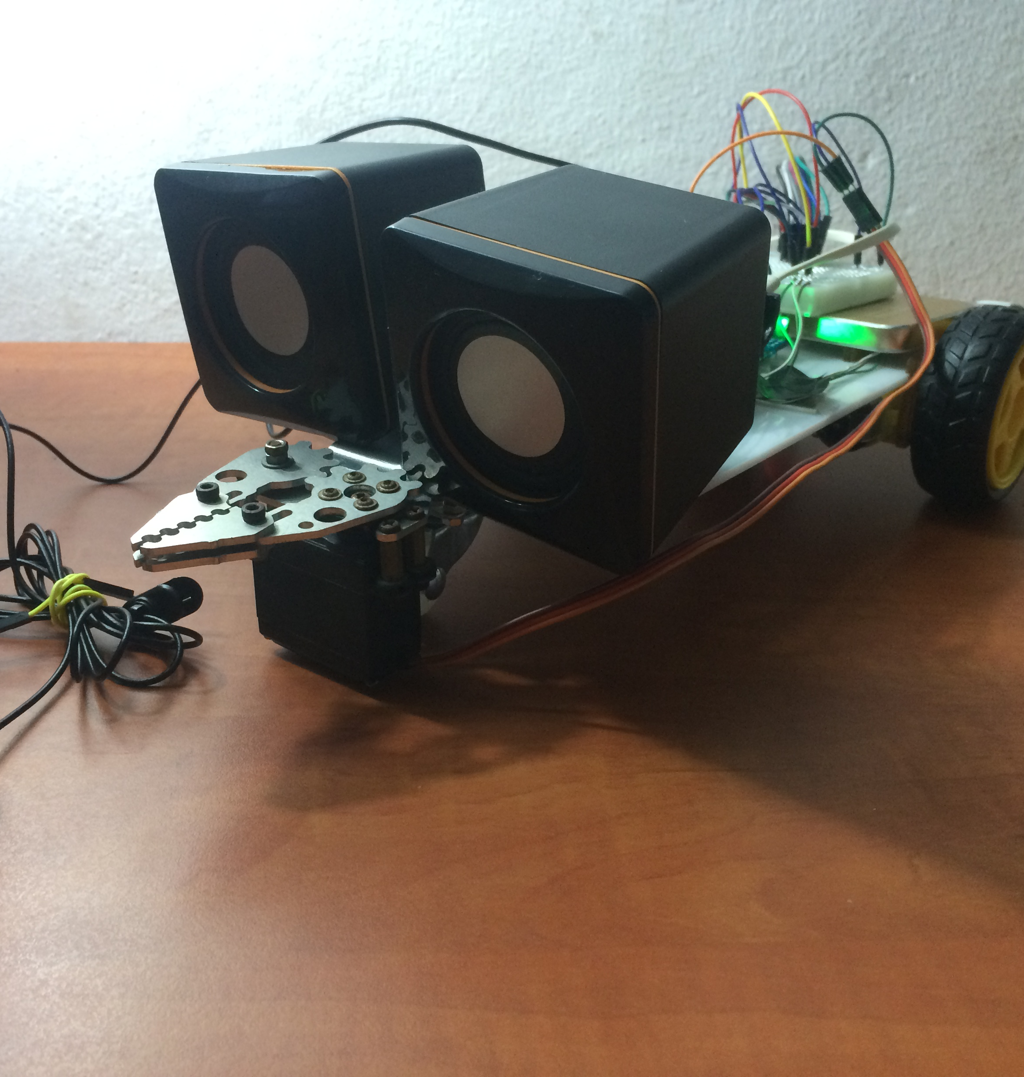
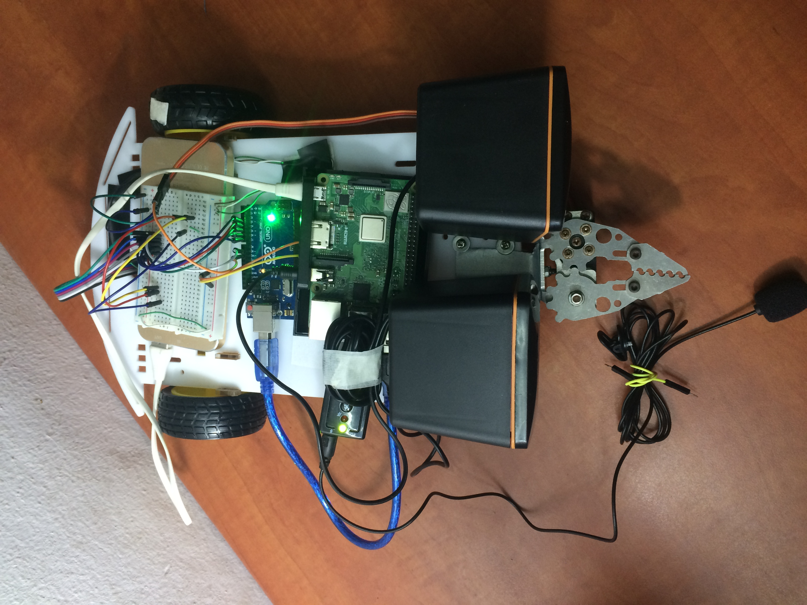
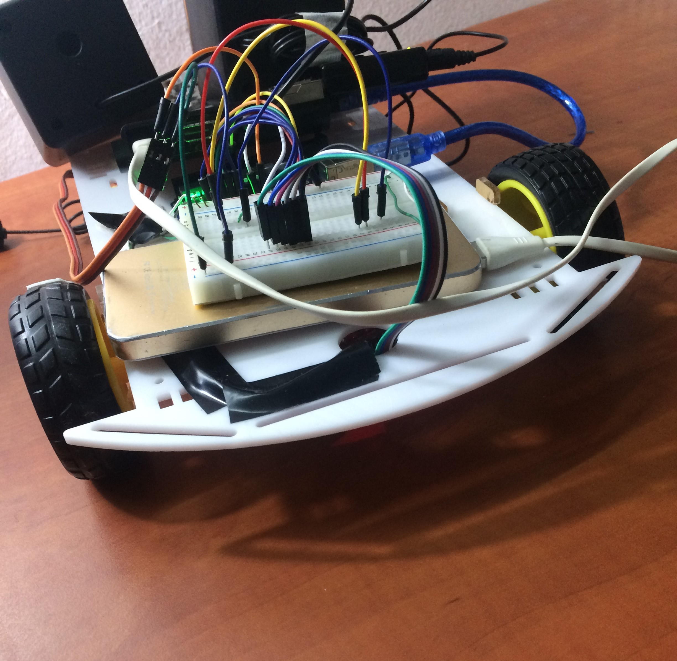
ALLUKA
“Smart Virtual Assistant Robot”
An-Najah National University
Faculty of Engineering and Information Technology
Department of Computer Engineering
Done By:
Eman Sawalha
Ghadeer Abu Alrob
Supervisor: Dr. Loai Malhis

Slide 2
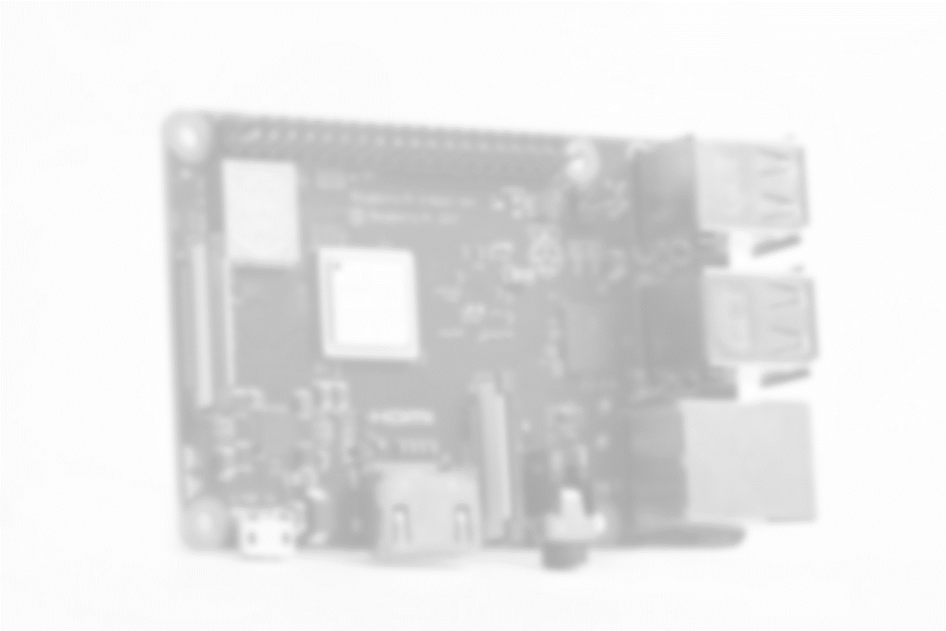

Thank you all for coming and supporting us
2

Slide 3

What we will cover?
01
What is Alluka?
02
How was Alluka designed?
What are the obstacles that we faced?
03
04
Future works
3

Slide 4
What is Alluka?
Alluka is an educational virtual assistant robot that helps people in their learning process this robot targets children and students.
Support two main features
Informative
Entertainment
Supported by:
Asking Alluka to perform movements moving forward, backward, to the right and to the left.
Within an option of giving specific number of steps to perform movement.
Catching stuff.
Supported by:
Asking for current time
Perform simple arithmetic operations
Weather and News in case of internet connection
Telling jokes

Slide 5
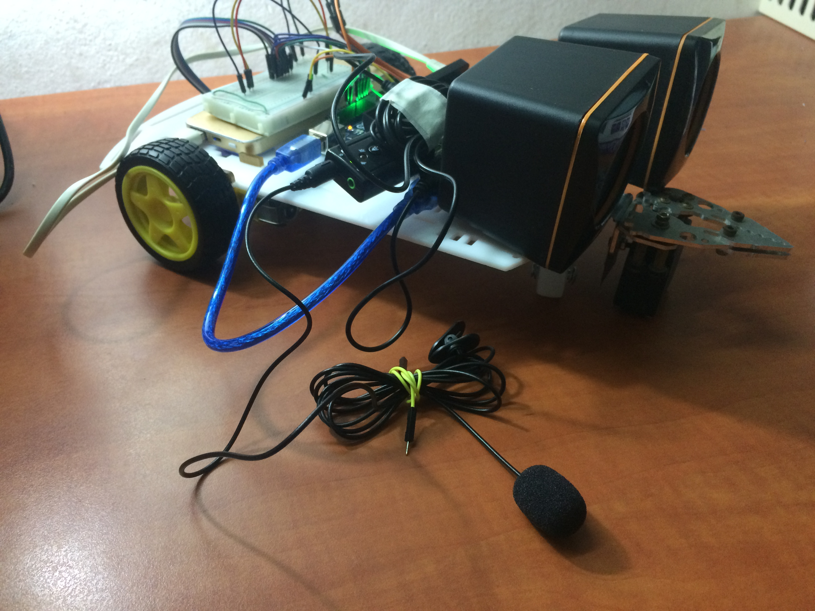
Structure of Alluka

Slide 6
How Alluka was designed?

Slide 7

Phases of designing system
Serial Communication between Raspberry Pi and Arduino
Motors and Claw connections phase
Virtual Assistant and voice recognition phase

Slide 8
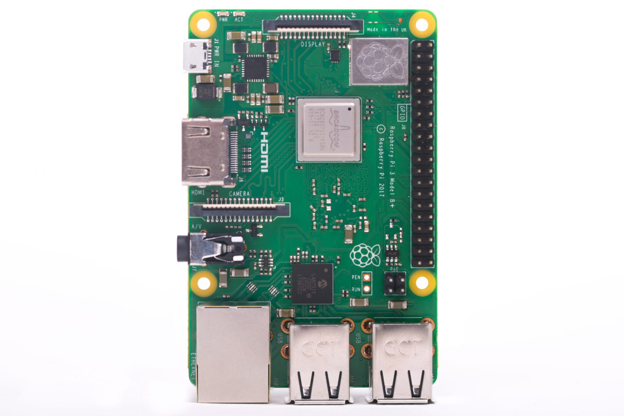
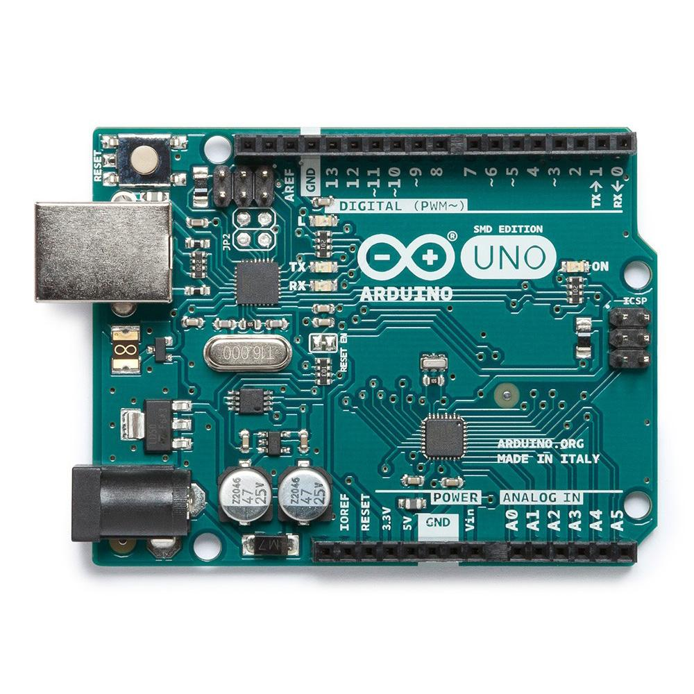
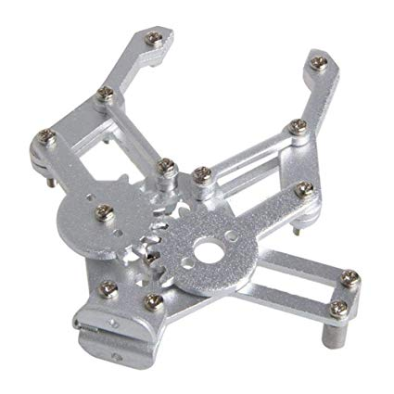
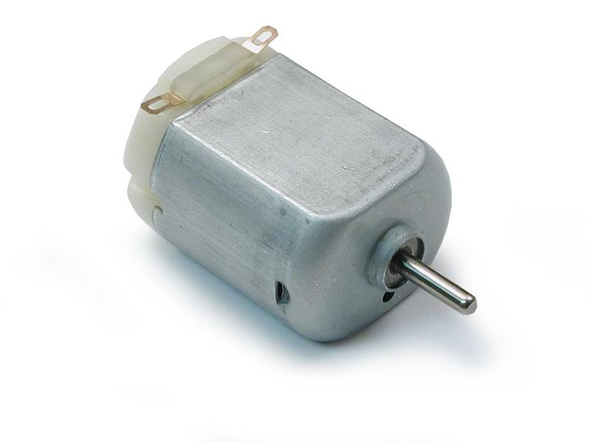


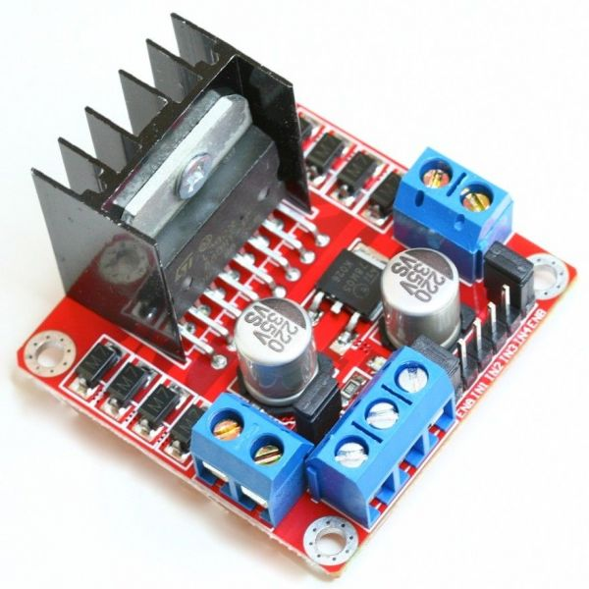
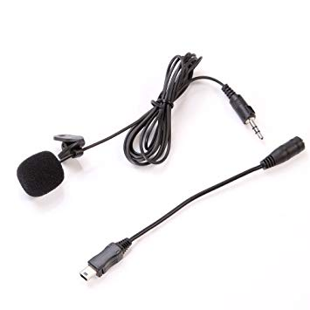
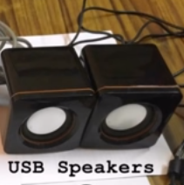

Slide 10
Tools and Programs
Raspberry Pi 3 B+
Arduino Uno
Claw / grapper
DC Motors
Voice Controlled Platform
Python 2.7 / C for Arduino
H-Bridge L298N
USB Microphone
USB Speakers
TTS/STT Engines

Slide 9
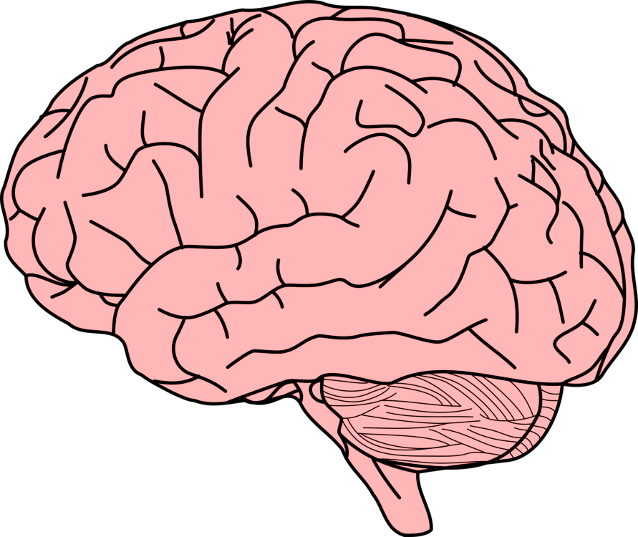
  Virtual Assistant and voice recognition phase is the brain of the system

Slide 10
Raspbian installing subphase
Audio configuration subphase
Jasper configuration and installation subphase
Troubleshoot
Virtual Assistant and voice recognition subphases:
10

Slide 11
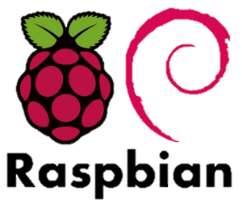
Raspbian installing subphase
Audio configuration subphase
Raspbian Stretch with kernel version 4.14 into SD card. November.18
Software programs that helped to achieve this step were SD Card Formatter and balenaEtcher .
Microphone sample rate 44.1kHz to 192kHz.
Ordinary Speakers
Create .asoundrc file to configure sounds in Raspberry Pi.
Used Alsamixer which is a program for sound architecture in Linux

Slide 12
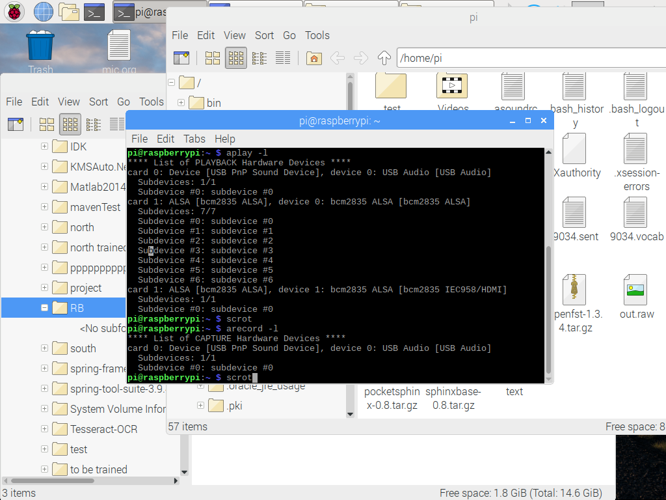
Cont.. Audio configuration subphase
12

Slide 13
.asoundrc file from inside:
pcm.!default {
type asym
capture.pcm "mic"
playback.pcm "speaker"
}
pcm.mic {
type hw
slave {
pcm "hw:0,0"
}
}
pcm.speaker {
type hw
slave {
pcm "hw: 1,0"
}
}

Slide 14
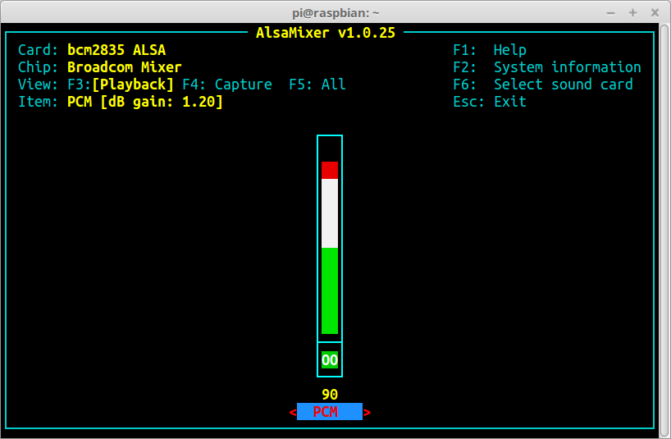

Slide 15
Slide 10
Jasper configuration and Installation phase
Jasper is an open source platform for developing voice-controlled applications.
Jasper is based on usage of two engines TTS/STT => Text-to-Speech and Speech-to-Text.
In the project we used offline engines. Pocketsphinx TTS and eSpeakSTT.

Slide 16
profile.yml

Slide 17
Speech Recognition:
Download dependencies: sphinxbase, CMUCLMTK, MIT language modeling toolkit, m2m-aligner, OpenFST, Phonetisaurus and eSpeakSTT.
CMUCLMTK tool used to generate a pronunciation dictionary from a list of words. (Phoneme)
JASPER JH AE S P ER
NOW N AW
OF AH V
NOW N AW
OF AH V
ON AA N
ON(2) AO N
17

Slide 18
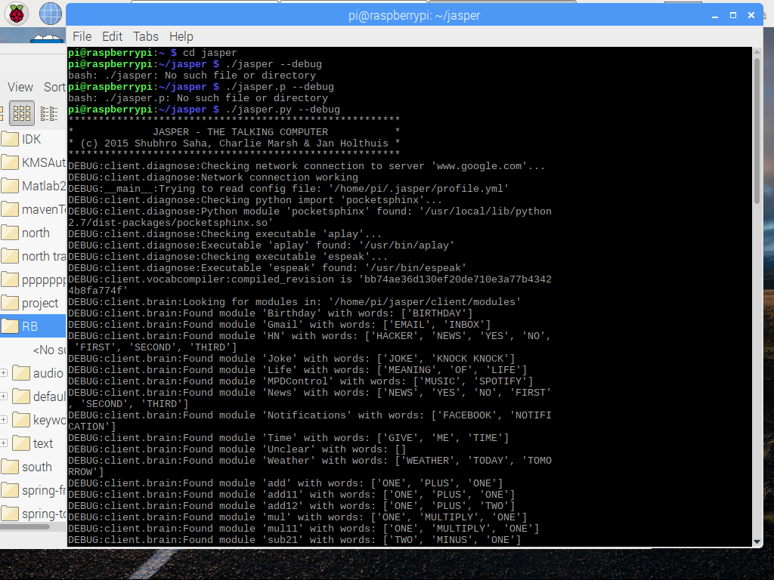
Slide 10

Slide 19
Implementation of Modules:
The programming language that we used to program modules was python.
The module itself consist of 3 functions:
    Words Array []
    Handle function ()
    isValid ()
19

Slide 20
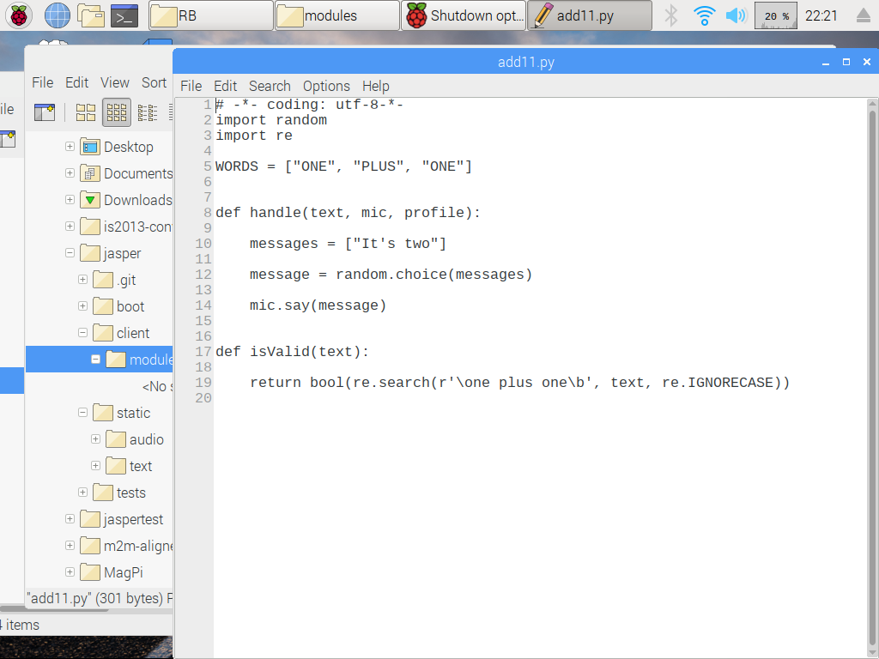
Simple code for a module using Python

Slide 21
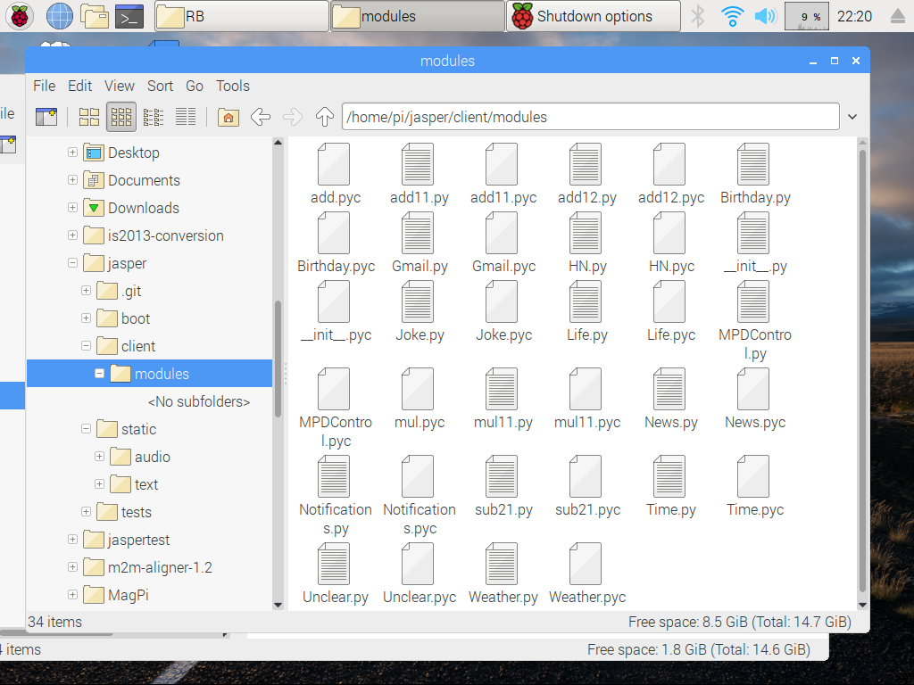
Modules inside Jasper File

Slide 22
Troubleshooting:
Though the installing process we face group of problems specially inside diagnose.py file. An action of editing the core of Jasper was needed to make Jasper compatible with our RP.
Also to discover problems in detecting and transforming sound to text we needed to enter the debug mode in Jasper to discover problem.
22

Slide 23
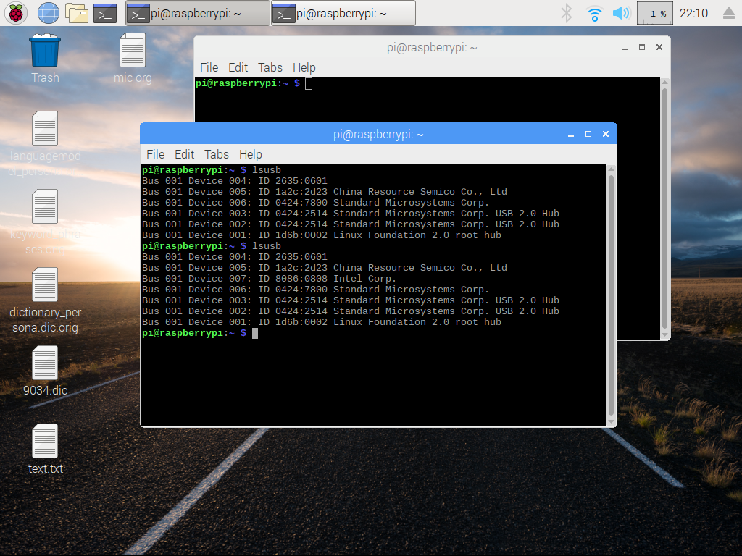
23

Slide 24
Motors and Claw connections phase
Connect two motors to L298N H-bridge
An the claw is based on a servo motors

Slide 25
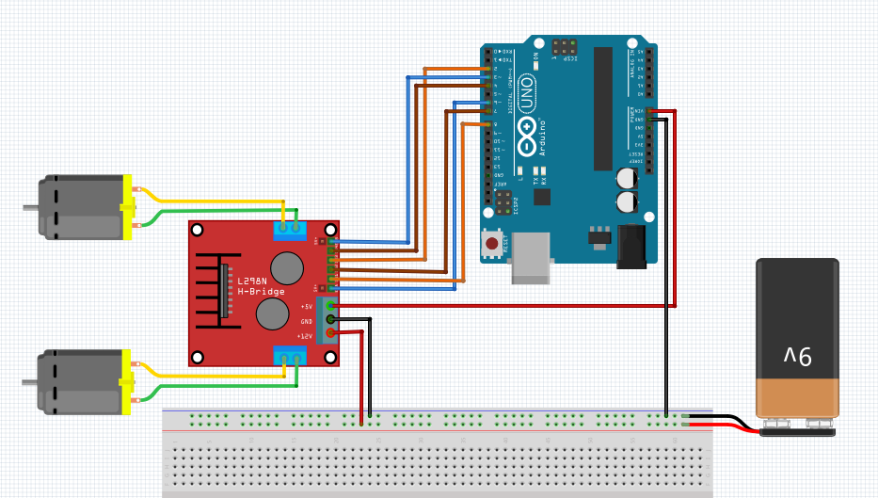
25

Slide 26
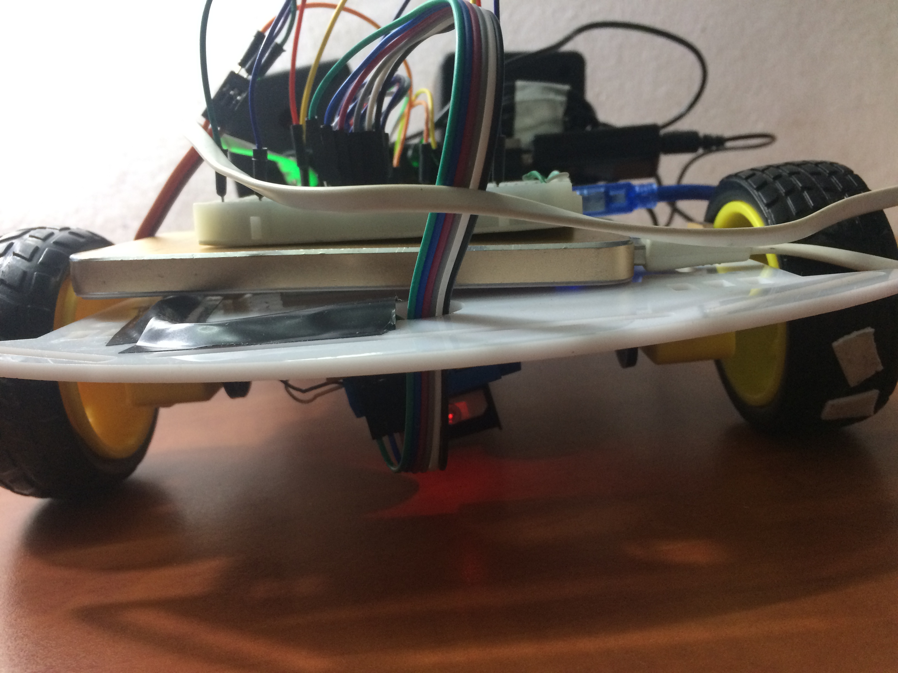
H-bridge

Slide 27
Slide 10
Motors and Claws connections phase
Programming language the we used to control motors and claw is C => Arduino IDE.
According the command that user give the Alluka perform the movement.
Also there is an advance option
of telling Alluka the number of steps.
The default number of steps is
5 steps.
Catching stuff using claw
Forward
Right
Backward
Left

Slide 28
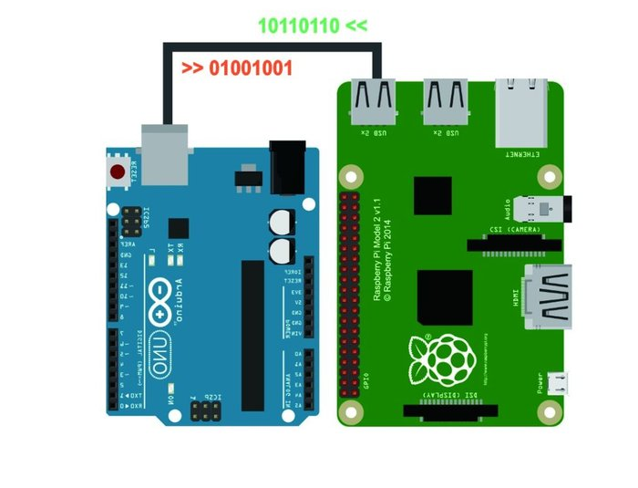
Slide 10
Serial Communication between RP and Arduino phase

Slide 29
Raspberry Pi side
Before connecting the Arduino with Raspberry Pi through USB a port between them must be defined through this piece of code.
import serial
ser = serial.Serial('/dev/ttyUSB0', 9600)
ser.write(b'3')
29

Slide 30
Arduino side
After connecting the Arduino with Raspberry Pi through USB a predefined port between them the baud rate that the Arduino receive data through must be defined as the following:
void setup()
{
Serial.begin(9600);
}
if(Serial.available())
Serial.read();
30

Slide 31

Slide 10
DEMO

Slide 32
Discussion and Results
The experiments show a good efficiency results of open source Jasper with eSpeakTTS and PocketSphinx as SST engines in voice recognition. But in fact, that the TTS engine sound a little bad for the children to uses.
Maybe the question that come to the mind that why not to choose other TTS engine that have a clear voice to children?

Slide 33
Future Work
Color recognition using image processing
Rearrange Alluka body
Have a better STT engine
Support more features as complex arithmetic operation

Slide 34
Any Questions?
THANK YOU FOR LISTENING
34

