Slide 1
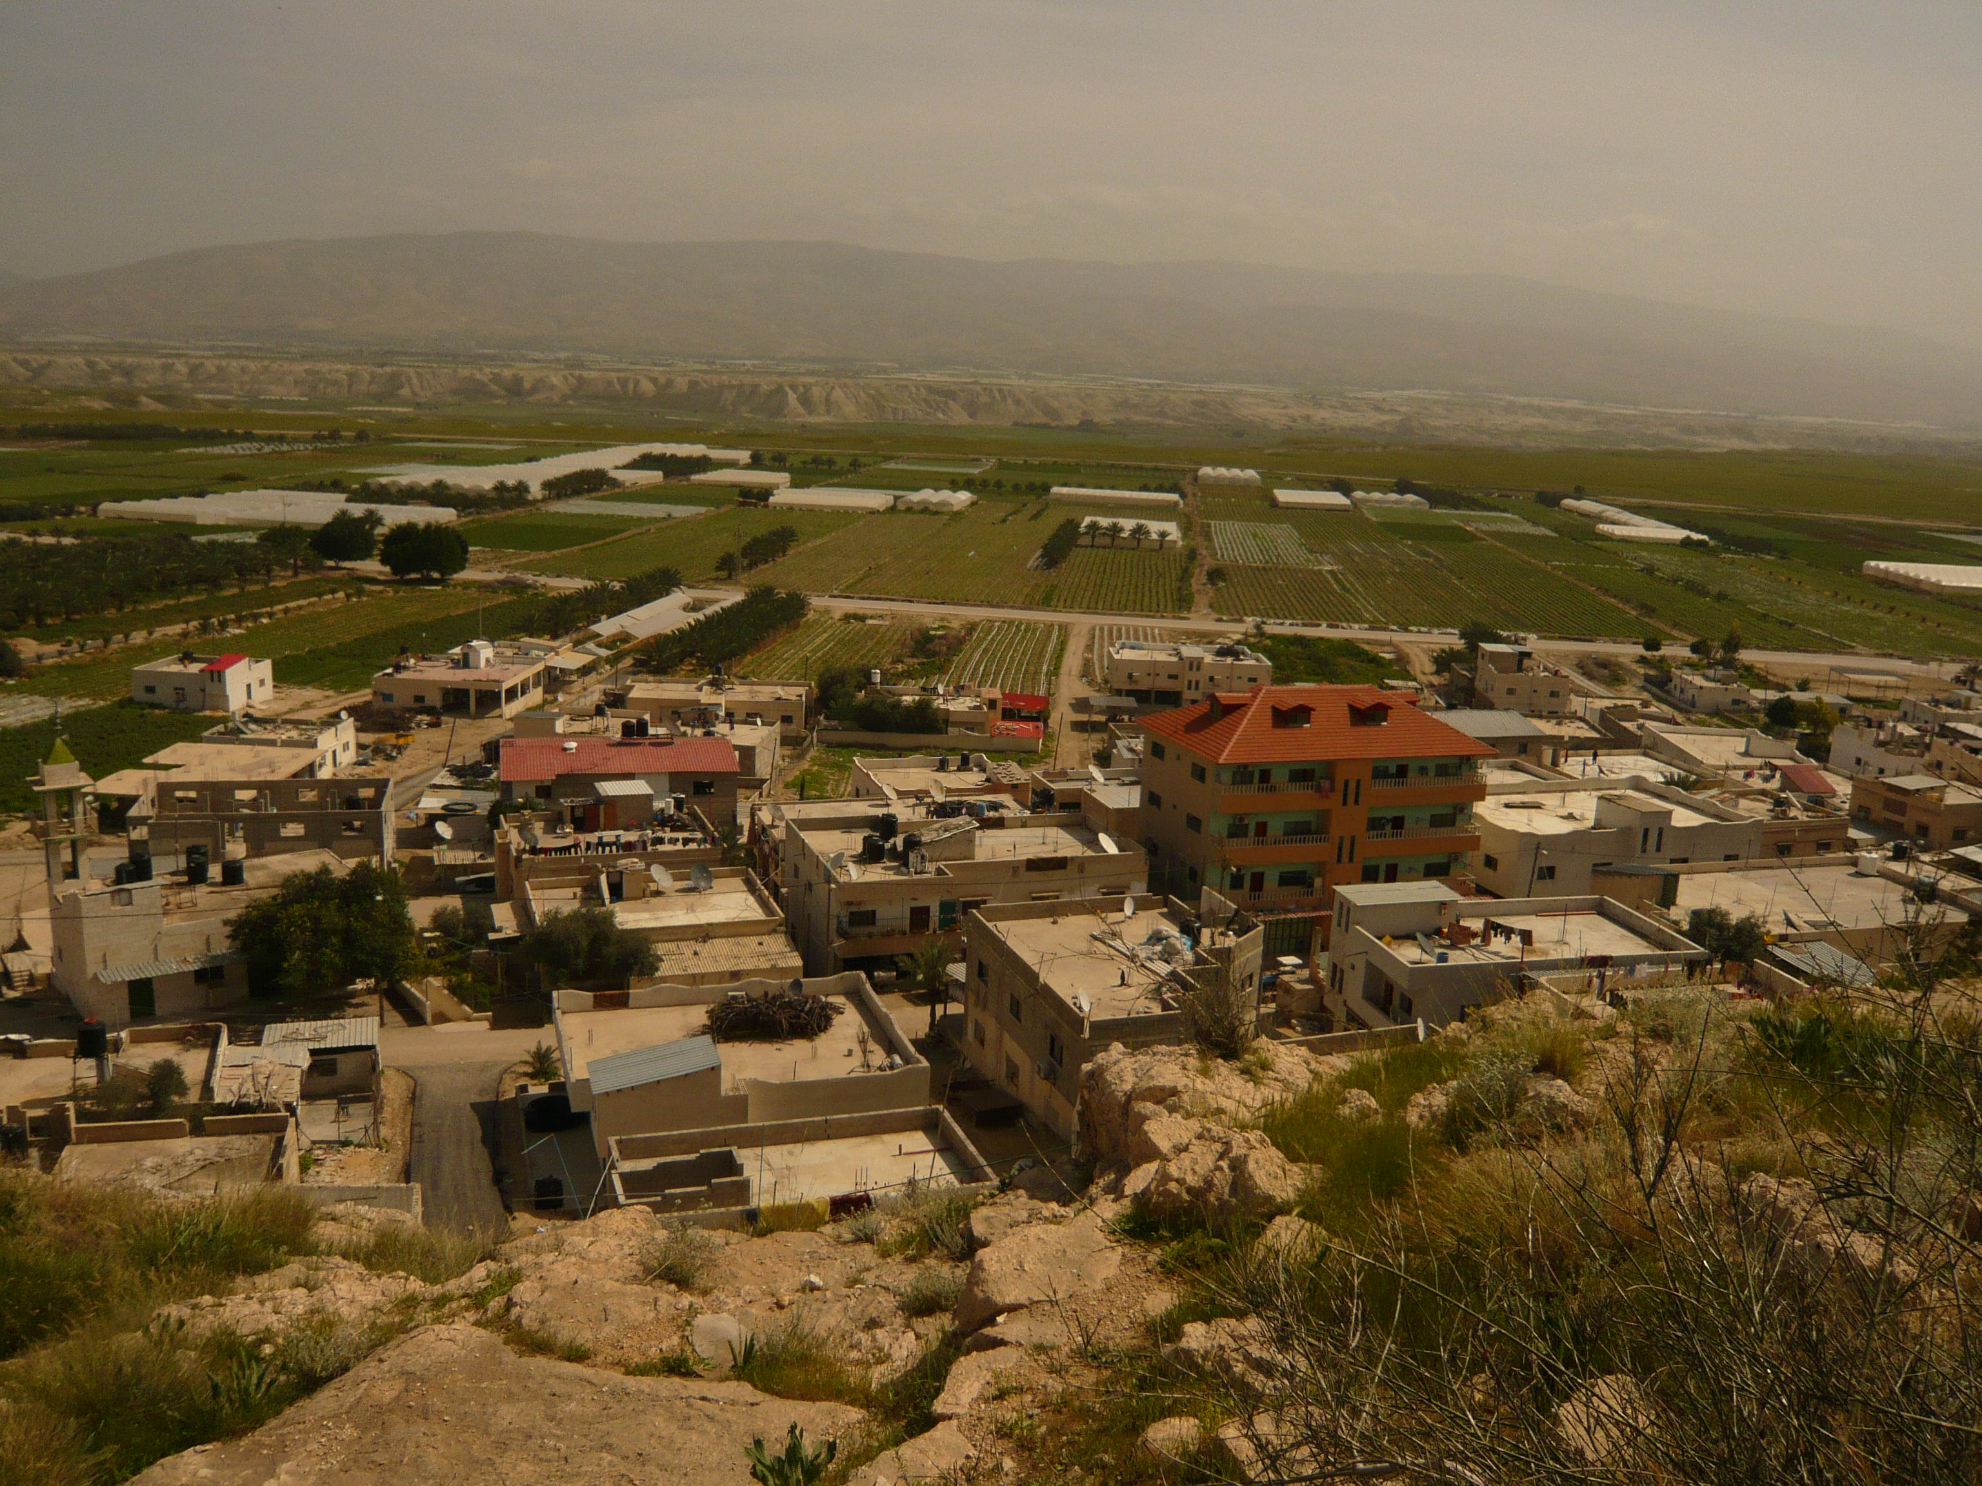
An-Najah National University
Chemical Engineering Department
Design of Desalination System for Brackish Water by RO-Membranes Powered by Solar Photovoltaic Cells
Presented by: Noor Al-Huda Marwan Mahmoud
Supervisor: Dr. Abdelrahim Abusafa
May 2011

Slide 2

Outline
Objectives
Water Resources
Water Quality
Desalination
Solar Energy
RO-PV Powered Design
Economic Analysis
Conclusion

Slide 3

Objectives
Identifying the brackish water resources.
Determining the brackish water quality in Palestine according to its salinity.
Identification of different water desalination technologies.
Determining the methods of pretreatment in desalination system.

Slide 4
Investigation the possibility of using solar photovoltaic systems for water desalination under Palestinian weather and environmental conditions.
Design of the components of the PV-powered RO desalination system.
Economic study.

Slide 5
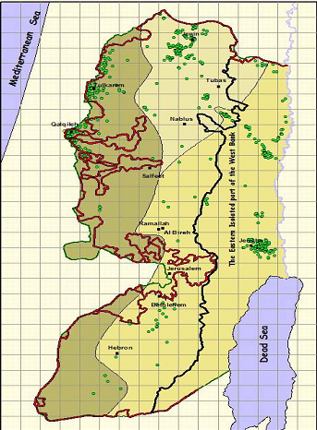
Water Resources
Brackish water (Ground water)
It composed of three Aquifers:
427 MCM/Y
Western aquifer
142 MCM/Y
North Eastern aquifer
165 MCM/Y
Eastern aquifer

Slide 6
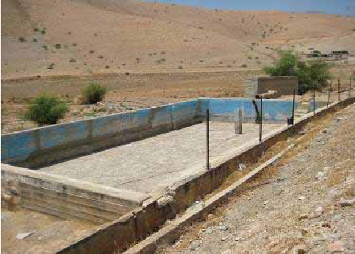
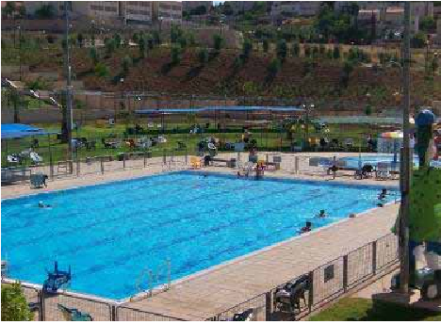
Water Consumption
Palestinian consumption
70 L/d/capita
In some rural places barely 20 L/d
<
WHO
100 L/d/capita
<
Israeli consumption 300 L/d/capita

Slide 7
Water Quality
Table (1): Water quality of groundwater in Zbaidat
Quality Parameter | Unit | Zbaidat Tank | Permissible limit (WHO)
TDS | mg/L | 2636 | 500-1000
pH |  | 7.58 | 6.5-8.5
Chloride | mg/L | 1200 | 250
Sodium | mg/L | 483 | 200
Sulfate | mg/L | 157 | 250
Magnesium | mg/L | 146 | <125
Calcium | mg/L | 200 | 75
Potassium | mg/L | 13.1 | 12
Iron | mg/L | 0 | 0.3
Bicarbonate | mg/L | 305 | 125-350
Silica | mg/L | 21.6 | <160
Nitrate | mg/L | 36 | 50
Hardness | mg/L as CaCO₃ | 1098 | 500
Turbidity | NTU | 1.0 | <1

Slide 8
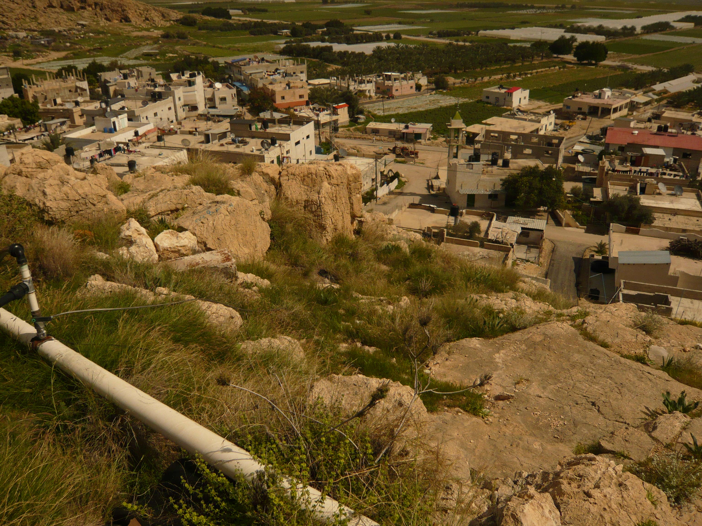
The water quality of Zbaidat village reservoir
Indicates:
High salinity water for drinking.
Very hard water.
On the limit for irrigation: SAR (6.34) < (26).
Low TSS (10ppm) and SiO₂ content and turbidity.

Slide 9

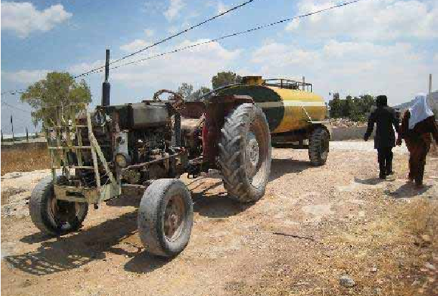
People in Zbaidat village have to bring water from far away; its very difficult and expensive

Slide 10


Desalination Technology
The two major types of desalination technologies:
Thermal : Multi-Stage Flash Distillation, Multi-Effect Distillation , Vapor Compression Distillation.
Membrane: Reverse Osmosis, Electrodialysis.

Slide 11
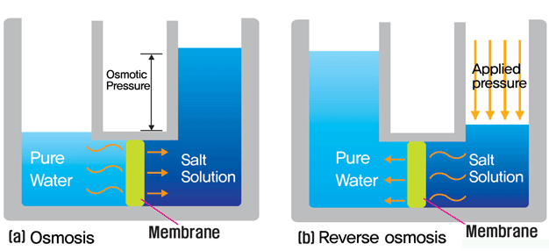
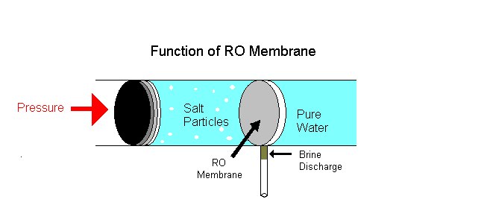
RO Principle

Slide 12
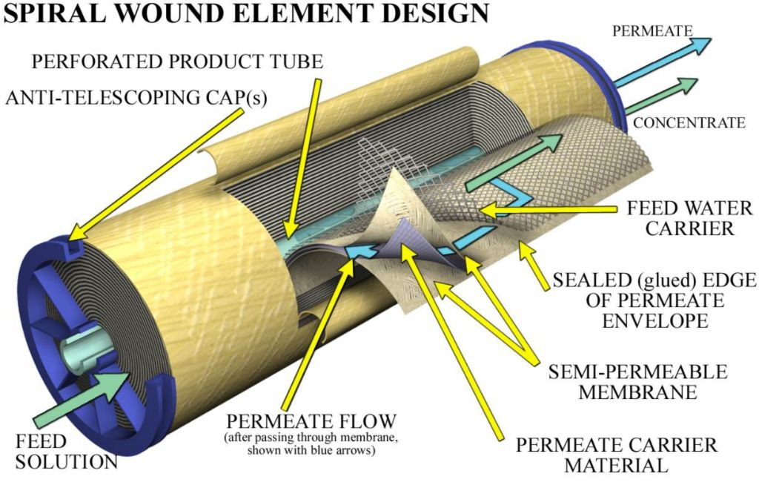
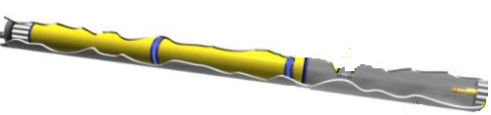
RO-Spiral Wound Element

Slide 13
Solar Energy
Why using PV energy ?
Palestine has a large number of rural villages lacking water and electricity.
Palestine enjoys over (2800) hours of the sunshine every year
An annual average daily solar radiation intensity amounting to (5.4) kWh/m²-day.

Slide 14

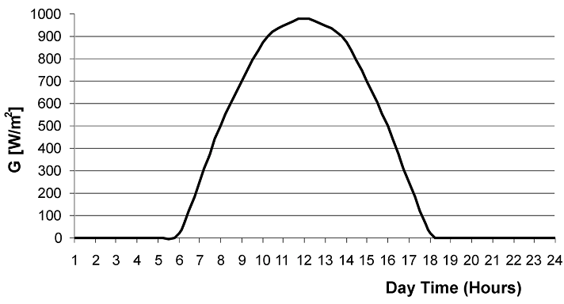
Where:
PSH: Peak sun shine hour
At standard conditions ( T=25C), the max solar intensity (G) : 1000 W/m²
Fig (1): Solar radiation intensity in Palestine

Slide 15

Types of PV Cells
PV Cell
Mono-crystalline silicon
Poly-crystalline silicon
Amorphous silicon
V_{OC} =0.61 Volt
I_{SC}=3.4A/100Cm²
V_{OC} =0.58 Volt
I_{SC}=2.9 A/100Cm²
V_{OC} =0.71 Volt
I_{SC}=1.5A/100Cm²

Slide 16
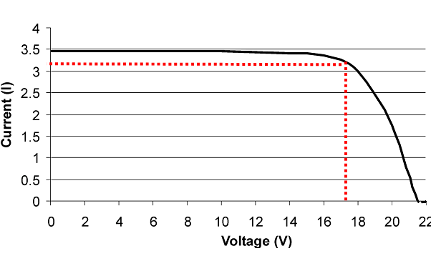
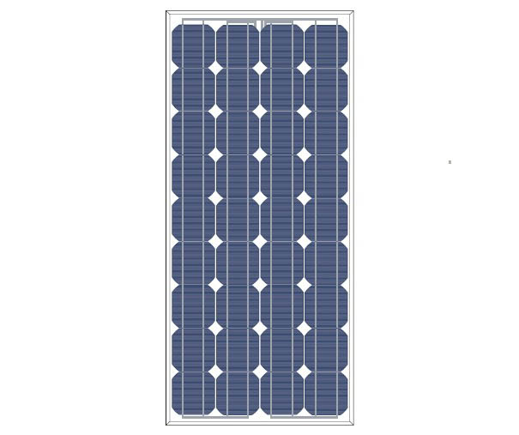
Standard Module (36 Cells):
At standard conditions (1000 W/m²), (T=25C).
For mono-crystalline silicon (M55) type.
Fig (2): IV-curve for PV-module (Type SM55).

Slide 17
Design of RO Desalination Powered by PV System
Components:
RO membranes
Pumps (RO-pump, Transfer-pump).
Pretreatment (Cartridge filter, RGF).
Piping system.
PV systems; Modules, Converter, Inverter, Batteries.

Slide 18
Design of Reverse Osmosis
Zbaidat tank:
TDS: 2636 ppm
Capacity: 10 m³/day
Operating hours: 10 hr/day
Recovery ‘R’: 65%

Slide 19
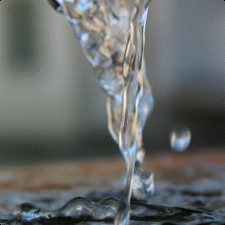
Total feed flow rate Q_{F :}
But the system operates 10 hr/day:

Slide 20
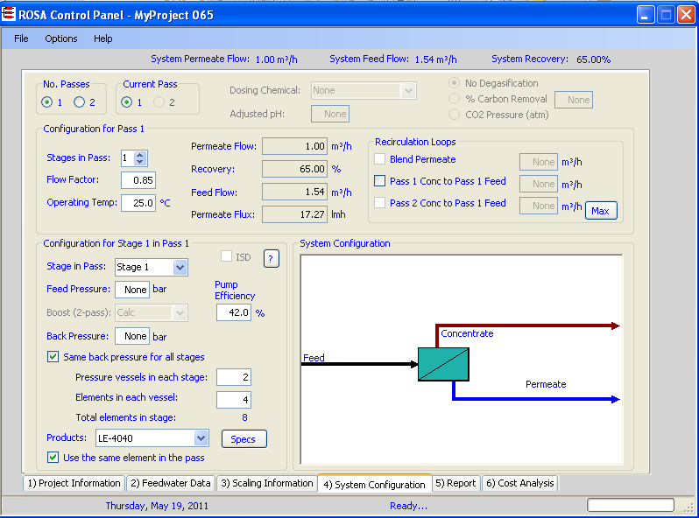
Running ROSA Software

Slide 21
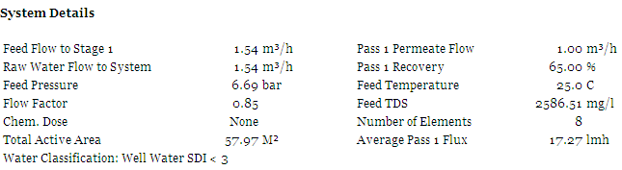
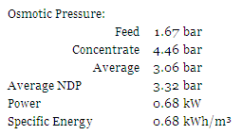


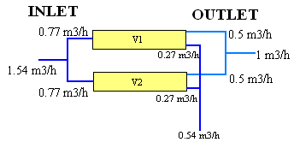
Stage 1 | Element | Recovery | Perm Flow (m³/h) | Perm TDS (mg/l) | Feed Flow (m³/h) | Feed TDS (mg/l) | Feed Press (bar)
 | 1 | 0.23 | 0.17 | 61.96 | 0.77 | 2586.51 | 6.34
 | 2 | 0.24 | 0.14 | 95.57 | 0.60 | 3320.36 | 6.31
 | 3 | 0.24 | 0.11 | 156.40 | 0.45 | 4340.46 | 6.28
 | 4 | 0.22 | 0.07 | 269.26 | 0.34 | 5662.71 | 6.27

Slide 22

Before and After Desalination

Slide 23
Design of Pumps
Equations
Results
Calculated values | Unit | RO pump | Transfer pump
Flow rate (Q_{F}) | m³/h | 1.694 | 3
Feed pressure (P₂) | bar | 7.35 | 3.79
Pump head (h_{a}) | m | 75 | 38.6
Output power of pump (P_{out pump}) | kW | 0.35 | 0.32
Type of pump | …. | CR2-110 | CR2-70
Efficiency of pump (η_{Pump}) | % | 42 | 42
Efficiency of motor (η_{Motor}) | % | 77 | 74
Input power of pump (P_{in Pump}) | kW | 1.1 | 0.75
Input power of motor (P_{in Motor} | kW | 1.43 | 1.014

Slide 24
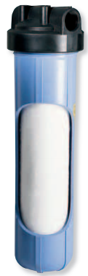

Pretreatment System Design
Cartridge filter
The 5 micron cartridge is used to remove particles and turbidity for high purity water systems.
It consists of:
Filter housing:
Flow rate: 40 Gpm
Melt blown solid filter cartridge

Slide 25
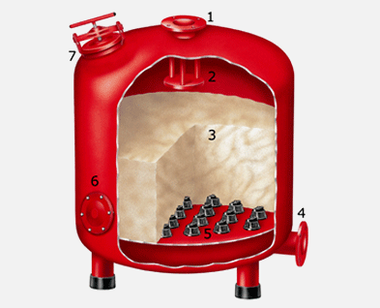
Rapid Gravity Filter
Parts:
Water inlet.
Water.
Sand bed.
Water outlet.
Filtration.
Service port.
Media filling.

Slide 26
Design of Rapid Gravity Filter:
Equations
Results
General | Unit | Calculated values
Flow rate (Q_{inlet}) | m³/h | 3
Filtration rate | m/h | 20
Diameter of the vessel (D_{Vessel}) | mm | 400
Uniformity coefficient (UC) | ….. | 1.6
Bed diameter (D_{p}) | mm | 0.6
Terminal velocity Flow rate (V_{t}) | m/min | 9.6
Backwash velocity at T=20 ºC (V_{b(20)}) | m/min | 0.96
Backwash velocity at T=25 ºC (V_{b(25)}) | m/min | 0.996

Slide 27
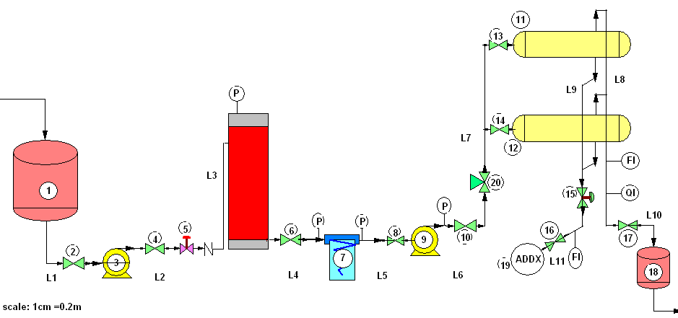
RO Desalination System Process Flow Diagram

Slide 28
Piping System Design
Equations
Results
Pipes, Fittings, and Valves | Head loss (m)
Pipes | 0.08
Elbows 90º | 0.014
Gate valves | 0.01
Glob valves | 0.015
Check valves | 0.005
Tee flow through run | 0.003
Gradual enlargements | 0.0003
Total minor and major loss (h_{Lt}) | 0.134

Slide 29
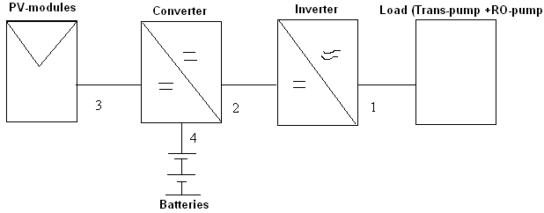
Photovoltaic System Design
Total energy needed daily from load = 24420 Wh/day
Peak power from PV generators = 5300 W_{P}
But the peak power produced from (1) M55 module is 53 W_{P}
So, the number of PV modules required is 100 modules

Slide 30
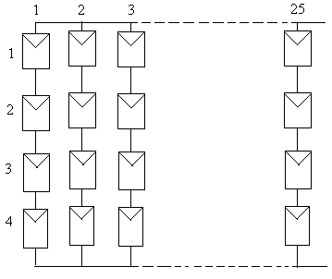
The selected arrangement of the modules:
One such standard module is appropriate for charging of 12 volt battery.
The nominal DC voltage amounting to 48 VDC.

Slide 31
The resulted 100 modules give:
Converter and Inverter:
Fig 3: The IV at 5400 Wh/m².day

Slide 32
Sizing Battery
Equations
Results
General for Lead acid block battery | unit | Calculated values
Nominal voltage (V_{Nom}) | Volt | 48
Depth of discharge (DOD) | % | 80
Efficiency of block battery | % | 85
Daily input energy to inverter (E_{input inv}) | Wh/day | 27
Ampere hour capacity (C_{Ah}) | Ah | 831
Cell rated at | V/Ah | 2 V/831Ah
Number og batteries |  | 24
Watt hour capacity (C_{Wh}) | kWh/Cell | 1.6
Charging time | h | 11

Slide 33

Economic Analysis
Plant lifetime is 20 years.
Operating days per year are 365 days.
Interest rate is 8%.
amortization factor (a): 0.1yr⁻¹
Capacity is 10 m³/day.
Salvage value of the units is 5000 $.
Total equipment costs (CC): 45350 $.
Installation (25% CC): 11338 $.
Total investment: 56688 $.

Slide 34
Costs Results
General | Unit | Cost
Fixed Cost | $/year | 5668.8
Membrane Replacement | $/year | 832
Batteries Replacement | $/year | 997
Total Annual Cost | $/year | 7388
Unit Production Cost | $/m³ | 2
Cost of kWh produced from PV generator | $/kWh | 0.27

Slide 35
Conclusion
There are large amounts of Brackish water in West Bank not suitable for drinking or for agricultural purposes which can be treated by desalination technologies.
Palestine has a high solar energy potential encouraging to use PV power systems for desalination of brackish water in rural sites.

Slide 36
Studying the water quality leads to think of suitable treatment process.
The osmotic pressure is directly proportional to total dissolved solid, it is found by ROSA software results that the osmotic pressure of Zbaidat brackish water is about 1.8 bar.
Total head loss due to pipes and fittings is very small, which means it has no effect on the pump head, so that it is neglected.

Slide 37
PV peak power of 530 W_{p} is necessary for desalination of 1 m³/day fresh water from brackish water, this correspond to amounting to 2.862 kWh/m³ of fresh water.
The peak power that is produced by PV module is directly proportional to the solar radiation intensity.
Although the energy is free, the water production cost from the PV-RO unit is 2 $/m³, which is cheap and economically viable in remote areas.

Slide 38

Many thanks to….
Dr. Abdelrahim Abusafa
Dr. Marwan Mahmoud
Everyone who listen to me

Slide 39


