Slide 1
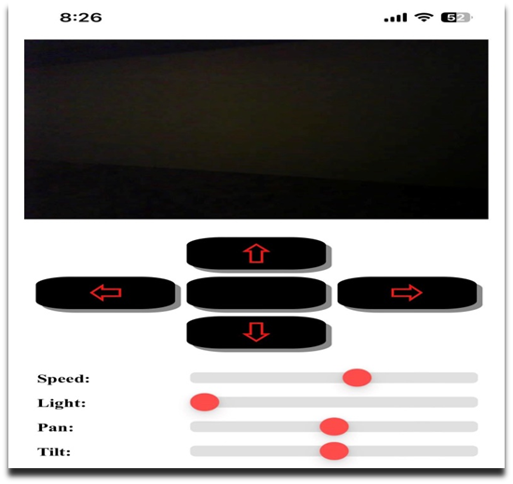
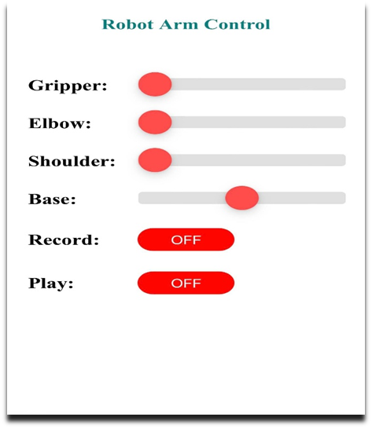
Wireless Emergency robot and Assistant with arm
Hala Alawneh
Wael Jaber
Obada Abulail
The main aims of the Project
Mainly, this project aims to reducing human losses and providing comfort and assistance to people and to do the overall danger work so it will be with controlled by humans. The objectives differ according to the kind of the job that require a secure sensitive, monitoring people in an area and giving some commands, or like mines detectors etc. This robot meant to be the base idea and the costumer can use this project for anything he wants by requesting other fellows, like sensors or motors or interfacing devices.
Besides that, this project which use internet of robotics things, is one of the firsts in this area, and it have a very shining future.
SOFTWARE IMPLEMENTATION
It required a Programming Tools of mobile application & arduino Language to build a project
HTML
Hypertext Mark-up Language, commonly abbreviated as HTML, is the standard mark-up language used to create web pages. Along with CSS, and arduino language, HTML is a cornerstone technology used to create web pages, as well as to create user interfaces for mobile.
CSS
Cascading Style Sheets (CSS) is a style sheet language used for describing the presentation of a document written in a language. Although most often used to set the visual style of web pages and user interfaces written in HTML. I used HTML and CSS both for the design of website and web page to control the Robot
ARDUINO LANGUEAGE
Arduino programming language can be divided in three main parts: functions, values (variables and constants), and structure.
Functions: For controlling the Arduino board and performing computations.
Variables: Arduino data types and constants.
Structure: The elements of Arduino (C++) code
C++ language
Arduino code is written in C++ with an addition of special methods and functions,. C++ is a human-readable programming language. When you create a 'sketch' (the name given to Arduino code files), it is processed and compiled to machine language.
SOFTWARE DESIGN
MOVING CONTROL IN ALL DIRECTIONS
The command would be sent from the client to esp32cam,
to driver for move the dc motors as we see . *see code in Appandices.
MOVING CONTROL OF ROBOT ARM IN ALL DIRICTIONS
The command would be sent from the client, to esp32 and pass the command to servo motors to move in specified directions that client requested as we see.
*see code in Appandices.
)
THEEORITICAL EQUATION
• First: we have 4 servo motors for arm, each one consume about ( 0.6A/6v) in max torque at 13kg/m .
so we need in this part about ( 0.6*4 ) = 2.4A.
Knowing that it is difficult to make all servos in max load in this project because we control each servo individually so the real power need less than 2.4
• Second: we have two DC motor to drive the vehicle each one consume 1.2A at max load so we need about ( 1.2*2 ) = 2.4A.
Knowing that in this project we exclude driving the vehicle and the arm at same time to avoid high current consumption.
• So finely we have chosen to use three lithium battery each one have ( 4.1v/3A)
And connected it in series to have about (12.4v/3A).
• Third : we have two microcontroller { esp32cam and esp32 }:
-Esp32cam : when we turn it + turn on the flash at maximum brightness power consumption =0.3A.
-Esp32: need 0.1A.
So ( 0.3 + 0.1 ) = 0.4A.
OVER ALL CURRENT = 2.4 + 0.4 = 2.8 A
.
• We know that the DC motor driver working at 12v so we can connect it directly with the battery, and the servos and microcontrollers need 6v to operating it so we chose to use Dc buck converter to reach to this voltage .
PROJECT RESULT
In this project the final system was slightly close to the designed one in the first seminar project, full movement control, live video stream of the system, light control and easy end-user interfacing had been achieved.
We have just two changes from the first seminar project, and they are:
1- We lowered the number of dof for robot arm by survey two servos to reach 4dof and that because the dc buck converter cannot pass above 3A and to make 6dof we need at least 3.4 A .
2- We have replaced nodemcu module with ESP32 because it is more practical.
After all, the system worked properly well with a low budget in compare with the same project applied without internet of things, yields that we have like a green light to proceed with o project with a high possibility of success.

