Slide 1

An-Najah National University
جامعة النجاح الوطنية
Faculty of Engineering
كلية الهندسة
Civil Engineering Department
Graduation Project II
3D-DYNAMIC ANALYSIS AND DESIGN OF Al-Motamayyezoon Building IN NABLUS
Supervisor: Dr. Riyad Awad.
Prepared by: Tariq M. Thawabi
Ameed S. Surakji
Adel S. Sabbah

Slide 2
Outline
Introduction.
Preliminary dimensions and 3D model.
Dynamic Analysis
Dynamic design.

Slide 3
Introduction
Building is located in Rafidia- Nablus .
The Building is composed of two Blocks, A and B.
Both blocks A&B have 10 stories including two basement floors in each block .
The total area of structure is 10250 m².

Slide 4
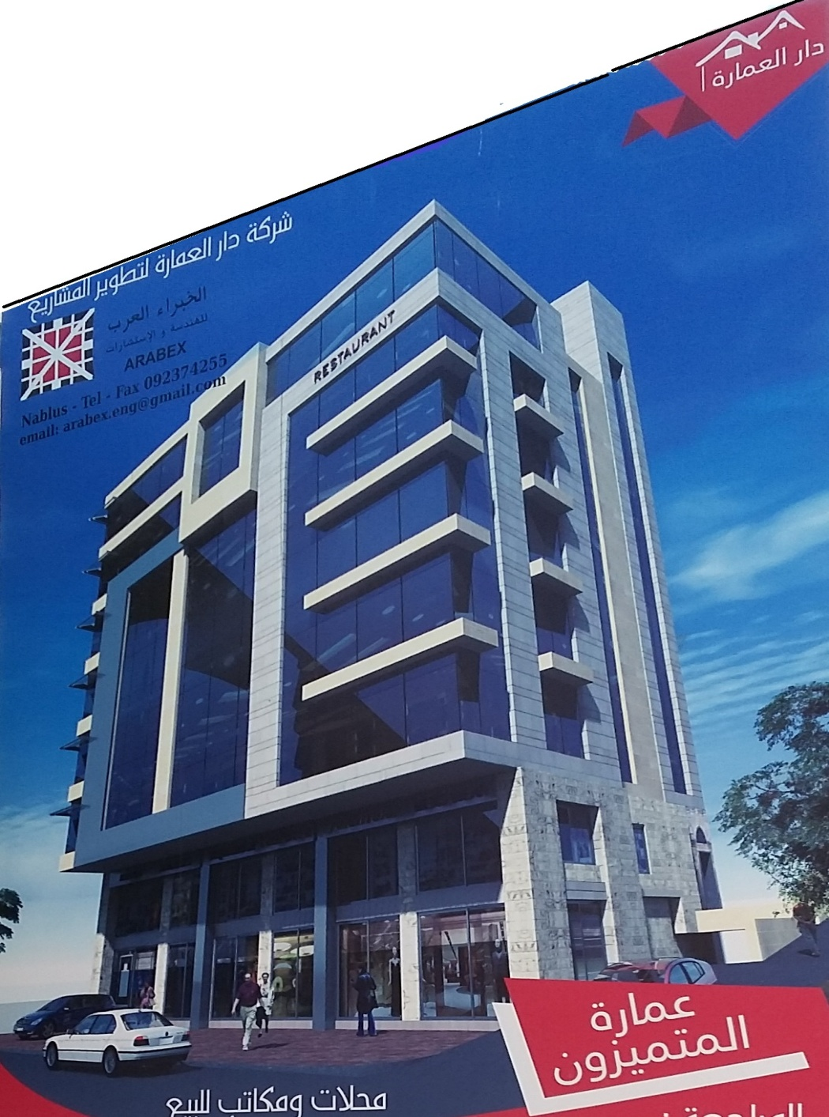
Introduction
Project description:

Slide 5
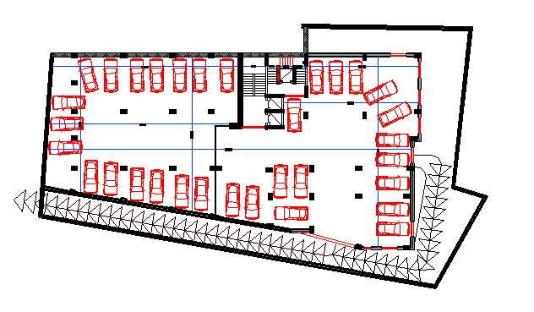
Introduction
Project description:
Basement 2

Slide 6
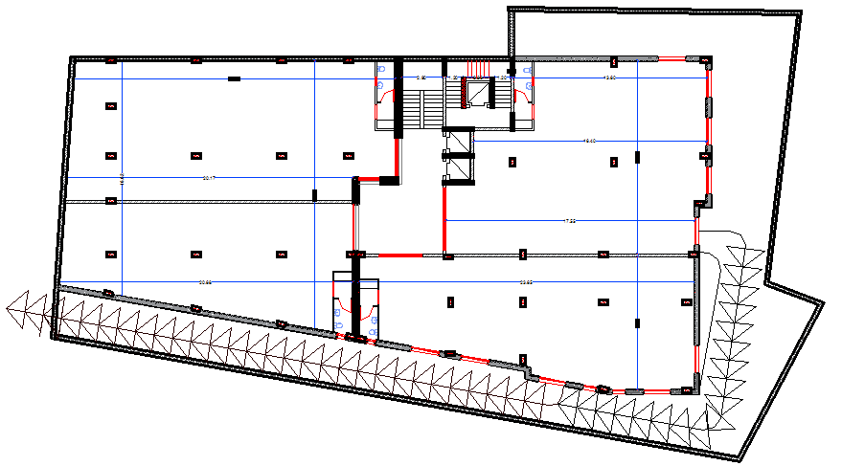
Introduction
Project description:
Basement 1

Slide 7
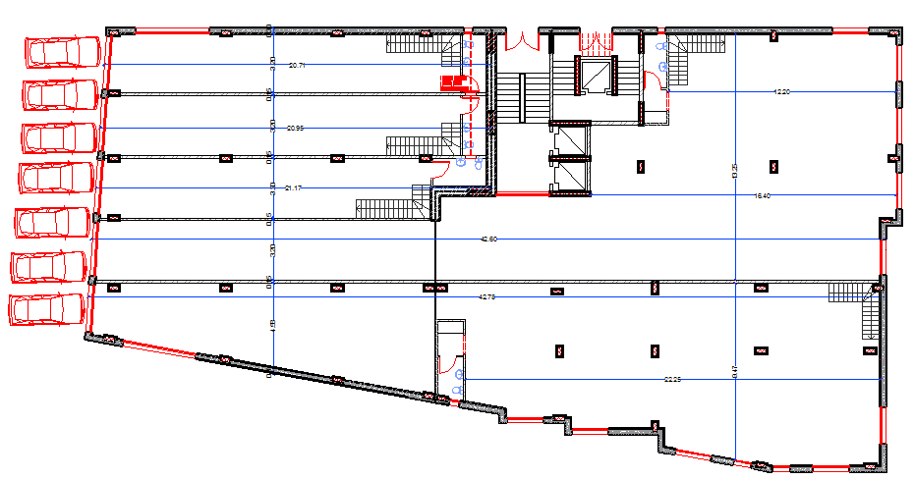
Introduction
Project description:
Ground Floor

Slide 8
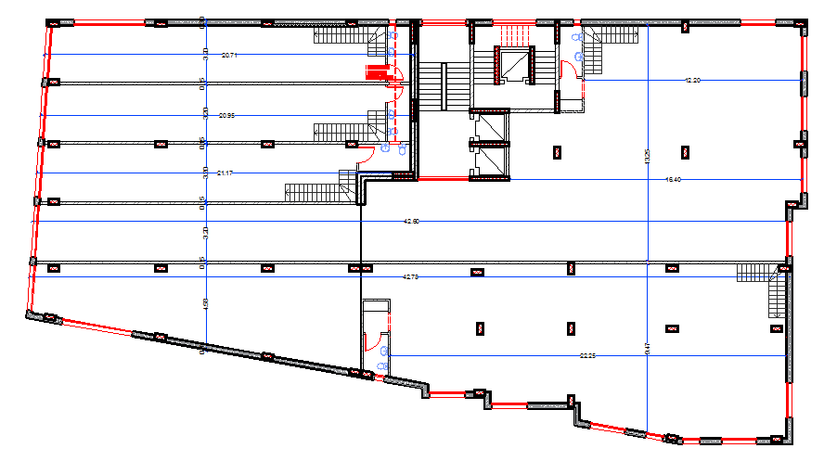
Introduction
Project description:
First Floor

Slide 9
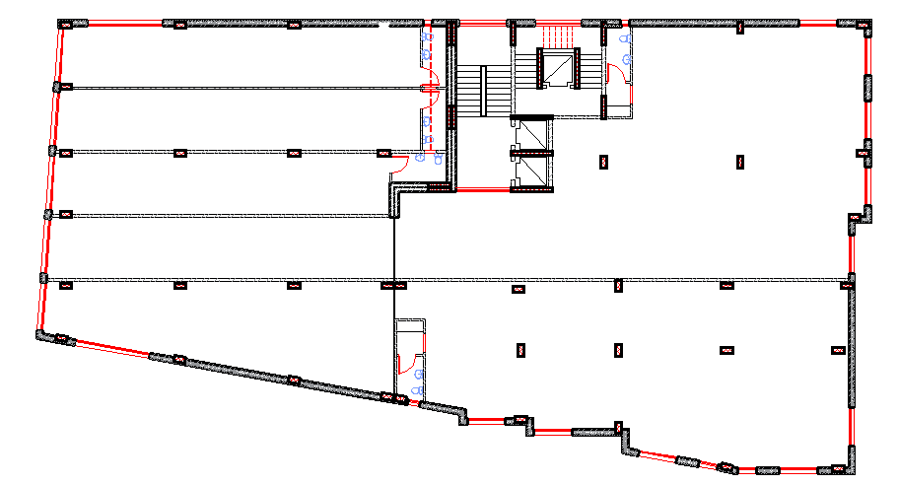
Introduction
Project description:
2&3 Floor

Slide 10
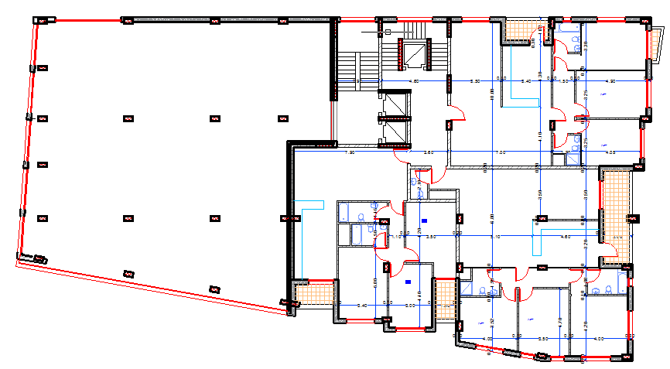
Introduction
Project description:
4,5,6&7 Floor

Slide 11
Introduction
Project description:
Story | Elevation (m) | Area (m²) | Use
2 ^{nd} Basement | -6.0 | 1025 | Garage
1 st Basement | -3.0 | 1025 | Exhibition
Ground Floor | 0.00 | 1025 | Exhibition
Story 1,2,&3 | 3.00, 6.00, 9.00 | 1025 | Exhibition
Story 4,5,6,&7 | 12.00, 15.00, 18.00, 21.00 | 1025 | Apartments

Slide 12
Introduction
Geotechnical information:
Soil layers are soft stone so the design bearing capacity is 250 KN/m² .
Codes and Standards:
UBC 97 ( Uniform Building Code)
ACI 318M-14 ( American Concrete Institute)
IBC 2012 ( International Building Code)

Slide 13
Introduction
Materials:
Concrete: strength: 28 MPa
Type: B350
Rebar Steel:
- Yielding strength of used steel (fy) = 420MPa.
- Modulus of elasticity of used steel (Es) = 200GPa

Slide 14
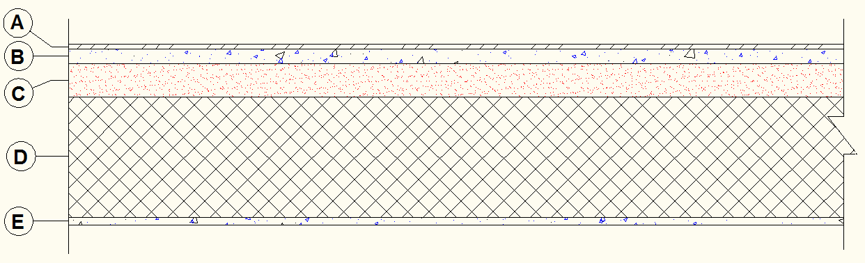
Introduction
Loads:
a. Gravity load
1) Super imposed dead load = 4 KN/m2
Zone | Material | Unit Weigh KN/m³ | Thickness cm | Wight (KN/m²) (unit weigh * thickness in m)
A | Tile | 27 | 1.0 | 0.27
B | Mortar | 23 | 3.0 | 0.69
C | Filling Material | 17 | 7.0 | 1.190
D | Slab Thickness | 25 | - | -
E | Plaster | 23 | 1.5 | 0.345
Partitions = 1 kN/m².

Slide 15
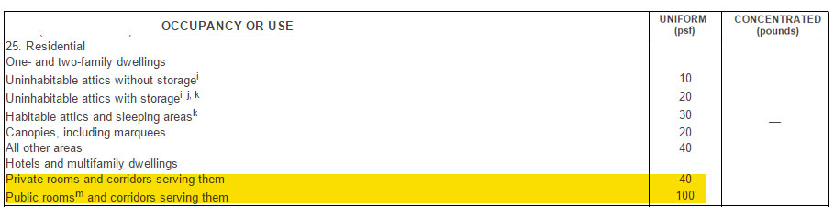
Introduction
Loads:
a. Gravity load
2) Live load =
For the Basement1&2 , GF & 1,2,3 Floor L.L = 5 KN/m2
For 4,5,6& 7 Floor L.L = 3 KN/m2

Slide 16
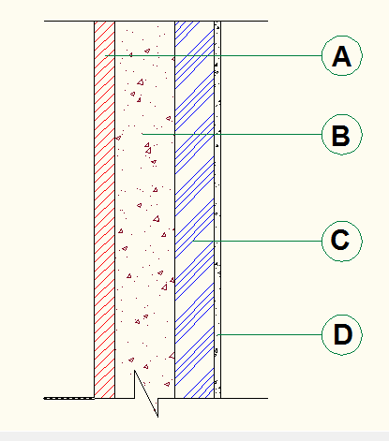
Introduction
Loads:
a. Gravity load
3) Wall load = 20 KN/m
Zone
A | Masonry stones | 5 | 27 | 1.35
B | Plan concrete | 15 | 23 | 3.45
C | Blocks | 10 | 12 | 1.2
D | Plaster | 1.5 | 23 | 0.345
Zone
material
Thickness
Unit weight KN/m3
Weight KN/m2
zone
Wall weight = 1.35+3.45+1.2+0.345 = 6.35 kN/m²
Wall weight = 6.35 * 3 = 19.05 KN/m
we will consider it as 20 KN/m .

Slide 17
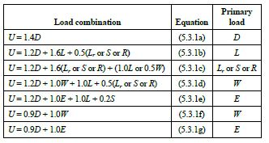
Introduction
Loads:
b. Lateral load ( Seismic)
The Building is located in Nablus ,which is classified zone 2B, according to Palestine seismic zone (z=0.2).

Slide 18
Introduction
Programs:
1- ETABS 2015
2- SAP 2000
3- AutoCAD

Slide 19
Preliminary dimensions and 3D model

Slide 20
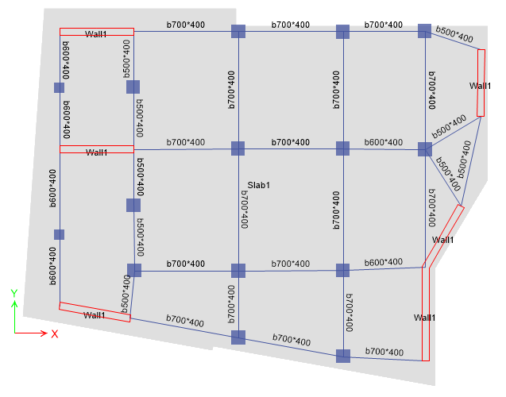
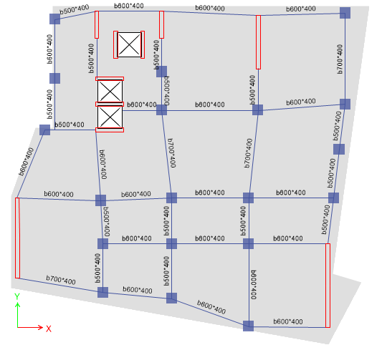
Preliminary dimensions and 3D model
Introduction to structural system.
The project is divided into 2 blocks
Block B
Block A

Slide 21
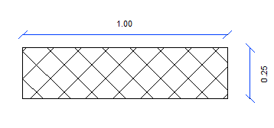
Preliminary dimensions and 3D model
Introduction to structural system
The structural system is two way solid Slab with drop beams.
Area = 2500 cm²
Moment of inertia I = 130208.3 cm⁴
weight = 2500*25/10000 = 6.25 KN/m²

Slide 22
Preliminary dimensions and 3D model
Preliminary Dimensions :
Column | Dimensions
Name | Cross section
C1 | 800mm*800mm
C2 | 600mm*600mm
Beam | Dimensions
B1 | 400mm*500mm
B2 | 400mm*600mm
B2 | 400mm*700mm

Slide 23
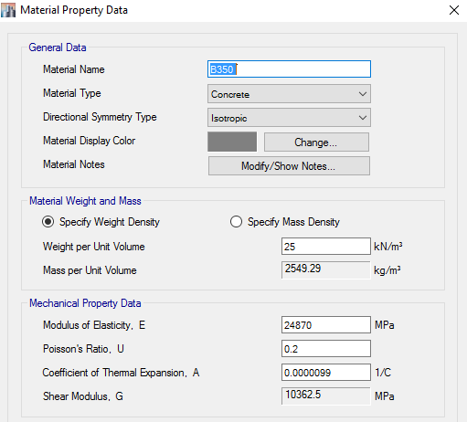
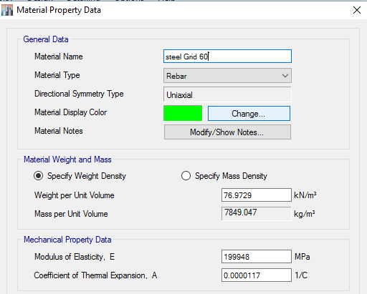
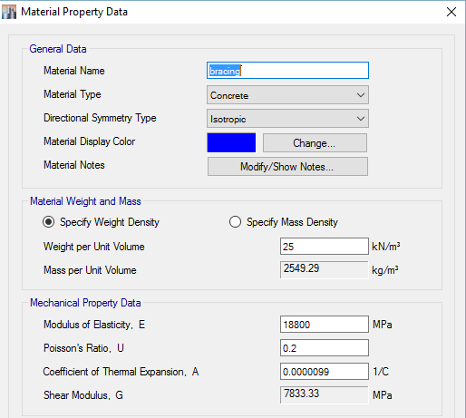
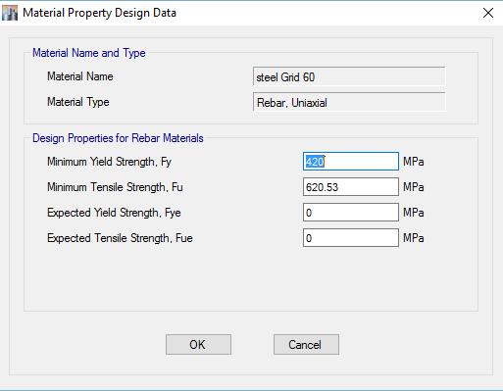
Preliminary dimensions and 3D model
Materials and modifiers :

Slide 24
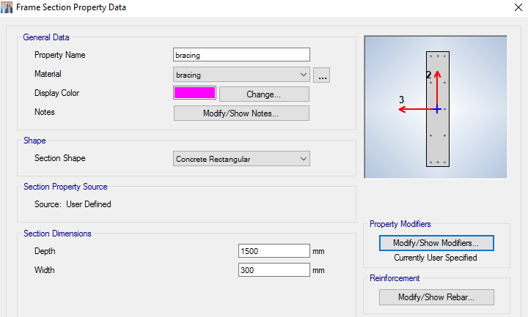
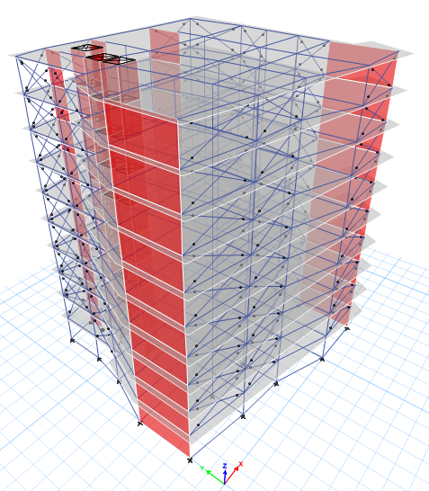
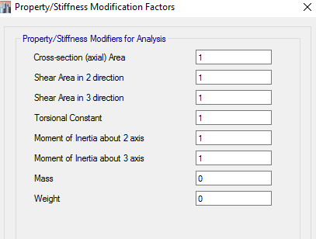
Preliminary dimensions and 3D model
Bracing:

Slide 25
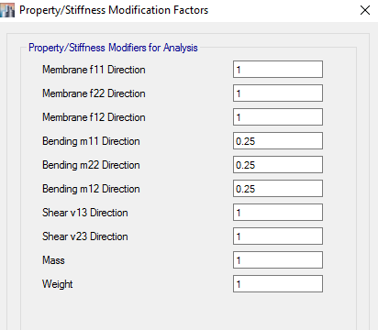
Preliminary dimensions and 3D model
Materials and modifiers :
Slab modifiers :

Slide 26
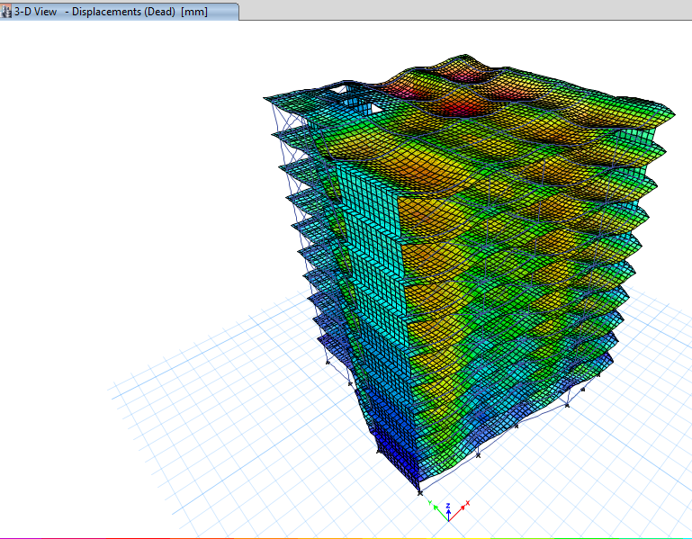
Preliminary dimensions and 3D model
Checks :
1) Check for compatibility
As shown the structure
move as a rigid unit
(moving together)

Slide 27
Preliminary dimensions and 3D model
Checks :
2- Equilibrium check (Base reactions)
By hand |  | By model | Error %
Dead | 60665.533 | 59649.989 | 1.67
Live | 22619.94 | 22623.115 | 0.014
SD | 21542.81 | 21545.825 | 0.013
Wall | 17030.19 | 17611.385 | 3.30
All less than 5%, OK

Slide 28
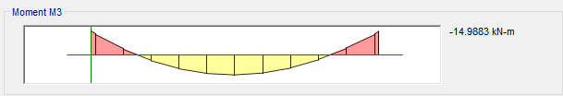
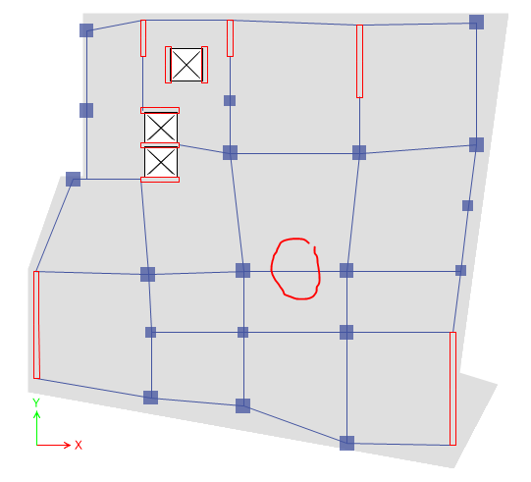

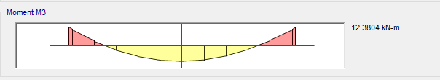
Preliminary dimensions and 3D model
Checks :
3- Check moment stress-strain relationships:
In our calculations , we took a strip in an interior beam from live load in block A as example:

Slide 29
Preliminary dimensions and 3D model
Checks :
3- Check moment stress-strain relationships:
M Etabs = (Mleft + Mright )/2 + M middle = (14.988 +14.8144) /2 + 12.38 = 27.281 KN.m
Mmanual "live" = WL2 /8
Load per unit length of beam from live load = (3.26+ 1.71 / 2)* (3 KN/m2) = 7.455 KN/m
Length of beam = 5.5 m
M = (7.455* 5.5^2) / 8 = 28.158
% error = 28.158-27.281/28.158 = 3.11 % < 10% → OK

Slide 30
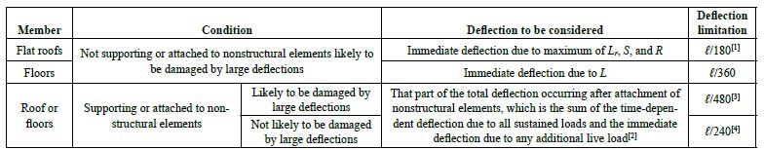
Preliminary dimensions and 3D model
Checks :
4- Check for deflection:
In Block A We have case 4 that is: L/240
In Block B We have case 3 that is: L/480

Slide 31
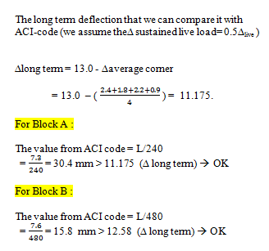
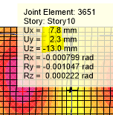
Preliminary dimensions and 3D model
Checks :
4- Check for deflection:
we assume the∆ sustained live load= 0.5∆_{live}

Slide 32
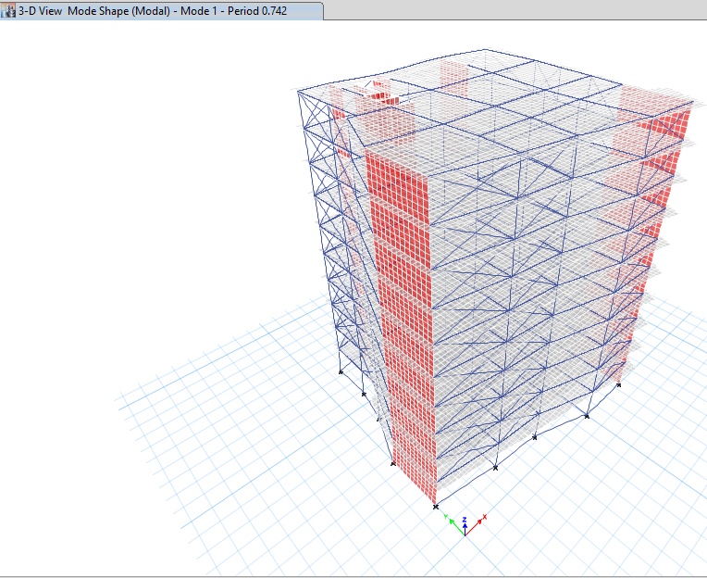
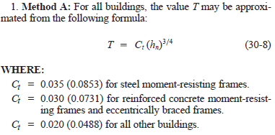
Preliminary dimensions and 3D model
5- Check the period:
1) Method A :
T = 0.0488(30)^{3/4 =} 0.625
Tetabs <=1.4*T method A
T etabs = 0.742
1.4 * Method A =0.875
T etabs <= 1.4*T method A → OK
fundamental period T=0.742

Slide 33

Preliminary dimensions and 3D model
5- Check the period :
2) Method B "Rayleigh analytical method":
Mass calculation:
Element/story | S1 | S2 | S3 | S4 | S5 | S6 | S7 | S8 | S9 | S10
Slab | 3366.06 | 3366.06 | 3366.06 | 3366.06 | 3366.06 | 3366.06 | 3366.06 | 3366.06 | 3366.06 | 3366.06
Masonry wall | - | 1576.87 | 1576.87 | 1576.87 | 1576.87 | 1576.87 | 1576.87 | 1576.87 | 1576.87 | 1576.87
SID | 2154.28 | 2154.28 | 2154.28 | 2154.28 | 2154.28 | 2154.28 | 2154.28 | 2154.28 | 2154.28 | 2154.28
Beams | 1118.63 | 1118.63 | 1118.63 | 1118.63 | 1118.63 | 1118.63 | 1118.63 | 1118.63 | 1118.63 | 1118.63
columns | 807 | 807 | 807 | 807 | 807 | 807 | 807 | 807 | 807 | 807
Wall "without Masonry" | 1261.49 | - | - | - | - | - | - | - | - | -
Mass(KN) | 8707.46 | 9022.84 | 9022.84 | 9022.84 | 9022.84 | 9022.84 | 9022.84 | 9022.84 | 9022.84 | 9022.84
Mass(Ton) | 887.61 | 919.75 | 919.75 | 919.75 | 919.75 | 919.75 | 919.75 | 919.75 | 919.75 | 919.75

Slide 34
Preliminary dimensions and 3D model
5- Check the period :
2) Method B "Rayleigh analytical method":
To find the period in X:
Drift values due to (1 KN/m2 – in x-direction):
 | Delta 1 | Delta 2 | Delta 3 | Delta average (mm)
Story 1 | 0.6 | 0.5 | 0.5 | 0.533
Story 2 | 1.2 | 1 | 1.1 | 1.100
Story 3 | 2.3 | 2.1 | 2.1 | 2.167
Story 4 | 3.4 | 3.2 | 3.3 | 3.300
Story 5 | 4.6 | 4.5 | 4.3 | 4.467
Story 6 | 5.7 | 5.8 | 5.7 | 5.733
Story 7 | 6.8 | 7.1 | 6.9 | 6.933
Story 8 | 8.4 | 8.2 | 8 | 8.200
Story 9 | 9.5 | 9.5 | 9.6 | 9.533
Story 10 | 10.9 | 10.8 | 11 | 10.900

Slide 35
Preliminary dimensions and 3D model
5- Check the period :
2) Method B "Rayleigh analytical method":
Period in X:
 | Mass | force | Delta | Mass*(Delta^2) | Force* Delta
Story 1 | 887.61 | 538.57 | 0.000533 | 0.00025216 | 0.28705781
Story 2 | 919.75 | 538.57 | 0.0011 | 0.001112898 | 0.592427
Story 3 | 919.75 | 538.57 | 0.002167 | 0.004319044 | 1.16708119
Story 4 | 919.75 | 538.57 | 0.0033 | 0.010016078 | 1.777281
Story 5 | 919.75 | 538.57 | 0.004467 | 0.018352773 | 2.40579219
Story 6 | 919.75 | 538.57 | 0.005733 | 0.030229689 | 3.08762181
Story 7 | 919.75 | 538.57 | 0.006933 | 0.044209153 | 3.73390581
Story 8 | 919.75 | 538.57 | 0.0082 | 0.06184399 | 4.416274
Story 9 | 919.75 | 538.57 | 0.009533 | 0.083585122 | 5.13418781
Story 10 | 919.75 | 538.57 | 0.0109 | 0.109275498 | 5.870413
 |  |  |  | 0.363196405 | 28.47204162

Slide 36
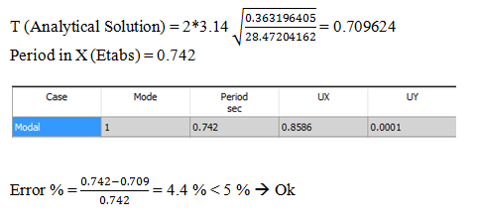
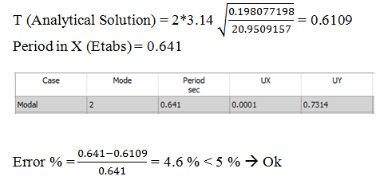
Preliminary dimensions and 3D model
5- Check the period :
2) Method B "Rayleigh analytical method":
Period in x :
Period in Y :

Slide 37
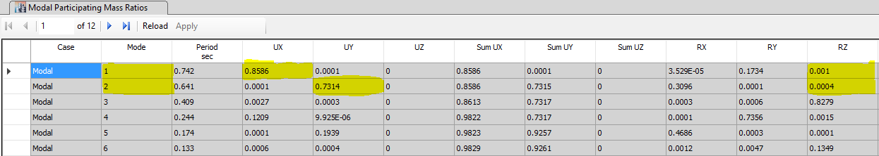
Preliminary dimensions and 3D model
6- Check if torsion mode exist in 1st two modes:

Slide 38
Dynamic Analysis
“UBC-97”

Slide 39

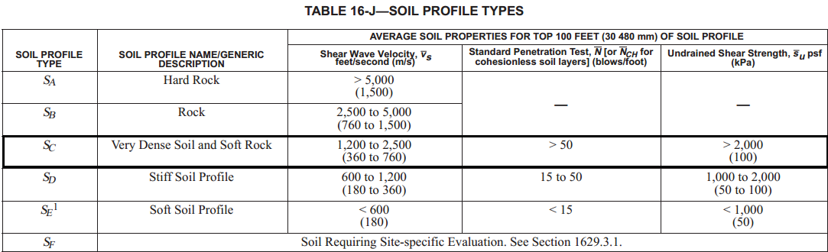
Dynamic Analysis:
Seismic Parameters
1- Site classifications

Slide 40
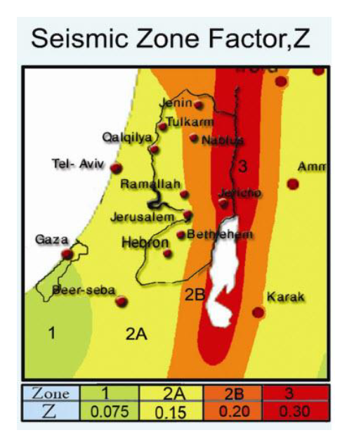
Dynamic Analysis:
Seismic Parameters
2- Seismic Zone Factor :
The Building is located in Nablus city which is in Zone 2B, and has Z = 0.2 g .

Slide 41
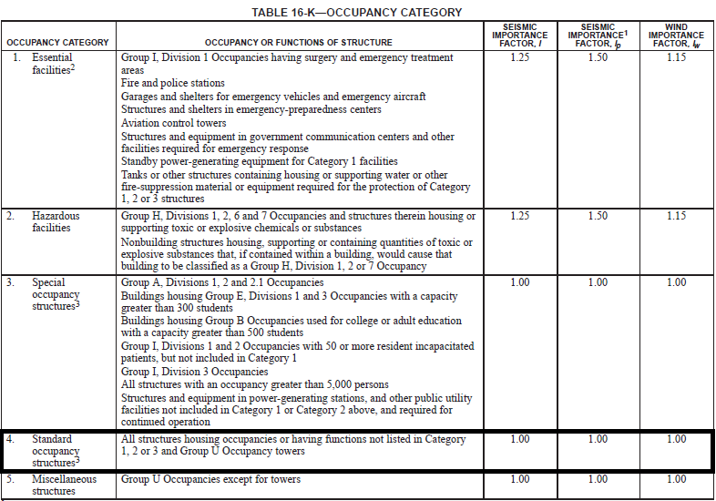
Dynamic Analysis:
Seismic Parameters
3- Importance factor:
we have a standard occupancy structure, so the importance factor I=1.00

Slide 42
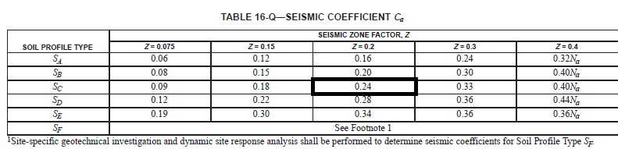
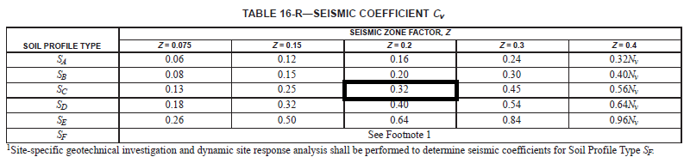
Dynamic Analysis:
Seismic Parameters
4- Acceleration seismic coefficient, Ca = 0.24
5- Velocity seismic coefficient, CV = 0.32

Slide 43
Dynamic Analysis:
Determination of building frame system and Response modification factor (R):
There are 3 types of building frame system according to resistance the gravity and lateral loads:
1- Bearing wall system
2- Building frame system
3- The moment resisting frame system

Slide 44
Dynamic Analysis:
Determination of building frame system and Response modification factor (R):
Columns take 66 % of gravity loads
Walls take 90 % of lateral loads in X- direction .
Walls take 81 % of lateral loads in Y- direction .
From this results and since the building is located in moderate seismic area then the system is building frame system with intermediate reinforcement.

Slide 45
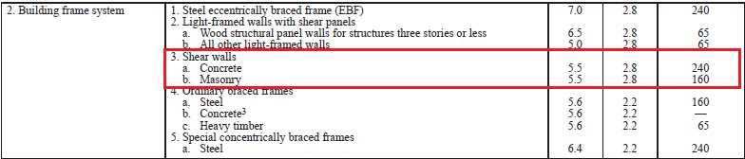
Dynamic Analysis:
Determination of building frame system and Response modification factor (R):
So we will use the Building Frame system with R= 5.5 .

Slide 46




Dynamic Analysis:
Determination of Seismic Base reactions :
Modal analysis using equivalent static method.
T= Ct *(Hn)3/4
By hand |  | By model
Dead | 60665.533 | 59649.989
Live | 22619.94 | 22623.115
SD | 21542.81 | 21545.825
Wall | 17030.19 | 17611.385
T= 0.0488× (30^{3/4}) = 0.625 second
W _{total =} W_{dead} + W _{SID} + W _{wall} + 0.25W_{live}
₌ 104893.5 KN
We assigned equivalent static load in ETABS, and the following results was obtained:

Slide 47
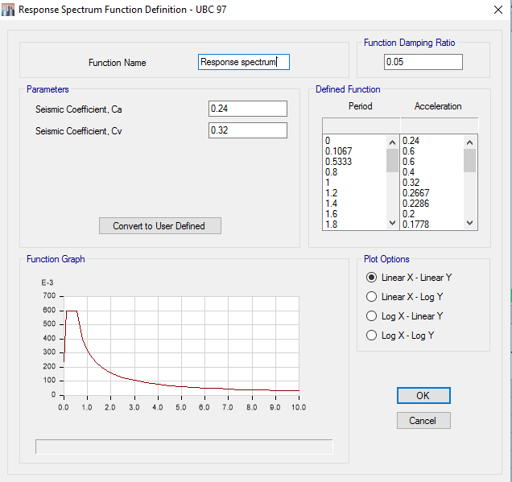
Dynamic Analysis:
Determination of Seismic Base reactions :
Modal analysis using Response spectrum analysis .
We used ETABS model to calculate the seismic forces from Response spectrum in two directions (X-direction, Y-direction).

Slide 48
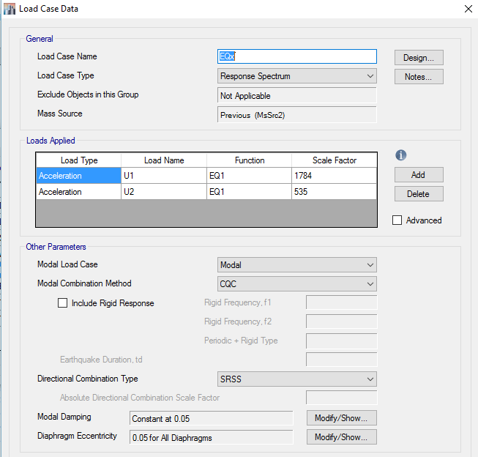

Dynamic Analysis:
Determination of Seismic Base reactions :
Modal analysis using Response spectrum analysis .
Because the earthquake loads don’t come from one directions, so the structure shall be designed to resist any seismic forces in each direction:
Ex = Ex + 0.3 Ey
Ey = Ey + 0.3 Ex
Then, The Acceleration in main
and other direction should be
multiplied by :

Slide 49
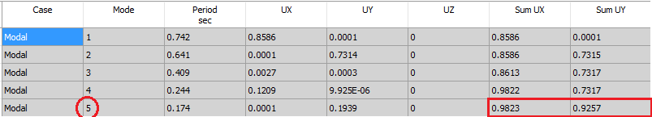
Dynamic Analysis:
Determination of Seismic Base reactions :
Modal analysis using Response spectrum analysis .
Checks :
a) modal participation mass ratio (MPMR) >90% in both X and Y.

Slide 50
Dynamic Analysis:
Determination of Seismic Base reactions :
Modal analysis using Response spectrum analysis .
Checks :
b) Check Period:
Period of mode of maximum MPMR in X <=1.4 T_{method A}
0.742 <= 1.4*0.625 → 0.742 <= 0.875 → OK
Period of mode of maximum MPMR in Y<=1.4 T_{method A}
0.641 <= 1.4*0.625 → 0.641<= 0.875 → OK

Slide 51
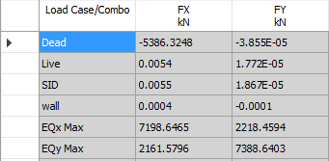
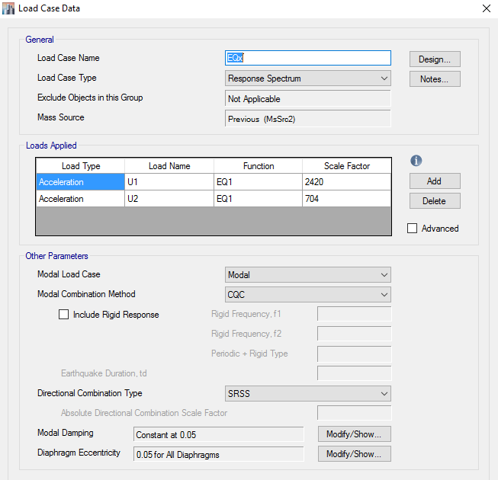
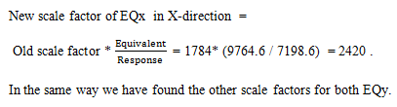
Dynamic Analysis:
Determination of Seismic Base reactions :
Modal analysis using Response spectrum analysis .
Checks :
C ) Make sure that the base shear from response spectrum cases >= base shear from
equivalent static method by modifying scale factor .
Since Base shear from Response spectrum is less than that of Equivalent static method , we need to modify scale factor :

Slide 52
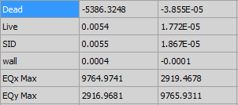
Dynamic Analysis:
Determination of Seismic Base reactions :
Modal analysis using Response spectrum analysis .
Checks :
After modifying the scale factor the base shear results in all direction were acceptable , so the check is ok .

Slide 53
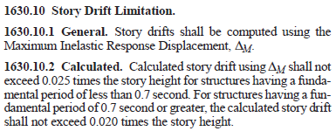
Dynamic Analysis:
D) Story Drifts Checks and Design of seismic Joint:
The maximum story drift in a building shall not exceed the allowable story drift as
Obtained from UBC-97 .
Since the period of our building is greater than 0.7 , the allowable story drift shall not
exceed 0.02 times the story height.
Δ_{M allowable =} 0.02*H_{s tory} = 0.02*3.0 = 60 mm

Slide 54
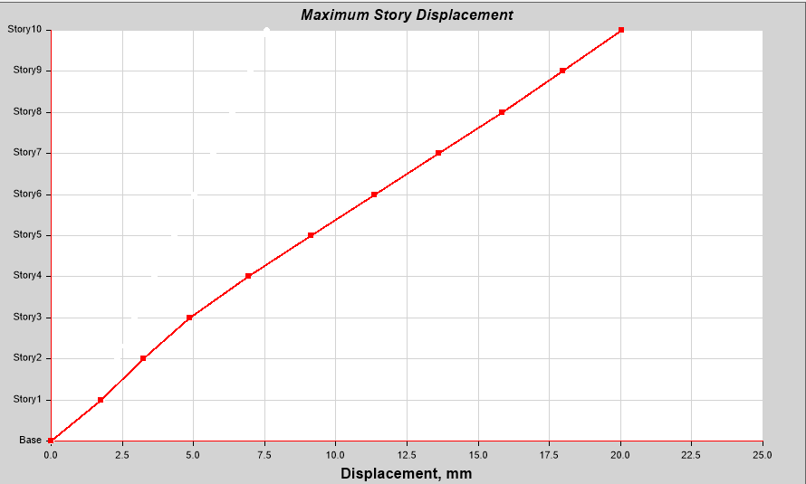
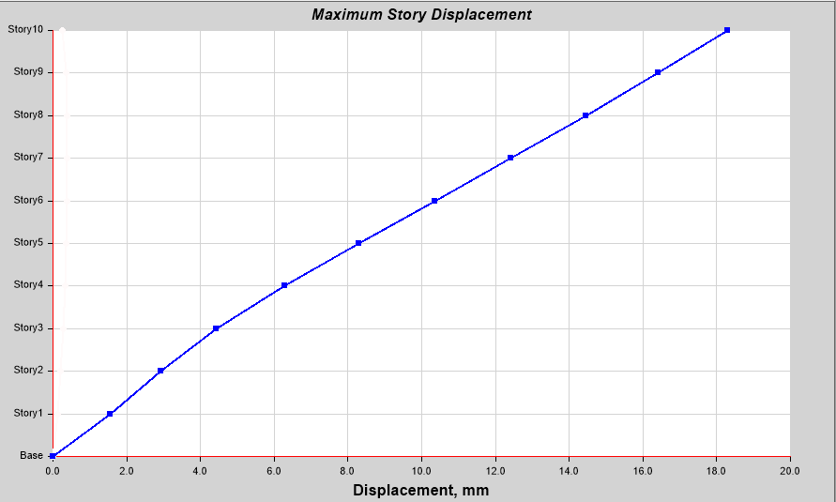
Dynamic Analysis:
D) Story Drifts Checks and Design of seismic Joint:
Max Story Drifts in both directions :

Slide 55

Dynamic Analysis:
Checks :
D) Story Drifts Checks and Design of seismic Joint:
The maximum story drift obtained Δ_{S} was 2.5 mm
Check if :
The maximum inelastic response displacement < maximum allowed story drift .
Δ_{M} = 0.7*R* max Δ_{S =} 0.7*5.5*2.5= 9.63 mm<< 60mm → Ok
The seismic joint:
Δ_{MT} = ( (InelasticΔ of block A)² + ( Inelastic Δ of block B)² )^{0.5}
= ( (20² + 18.6²) )^{0.5} = 27.31 mm
The seismic joint size is 30 mm .

Slide 56

Dynamic Analysis:
Structural Configuration:
1- Plane Configuration
Displacement from mode 3

Slide 57

Dynamic Analysis:
Structural Configuration:
1- Plane Configuration
Δ1(y) = 0.0196 mm , Δ2(y) = 0.0173 mm.
so Δ_{avg} (y) = Δ1 + Δ2 / 2 = 0.01845 mm
Δ _{max} = 0.02147 < 1.2 Δ_{avg} = 0.02214 mm .
So there is no torsional irregularity nor extreme torsional irregularity .

Slide 58

Dynamic Analysis:
Structural Configuration:
2- Vertical configuration

Slide 59
Dynamic design

Slide 60
Design criteria
Strength
Serviceability and Stability
Cost effective

Slide 61



Design of Slab:
Check slab for shear:

Slide 62


Design of Slab:
Design of slab for flexure:
Mu_{min} =59.4 KN.m.

Slide 63

Design of Slab:
Slab Reinforcement for both Blocks

Slide 64

Design of beams:
Design For Flexural :
Design For shear and torsion :
Block 1
Notes:
three beam sections 500,600, 700, we find the minimum steel needed for each and once the reinforcement is less… and for more we give more ,,,

Slide 65


Design of beams:

Slide 66


Design of columns:
Rebar percentage
Block 1

Slide 67


Design of columns:

Slide 68



Design of shear walls :
Check shear wall stresses :
The max stress in shear wall is 4.32MPa >Fr=3.28MPa➔the wall is cracked
➔the inertia modifiers is 0.35Ig.
Block 1

Slide 69

Design of shear walls :
We chose shear wall as example
Sw1 has a thickness of 300mm and width of 2 m.
Pu | Mux | Muy | Vux | Vuy
2458 KN | 214 KN.m | 76 KN.m | 129KN | 325KN

Slide 70


Design of shear walls :

Slide 71


Design of shear walls :
Using the section designer on ETABS to draw a bending moment-axial
interaction diagram ,the following values for steel ratio and area of steel are obtained .

Slide 72

Design of shear walls :
As a result:
Use Vertical reinforcement of 4 Ø 16/ m
Use Horizontal (shear ) reinforcement of
4 Ø12/m
U-bar at each end of shear-wall and splicing it with horizontal (shear) straight bar,
Should be considered.

Slide 73

Design of Stairs:
Stairs dimensions:
∝ = 27 º ,
Going = 30 cm.
Riser = 15 cm.
Floor height = 3.2m
No. of goings = 21.
No. of risers = 22.
Use solid slab with 15 cm thickness, d=120 mm.

Slide 74


Design of Stairs:
Check for shear
Design for flexure:

Slide 75

Design of Stairs:

Slide 76

Design of footing :
Block (1):

Slide 77
Design of footing :
Design of a Single Footing:
Footing Name | Type of Load | Value of Load | Service Load | Area of Footing | B=L | B=L (Used) | Actual Area | d (mm) (Wide Beam Shear) | d (mm) (Used) | h (mm) | Vu,punching |  | ΦVc,p | Result
F1 | dead | 1477.879 | 1998.50 | 8.03 | 2.83 | 2.9 | 8.41 | 352.84 | 390 | 460 | 2167.57 | ≤ | 2250.88 | OK
 | live | 520.6250
F2 | dead | 1845.6387 | 2265.29 | 9.06 | 3.01 | 3.1 | 9.61 | 378.42 | 420 | 490 | 2439.19 | ≤ | 2485.13 | OK
 | live | 419.647
F3 | dead | 1967.3647 | 2479.34 | 9.92 | 3.15 | 3.2 | 10.24 | 403.78 | 450 | 520 | 2694.77 | ≤ | 2728.12 | OK
 | live | 511.975
F4 | dead | 2114.3654 | 2685.01 | 10.86 | 3.29 | 3.3 | 10.89 | 426.21 | 480 | 550 | 2931.18 | ≤ | 2979.83 | OK
 | live | 570.648
Dimensions and checks for all single footings in the first block

Slide 78
Design of footing :
Design of a Single Footing:
Footing Name | q_{u} (kN/m²) | l₁ (m) | M_{u} (kN.m) | ρ | A_{s,main} (mm²) in both directions bottom | A_{s,main} in both directions bottom | A_{s,shrinkage} (mm²) in both directions top | A_{s,shrinkage} in both directions top
F1 | 309.92 | 1.05 | 170.85 | 0.00306 | 1195 | 1Φ16/150 | 0 | 0
F2 | 300.33 | 1.15 | 198.60 | 0.00307 | 1290 | 1Φ16/150 | 0 | 0
F3 | 310.55 | 1.2 | 223.59 | 0.00301 | 1355 | 1Φ16/150 | 468 | 1Φ12/250
F4 | 316.83 | 1.25 | 247.52 | 0.00293 | 1405 | 1Φ18/150 | 495 | 1Φ12/200
Reinforcement for all single footings in the first block

Slide 79


Design of footing :
Design of a Single Footing:
main reinforcement for the single footing (F2):

Slide 80
Design of footing :
Design of a Wall Footing
Footing Name | Type of Load | Value of Load | Service Load | B | B (Used) | d (mm) (Wide Beam Shear) | d (mm) (Used) | h (mm)
F5 | dead | 296 | 431 | 1.724 | 1.8 | 238.93 | 240 | 310
 | live | 135
F6 | dead | 412 | 538 | 2.152 | 2.2 | 306.58 | 310 | 380
 | live | 126
F7 | dead | 461 | 575 | 2.3 | 2.4 | 333.56 | 340 | 410
 | live | 114
F8 | dead | 487 | 608 | 2.432 | 2.5 | 353.80 | 360 | 430
 | live | 121
Dimensions for all wall footings in the first block

Slide 81
Design of footing :
Design of a Wall Footing
Footing Name | q_{u} (kN/m²) | l₁ (m) | M_{u} (kN.m) | ρ | A_{s,main} (mm²) in the transverse bottom | A_{s,main} in the transverse bottom | A_{s,shrinkage} (mm²) in the long direction bottom | A_{s,shrinkage} in the long direction bottom
F5 | 309.92 | 1.05 | 170.85 | 0.00306 | 890 | 1Φ14/150 | 558 | 1Φ12/200
F6 | 300.33 | 1.15 | 198.60 | 0.00307 | 1135 | 1Φ16/150 | 684 | 1Φ12/150
F7 | 310.55 | 1.2 | 223.59 | 0.00301 | 1237 | 1Φ16/150 | 738 | 1Φ12/150
F8 | 316.83 | 1.25 | 247.52 | 0.00293 | 1308 | 1Φ18/150 | 774 | 1Φ12/150
Reinforcement for all wall footings in the first block

Slide 82


Design of footing :
Design of a Wall Footing
and shrinkage reinforcement for the wall footing (F7)

Slide 83

Design of footing :
Design of a Combined Footing

Slide 84
Design of footing :
Design of a Combined Footing
Footing Name | Mu | ρ | Area of Steel ( Longitudinal )
F5 | 1288.10 | 0.00502 | As(main)Bottom = | 2411 | 1Φ25/200
 |  |  | As(main)Top = | 1599 | 1Φ18/150
F6 | 1022.72 | 0.00386 | As(main)Bottom = | 1814 | 1Φ20/150
 |  |  | As(main)Top = | 1566 | 1Φ20/200
F7 | 1096.28 | 0.00324 | As(main)Bottom = | 1620 | 1Φ18/150
 |  |  | As(main)Top = | 1665 | 1Φ18/150
F8 | 1806.92 | 0.00528 | As(main)Bottom = | 3958 | 1Φ25/100
 |  |  | As(main)Top = | 2498 | 1Φ25/200
Longitudinal reinforcement for all combined footings in the second block

Slide 85
Design of footing :
Design of a Combined Footing
Footing Name | The Column | L | qu | Mu | ρ | Area of Steel ( Transverse )
F5 | C2 | 1.28 | 842.40 | 557.04 | 0.00687 | As(main) = | 3298.26 | So | As(main) = | 3299 | 1Φ25/150
 |  |  |  |  |  | As(min.) = | 990
 | C1 | 1.28 | 636.20 | 420.69 | 0.00509 | As(main) = | 2442.70 | So | As(main) = | 2443 | 1Φ25/200
 |  |  |  |  |  | As(min.) = | 990
F6 | C2 | 1.27 | 776.73 | 606.82 | 0.00790 | As(main) = | 3711.66 | So | As(main) = | 3712 | 1Φ25/130
 |  |  |  |  |  | As(min.) = | 972
 | C1 | 1.27 | 673.54 | 526.20 | 0.00676 | As(main) = | 3178.12 | So | As(main) = | 3179 | 1Φ25/150
 |  |  |  |  |  | As(min.) = | 972
F7 | C2 | 1.3 | 754.43 | 793.10 | 0.00926 | As(main) = | 4630.75 | So | As(main) = | 4631 | 1Φ25/100
 |  |  |  |  |  | As(min.) = | 1026
 | C1 | 1.3 | 689.73 | 725.07 | 0.00838 | As(main) = | 4191.69 | So | As(main) = | 4192 | 1Φ25/100
 |  |  |  |  |  | As(min.) = | 1026
F8 | C2 | 1.55 | 842.31 | 85.28 | 0.00040 | As(main) = | 301.57 | So | As(main) = | 1476 | 1Φ18/150
 |  |  |  |  |  | As(min.) = | 1476
 | C1 | 1.55 | 747.72 | 75.71 | 0.00036 | As(main) = | 267.58 | So | As(main) = | 1476 | 1Φ18/150
 |  |  |  |  |  | As(min.) = | 1476
Transverse reinforcement for all combined footings in the second block
Footing Name | As(shrinkage)
F5 | 495 | 1Φ12/200
F6 | 486 | 1Φ12/200
F7 | 513 | 1Φ12/200
F8 | 738 | 1Φ12/150

Slide 86

Design of footing :
Design of a Combined Footing
main and shrinkage reinforcement for the combined footing (F6):

Slide 87

Design of Retaining Wall :
Cantilever Retaining Wall Design:
Check Stability
Check Overturning
Check Sliding
Check Bearing Capacity
Stem Design
Toe and Heel Design

Slide 88

Design of Retaining Wall :

Slide 89
Thank You For Listening

