Slide 1



An-Najah National University
Faculty of Engineering and Information Technology
Industrial Engineering Department
Graduation Project
Preparing a Disaster Risk management Plan (DRMP)
to Asera Al-Shamaliah Municipality
Done by:
Abeer Alyousef (11716383)
Ruba Abdulfattah (11715420)
Dana Khadra (11716025)
Rahaf Jawabreh (11716549)
Safaa Bakier (11612657)
Supervised by: Eng. Suleiman Daifi

Slide 2







Safaa Bakier
Ruba Abdulfattah
Dana Khadra
Rahaf Jawabreh
Abeer Alyousef

Slide 3

Presentation Outline
Introduction
Disaster Risk Assessment (DRA)
SWOT Analysis
Disaster Risk Management Unit Organizational Structure
Command Center
Response and Recovery Process Flow Chart
Disaster Risk Management Plans (DRMP)
Monitoring and Evaluation
Conclusions and Recommendations

Slide 4

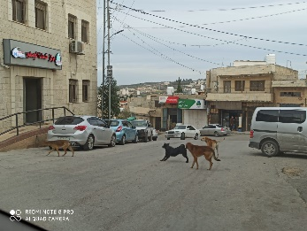

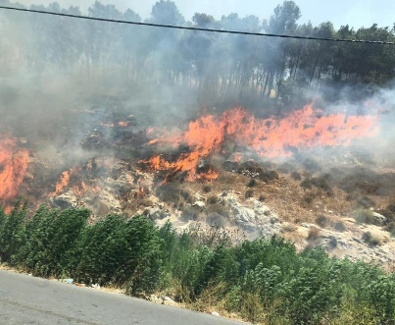
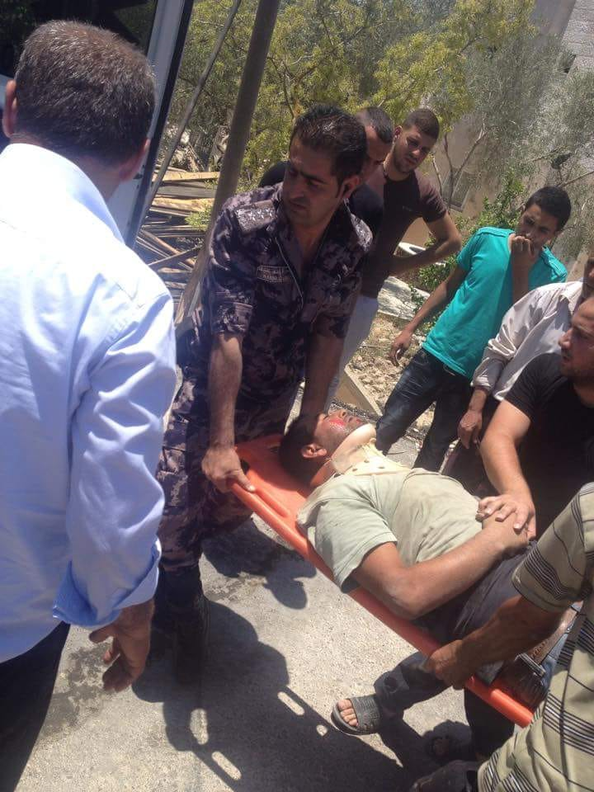
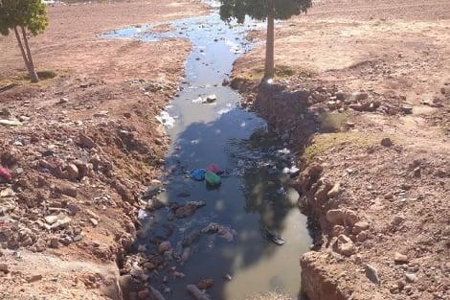
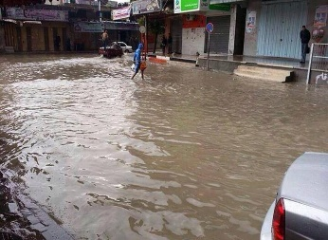

Introduction
Natural disasters
Man-made disasters
How to deal with disasters?

Slide 5
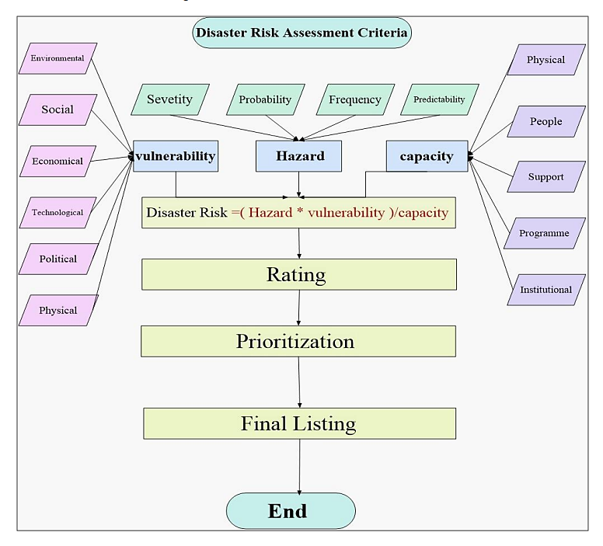

Disaster Risk Assessment (DRA):
DRA Criteria:

Slide 6
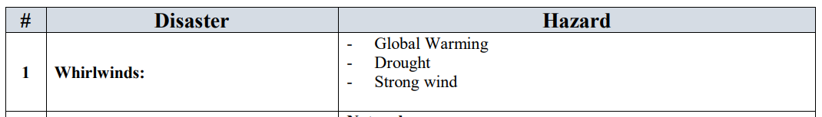
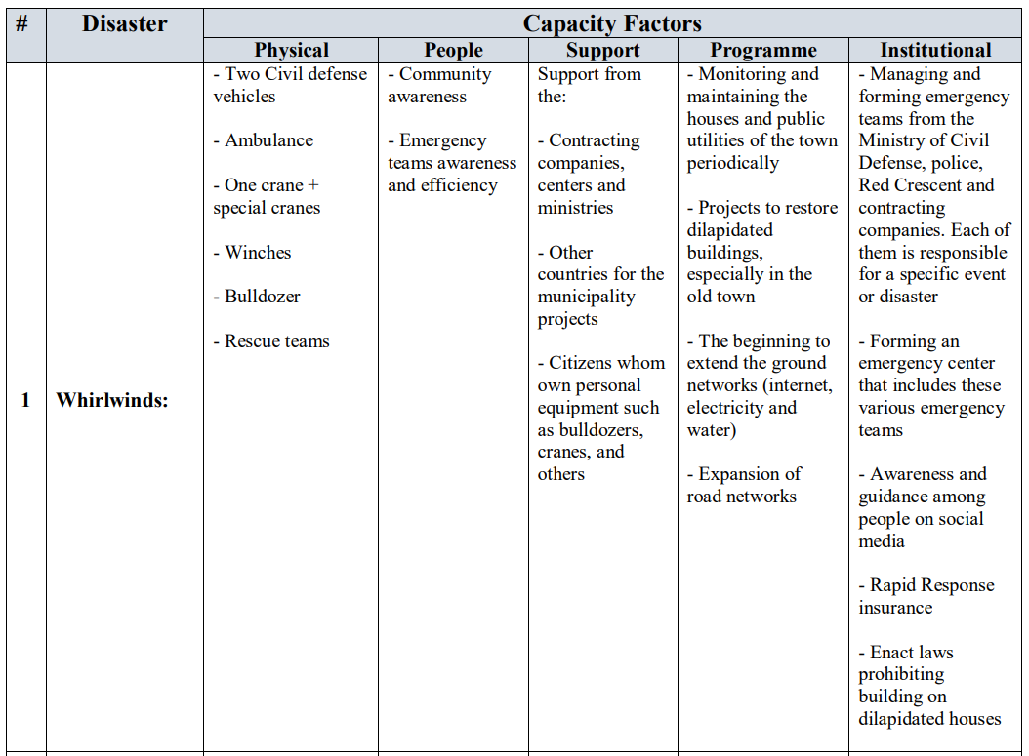
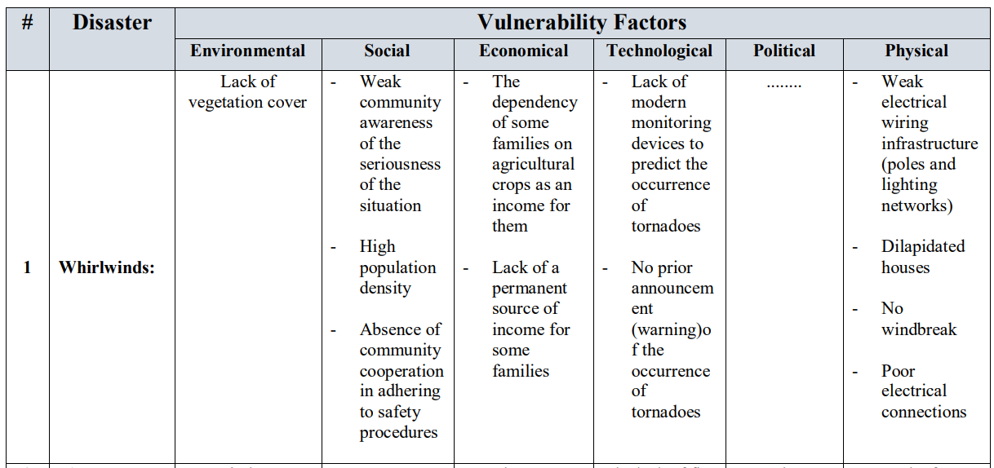
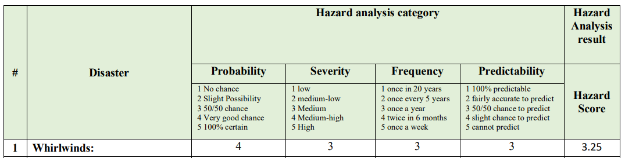
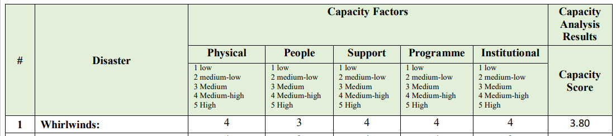
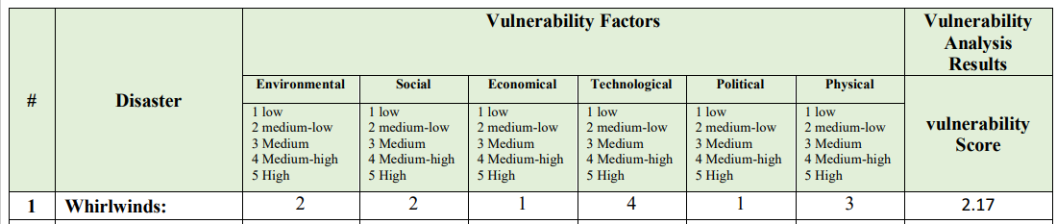
Disaster Risk Assessment (DRA):
1. Qualitative Analysis:
2. Quantitative Analysis:

Slide 7
Disaster Risk Assessment (DRA):
DRA Criteria:

Slide 8
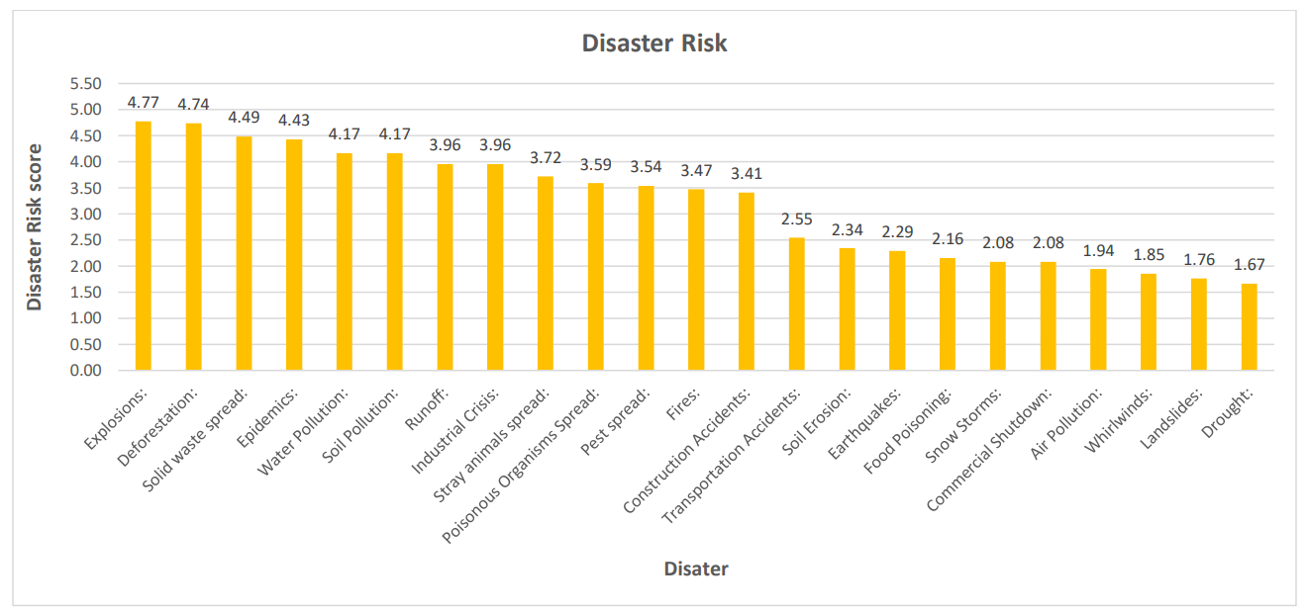
Disaster Risk Assessment (DRA):
Disasters Risk Score:

Slide 9
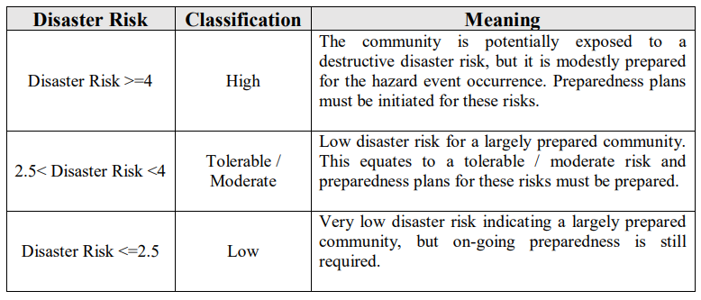
Disaster Risk Assessment (DRA):
3.Disaster Risk Rating Scale:

Slide 10
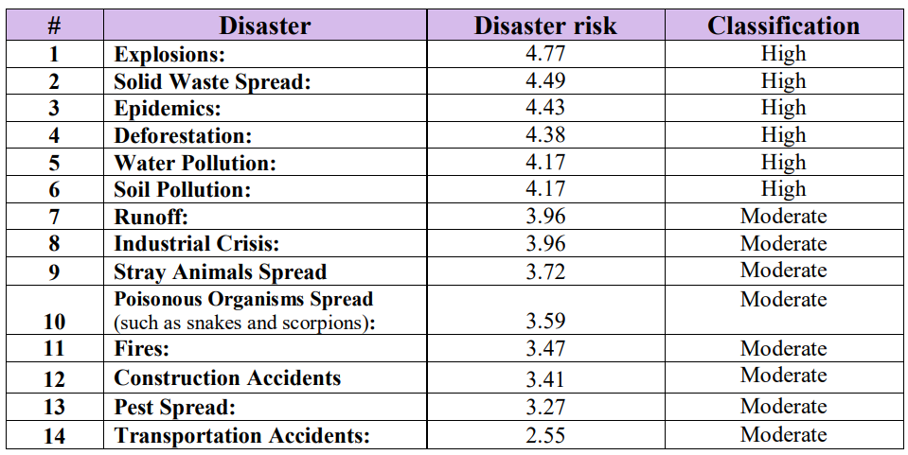
Disaster Risk Assessment (DRA):
4.Prioritization:

Slide 11
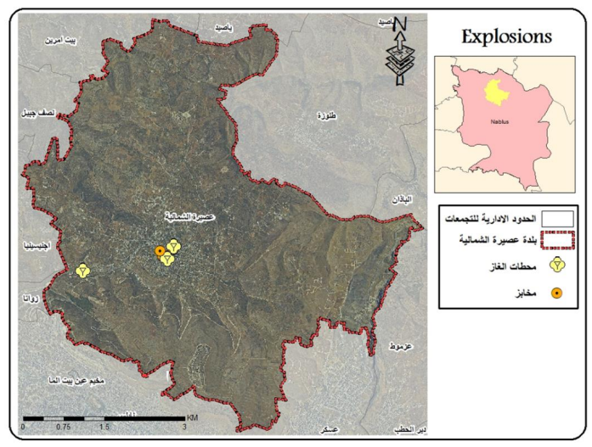
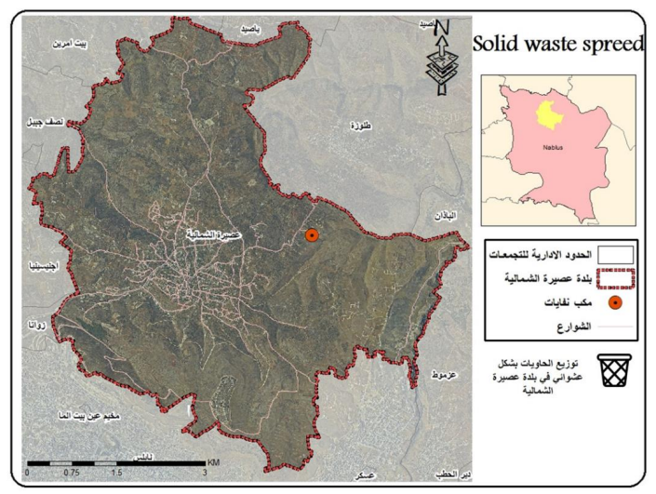
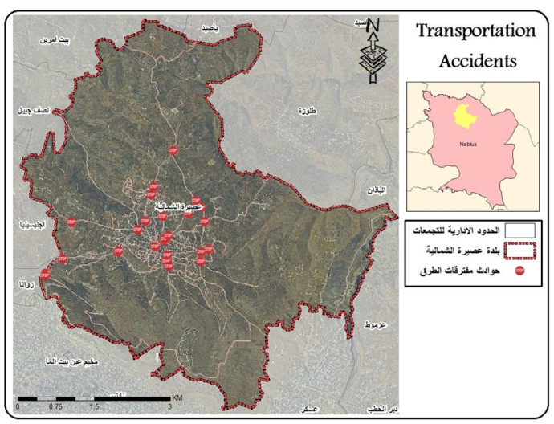
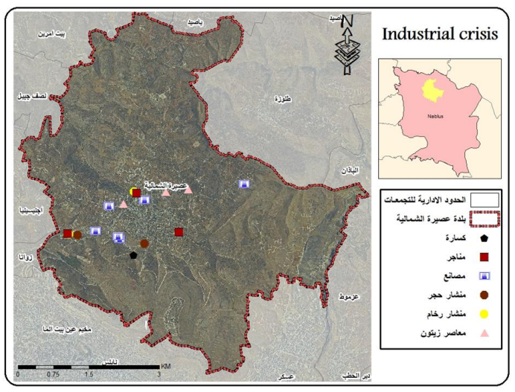
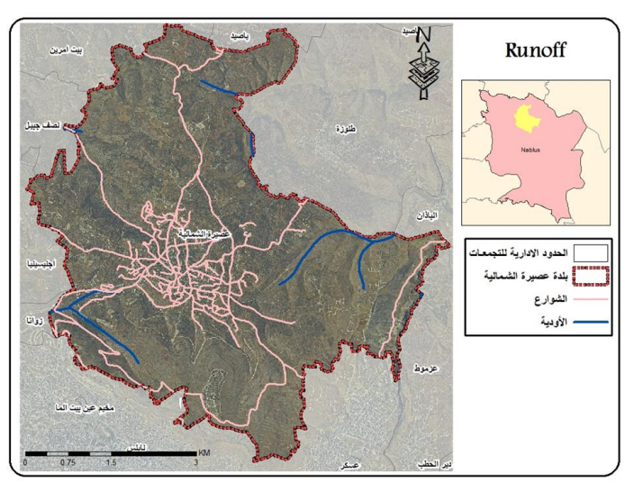
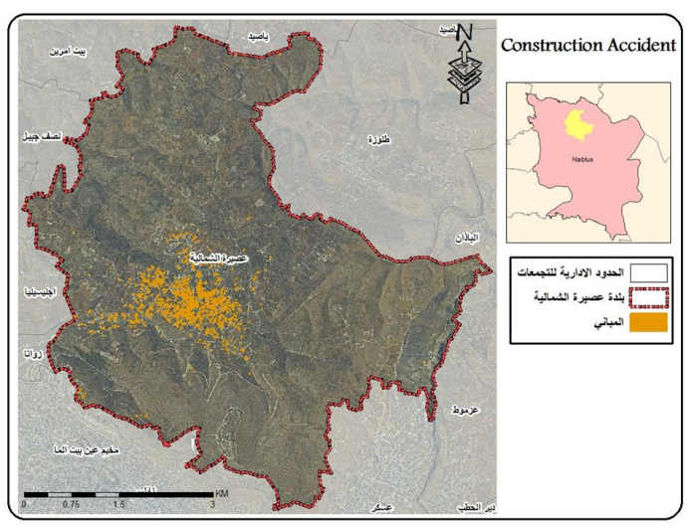
Disaster Risk Assessment (DRA):
5.Disaster Risk Maps:

Slide 12


SWOT Analysis

Slide 13
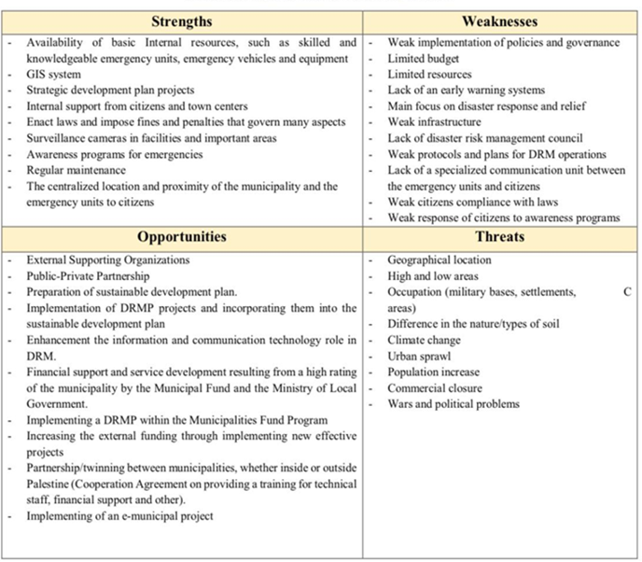

Slide 14

Prevention and Mitigation
Preparedness
Response
Rehabilitation and Recovery

Slide 15
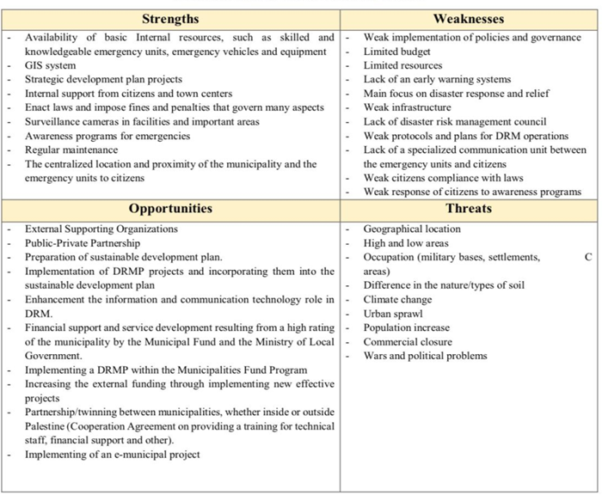








Disaster Prevention and Mitigation
DRMP

Slide 16
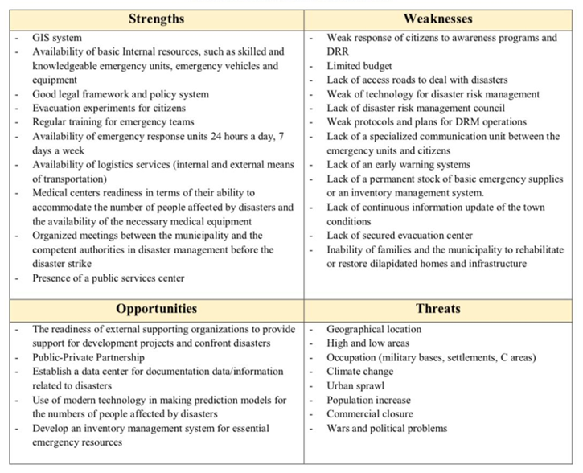







Disaster Preparedness
Commercial closure
And wars

Slide 17
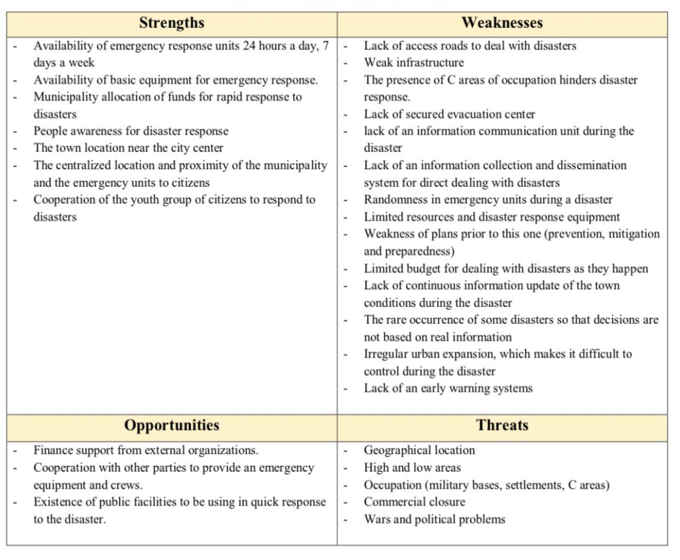









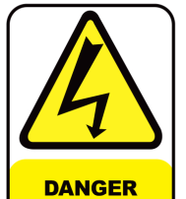
Disaster Response
Close to the city center

Slide 18
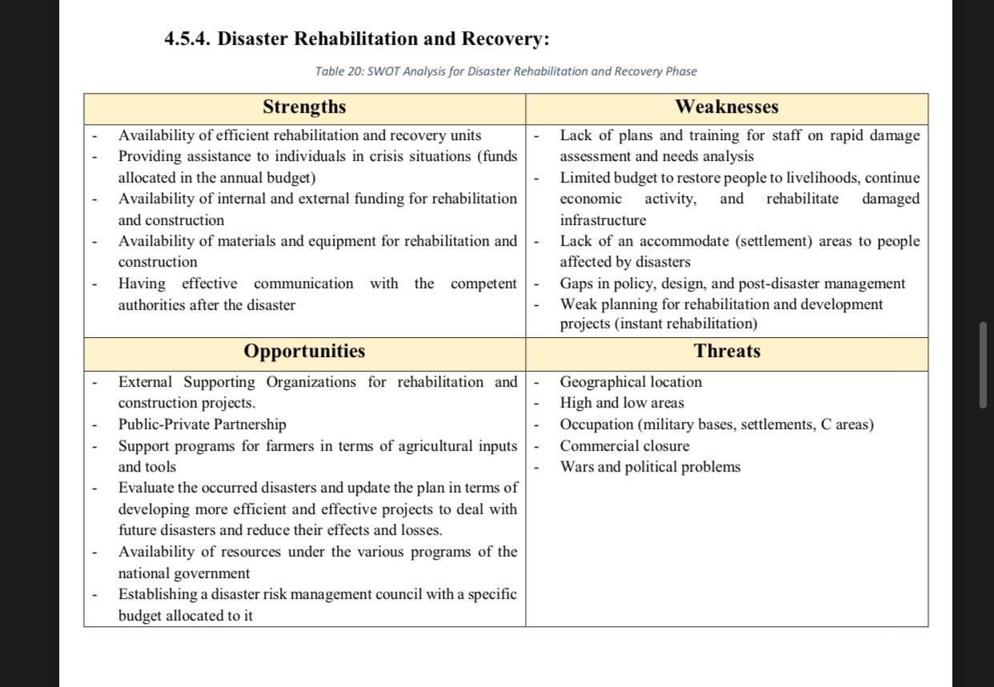





Disaster Rehabilitation and Recovery

Slide 19
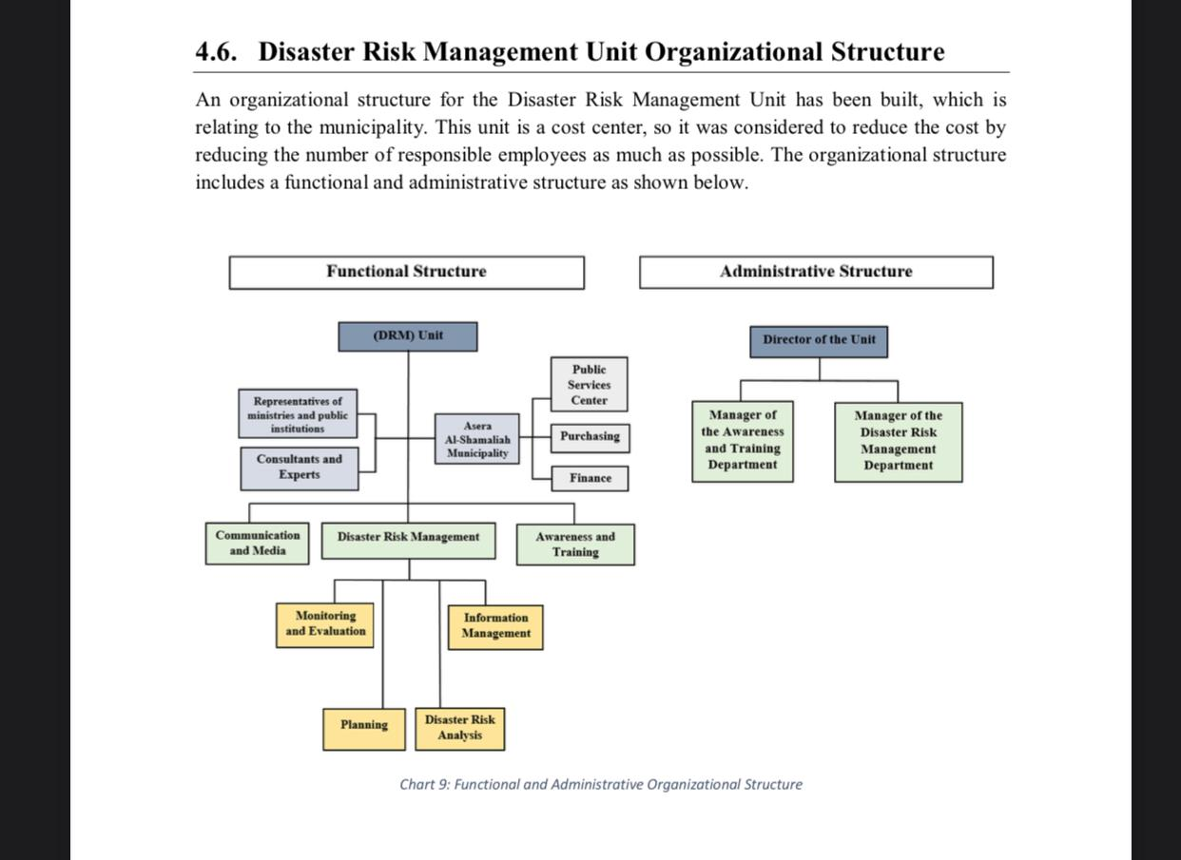
Disaster Risk Management Unit Organizational Structure

Slide 20
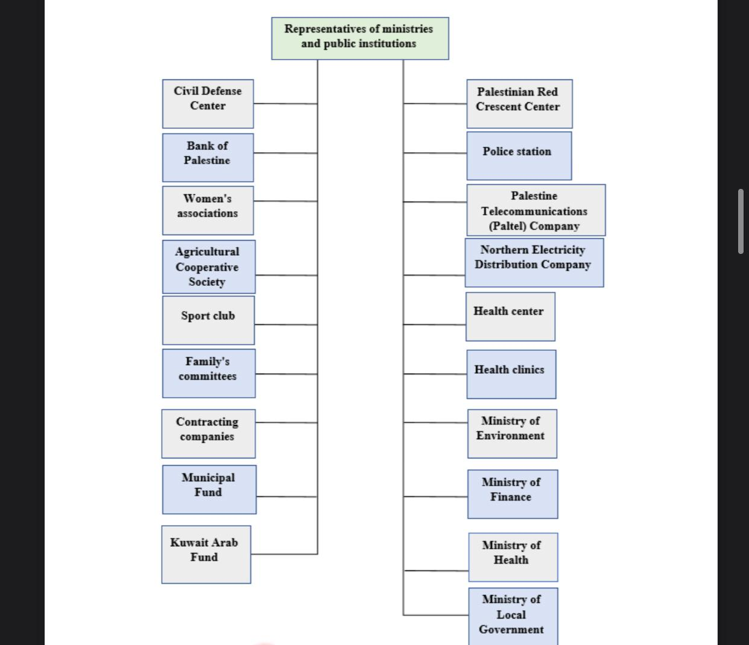



Slide 21

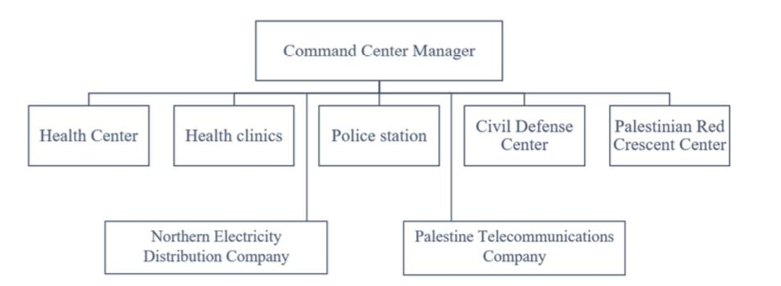
Command Center

Slide 22








Health Center
Police station
Bank of Palestine
Palestinian Red Crescent Center
Civil Defense Center
Palestine Telecommunications
Northern Electricity Distribution Company

Slide 23
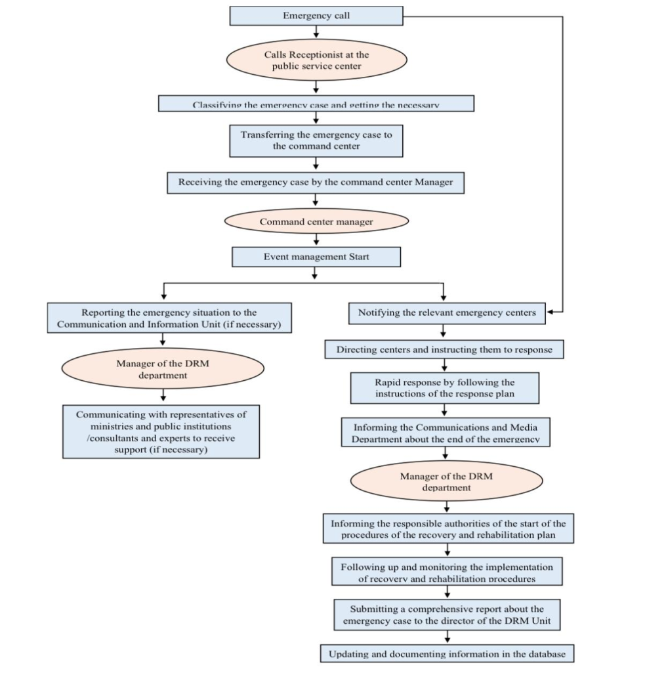


Response and Recovery Process Flow Chart.
.
.
.
.

Slide 24

Disaster Risk Management Plan (DRMP)

Slide 25
Disaster Risk Management Plan (DRMP)
Response plan
Prevention and mitigation plan
Preparedness plan
Recovery and rehabilitation plan

Slide 26
Procedures categorizes
Physical
Tools
Institutional
Roles and responsibilities for related parties
Capacity building
Enact regulations, laws
Equipment
Material
Infrastructure projects
Preparing systems and procedures
Providing control or monitoring procedures
Awareness
Developing awareness programs for helping citizens to deal with different types of disasters

Slide 27
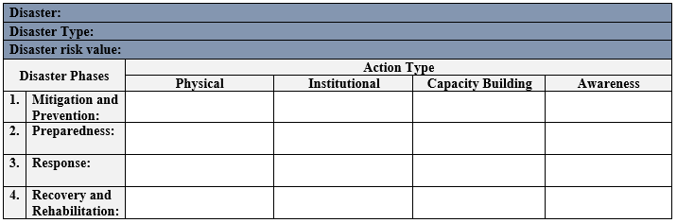
Disaster Risk Management Plan (DRMP) template

Slide 28
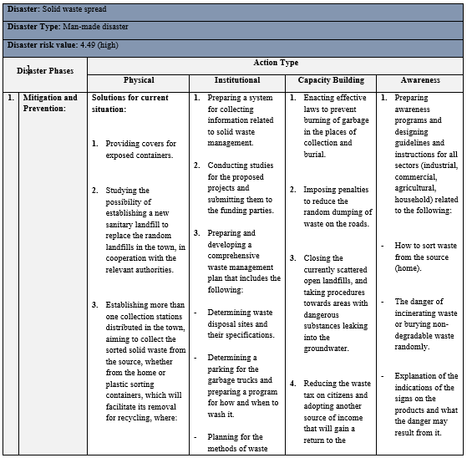
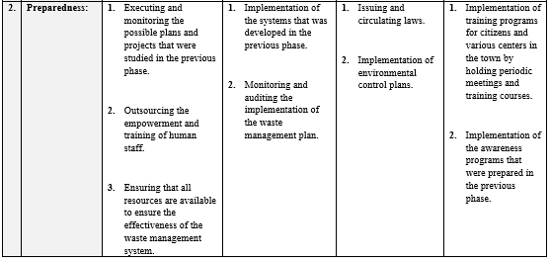
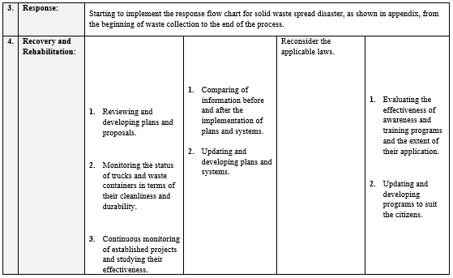
Solid Waste Spread Disaster:

Slide 29
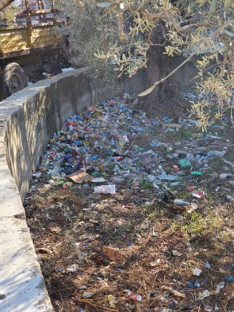
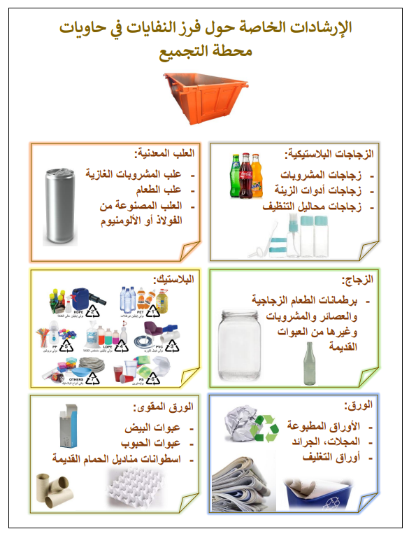
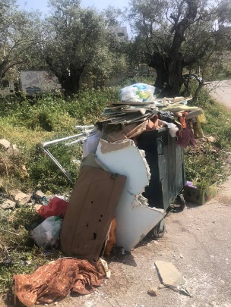
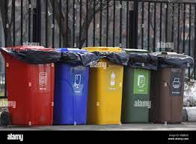
Solid Waste Spread Disaster:
Prevention and mitigation:
Sorting solid waste: One or more collection stations distributed in the town
A new sanitary landfill
Procedures contain:

Slide 30


Cont. Solid Waste Spread Disaster:
Preparedness:
Executing and monitoring the possible plans and projects
Outsourcing the empowerment and training of human staff
Ensuring that all resources are available
continue

Slide 31
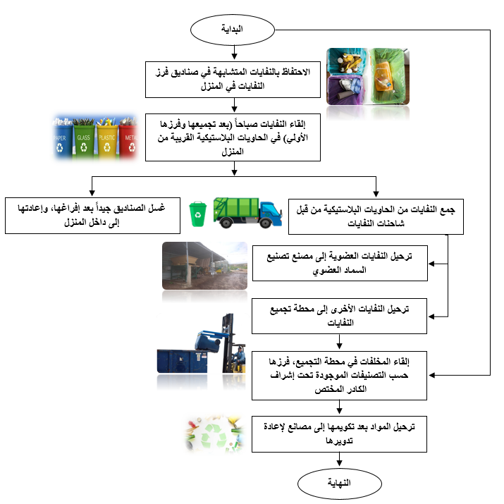


Response Flowchart
.
.
.

Slide 32

Cont. Solid Waste Spread Disaster:
Recovery and Rehabilitation:
Reviewing, monitoring, studying effectiveness and developing plans or proposals
continue

Slide 33
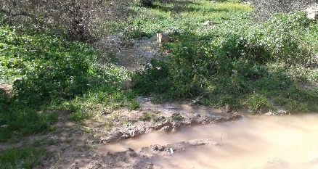
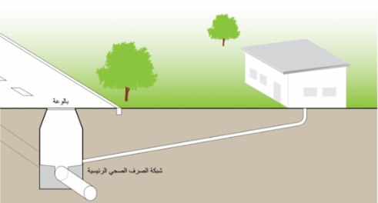
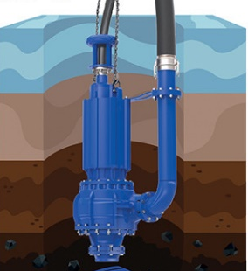
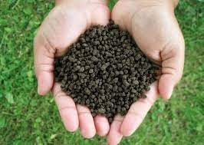
Water and Soil Pollution Disaster
Prevention and mitigation:
Setting a plan for replacement or repair for underground pipes and pumps, in addition to using cathodic protection method to protect them from corrosion and rust
Allocating a place in the sanitary landfill to dispose of the water of olive presses
Sewage treatment by various methods
Establishing a sewage network project in the town
Reducing the use of chemical fertilizers and pesticides
Procedures contain:

Slide 34
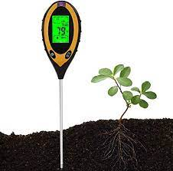

Cont. Water and Soil Pollution Disaster
Preparedness:
Executing and monitoring the possible plans and projects
Outsourcing such as the Ministry of Health and the Ministry of
Agriculture to do the periodic inspection of soil and water pollution
Ensuring that all resources are available
continue

Slide 35
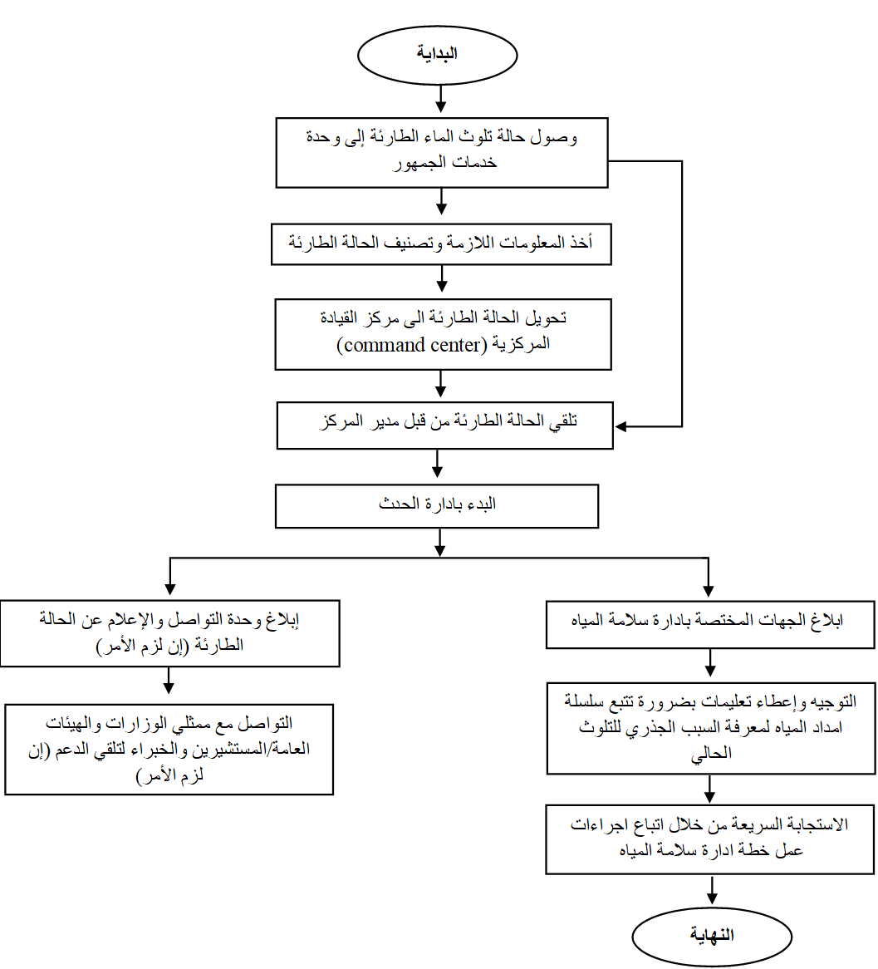
Response Flowchart
.
.
.

Slide 36


Cont. Water and Soil Pollution Disaster
Recovery and Rehabilitation:
Treating polluted water using different methods.
Remediation of contaminated soil Using remedial techniques that are appropriate to the nature, toxicity and origin of soil pollutant
Reviewing, monitoring, studying effectiveness and developing plans or proposals
continue

Slide 37
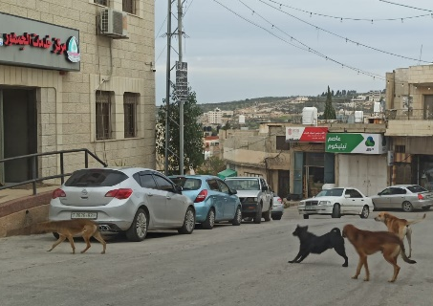
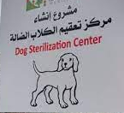
Stray Animals Spread Disaster
Prevention and mitigation:
Forming a stray animal combatting squad
Providing a private clinic for stray dogs to carry out sterilization operations
Communicate with the Palestinian Animal League (PAL)
Procedures contain:

Slide 38


Cont. Stray Animals Spread Disaster
Preparedness:
Executing and monitoring the possible plans and projects
Outsourcing such as (the Palestinian Animal League (PAL)) to empower the stray animal combatting squad and train them
Vaccinate the stray animal combatting squad with rabies vaccine to protect them.
Ensure that all resources are available to ensure the effectiveness of the stray animal management system
continue

Slide 39
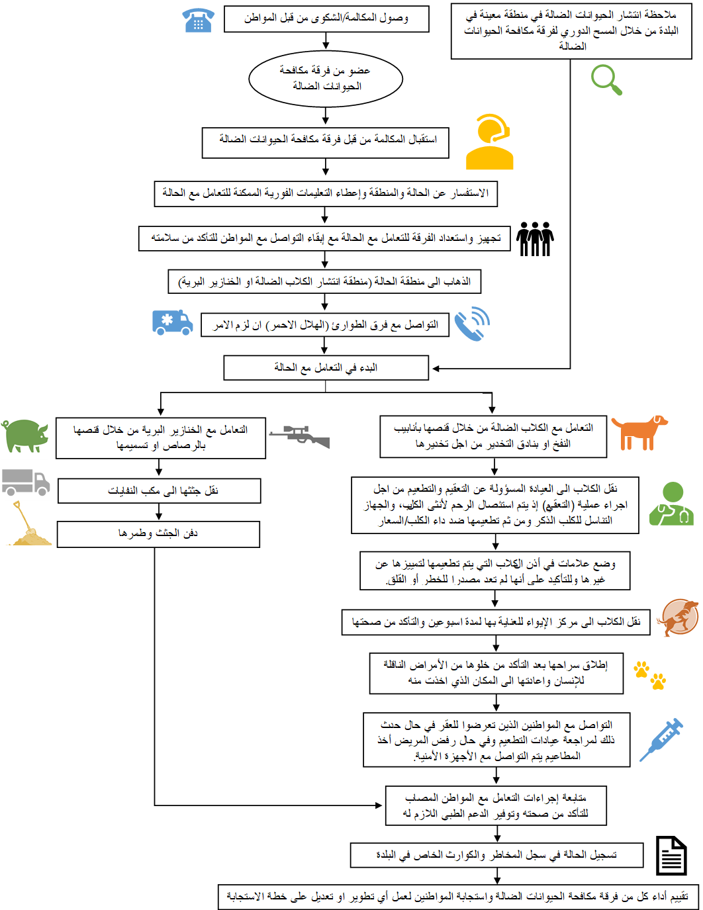
Response Flowchart
.
.
.

Slide 40
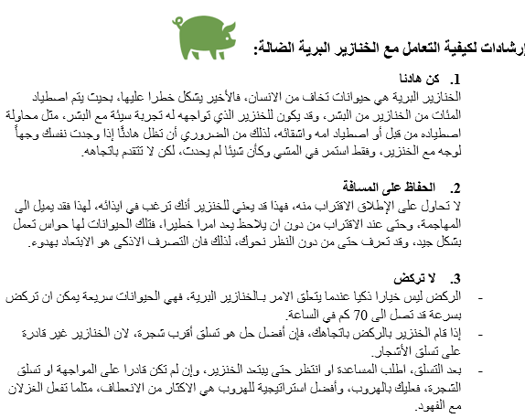



Cont. Stray Animals Spread Disaster
Recovery and Rehabilitation:
Continuous monitoring of the established projects and studying their effectiveness.
Keeping pace with the projects established in modern countries and applying them when the possibilities are available for that.
continue

Slide 41






Transportation Accident Disaster
Prevention and mitigation:
Penalties and fines for violating the rules of speed and traffic
Footpaths near schools.
- Lighten road signs and bumps.
Periodic maintenance of streets and roads.
convex mirrors.
Baffles.
Procedures contain:

Slide 42

Cont. Transportation Accident Disaster
Preparedness:
Implementation of the first phase procedures.
Outsourcing consulting to develop and implement procedures
Implementation of the penalties and violations procedures.
Continue

Slide 43

Response Flowchart
.
.
.

Slide 44


Cont. Transportation Accident Disaster
Recovery and Rehabilitation:
Continuous monitoring of the established procedures and studying their effectiveness.
Reconsidering the applicable laws - and imposing stricter ones -.
Monitoring the condition of roads and streets in terms of their validity and durability.
Continue

Slide 45





Deforestation Disaster
Preparedness:
Outsourcing (the Ministry of Health and the Ministry of Agriculture).
Implementation of the first phase procedures.
Prevention and mitigation:
Land Reclamation and reforestation.
Prevent overgrazing.
Punishment for cutting down trees without permission.
Create awareness banners near the lands.

Slide 46




Recovery and Rehabilitation
Use of modern and rapid technologies for land reclamation and reforestation.
Continuous monitoring of established procedures and studying their effectiveness,
Response

Slide 47




Runoff Disaster
Prevention and mitigation:
Identify areas at risk of flooding.
Construction of water diversion channels.
Increasing the diameter of water ferries.
Construction of barriers and storage wells.
Distances between water canal projects and residences.
Preparedness:
Implementation of the first phase procedures.
Outsourcing.
Accurate meteorological tracking.

Slide 48


Response
Recovery and Rehabilitation
Continuous monitoring of established procedures and studying their effectiveness.
Follow-up of affected citizens according to losses.

Slide 49







Explosions and Fires Disaster
Prevention and mitigation:
Presence of alarm
Install doors and fire protection systems
Use of sealed valves.
Saving emergency exit.
Building secondary roads
Preparedness:
The presence of fire extinguishers
Having cars fire extinguishing near the town.

Slide 50



Response
Recovery and Rehabilitation
After analyzing the disaster, seeing the need for lack of tools and equipment.
Attract projects to maintain the infrastructure affected by the event.

Slide 51






Epidemics Disaster
Prevention and mitigation:
Studying the health centers and clinics capacities.
Establishing a plan contains the different types of the possible epidemics, then setting appropriate actions for handling it.
Preparedness:
Identifying empty places inside the town that can be used to receive and isolate patients.
Initiating the procedure for requesting the appropriate vaccination and diagnosis.
Holding awareness programs for citizens .

Slide 52






Response
Recovery and Rehabilitation
Developing and updating all programs and plans to ensure the effectiveness of the plans.
Outsourcing to train medical staff on modern methods of treatment

Slide 53


Slide 54
Key Performance indicators for disaster and crisis management
Percentage of areas covered by early warning networks (%)
Percentage of benefit from municipalities twinning in developing risk management plans (%)
Percentage of disaster risk reduction (%)
Percentage of citizens’ commitment to the new laws for risk management plans (%)
Proportion of the population with sufficient knowledge to deal with basic disasters (%)
Response rate to Availability of tools and equipment needed to implement the plans (%)

Slide 55
Conclusions and
Recommendations

Slide 56




Conclusions
The world moving towards the concept of risk management.
The methods and strategies have been developed to deal with disasters to reduce their risks.
The study also focused attention on establishing a disaster management center.
it also focused on sharing Knowledge between municipalities to benefit from, transfer and develop expertise for their workers.

Slide 57
Recommendations
Continuous development in the methodology of risk assessment
Carrying out all measures to prepare for possible future disasters through developing the current situation.
Continuous contact with other municipalities from different countries and benefit from them.
Continuous documentation of all disasters to which the town is restricted.

Slide 58
Recommendations
Commitment to the existing structure and work on its development.
Work to provide a website for municipality of Asira, to include: Emergency and disaster page
Work on evaluating the town in terms of its ability to cover risk management plans.

Slide 59





