Slide 1

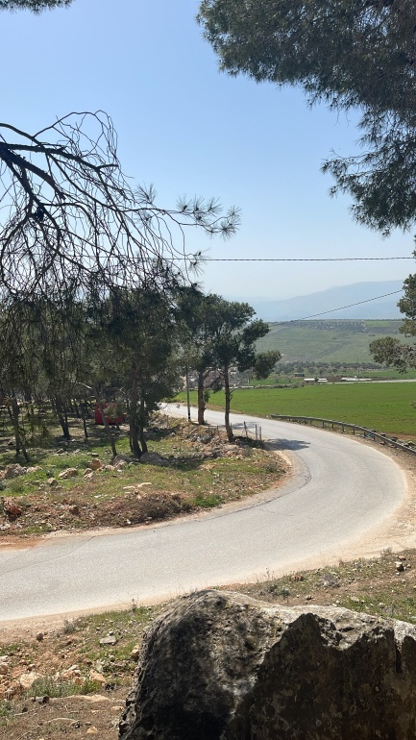
An-Najah National University
Faculty of Engineering and Information Technology
Civil Engineering Department
Transportation Management Plan of Tubas Main Street
`
By
Alaa Bana
Mohammad Tanbour
Nihad Shakhsheer
Ibraheem Qurnfulah
Under supervision of: Prof. Khaled Al-Sahili

Slide 2
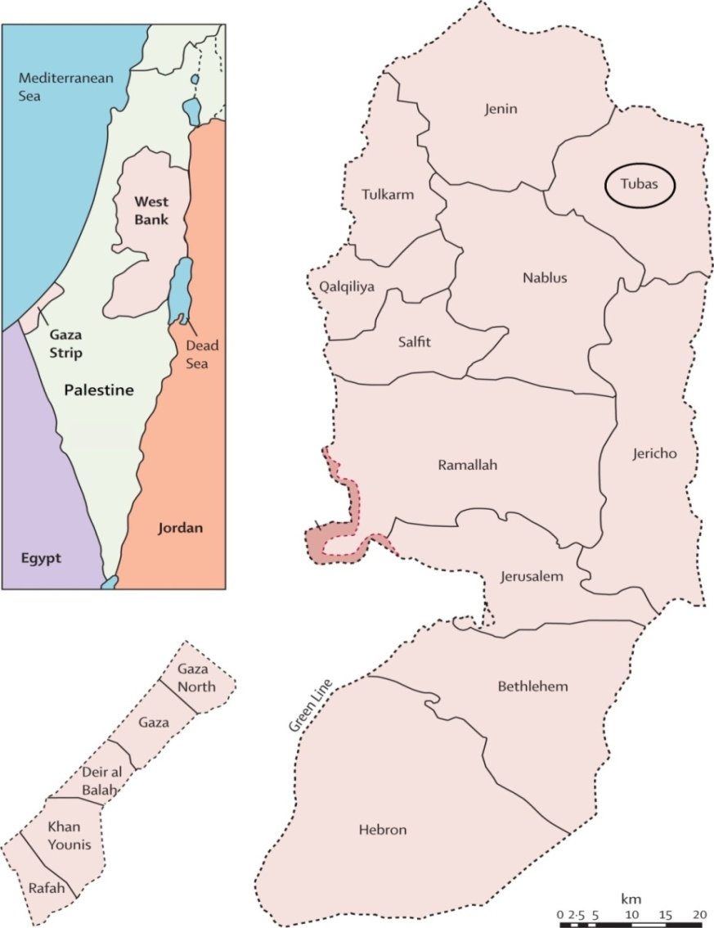
INTRODUCTION
`
Tubas is one of the major cities in the West Bank.
This project focuses on the main Tubas Street of the city of Tubas and the surrounding area, which is expected to grow rapidly in the coming years.
Due to developments, Tubas City's traffic flow has greatly increased in recent years.
Due to developments, Tubas City's traffic flow has greatly increased in recent years.

Slide 3
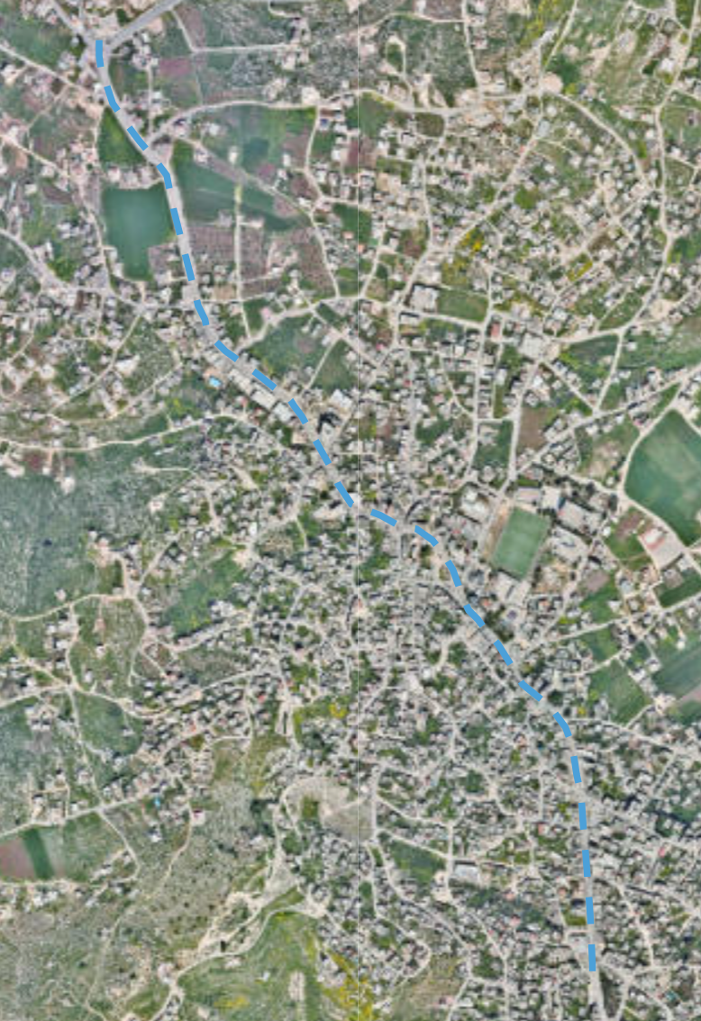
Study area
`
The study area for this project is located along the main street in Tubas City center

Slide 4

Objectives
`
This project aims to study, evaluate, and provide solutions to the problems that are expected to appear in the region in the near future
Therefore, our study will include the evaluation and proposed solution to these aspects:
1. Traffic operating conditions.
2. Geometric conditions of the streets in the area.
3. Parking conditions.
4. The impact of the proposed Passing-Through
road project.
5. Suggestions for solutions of existing and future
problems.

Slide 5
Significance of the Study
`
The study area has heavy traffic volume almost all day long. It is also expected to grow and develop at a fast rate, and expected to have emerging problems due to this growth, such as congestion, delay, and deteriorating level of service.
The study and scenario planning will assess the current traffic system's level of service and, if necessary, seek to improve it in order to prevent the major anticipated escalation of traffic-related issues in the coming years.

Slide 6
Project Constrains
`
A few problems and constrains were faced during this project, some of which were overcome while others we had to work with in order to finish this project.
Constrains such as:
Difficulty of forecasting future events, such as population growth and future plans.
Limited right of way limits our options in terms of applicable solutions.
Limited proposed solutions because of limitations in area of the study area.
It is also expected that the budgetary constraint is an important one that faces Tubas Municipality in executing the proposed alternatives.

Slide 7
DATA COLLECTION
`
municipal contribution
A meeting was held with the mayor, and municipal engineer to clarify the most important traffic problems that the city is going through.
Clarification about the strategic plan developed by the municipality of Tubas and the possibility of benefiting from the project that we are doing in this plan.
The municipal engineer was contacted to attach the necessary plans and information to help us collect data.
We also conducted a field visit in the presence of Prof. Dr. Khaled Al-Sahili, Dr. Imad Dawas and the municipality engineer.
Informing the municipality engineer of the data collection process that we carried out during the project period and take advice and instructions from the engineer.

Slide 8
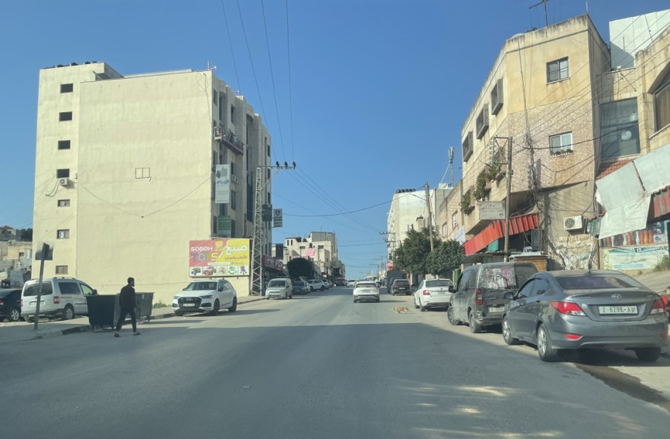
`
2. Roads inventory study
The road inventory study is an important task to determine the road classification, elements and its conditions. Tubas main street has been divided into four sections .
Section one
Section description:
• It is a two lane street without median
• There are sidewalks on both sides of the street.
• Parking is permitted on both sides of the street.
• It has a good pavement condition and good
sidewalks condition.
• Illegal double parking of vehicles
• There are no crosswalk signs in this section
• There are no speed limit signs on this section.

Slide 9
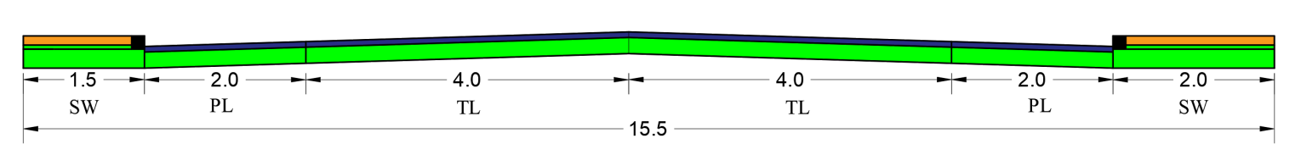
`
Dimensions of the Street Elements of Section 1
at Section 1 Existing Cross Section

Slide 10
DATA COLLECTION
`
3. Traffic Volume Counts
In order to conduct the required studies, several field visits
Counts were performed at all major intersections along the study corridor for 4 hours: 2 hours in the AM peak period (from 7:00 to 9:00 AM) and 2 hours in the PM peak period (from 1:00 to 3:00 PM). The records were entered in Microsoft. EXCEL, then the Peak Hour, Peak Hour Volume.

Slide 11
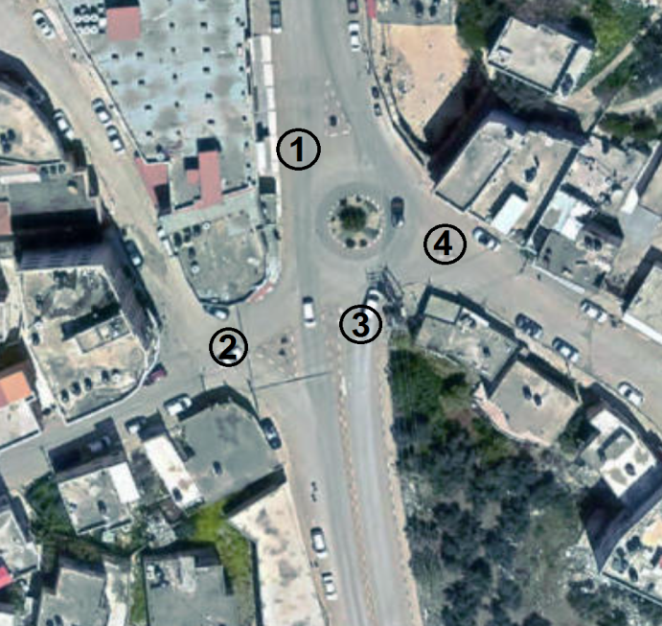
Approaches of Martyr Mazen Fakeha Roundabout
Traffic Volume for the Martyr Mazen Fakeha Roundabout
Approach 1
Time | Right |  |  | Through |  |  | Left |  |  | U-turn |  |  | Total
 | Passenger | Taxi | Truck | Passenger | Taxi | Truck | Passenger | Taxi | Truck | Passenger | Taxi | Truck
7:00-7:15 | 2 | 1 | 1 | 65 | 20 | 5 | 2 | 0 | 0 | 2 | 1 | 0 | 99
7:15-7:30 | 3 | 1 | 1 | 77 | 22 | 5 | 2 | 0 | 0 | 3 | 0 | 0 | 114
7:30-7:45 | 3 | 1 | 0 | 63 | 23 | 5 | 3 | 0 | 0 | 2 | 0 | 2 | 102
7:45-8:00 | 6 | 0 | 0 | 75 | 19 | 7 | 0 | 0 | 1 | 3 | 0 | 0 | 111
8:00-8:15 | 6 | 0 | 0 | 67 | 12 | 6 | 2 | 0 | 1 | 3 | 0 | 0 | 97
8:15-8:30 | 3 | 0 | 0 | 62 | 14 | 11 | 2 | 0 | 0 | 4 | 1 | 0 | 97
8:30-8:45 | 6 | 1 | 1 | 71 | 17 | 12 | 1 | 0 | 0 | 2 | 0 | 1 | 112
8:45-9:00 | 9 | 1 | 1 | 63 | 14 | 12 | 5 | 0 | 1 | 2 | 0 | 1 | 109
Total | 38 | 5 | 4 | 543 | 141 | 63 | 17 | 0 | 3 | 21 | 2 | 4 | 841

Slide 12
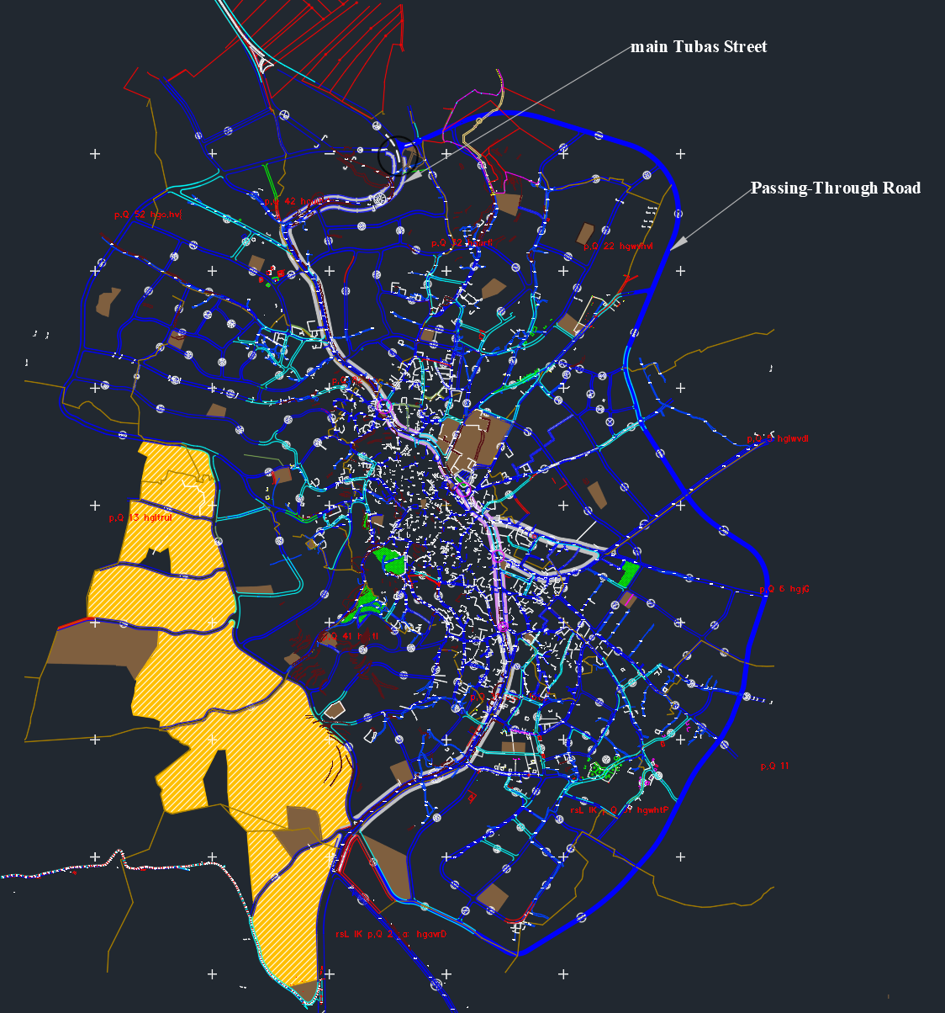
`
4. Passing-Through Road Count
The main Tubas Street is a link between adjacent cities. The Municipality of Tubas has prepared a strategic plan for the city. One of the most important items of which is the establishment of the Passing-Through road (the bypass around the city of Tubas). Therefore, we conducted a study to evaluate the effectiveness of the Passing-Through road in alleviating the traffic congestion on the main Tubas Street, by determining the percentage of vehicles that pass through the main Tubas Street.

Slide 13
The following table shows a Plates Numbers for Vehicles Crossing the City from the South at (7:00-7:15 AM)
`
Plates for vehicles Crossing the city from the south (7:00-7:15 AM)
number | vehicle plate | number | vehicle plate | number | vehicle plate
1 | 0384 | 37 | 2451 | 73 | 97
2 | 1077 | 38 | 5481 | 74 | 2363
3 | 4558 | 39 | 8746 | 75 | 3536
4 | 8966 | 40 | 2698 | 76 | 3697
5 | 2188 | 41 | 7497 | 77 | 3797
6 | 8581 | 42 | 4564 | 78 | 3756
7 | 0886 | 43 | 6353 | 79 | 0759
8 | 8296 | 44 | 3840 | 80 | 5569
9 | 2540 | 45 | 1519 | 81 | 7280
10 | 8326 | 46 | 3126 | 82 | 1233
11 | 7653 | 47 | 1094 | 83 | 7157
12 | 0727 | 48 | 5493 | 84 | 1479
13 | 9169 | 49 | 4099 | 85 | 1001
14 | 5665 | 50 | 2854 | 86 | 2131
15 | 1722 | 51 | 4895 | 87 | 7249
16 | 8164 | 52 | 0103 | 88 | 9838
17 | 8902 | 53 | 8355 | 89 | 5403
18 | 4048 | 54 | 6581 | 90 | 9501
19 | 2340 | 55 | 2443 | 91 | 7255
20 | 5026 | 56 | 9752 | 92 | 7012
21 | 5407 | 57 | 7336 | 93 | 5245
22 | 0390 | 58 | 4117 | 94 | 6351
23 | 6888 | 59 | 3375 | 95 | 0109
24 | 2030 | 60 | 0434 | 96 | 5139
25 | 0335 | 61 | 2778 | 97 | 5685
26 | 1637 | 62 | 6449 | 98 | 8972
27 | 3459 | 63 | 4203 | 99 | 1186
28 | 2394 | 64 | 5981 | 100 | 4623
29 | 2316 | 65 | 9192 | 101 | 0452
30 | 4984 | 66 | 8321 | 102 | 8356
31 | 0168 | 67 | 8403 | 103 | 7697
32 | 8004 | 68 | 0502 | 104 | 7803
33 | 0680 | 69 | 2063 | 105 | 6420
34 | 7168 | 70 | 4670 | 106 | 8805
35 | 1337 | 71 | 4378
36 | 6233 | 72 | 7305

Slide 14
`
5. Parking count
The main Tubas Street contains shops, restaurants, service centers and government ministries, which necessitates the presence of parking spaces along the main street to meet the needs of road users. We conducted a study of whether the existing parking lots are sufficient or not, and finding solutions if necessary.
We divided the study area into four sections, we recorded the number plates of the vehicles parked on the left and right sides of each segment, and counted every half hour.

Slide 15
The following table shows a parking count sample in section 3
( section 3 )
number | 9-9:30 AM |  | 9:30-10 AM | 10-10:30 AM |  | 12-12:30 PM |  | 12:30-1 PM |  | 2:00-2:30 PM
 | vehicle plate | status | vehicle plate | vehicle plate | status | vehicle plate | status | vehicle plate | status | vehicle plate | status
1 | 3326 | legal | 4380 | 3326 | legal | 1890 | illegal | 8111 | legal | 3326 | legal
2 | 5885 | legal | 9426 | 5352 | legal | 3326 | legal | 3326 | legal | 7916 | illegal
3 | 6059 | illegal | 3326 | 5568 | illegal | 1182 | legal | 2525 | illegal | 1993 | legal
4 | 9192 | legal | 6213 | 6213 | illegal | 2525 | illegal | 4045 | illegal | 9201 | legal
5 | 5527 | legal | 7955 | 5229 | legal | 4045 | illegal | 4953 | illegal | 7133 | legal
6 | 6213 | illegal | 6696 | 7399 | legal | 6320 | legal | 9201 | illegal | 6749 | legal
7 | 5098 | legal | 6189 | 5527 | legal | 9192 | legal | 4682 | legal | 5568 | legal
8 | 2658 | illegal | 1275 | 891 | legal | 5527 | legal | 6092 | legal | 5527 | legal
9 | 8200 | illegal | 5670 | 3367 | legal | 2939 | legal | 6288 | legal | 5583 | legal
10 | 5213 | legal | 6278 | 2815 | illegal | 8111 | legal | 7181 | legal | 1091 | legal
11 | 7705 | legal | 4558 | 6351 | illegal | 2815 | legal | 9192 | legal | 8885 | legal
12 | 7210 | legal | 3870 | 8200 | illegal | 1953 | legal | 2939 | illegal | 3489 | legal
13 | 6293 | legal | 4960 | 5213 | legal | 8885 | legal | 5527 | legal | 6305 | legal
14 | 9551 | legal | 1156 | 7705 | legal | 7501 | legal | 8885 | legal | 2700 | illegal
15 | 7980 | legal | 8200 | 7210 | legal | 5213 | illegal | 2815 | legal | 7507 | illegal
16 | 5293 | legal | 5213 | 2110 | illegal | 7705 | legal | 5452 | legal | 4173 | legal
17 | 4281 | legal | 7705 | 6229 | legal | 1426 | legal | 6813 | legal | 5213 | legal
18 | 6036 | illegal | 7210 | 5154 | legal | 2110 | illegal | 7500 | illegal | 2110 | illegal
19 | 1456 | legal | 2110 | 9551 | legal | 2549 | illegal | 1809 | legal | 1240 | legal
20 | 6186 | legal | 9551 | 4654 | legal | 9551 | legal | 1066 | legal | 6988 | legal
21 | 2609 | legal | 8817 | 4261 | legal | 6603 | legal | 5213 | legal | 6603 | legal
22 | 6180 | legal | 8799 | 1300 | illegal | 5364 | illegal | 7705 | legal | 1581 | illegal
23 | 7836 | legal | 1173 | 5291 | illegal | 4141 | legal | 2449 | legal | 5364 | illegal
24 | 6231 | legal | 2062 | 1042 | illegal | 7231 | legal | 1426 | legal | 4281 | legal
25 | 1014 | legal | 5357 | 5111 | legal | 4281 | legal | 2900 | legal | 9931 | legal

Slide 16
`
5. Accidents count
Since the aim of our project is to study the operational conditions of the main road and find solutions to existing problems, we have obtained from the Traffic Police the accident records in the study area on the main street in the city of Tubas.
The following table shows a Accidents count sample.
id | Case number | year | date | time | Trafficcase type | Trafficcase reason | full location | City | Location1 | Related partiescount | Vehicle count
1036968 | TR/2019/1629 | 2019 | 4/1/2019 | 0:00:00 | اضرار مادية | التحول عن مسلك السير | طوباس | طوباس | طوباس مقابل سوبر ماركت الفارس | 2 | 1
1039645 | TR/2019/4253 | 2019 | 8/1/2019 | 17:15:00 | دهس | عدم إتخاذ التدابير اللازمة لسلامة عابري الطريق والركاب | طوباس | طوباس | طوباس قرب دوار النخلة | 2 | 1
1039569 | TR/2019/4178 | 2019 | 9/1/2019 | 9:10:00 | اضرار مادية | الرجوع للخلف والتسبب بحادث طرق | طوباس | طوباس | طوباس خلف المحكمة | 2 | 2
1040631 | TR/2019/5216 | 2019 | 11/1/2019 | 0:00:00 | دهس | عدم إتخاذ التدابير اللازمة لسلامة عابري الطريق والركاب | طوباس | طوباس | قرب مفرق تياسير | 2 | 1
1043152 | TR/2019/7684 | 2019 | 15/1/2019 | 7:30:00 | اضرار مادية | عدم المحافظة على مسافة توقف آمن أثناء السفر | طوباس | طوباس | طوباس قرب براديس | 2 | 2
1043430 | TR/2019/7958 | 2019 | 15/1/2019 | 15:10:00 | دهس | عدم إتخاذ التدابير اللازمة لسلامة عابري الطريق والركاب | طوباس | طوباس | طوباس قرب التوحيد | 2 | 1
1044282 | TR/2019/8801 | 2019 | 16/1/2019 | 16:30:00 | اضرار مادية | التحول عن مسلك السير | طوباس | طوباس | طوباس قرب اسواق المدينة | 2 | 2
1044531 | TR/2019/9046 | 2019 | 17/1/2019 | 10:10:00 | تصادم | عدم تأمين الإستدارة يميناً أو يساراً | طوباس | طوباس | طوباس قرب سوبر ماركت الاخوة | 5 | 2
1044523 | TR/2019/9038 | 2019 | 17/1/2019 | 10:40:00 | تصادم | عدم تأمين وقوف المركبة | طوباس | طوباس | طوباس دوار البلدية | 2 | 2
1049460 | TR/2019/13882 | 2019 | 25/1/2019 | 8:20:00 | تصادم | عدم تأمين فتح الباب | طوباس | طوباس | طوباس امام مطعم ياسر | 2 | 2

Slide 17
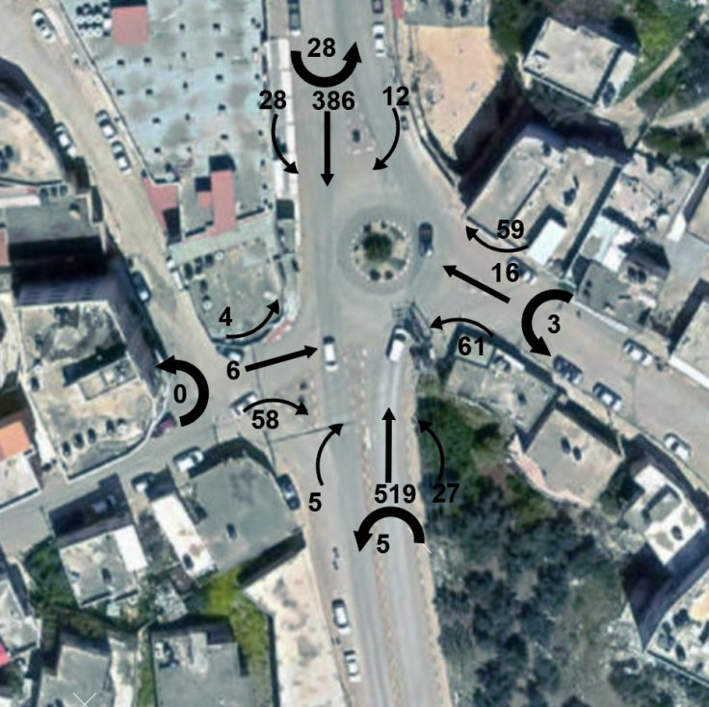
ANALYSIS AND RESULTS
`
1. Traffic analysis
1.1. Input data
we determined the peak hour for all the main roundabouts and intersections in the study area, and we determined the peak hour factor.
Conclusion of traffic count at intersection
No. Intersection | Intersection Name | Peak Hour | Peak Hour Volume (veh/hr) | Peak Hour Factor
1 | Al Quds Roundabout | 7:30 - 8:30 AM | 1217 | 0.95
2 | Tayaseer Intersection | 1:00 - 2:00 PM | 1398 | 0.96
3 | The Municipality Roundabout | 1:15 - 2:15 PM | 1364 | 0.94
4 | Al-Tawhid Mosque Roundabout | 1:30 - 2:30 PM | 1385 | 0.98
5 | Al Turkish Hospital Roundabout | 7:45 - 8:45 AM | 826 | 0.96
Peak Hour Volume of Al Quds Roundabout

Slide 18
1.2. Analyzing the current situation using Synchro
Synchro is a program we used to analyze the current situation of the area as a network by drawing the network on the program and adding required data such as lanes, traffic volume, traffic control, and signals timing, which will be discussed later in this section.
The figure below shows the current layout of the study area intersections.

Slide 19
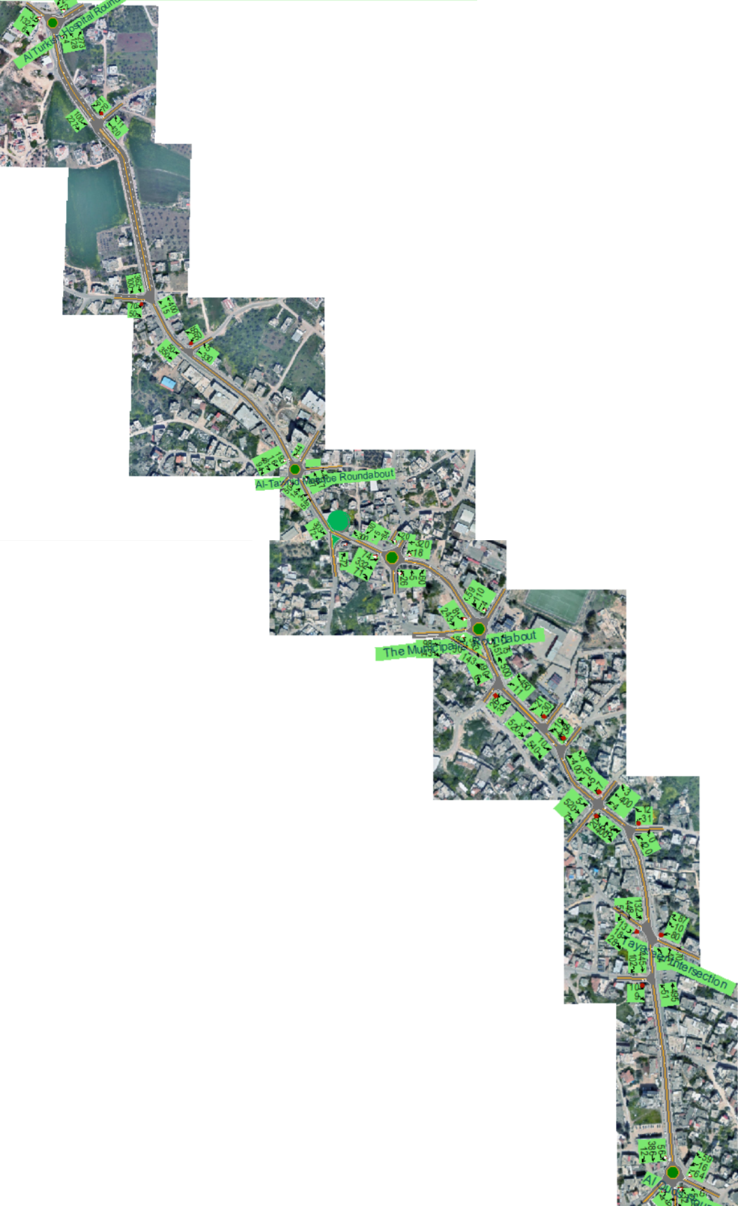
The figure below shows the current layout of the study area intersections.

Slide 20
1.3 Output data
Results of LOS
Intersection Name | Al Quds Roundabout | Tayaseer Intersection | The Municipality Roundabout | Al-Tawhid Mosque Roundabout | Al Turkish Hospital Roundabout
Intersection LOS | C | F | E | E | A
Delay (sec/veh) | 15.2 | 33.5 | 43.1 | 36.8 | 9.1

Slide 21
2. Passing-Through Count Analysis
Based on the traffic counts of vehicles passing through the main street, Table provides the summary of results.
Based on the results of the crossing through traffic analysis, it was found that 28.61% of the traffic along the main street crosses through.
Category | Total number of vehicles | vehicles passed | percent %
Plates for vehicles entering the city from the south and leaving the city from the north at (7:00 - 9:00 AM) | 670 | 176 | 26.27%
Plates for vehicles entering the city from the north and leaving the city from the south at (7:00 - 9:00 AM) | 409 | 116 | 28.36%
Plates for vehicles entering the city from the south and leaving the city from the north at (1:00 - 3:00 AM) | 684 | 176 | 25.73%
Plates for vehicles entering the city from the north and leaving the city from the south at (1:00 - 3:00 AM) | 488 | 176 | 36.07%
Total | 2251 | 644 | 28.61%

Slide 22
3. Parking Count Analysis
We divided the study area into four sections, and we counted and analyzed each section separately:
Section No. | Type | Damand (Space-hour) | Supaly (Space-hour) | Spaces required
Section 1 | space | 64 | 60 | 4
 | (Space-hour) | 141 | 171 | 0
Section 2 | space | 109 | 77 | 32
 | (Space-hour) | 252 | 219 | 33
Section 3 | space | 44 | 45 | 0
 | (Space-hour) | 90 | 125.4 | 0
Section 4 | space | 51 | 181 | 0
 | (Space-hour) | 113.75 | 515.85 | 0

Slide 23
4. Accidents count analysis
A total of 278 traffic accidents occurred in the study area out of 677 traffic accidents occurred in the city of Tubas during the period of 2019 – 2022, 41% of total accidents in the city.
The Location Case type
Location | number | percent %
قرب مفرق تياسير | 30 | 38%
طوباس قرب مسجد التوحيد | 23 | 29%
طوباس دوار البلدية | 20 | 26%
طوباس امام مطعم ياسر | 14 | 18%
طوباس دوار القدس | 12 | 15%
امام مجمع الكراجات | 17 | 22%
دوار المستشفى التركي | 14 | 18%
مقابل بنك فلسطين | 16 | 21%
قرب مديرية الشرطة | 12 | 15%
طوباس مقابل بنك القدس | 11 | 14%
traffic case type | number | percent %
اضرار مادية | 134 | 48%
دهس | 45 | 16%
تصادم | 86 | 31%
إنقلاب | 13 | 5%
Sum | 278 | 100%

Slide 24
Cause
Cause of Accident | number | percent %
التحول عن مسلك السير | 26 | 9.35%
عدم إتخاذ التدابير اللازمة لسلامة عابري الطريق والركاب | 46 | 16.55%
الرجوع للخلف والتسبب بحادث طرق | 14 | 5.04%
عدم المحافظة على مسافة توقف آمن أثناء السفر | 61 | 21.94%
عدم تأمين الإستدارة يميناً أو يساراً | 26 | 9.35%
عدم تأمين فتح الباب | 12 | 4.32%
قيادة مركبة بسرعة لا تتفق بظروف الطريق | 19 | 6.83%
البدء بالمسير من حالة الوقوف | 14 | 5.04%
عدم الإمتثال لإشارة (قف) أو (إعطاء الأولوية ) | 12 | 4.32%
السوق بدون حذر | 12 | 4.32%
اساب اخرى | 36 | 12.95%
sum | 278 | 100%

Slide 25
PROPSOED SOLUTIONS
1. Why we will do this?
Due to:
Parking problems - on street parking- .
Traffic congestion due to the increase in traffic volume and development in the region.
Geometric problems at intersections .
High rate of accidents

Slide 26
Based on the results of the traffic volume analysis using Synchro program, it was found that the level of service at the intersections and roundabouts is poor.
The previous table shows that at least one warrant has been achieved at Tayaseer Intersection, the Municipality Roundabout, and Al-Tawhid Roundabout.
Name intersection | Warrant 2 | Warrant 3 | Warrant 7
Al Quds Roundabout | no | no | no
Tayaseer Intersection | no | no | yes
The Municipality Roundabout | yes | yes | yes
Al-Tawhid Mosque Roundabout | yes | no | yes
Al Turkish Hospital Roundabout | no | no | no

Slide 27
2. Proposed traffic solutions
Based on these results, traffic signals were put at these three intersections. Traffic signals at these locations were designed using Synchro.
Compare Between Results After and Before Installing Traffic Lights
Intersection name | Existing |  | With the installation of traffic lights
 | Delay (sec/veh) | Intersection LOS | Delay (sec/veh) | Intersection LOS
Al Quds Roundabout | 15.2 | C | 15.2 | C
Tayaseer Intersection | 33.5 | F | 16.8 | B
The Municipality Roundabout | 43.1 | E | 13 | B
Al-Tawhid Mosque Roundabout | 36.8 | E | 12.1 | B
Al Turkish Hospital Roundabout | 9.1 | A | 9.1 | A

Slide 28
3. Proposed solutions for Passing-Through road
Based on the results of the crossing through traffic analysis, it was found that 28.61% of the traffic along the main street crosses through. Therefore, most of these would use the Ring Road once it is constructed, which will reduce the level of congestion along the main street.
Compare Between Results After and Before Passing-Through road cut
Intersection name | Existing |  | Future without Passing-Through road |  | Future with Passing-Through road
 | Delay (sec/veh) | Intersection LOS | Delay (sec/veh) | Intersection LOS | Delay (sec/veh) | Intersection LOS
Al Quds Roundabout | 15.2 | C | 28.5 | D | 12.4 | B
Tayaseer Intersection | 33.5 | F | 116.1 | F | 22.4 | C
The Municipality Roundabout | 43.1 | E | 105.5 | F | 33.3 | D
Al-Tawhid Mosque Roundabout | 36.8 | E | 108.1 | F | 35.4 | E
Al Turkish Hospital Roundabout | 9.1 | A | 9.9 | A | 8.9 | A

Slide 29
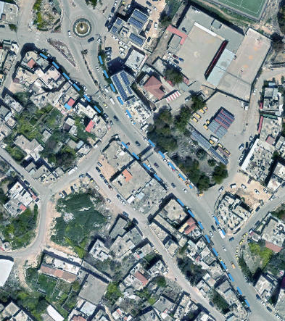
4. Proposed parking solutions
To solve the parking problem in Tubas street, it is recommended to use metered parking along the main street from 8 AM to 9 PM.
The following figure shows the proposed location for the installation of parking meters in Section 2

Slide 30
This has to be enforced by the traffic city police.
In addition, the municipality must enforce the planning regulations that require providing parking spaces for every building.

Slide 31
5. Accidents
Based on the results of the incidents we collected, there are some recommendations:
5.1 Putting signs on the roads.
Stop sign.
Slow down signal.
approaching a roundabout signal.
Footpath signal.

Slide 32
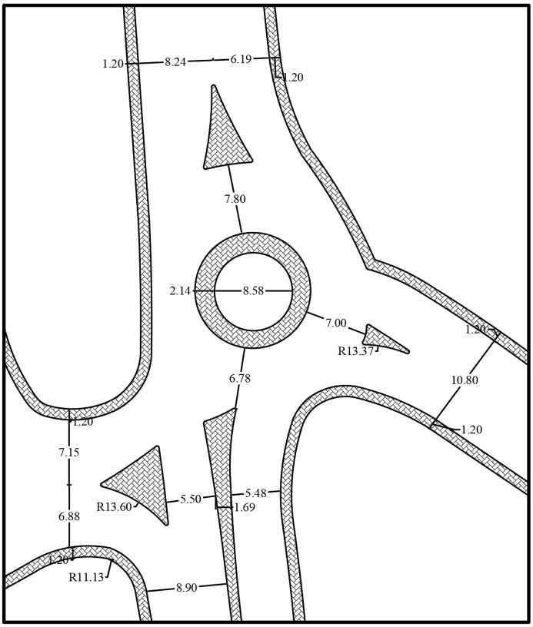
5.2 Geometric modification of roads.
Engineering Improvements to the Current Situation at Al Quds Roundabout

Slide 33
CONCLUSIONS
This chapter will summarize the work done throughout this project, directing attention to observed problems in the area (Geometric, traffic, and future forecasted problems).
In this project, we try to develop plans that will give a suggested solution to these problems.
We conducted field visits, traffic counts, and geometry inspections. We incorporated the software AutoCAD, and Synchro in order to evaluate and analyze the current conditions and proposed scenarios come up with the information presented in the project.

Slide 34
These studies shined a light on the following problems:
• Traffic analysis: LOS high values of delay, congestion on some intersections. This low level of service at the critical intersections of the network, combined with high delays and traffic congestion lead to an overall poor level of service in the area, and seeing as this area is only expected to grow more, these problems will grow with it.
• Geometry analysis: We have modified the engineering dimensions at the intersections and roundabouts located on the main Tubas Street, such as islands and sidewalks, to reduce traffic violations such as excessive speed, double parking, lack of priority, unorganized pedestrian traffic due to the lack of special areas for pedestrian crossing, and illegal parking on both sides of the streets and on intersections. As a result, it will lead to a decrease in the accident rate in the study area.
• Forecasted problems: due to the high development rate of the study area ,and Increasing population growth in the city.

Slide 35


