Slide 1
ROMO
(The robotic mop)

Slide 2

OUTLINE :
Idea
Features
Hardware Components
01
02
03
Challenges
04
Future work
DEMO
05
06

Slide 3

Idea
ROMO is a special floor cleaning robot , the user
can control its movement and pump water.

Slide 4
Features
02
The user can control the robot's movement and water pumping.
The user can make it work automatically through the mobile phone.
the robot senses obstacles and pumps water every certain period of time.
Sterilization process by ultraviolet rays.

Slide 5
03
Hardware Components

Slide 6
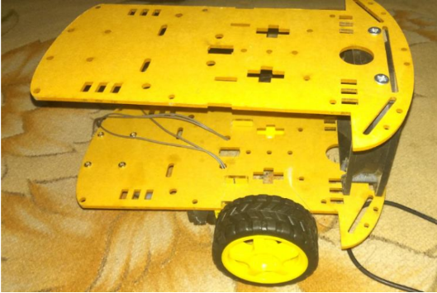
Robot Body
Figure 1: cart

Slide 7
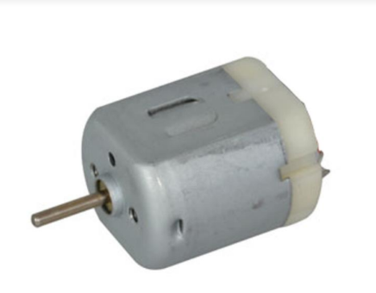
DC Motors
Used in order to accurately steer the car in the four directions needed.
Figure 2: DC motor

Slide 8
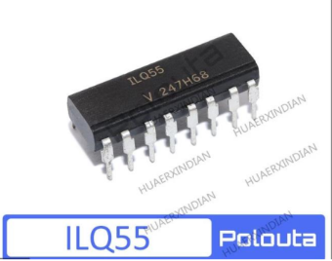
H-Bridge Motor Drivers
“H-Bridge” is simply an arrangement of switching the polarity of the voltage applied to a DC motor, thus controlling its direction of rotation. Using transistors also allows you to control the motor speed with PWM.
Figure 3: H-bridge

Slide 9
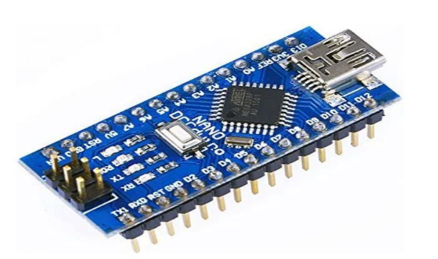
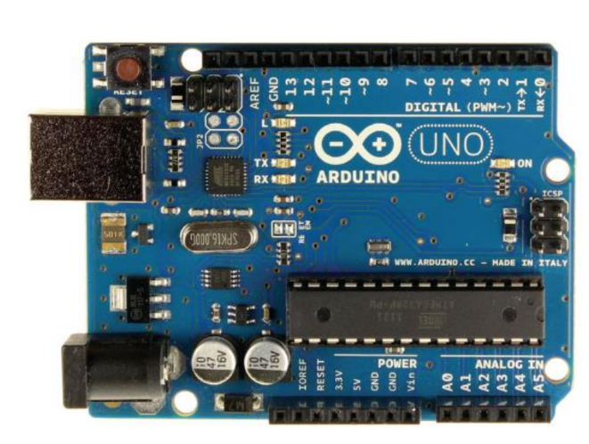
microcontrollers
Arduino UNO
Arduino Nano

Slide 10
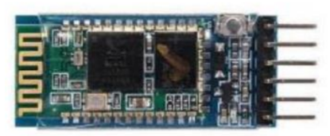
HC-05 Bluetooth
Figure 4: HC-05
The HC-05 is a class 2 Bluetooth module designed for transparent wireless serial communication, It makes an easy way to interface with controller.

Slide 11
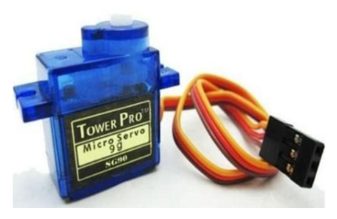
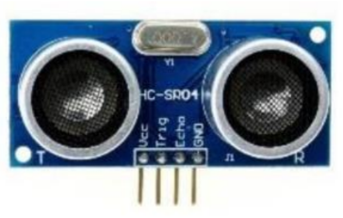
Ultrasonic and Servo motor
Figure 5: Ultrasonic
Figure 6: Servo motor

Slide 12
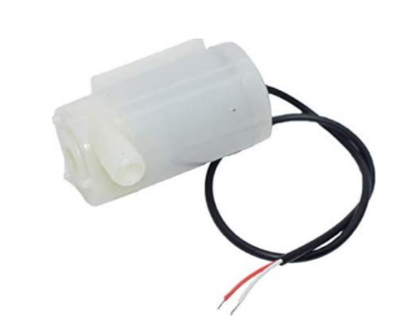
Pump
5v motor.
Figure 7: pump

Slide 13
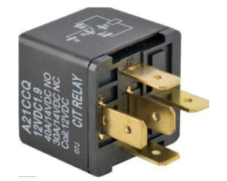
Relay
Figure 8: Relay

Slide 14
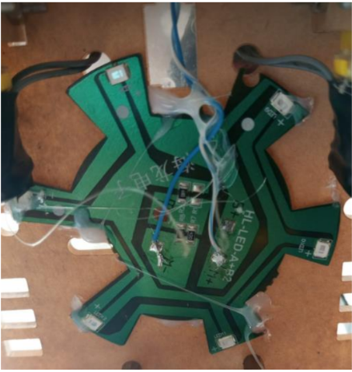
Ultraviolet
ultraviolet rays is used for sterilization.
Figure 9: Ultraviolet

Slide 15
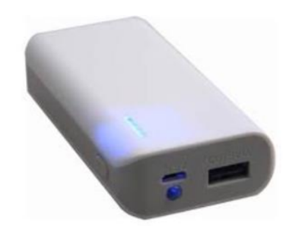
Power bank
The power bank was used to operate the robot to reduce the weight
because its size is small, in addition it’s easy to charge and preserves the
environment.
Figure 10: Power bank

Slide 16
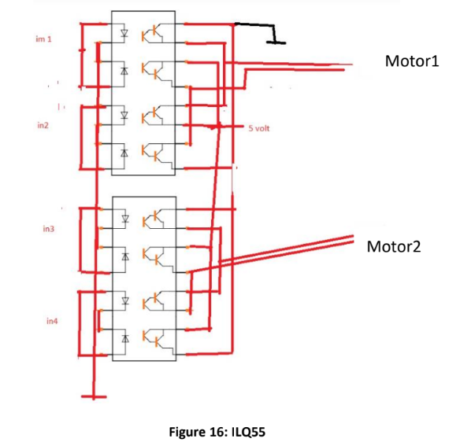
Diodes
To avoid collision

Slide 17
Challenges
04
1. the lack of time for the summer semester
2. the lack hardware available in Palestine, which is imported at a low cost, is not completely reliable, resulting in numerous problems
3. we wanted to use Raspberry Pi but couldn't find it in the market.

Slide 18
Future work
05
1- Make the robort respond to voice commands.
2- Using camara to more accurately identify obstacles.

Slide 19
DEMO

Slide 20


