Slide 1

Automated Drip Irrigation System
May 20th, 2018
Ahmed H. Dweikat
Supervised By: Dr. Alladin Masri
Taher Dweikat

Slide 2
Agenda
Overview
Technologies
Methodology
Future work
Demo

Slide 3
Overview
By using soil moisture, humidity and temperature sensors outputs to control the drip irrigation process, Wi-Fi to connect to the web server to send and receive data, and Arduino microcontrollers to control all the operations, automated drip irrigation process will be applied

Slide 4
Technologies
Software
  Visual Studio 2015
  SQL Server Management Studio 2012
  Internet Information Services (IIS)
  Arduino 1.6.12 IDE

Slide 5
Technologies
Hardware
  Arduino Mega 2560
  Arduino Uno
  ESP8266 Wi-Fi module
  Arduino Wi-Fi Shield
  Solar System
  Sensors
    Soil moisture(FC-28)
    DHT-22
      Temperature
      Humidity
    Ultrasonic (HC - SR04 )
    Water Flow (YF-S201 )

Slide 6
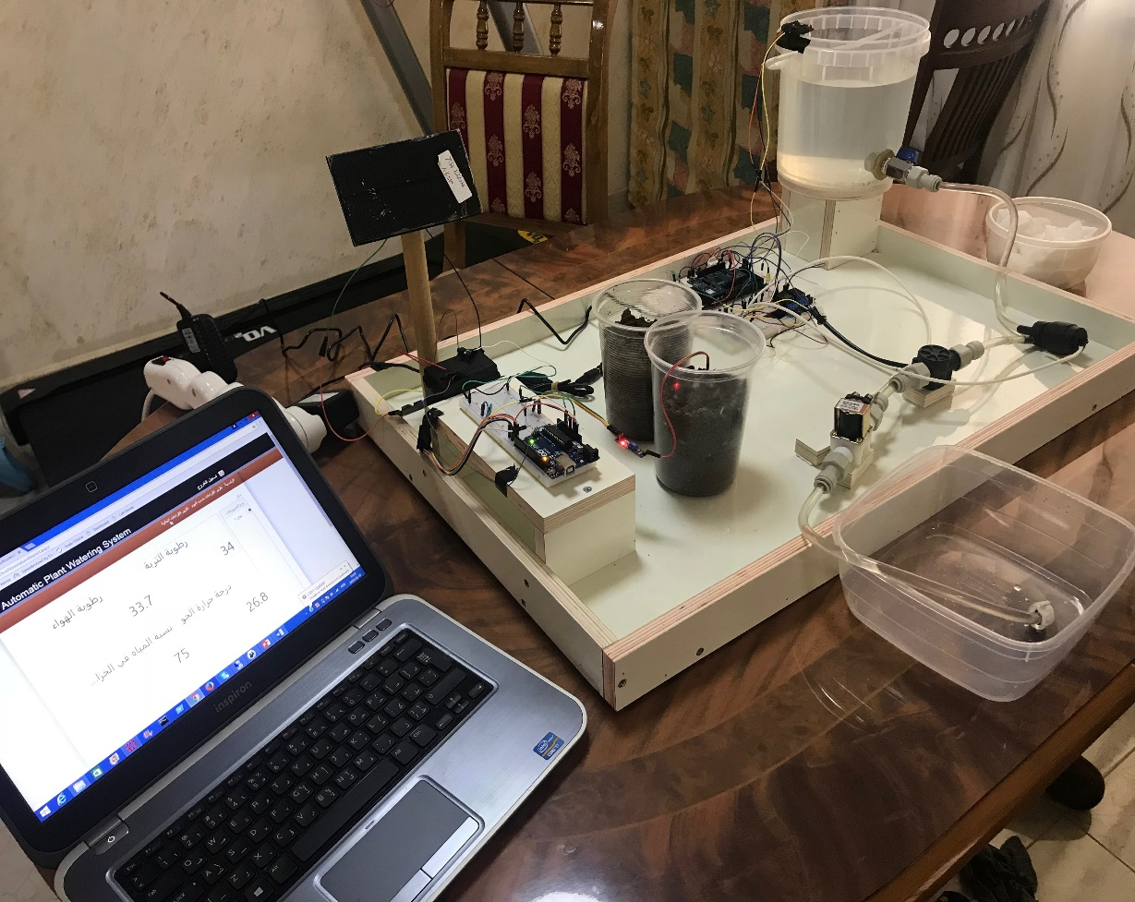
Methodology
Central Controlling unit
Error Detection
Peripheral Controlling unit
Software Web Application
Analytical Dashboards

Slide 7
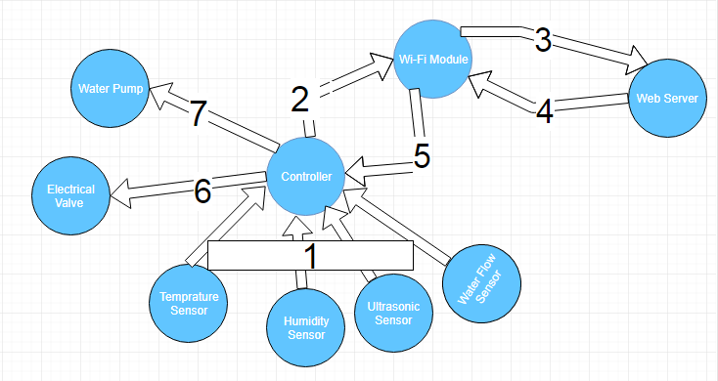
Central Controlling Unit

Slide 8
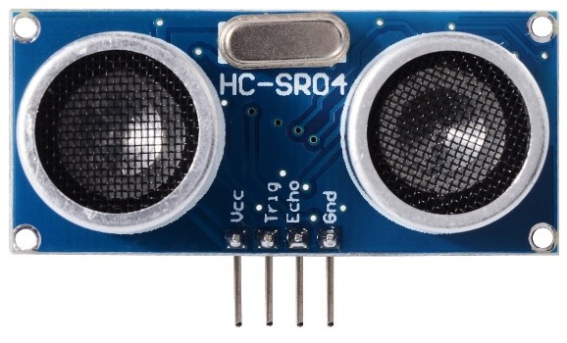
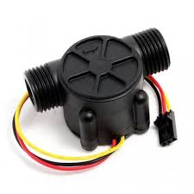
Error Detection
Ultrasonic sensor to measure the water level of the tank.
Water flow sensor to detect some failures in the water pump.

Slide 9
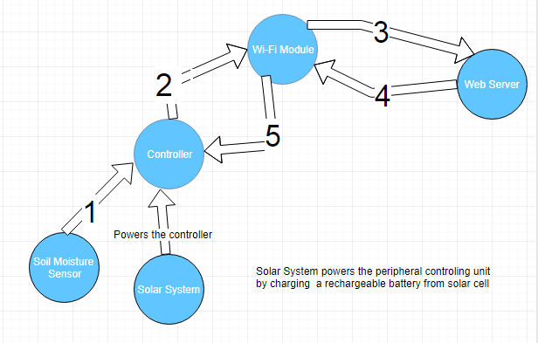
Peripheral Controlling Unit

Slide 10
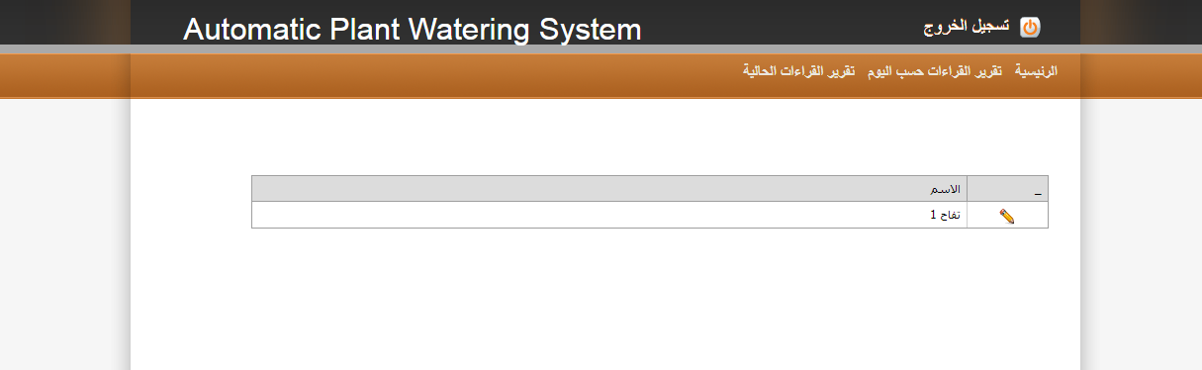
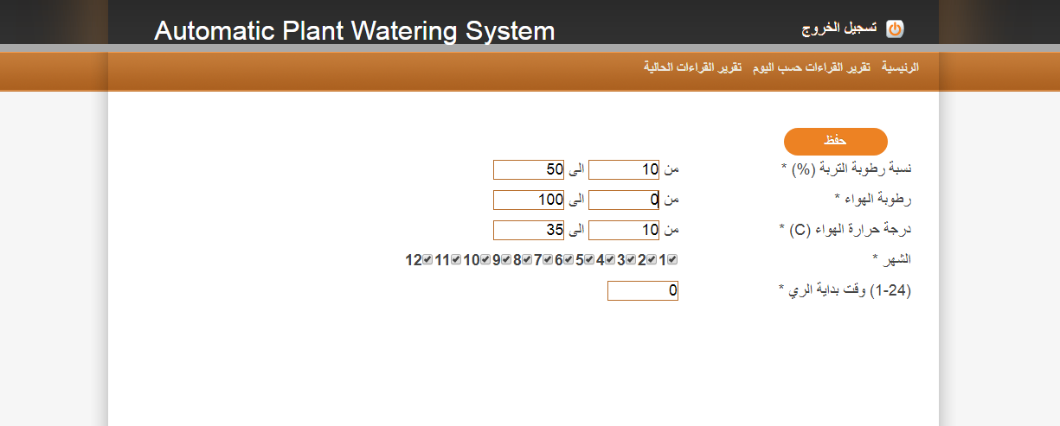
Define Line Criteria

Slide 11
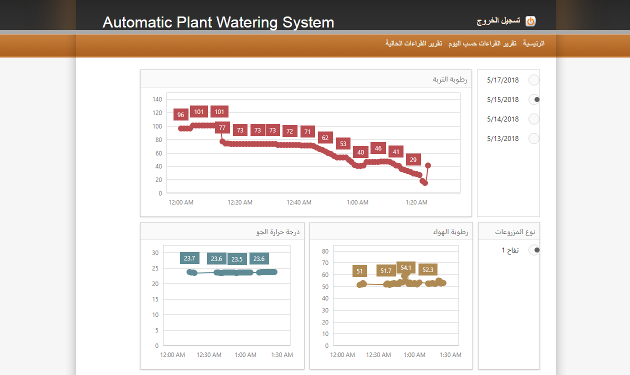
Analytical Dashboards

Slide 12
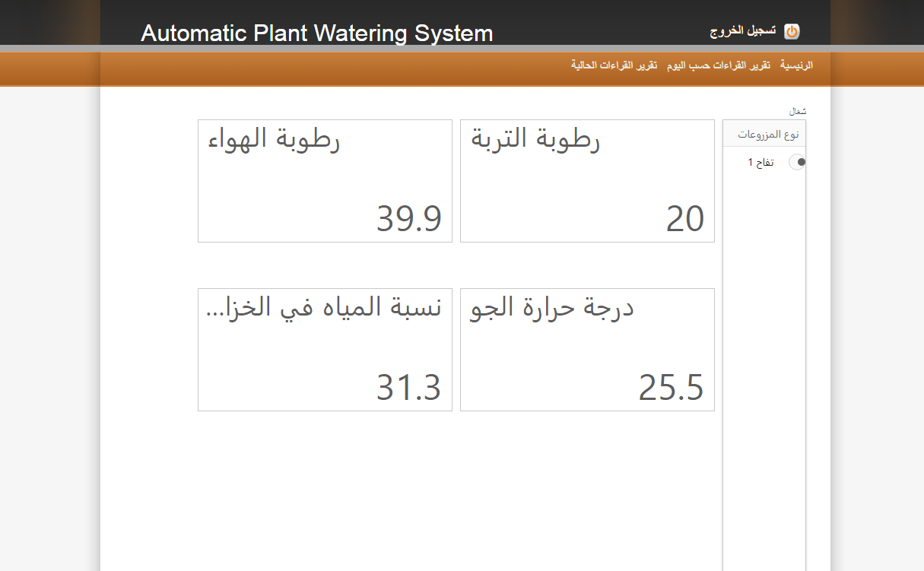
Current Measurments Display

Slide 13
Future Work
Add Fertilizers automatically.
Create some predefined criteria for specific type of trees.
Add more error detection mechanisms.
Mobile application to increase the usability.

Slide 14
Demo

Slide 15
Questions & Discussion

