Slide 1
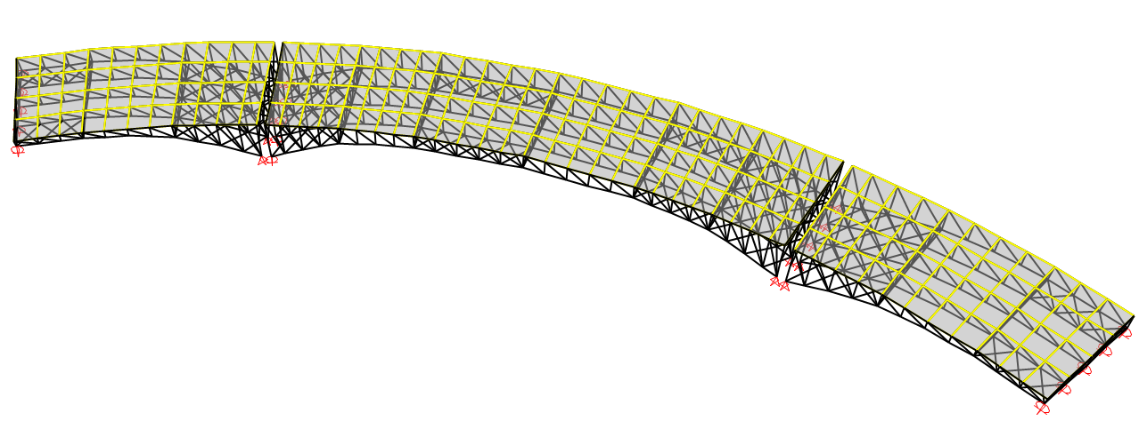
Structural Analysis and Design of Al-Bathan Bridge

Slide 2
Out-line
About Al-bathan Bridge
Geometry and layout
Loads
Modeling
Design

Slide 3
Why is Al-bathan Bridge
To solving the road congestion problem in Al-bathan region, the bridge is purposed.
The purpose from this project-is to apply the principles of analysis and design of steel and concrete structures.
Al-Bathan has a hard topography ,which makes expanding of streets difficult.
Focusing on structural analysis and design of bridge.

Slide 4
Geometry and layout
Location description
Horizontal layout
Profile
Cross section

Slide 5
Location description
Al-bathan lies to the north east of Nablus.
Connect the main street between _Jeneen, Nablus, Tubas-Nablus
Its topography range from valleys to mountains
The bridge will connect between two points across a valley 30 m deep and 150 m width

Slide 6
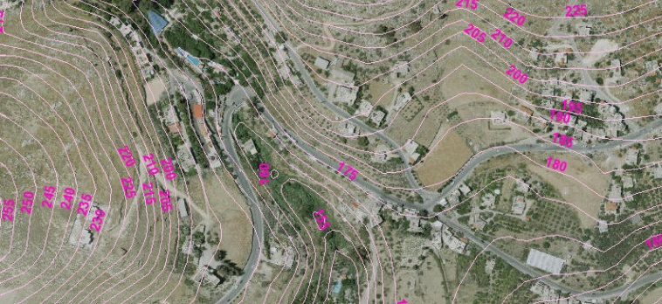
Cantors map

Slide 7


Horizontal Layout
straight segments of the road, known as tangents.
design the horizontal alignment need to minimum radius, length of the curve
R=140m by using
Length of the curve =158m using L=

Slide 8
Profile
Profile is a drawing shows the elevation of ground on the vertical axis with stations on horizontal axis .
Show the nature ground elevation.
Shows the longitudinal section of the bridge.
Describe the location of the abutments and piers for the bridge.

Slide 9
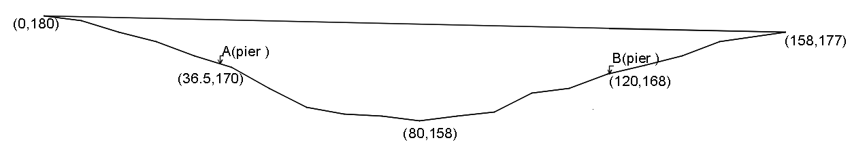
Profile

Slide 10
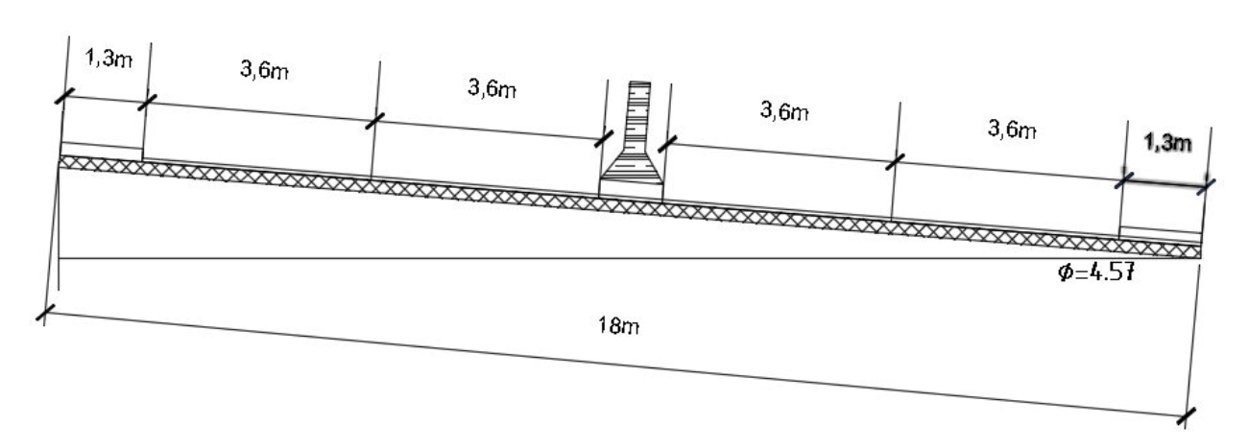
Cross section
two lanes for each direction- 3.6 m width for each lane
side walk-width 1.3 m
Median-width 1 m
Slope of the cross section=8%

Slide 11
Types of bridges
Beam bridge
Suspension bridge
Arch bridge
Truss bridge

Slide 12
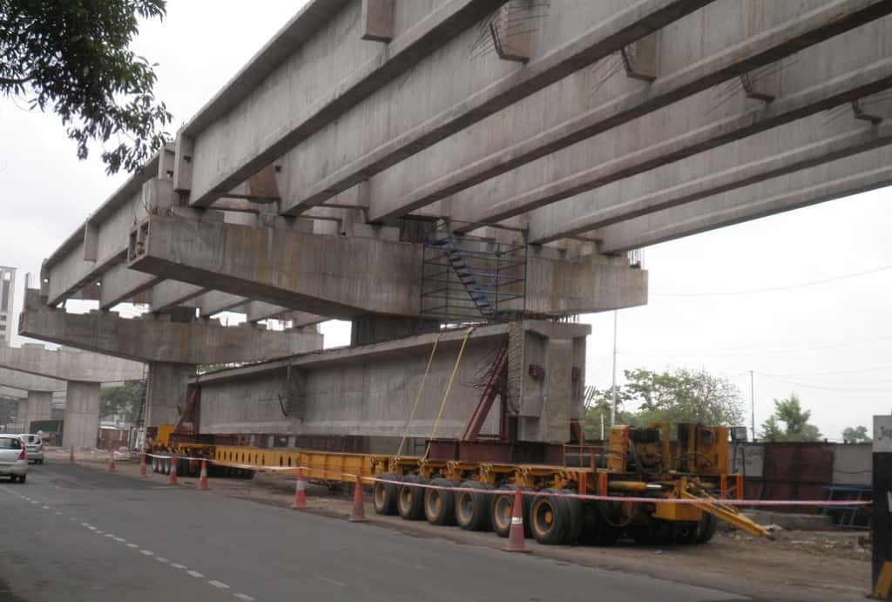
Beam bridge

Slide 13

Suspension bridge

Slide 14
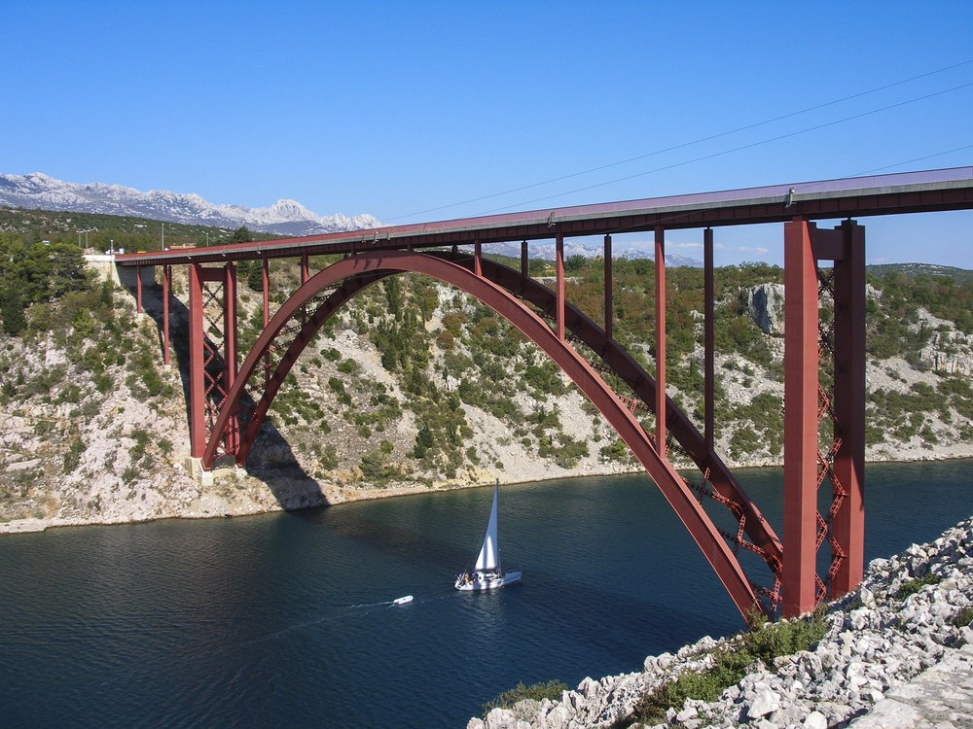
Arch bridge

Slide 15

Truss bridge

Slide 16
Loads
Loads types
Loads scenarios
Loads combinations

Slide 17
Loads types
Dead loads
Dead load of structural components and non structural attachments ((DC))
Dead load of wearing surface and utilities ((DW))
Live loads
Wind loads
Temperature load
Seismic load

Slide 18
Dead loads
Dead load of structural components and non structural attachments ((DC))
DC1 loads: self weight of bridge, deck section, and cross frame
DC2 loads: raised sidewalks, roadway barriers, lighting structure, and other attachments to the structure
Dead load of wearing surface and utilities ((DW))
flexible pavement
rigid pavement

Slide 19
Live loads
Represented by vehicles loads which have different types and sizes
Bridge engineers have developed what is called a national vehicular loads.
national vehicular load is a theoretical load that doesn’t actually exist but that conservatively represents the load effects of vehicles that may legally act on the bridge
AASHTO using HL-93 (highway loads 1993)

Slide 20

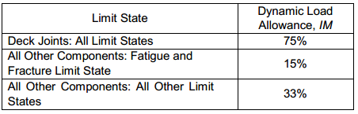
Dynamic load allowance(IM)
As we took in the previous section, that the HL-93 loading based on a static live load, and to take the effect of dynamic load, we will multiplied the vehicle load by a factor called load allowance factor .
Dynamic load allowance depend on the component and the limit state …..

Slide 21
Vehicular loads
Design truck
Design tandem
Design lane load

Slide 22
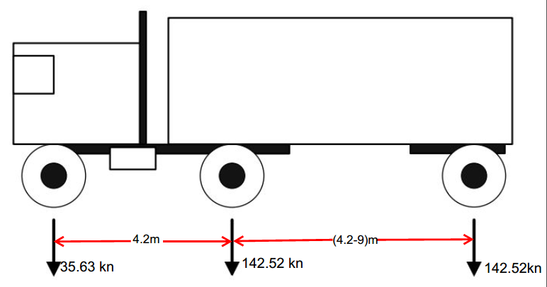
Design truck

Slide 23
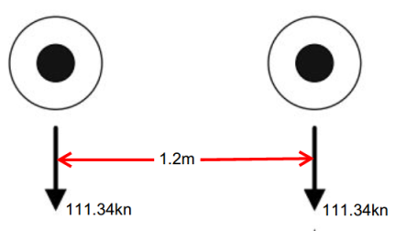
Design tandem

Slide 24
Design lane load
The design lane has a uniform load of 9.5KN per linear meter on the longitudinal direction of the bridge
9.5/3.6 = 2.64 kn/m^2
In our project we use design truck and lane load .

Slide 25
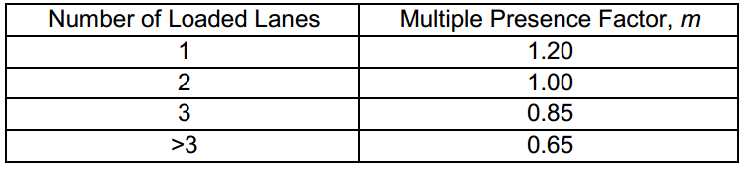
Multiple presence factor
their unlikely that each lane will be fully loaded simultaneously. To account for this probability, AASHTO applies multiple presence factor.

Slide 26
Centrifugal Force, CE
Centrifugal force is defined as a lateral force resulting from a change in direction of a vehicle movement
C=f*v^2/g*R
C= factor is multiplied by the total axels loads .
F= 4/3 for load combinations other than fatigue, 1 fore fatigue.
V=highway design speed= 18.06m/sec.
g=gravitational acceleration(9.81 m/s²).
R= radius of curvature of traffic lane = 132.5m.
C=0.335 .
C*W= 0.335*320.67 =107.29 kn .

Slide 27
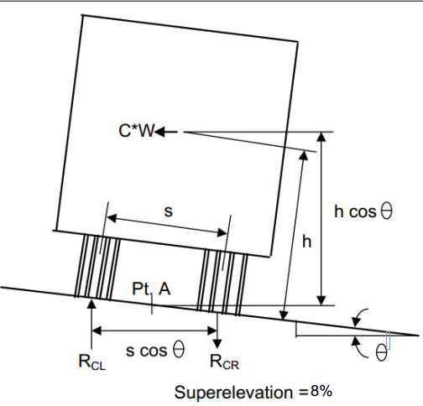
Centrifugal Force, CE

Slide 28
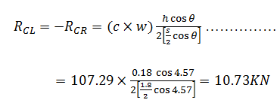
Centrifugal Force, CE

Slide 29
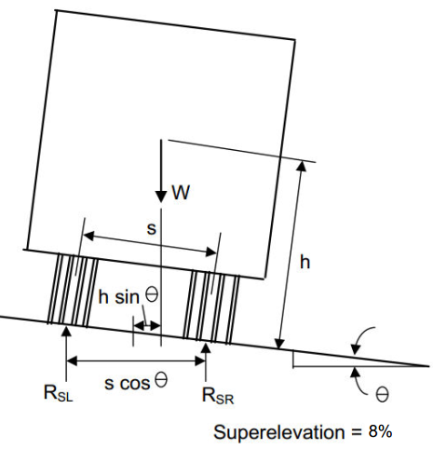
super elevation effect
The effect of super elevation will reduce the centrifugal force effect.

Slide 30
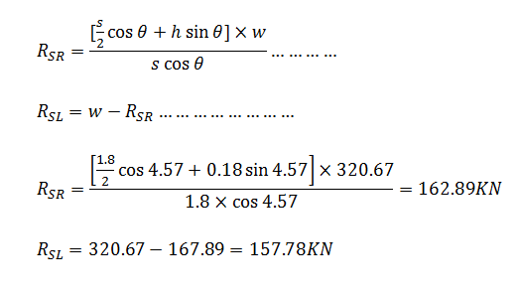
super elevation effect

Slide 31
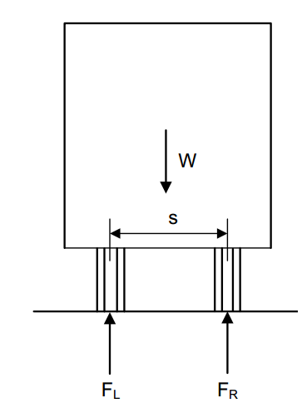
Unit wheel load factors
Take the affect of both Centrifugal Force and super elevation .

Slide 32
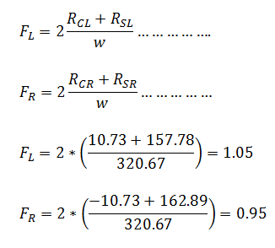
Unit wheel load factors

Slide 33
Unit wheel load factors
unit wheel load factors are approximately equal 1 then we can neglect effect centrifugal force and super elevation.

Slide 34
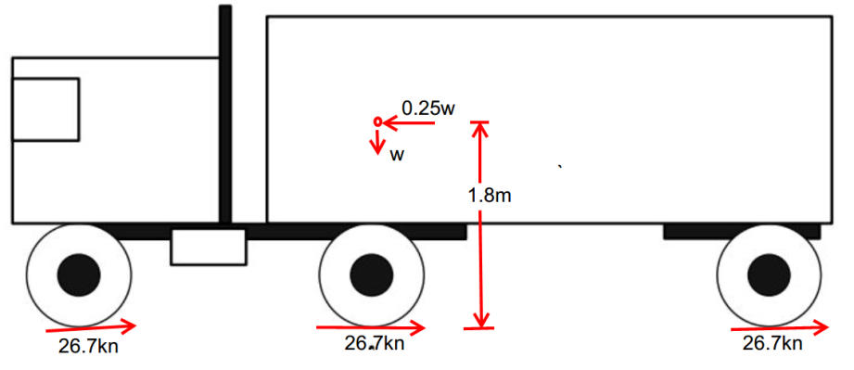
Braking Force, BR
25 percent of the axel weight of the design truck or design tandem
The braking force is applied 1.8 m above the road way surface .

Slide 35
Braking Force, BR
The moment from braking force (M) is 144.3 KN.m
the force on tire A equal 144.3/8.4 =17 KN and for C equal -17kN , These load have to add to truck load.

Slide 36
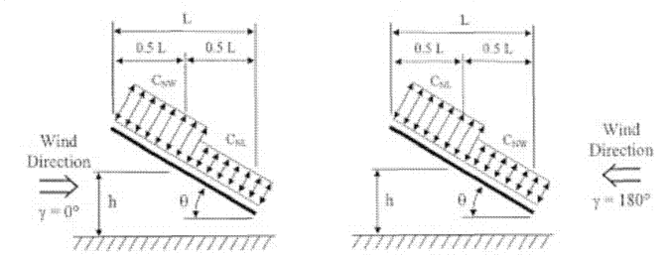
Wind loads
a minimum strength design level wind pressure 0.77 KN/m² is required
The wind load will affect the bridge in both directions(horizontal and longitudinal)
wind load will affect on the live load in addition to structural components.

Slide 37
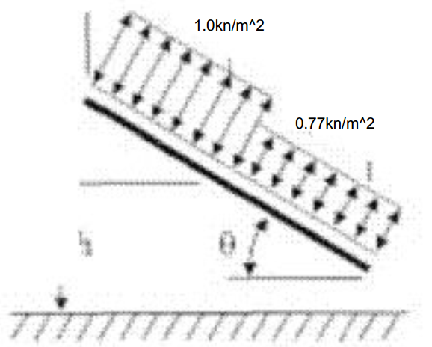
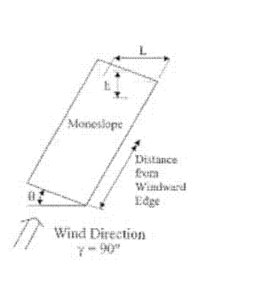
Wind loads
Horizontal Direction
Longitudinal Direction

Slide 38
Temperature loads
Uniform Temperature Load
Uniform temperature means that the temperature will affect on all the structure elements in the same way
Pinned ends spans and temperature means internal forces
The difference in the temperature between day and night
15 C
Temperature Gradient load
will be variation of the temperature effect on structure elements.
Using thermal joints

Slide 39
Seismic loads
We will leave the seismic design to the graduation project two

Slide 40
Loads combinations
Design load combinations
1.25Dc+1.5Dw+1.35(LL+BR+IM) +0.4Ws+Wl
Deflection load combinations

Slide 41
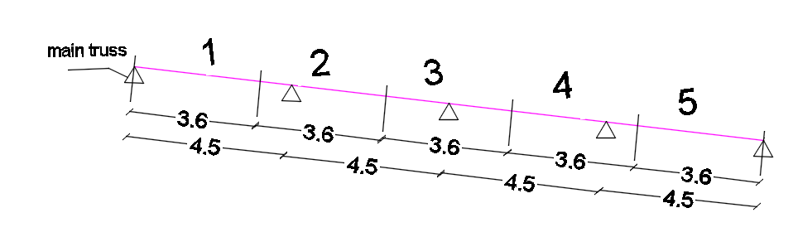
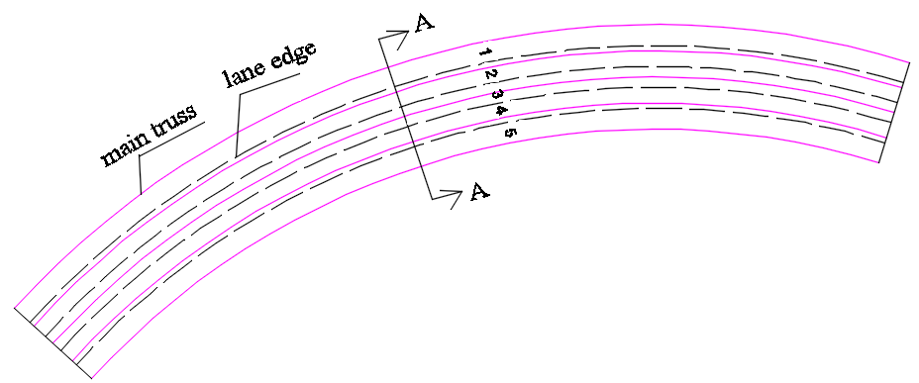
Loads scenarios
vehicles affect the bridge at deferent positions and that means many of positions may be cause maximum effect on the bridge

Slide 42
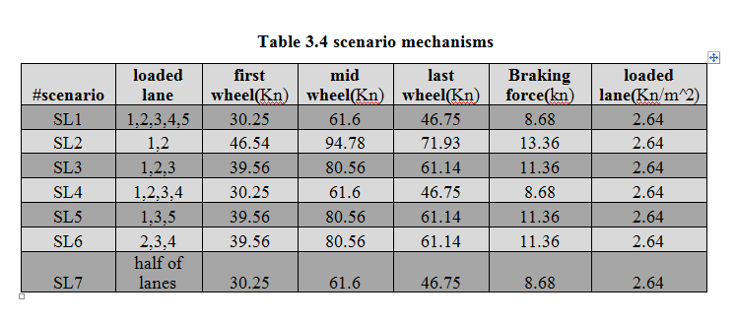
Loads scenarios

Slide 43
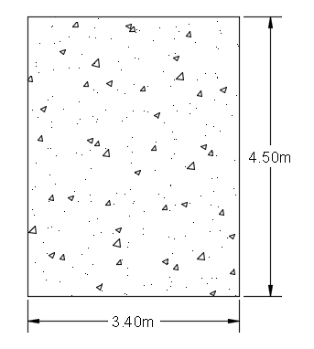
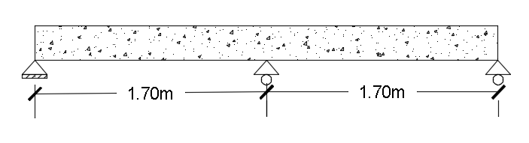
Design of deck
the surface of a bridge, and is one of structural element of the superstructure of a bridge
Using pre-cast concrete

Slide 44
Design of deck
Deflection limit
Shear design
Shear force
Punching force
Design flexure
Design of dowels

Slide 45
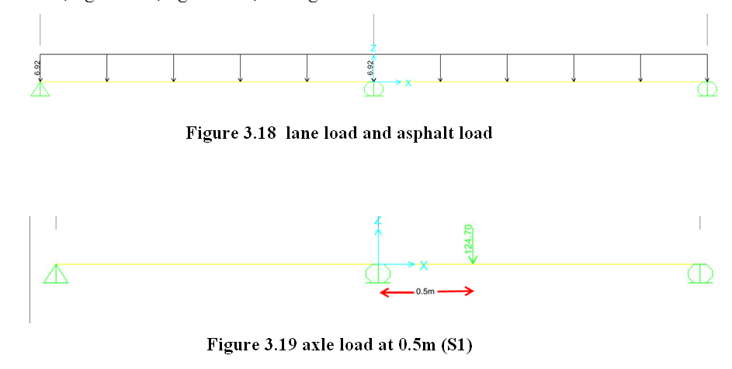
Loads scenarios of deck

Slide 46
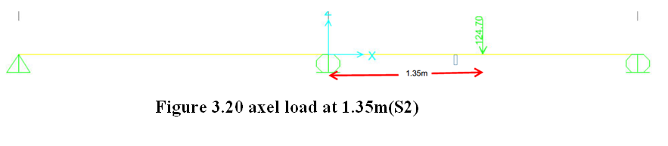
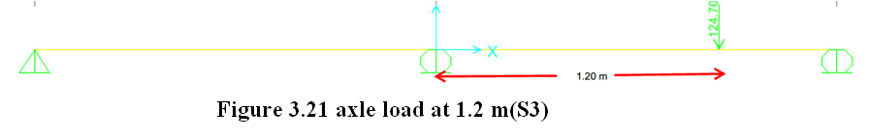
Loads scenarios of deck

Slide 47
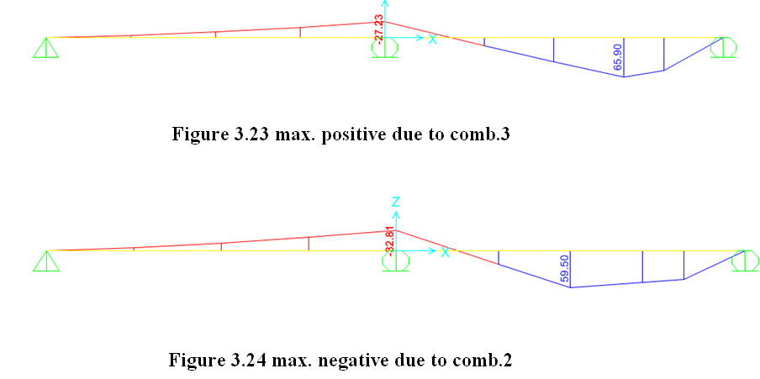
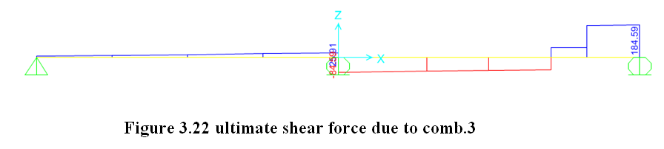
Max. moments and shear

Slide 48



Design of deck
For deflection limit
Shear design and by using and
and assuming thickness of slab=250mm then shear is okay
For punishing using
punishing okey
For flexure
Positive steel= and neg. =
shrinkage steel =

Slide 49
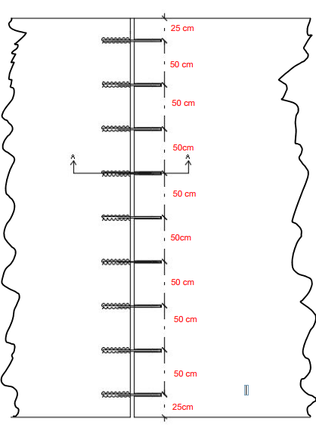
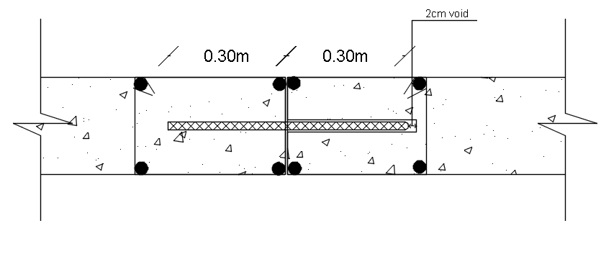
Design of deck
Design of Dowels
used dowels to connect to adjacent two segments and this connections allow to slab rotation and movement along dowels direction but connections resist shear force
to eliminate uniform temperature effect
Top view of dowel section A-A

Slide 50
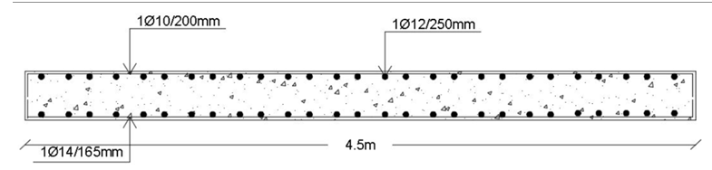

Slide 51
Modeling
Conceptual design
Model checks

Slide 52
Conceptual design
Conceptual design is a preliminary dimensions at initial stage of design
length of constant truss =40 m,
the connection pin to allow the deformation due to temperature ,
the depth of member D=2m ,but to be more conservative we use 2.2 m.
the number of main trusses are 5 trusses
The bridge divided into three
spans, two sided spans and mid one
The sided spans are simple spans and the mid one has a pined supports at its ended

Slide 53
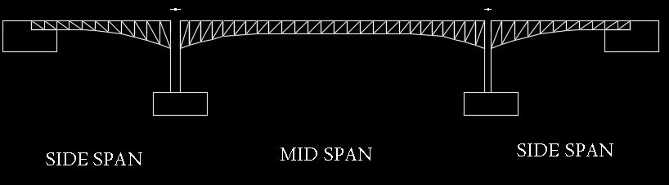
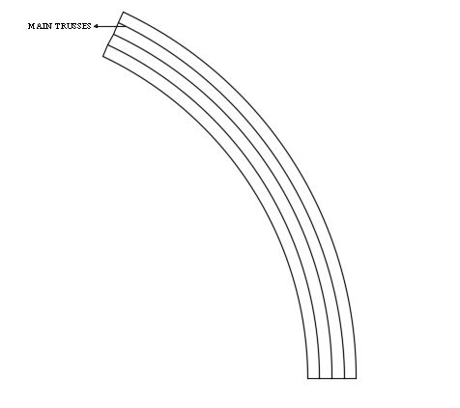
Conceptual design

Slide 54
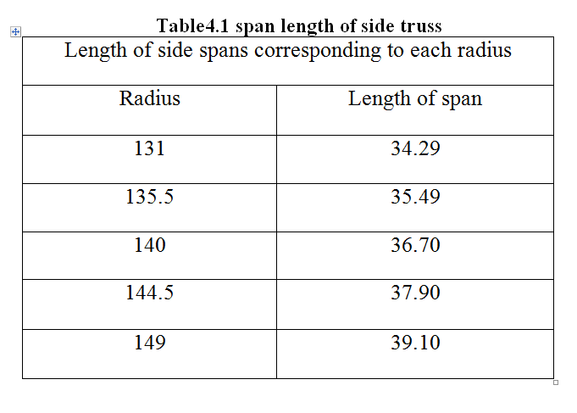
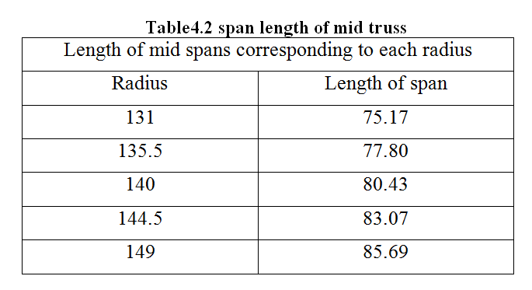
Span length of truss

Slide 55
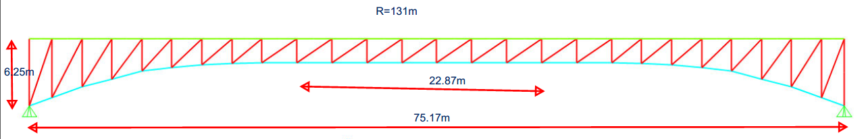
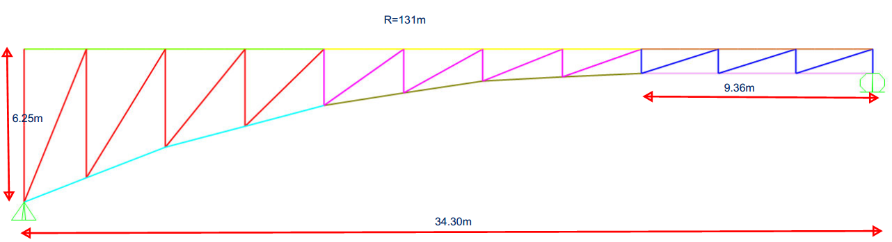

Slide 56
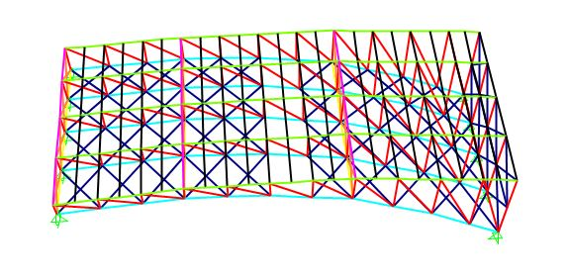
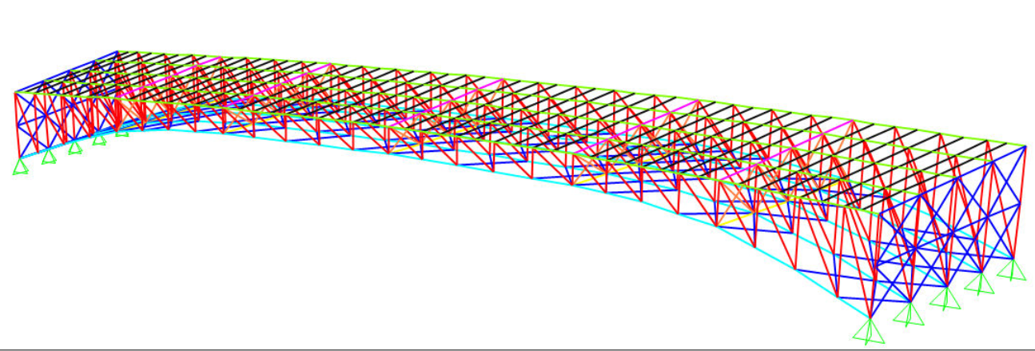
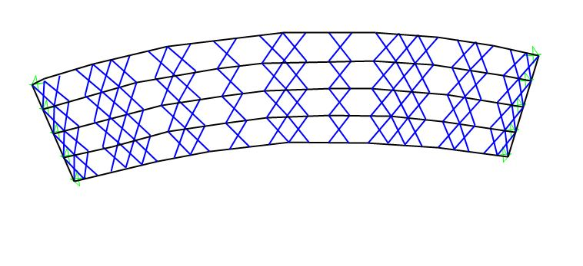
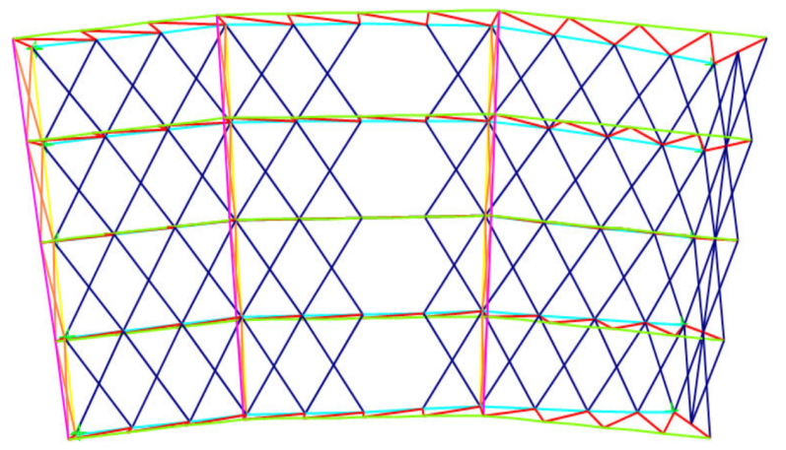

Slide 57
Model checks
Computability check
Equilibrium check
Stress-strain check

Slide 58
Computability check
Using animation in SAP, it is clear that the model is computability in the twelve modes since it is behave as a one unit
period(Tn) for first mode is 0.39 sec
we will verify and check Tn in chapter of seismic design
summation of mass participation ration must exceed 90% regarding to IBC 2012

Slide 59
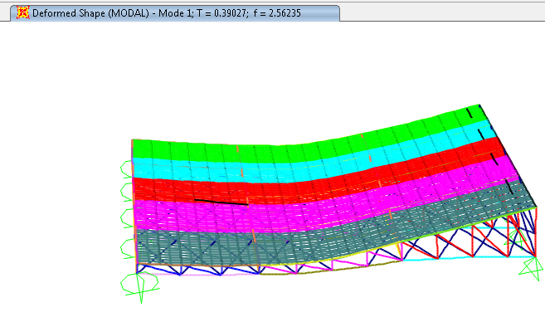

Slide 60



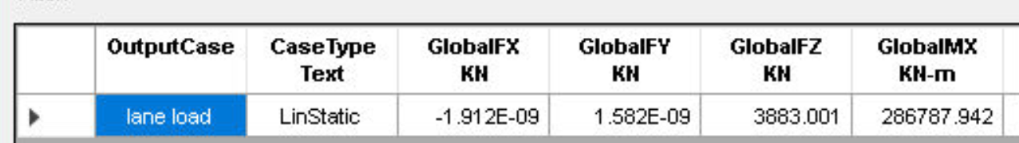
Equilibrium check
this check to ensure if we put loads by their correct values
For side truss loaded lane
Asphalt load(Dw)
For mid truss loaded lane

Slide 61
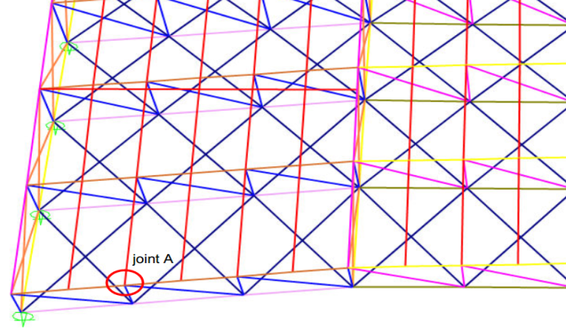
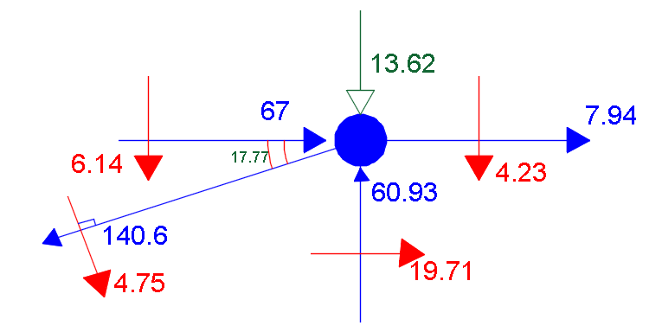
Stress-strain check
We did this check to ensure transfer of the loads in members.
For side truss we select joint A,
asphalt load and distance=3.4m
After modeling in SAP:

Slide 62
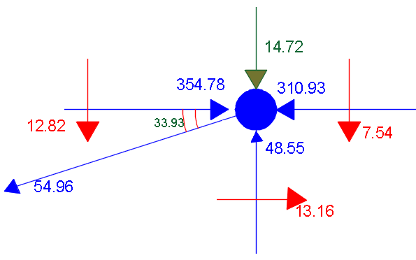
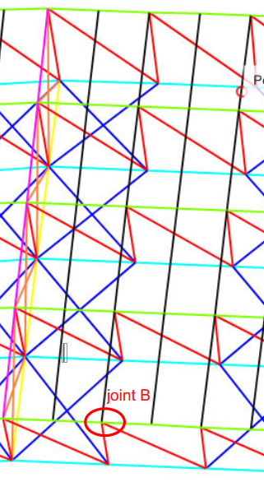
we applied equilibrium principle to do stress –strain check and get error=14% in Y and error=28% in X
The same principle applied on mid truss at joint B
and get error=0.5% in Y and error=27% in X

Slide 63
Design of the bridge
Cross sections
Checks

Slide 64
design Cross Sections
categorized truss members into groups to be practical design and for beauty appearance issues

Slide 65
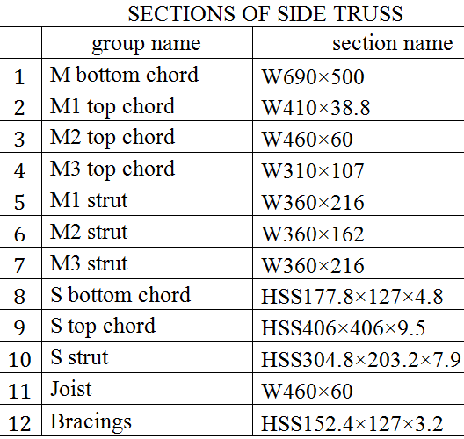

design Cross Sections

Slide 66
Design checks
Capacity check
Deflection check
Period check

Slide 67

Capacity check
Capacity for members have to be in range of (0-1); then member can carry applied load

Slide 68

Capacity check

Slide 69


Deflection check
checked if the deflections less than allowable deflections
Deflection in side truss
Dead load deflection:
max. deflection in side truss(R=144.5) due to dead.
And the same principles applied for live load deflection and long term deflection for both side and mid trusses

Slide 70


Period check
put 1Kn on the middle of bridge to calculate period
Use and
%error = ×100% = 40% for mid bridge
%error = ×100% = 31.5% for side truss

