Slide 1


Medicine refrigerator controlling and monotoring system.

Slide 2
The Contents
Overview & problem statement
01
02
Our solutions
Traditional VS Our System
03
Mechanism&Controller
04

Slide 3
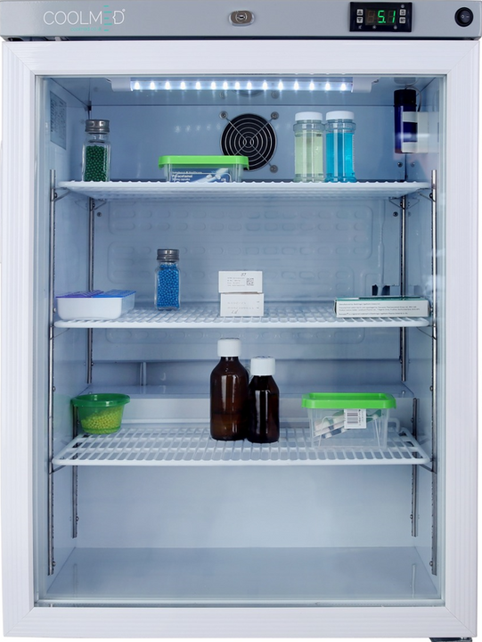
Overview & problem statement
In hospitals, the existing medication storage system faces numerous problems, such as inadequate security measures, a lack of effective temperature monitoring, and the absence of dedicated storage spaces for individual medicines, leading to difficulties in locating them.

Slide 4

Our Solution
To address these issues, we have developed an intelligent medication monitoring and control system. This innovative system revolutionizes medication storage by incorporating advanced features to enhance security, monitoring, and control.

Slide 5
Main features
01
02
03
Monitoring: The Blynk application allows real-time and historical temperature monitoring of the refrigerator, providing data from the Ministry of Health for the past 30 days
Controlling: The system enables organized placement of medicines in specified positions, simplifying the addition and extraction of medications from the refrigerator
Protection: The system ensures that only authorized doctors can access the refrigerator. It also activates an alternative cooling system if the temperature rises unexpectedly

Slide 6
Traditional VS Our System
Traditional system | Our system
Low security | High Security
Weak Monitoring‏ | Better monitoring‏
Just Putting medicines‏ | Controlling the placement and sorting of medicines, each in its place, which facilitates the process of placing and retrieving it
There is no alternative plan in case the developer fails‏ | Existence of an alternative plan in case the developer fails‏

Slide 7
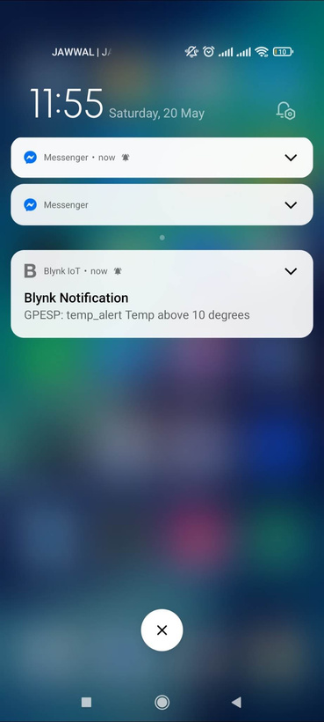
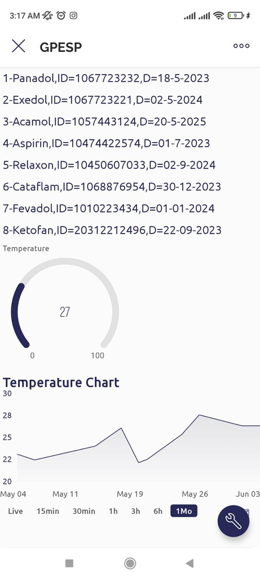
Blynk result:

Slide 8
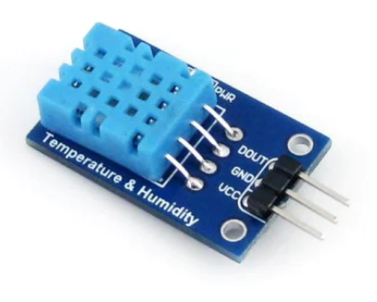
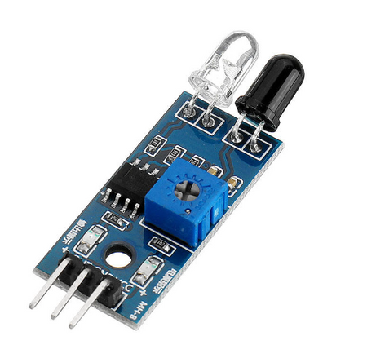
Mechanism:
DHT sensor to measure temperature
IR sensor : To locate empty places

Slide 9
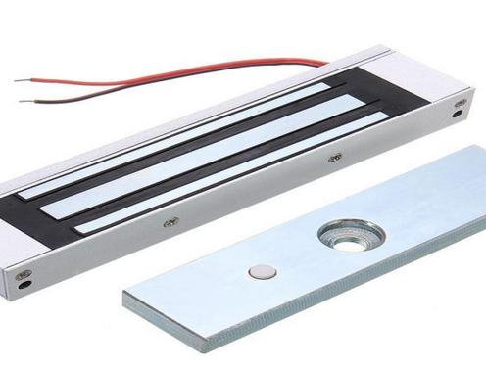
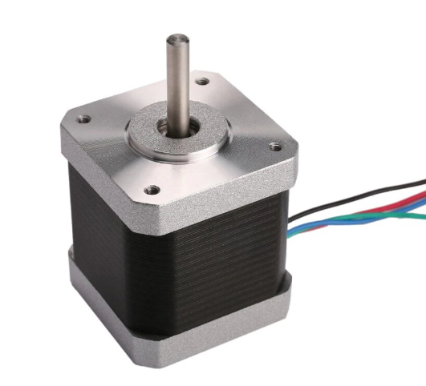
Mechanism:
Door magnet:For protection when closing and opening the door
Stepper Motor:
To help the medicine-carrying tablet to rotate

Slide 10
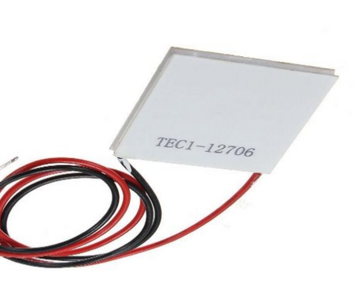
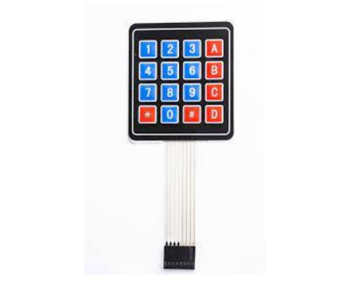
Mechanism:
Peltier Cooler: for cooling when needed
Keypad :to enter password

Slide 11
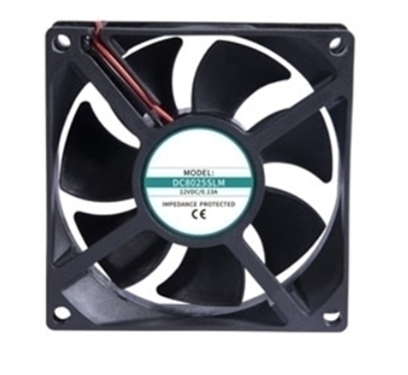
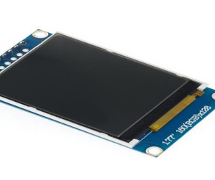
Mechanism:
Fan to increase cooling provided by Peltier
TFT 1.77 :To display the contents of the refrigerator

Slide 12
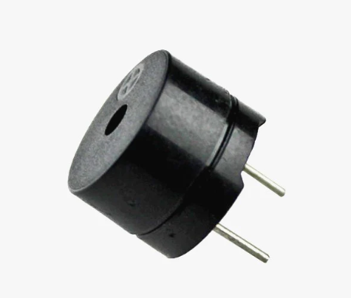
Mechanism:
Buzzer : Issuing a sound in case of emergency

Slide 13
Controllers:
The main tools to control the systems implemented

Slide 14
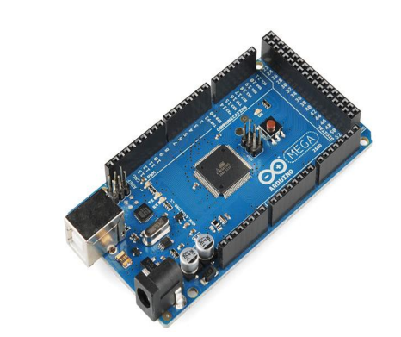
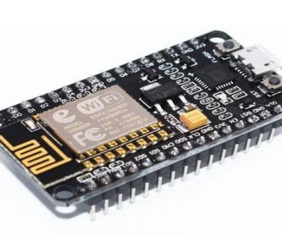
Controllers:
Aduino Mega
NodeMcu ESP8266

Slide 15



Thank You

