Slide 1

Development of a Water Master Plan for Qalqiliya Governorate (2020-2040)
Graduation Project
Prepared by:
Mohammad emad khaled
Mohammad Khaled naji
Majd ma’moon alali
Muthana tayseer ghanem
Under supervision of:
Dr. Anan Jayousi

Slide 2
Outline of the project :
Introduction
Objectives
Methodology
Expected outcomes
Population and Clustering communities
Demand and Gap Calculation
Future potential water recourses
Facility Master Plan For Qalqiliya Governorate

Slide 3
Introduction
As a result of the increase in the total population, the demand for water increases to ensure a healthy and normal life for humans and animals. Therefore, solutions must be found to service this increase in the number of people in the future.

Slide 4
Objective
work to find new and sufficient sources of water to meet the population's need if the current amount of water is not sufficient to meet the needs of the population in the future .

Slide 5
Methodology
Data collection .
Analysis of present water demand.
Create the concept of clusters in the Governorate.
Estimation of future water demand .
Estimation of future water gap.
Investigate potential future water resources.
Develop the needed infrastructure to convey water from proposed water resources to different clusters.

Slide 6
Expected Outcome
conveying water from resources such as wells, that will be built to harvest and store rainwater. So there’s an infrastructure water lines that will carry water from wells to a reservoirs. Each reservoir will exist in one cluster in Qalqiliya .
If the network losses are large, it should be reduced.

Slide 7
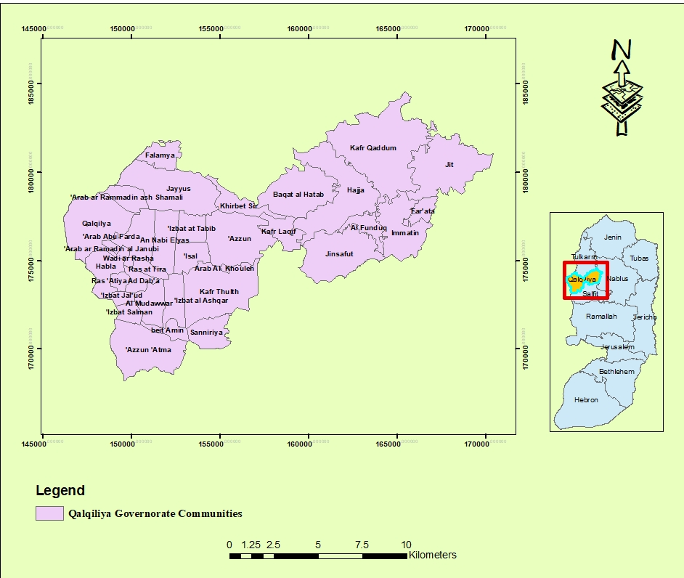
Qalqiliya Governorate Location and Communities

Slide 8
Population and Clustering of the Communities
Qalqiliya Governorate consist of 34 communities, in this study the Governorate was divided into clusters.
The Governorate communities was divided into clusters based on many criteria like location, water resources, and the topography.
Qalqiliya Governorate was divided according to the previous criteria into four claster:
1) Qalqiliya cluster.
2) kafer Qadoum cluster.
3) kafer Thulth cluster.
4) Jayyus cluster.

Slide 9
Qalqiliya Clusters Communities
Qalqiliya Cluster | Kafer Qadoum Cluster | Kafer Thulth Cluster | Jayyus Cluster
Qalqiliya | Kafer Qadoum | Kafer Thulth | Jayyus
Habla | Haja | 1zzbat Jaloud | Falamya
Arab Abu Farda | Al-Funduq | 1zzbat al-Ashqar | Azzun
Arab al Ramadin al-Janobya | Jinsafut | Al-Mudawwar | Sir
Ras Atiya | Immatin | 1zzbat Salman | Nabi-Elias
Ras al-Tira | Fara'ta | Azun Atmah | Izzbat-al Tabeeb
Al-Daba'a | Jit | Saniriya | Isla
Wadi al-Rasha |  | Beit-Ameen | Kafer Laqif
 |  | Arab al-Khawla | Arab-al Ramadin al-Shamalya

Slide 10
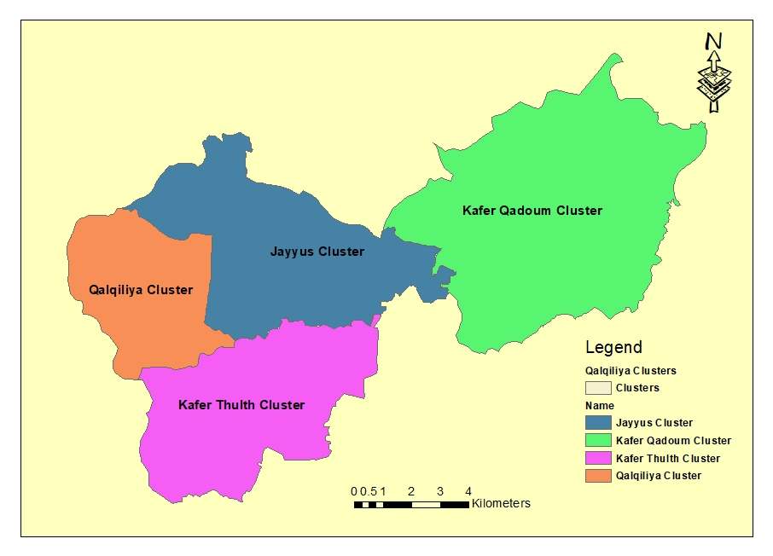
Qalqiliya Clusters

Slide 11
Qalqiliya Clusters Population
Year | 2020 | 2025 | 2030 | 2040
Qalqiliya cluster | 66427 | 73654 | 81684 | 100550
Jayyus cluster | 19065 | 19966 | 21913 | 26186
Kafer Thulth cluster | 15673 | 18057 | 20838 | 27846
Kafer Qadoum cluster | 16517 | 18066 | 19799 | 23922

Slide 12
Existing Facilities
Most of the communities in Qalqiliya Governorate contain a water network, in addition to collecting rain water.
for the water sources, there are two main sources of water in the governorate:
1) the local artesian wells .
2)the Israel Water Company (Mekorot).

Slide 13
Distribution of communities Depend on water recourse
Water resource | Mekorot | Artesian wells with water distribution network | Artesian wells with mobile tank
Communities Name | Kafer Qadoum Fara'ta Immatin Al-Funduq Haja Jinsafut Jit Saniriya Kafer Laqif Baqat Al-Hatab Nabi Elias Isla | Qalqiliya , Jayyus Falamya , Azzun Sir , Habla Izzbat-al Tabeeb Kafer Thulth 1zzbat Jaloud 1zzbat al-Ashqar Al-Mudawwar 1zzbat Salman Azun Atmah Beit-Ameen Ras Atiya Ras al-Tira , Al-Daba'a | Wadi al-Rasha Arab al Ramadin al-Janobya Arab Abu Farda Arab al-Khawla Arab-alRamadin al-Shamalya

Slide 14


Present Demand Calculation
the equation used:
Equation 1: loss Equation
Loss % = 100%
Equation 2:futuer population
P_{n} = P_{0 (1+i)} ^{n}
Equation 3:Demand Equation
Demand =

Slide 15

Equation 4: Demand Equation
Demand = $\frac{Consumption}{1−loss \%}$

Slide 16
Future Demand Calculation
Considerations on which the demand was calculated
The assumption in demand calculation was the as the following:
1-The normal rate of consumption per person per day is 120 L/C/day.
2-the domestic consumption is 90% from the total consumption.
3-the Physical loss percent in the network is 15%.

Slide 17


As a result of the previous consideration the normal demand value due to Municipalities represent in this equations:
Domestic consumption =
Normal Demand =
If the calculated demand less than the normal demand, the normal demand will using in the calculation of future demand.

Slide 18
Future Water Demand and Gap in Qalqiliya Governorate
Due to the increasing in the population due to the years the amount of recent water supply to communities will be not enough to serve the new number of people and this named as the Water Gap. So as a result of this gap the amount of water supply should be increase to service the people in future.

Slide 19
Future Water Demand and Gap in Qalqiliya Governorate
Future Water Demand in meter cubic per day = $\frac{(Population ∗ water demand per capita per day ) }{1000}$
$$\frac{\left(Population ∗ water demand per capita per day ) \right.}{1000}×365$$
Future Water Demand in meter cubic per year=

Slide 20
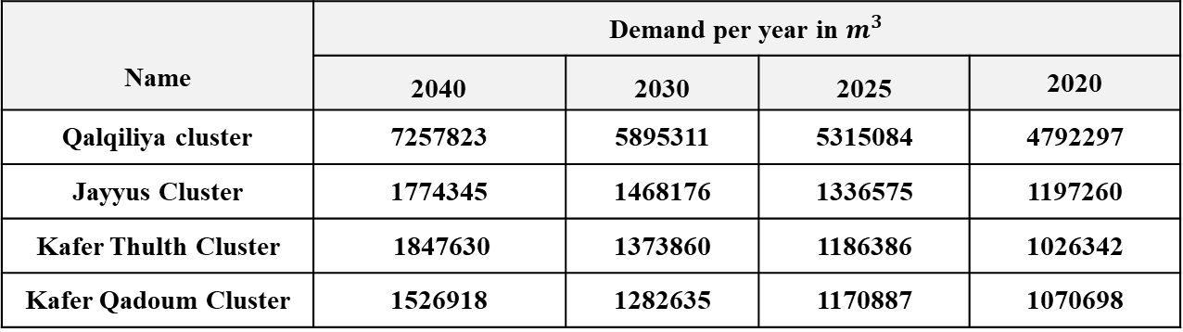
Future Demand for Each Cluster
Demand per year in $m^{3}$ |  |  |  | Name
2020 | 2025 | 2030 | 2040
4792297 | 5315084 | 5895311 | 7257823 | Qalqiliya cluster
1197260 | 1336575 | 1468176 | 1774345 | Jayyus Cluster
1026342 | 1186386 | 1373860 | 1847630 | Kafer Thulth Cluster
1070698 | 1170887 | 1282635 | 1526918 | Kafer Qadoum Cluster

Slide 21
Water Gap Calculations
The assumption of gap calculation depends on the amount of water that must be supplied as the following:
Water Gap = future demand - Demand of year 2020
Water Gap in 2025 = demand 2025 - Demand of year 2020
Water Gap in 2030 = demand 2030 - Demand of year 2020
Water Gap in 2040 = demand 2040 - Demand of year 2020

Slide 22
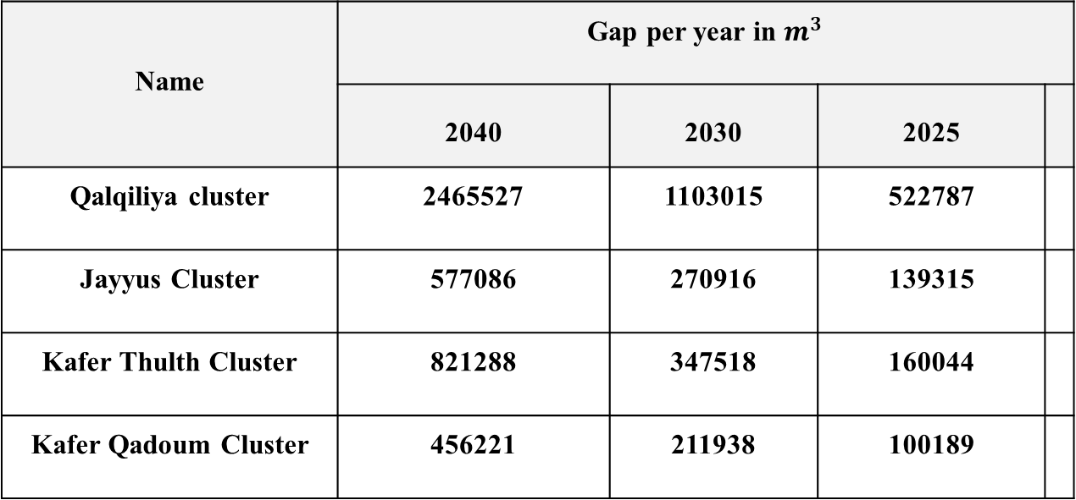
Water Gap in Each Cluster
Gap per year in $m^{3}$ |  |  |  | Name
 | 2025 | 2030 | 2040
 | 522787 | 1103015 | 2465527 | Qalqiliya cluster
 | 139315 | 270916 | 577086 | Jayyus Cluster
 | 160044 | 347518 | 821288 | Kafer Thulth Cluster
 | 100189 | 211938 | 456221 | Kafer Qadoum Cluster

Slide 23
water resources in Qalqiliya Governorate
Ground Water
in Qalqiliya Governorate there are many wells that service many communities in shown in the following table :

Slide 24
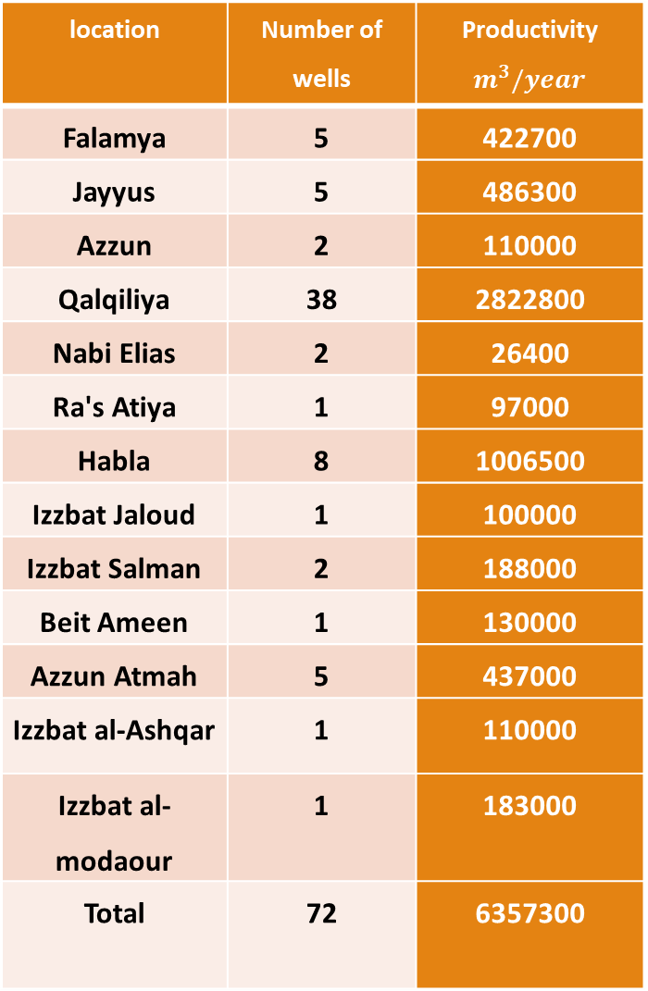
Productivity $$m^{3}/year$$ | Number of wells | location
422700 | 5 | Falamya
486300 | 5 | Jayyus
110000 | 2 | Azzun
2822800 | 38 | Qalqiliya
26400 | 2 | Nabi Elias
97000 | 1 | Ra's Atiya
1006500 | 8 | Habla
100000 | 1 | Izzbat Jaloud
188000 | 2 | Izzbat Salman
130000 | 1 | Beit Ameen
437000 | 5 | Azzun Atmah
110000 | 1 | Izzbat al-Ashqar
183000 | 1 | Izzbat al-modaour
6357300 | 72 | Total

Slide 25
Storm Water:
The annual average of rainwater in Qalqiliya governorate is 625 mm

Slide 26
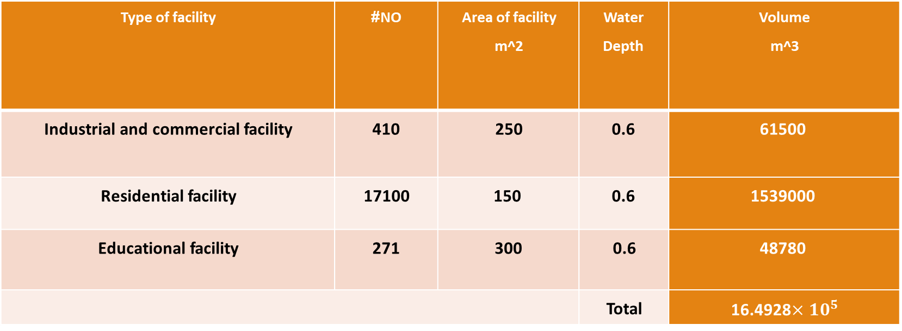
Because the Qalqiliya governorate does not contain springs, the table below shows the amount of rainwater that can be collected from the roofs of existing facilities
Volume m^3 | Water Depth | Area of facility m^2 | NO# | Type of facility
61500 | 0.6 | 250 | 410 | Industrial and commercial facility
1539000 | 0.6 | 150 | 17100 | Residential facility
48780 | 0.6 | 300 | 271 | Educational facility
16.4928$×{10}^{5}$ | Total

Slide 27
Treated Water
Treated water is one of the possible solutions to reduce the consumption of fresh water And use it in the field of agriculture.

Slide 28
Calculate the amount of treated water
Use the return flow in Qalqiliya Governorate = 80%
Using Manning’s equation:
Q=1.49/n * A*R^2/3 * S^0.5
Calculate a value Qsewar of Qalqiliya site:
Qsewar 2025 = Qww + Qinfiltration
Qww = population *water demand per cabita *return flow
Qinfiltration = population *water demand per cabita *return flow*20%
Assuming that the quantity of water produced from treatment is 60% of wastewater.

Slide 29
Amount Of Treated Water Expected in Qalqiliya governorate in the Future
cluster | Treated water m3/year 2025 | Treated water m3/year 2030 | Treated water m3/year 2040
Qalgiliya cluster | 2891997 | 3167861 | 3899847
Jayyus cluster | 455578 | 500445 | 604802
Kafer thulth cluster | 683343 | 791174 | 1064176
Kafer Qadoum cluster | 1944872 | 2129380 | 2567096

Slide 30
Facility Master Plane for Qalqiliya Governorate
This chapter will talk about the propose projects and facilities that can fill the gap of water in Qalqiliya Governorate and service the increasing population in each cluster.

Slide 31
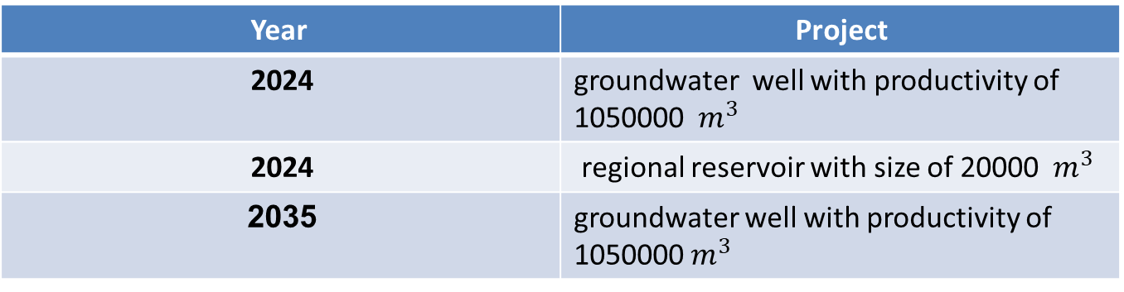
Proposed Projects In Qalqiliya Cluster
There are many projects that will do in Qalqiliya Cluster as a result of the largest Water gap in this cluster.
The gap in Qalqiliya Cluster is:
Year | 2025 | 2030 | 2040
Gap | 522787 | 1103015 | 2465527
Project | Year
groundwater well with productivity of 1050000 ${ m}^{3}$ | 2024
regional reservoir with size of 20000 ${ m}^{3}$ | 2024
groundwater well with productivity of 1050000${ m}^{3}$ | 2035

Slide 32
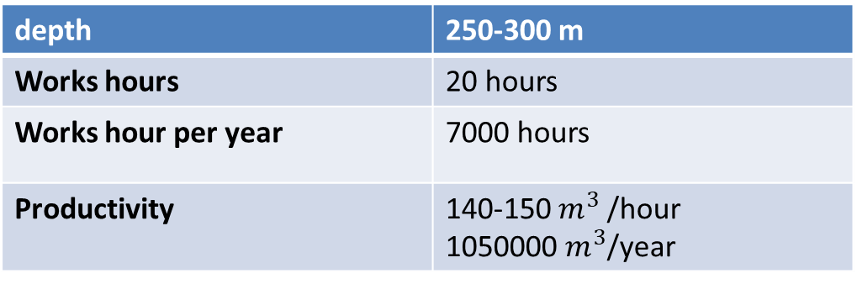
Wells specifications
Due to Palestinian specifications the Wells that use to domestic using should be with depth of 250 m at least.
Groundwater Wells Specification
depth | 250-300 m
Works hours | 20 hours
Works hour per year | 7000 hours
Productivity | 140-150${ m}^{3}$ /hour 1050000 $m^{3}$/year

Slide 33
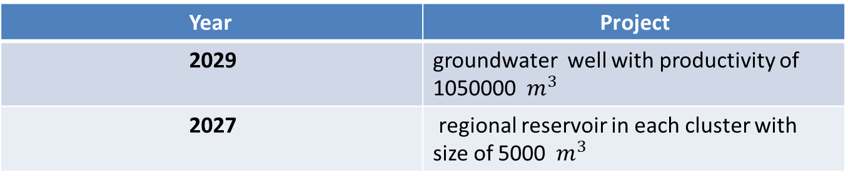
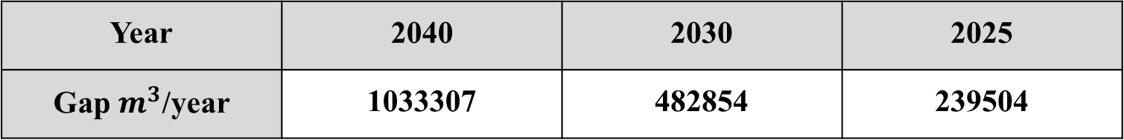
Proposed Projects in Jayyus Cluster and Kafer Qadoum Cluster
The proposed project in Jayyus cluster is to connect Jayyus cluster wells with a regional reservoir in kafer Qadoum cluster and Jayyus Cluster , the gap in these clusters is:
2025 | 2030 | 2040 | Year
239504 | 482854 | 1033307 | Gap $m^{3}$/year
Project | Year
groundwater well with productivity of 1050000 ${ m}^{3}$ | 2029
regional reservoir in each cluster with size of 5000 ${ m}^{3 }$ | 2027

Slide 34
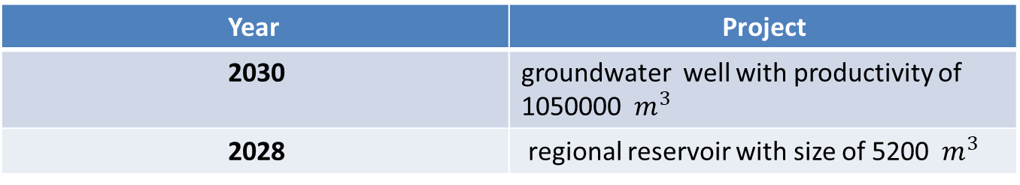
Proposed Projects in Kafer Thulth cluster:
Water gap in Kafer Thulth Cluster is:
2025 | 2030 | 2040 | Year
160044 | 347518 | 821288 | Gap cm/year
Project | Year
groundwater well with productivity of 1050000 ${ m}^{3}$ | 2030
regional reservoir with size of 5200 ${ m}^{3 }$ | 2028

Slide 35
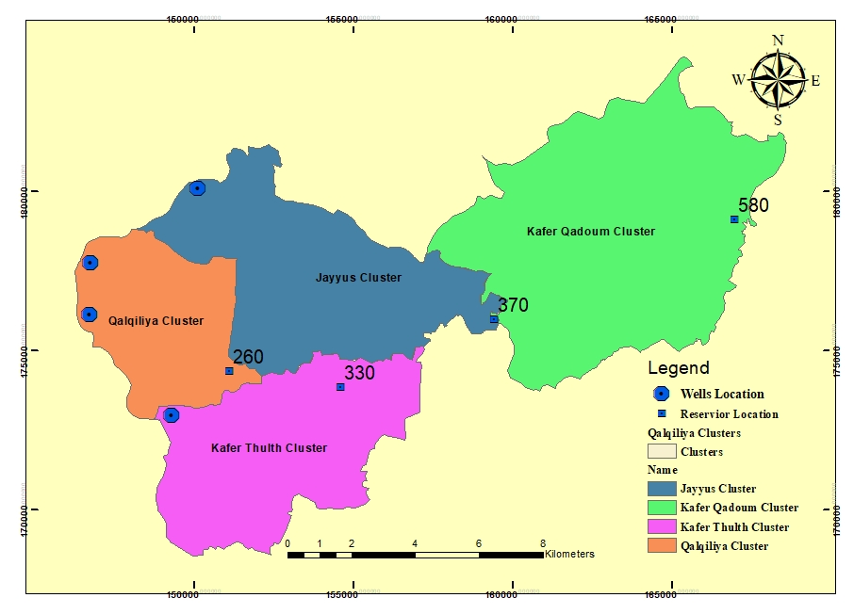
Wells &Regional Reservoir Location and Elevation

Slide 36


