Slide 1

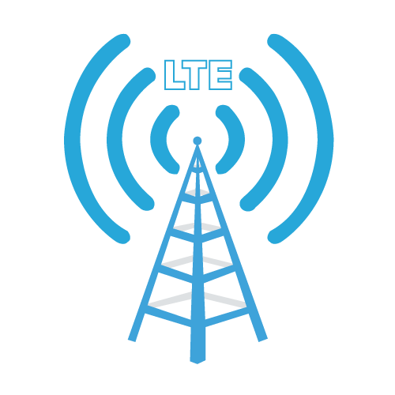
4G LTE on TV Band
Presented by
Eman Mahmoud
Abeer Thawabi
Supervised by
Dr. Ahmed Masri

Slide 2


Outlines
Overview on Generation of Network
LTE Architecture
LTE Antennas
TV Band Big Data Analysis
LTE Dimensioning
Graphical User Interface for LTE Planning
Conclusion

Slide 3




Overview on Generations of Network
1G
Analog
2G
FDMA
TDMA
3G
CDMA
4G
OFDMA

Slide 4
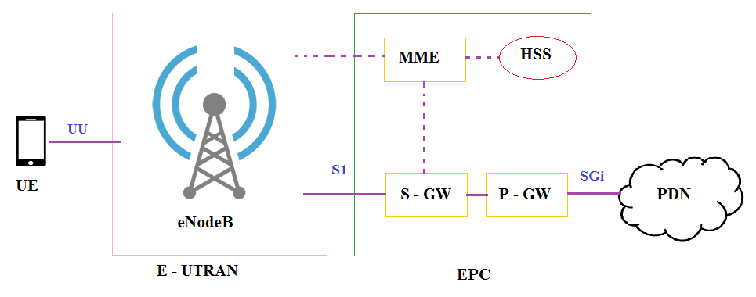
LTE Architecture

Slide 5
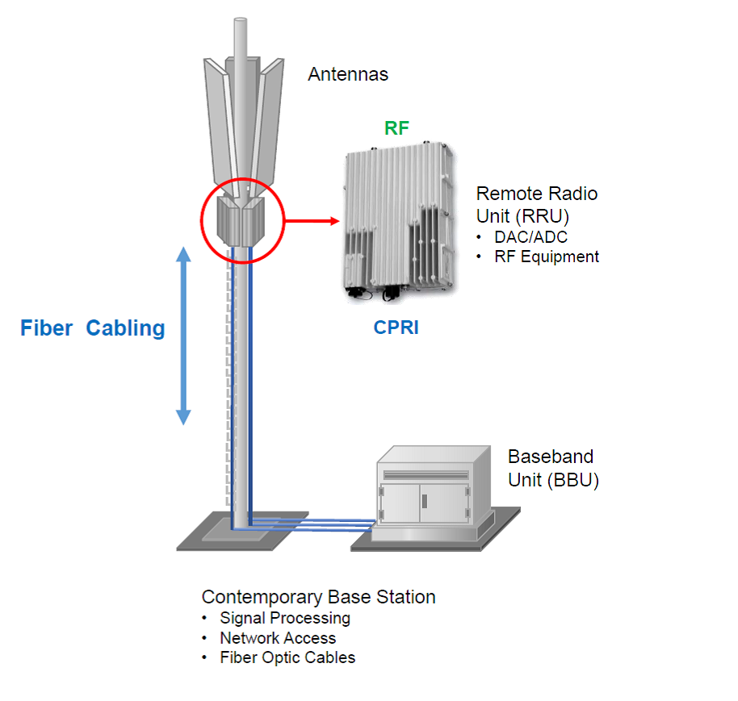
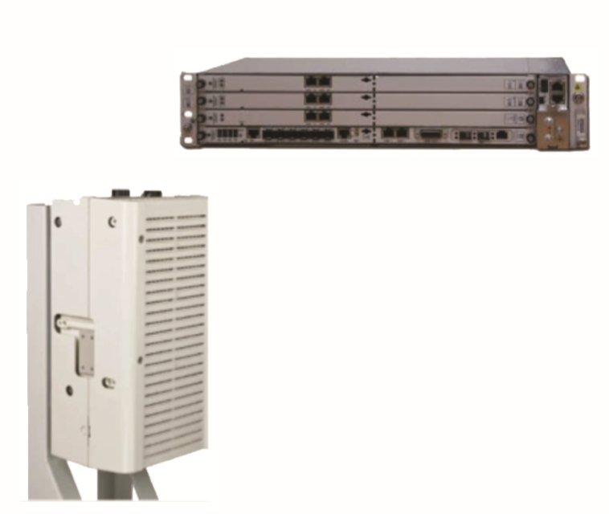
LTE Antennas

Slide 6
TV Band Big Data Analysis
TV Band in Palestine is (470 – 806 MHz).
Digital Dividend.
Uplink(MHz) | Downlink(MHz)
699-716 | 729-746
777-787 | 746-756
788-798 | 758-768
704-7016 | 734-746

Slide 7
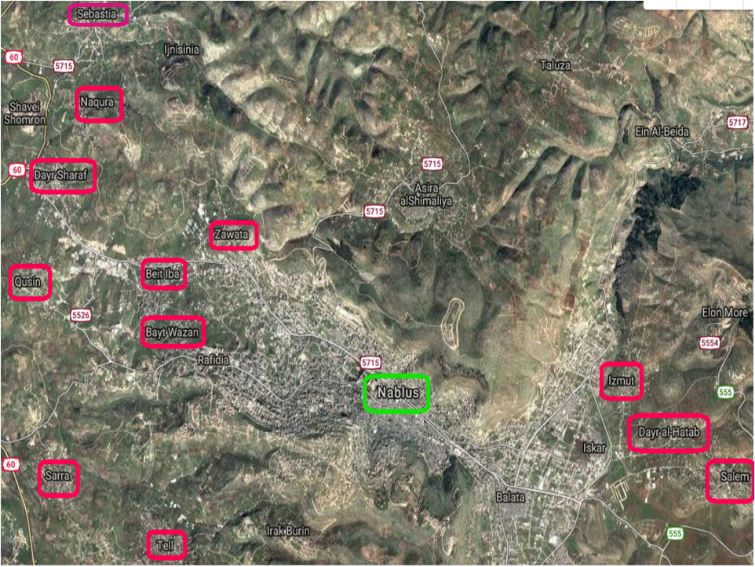

Slide 8
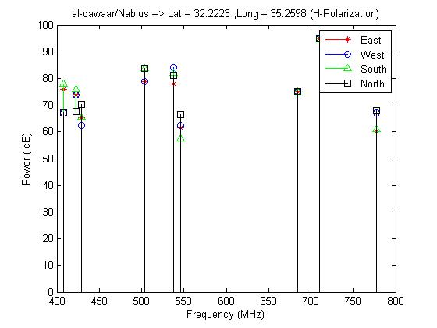

Slide 9
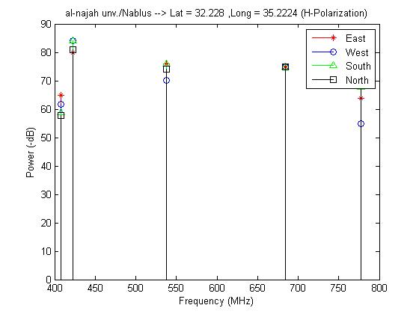

Slide 10
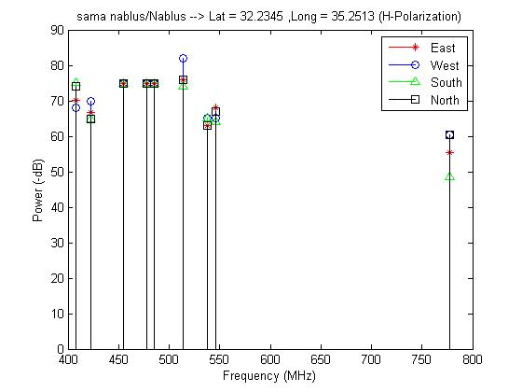

Slide 11
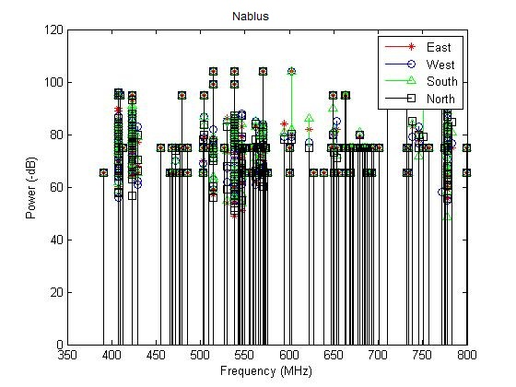

Slide 12
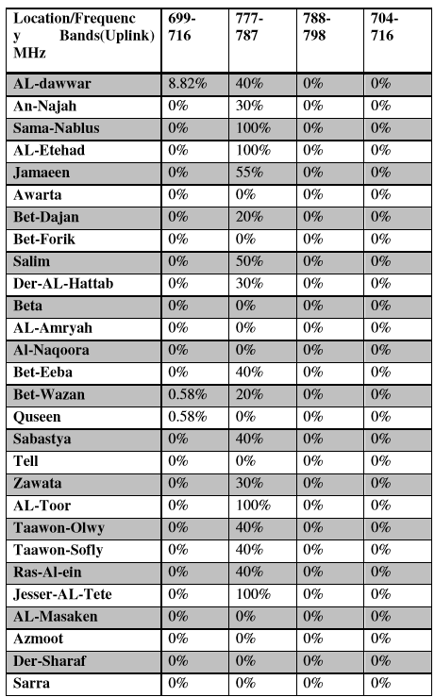
TV
Band
Big
Data
Analysis
For the Uplink LTE bands

Slide 13
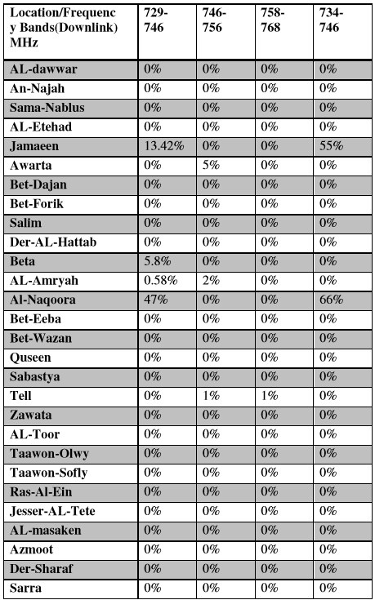
TV
Band
Big
Data
Analysis
For the Downlink LTE
bands

Slide 14
TV Band Big Data Analysis
Frequency Bands(Uplink) MHz | 699-716 | 777-787 | 788-798 | 704-716
Average Band Usage | 0.3564% | 31.25% | 0% | 0%
Frequency Bands(Downlink) MHz | 729-746 | 746-756 | 758-768 | 734-746
Average Band Usage | 2.385% | 0.285% | 0.0357% | 4.321%

Slide 15

LTE Dimensioning
Coverage Planning.
Capacity Planning.
Excel Sheet from JAWWAL.

Slide 16
LTE Dimensioning
Coverage Planning
Number of Sites
Capacity Planning
Data Rate
Step by step in calculations and equations.
Until we reach Number of Sites and Data Rate.

Slide 17
Coverage Planning
Frequency Band
Effective UE Height [m]
Receive Antenna Gain
Effective Antenna Height [m]
Total Power Per Cell

Slide 18
Coverage Planning
Noise & Losses
Thermal Noise | -173.98 dBm/Hz
Noise Floor | -124.22 dBm
Cell associated Losses (Cable + Connectors + Combiner) | -0.5 dB
Building Penetration Losses | 10.0 dB
Body Loss | 5.0 dB
UE associated Losses (Cable + Connectors + Combiner) | 0.0 dB

Slide 19
Number Of Sites
Cell radius (Km)
Coverage Area )Km^2)
Total number of coverage cells
Total number of 3 sector sites
Path loss exponent dB/dec
Path loss at 1Km
Radio Horizon Limited Cell Radius (km)

Slide 20
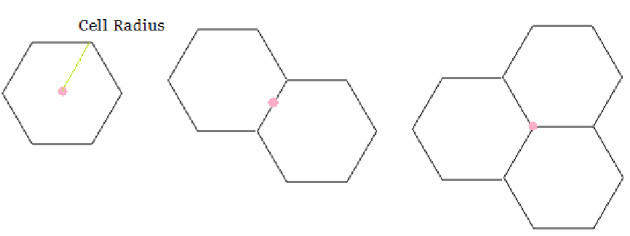
Types of Sites
Omni-directional Sites.
Bi-sector Sites.
Tri-sector Sites.

Slide 21
Capacity Planning
MIMO System
Cyclic Prefix
Number of Slots

Slide 22
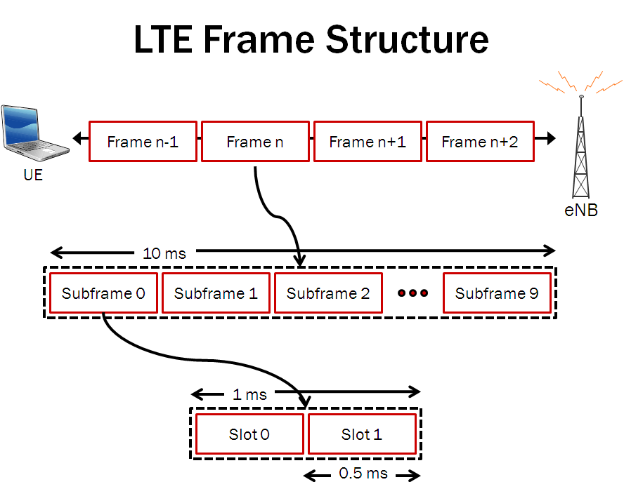
Number of Slots

Slide 23
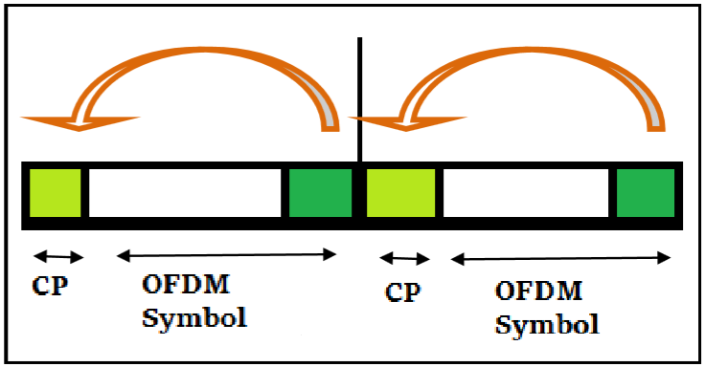
Cyclic Prefix
It is a guard period in the beginning of each OFDM symbol to save the continuity of the signal.

Slide 24
Capacity Planning
Efficiency f(CQI)
Total overhead
Maximum Achievable Data Rate
Effective payload

Slide 25
Graphical User Interface for LTE Planning
MATLAB
Coverage and Capacity Planning

Slide 26
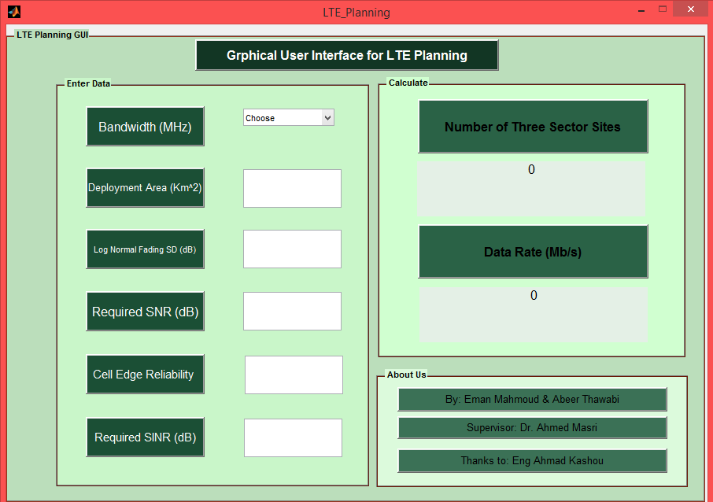

Slide 27
Conclusion
We can implement LTE on these Bands:
*Uplink →(788-798), (704-716)MHz.
*Downlink →(758-768)MHz.
GUI by using MATLAB to calculate:
*Number of three sector sites.
*Data Rate.

Slide 28
Thank You

