Slide 1

Graduation Project II
Structural analysis and design for Al-Aqsa school in Jerusalem
By:
1. Faraj Ghanem.
2. Mohammad Fahmawi.
3.Qais Khalil.
Under supervision of:
Dr. Abdul Razzaq Touqan
2017

Slide 2



Outline
1 Project description.
2 Seismic Design Parameters.
3 Check for Structural Irregularities.
4 Structural System Type.
5 Preliminary Evaluation.
.
6 Frame analysis by direct design method
.
7 Three Dimensional Structural Analysis.
8 ETABS Model Checks.
.

Slide 3

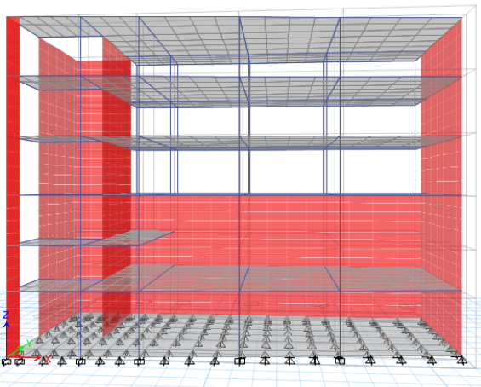
Project Description
This school is located in Jerusalem.
This school consists of:
Second, Third and Fourth Floor
Mezzanine
First Floor
Basement

Slide 4
Materials
Structural
Non Structural
Tile (𝛾 = 26kN/𝑚³ )
Block (𝛾 =12 kN/𝑚³ )
Reinforcement
steel
Aggregate
(𝛾 =20 kN/𝑚³ )
Concrete
Plaster
(𝛾 = 23 kN/𝑚³ )
Concrete Mortar
(𝛾 = 23kN/𝑚³ )

Slide 5
The Codes Used in This Project
The Codes used in this project are the following :
1
  ACI 318-14 (American Concrete Institute).
2
  IBC2015 (International Building Code).
3
  ASCE-7 (2010).

Slide 6



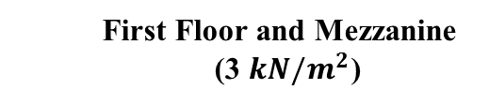
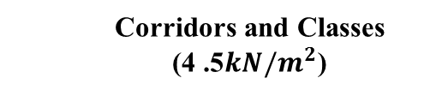
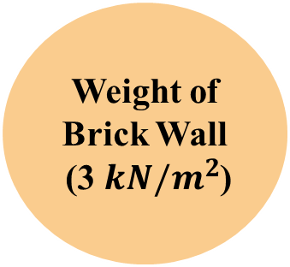




Gravity loads
Live Load
Weight of Brick Wall
(3 $kN/m^{2}$)
Slab Own Weight (6$.25 kN/m^{2}$)
First Floor and Mezzanine
(3 $kN/m^{2}$)
First Floor
(3 $kN/m^{2}$)
Classes
(3 $kN/m^{2}$)
Mezzanine
(4 $kN/m^{2}$)
Corridors
(4 $kN/m^{2}$)
Super Impose Dead Load
Corridors and Classes
(4 .5$kN/m^{2}$)
Roof
(2 $kN/m^{2}$)
Roof (2 $kN/m^{2}$)

Slide 7
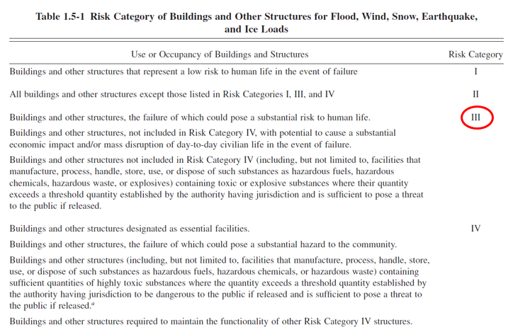
Seismic Design Parameters
Risk Category

Slide 8


S_{DS} = 0.48
S_{D1}= 0.32
Seismic Design Parameters
SM₁ =
S₁ x F_{V} = 0.32
SM_{S} =
S_{S} x F_{a} = 0.48
F_{v} = 1.6
Seismic Design Category (D)
F_{a} = 1.2
Importance Factor,
I = 1.25
S_{S} =
2.5 x Z
= 0.4
Site Class (C)
Seismic Zone Factor,
Z = 0.16
S₁=
1.25 x Z
= 0.2

Slide 9
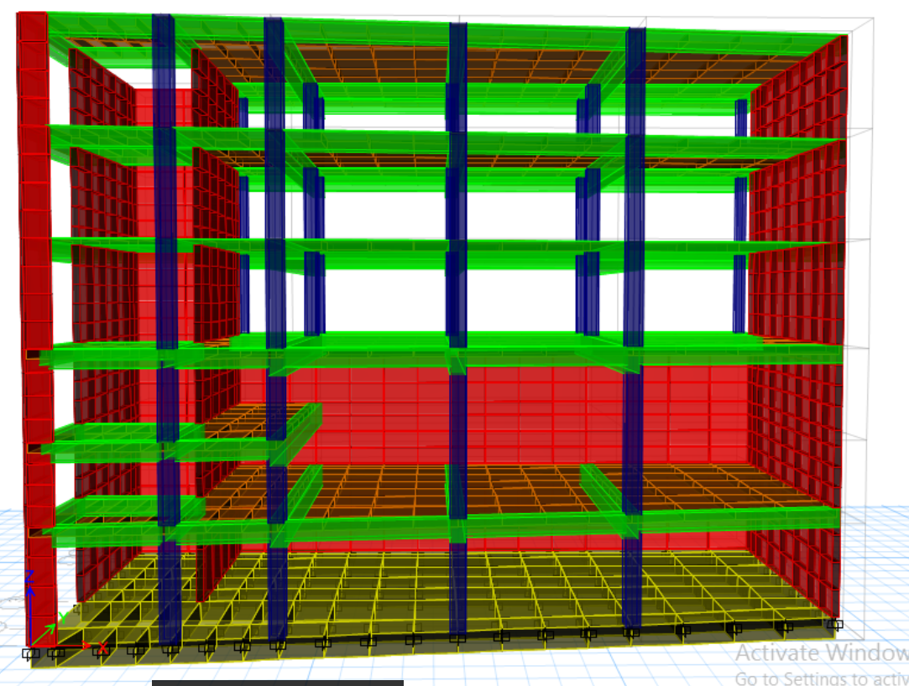

Check for Structural Irregularities

Slide 10
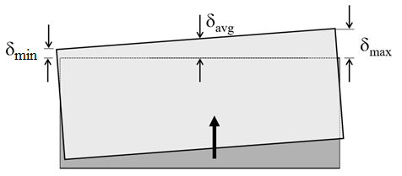
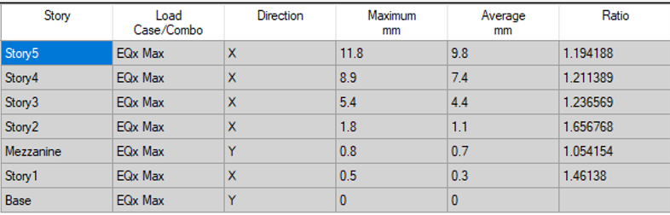
Horizontal Irregularities
1a. Torsional Irregularity
1b. Extreme Torsional Irregularity
In x-direction :

Slide 11
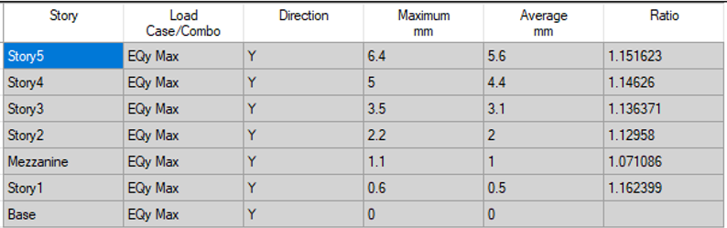
Horizontal Irregularities
1a. Torsional Irregularity
1b. Extreme Torsional Irregularity
In y-direction :

Slide 12
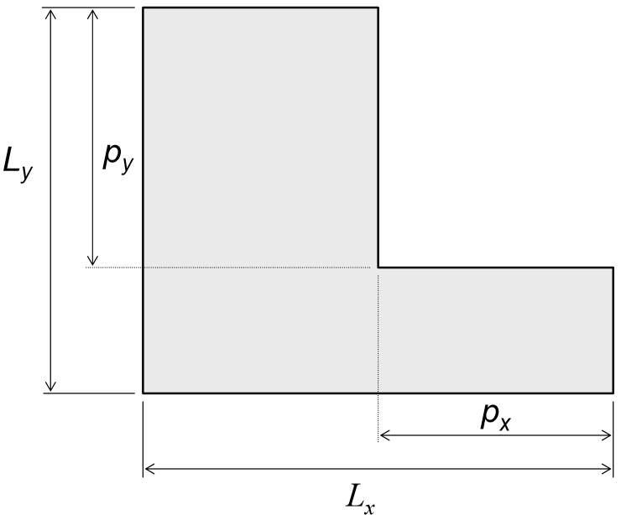
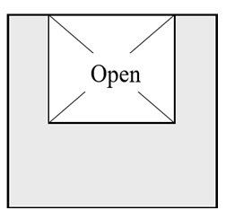
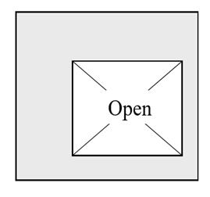
Horizontal Irregularities
2.Reentrant Corner Irregularity
3. Diaphragm Discontinuity Irregularity

Slide 13
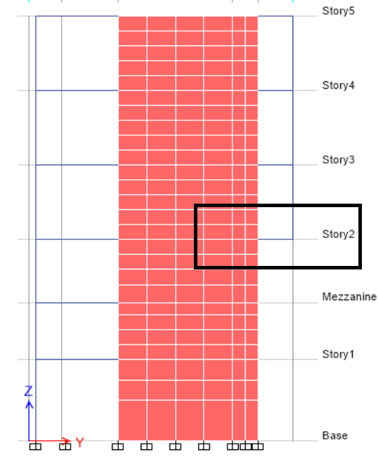
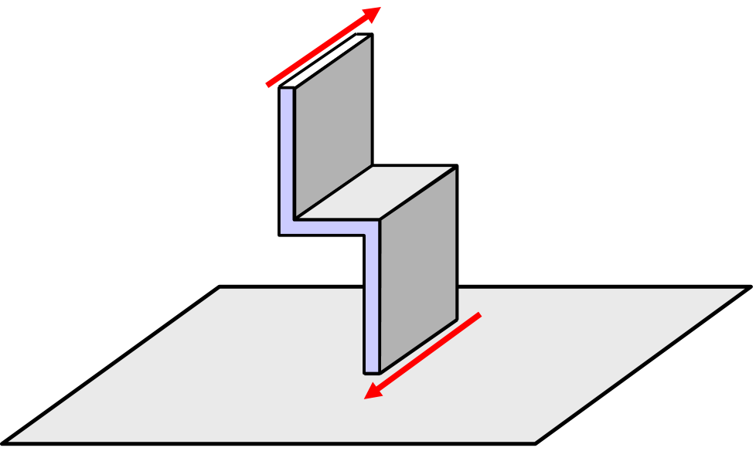
Horizontal Irregularities
4. Out-of-Plane Offset Irregularity.

Slide 14
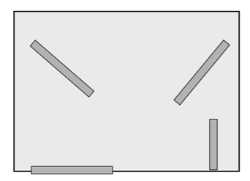
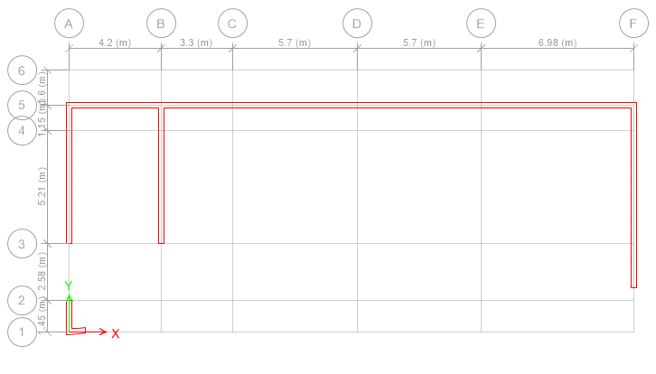
Horizontal Irregularities
5. Nonparallel System Irregularity

Slide 15
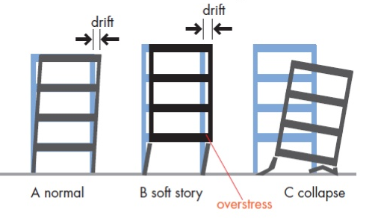
Vertical Irregularities
1a. Stiffness-Soft Story Irregularity
1b. Stiffness-Extreme Soft Story Irregularity

Slide 16
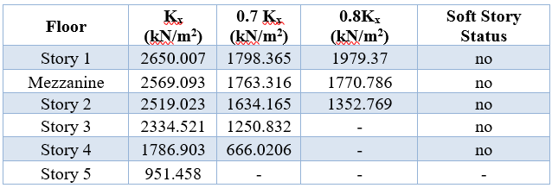
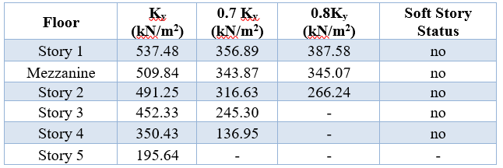
Vertical Irregularities
In x-direction :
In y-direction :

Slide 17
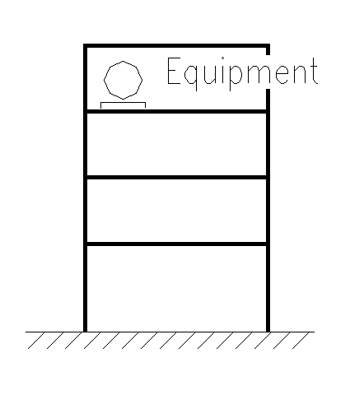
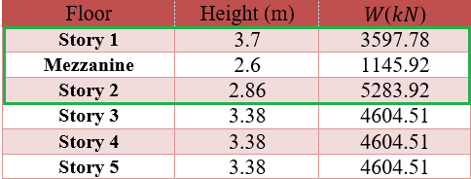
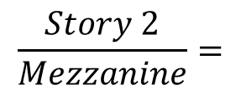

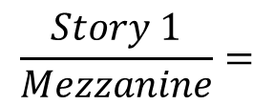

Vertical Irregularities
2. Weight (Mass) Irregularity
$$\frac{Story 1}{Mezzanine}=$$
$$\frac{4604.51}{1145.92} ∗100 \%=401\%$$
$$\frac{Story 2}{Mezzanine}=$$
$$\frac{5283.92}{1145.92} ∗100 \%=461\%$$

Slide 18
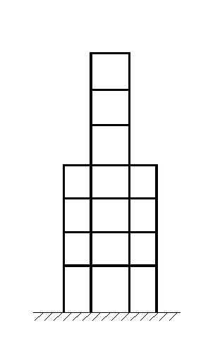
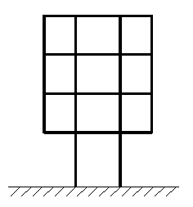
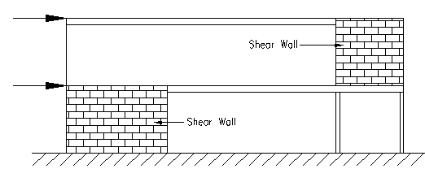
Vertical Irregularities
3. Vertical Geometric Irregularity
4. In-Plane Discontinuity in Vertical Lateral Force-Resisting Element Irregularity

Slide 19
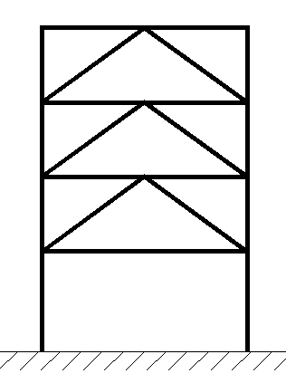
Vertical Irregularities
5a. Discontinuity in Lateral Strength–Weak Story Irregularity.
5b. Discontinuity in Lateral Strength–Extreme Weak Story Irregularity.

Slide 20

After all the problems of irregularity in the building, a decision was made to change the architectural shape in order to avoid these.

Slide 21
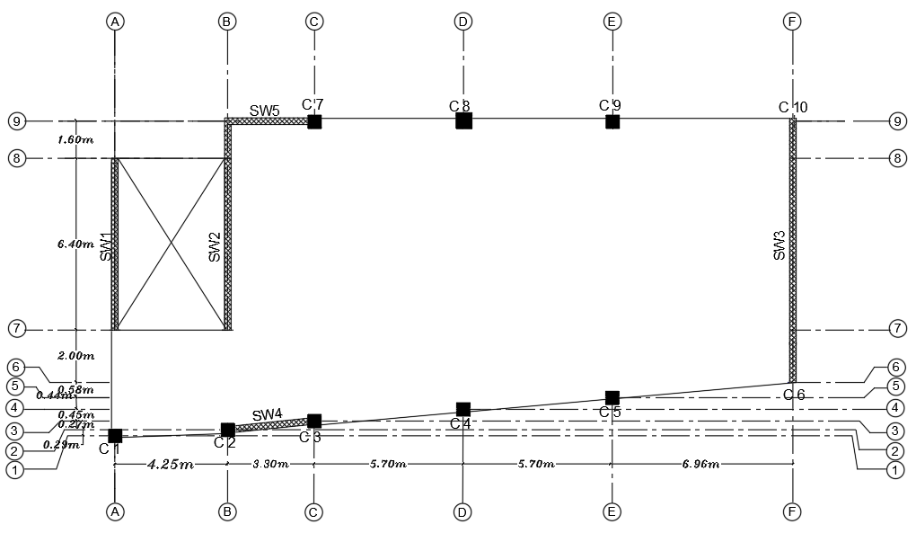
The new structure
The new plan for all stories
Area = 251.23 m²

Slide 22
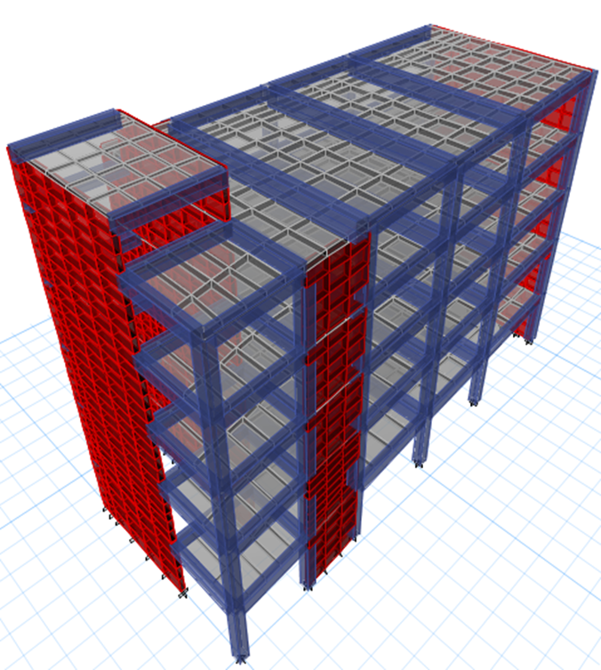

Preliminary Evaluation

Slide 23

Slab
Selected slab system:
The selected system was two – way solid slab.

Slide 24
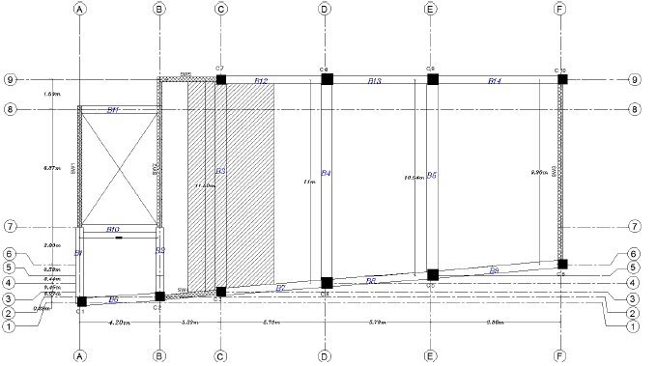
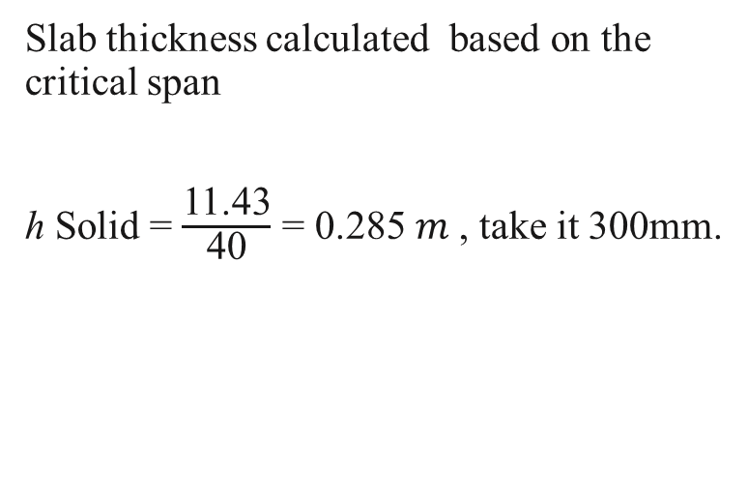
Slab
Slab thickness calculated based on the critical span
ℎ Solid = $\frac{\text{11.43}}{\text{40}}$ = 0.285 𝑚 , take it 300mm.

Slide 25
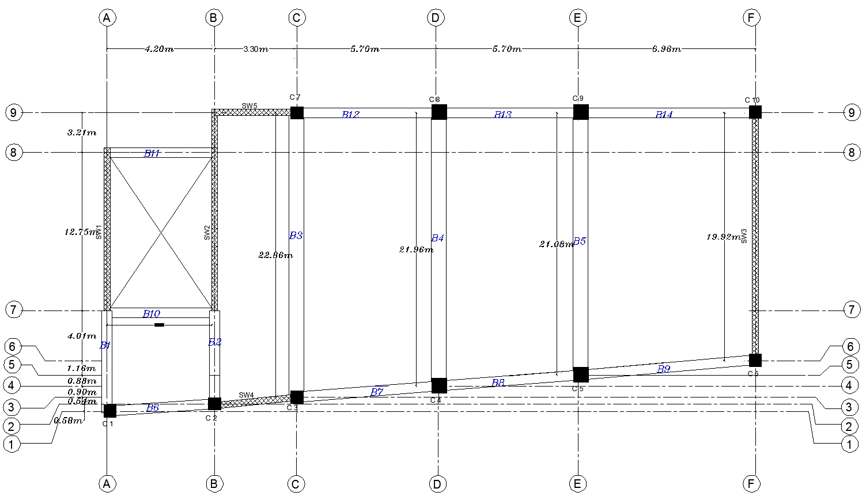
Beams
1
Beams distribution
For all floors the Beam distribution is shown:

Slide 26
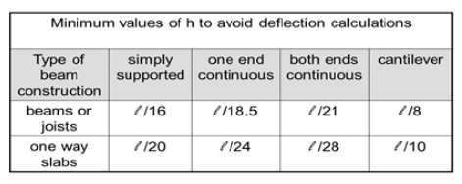
Beams
2
Beams dimensions
In X-direction the critical beam is one end continuous
In Y-direction the critical beam is simply supported

Slide 27
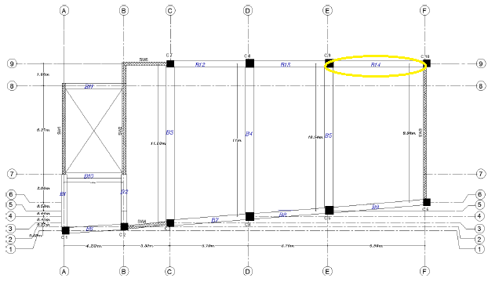
Beams
In x-direction :
H beam = 6.98 /18.5 = 380 mm, take it 600 mm.
B beam = 6.98 / 20 = 350 mm, take it 400 mm.

Slide 28
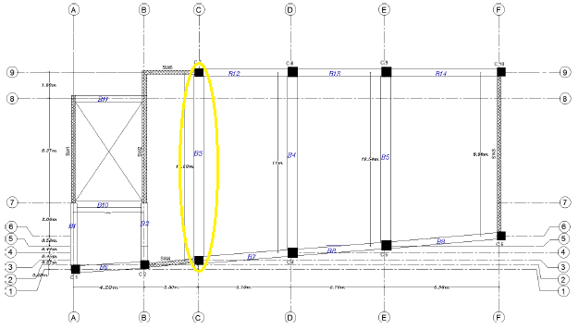
Beams
In y-direction :
H beam = 11.43/16 = 710 mm , take it 900 mm.
B beam = 11.43/(20 ) = 570 mm , take it 600 mm.

Slide 29
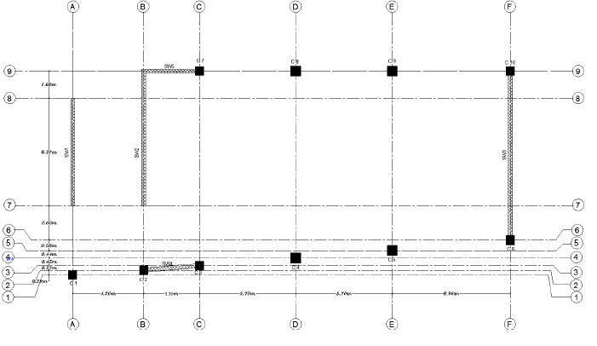
Columns
1
Columns distribution
For all floors the distribution is shown:

Slide 30
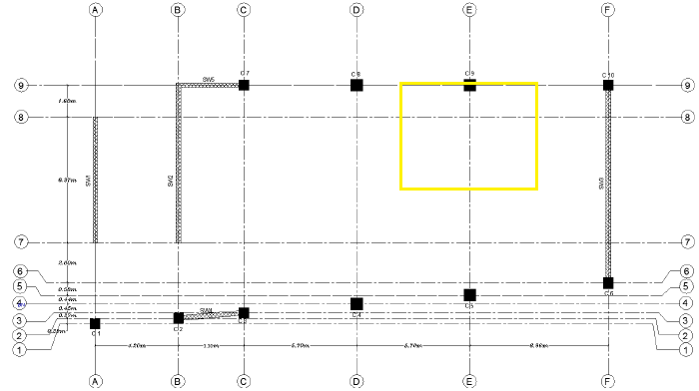
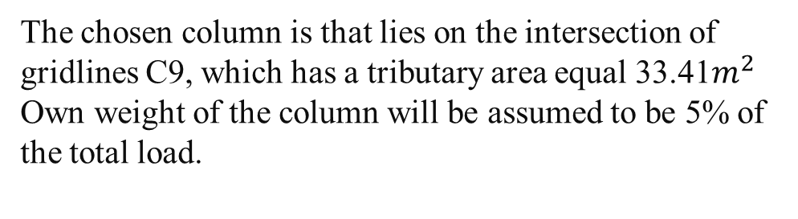
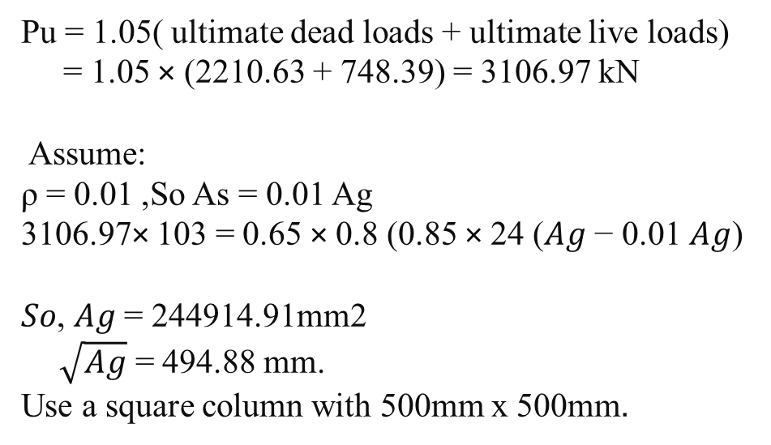
2
Dimension of column
Columns
The chosen column is that lies on the intersection of gridlines C9, which has a tributary area equal 33.41$m^{2}$ Own weight of the column will be assumed to be 5% of the total load.
Pu = 1.05( ultimate dead loads + ultimate live loads)
= 1.05 × (2210.63 + 748.39) = 3106.97 kN
Assume:
ρ = 0.01 ,So As = 0.01 Ag
3106.97× 103 = 0.65 × 0.8 (0.85 × 24 (𝐴𝑔 − 0.01 𝐴𝑔)
𝑆𝑜, 𝐴𝑔 = 244914.91mm2
$\sqrt{\text{Ag}}$ = 494.88 mm.
Use a square column with 500mm x 500mm.
+ 420 × 0.01 𝐴𝑔)

Slide 31
Shear Walls
Shear wall distribution
For all floors the distribution was:

Slide 32
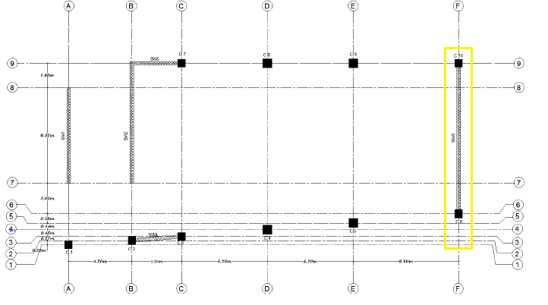
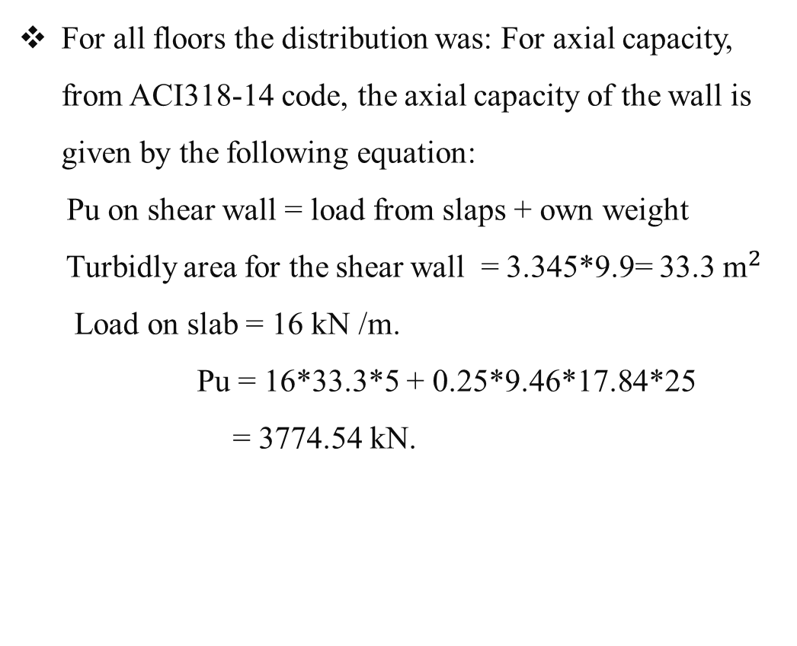
Shear Walls
Shear wall checks
For all floors the distribution was: For axial capacity, from ACI318-14 code, the axial capacity of the wall is given by the following equation:
Pu on shear wall = load from slaps + own weight
Turbidly area for the shear wall = 3.345*9.9= 33.3 ${\text{m}}^{2 }$
Load on slab = 16 kN /m.
Pu = 16*33.3*5 + 0.25*9.46*17.84*25
= 3774.54 kN.

Slide 33
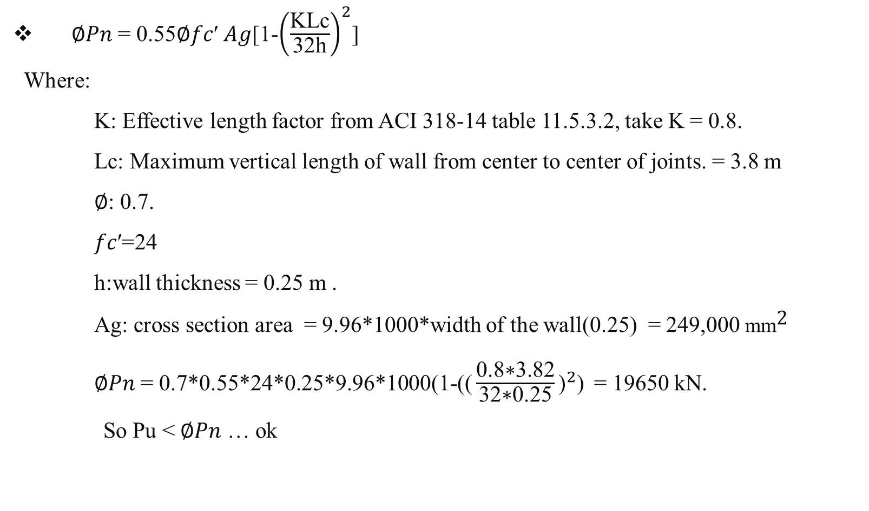
Shear wall checks
Shear Walls
∅𝑃𝑛 = 0.55∅𝑓𝑐′ 𝐴𝑔[1-${\left(\frac{\text{KLc}}{\text{32}\text{h}}\right)}^{2}$]
Where:
K: Effective length factor from ACI 318-14 table 11.5.3.2, take K = 0.8.
Lc: Maximum vertical length of wall from center to center of joints. = 3.8 m
∅: 0.7.
𝑓𝑐′=24
h:wall thickness = 0.25 m .
Ag: cross section area = 9.96*1000*width of the wall(0.25) = 249,000 ${\text{mm}}^{\text{2} }$
∅𝑃𝑛 = 0.7*0.55*24*0.25*9.96*1000(1-(${\text{(}\frac{\text{0.8}\text{∗}\text{3.82}}{\text{32}\text{∗}\text{0.25}}\text{)}}^{2}$) = 19650 kN.
So Pu < ∅𝑃𝑛 … ok

Slide 34
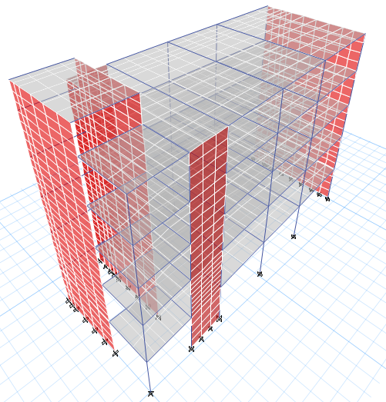
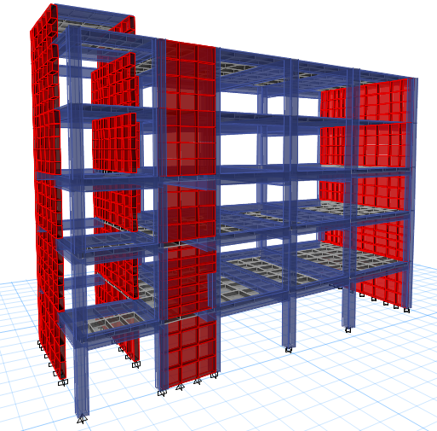
Three Dimensional Structural Analysis

Slide 35
ETABS Model Checks
Drawing structural model
Structural system type
Compatibility
Base shear by ELM
External equilibrium
Mass participation ratio
Checks
Internal equilibrium
Base shear by Response Spectrum
Slab deflection
Slab shear
Fundamental period
Drift

Slide 36
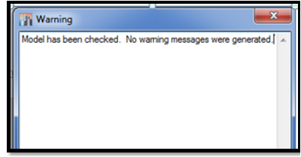
ETABS Model Checks
Drawing structural model
1

Slide 37
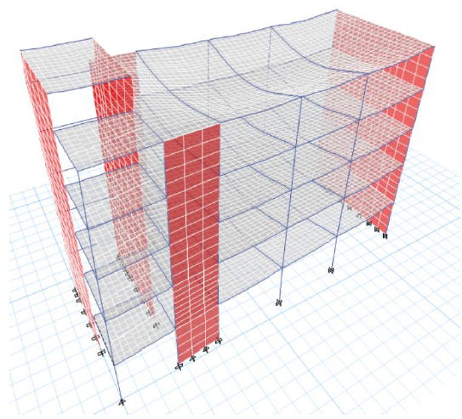
ETABS Model Checks
2
Compatibility
All structural members are moving as one unit.

Slide 38
ETABS Model Checks
3
External equilibrium
All loads on the structure and reactions are same.
Load type | Manual results (kN) | ETABS results (kN) | Difference %
Live | 4430.28 | 4432.66 | 0.05
Dead | 18229.76 | 18023.44 | 1.13
SD | 5623.44 | 5627.01 | 0.06
Wall | 2297.55 | 2297.99 | 0.02

Slide 39
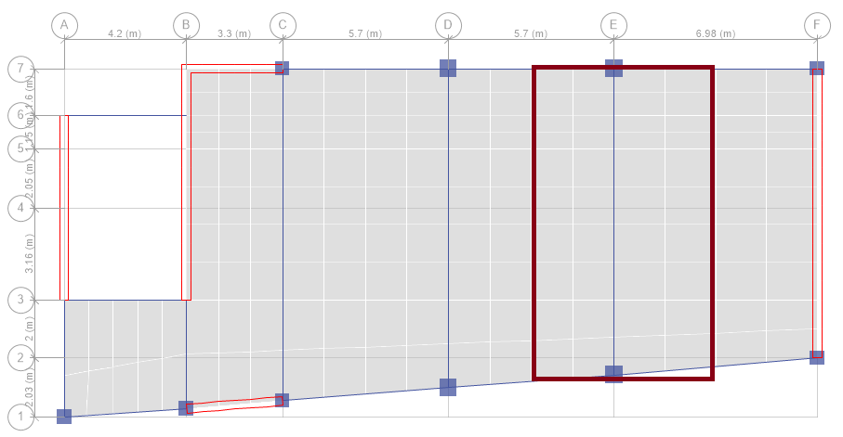
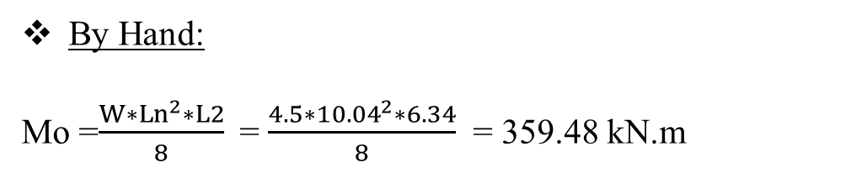
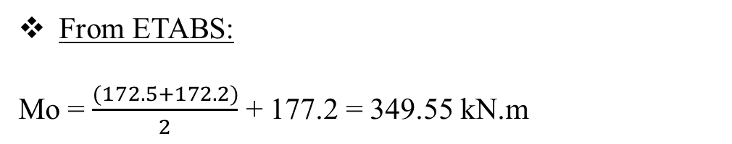
ETABS Model Checks
4.a
Internal equilibrium ( for frame )
Make a check on third floor slab for SD load (WSD = 4.5 kN/$m^{2})$
By Hand:
Mo =$\frac{W∗{Ln}^{2}∗L2}{8}$= $\frac{4.5∗{10.04}^{2}∗6.34}{8}$ = 359.48 kN.m
From ETABS:
Mo = $\frac{(172.5+172.2)}{2}$ + 177.2 = 349.55 kN.m
Difference % = 2.7 % < 10% then OK.

Slide 40

ETABS Model Checks
4.b
Internal equilibrium ( for column)
Make a check on column(gridlines E7) for SD
By Hand:
P SD = W _{SD} * Tributary area * No. of stories
P SD = (3* 33.41* 1) + (4.5* 33.41* 3)
+(1.5* 33.41* 1) = 601.38 kN
From ETABS:
P SD = 567.00 kN
Difference% = 5.6 % < 10 % then OK.

Slide 41


ETABS Model Checks
5.a
Slab shear (V13)
ФVc =$Ф∗\frac{1}{6}∗\sqrt{f`c}∗bw∗d$
=$0.75∗\frac{1}{6}∗\sqrt{24}∗1000∗\frac{260}{1000}$
= 159.2 kN/m
Colors indicate that no shear value
in x-direction more than shear
capacity of slab.

Slide 42


ETABS Model Checks
5.a
Slab shear (V23)
ФVc = 159.2 kN/m
Colors indicate that no shear value
in y-direction more than shear
capacity of slab.
.

Slide 43


ETABS Model Checks
6
Fundamental period
Code:
Ta = Ct ${\text{(}\text{hn}\text{)}}^{x}$
= 0.0466${\text{(}\text{17.84}\text{)}}^{0.9}$
= 0.623 sec
Upper limit of period = Cu*Ta
=1.4*0.623
= 0.872 sec
ETABS:
Fundamental period = 0.648 sec<0.872 sec

Slide 44


ETABS Model Checks
7
Structural system type
Building frame system (special reinforced concrete shear walls).
R = 6
$Ω_{o}$= 2.5
Cd = 5

Slide 45

ETABS Model Checks
8
Base shear by ELM
By Hand:
V = Cs * W
Where: W: effective seismic wieght (Dead load
+ SD + Wall load) = 25948.41 kN
Cs : siesmic response coefficent = 0.10
→V = 2594.84 kN
By ETABS:
→V = 2505.95 kN
Difference % = 3 % OK

Slide 46

ETABS Model Checks
8
Mass participation ratio
ASCE7-10 states ” The analysis shall include a sufficient number of modes to obtain a combined modal mass participation of at least 90 percent of actual mass in each of orthogonal horizontal directions of response considered by the model”.

Slide 47

ETABS Model Checks
9
Base shear by Response Spectrum
Input data of Response Spectrum

Slide 48


ETABS Model Checks
9
Base shear by Response Spectrum
Results of current dynamic analysis
Results of modified dynamic analysis

Slide 49

ETABS Model Checks
10
Slab deflection
Make a check on fifth slab in critical panel.
Δ Allowable = L / 240 = 10540/240 = 43.92 mm
Δ Long term = ΔL+ (λ∞ × ΔD) + (λt × ΔSL)
= 38.2 mm < 43.92 mm
Thickness of slab is suitable.

Slide 50


ETABS Model Checks
11
Drift
In x-direction :
In y-direction :
50

Slide 51

Design of Structural Elements

Slide 52

Structural Design
Slabs
Beams
Shear walls
Design
columns
Footings
Stairs

Slide 53


Slabs
Slabs Design
1
The ultimate minimum moment in both direction X and Y
depth of slap (H)=300 mm
width of slap section (B)= 1000 mm.
effective depth of the slap (d) = 260 mm.
As min = 0.0018 x 1000 x 300 = 540 mm2
a = 540 × 4200.85 × 24 ×1000 = 11.18 mm.
∅M = $\frac{\text{540 }\text{×} \text{420}\text{×}\text{ (}\text{260 }\text{−}\text{11.182}\text{)}}{{\text{10}}^{\text{6}}}$ = 57.7 kN.m
Flexural Capacity for slab:
∅M = As × 𝑓𝑦 × (d −$\frac{\text{a}}{2}$ )
Reinforcement Ratio of steel (𝜌):
𝜌 = 0.85𝑓𝑐′𝐹𝑦 (1-$\sqrt{\text{1}\text{− }\frac{\text{2.}\text{61}\text{Mu}}{\text{B}d^{2} \text{fc}\text{′}}}$)
𝜌𝑚𝑖𝑛 = 0.0018.

Slide 54

Slabs
In x-direction :M11
For zone A : As = 5∅18mm.
For zone B : As = 7∅18mm.

Slide 55

Slabs
Steel Detailing In x-direction

Slide 56

Slabs
In y-direction :M22
Use the minimum area of steel (5Ф12mm) for the bottom and top steel in Y- direction.

Slide 57

Slabs
Steel Detailing In y-direction

Slide 58

Shear Wall
Steel Detailing
3
  We use = Ф10/200 mm.

Slide 59

Columns
Columns distribution

Slide 60

Columns
Slenderness check
Code ACI318-14 permits to neglect the slenderness in braced columns if :
$\frac{KLu}{r}$ ≤ 34 – 12 $\frac{M1}{M2}$
≤ 40
Where:
K: the effective length factor.
L_{u}: the unsupported height.
r: the radius of gyration which equals to $\sqrt{\frac{I}{A}}$ , where I is the moment of inertia and A is the area of the section.
M₁: Smaller factored end moment on column.
M₂: larger factored end moment on column.

Slide 61


Columns
Slenderness check
Check slenderness on column C5 in two direction
Assume k=1
Lu = 4m
r = 0.3h = 0.3*0.5 = 0.15m
$\frac{KLu}{r}$ = $\frac{1∗4}{0.15}$ = 26.67
36.4 ≤ 34 – 12* $\frac{224.3}{−403.8}$ = 40.67
≤ 40
36.4 ≤ 34 – 12* $\frac{−54.3}{78.5}$ = 42.30
≤ 40
Neglect slenderness.

Slide 62

Columns
Reinforcement percentages
All values are permitted as ACI318-14.

Slide 63


Columns
ACI requirements of columns

Slide 64


Columns
Summery of columns

Slide 65

Columns
Detailing of column group C-1

Slide 66


Beams
1
Beams Design
The negative ultimate moment on the section = 726.7 kN.m.
The positive ultimate moment on the section = 598.6 kN.m.
The ultimate shear force on the section = 683.2 kN/m.
ρ = $\frac{\text{(}\text{0.85}\text{∗}\text{24}\text{)}}{\text{420}}$ (1-$\sqrt{\text{(}\text{1}\text{−} \frac{ \text{2.61}\text{∗}\text{(}\text{Mu}\text{)}\text{∗}{\text{10}}^{\text{6}}}{\text{600}\text{∗}{\text{(}\text{830}\text{)}}^{\text{2}}\text{∗}\text{24}}\text{)} }$
ρminimum = 0.0033
Top area of steel = 5 Ø 25 mm.
Bottom area of steel = 4 Ø 25 mm.
Stirrups Ø 10 mm were used.

Slide 67

Beams
1
Beams Design
The ultimate shear force (Vu) obtained from ETABS = 683.2 kN/m.
By calculating the concrete capacity from :
$ФVc= 0.75×\frac{1}{6}\sqrt{24}×600∗830= 305 kN/m$
Vu > ФVc, so a shear reinforcement is required that calculation as the following:
Vs
683.2 = 0.75 × ( 305 +Vs ) ➔ Vs = 378.2 kN/m.
By substituting in
$\frac{Av}{s}$ = $\frac{378.2 1000 }{420∗830}= 1.085 >$ $\frac{\text{Av}}{\text{s}},$ minimum (0.5 ${\text{mm}}^{\text{2}}$/mm).
Stirrups Ø 10 mm were used.

Slide 68



Beams
2
Beams Detailing

Slide 69

Beams
2
Beams Detailing

Slide 70

Shear Wall
1
Shear wall design
Internal forces in shear wall:
Vu = 1064 kN
Mu = 7913.2 kN
Pn = 4972 kN

Slide 71

Shear Wall
For vertical shear reinforcement:
$\frac{\text{Al}}{\text{s}}$ = ρl × wall thickness = 0.0025 × 250 = 0.625 mm2 / mm.
* S max = 450 mm.
For two curtains (layers) of reinforcement with Ø 10 mm:
$\frac{\text{Av}}{\text{s}}$ =$\frac{2∗78.5}{\text{s}}$= 0.625 , So S = 251.2 mm, ok.
use 2Ф10/250mm.

Slide 72

Shear Wall
For horizontal shear reinforcement:
$\frac{\text{At}}{\text{s}}$ = ρt × wall thickness = 0.0025 × 250 = 0.625 mm2 / mm.
S max = 450 mm.
For two curtains (layers) of reinforcement with Ø 10 mm:
$\frac{\text{Av}}{\text{s}}$ = 2∗𝐴𝑟𝑒𝑎 𝑜𝑓 𝑏𝑎𝑟𝑠 = $\frac{\text{2}\text{∗}\text{78.5}}{\text{s}}$ = 0.625, So S = 251.2 mm, ok.
use 2Ф10/250mm.

Slide 73

Shear Wall
Special boundary elements check.
Special boundary elements are needed if the stress σ > 0.2 f'c
σ = 0.2 x 24= 4.8 MPa.
To compute stress from σ = $\frac{P}{A}$ + $\frac{MC}{I}$ Where:
I: Moment of inertia equal $\frac{bh^{3}}{12}$= $\frac{250{ × 9960}^{3}}{12}$= 2.05 × ${10}^{13}$ mm2
C: Equal 0.5 × Lw = 0.5*9960 = 4980 mm
So, σ = $\frac{4972 × {10}^{3}}{250 × 9960}$ + $\frac{7913 × {10}^{6 }× 4980}{2.05 × {10}^{13}}$ = 3.89 Mpa. < 4.8 MPa, oK.
Therefore, there is no need for boundary elements.

Slide 74

Shear Wall
Steel Check
2
.
For area of steel = Ф10/250 mm the interaction diagram shown in the figure .
The point intersection of ФPn and ФMn is within the curve so use Ф10/250 mm

Slide 75


Design of footing
Mat Footing
Single
Footing
Combined Footing
Wall
Footing
Piles

Slide 76



Footing
Mat Footing was selected
Allowable bearing pressure is small q all = 200 kN /$m^{2}$.
Area of single footings and wall footings in the base is more than half ground floor area.
Required area of footing =$\frac{Pservice}{q all}$
Required area of footing = $\frac{30552.51 }{200}$ = 152.8 $m^{2}$
Area of basement = 277.31 $m^{2}$
Percentage between required area of footing and area of basement equals 0.55, which is greater than 0.50.

Slide 77

Design of footing

Slide 78


Design of footing
Pressure under footing check
σ max = 190.8 kN/$m^{2}$
Qallowable = 200 kN/$m^{2}$>190.8 kN/$m^{2}$OK

Slide 79



Design of footing
Punching shear check
ФVcp $≤ Ф∗0.17(1+\frac{2}{β})\sqrt{f`c}∗bo∗d$
$≤ Ф∗0.083(2+\frac{d∗αs}{bo})\sqrt{f`c}∗bo∗d$
$≤ Ф∗0.333∗\sqrt{f`c}∗bo∗d$
ФVcp = 2931 kN
Vup = Pu – A1 * σult
= 4104.3 – (1.27 *201.94)
= 3847.84 kN > 2931 kN, Not OK.
Increase thickness to 800 mm
ФVcp = 4037 kN > 3847.84 kN, OK.

Slide 80


Design of footing
Shear V13 check
ФVc =$Ф∗\frac{1}{6}∗\sqrt{f`c}∗bw∗d$
=$0.75∗\frac{1}{6}∗\sqrt{24}∗1000∗\frac{730}{1000}$
= 447 kN/m
Vu13 = 389.91 kN/m < 447 kN/m
Thickness is suitable in this direction.

Slide 81

Design of footing
Shear V23 check
ФVc = 447 kN/m
Vu23 = 404.69 kN/m < 447 kN/m
Thickness is suitable in this direction.
→ No need for shear reinforcement.

Slide 82



Design of footing
Design mat footing (M11)
Other values are minimum steel.
$ρ$ min = 0.0018
As min = 0.0018 *1000*800
= 1440 ${mm}^{2}$/m (6Ø18/m)

Slide 83



Design of footing
Design mat footing (M22)
Other values are minimum steel.
$ρ$ min = 0.0018
As min = 0.0018 *1000*800
= 1440 ${mm}^{2}$/m (6Ø18/m)

Slide 84

Design of footing
Section A-A in mat footing

Slide 85


Design of stairs
Check deflection
Check shear
Thickness of stair = 200 mm
Design moment
M max = 27 kN.m
ρ = 0.00292 > ρmin
As = 0.00292 *1000*170
= 500 ${\text{mm}}^{2}$/m
Use 4Ø 14 /m
And so on.

Slide 86

Design of stairs
Longitudinal section

Slide 87

Thank you

Slide 88


