Slide 1
IoT BASED PATIENT MONITORING SYSTEM USING RASPBERRY PI 3
Supervisor: Dr.Falah Hasan.
Prepared by : Lubna Ateeli
Aseel BniJamaa

Slide 2
Outline:
The idea of project
Advantages
Hardware
Software
Constrains
conclusion

Slide 3
The idea of project:
In this project, monitoring system is presented which allows doctor to view his patient’s vital parameter remotely and dynamically in a Web page in real time , all he needs is an internet access.

Slide 4
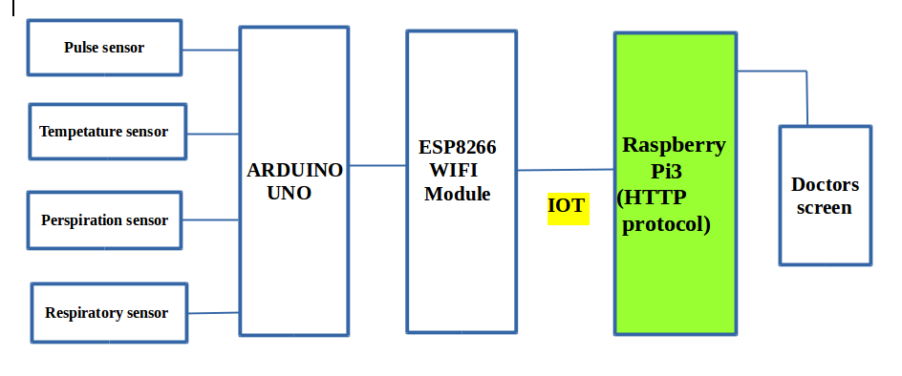

Slide 5
Advantages
enabling more care and attention towards the patient’s health by the doctor
Live monitoring
Low cost
This type of system really helpful in hospitals for the critical situation patients who need continuous observation overseas

Slide 6
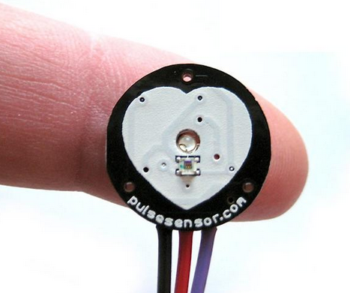
Hardware
Pulse sensor

Slide 7
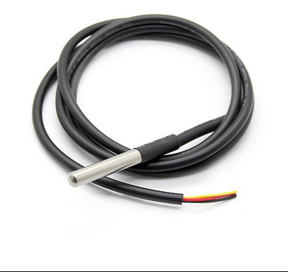
DS18b20 temperature sensor

Slide 8

perspiration sensor

Slide 9
Respiratory Sensor

Slide 10
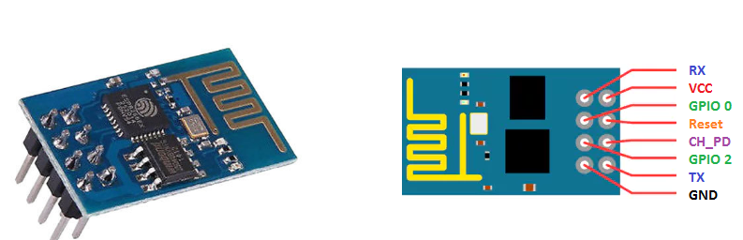
Esp8266 Wi-Fi

Slide 11
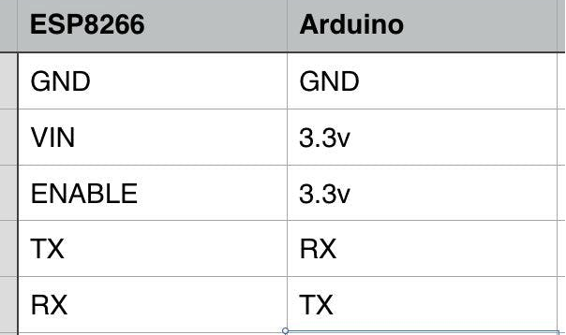

Slide 12
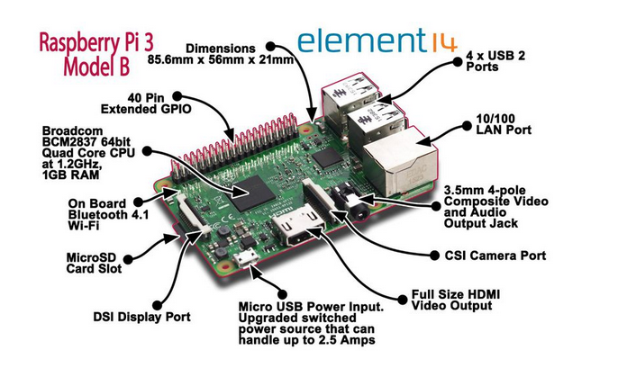
Raspberry pi 3

Slide 13
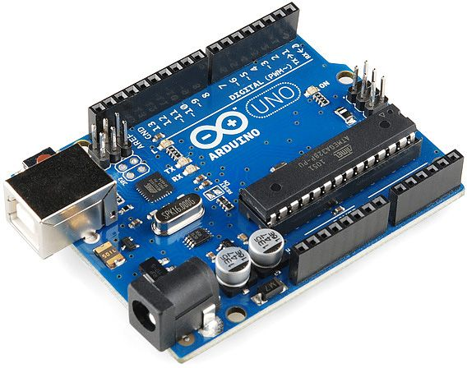
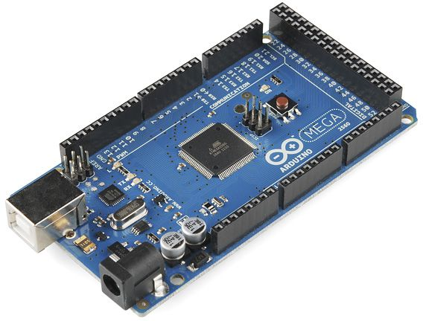
Arduino

Slide 14
why we Connect Arduino to the internet by adding ESP8266 Wi-Fi Module
the ESP8266 Wi-Fi module is a complete Wi-Fi network
wireless internet access interface to any microcontroller­ based design on its simple connectivity through Serial Communication or UART interface

Slide 15
Software
We collected the sensor codes together in Arduino file ,then send all data serially to esp8266 by using esp library and write hard code In order to be transferred later to the server
هون في صورة لصفحة esp

Slide 16
Client and server
HTTP (Hypertext Transfer Protocol) is the set of rules for transferring files (text, graphic images, sound, video, and other multimedia files) on the World Wide Web. As soon as a Web user opens their Web browser, the user is indirectly making use of HTTP. HTTP is an application protocol that runs on top of the TCP/IP suite of protocols (the foundation protocols for the Internet)

Slide 17
Private network
A private network is any connection within a specified network wherein restrictions are established to promote a secured environment. This type of network can be configured in such a way that devices outside the network cannot access it. Only a selected set of devices can access this type of network depending on the settings encoded in the network routers and access points. On the other hand, a public network is defined as a network that anyone can freely connect to little or no restriction

Slide 18
How to Set up a Private Network between raspberry pi3 and esp8266?

Slide 19
create an empty file for each sensor:
In order to do this we need to communicate between raspberry pi3 and esp wifi by using HTTP protocol to take the readings from sensor ,after that by adding modifications to the code by opening four files reading them and put each readings in its own file

