Slide 1

Graduation Project 2
Deasign and And Analysis of Arafat Residential Building
By:Abdularahman Shami
Mohammad Abualrob
Mohammad Khalili
Mohammad Nour
Under supervisor of Dr.Mohammad Ghazal

Slide 2
Outlines
Introduction.
Site condition.
Brief scope of project 1.
Proposed designs.
Conclusion.

Slide 3
Introduction
Arafat Residential Building is an under construction project, it is reinforced concrete structure consisting of 9 floors, total area for basement floor is around 447 m², for the other floors 761 m², building is located in Al-Dahia in Nablus City.

Slide 4
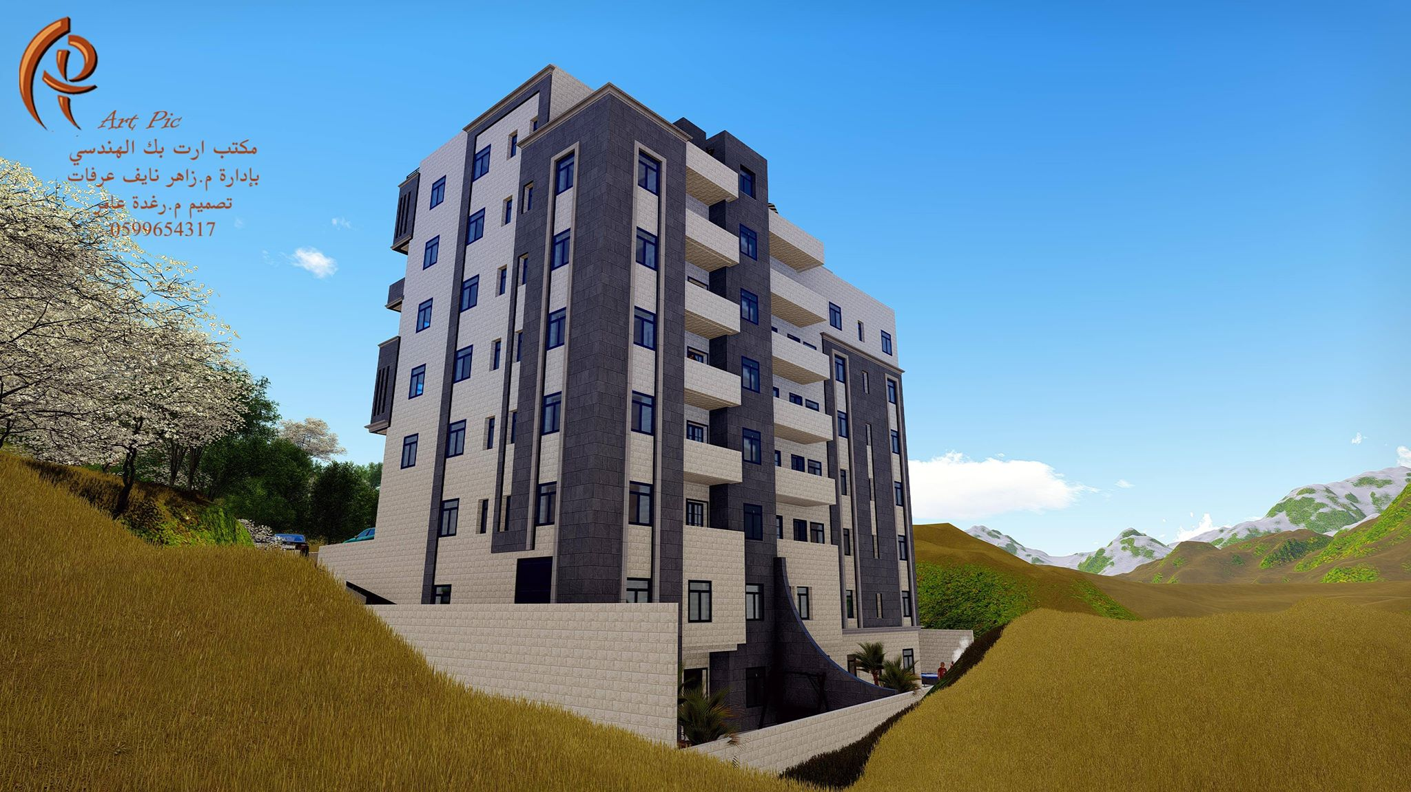

Slide 5
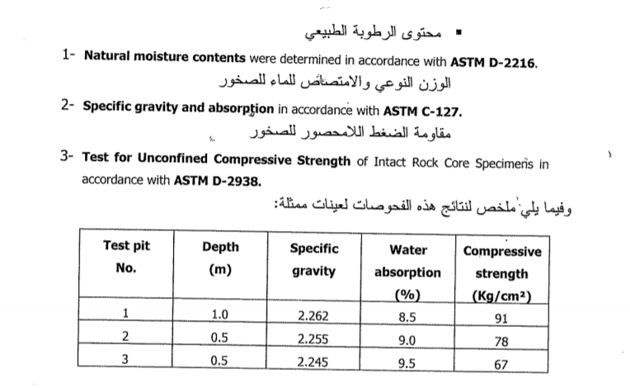
Site condition
Taking the lowest result (67)
Q_{all} =5%*67 =3.35 kg/cm²

Slide 6
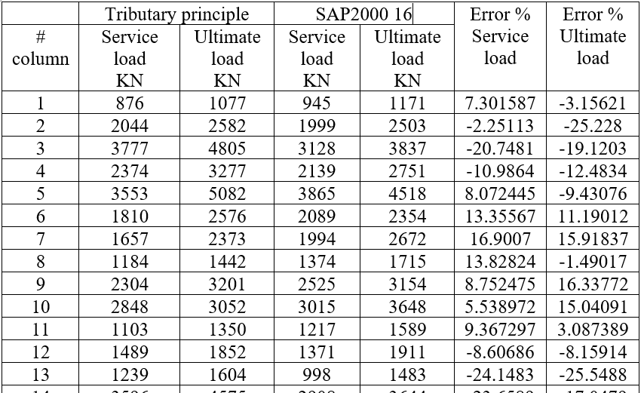
Brief scope of project 1

Slide 7
So depending on results from from SAP2000 16 in designing footings in which we will take into consideration two conditions of soil :
3 kg/cm².
1.5 kg/cm².
These results lead us to design the following footings:
Isolated and combined footings,
Raft footings.
Retaining wall.

Slide 8
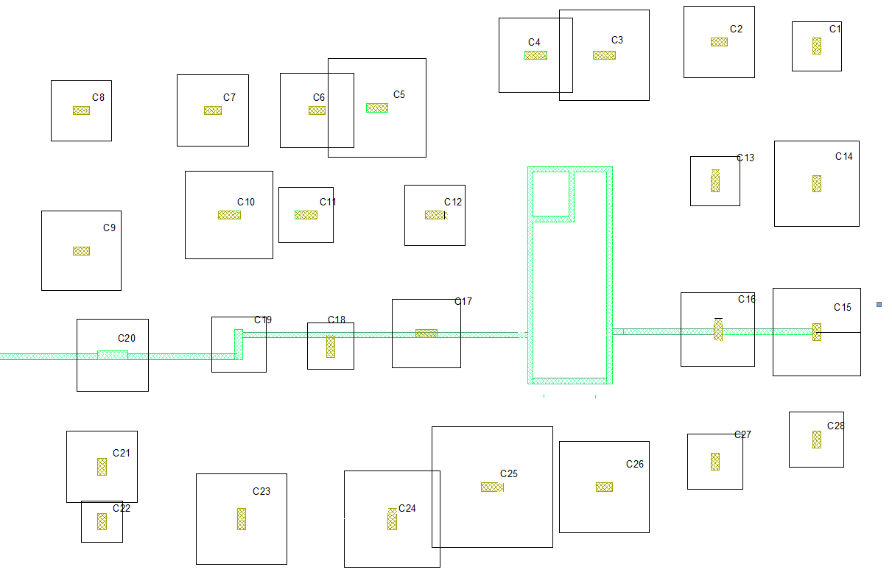
Bearing capacity 3 kg/cm²

Slide 9
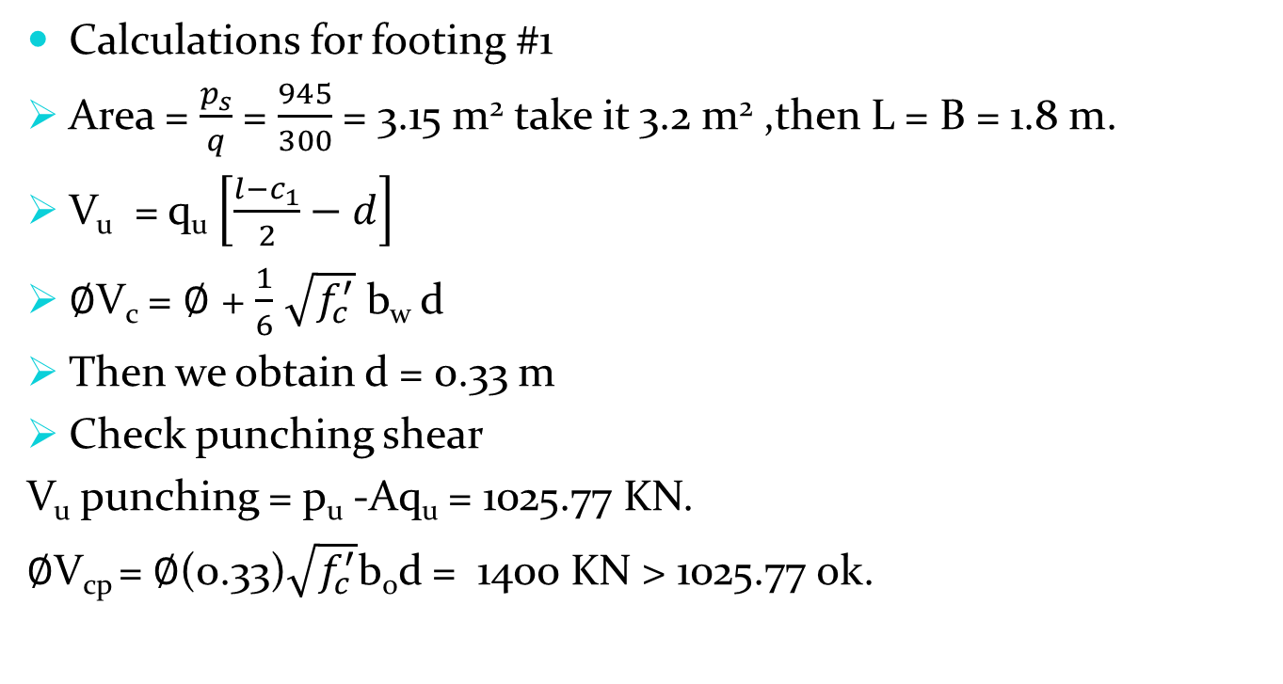
Design of Isolated footings
Calculations for footing #1
Area = $\frac{p_{s}}{q}$ = $\frac{945}{300}$ = 3.15 m² take it 3.2 m² ,then L = B = 1.8 m.
V_{u} = q_{u} $\left[\frac{l−c_{1}}{2}−d\right]$
$∅$V_{c} = $∅$ + $\frac{1}{6}$ $\sqrt{f_{c}^{′}}$ b_{w} d
Then we obtain d = 0.33 m
Check punching shear
V_{u} punching = p_{u} -Aq_{u} = 1025.77 KN.
$∅$V_{cp} = $∅$(0.33)$\sqrt{f_{c}^{′}}$b_{o}d = 1400 KN > 1025.77 ok.

Slide 10
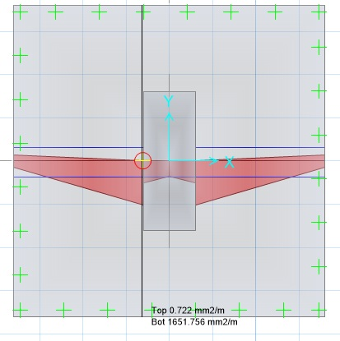
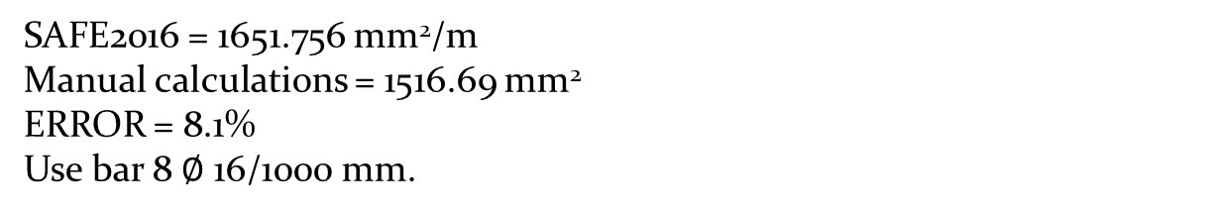
SAFE2016 calculations.
SAFE2016 = 1651.756 mm²/m
Manual calculations = 1516.69 mm²
ERROR = 8.1%
Use bar 8 $∅$ 16/1000 mm.

Slide 11
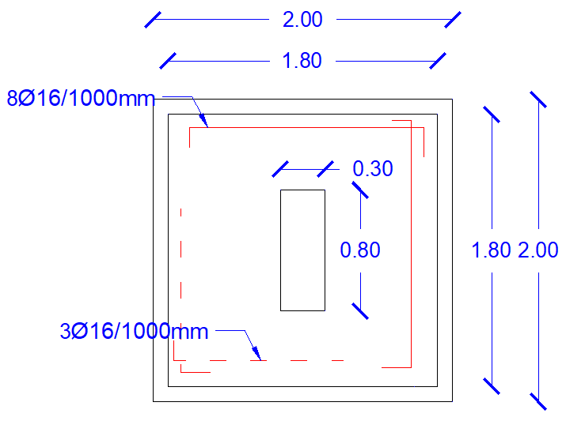
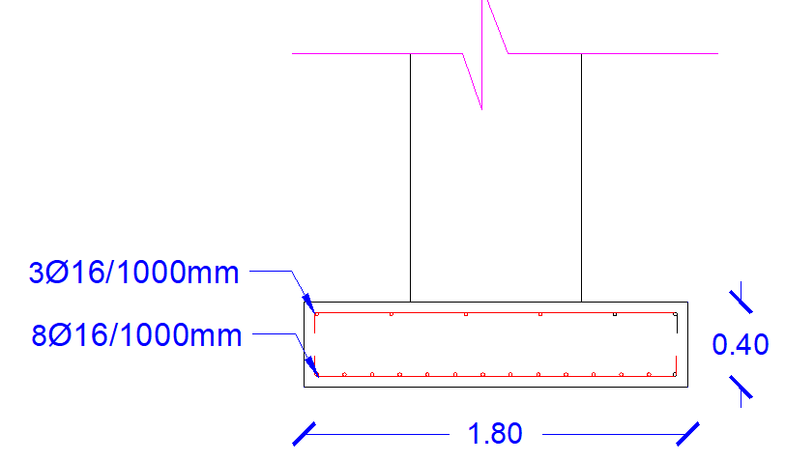

Slide 12
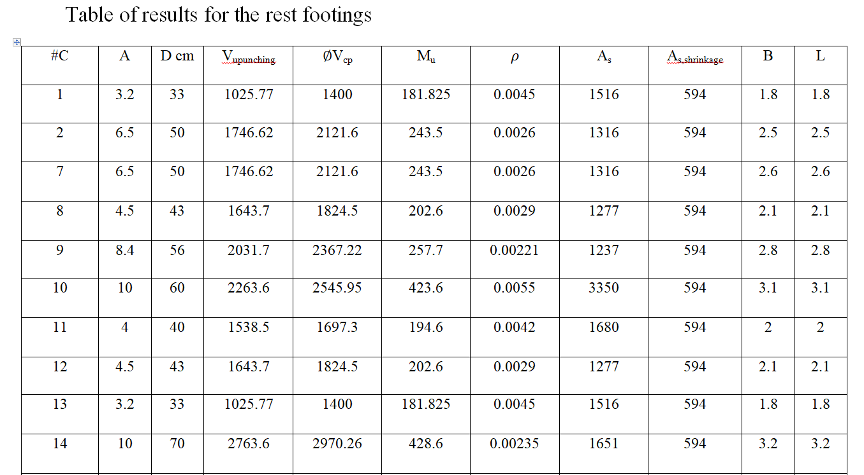

Slide 13
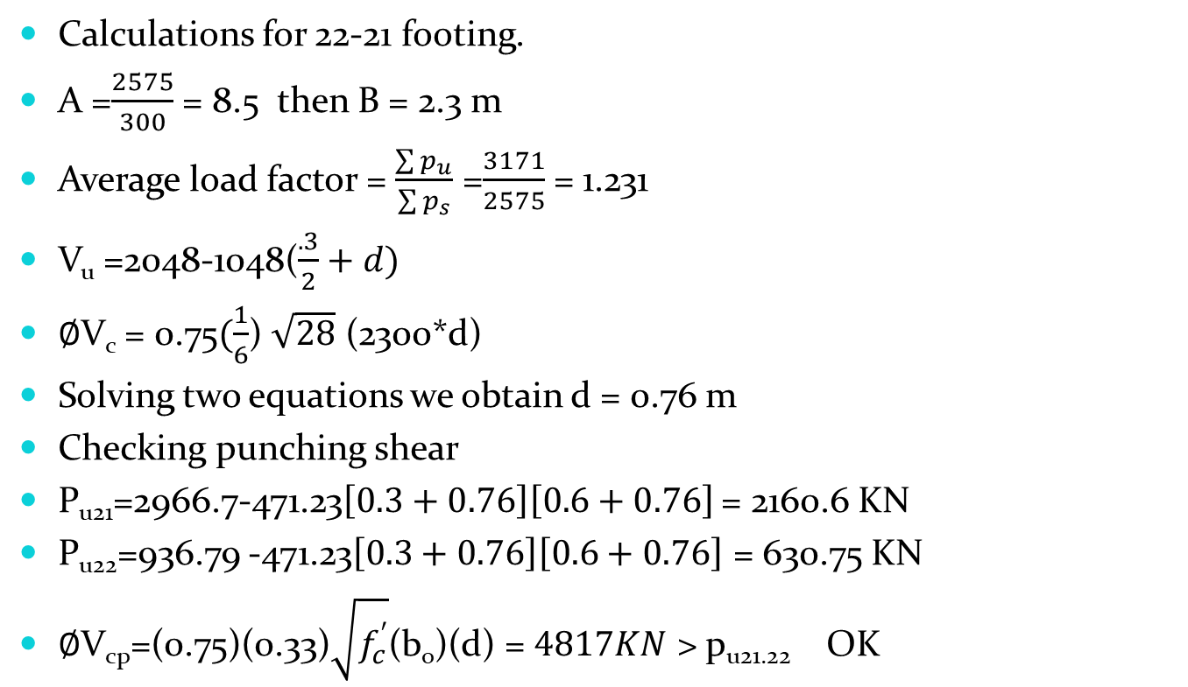
Design of combined footings
Calculations for 22-21 footing.
A =$\frac{2575}{300}$ = 8.5 then B = 2.3 m
Average load factor = $\frac{\sum{p_{u}}}{\sum{p_{s}}}$ =$\frac{3171}{2575}$ = 1.231
V_{u} =2048-1048($\frac{.3}{2}+d)$
$∅$V_{c} = 0.75$(\frac{1}{6}$) $\sqrt{28}$ (2300*d)
Solving two equations we obtain d = 0.76 m
Checking punching shear
P_{u21}=2966.7-471.23$\left[0.3+0.76\right]\left[0.6+0.76\right]$ = 2160.6 KN
P_{u22}=936.79 -471.23$\left[0.3+0.76\right]\left[0.6+0.76\right]$ = 630.75 KN
$∅$V_{cp}=(0.75)(0.33)$\sqrt{f_{c}^{′}}$(b_{o})(d) = $4817KN$ > p_{u21.22} OK

Slide 14
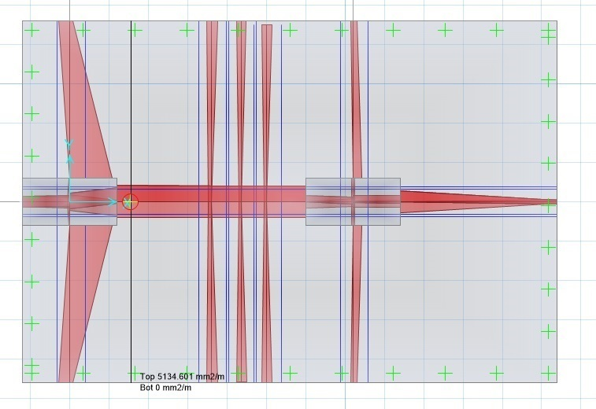
SAFE2016 calculations
Manual calculations A_{s} =5489.87
SAFE2016 = 5134.6 mm²/m , ERROR = 6.4 %

Slide 15
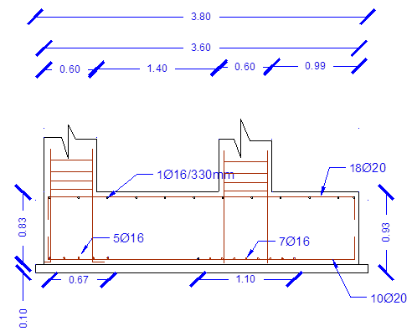
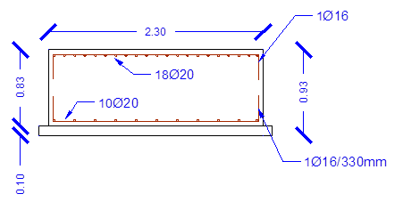

Slide 16
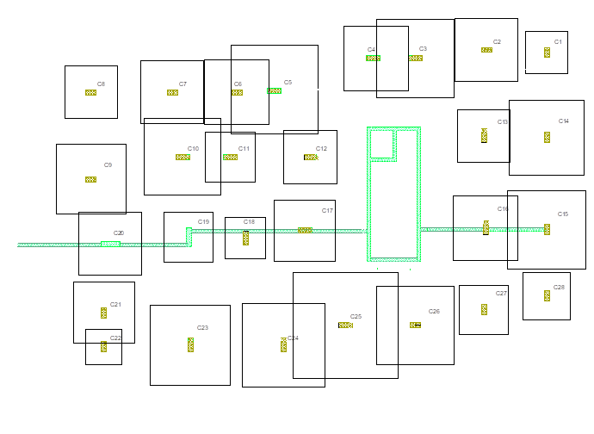

Second condition, $Q_{all}$ = 150 KN/m2

Slide 17
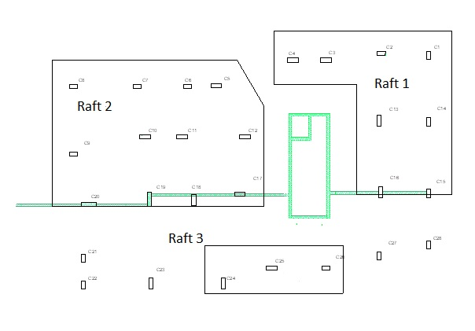
Proposed design

Slide 18
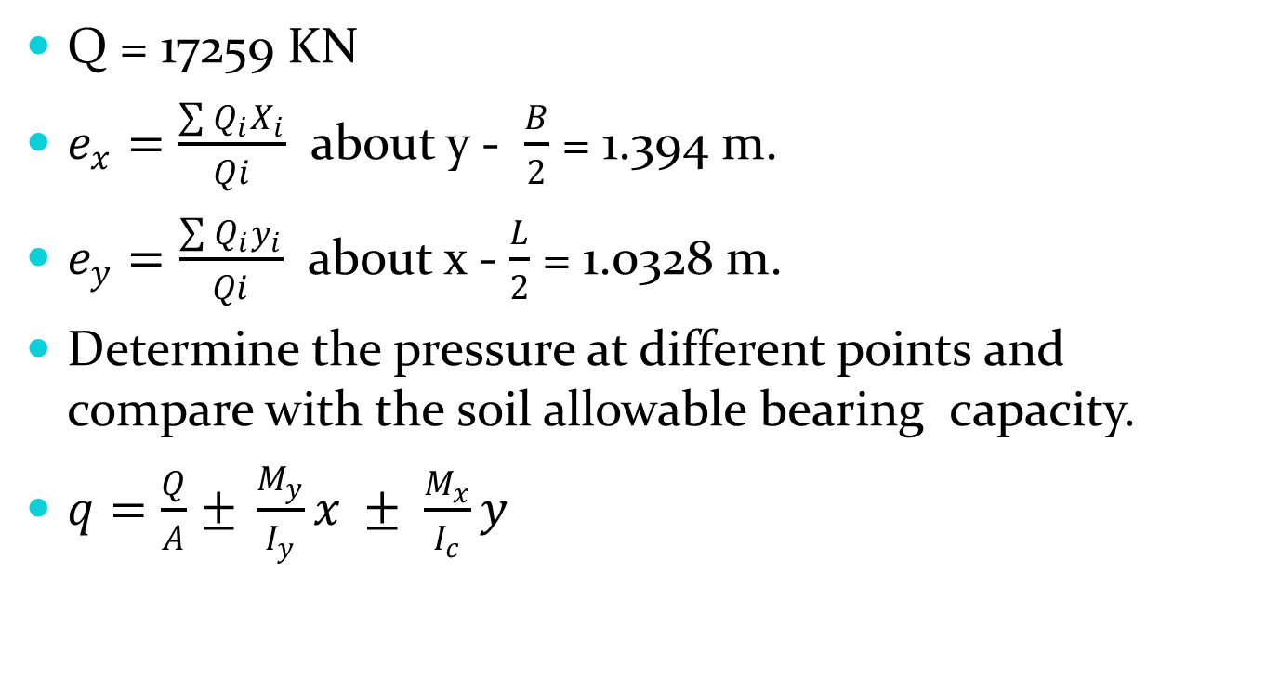
Design of raft 1
Q = 17259 KN
$e_{x}=\frac{\sum{Q_{i}X_{i}}}{Qi}$ about y - $\frac{B}{2}$ = 1.394 m.
$e_{y}=\frac{\sum{Q_{i}y_{i}}}{Qi}$ about x - $\frac{L}{2}$ = 1.0328 m.
Determine the pressure at different points and compare with the soil allowable bearing capacity.
$q=\frac{Q}{A}$ $± \frac{M_{y}}{I_{y}}x ± \frac{M_{x}}{I_{c}}y$

Slide 19
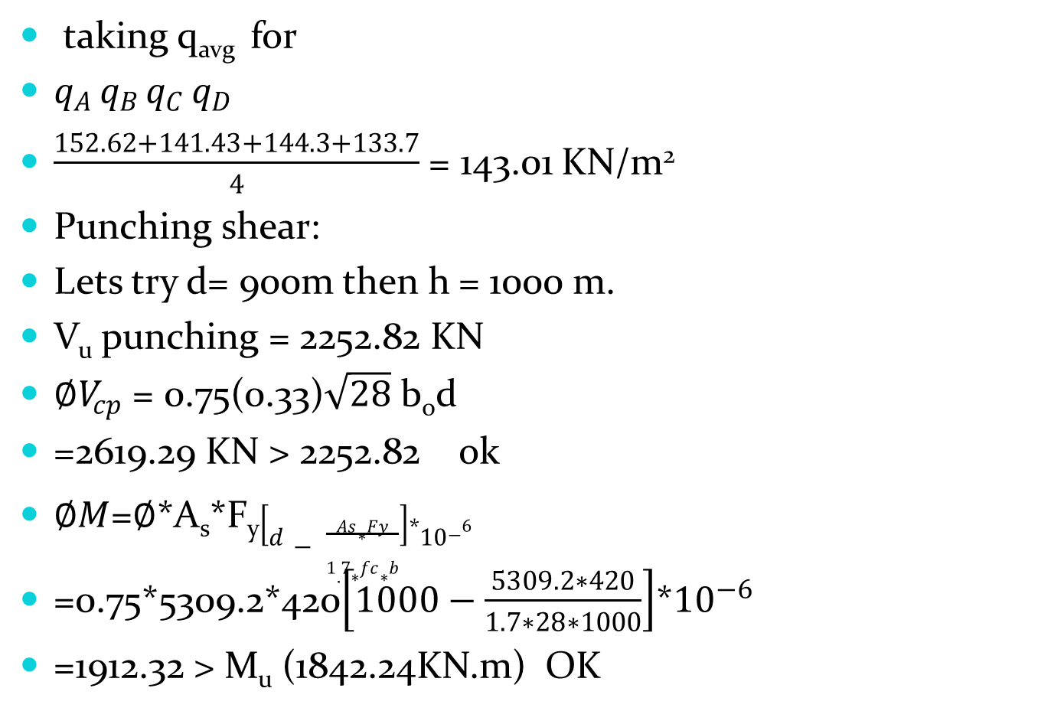
taking q_{avg} for
$q_{A }q_{B }q_{C }q_{D }$
$\frac{152.62+141.43+144.3+133.7}{4}$ = 143.01 KN/m²
Punching shear:
Lets try d= 900m then h = 1000 m.
V_{u} punching = 2252.82 KN
$∅V_{cp}$ = 0.75(0.33)$\sqrt{28}$ b_{o}d
=2619.29 KN > 2252.82 ok
$∅M$=$∅$*A_{s}*F_{y}$\left[d− \frac{As∗Fy}{1.7∗fc∗b}\right]$*${10}^{−6}$
=0.75*5309.2*420$\left[1000−\frac{5309.2∗420}{1.7∗28∗1000}\right]$*${10}^{−6}$
=1912.32 > M_{u} (1842.24KN.m) OK

Slide 20
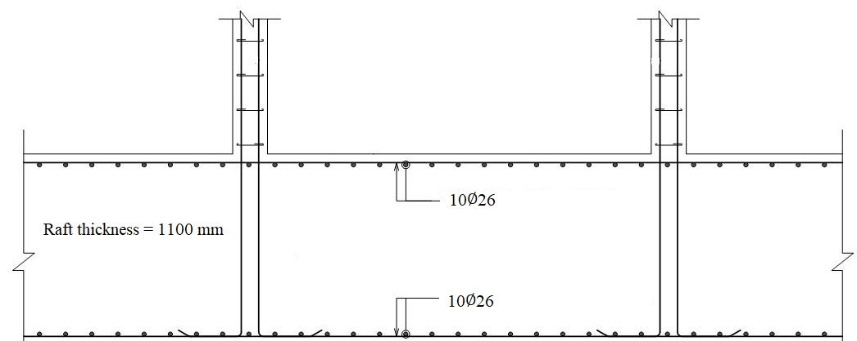

Slide 21
Design of retaining wall
Assuming the preliminary dimensions for the retaining wall:

Slide 22
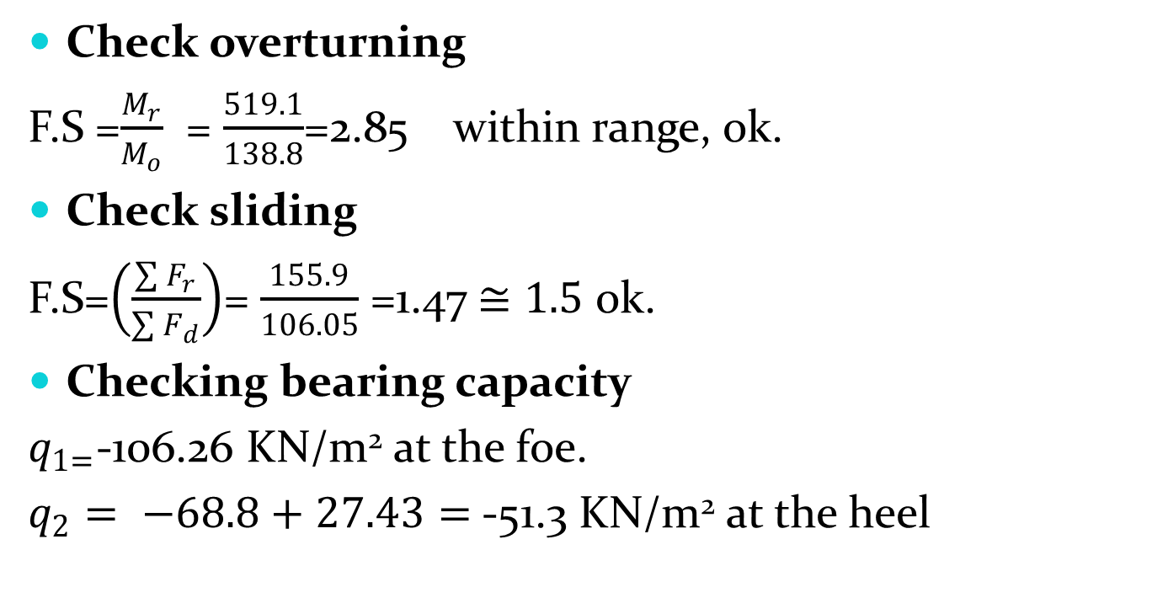
External stability checks
Check overturning
F.S =$\frac{M_{r}}{M_{o}}$ = $\frac{519.1}{138.8}$=2.85 within range, ok.
Check sliding
F.S=$\left(\frac{\sum{F_{r}}}{\sum{F_{d}}}\right)$= $\frac{155.9}{106.05}$ =1.47 $≅1.5$ ok.
Checking bearing capacity
$q_{1=}$-106.26 KN/m² at the foe.
$q_{2}= −68.8+27.43=$-51.3 KN/m² at the heel

Slide 23
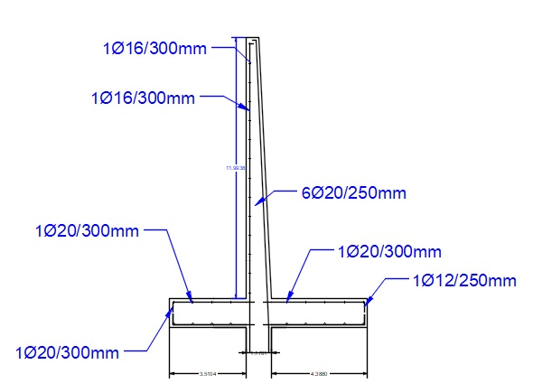

Slide 24
Conclusion
Based on results obtained from analysis of weights loaded on footings and site conditions we designed three types of footings :
Isolated footing.
Combined footings.
Raft foundation.
Retaining wall was designed to overcome the assumed lateral earth pressure, programs used to analysis and design are SAP2000 and SAFE2016 and specifications are based on ACI.

Slide 25
THANKS FOR LISTENING

