Slide 1
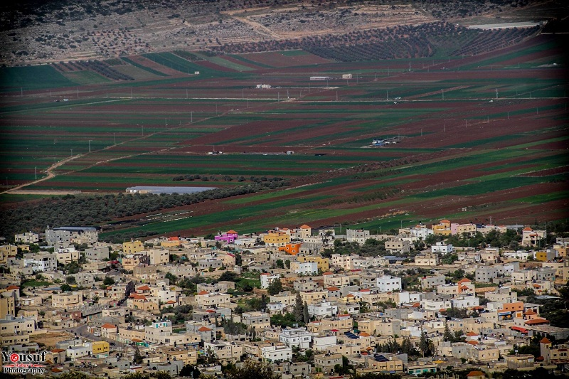
Assessment Of The Impact Of Catchments Providing Water
To Marj Sanour & Design Of Water Collection System
(Hydrologic Analysis)
By: Isam Khasib Farouq Hamad Bashar Ibrahim
Supervisor: Eng. Hamees Tubeileh

Slide 2

Outline:
  Geography and Topography.
  Challenges & Solutions.
  Hydrology parameters calculations.
  Flows & volumes results.
  American & Tubas patterns.
  Suggested Activities and projects.
  Projects Evaluation.
  Design of storm collection system.

Slide 3
Study Area
  Geography and Topography

Slide 4
  Geography and Topography
The Marj Sanour watershed forms a unique closed watershed area in the West Bank. The total area of the watershed is about 58.58km².
The Marj watershed area has an almost rectangular shape with northwest-southeast elongation.
The lake region is located between 350 and 375 contour lines above sea level.

Slide 5
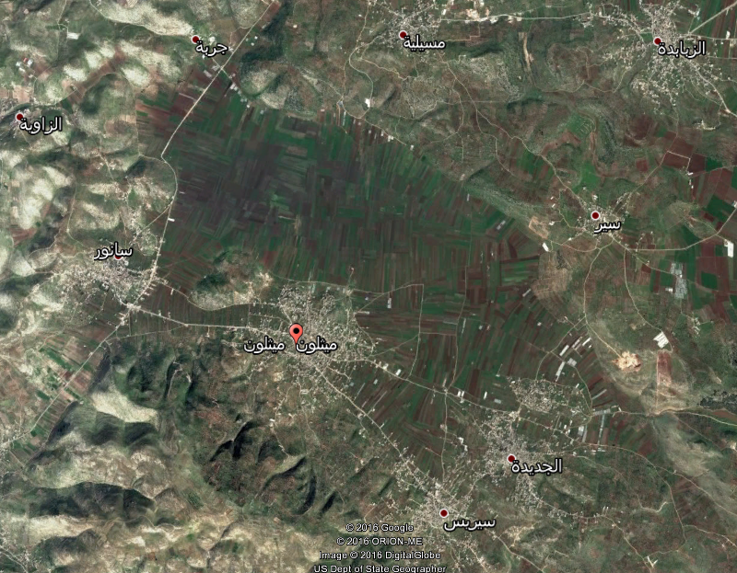

Slide 6


Slide 7
Methodology:
Allocation of catchments
GIS model
Daily rainfall data
Soil type and texture
Frequency analysis (rainfall V.S. return period)
Curve number determination
Hydrographs
HEC-HMS model

Slide 8
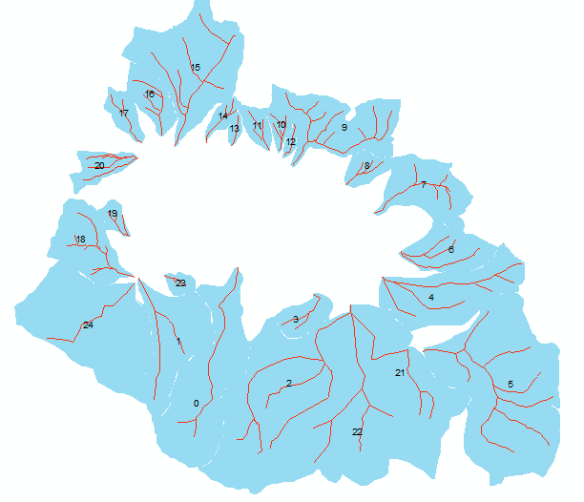
Methodology: allocation of catchments using GIS-Software
Allocation of catchments

Slide 9
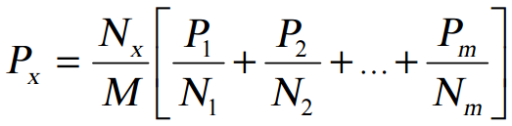
Methodology:
Rainfall data collection: Rainfall data were collected from Arraba, Qabatia, Maythaloon & Raba stations from 2008 to 2016.
Correcting missing data using Normal Ratio method

Slide 10
Methodology:
Frequency analysis using corrected rainfall data for Maythaloon station.
We have chosen the highest daily rainfall in each year.
Year | Precipitation (mm)
2008 | 66
2009 | 65
2010 | 83.5
2011 | 60
2012 | 89.5
2013 | 79
2014 | 70
2015 | 48
2016 | 58.5

Slide 11

Methodology:
Probability of exceedance using Weibull distribution.
Year | Precipitation (mm) | Ranking (m) | Probability | Return period
2008 | 66 | 6 | 0.60 | 1.67
2009 | 65 | 5 | 0.50 | 2.00
2010 | 83.5 | 2 | 0.20 | 5.00
2011 | 60 | 7 | 0.70 | 1.43
2012 | 89.5 | 1 | 0.10 | 10.00
2013 | 79 | 3 | 0.30 | 3.33
2014 | 70 | 4 | 0.40 | 2.50
2015 | 48 | 9 | 0.90 | 1.11
2016 | 58.5 | 8 | 0.80 | 1.25

Slide 12
Methodology:
Precipitation against return period

Slide 13
Methodology:
Catchments parameters: SCS-Curve number, slope, length of main streams & lag time.
Starting with CN, four hydrologic soil groups:
Group A
Group B
Group C
Group D

Slide 14
Methodology:
In Marj Sanour we have three soil types and these are :
Brown Rendzinas and Pale Renzinas.
Grumusols.
Terra Rossas, Brown Rendzinas and Pale Rendzinas.

Slide 15
Methodology:
Soil moisture conditions are three types:
Condition I: soils are dry
Condition II: average (normal) conditions
Condition III: saturated (wet) soils

Slide 16
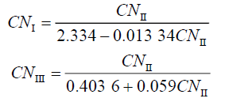
Methodology:
CN II is considered the base CN.

Slide 17
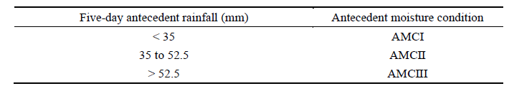
Methodology:
Shadeed and Almasri (2010) have shown the antecedent moisture condition based on five days of rainfall precede the design storm

Slide 18
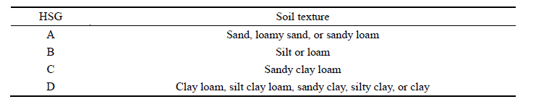
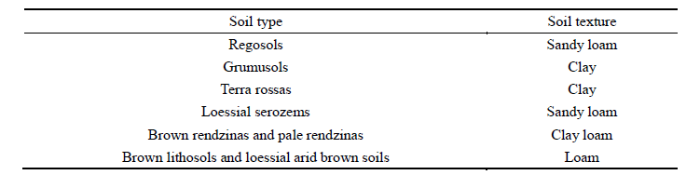
Methodology:
Also, Shadeed and Almasri (2010) could classify the soil type and soil texture into type A, B, C or D soil.

Slide 19
Methodology:
We can consider Marj Sanour soils as follows:
Grumusols: Type D
Terra Rossas, Brown Rendzinas And Pale Rendzinas: Type D
Brown Rendzinas And Pale Renzinas: Type C

Slide 20
Methodology:
Land uses in the Marj are indicated as follows:
Olive Groves
Natural Grass Land
Non Irrigated Arable Land
Agricultural Land With Natural Vegetation
Discontinuous Urban Fabric
Military Camps

Slide 21
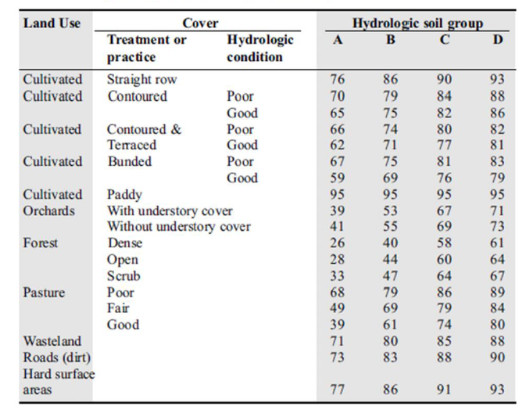
Methodology:

Slide 22
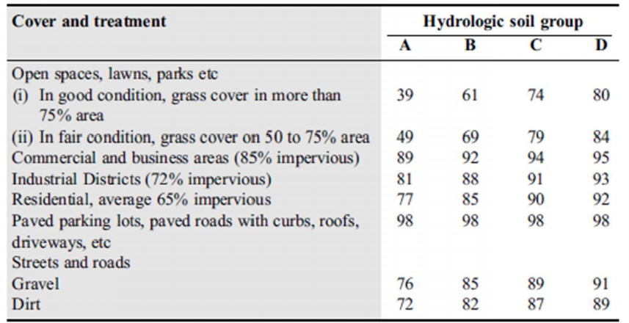
Methodology:

Slide 23
Methodology:
catchment No. | Length of main streams in Km | S % | Length in ft | CN 2 | CN 3 | Lag time (min)
0 | 2.71 | 20.05 | 8891.08 | 84.00 | 92.40 | 81.62
1 | 2.03 | 19.5 | 6660.10 | 84.50 | 92.60 | 65.10
2 | 3.7 | 13.71 | 12139.11 | 82.20 | 91.40 | 132.34
3 | 0.82 | 6.16 | 2690.29 | 78.70 | 89.50 | 64.01
4 | 2.33 | 4.71 | 7644.36 | 77.50 | 88.80 | 173.56
5 | 2.94 | 12.72 | 9645.67 | 80.10 | 90.30 | 119.75
6 | 1.45 | 10.78 | 4757.22 | 78.50 | 89.40 | 76.65
7 | 1.44 | 7.03 | 4724.41 | 81.40 | 90.90 | 88.74
8 | 0.73 | 11.3 | 2395.01 | 83.30 | 92.00 | 38.76
9 | 1.63 | 12.8 | 5347.77 | 84.70 | 92.70 | 67.10
10 | 0.58 | 14.2 | 1902.89 | 83.70 | 92.20 | 28.51
11 | 0.75 | 17.22 | 2460.63 | 84.00 | 92.30 | 31.66
12 | 0.55 | 9.66 | 1804.46 | 79.10 | 89.70 | 36.84

Slide 24
Methodology:
catchment No. | Length of main streams in Km | S % | Length in ft | CN 2 | CN 3 | Lag time (min)
12 | 0.55 | 9.66 | 1804.46 | 79.10 | 89.70 | 36.84
13 | 0.49 | 24.21 | 1607.61 | 84.30 | 92.50 | 18.82
14 | 0.76 | 19.35 | 2493.44 | 80.90 | 90.70 | 32.35
15 | 2.09 | 18.76 | 6856.96 | 73.10 | 86.22 | 87.86
16 | 1.21 | 14.69 | 3969.82 | 69.50 | 83.97 | 69.40
17 | 0.96 | 16.82 | 3149.61 | 71.90 | 85.46 | 51.17
18 | 1.01 | 22.07 | 3313.65 | 84.70 | 92.74 | 34.78
19 | 0.55 | 18.93 | 1804.46 | 79.20 | 89.78 | 26.23
20 | 0.97 | 18.15 | 3182.41 | 78.40 | 89.31 | 42.98
21 | 2.61 | 3.89 | 8562.99 | 78.70 | 89.47 | 203.64
22 | 2.46 | 10.7 | 8070.87 | 80.80 | 90.66 | 111.52
23 | 0.4 | 18.93 | 1312.34 | 71.10 | 84.97 | 24.36
24 | 1.86 | 19.16 | 6102.36 | 83.60 | 92.15 | 62.48

Slide 25
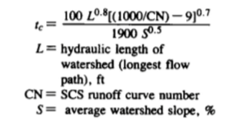
Methodology:
lag time in each catchment was calculated using SCS-lag equation because we will be using it in HEC-HMS software.

Slide 26
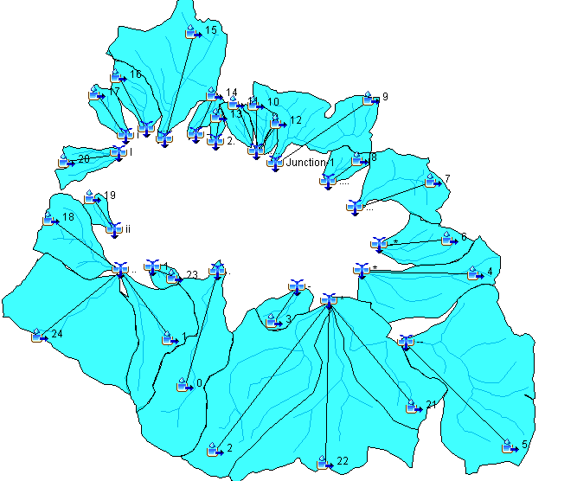
Results & calculations:
the HEC-HMS software to complete the hydrologic analysis and find the hydrographs.

Slide 27
catchment # | Peak flow(m³/s) | Volume(m³)
0 | 11 | 84.49
1 | 7.7 | 85.01
2 | 11.2 | 81.89
3 | 2 | 77.08
4 | 4.3 | 75.35
5 | 14.2 | 79.08
6 | 3.5 | 76.83
7 | 4.7 | 80.6
8 | 2.1 | 83.44
9 | 8.1 | 85.28
10 | 1.7 | 83.96
11 | 1.9 | 84.22
12 | 0.5 | 77.58
13 | 0.9 | 84.75
14 | 1.4 | 80.09
15 | 8 | 69.19
16 | 2.7 | 88.67
17 | 1.5 | 67.43
18 | 8.1 | 85.38
19 | 0.9 | 55.06

Slide 33
Design of Collection System
    Suggested Activities and projects:-
    Land Management Projects.
    Rainwater harvesting projects.
    Water Transfer Projects.
    Groundwater Recharge Projects.

Slide 34
Projects Evaluation
Type of Projects | Environment |  | Economy |  | Social |  | Overall
 | Score | Rank | Score | Rank | Score | Rank | Score | Rank
Land Management Projects | 30.40% | 1 | 60.80% | 1 | 90.60% | 2 | 53.80% | 1
Rainwater Harvesting Projects | 21.10% | 2 | 59.90% | 2 | 91.00% | 1 | 48.90% | 2
Water Transfer projects | 15.20% | 4 | 46.00% | 3 | 79.00% | 3 | 41.00% | 3
Artificial Recharge Projects | 17.50% | 3 | 13.70% | 4 | 45.10% | 4 | 24.30% | 4

Slide 36

    Design of storm collection system

Slide 37
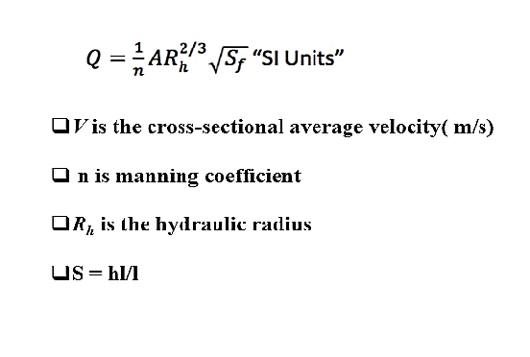

Slide 38
    Design Criteria
The velocity : (0.6 – 3 m/sec).
The cover: Is the difference elevation between the ground elevation and the invert of conduit elevation (1-5 m).
The slope: is the slope of bed conduit. (1-10%).
The distance between manholes are (30-50 m): This range for economic criteria.

Slide 39
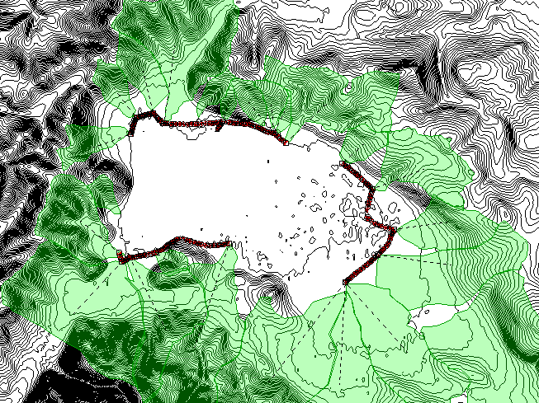

Slide 40
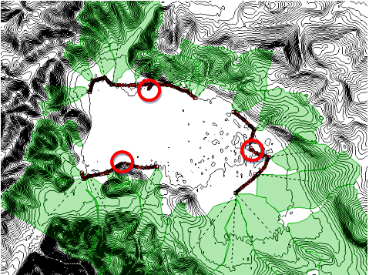

Slide 41
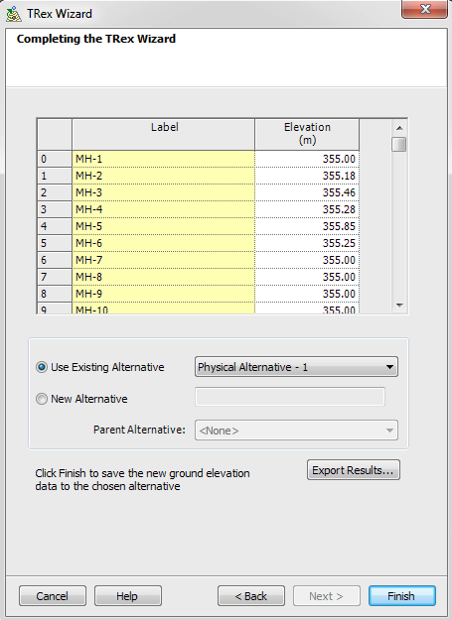

Slide 42
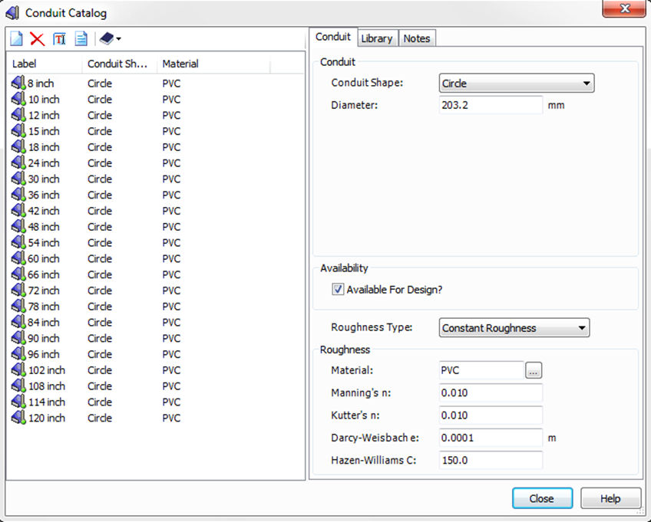

Slide 43
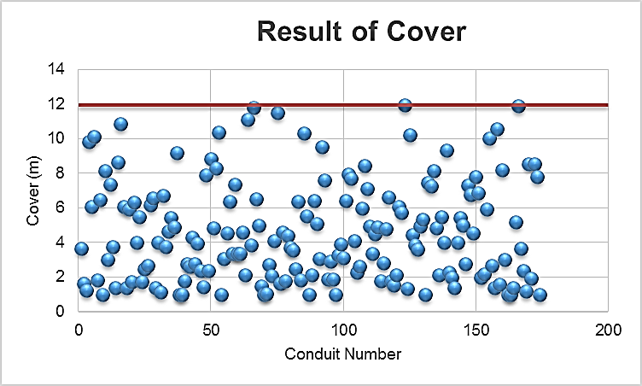

Slide 44
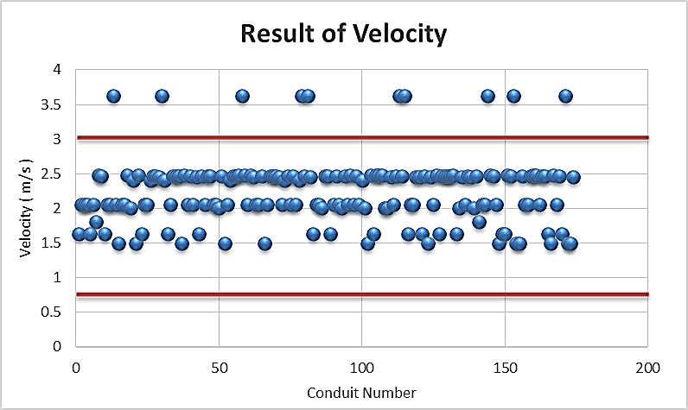

Slide 45
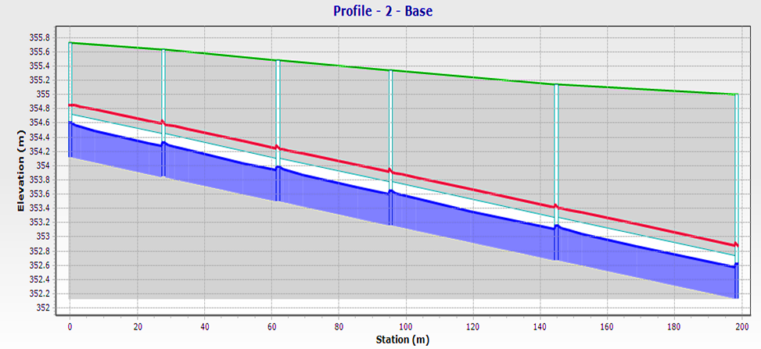

Slide 46
Diameter (inch) | No. of Conduits | Length (m)
18 | 55 | 2075.9
24 | 96 | 4321.3
42 | 23 | 853.5

Slide 47

Thanks for listening

