Slide 1

NexusQuest
Code. Collaborate. Compete.

Slide 2
Table of Contents
1
2
3
Introduction
Roles
Core Features
Discover the vision behind NexusQuest.
Understand the roles of educators and students.
Explore the functionalities that empower learning.
4
5
6
Technology Stack
Conclusion
Future Work
A glimpse into the robust architecture.
Summarizing the impact and potential of NexusQuest.
Our roadmap for continuous innovation.

Slide 3
CHAPTER 1
Introduction

Slide 4
Where development meets learning
NexusQuest is a web-based interactive IDE for hands-on coding practice and problem-solving.
Provides a focused workspace to write code, solve tasks, and test solutions in real time.
Integrates an educational platform with tutorials, quizzes, and structured learning activities.
Enables students to learn by doing within the same environment.
Allows teachers to manage, organize, and deliver learning content.
Combines development tools and educational workflows into one seamless learning ecosystem.

Slide 5
CHAPTER 2
Roles

Slide 6
What are our Roles?
Students
Teachers
View and study tutorials.
Solve coding tasks and exercises.
Take quizzes and assessments.
Practice and improve skills through learning activities.
Track learning progress and achievements.
Create and manage tutorials.
Design and manage tasks and exercises.
Create and control quizzes and assessments.
Maintain and organize learning content.

Slide 7
CHAPTER 3
Core Features

Slide 8
CHAPTER 3.1
Common Features

Slide 9
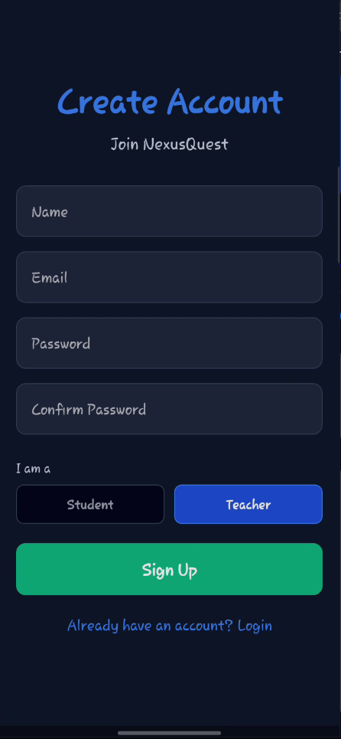
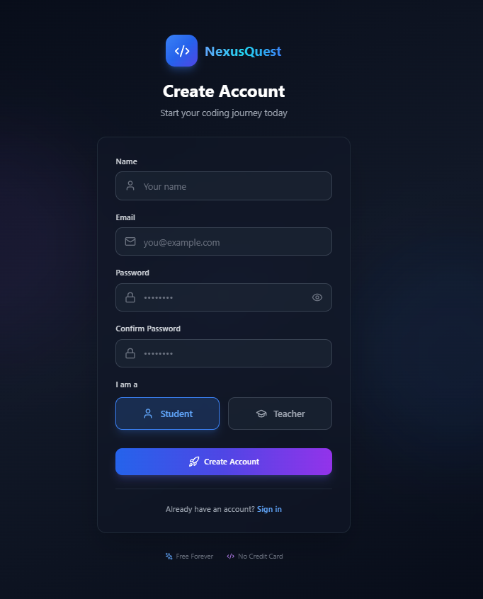
Authentication
Sign-up screens

Slide 10
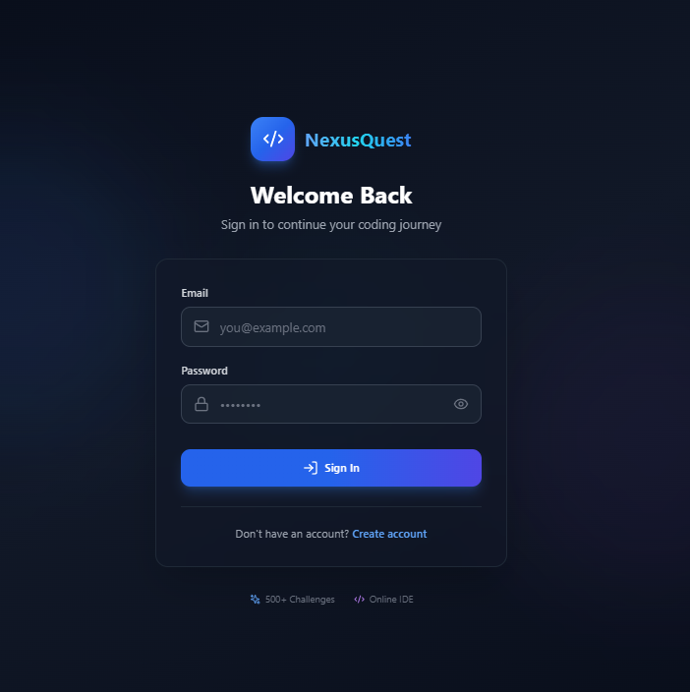
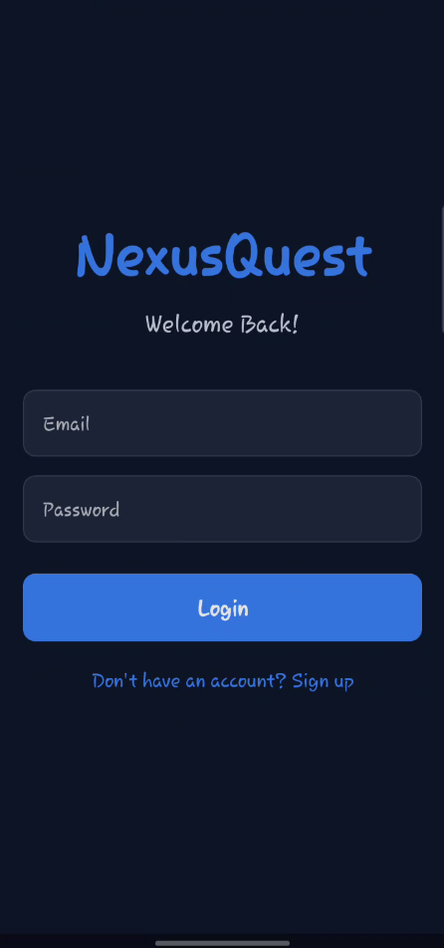
Authentication
Sign-in screens

Slide 11
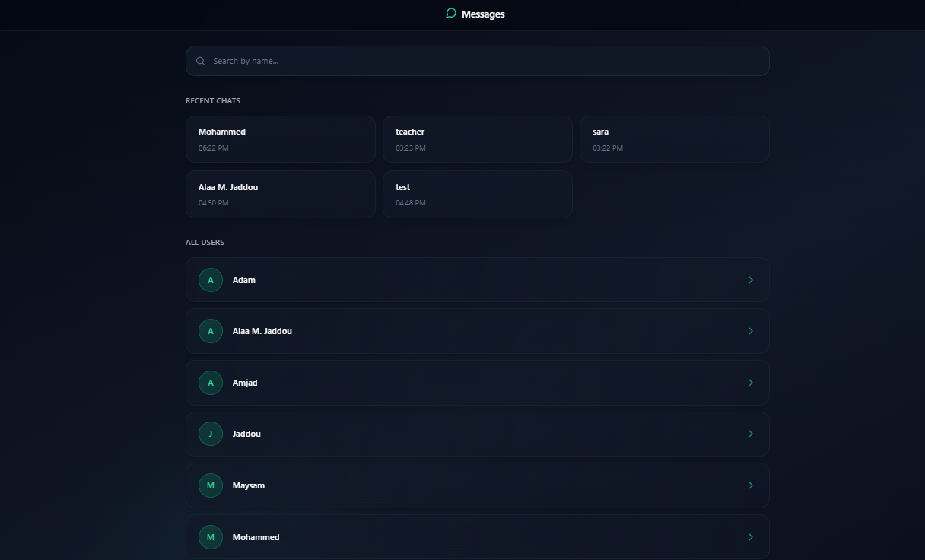
Communication
Recent chats screen

Slide 12
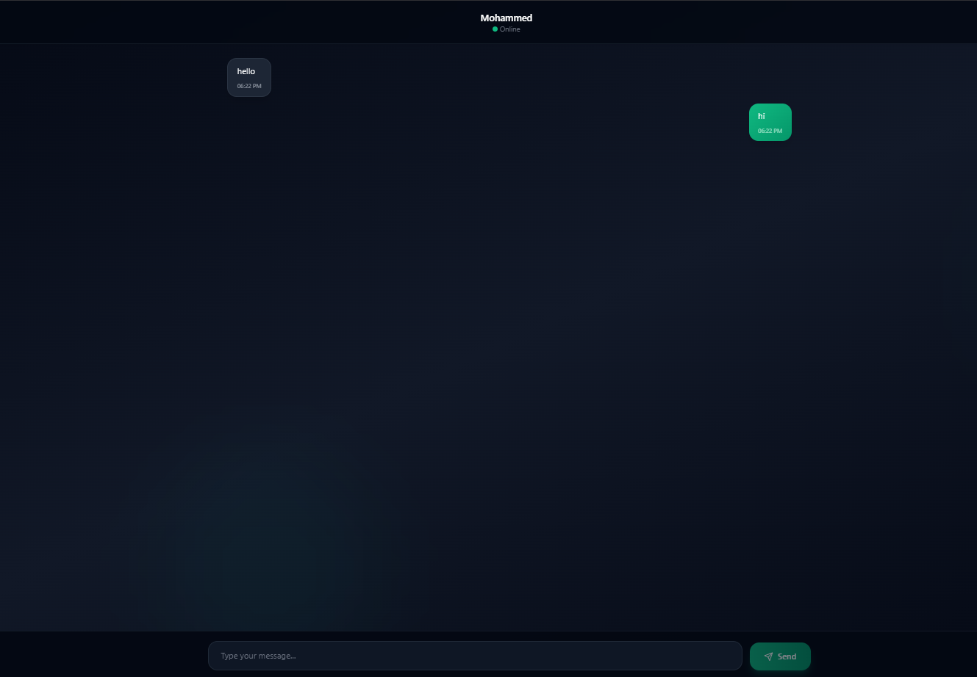
Communication
Conversation screen

Slide 13
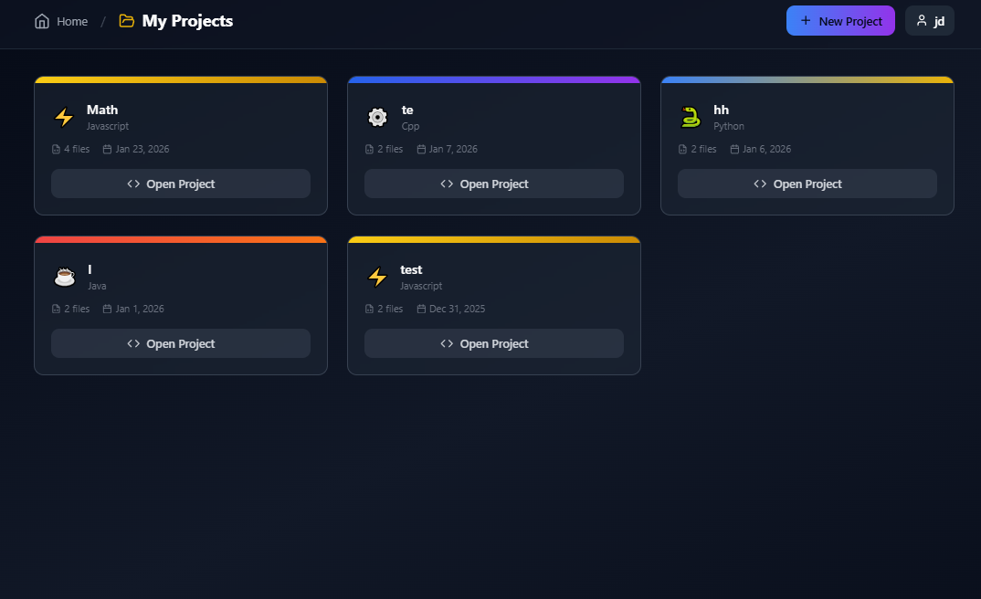
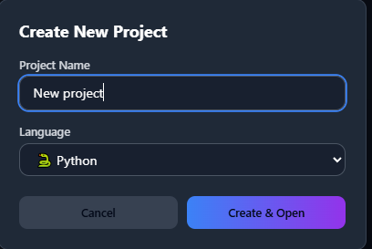
Projects building
My projects screen

Slide 14
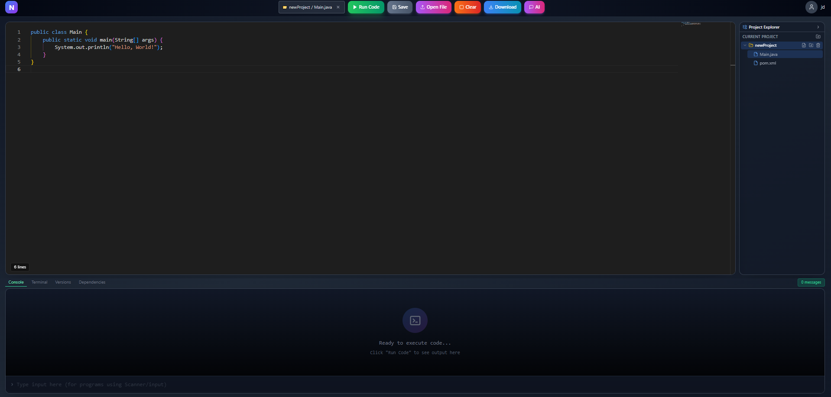
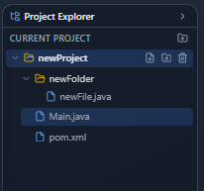
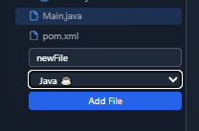
Projects building
project screen

Slide 15
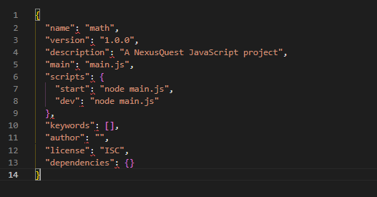
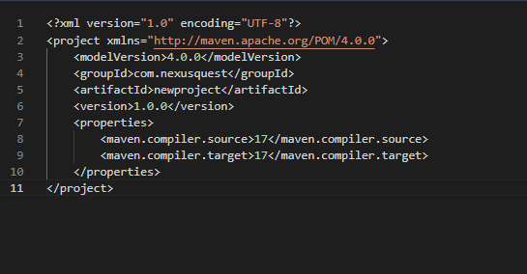
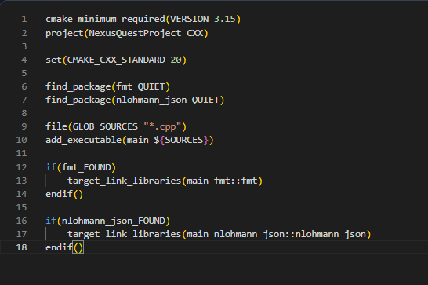
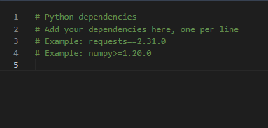
Projects building
Package managers

Slide 16
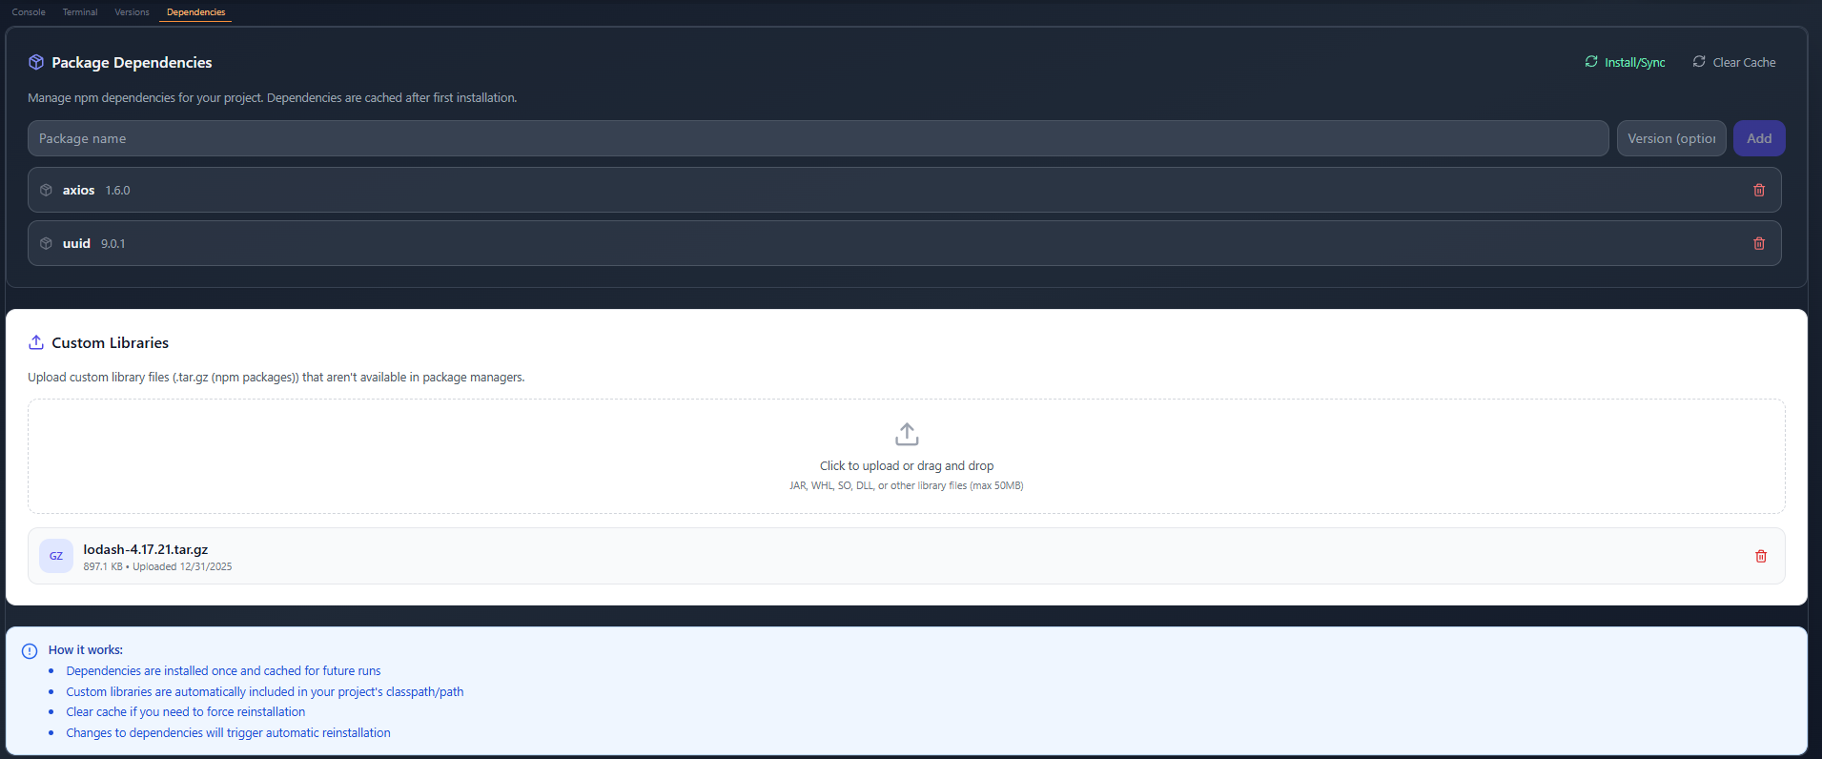
Projects building
Dependencies manager

Slide 17
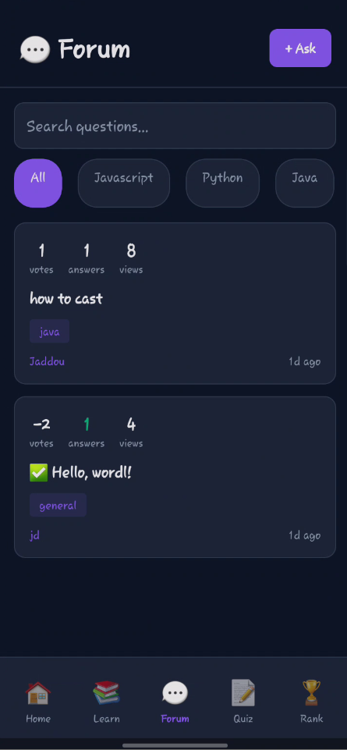
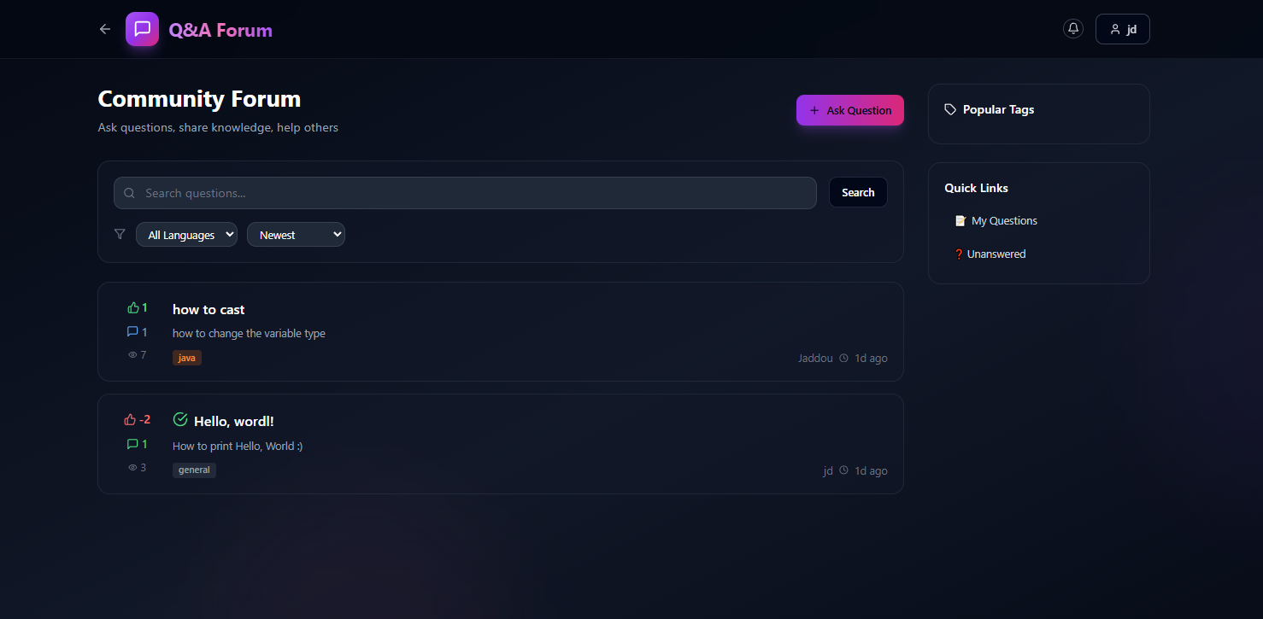
Community
Q&A Screen

Slide 18
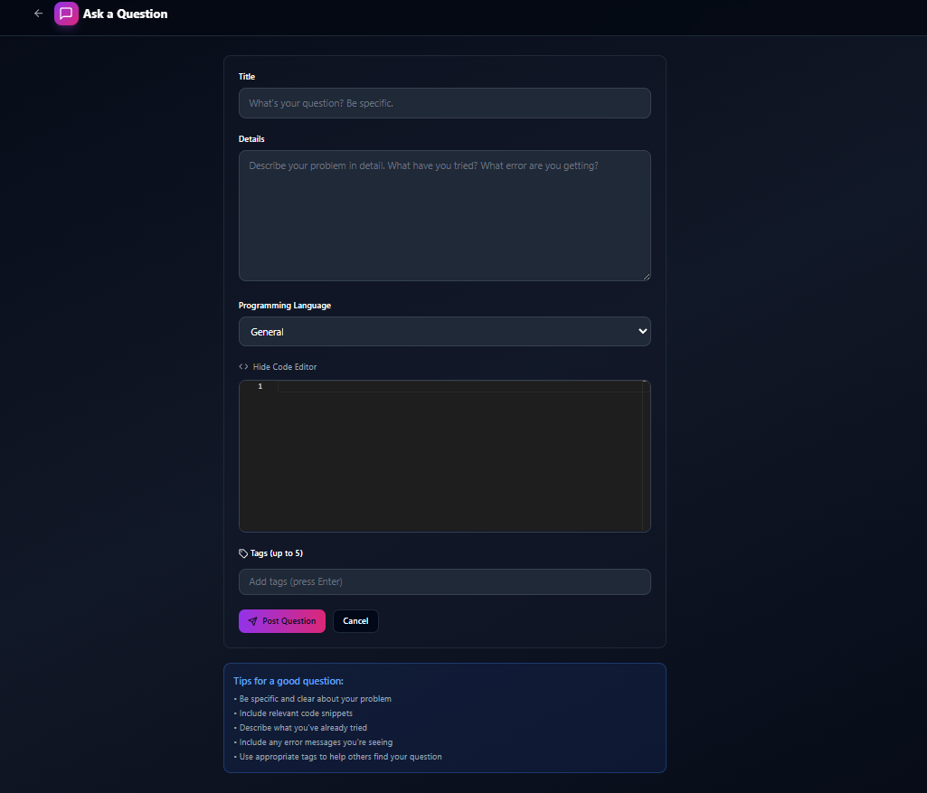
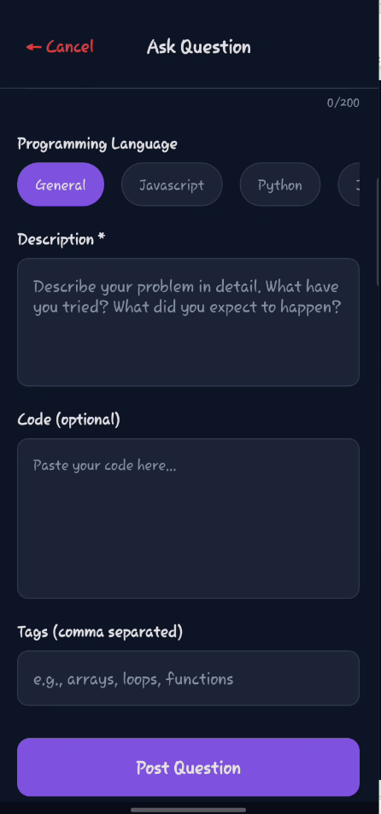
Community
Ask a question screen

Slide 19
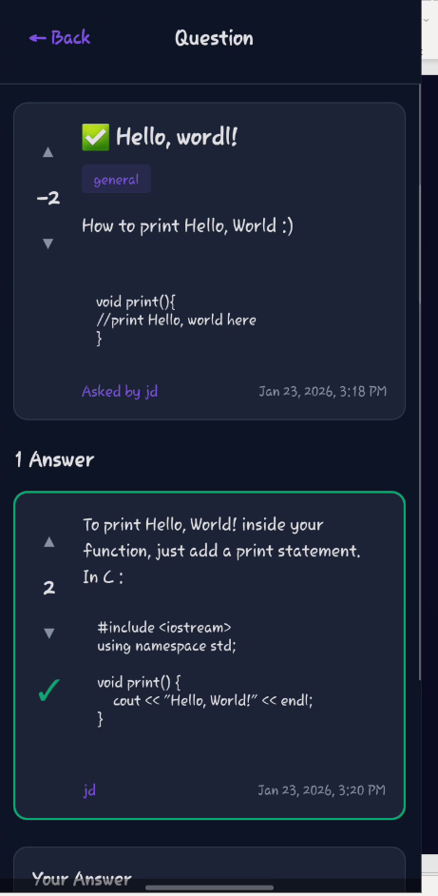
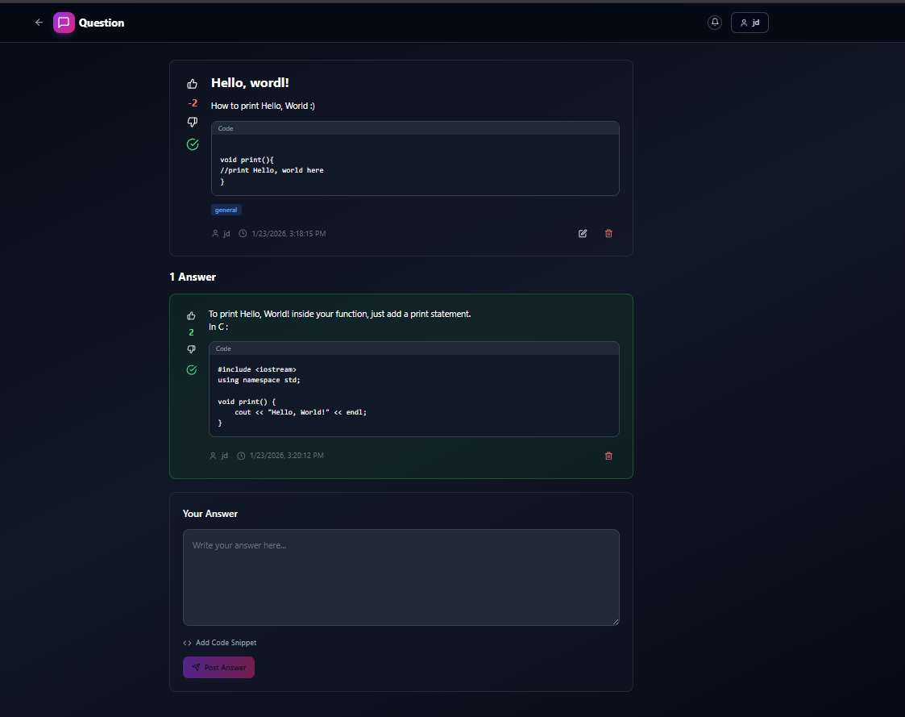
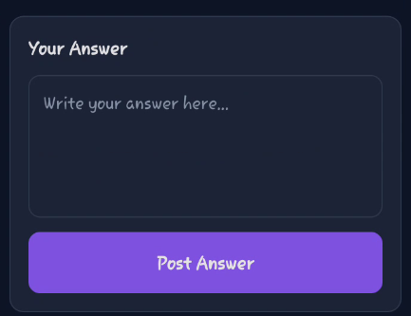
Community
Question screen

Slide 20
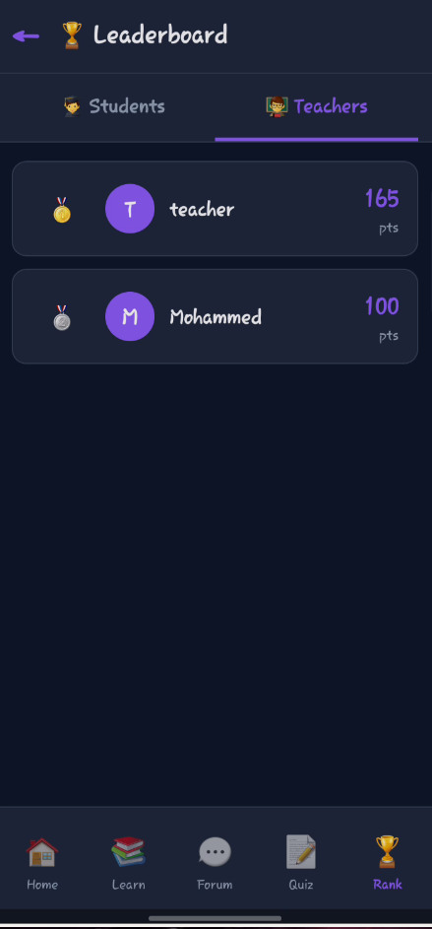
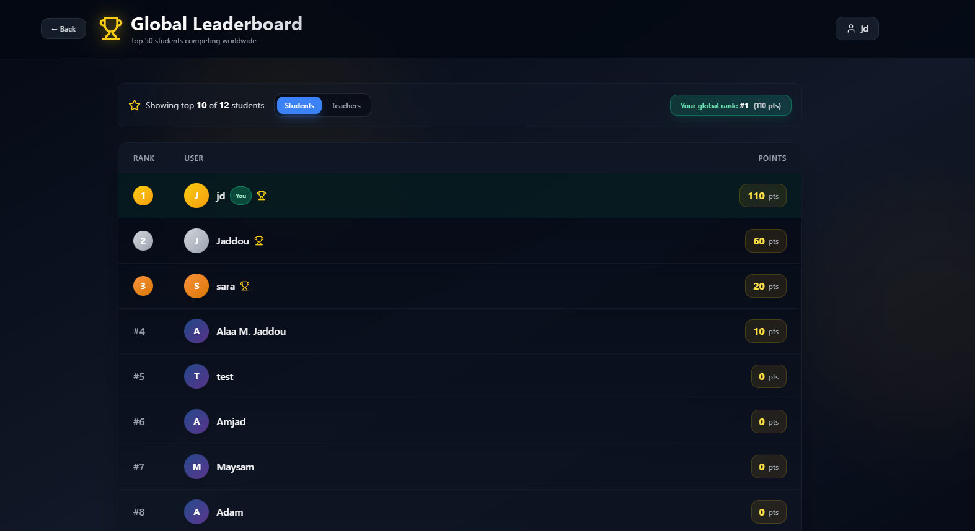
Leaderboard
Leaderboard screen

Slide 21
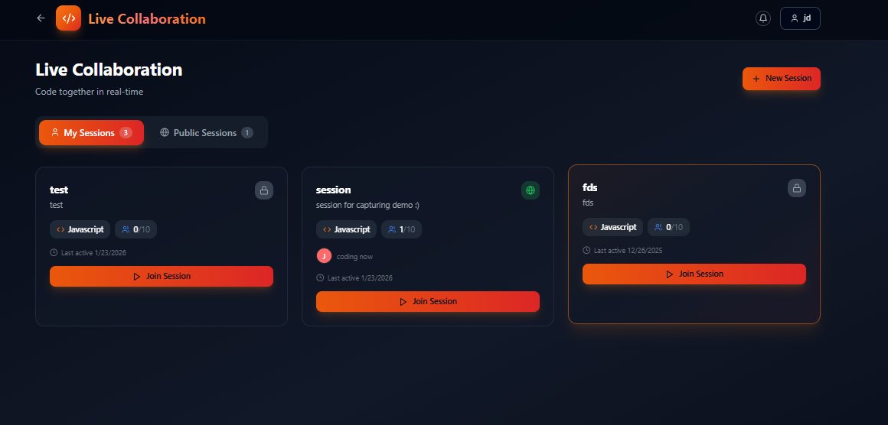
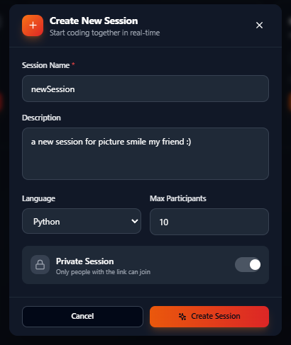
Collaboration
Collaboration sessions list screen

Slide 22
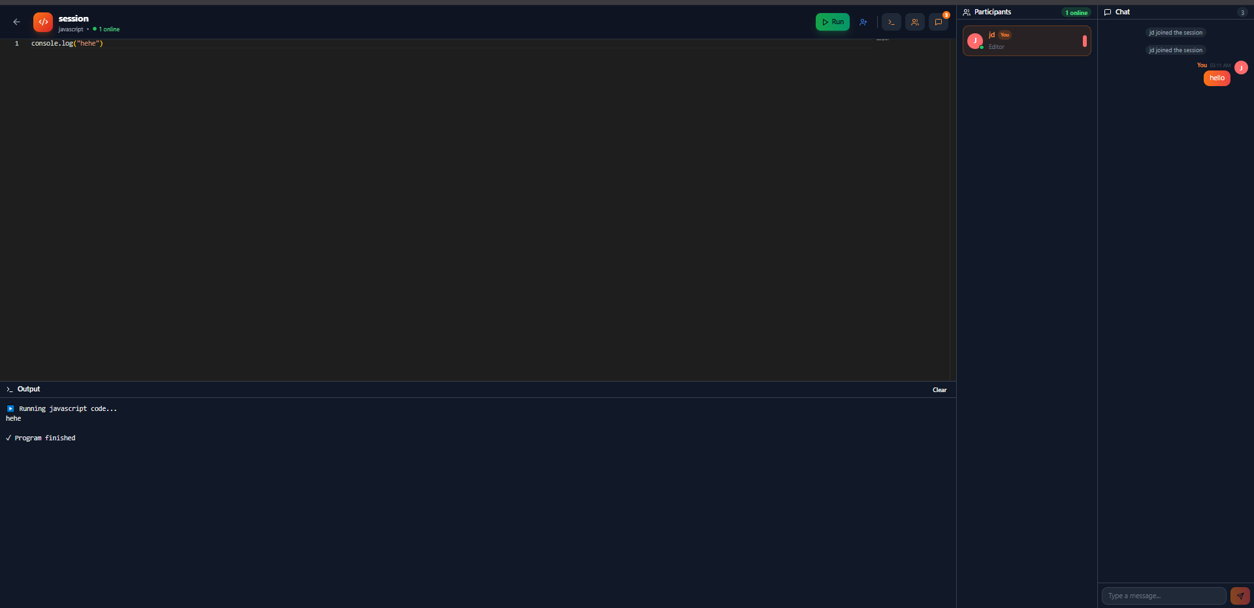
Collaboration
Collaboration session screen

Slide 23
CHAPTER 3.2
Students Features

Slide 24
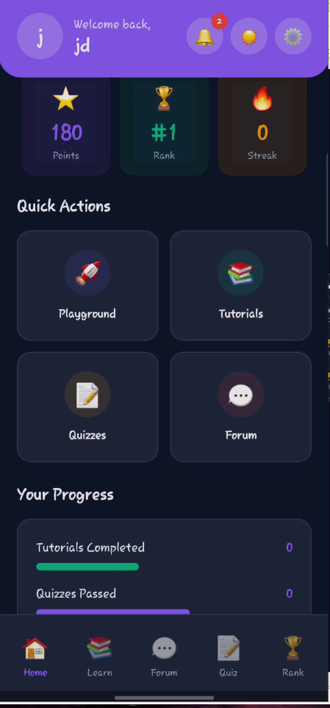
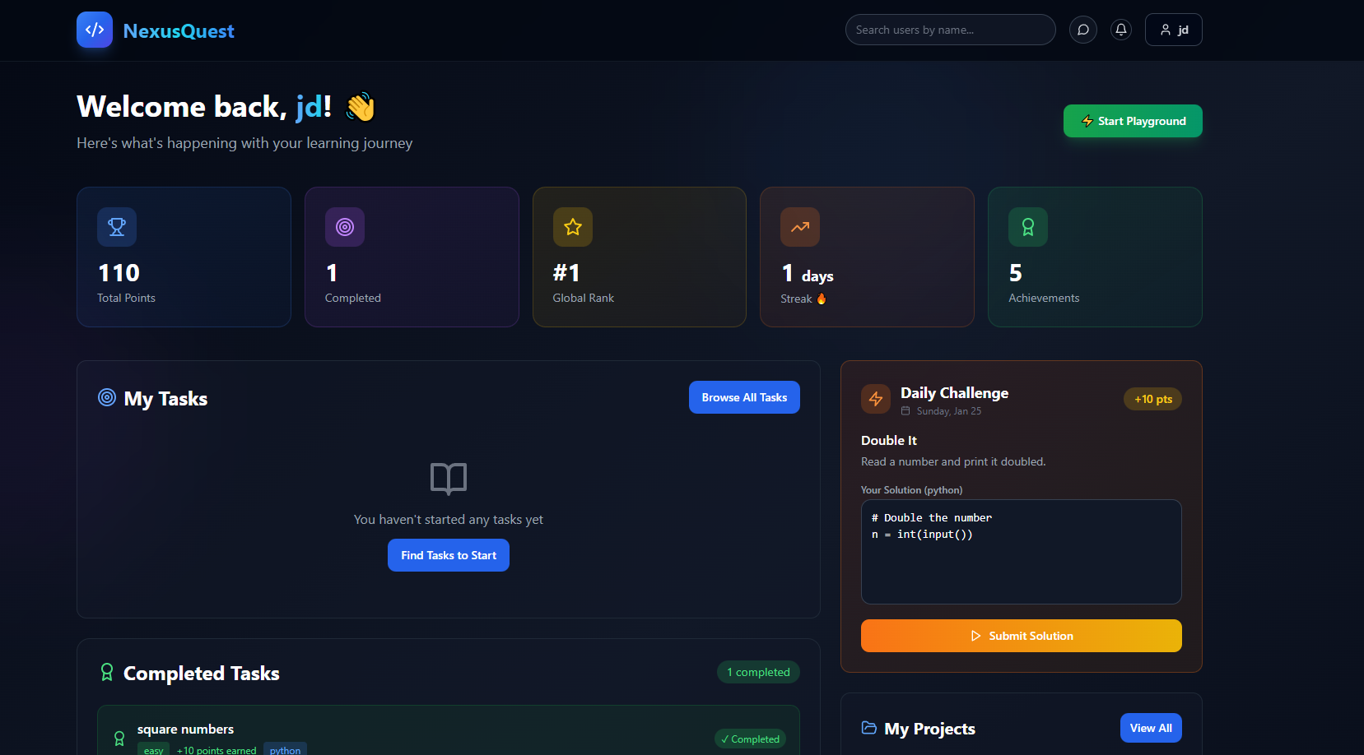
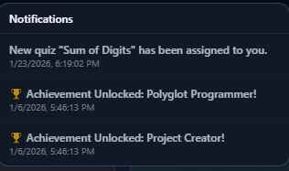
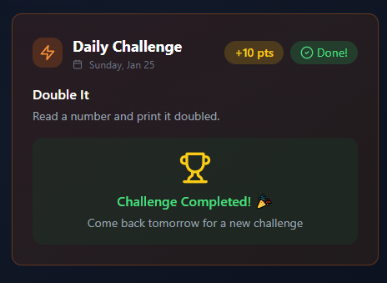
Dashboard
Dashboard screen

Slide 25
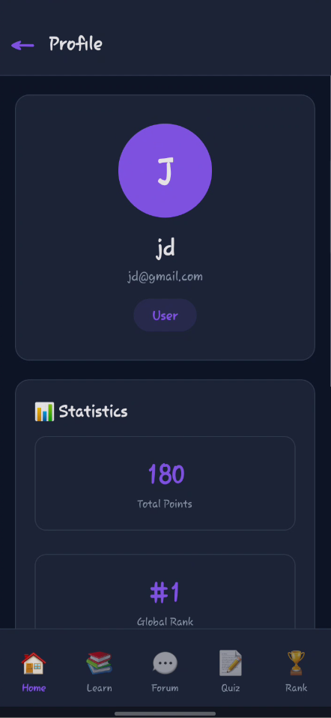
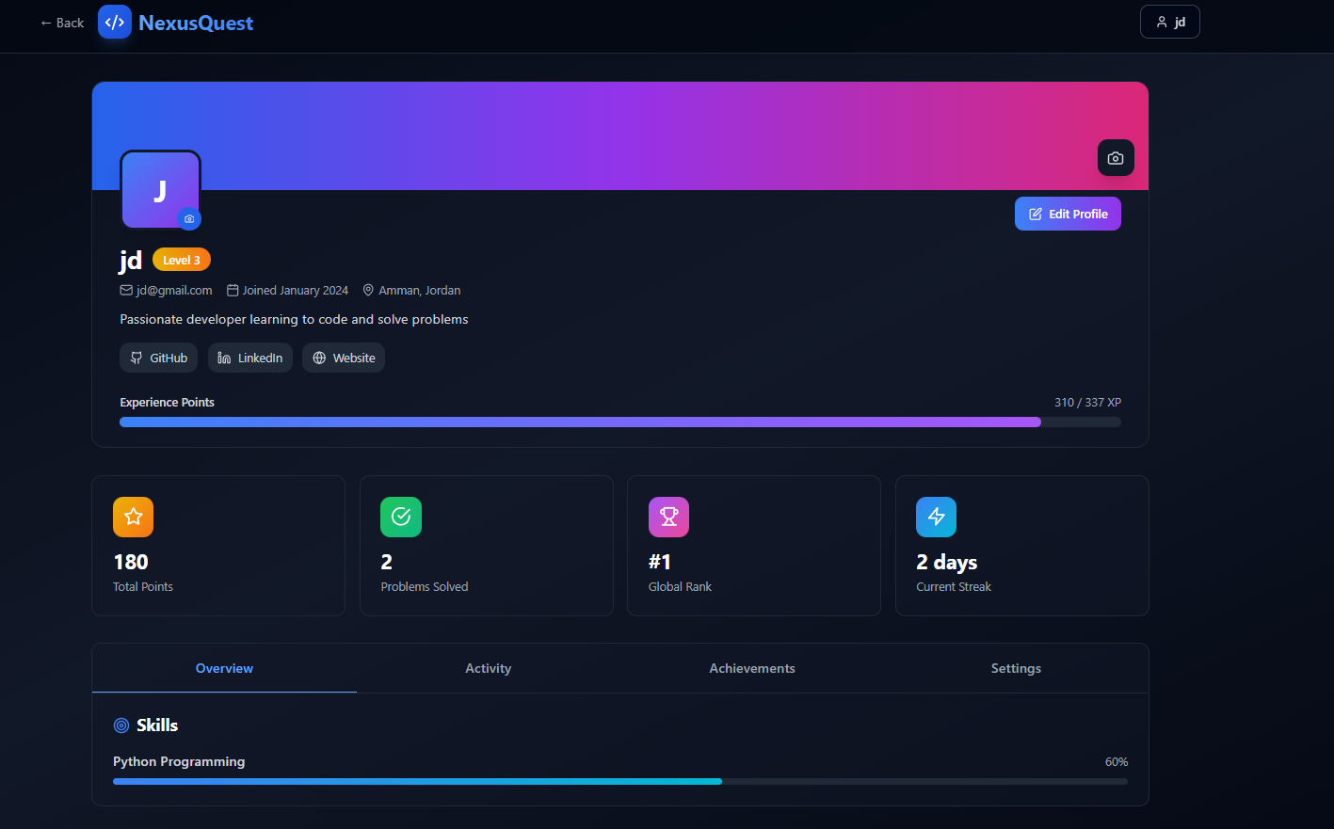
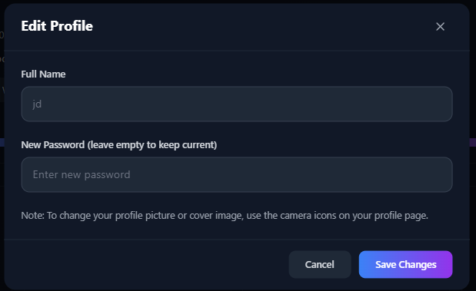
Profile
Profile screen

Slide 26
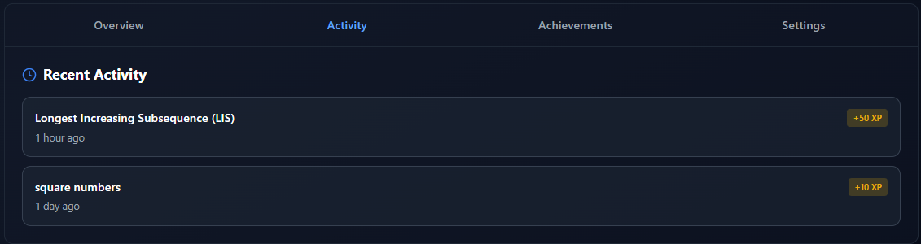
Profile
Activities tab

Slide 27
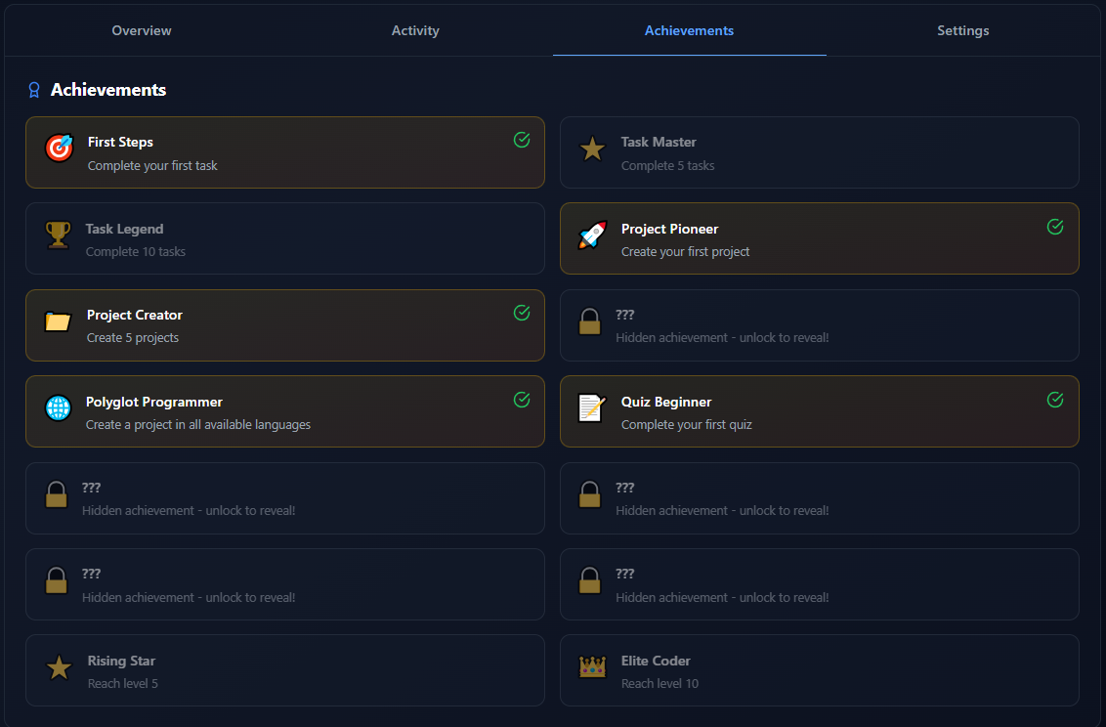
Profile
Achievements tab

Slide 28
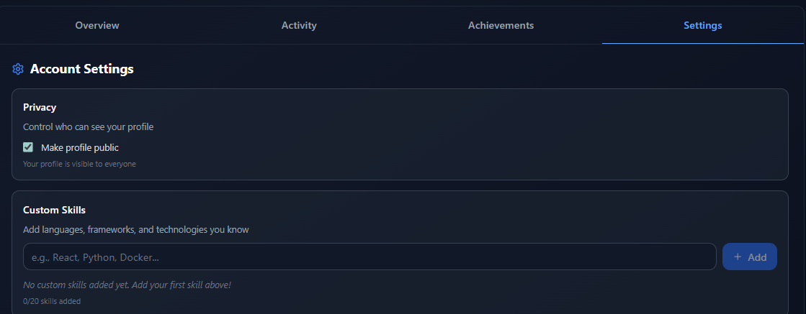
Profile
Settings tab

Slide 29
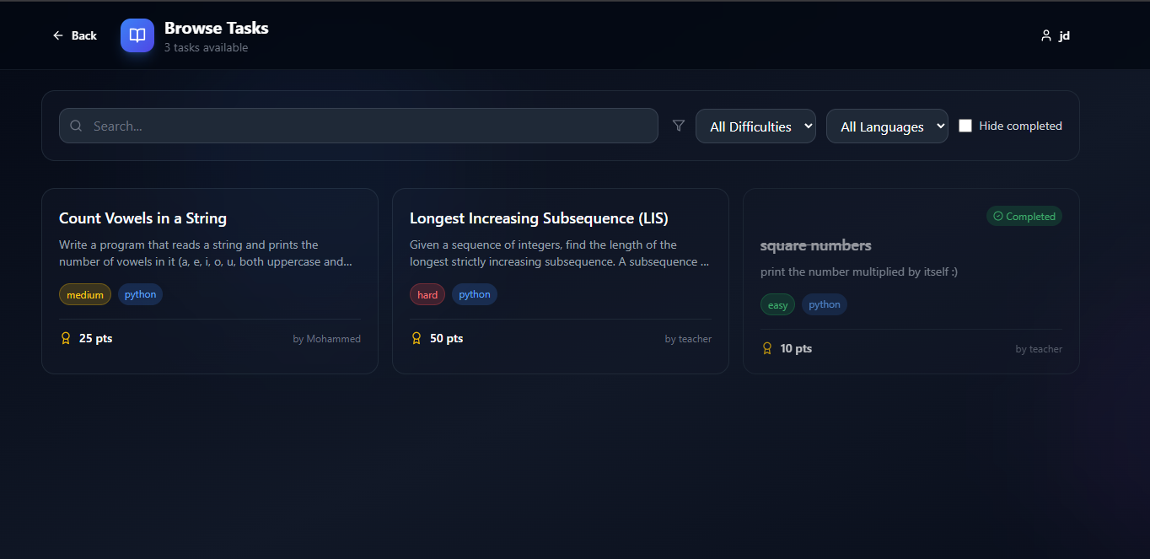
Tasks
Browse tasks screen

Slide 30
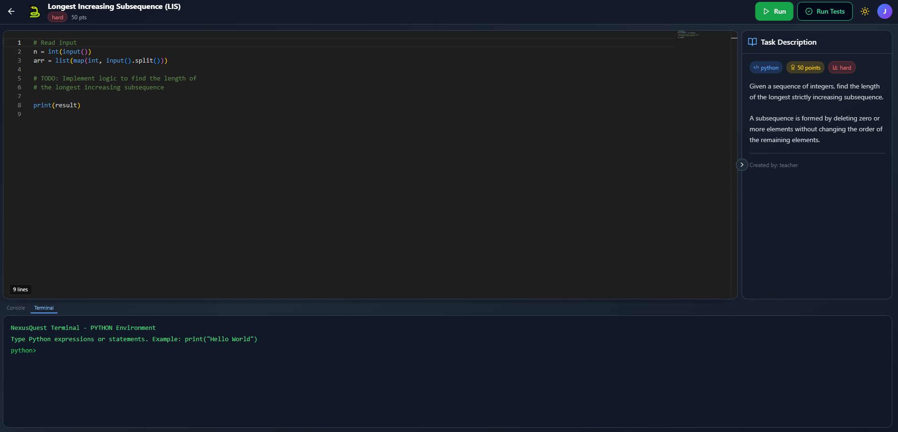
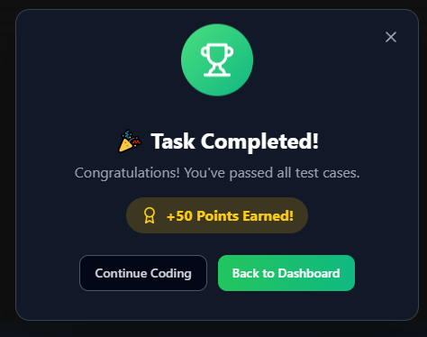
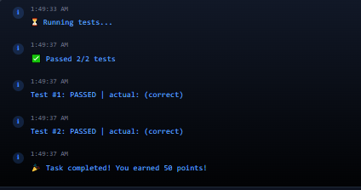
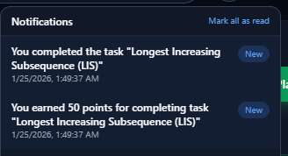
Tasks
Task screen

Slide 31
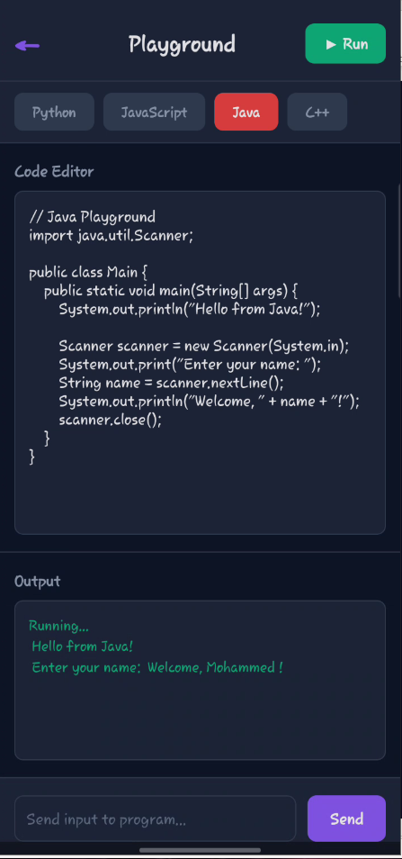
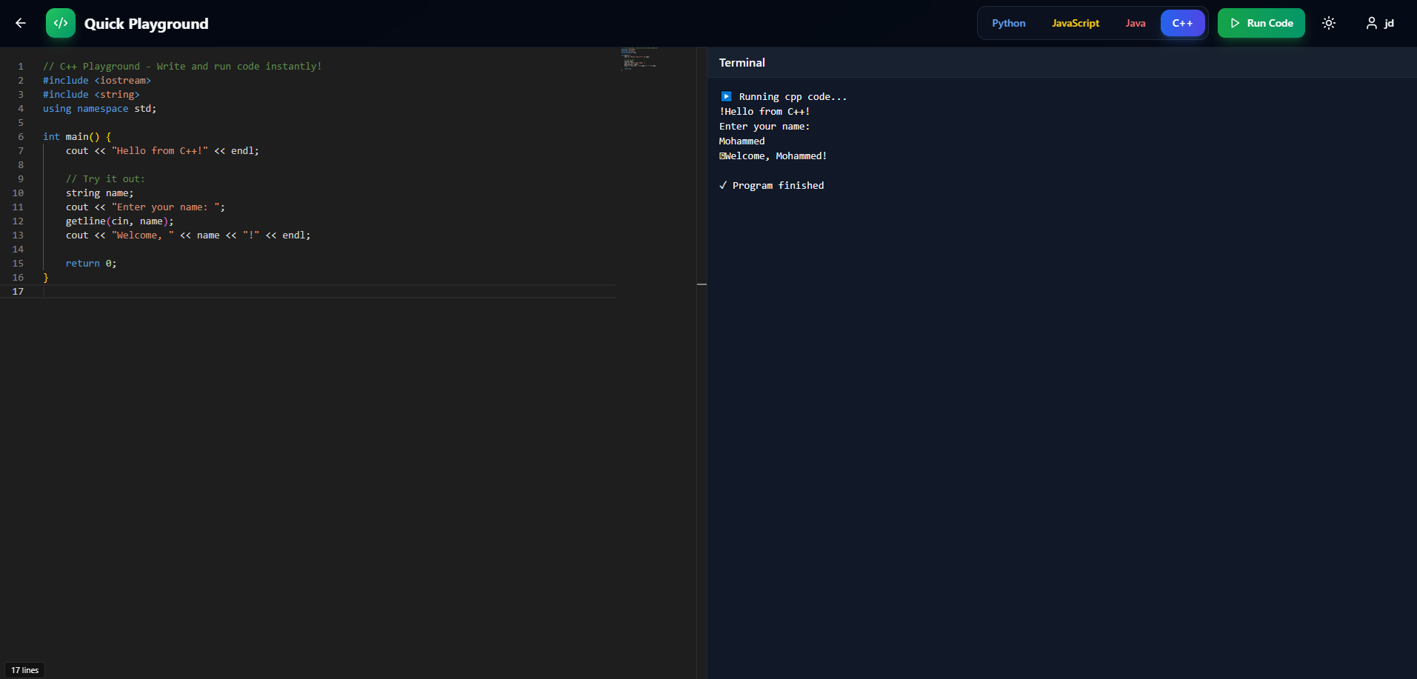
Playground
Playground screen

Slide 32
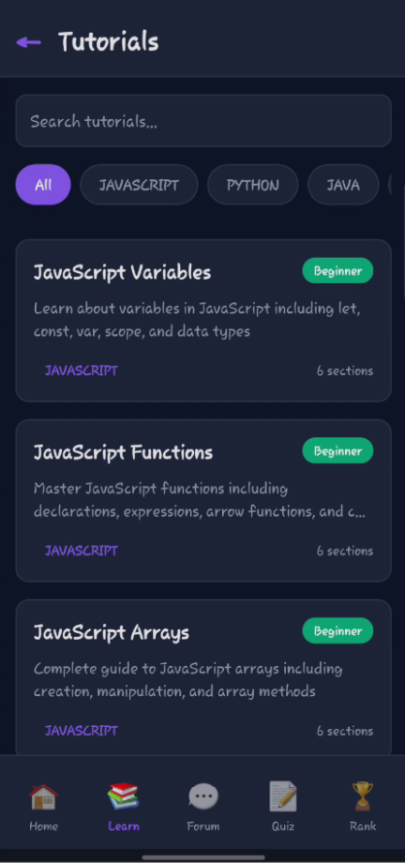
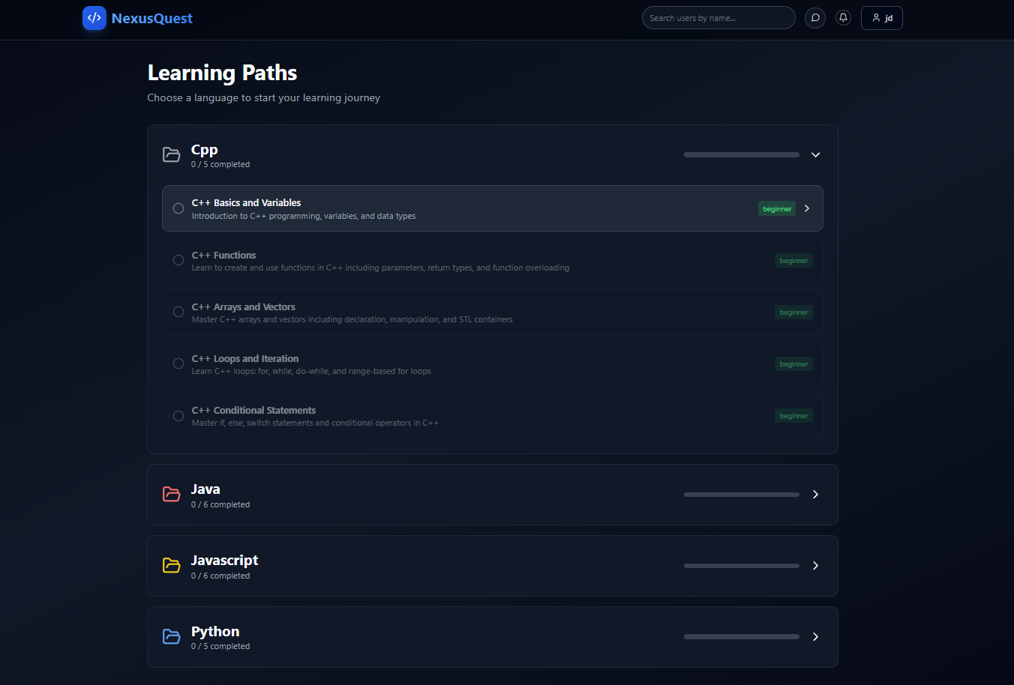
Tutorials
Tutorials list screen

Slide 33
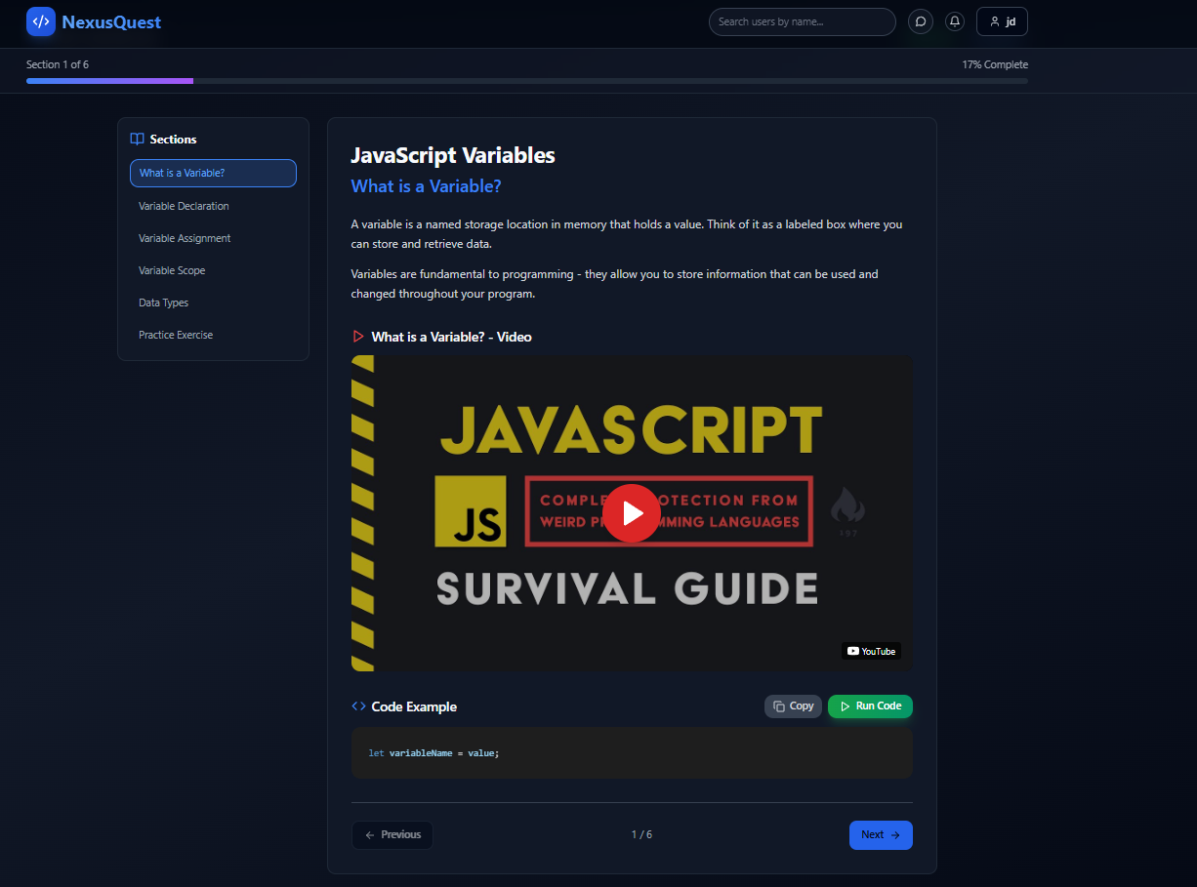
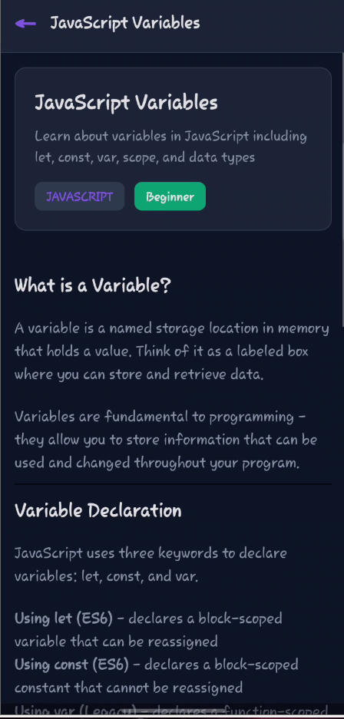
Tutorials
Tutorial screen

Slide 34
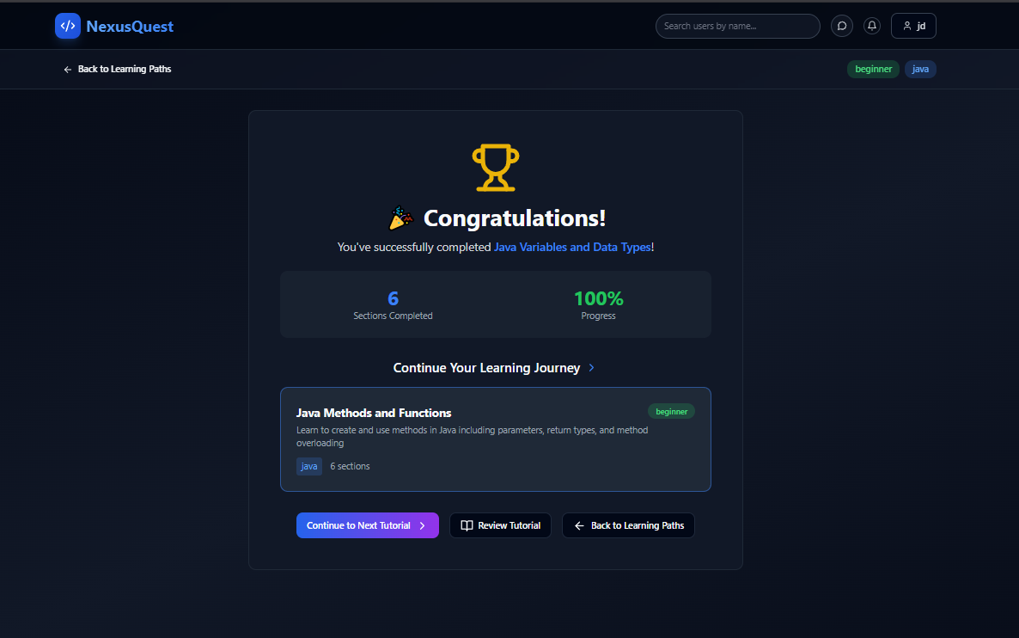

Tutorials
Tutorials completion screen

Slide 35


Quizzes
Quizzes list screen

Slide 36

Quizzes
Quiz disclaimer screen

Slide 37


Quizzes
Quiz screen

Slide 38

Quizzes
Quiz submission screen

Slide 39
CHAPTER 3.3
Teachers Features

Slide 40


Profile
Profile screen

Slide 41



Dashboard
Dashboard screen

Slide 42

Task
Tasks tab

Slide 43



Task
Create task

Slide 44


Quizzes
Quizzes tab

Slide 45


Quizzes
Students submissions

Slide 46


Quizzes
Create quiz

Slide 47


Tutorials
Tutorials tab

Slide 48


Tutorials
Create tutorial

Slide 49
CHAPTER 4
Technology Stack

Slide 50


Backend Technologies

Slide 51


Frontend Technologies
For Web
For Mobile

Slide 52

Database Technologies

Slide 53


Other Technologies

Slide 54
CHAPTER 5
Future Work

Slide 55



Looking Forward: Enhancing NexusQuest
Our commitment to continuous improvement means we are always planning for the future. Here are some areas for upcoming development.
Expanded Language Support
Extending execution capabilities beyond the current four languages to support a wider range of programming languages,
enabling more diverse learning paths and use cases.
Advanced Collaboration Workspace
Enhancing the collaboration feature to support multi-file projects, allowing teams to work on structured,
real-world codebases rather than being limited to a single file.
Competitive Tournaments
Introducing coding tournaments and competitive events where users can participate individually or in teams,
fostering engagement, motivation, and skill growth through structured challenges..

Slide 56
CHAPTER 6
Conclusion

Slide 57
Shaping the Future of Learning
NexusQuest is more than just an e-learning platform; it's a dynamic ecosystem designed to ignite curiosity, foster critical thinking, and empower both educators and students. By continuously evolving and integrating cutting-edge technologies, we aim to redefine what's possible in education.
Join us on this quest to make learning an engaging, effective, and empowering experience for everyone.

Slide 58
Thank you…
Any questions ?!.
^^

