Slide 1
Software to calculate heating and cooling loads
Prepared by:
Ahmad Ismail
Laith Husain
Adham Harazneh Supervisor:
Dr. Salameh Abd Al-Fattah

Slide 2
outline
The importance of heating and cooling.
ASHARE
HAP and Carriers
Methodology
. Selection of CFM
. Mathematical formulas
Visual basic
Future work

Slide 3
The importance of heating and cooling.
HVAC
Sizing
Consumed power
Accurate calculation

Slide 4
The main object of this project.
Heating and cooling calculations
Building information
Software function
Location
Java

Slide 5
What is cooling and heating loads?
Cooling load definition
Cooling load types
Main object of cooling load
Heating load definition
Types of heating load

Slide 6

ASHRAE
The definition of ASHRAE.
How adding chapter to ASHRAE

Slide 7
Our literature view
Previous programs
HAP
Previous researches

Slide 8
methodology
Object
Mathematical formulas
Windows
Java
Inputs and outputs
Run software
Check

Slide 9
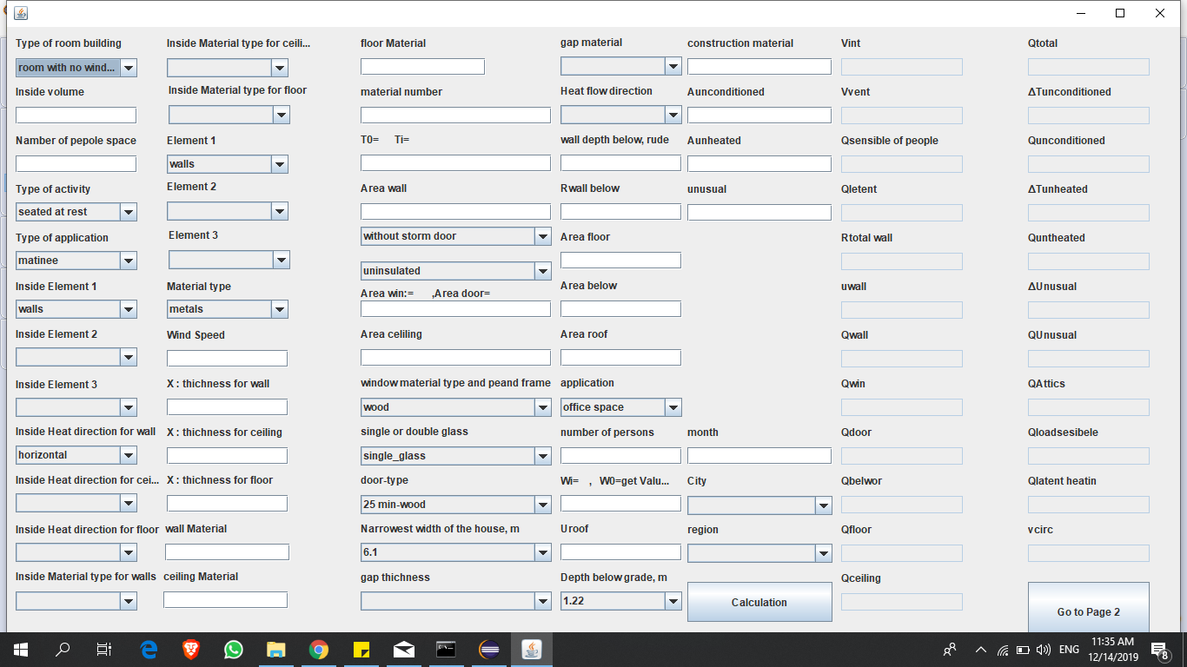
Software windows
Heating load

Slide 10
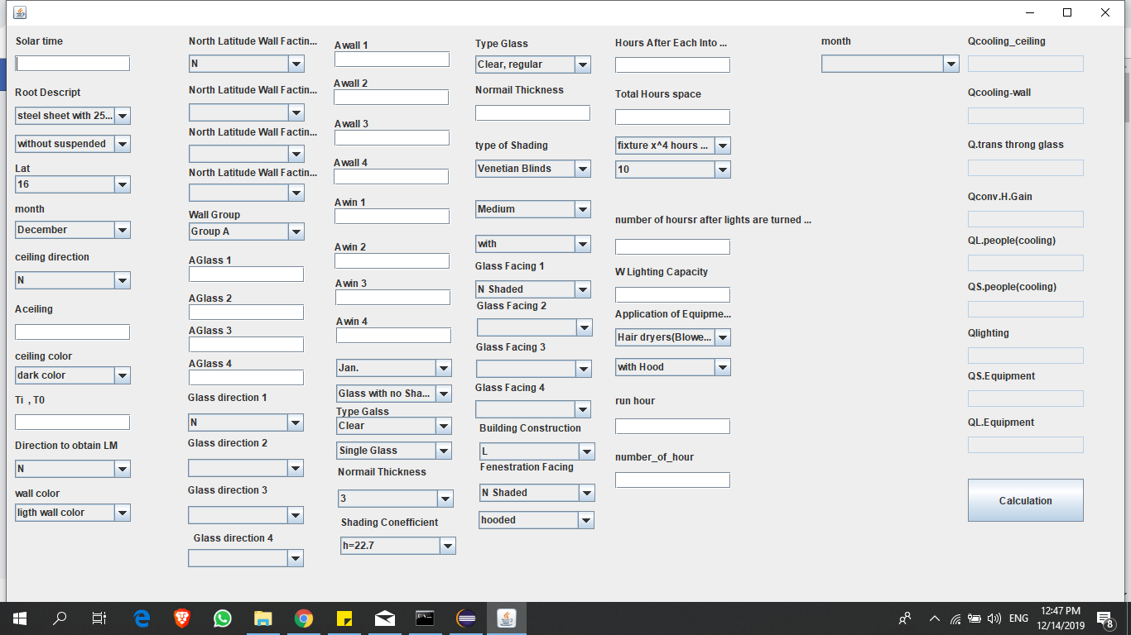
Software windows
Cooling load

Slide 11
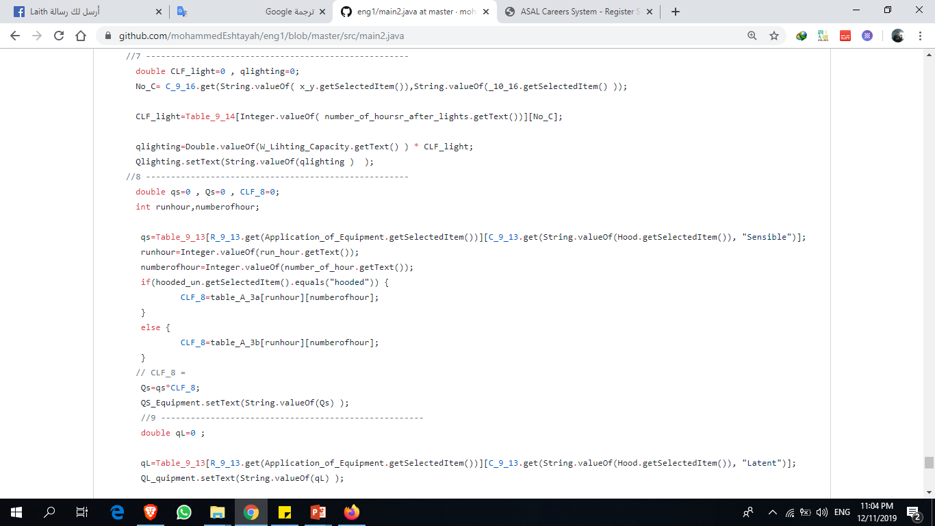
Sample of code

Slide 12
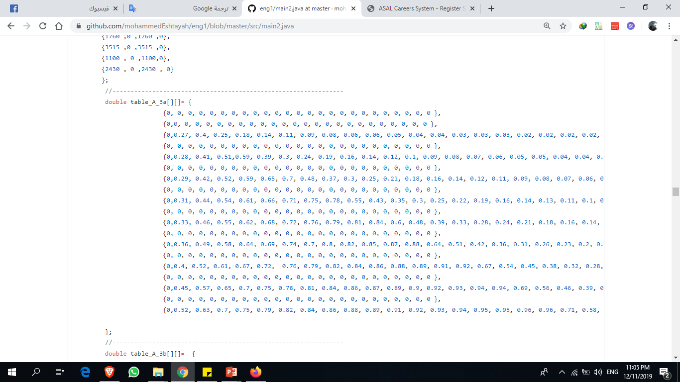
Sample of code

Slide 13
How to use the software:
First : Download.
Second : Windows.
Third: Information required.
Fourth : Start with heating load window and fill inputs.
Fifth :Calculate.
Sixth : Save .
Seventh : Go to second page
Eighth : Fill inputs and press calculate.
Ninth : Save.
Tenth : Exit .

Slide 14
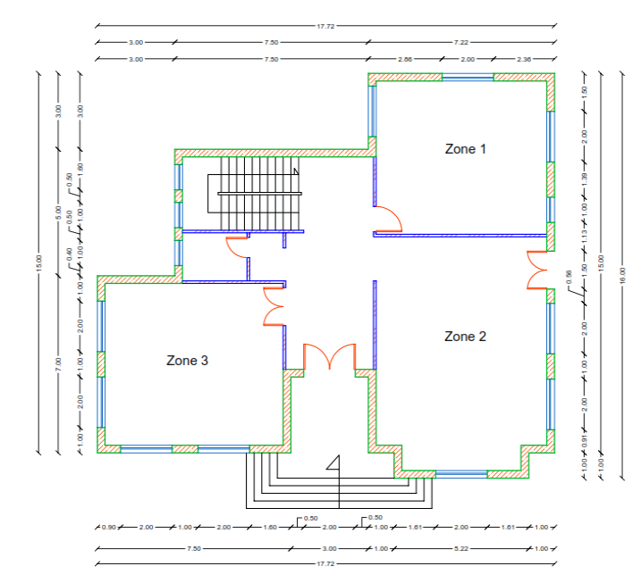
Apply software on an existing building.

Slide 15
Apply software on an existing building.

Slide 16
Apply software on an existing building.

Slide 17
Apply software on an existing building.

Slide 18
Apply software on an existing building.
4-windows
aluminum ,double glass , air speed 5m/s
Area for window₁ = 1.25*2= 2.5 m²
Area for glass₁ = 2.5*0.7= 1.75 m²
Area for window₂=1*1=1m²
Area for glass₂=1*0.75=0.75 m²
5-Weather data
Region -Middle East
Location- Palestine City-Nablus
Latitude-32.2 degree Longtitude-35.2 degree
Elevation 648.0 M
Summer design dry bulb=29.9 Celsius - Summer coincident wet bulb = 18.3 Celsius
Summer daily range =11.6 k
Winter design dry bulb= 2.9 Celsius
Winter coincident wet bulb = -2.5 Celsius

Slide 19
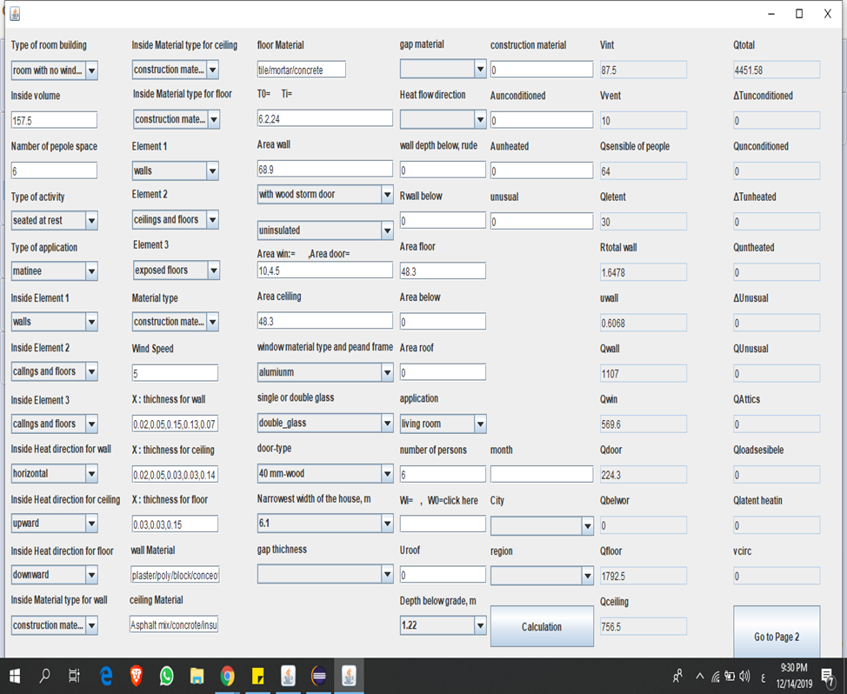
Apply software on an existing building.

Slide 20
Conclusion
The accuracy of doing heating and cooling loads calculations for west bank zone
Features in this software( especially region)
Role of Engineer
Future work :
a) Regions
b) Duct
c) Domestic and pump
d) Drawing

Slide 21


