Slide 1
EVALUATION AND REDESIGN JENIN-NABLUS STREET
(AL-SHUHADA - ARABA SECTION)
Graduation project 2

Slide 2
Contents:
Project description
Methodology
Data Collection
Traffic Analysis
Geometric Design
Pavement Design
Traffic Control Devices
Bill of Quantity and Cost
Conclusion and Recommendations

Slide 3
CH 1 Project Description
1.1 Location
The street extends from Al-Shuhada roundabout (North) to Araba roubdabout (South), and lies in the south of Jenin governorate as shown in the next slide.

Slide 4
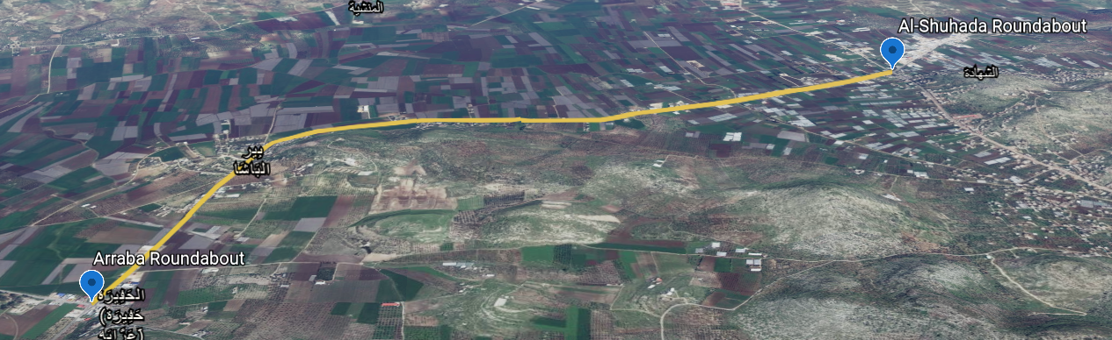
Figure 1.1: 3D Map of Al-Shuhada – Araba Street

Slide 5
1.2 OBJECTIVES OF THE PROJECT
It is intended to improve the capacity and serviceability of the street through providing the required geometric, traffic, and pavement enhancing designs, and estimating the total expected cost of the project.

Slide 6
1.3 General Information
Length | 5.2 Km
Pavement Condition | Poor
Traffic Devices | None
Number of Lanes | 2
Shoulders, Medians | None
Current LOS | E
Width | 7.2

Slide 7
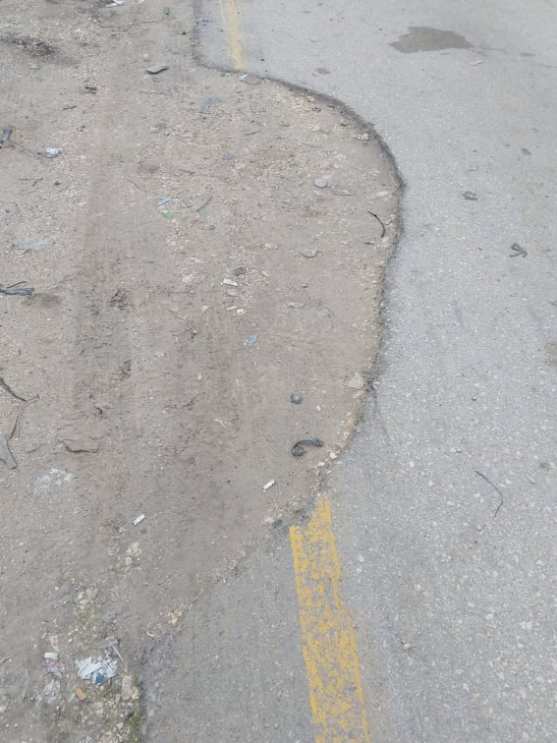
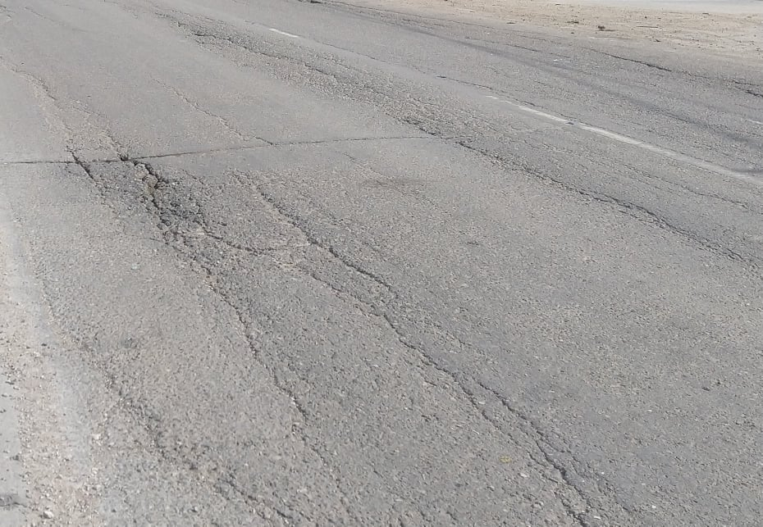
Figure 1.2(a): Edge Crack
Figure 1.2(b): Longitudinal Crack

Slide 8
CH 2 METHODOLOGY
2.1 STANDARDS AND SPECIFICATIONS
AASHTO (For pavement and geometry design)
HCM (For traffic analysis)

Slide 9
2.2 SOFTWARE PROGRAMS
Civil 3D (For geometric and pavement design)
HCS (For traffic analysis)

Slide 10
2.3 DATA COLLECTION
Traffic count
Inventory Study
Maps

Slide 11
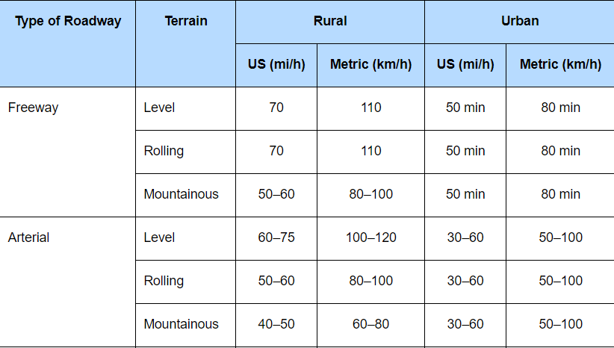
2.3.1 DESIGN SPEED
The design speed is determined due the classification and nature of the study area
Determined the design speed to be 100Km/h
Table 2.1: Design speed

Slide 12
2.3.2 LEVEL OF SERVICE
The road is rural arterial of class I
Determined the desired LOS to be B

Slide 13
2.4 PROJECT DESIGN CONSTRAINTS
Difficulties in getting surveying.
Getting soil samples from site.
Some of the existing buildings encroach the master plan of the street, and thus minimize the right of way of the street and hinders the geometric design process.
This area is located in a rural region were limited control of the respective authority exist, sometimes. Therefore, the road has varying right of way along its section; therefore, varying the design options and limiting the full design of the road along its full length.
the spread of Corona virus (Covid 19) Pandemic.

Slide 14
CH 3 DATA COLLECTION
3.1 DATA COLLECTION AND SITE VISIT
As a primary step of any project is to visit the location of the problem that needs to be solved, and collect general information that may guide to the problem causes.

Slide 15
DATA COLLECTED:
Master Plan – From the Ministry of public works.
Traffic count during Saturday and Thursday.

Slide 16
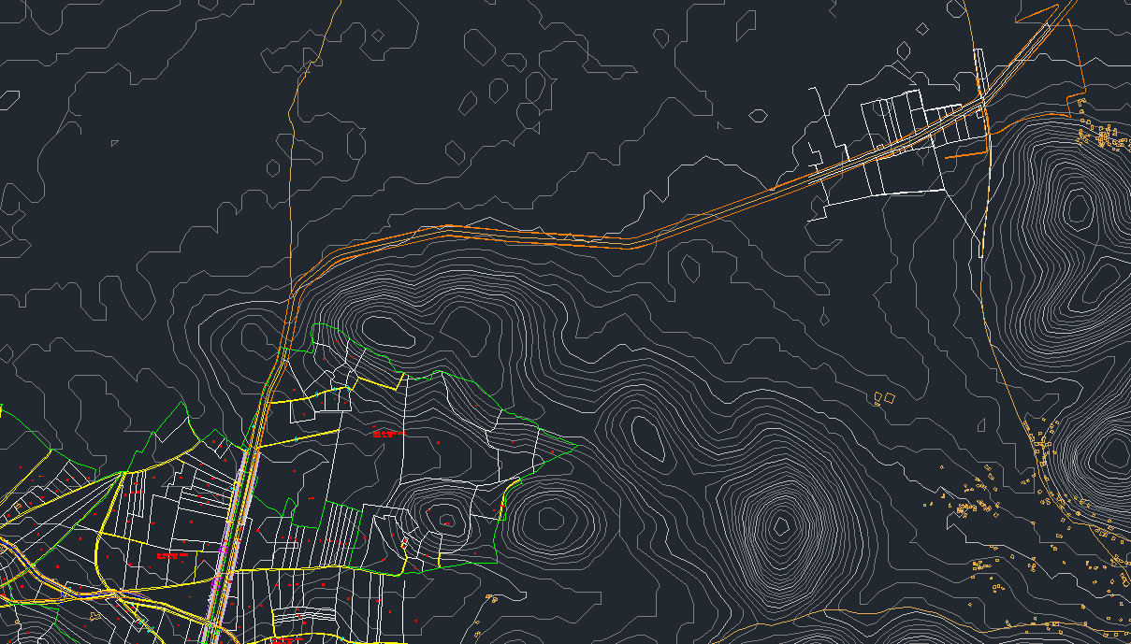
Figure 3.1 : Master Plan and Contour Lines of 5 m Intervals

Slide 17
3.2 TRAFFIC STUDY
This is a major step to start analyzing the situation to get into the problem.

Slide 18
Table 3.1 : Traffic Count Results
PH | PHV (veh/hr) | PHF | DHV (veh/hr)
2:45 - 3:45 PM | 1431 | 0.94 | 1524
Table 3.2 : Vehicles Classification
 | PC | TAXI | MINIBUS | BUS | TRUCK | OTHERS
TOTAL | 6089 | 1299 | 189 | 42 | 575 | 465
PERCENTAGE | 71.55 | 14.09 | 1.98 | 0.38 | 6.52 | 5.46

Slide 19
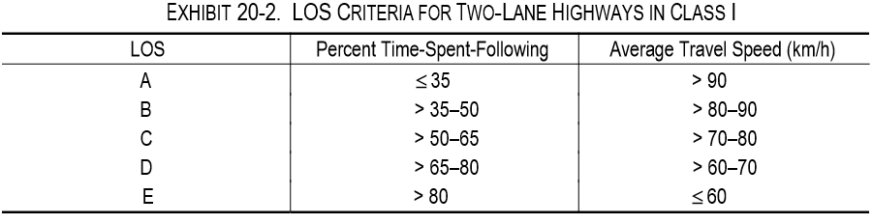
CH 4 TRAFFIC ANALYSIS
Two conditions will be considered:
Existing conditions for the street.
Future conditions for the street
Since the street is of CLASS I, LOS depends on the Percent Time Spent Following (PTSF) and Average Travel Speed (ATS).
Table 4.1 : LOS Criteria for Class I streets

Slide 20
4.1 Analysis of the Existing Conditions
The terrain is level, with length equals 5200 m and right of way = 22 m.
First, we need to determine all the required input data from data collected and tables of HCM, then adjust them with the equations.
We get that:
The shoulder width is 1m and the lane width is 3.6 m, so f_{LS} = 4.9 Km/h.
There are one access point, while the length of the street is approximately 5.2 Km, so f_{A} = 0.0 Km/h.

Slide 21
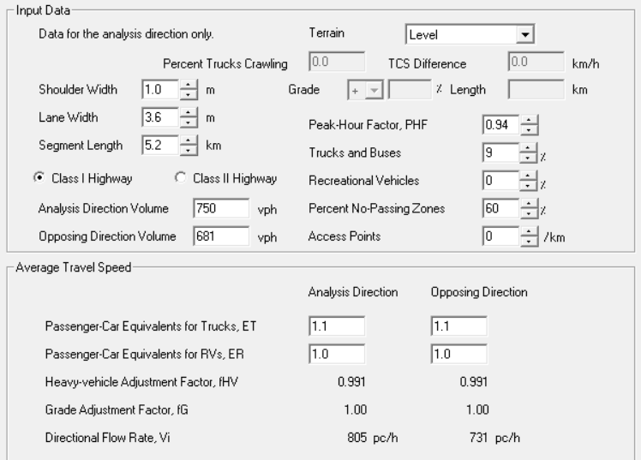
Percent of no-passing zones is about 60%
V_{d} = 750 veh/h, V_{O} = 681 veh/h, PHF = 0.94.
P_{T} = 8.9%, P_{R} = 0%, so E_{T} = 1.1 and E_{R} = 1.0.
Figure 4.1 : Input Data

Slide 22
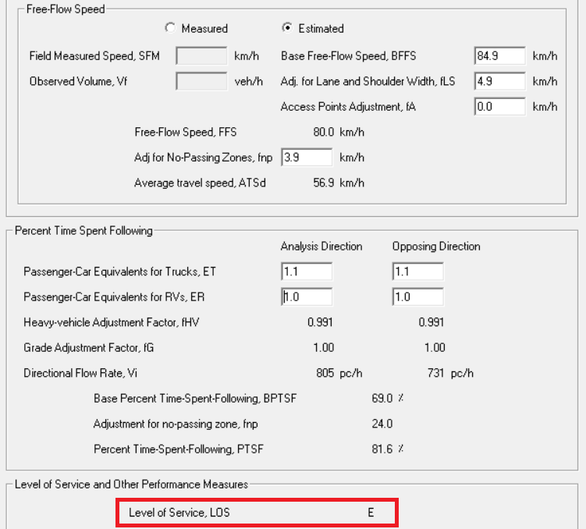
Figure 4.2 : Output Data

Slide 23
Comments:
Since the existing LOS result was worse than desired LOS (B; From AASHTO), the two-lane highway will be converted into multilane highway in future analysis and design.

Slide 24
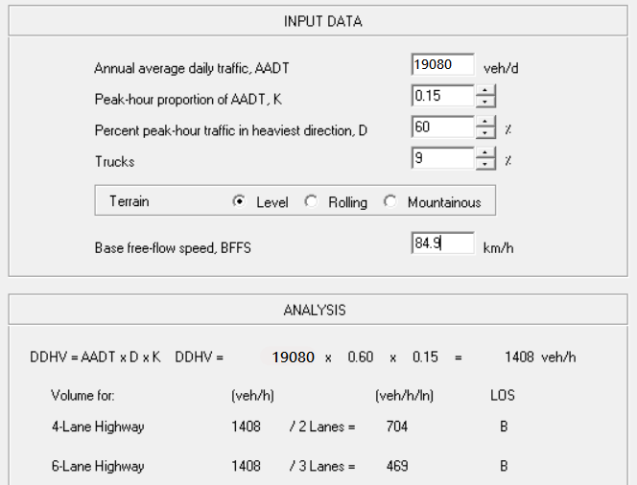
Future condition LOS: B
Figure 4.3: Future LOS

Slide 25
CH 5 GEOMETRIC DESIGN
5.1 Horizontal Alignment Design Criteria
In the design process, the center line was laid out using Civil 3D program, and then curves were designed such that the radius of designed curves is not smaller than the minimum required radius.

Slide 26
Design Speed
The preliminary design speed was chosen to be 100 km/h but a reduction of this speed at some curves is needed because of the limited right of way, and existence of some sharp horizontal and vertical curves.

Slide 27
Design Vehicle
The design vehicle for this street is a three-axle single-unit truck.
Super Elevation
A value of 8% super elevation rate was considered as a maximum value to determine the minimum radius.

Slide 28
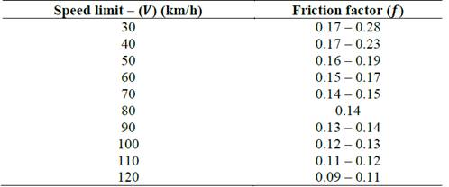
Side Friction Factor
The coefficient of side friction (f_{s}) is the friction force divided by the mass perpendicular to the road surface.
For design speed of 100 km/h, the (f_{s}) is (0.12) based on AASHTO (2011).
Table 5.1 : Coefficient of Side Friction for Different Design Speeds

Slide 29
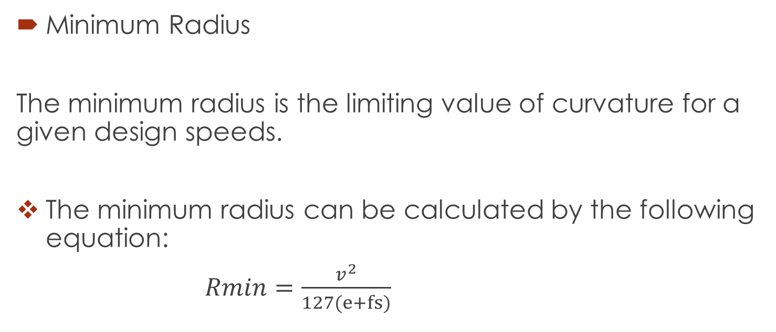
Minimum Radius
The minimum radius is the limiting value of curvature for a given design speeds.
The minimum radius can be calculated by the following equation:
$Rmin=\frac{v^{2}}{127(e+fs)}$

Slide 30
So the minimum radius of the horizontal curves for design speed of 100 km/h equals 394 m.
The speed in some curves was reduced to 70 km / h. Therefore, the minimum radius in these curves is 214 m.

Slide 31
5.2 Horizontal Curves
In order to connect straight tangent sections of roadway with a horizontal curve, several options are available. The most suitable option is the simple curve, which is just a standard curve with a single constant radius that satisfies the design speed of the road.

Slide 32
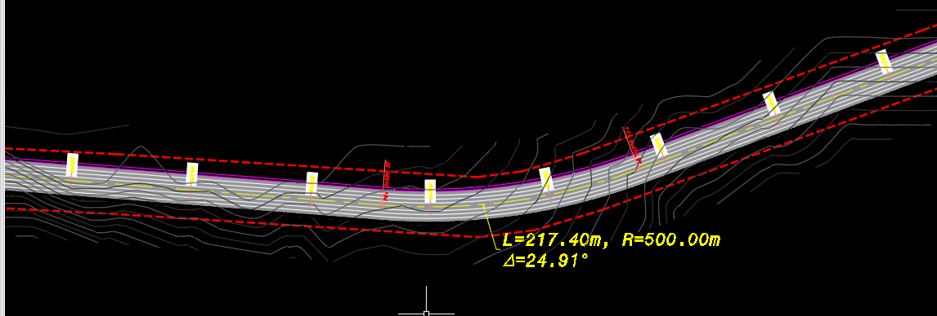
Figure 5.1 : Example on Horizontal Curves

Slide 33
5.3 Vertical Alignment
The vertical alignment of a highway consists of straight segments of highway known as grades connected by vertical curves. The design of the vertical alignment involves the selection of suitable grades for the tangent sections and the design of the vertical curves. The topography of the area has a significant impact on the design of the vertical alignment

Slide 34
Vertical Curves
A vertical curve provides a transition between two slopes roadways, allowing the vehicle to cross the elevation rate change at a gradual rate rather than a sharp cut.
There are two types of vertical curves: sag curves and crest curves.

Slide 35
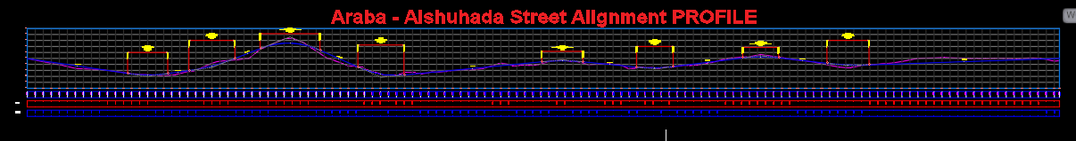
Figure 5.2 : Vertical Alignment (Curves)

Slide 36
5.4 Cross Section
Road width should be minimized so as to reduce the costs of construction and maintenance, whilst being sufficient to carry the traffic loading efficiently and safely and to meet the design speed of the road. Also, there must be a commitment not to violate private land property surrounding the road.
The available right-of-way is 22 m.

Slide 37
The main elements of the road cross section are the travel lanes, shoulders, curb stones, sidewalks, side ditches and side slopes.
Travel Lanes
Lane width usually varies from 3.0 m to 3.6 m. Based on the factors above and the available right of way the recommended lane width was chosen to be 3.6 m.

Slide 38
Shoulders
Shoulders are contiguous with the travel lanes providing space along the highway for vehicles to stop especially during emergencies.
Shoulders width was chosen to be 2 m for 4-lane highway along the street except Bir al-Basha region

Slide 39
Sidewalks
We use sidewalks with clear width of 2 m in Bir al-Basha section on both sides.
Guard Rails
Guardrails are used at sharp curves and sections with high fills as illustrated in appendix H
Side Slopes
Side slopes were taken to be 1V:1.75H
Side Ditches
Side slope of the ditch was designed to be 1H: 2V.

Slide 40
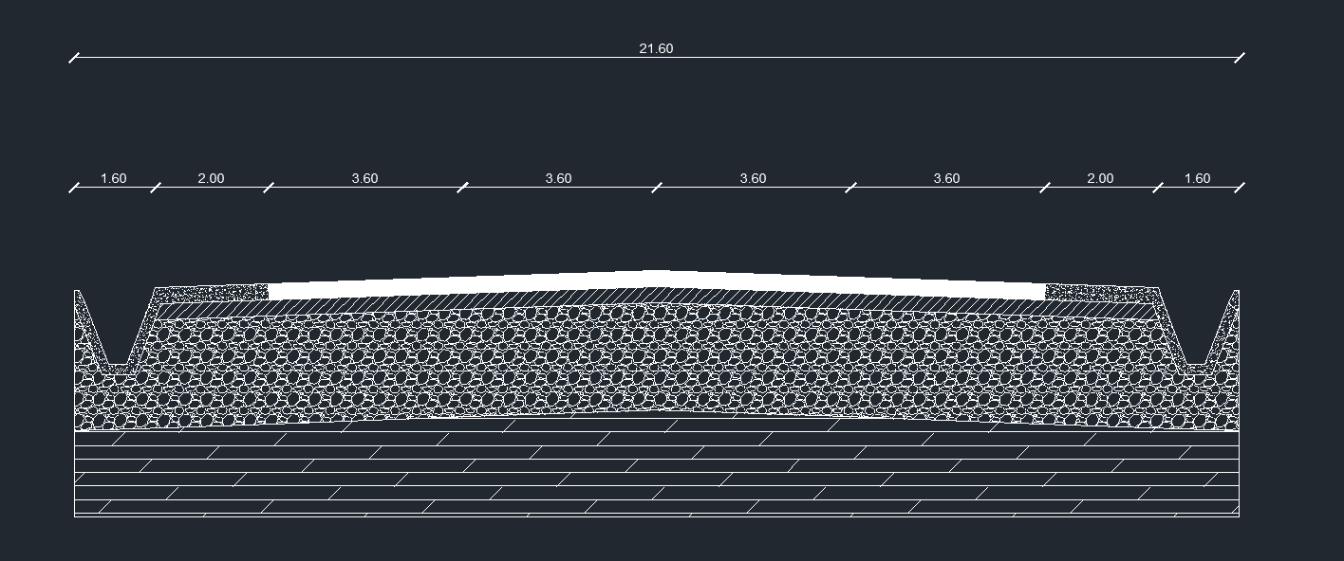
Figure 5.3 : Cross Section

Slide 41
CH 6 PAVEMENT DESIGN
6.1 Introduction
Pavement design is the major component in the road construction. Highway pavements are divided into two main categories flexible and rigid.
Due to the nature of the street area and relevance of the street, a flexible pavement will be designed for.

Slide 42
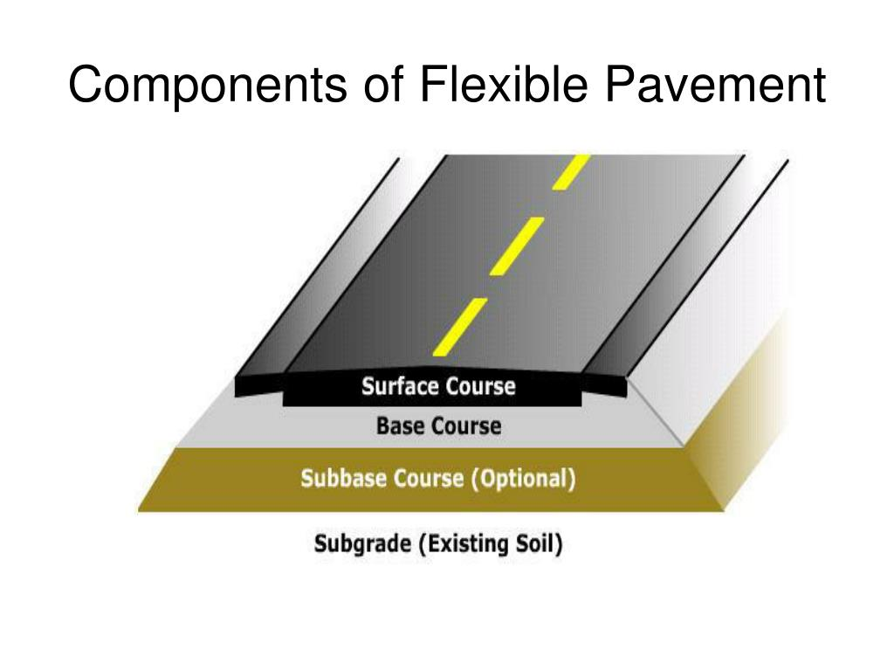
6.2 Structural Components of Flexible Pavement
The components of flexible pavement are subgrade or roadbed, sub-base, the base and the wearing surface as shown below.
Figure 6.1 : Structural Components of Flexible Pavement

Slide 43
6.3 Geotechnical Report Analyses
Soil Tests Results
Five samples of subgrade soils were taken along the street area. Each sample weighs 10 Kg, excavated from depth of more than 50 centimeters.
Sample No. | %finer sieve # 200 | Liquid Limit % | Plasticity Index | Soil Classification | CBR Value
1 | 68 | 30 | 11 | A-6 | 7.06
2 | 63 | 40 | 16 | A-6 | 8.02
3 | 61 | 40 | 17 | A-6 | 7.00
4 | 55 | 39 | 20 | A-6 | 5.65
5 | 51 | 37 | 22 | A-6 | 6.03

Slide 44
6.4 Soil Treatment
The purpose of soil treatment is to improve the strength of the pavement, and this process is done using two techniques, rock fill and geotextile.
Rock Fill
It is preferable to replace the existing soil with rocky materials. These rocky materials must be to a certain depth, as this depth depends on the size of the material itself, which is practically about 0.80 meters.

Slide 45
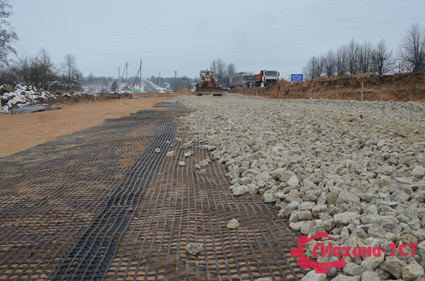
Geotextile
Geotextiles are thin & strong membrane fabric which is used to reinforce soil & prevent from damage. (See Figure 6.2)
The geotextile was placed between the subgrade and rock fill layers as this the most appropriate option due to the nature of the study area.
Figure 6.2 : Geotextile

Slide 46
6.4 Structural Design
Several of factors are considered in AASHTO procedure for flexible pavement such that:
• Pavement performance
• Traffic
• Subgrade material
• Materials of construction
• Environment
• Drainage
• Reliability

Slide 47
6.4.1 Pavement Performance
Pavement performance modeling is the study of pavement deterioration throughout its lifecycle and the evaluation in terms of comfort riding.
It is assessed using Present Serviceability Index (PSI) indicator
Recommended values for the terminal serviceability index are 2.5 or 3 for major highway. The value of 2.5 is selected.

Slide 48
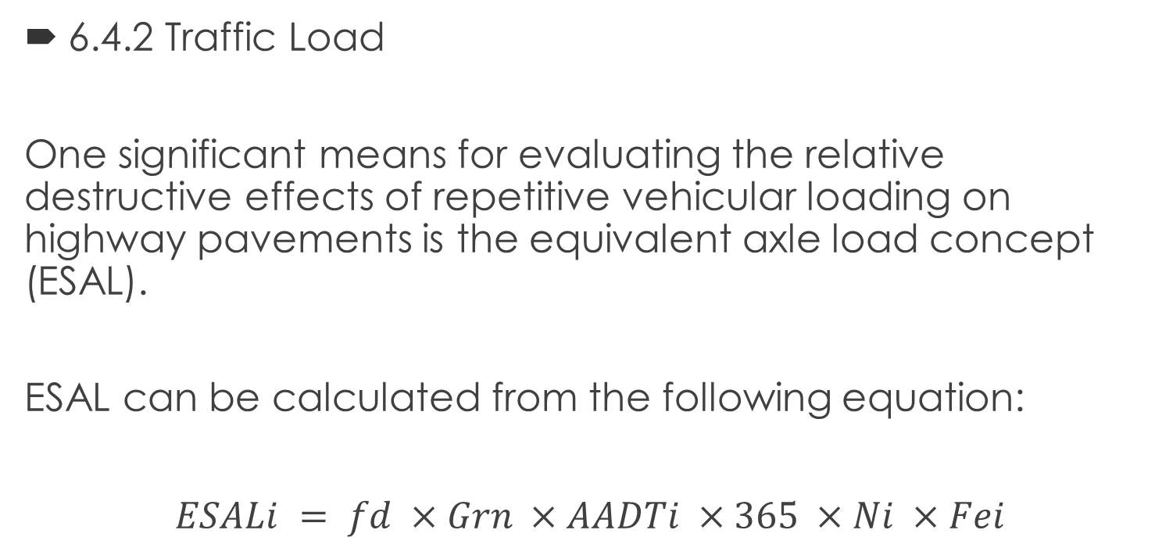
6.4.2 Traffic Load
One significant means for evaluating the relative destructive effects of repetitive vehicular loading on highway pavements is the equivalent axle load concept (ESAL).
ESAL can be calculated from the following equation:
$ESALi = fd ×Grn ×AADTi ×365 ×Ni ×Fei$

Slide 49
Load Equivalency Factor:
Based on vehicles classification, the load equivalency factor is taken from the Ministry of Public Works and Housing ESAL table. The total ESAL is computed as illustrated in the following table.

Slide 50
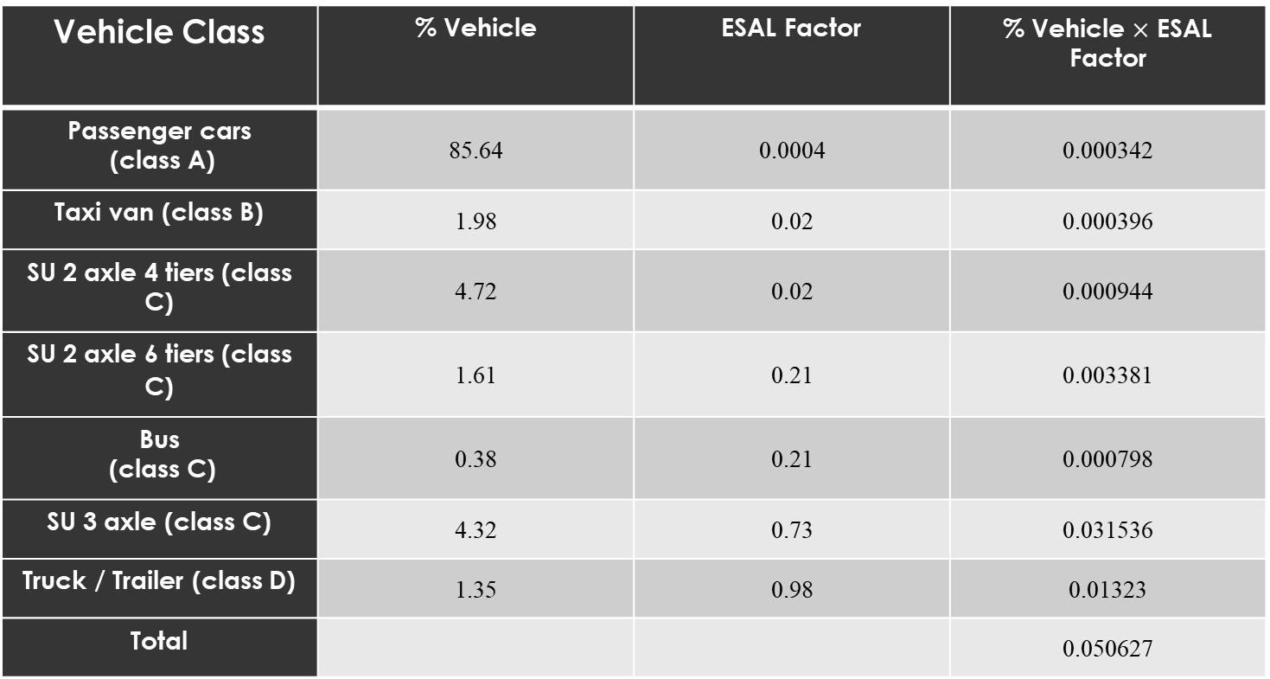
Table 6.2: ESAL Table
Vehicle Class | % Vehicle | ESAL Factor | % Vehicle $×$ ESAL Factor
Passenger cars (class A) | 85.64 | 0.0004 | 0.000342
Taxi van (class B) | 1.98 | 0.02 | 0.000396
SU 2 axle 4 tiers (class C) | 4.72 | 0.02 | 0.000944
SU 2 axle 6 tiers (class C) | 1.61 | 0.21 | 0.003381
Bus (class C) | 0.38 | 0.21 | 0.000798
SU 3 axle (class C) | 4.32 | 0.73 | 0.031536
Truck / Trailer (class D) | 1.35 | 0.98 | 0.01323
Total |  |  | 0.050627

Slide 51

Growth factor:
$Grn$= ${[(1+r)}^{n}−1]$ / r
r = 3.5 % … $Grn$= 28.28.
Design Lane Factor:
It depends on the number of lanes.
$fd$ = 45%.

Slide 52

AADT
AADT = $PHV$/ K
K = 0.15
AADT = 1431/0.15 = 9540 veh/day.
Total ESAL
Total ESAL = 2.2 $×$10⁶

Slide 53
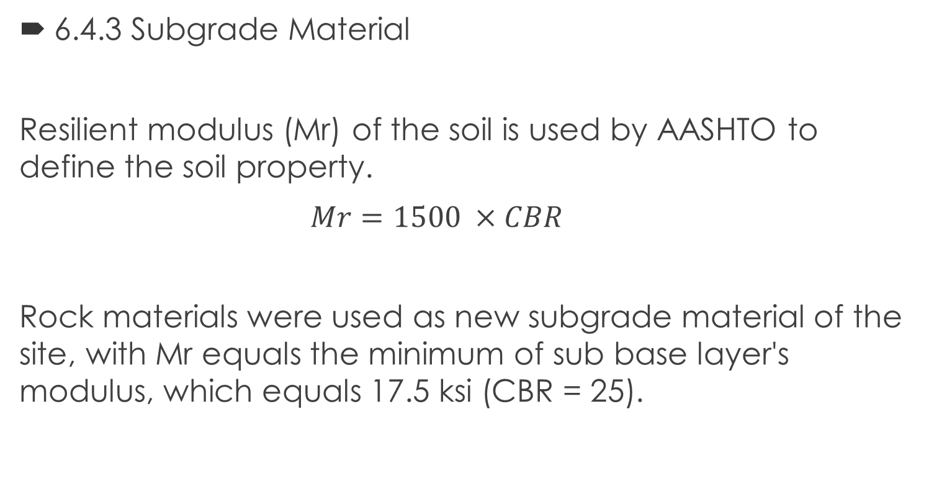
6.4.3 Subgrade Material
Resilient modulus (Mr) of the soil is used by AASHTO to define the soil property.
$Mr=1500 ×CBR$
Rock materials were used as new subgrade material of the site, with Mr equals the minimum of sub base layer's modulus, which equals 17.5 ksi (CBR = 25).

Slide 54
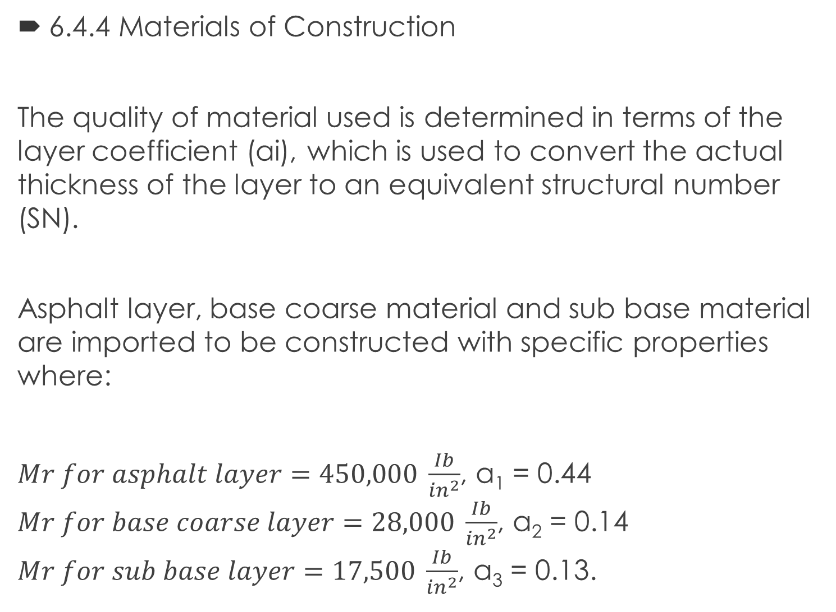
6.4.4 Materials of Construction
The quality of material used is determined in terms of the layer coefficient (ai), which is used to convert the actual thickness of the layer to an equivalent structural number (SN).
Asphalt layer, base coarse material and sub base material are imported to be constructed with specific properties where:
$Mr for asphalt layer=450,000 \frac{Ib}{{in}^{2}}$, a₁ = 0.44
$Mr for base coarse layer=28,000 \frac{Ib}{{in}^{2}}$, a₂ = 0.14
$Mr for sub base layer=17,500 \frac{Ib}{{in}^{2}}$, a₃ = 0.13.

Slide 55
6.4.5 Drainage
By assuming that the quality of drainage is fair, the water is removed within one week, and the percent saturation condition is (5-25) %.
The result of drainage coefficient m _{i} for base coarse and sub base equals 0.90.

Slide 56
6.4.6 Reliability
Reliability of R = 0.9 is considered for a rural arterial road
Standard deviation of a flexible pavement is assumed to be So = 0.45.

Slide 57
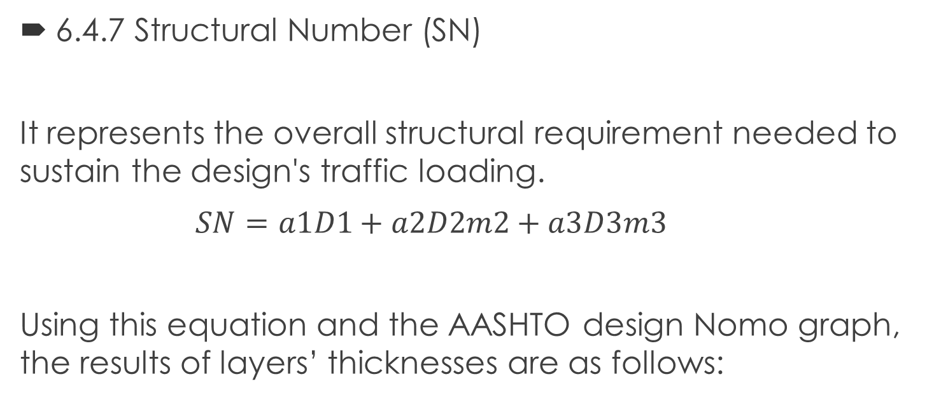
6.4.7 Structural Number (SN)
It represents the overall structural requirement needed to sustain the design's traffic loading.
$SN=a1D1+a2D2m2+a3D3m3$
Using this equation and the AASHTO design Nomo graph, the results of layers’ thicknesses are as follows:

Slide 58
SN for base course SN₁ = 2.4
SN for sub base SN₂ = 2.8
SN for subgrade SN₃ = 2.8
The corresponding thicknesses are as follows:
Thickness of asphalt layer D1 = 3.5 inches = 9 cm.
Thickness of base coarse layer D2 = 12 inches = 30 cm.

Slide 59
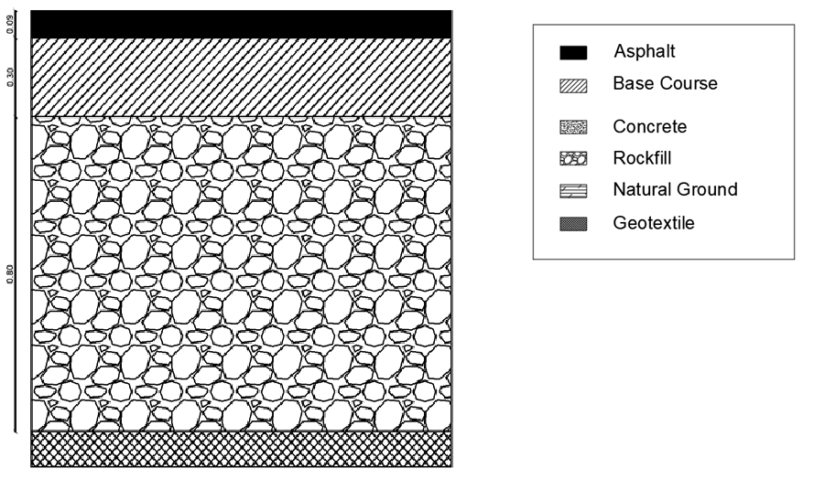
Figure 6.2 : Structural Components of Flexible Pavement

Slide 60
CH 7 TRAFFIC CONTROL DEVICES
This chapter aims to apply the traffic control devices on the alignment of the designed street.
Types of traffic control devices:
Traffic Signs
Road surface Markings
Traffic Signals

Slide 61
7.1 Application of Traffic Control Devices
The traffic control for four-lane designed street will be assigned by two types of control devices, they are markings and signs since there is no need for signals.
7.1.1 Application of Traffic Signs
These included regulatory signs (such as speed limit sign), and warning signs.

Slide 62
7.1.2 Application of Traffic Markings
Application of Longitudinal Markings
Solid white lines are used to prohibit passing, and broken lines used where it's permitted, and used for inside shoulders.
Yellow solid lines where set to make the right and left edges of the travel lanes (carriage way)
Application of Transverse Markings
Crosswalks are set at Bir Al-Basha area and in case of existence of pedestrians.
Markings are shown in plans as shown in Appendix H.

Slide 63
CH 8 BILL OF QUANTITY AND COST
8.1 Introduction
The length of the Al-Shuhada-Araba road is 5,184 m. The cut and fill calculations and quantities estimate were done using CIVIL 3D program.
As mentioned in pavement chapter, the cost of asphaltic material is high by contrast of other material as base course and sub-base, so the proper design was two layers of asphalt with 9cm, binder course 5 cm and wearing 4 cm.
Miscellaneous works contain signs, curbstone, traffic marking, guard rail and concrete ditches. Moreover, drainage cost as ditch is added in calculation of cost.

Slide 64
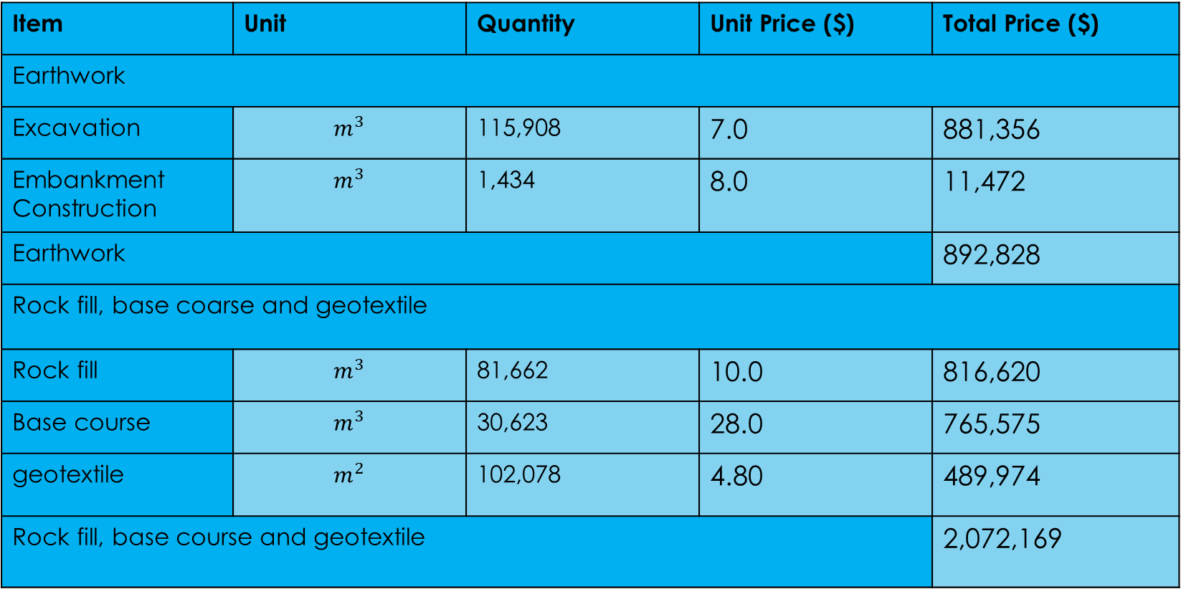
8.2 Quantity and Cost Estimates
Table 8.1 BOQ&Cost
Item | Unit | Quantity | Unit Price ($) | Total Price ($)
Earthwork
Excavation | $$m^{3}$$ | 115,908 | 7.0 | 881,356
Embankment Construction | $$m^{3}$$ | 1,434 | 8.0 | 11,472
Earthwork |  |  |  | 892,828
Rock fill, base coarse and geotextile
Rock fill | $$m^{3}$$ | 81,662 | 10.0 | 816,620
Base course | $$m^{3}$$ | 30,623 | 28.0 | 765,575
geotextile | $$m^{2}$$ | 102,078 | 4.80 | 489,974
Rock fill, base course and geotextile |  |  |  | 2,072,169

Slide 65
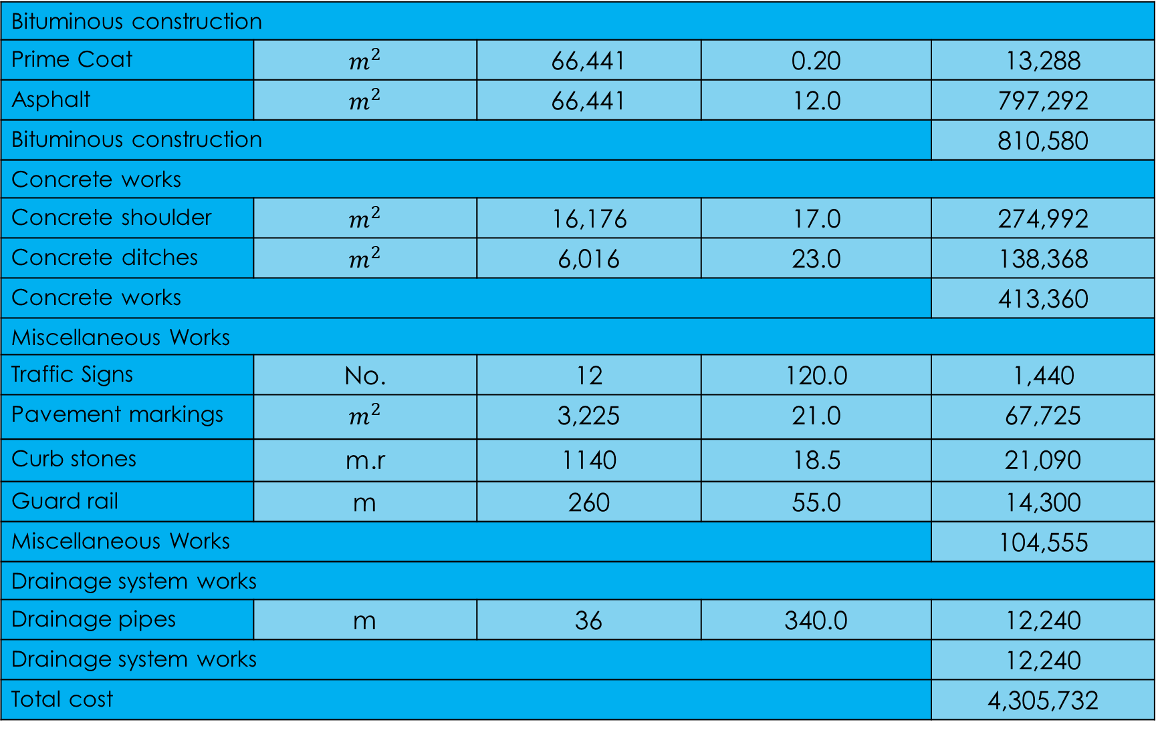
Bituminous construction
Prime Coat | $$m^{2}$$ | 66,441 | 0.20 | 13,288
Asphalt | $$m^{2}$$ | 66,441 | 12.0 | 797,292
Bituminous construction |  |  |  | 810,580
Concrete works
Concrete shoulder | $$m^{2}$$ | 16,176 | 17.0 | 274,992
Concrete ditches | $$m^{2}$$ | 6,016 | 23.0 | 138,368
Concrete works |  |  |  | 413,360
Miscellaneous Works
Traffic Signs | No. | 12 | 120.0 | 1,440
Pavement markings | $$m^{2}$$ | 3,225 | 21.0 | 67,725
Curb stones | m.r | 1140 | 18.5 | 21,090
Guard rail | m | 260 | 55.0 | 14,300
Miscellaneous Works |  |  |  | 104,555
Drainage system works
Drainage pipes | m | 36 | 340.0 | 12,240
Drainage system works |  |  |  | 12,240
Total cost |  |  |  | 4,305,732

Slide 66
CH 9 CONCLUSION AND RECOMMENDATIONS
9.1 Conclusion
We increased the road width to become 22 m, except for the Bir Al-Basha area by 12 m, the pavement structure layers are designed such as , asphalt layer was (9 cm) and base coarse was (30 cm ). The shoulders are improved and we expanded it to become (2 m), the lanes are increased to become 4 lanes with a width of 3.6 m, except for the Bir al-Basha area, two lanes with a width of 3.6 m. And in the traffic operation we applied the traffic signs such as (regulatory sings and guiding signs) and pavement markings.

Slide 67
9.2 Recommendations
There are the large volume of new vehicles in the future so the Jenin-Nablus street must take into the consideration.
Since the road classified as Rural Arterial, we don’t advice to open new crossings.
Layers' materials should be imported with specific properties and tested to achieve the predicted results.

Slide 68
When we design the street, we must control traffic safety and modernize the private data in order to face the upcoming changes.
The Ministry of Public Works and Housing should fund enough money to achieve all design specifications.
The Ministry of Public Works and Housing is advised to take into consideration the new design for the road in all their future projects to attain the maximum benefit and serviceability.

Slide 69
THANKS YOU FOR LISTENING

