Slide 1

SmartOps
Integrated Operations Management
Platform for SMEs
Bachelor's Graduation Project – Computer Engineering Department
An-Najah National University | Fall 2025/2026
Presented by
Yousef Hanna · Mahmoud Asmar
Supervised by
Dr. Amjad AbuHassan
Notes:
Welcome and introduce the project SmartOps, mention your names, supervisor, and the university. Take about 1-2 minutes on this slide.

Slide 2
Presentation Agenda
What we'll cover today
01
Problem Statement & Motivation
02
Project Objectives & Significance
03
System Architecture & Tech Stack
04
Core Features Walkthrough (Web & Mobile)
05
AI Health Analysis Module
06
Cloud Deployment
07
Results & Demo
08
Conclusions & Future Work
Notes:
Briefly walk through what you'll cover. This presentation is structured for approximately 20-25 minutes.

Slide 3




The Problem
What SMEs are struggling with today
Fragmented Tools
No Client Portal
Spreadsheets, messaging apps, and standalone tools that don't communicate with each other
Clients have no structured way to submit project requests or monitor progress
No Task Oversight
No Performance Analytics
Employees lack a unified interface for task assignments, status updates, and notifications
No systematic way to prioritize work or identify bottlenecks and delay risks
Notes:
Explain how SMEs rely on disconnected tools, causing poor visibility, missed deadlines, and communication breakdowns. This is the gap SmartOps was built to fill.

Slide 4

Project Objectives
Centralized web platform for project creation, assignment & tracking
Role-Based Access Control (RBAC) for Admin, Employee & Client roles
Client-facing portal to submit requests, browse templates & track progress
Real-time notification system via Socket.IO
Project templates catalog for faster project kickoff
AI-based project health analysis, risk scoring & delay prediction
Responsive UI for desktop & mobile (React.js + Flutter)
Notes:
Walk through each objective. Emphasize the seven main goals of the project and how each addresses one of the problems shown on the previous slide.

Slide 5
Technology Stack
Frontend
Mobile
Backend
Cloud
React.js 19
Flutter (Dart)
Node.js + Express.js 5
Railway PaaS
Vite 8
Dio HTTP client
MySQL 2 (connection pool)
MySQL 8 (managed)
Tailwind CSS 3
flutter_secure_storage
JWT (RFC 7519, HS256)
GitHub CI/CD
React Router DOM v7
Material Design 3
bcryptjs · Zod DTOs
Auto HTTPS
Socket.IO Client
Provider / setState
Socket.IO · Brevo/Nodemailer
Env variable secrets
Axios · Zod
iOS & Android
RBAC Middleware
Vercel / Netlify (frontend)
Notes:
Describe each layer: frontend (React.js SPA), mobile (Flutter cross-platform), backend (Node/Express REST API), and cloud (Railway). Highlight that both web and mobile share the same backend.

Slide 6
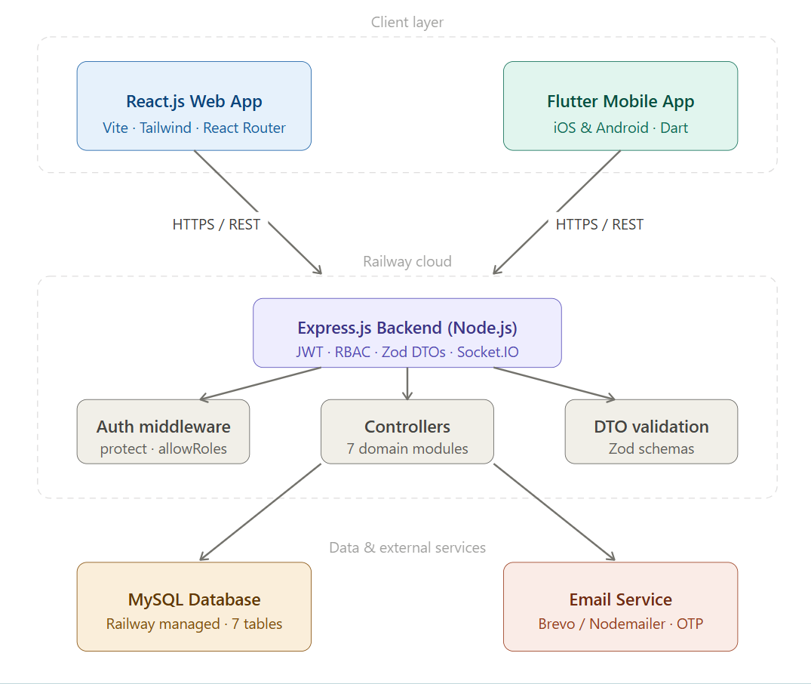
System Architecture
Notes:
Walk through the full-stack architecture: React.js web and Flutter mobile both connect over HTTPS/REST to the Express.js backend on Railway. The backend connects to MySQL and sends real-time notifications via Socket.IO. External email goes through Brevo/Nodemailer.

Slide 7
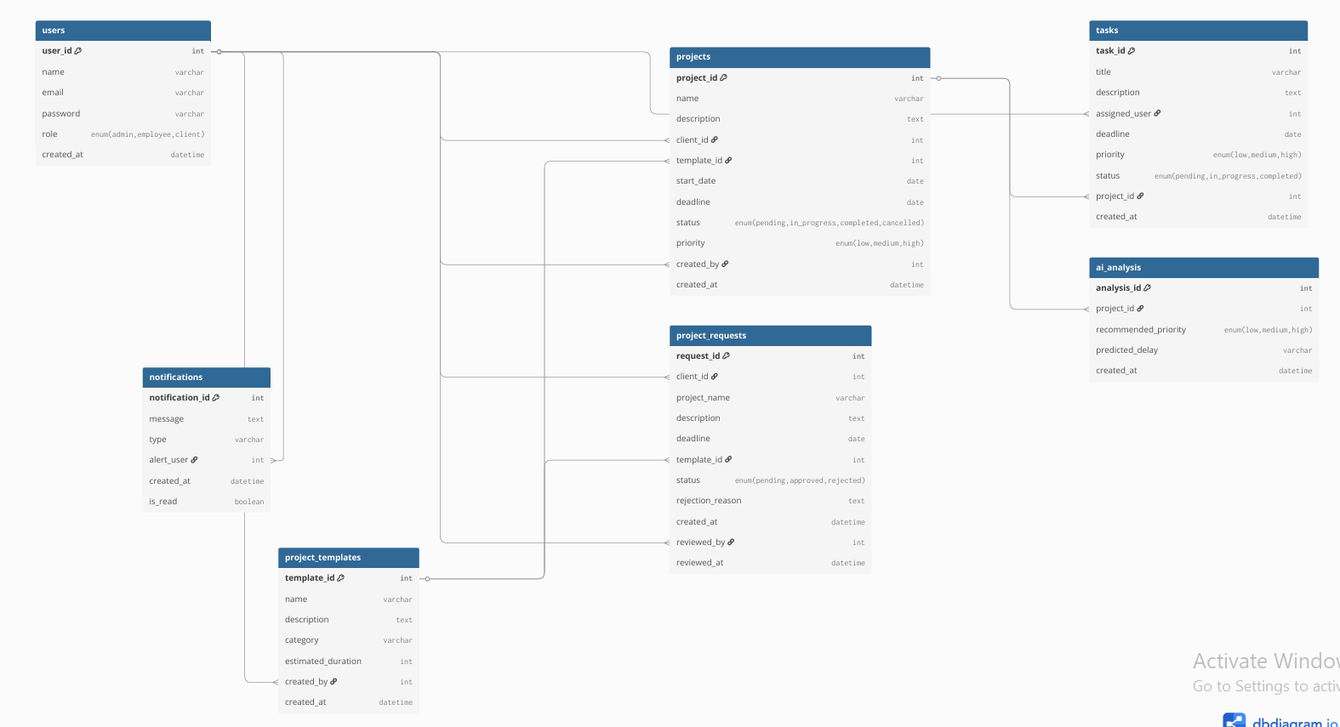
Database Design
7-table MySQL schema
users
All roles: admin, employee, client
projects
Client association, status, priority, deadline
tasks
Assigned to employee, priority, status
project_requests
Client requests with approval workflow
project_templates
Predefined software project types
notifications
Event-driven alerts with is_read flag
ai_analysis
Health score & delay prediction per project
Notes:
Describe the 7 tables and their relationships. Point out that the ai_analysis table is designed and ready for a future ML model even though the current implementation uses rule-based scoring.

Slide 8
Security & Access Control
Dual-layer RBAC enforced on frontend and backend
Admin
Employee
Client
Full system access
View assigned tasks
Submit project requests
Create/manage users
Update task status
Browse templates
Review client requests
View notifications
Track project progress
Assign tasks
Access own dashboard
Read-only task view
Export reports
View projects
View notifications
AI analysis
🔒 bcryptjs password hashing (salt=10) · JWT HS256, 7-day expiry · Parameterized SQL (no injection) · CORS restricted to trusted origins · OWASP Top 10 mitigations applied
Notes:
Explain the dual-layer RBAC: frontend route guards prevent navigation, backend middleware enforces authorization. Describe the security measures: bcrypt hashing, JWT, parameterized SQL, and CORS.

Slide 9
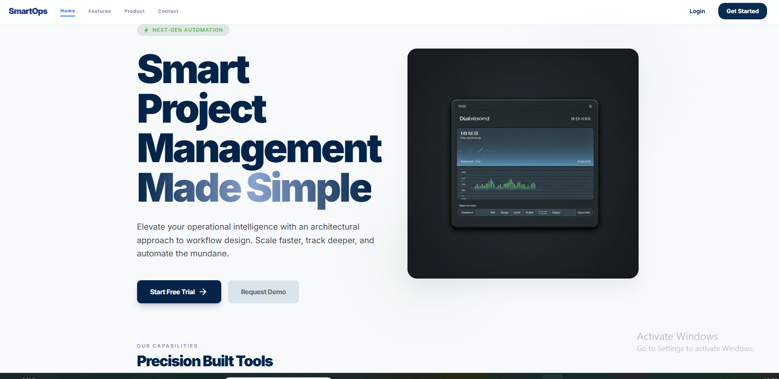
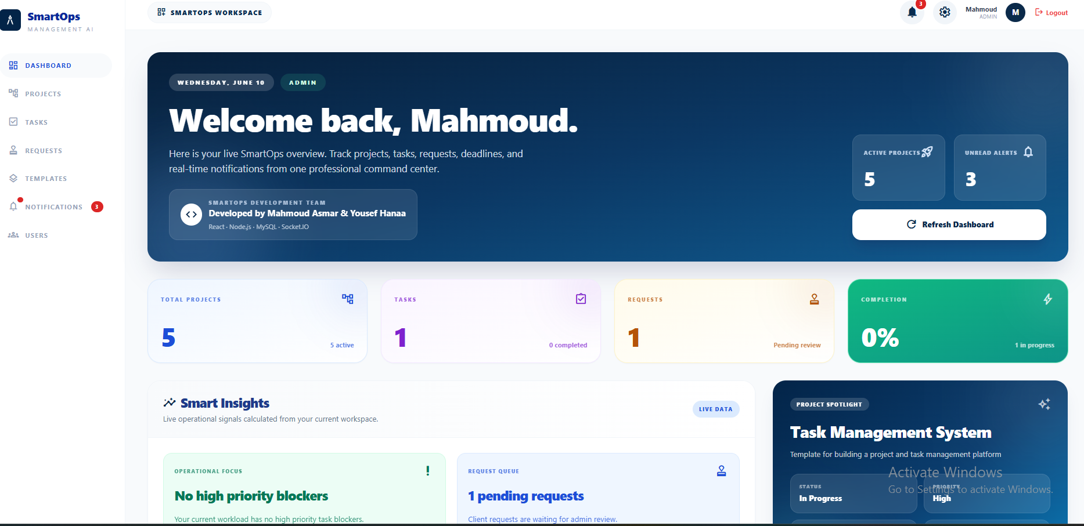
Landing Page & Dashboard
The entry point — and the command center
Landing Page
Admin Dashboard (Web)
Notes:
Show the landing page (public) and then the role-specific dashboard. The admin dashboard shows project counts, tasks, requests pending, completion rate, and smart insights. Point out that each role sees a different version.

Slide 10
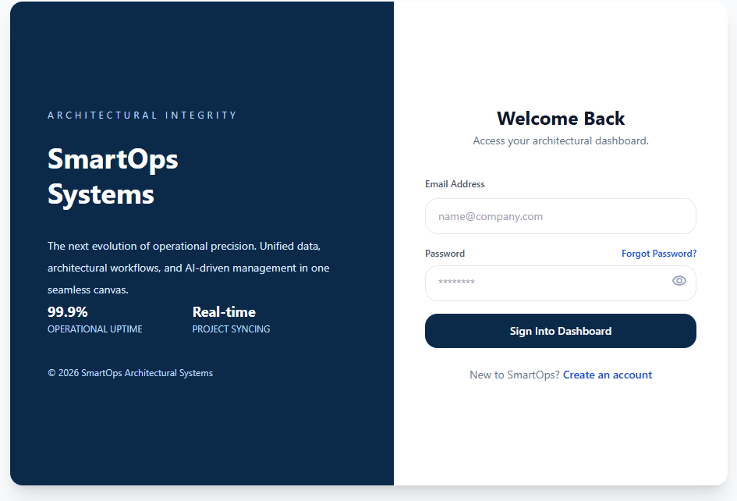
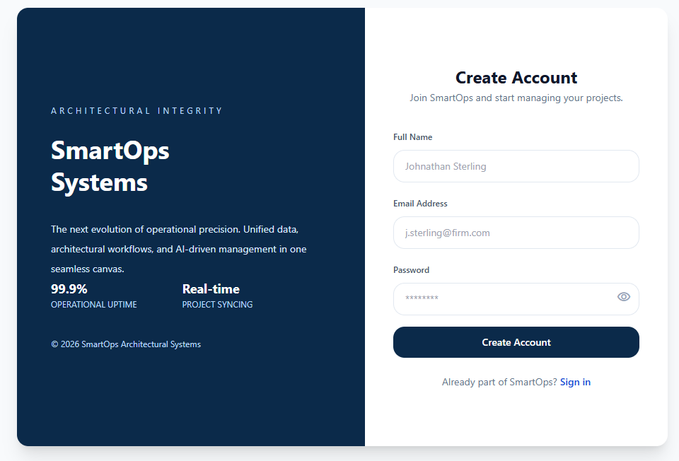
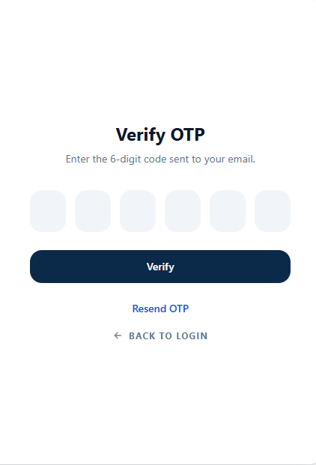
Authentication Flow
Secure login, registration & OTP-based password recovery
Login
Register
Verify OTP
Password recovery: Enter email → Receive 6-digit OTP via email → Verify OTP → Set new password (10-minute OTP expiry)
Notes:
Walk through the authentication flow. Admin creates users. Public users register as clients. JWT is issued on login, stored in localStorage, and sent as a Bearer token on every request. Explain the 3-step password recovery flow using OTP sent by email.

Slide 11
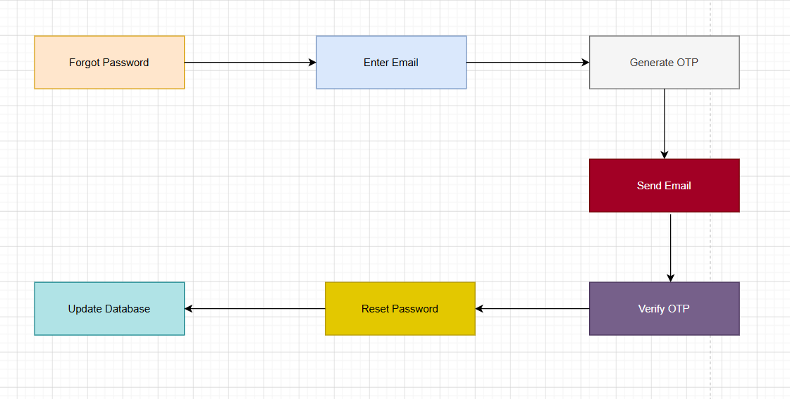
OTP- Password Recovery Workflow
Notes:
Walk through the full-stack architecture: React.js web and Flutter mobile both connect over HTTPS/REST to the Express.js backend on Railway. The backend connects to MySQL and sends real-time notifications via Socket.IO. External email goes through Brevo/Nodemailer.

Slide 12

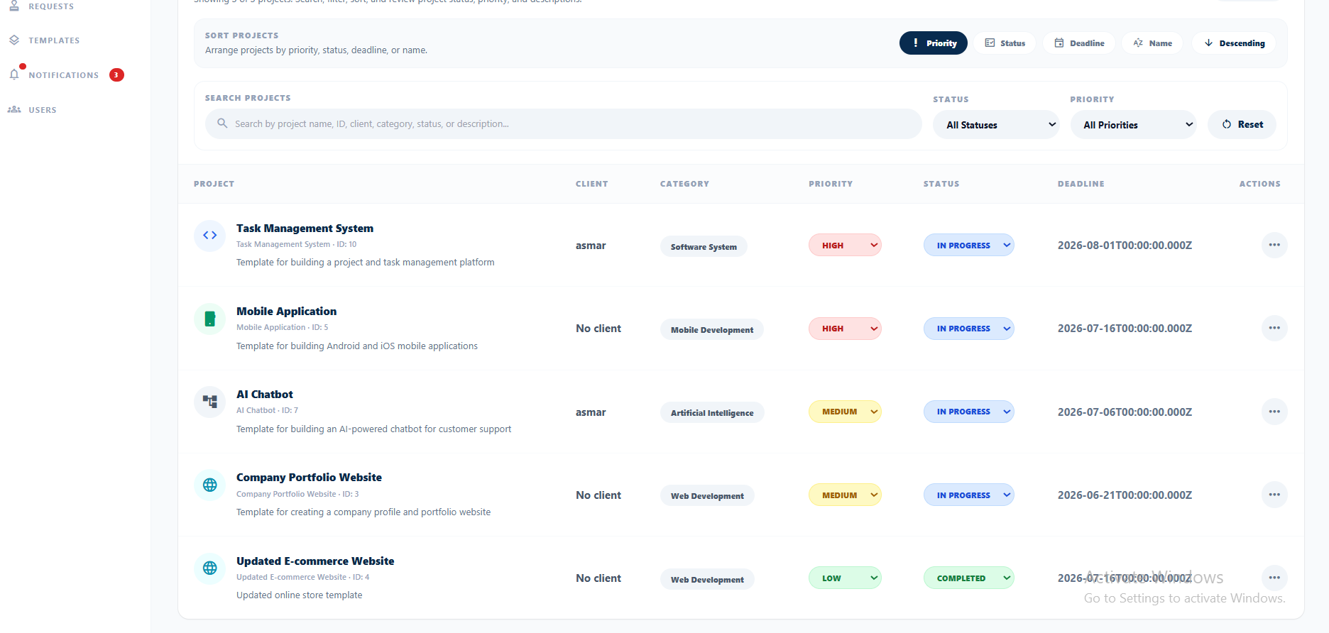
Project Management
Full lifecycle: from client request to completed project
Projects Page (Admin View)
Projects originate ONLY from approved client requests
Database transaction ensures atomic project creation
Status: Pending → In Progress → Completed → Cancelled
Priority levels: Low / Medium / High
Each role sees only their own relevant projects
Completion notification sent to client automatically
Notes:
SmartOps doesn't allow admins to create projects manually. Every project must start from a client request that gets approved. Describe the database transaction used for atomic approval, and that data visibility adapts by role.

Slide 13
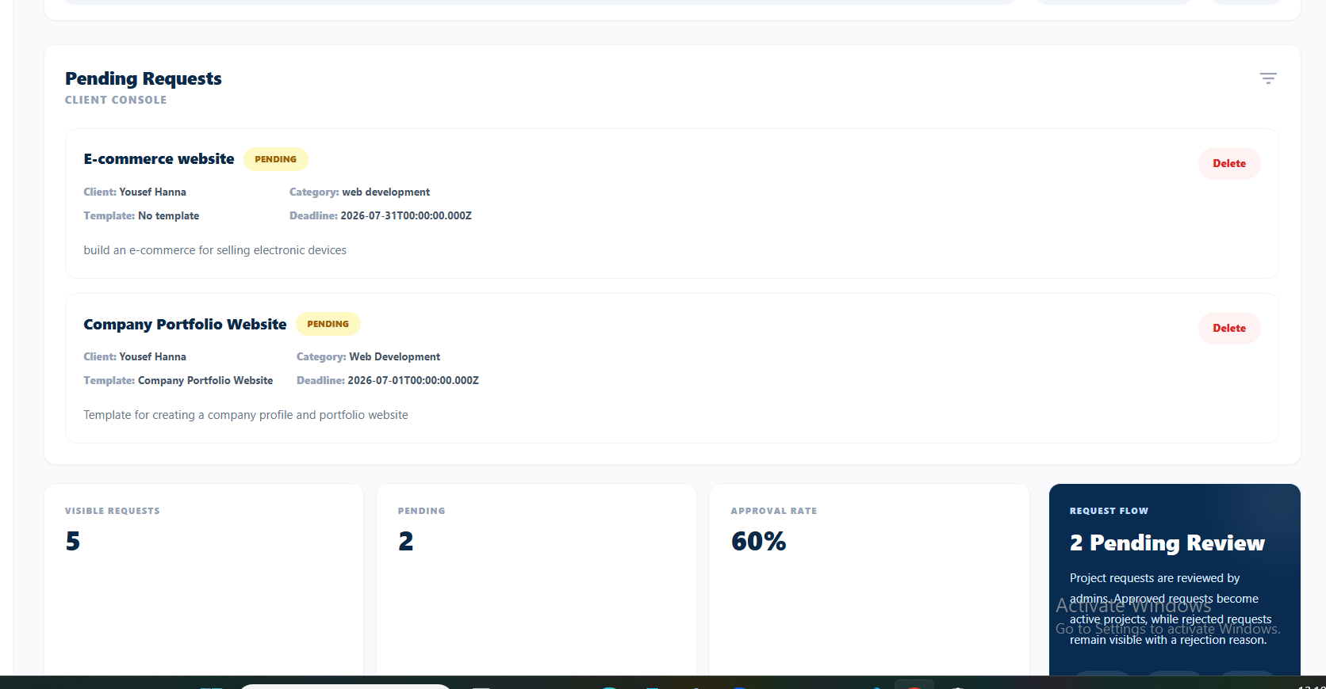
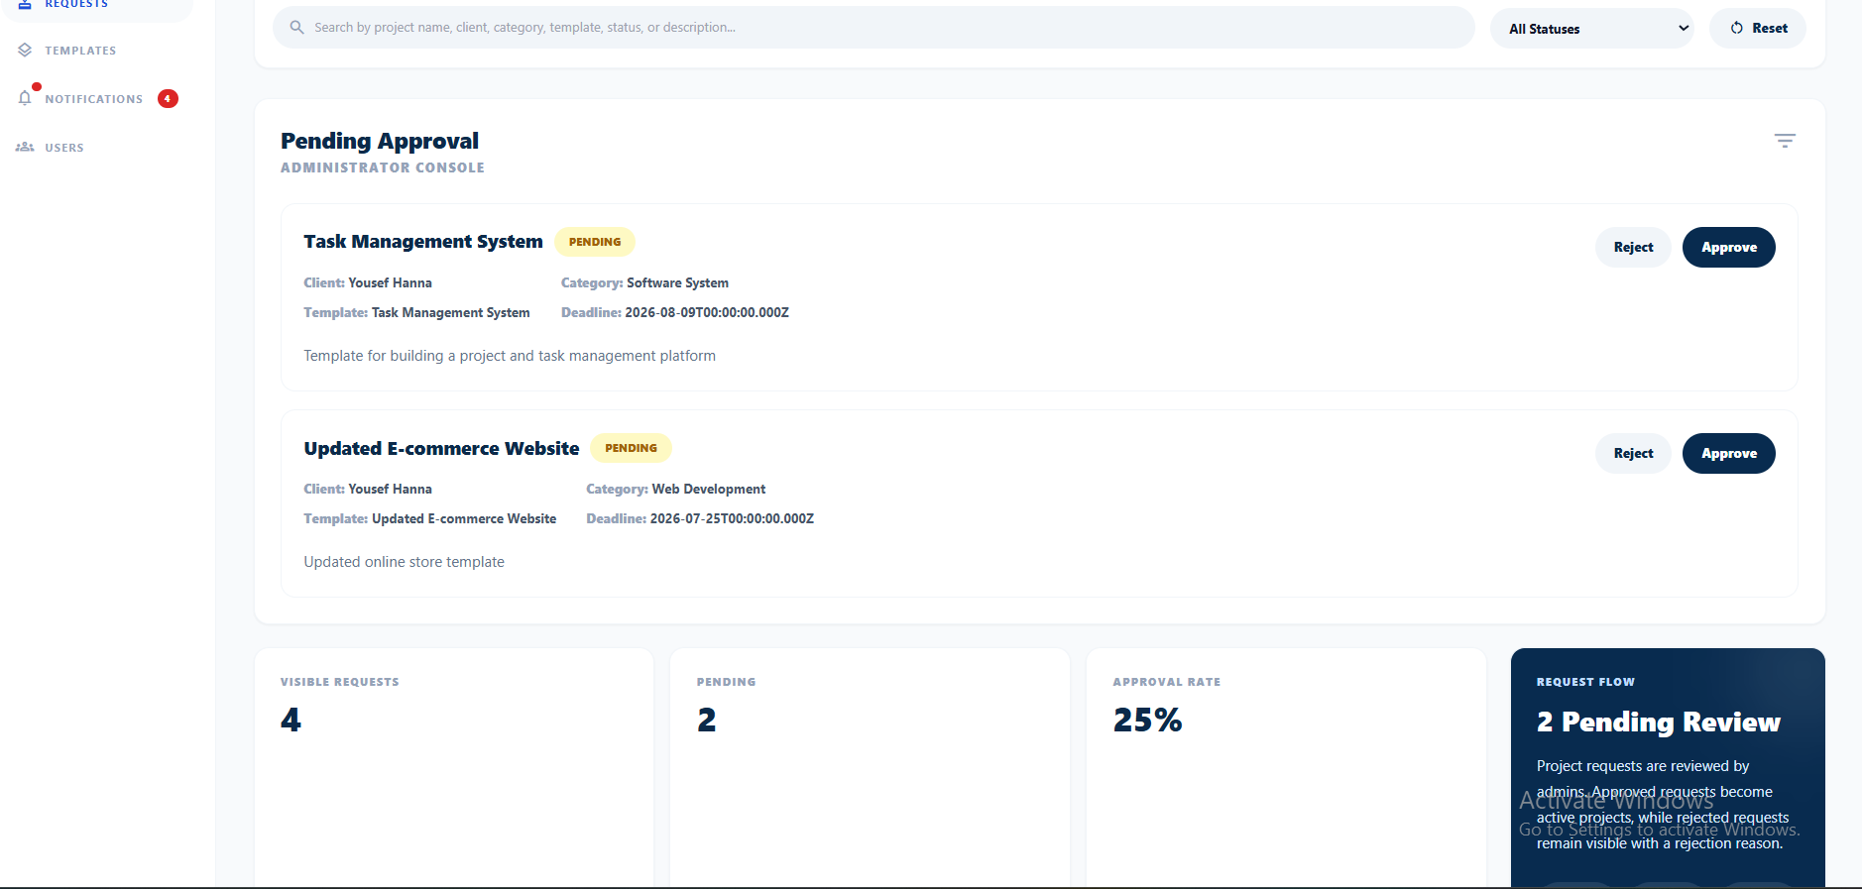
Client Request
A key differentiator — clients as first-class users
Client View
Admin View
Notes:
Explain the complete request lifecycle. Client browses templates, submits request → admin reviews, can approve or reject with a reason → on approval a project is created atomically → client is notified. This is what makes SmartOps unique compared to Jira, Trello, etc.

Slide 14
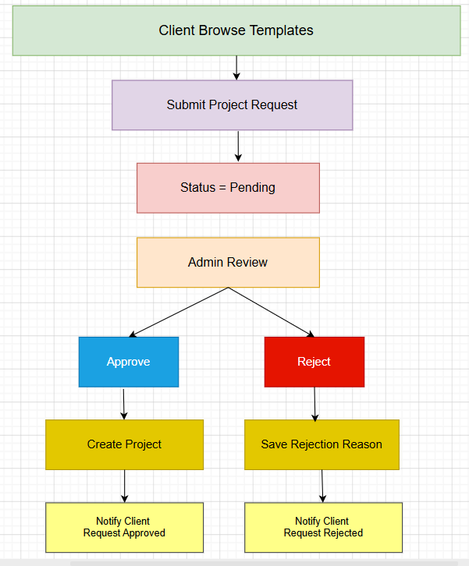
Client Request Workflow
Notes:
Walk through the full-stack architecture: React.js web and Flutter mobile both connect over HTTPS/REST to the Express.js backend on Railway. The backend connects to MySQL and sends real-time notifications via Socket.IO. External email goes through Brevo/Nodemailer.

Slide 15
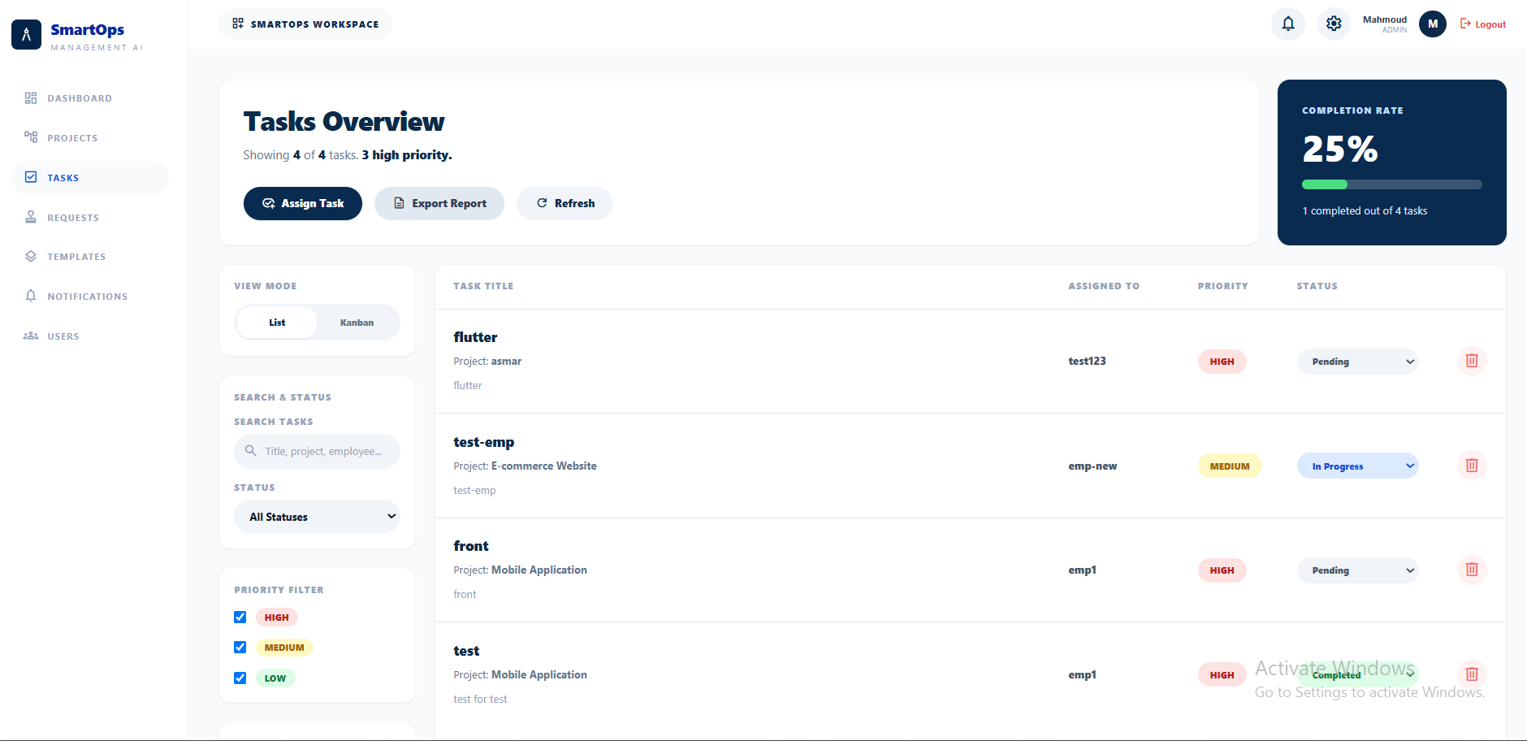
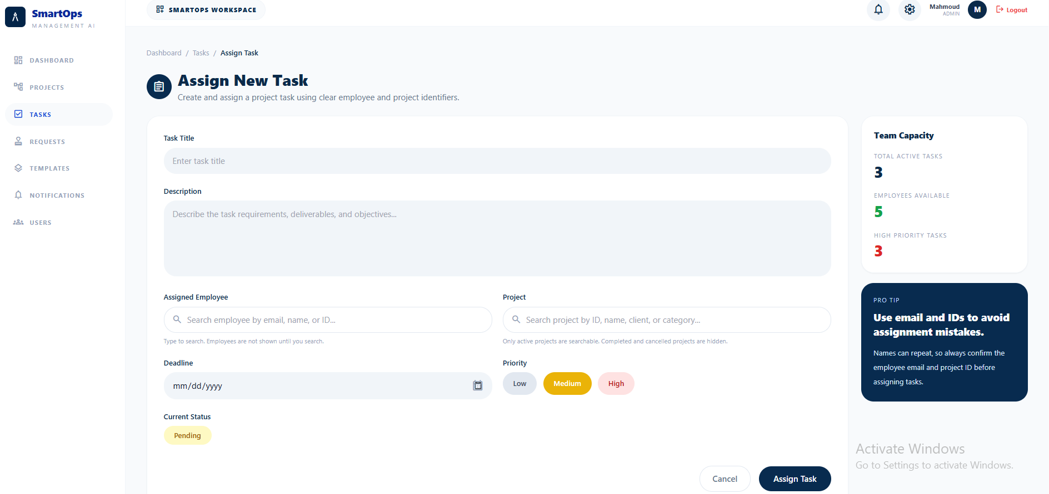
Task Management
Assignment, tracking, and status updates
Tasks Overview (Admin)
Assign New Task
Task status flow: Pending → In Progress → Completed · Only the assigned employee can update their own task · Admin notified on every update
Notes:
Admin assigns tasks by selecting an employee and project. The system validates that the assigned user is an employee role. A notification is sent to the employee automatically. Only the assigned employee can change task status, and the admin is notified each time.

Slide 16
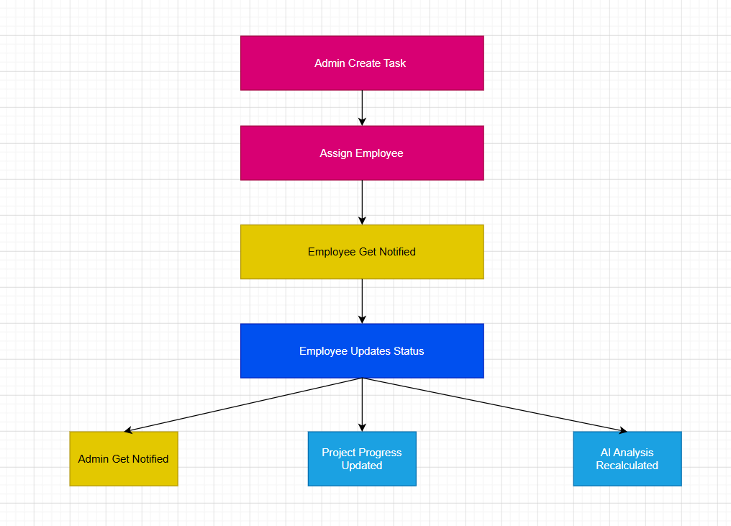
Task Management Workflow
Notes:
Walk through the full-stack architecture: React.js web and Flutter mobile both connect over HTTPS/REST to the Express.js backend on Railway. The backend connects to MySQL and sends real-time notifications via Socket.IO. External email goes through Brevo/Nodemailer.

Slide 17
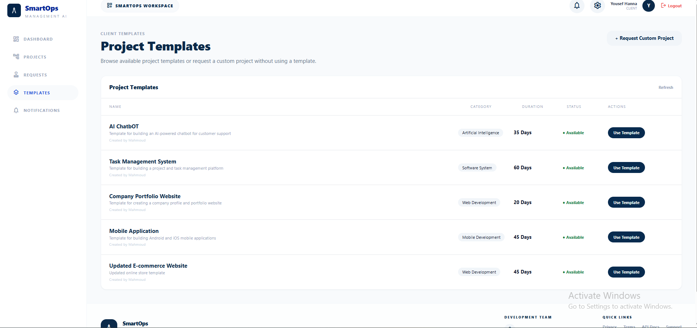
Project Templates Catalog
Pre-built templates for faster project kickoff
Templates Page (Client View)
Available Categories:
Web Applications
Mobile Applications
E-commerce Systems
Management Systems
AI-based Systems
IoT / Embedded Systems
Network & Cybersecurity
Database Systems
UI/UX Redesign
Automation Systems
Cloud-based Solutions
Notes:
Clients browse the template catalog and choose one when submitting a project request. This pre-populates standard fields and estimated durations, reducing the time from request to project kickoff. Admins can create, edit and delete templates.

Slide 18
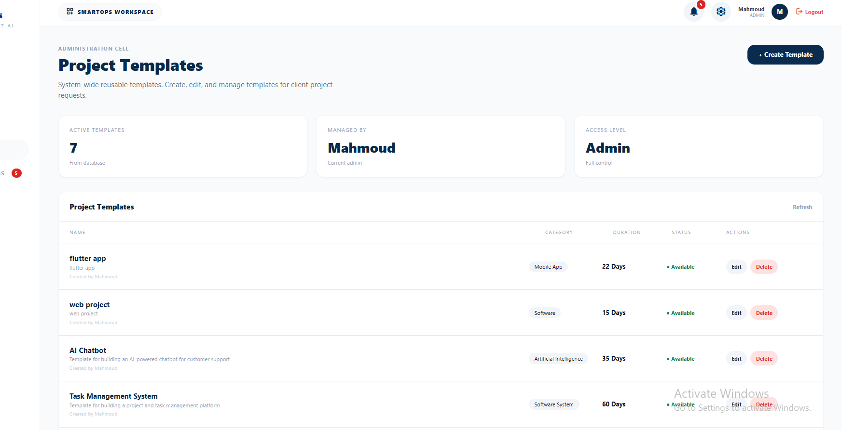
Project Templates Catalog
Pre-built templates for faster project kickoff
Templates Page (Admin View)
Available Categories:
Web Applications
Mobile Applications
E-commerce Systems
Management Systems
AI-based Systems
IoT / Embedded Systems
Network & Cybersecurity
Database Systems
UI/UX Redesign
Automation Systems
Cloud-based Solutions
Notes:
Clients browse the template catalog and choose one when submitting a project request. This pre-populates standard fields and estimated durations, reducing the time from request to project kickoff. Admins can create, edit and delete templates.

Slide 19
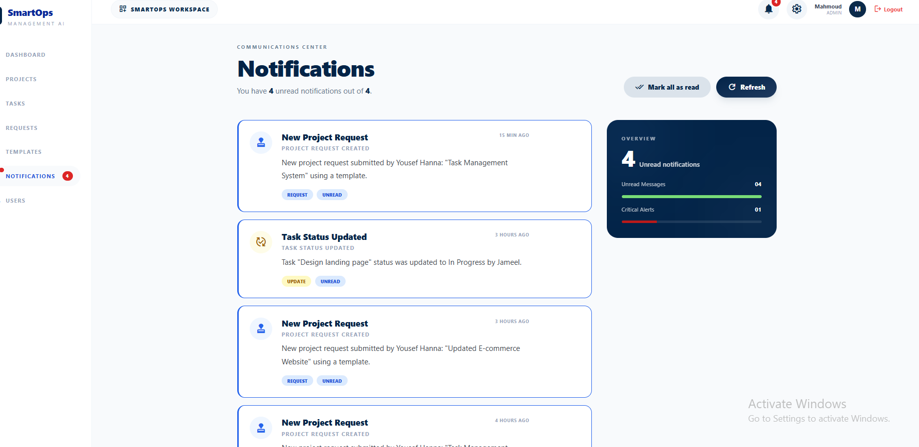
Real-Time Notification System
Server-side triggered, Socket.IO delivered
Notifications Page
Trigger Events:
Task assigned to employee
→ Employee
Employee updates task status
→ Admin
Project marked as completed
→ Client
Project request approved
→ Client
Project request rejected
→ Client
New project request submitted
→ Admin
Notes:
Notifications are pushed in real-time using Socket.IO — no page refresh needed. The notification bell in the navbar updates live. Users can mark individual or all notifications as read. Describe the 6 trigger events.

Slide 20
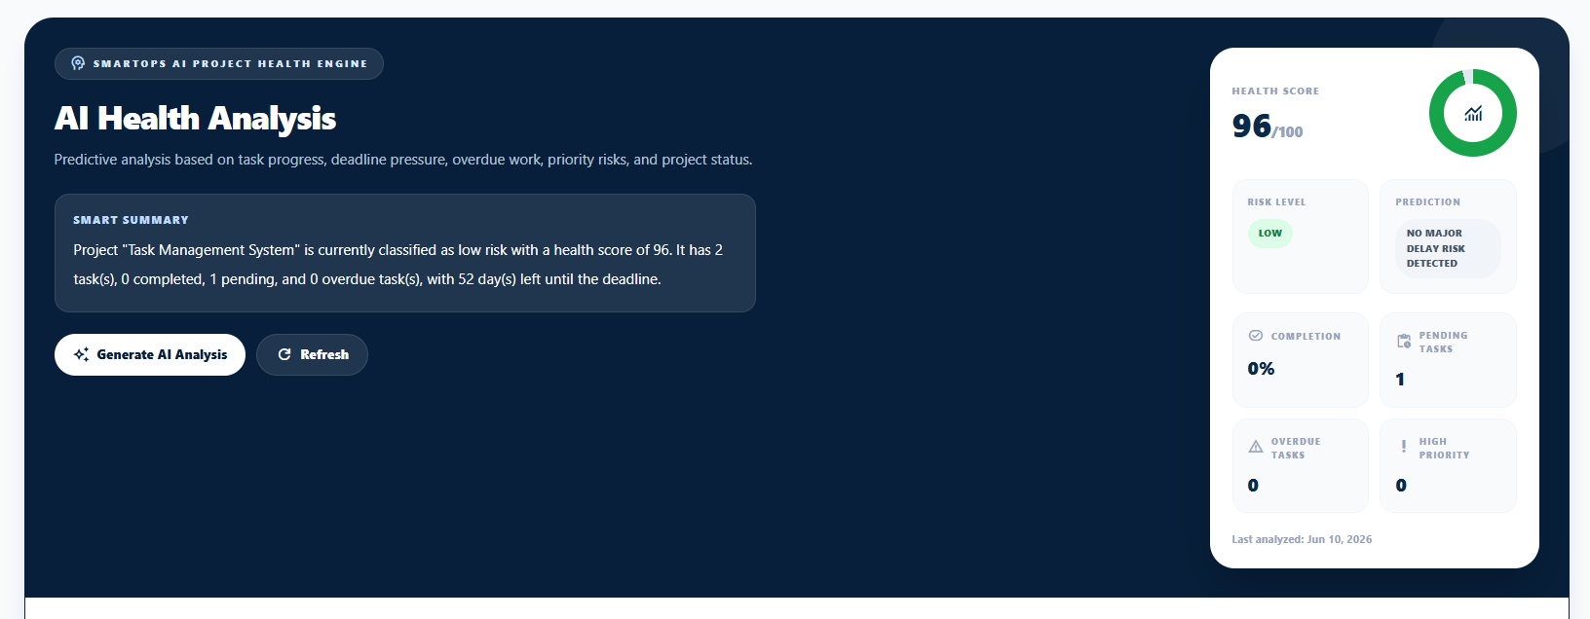
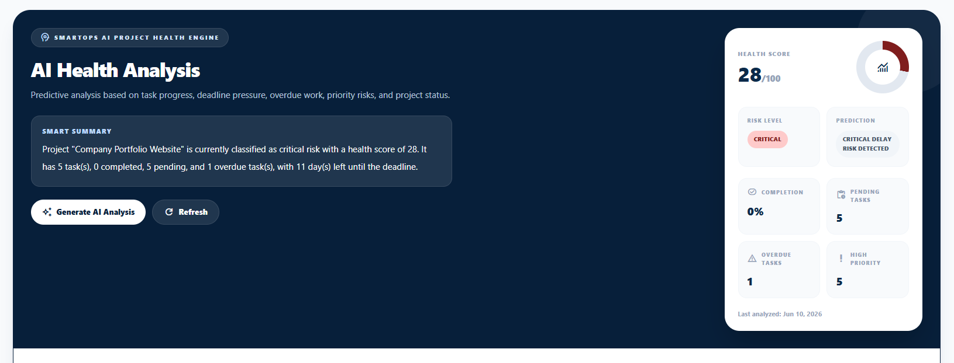
AI Health Analysis Module
Intelligent project monitoring — a key differentiator
Low Risk Project (Score: 96)
Module Outputs:
Health Score
0 – 100
Risk Level
Low / Medium / High / Critical
Delay Prediction
Based on deadline + overdue tasks
Critical Risk Project (Score: 28)
Bottleneck Detection
High-priority not started, many pending
Smart Summary
Natural-language project condition
Recommendations
Actionable steps to reduce risk
Auto-Notification
Alerts triggered on high-risk detection
Notes:
The AI module uses a rule-based scoring engine (not ML, because of insufficient historical data). It evaluates task completion rates, overdue tasks, high-priority status, and deadline pressure. It outputs a health score, risk classification, smart summary, bottleneck list, and recommendations. The ai_analysis table is ready for a future ML model.

Slide 21
AI Health Score Calculation
Deadline already passed → −25
Deadline ≤ 3 days → −18
Deadline ≤ 7 days → −10
Completion Rate ≥ 80% → +10
Completion Rate ≥ 50% → +5
Health Score =
100
- 20 if project has no tasks
- 4 * Pending Tasks
- 12 * Overdue Tasks
- 8 × High-Priority Unfinished Tasks
− Deadline Penalty
+ Completion Bonus
Notes:
Walk through the full-stack architecture: React.js web and Flutter mobile both connect over HTTPS/REST to the Express.js backend on Railway. The backend connects to MySQL and sends real-time notifications via Socket.IO. External email goes through Brevo/Nodemailer.

Slide 22
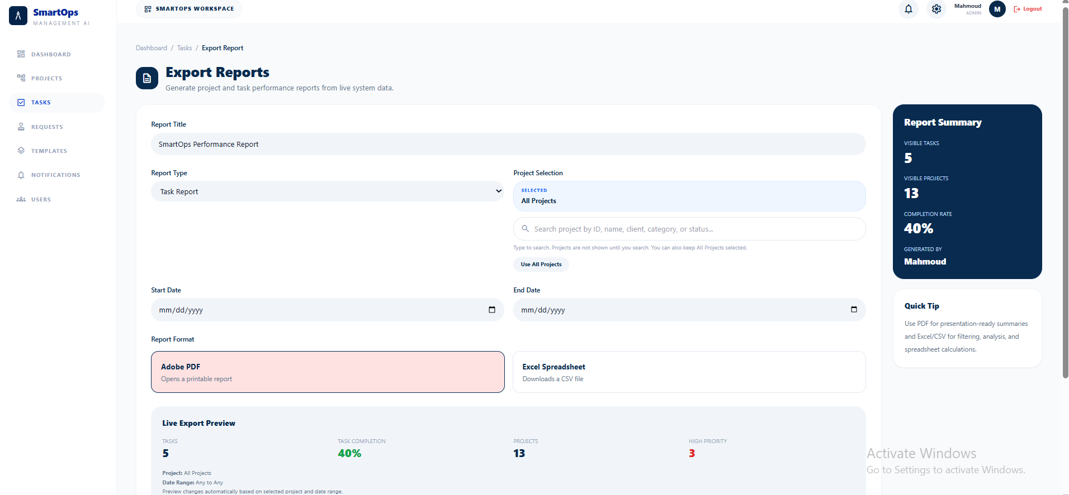
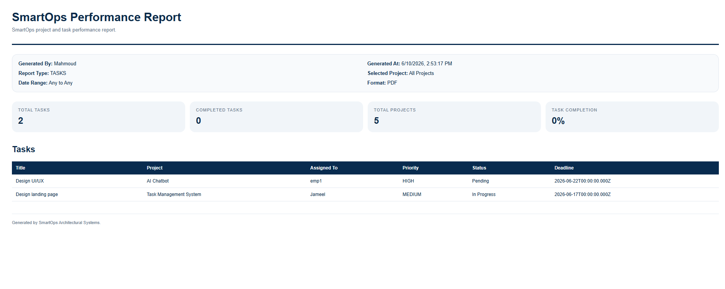
Export Reports
Generate PDF or Excel reports from live system data
Export Report Page (Admin)
Sample PDF Report
SmartOps provides automated report generation to support project monitoring, performance evaluation, and management decision-making through downloadable PDF and Excel reports.
Notes:
Admin can generate task or project reports filtered by project, date range, and format (PDF for print, Excel/CSV for analysis). The report is generated from live data and includes completion rates, task breakdowns, and responsible employees.

Slide 23
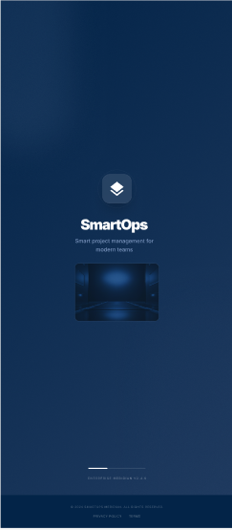
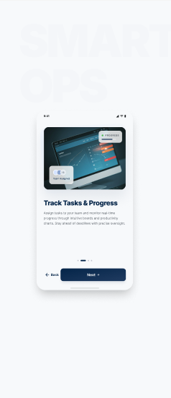
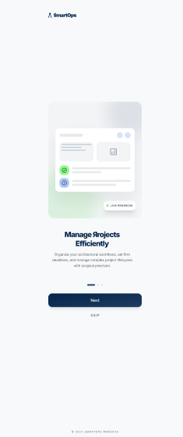
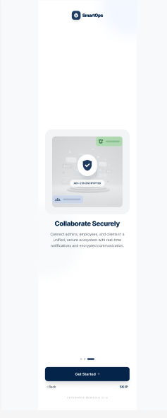
Flutter Mobile Application
Cross-platform iOS & Android — same backend, native feel
Splash Screen
Onboardering 1
Onboardering 2
Onboardering 3
Single
codebase
iOS &
Android
Secure
JWT
Same
API
Material
Design 3
Notes:
The Flutter app connects to the same Express.js backend as the web app. JWT tokens are stored securely using flutter_secure_storage. The app uses Material Design 3 and has full feature parity with the web version.

Slide 24
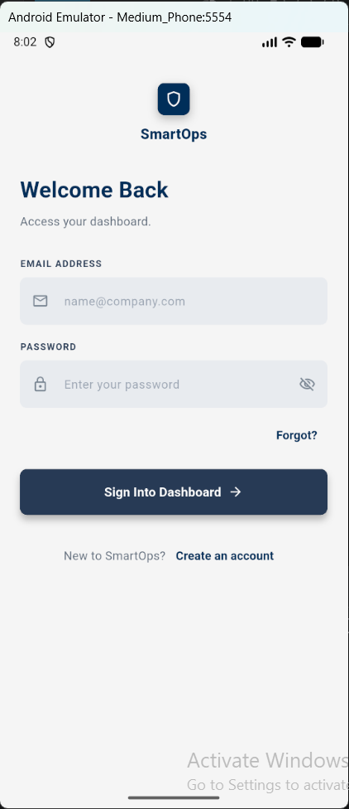
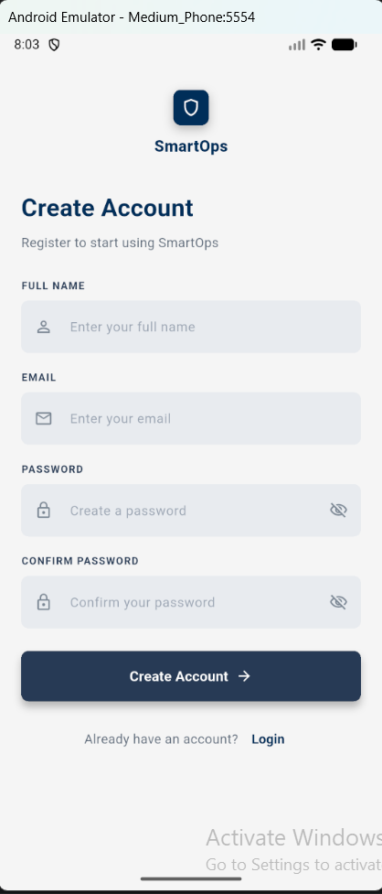
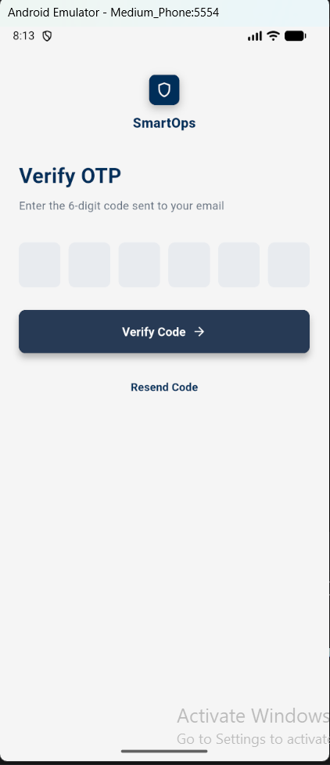
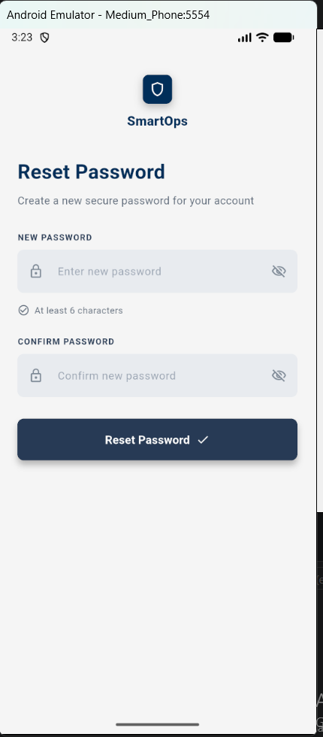
Flutter Mobile Application
Cross-platform iOS & Android — same backend, native feel
Login
Register
Forgot Password
Reset Password
Single
codebase
iOS &
Android
Secure
JWT
Same
API
Material
Design 3
Notes:
The Flutter app connects to the same Express.js backend as the web app. JWT tokens are stored securely using flutter_secure_storage. The app uses Material Design 3 and has full feature parity with the web version.

Slide 25
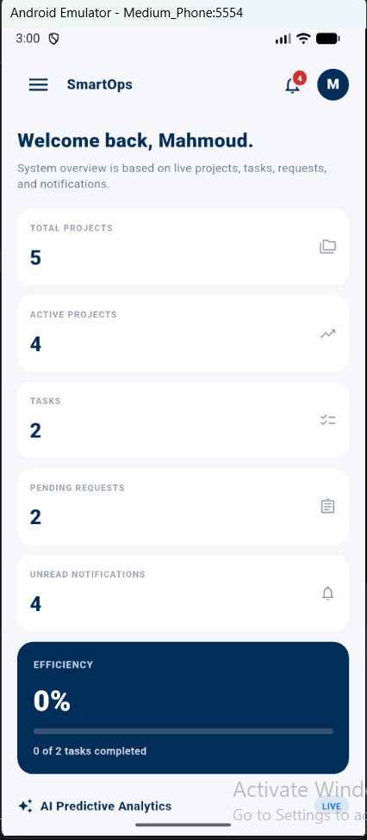
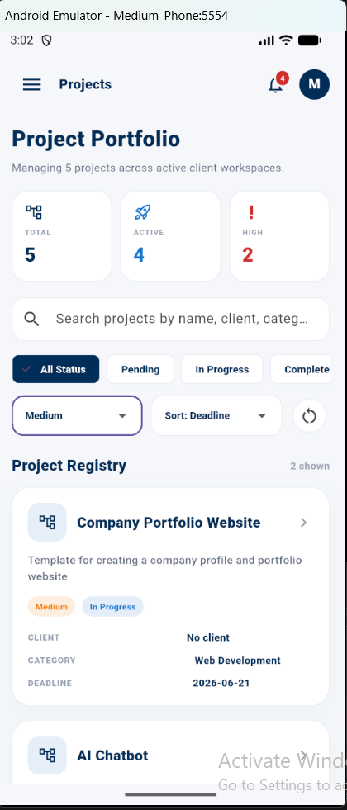
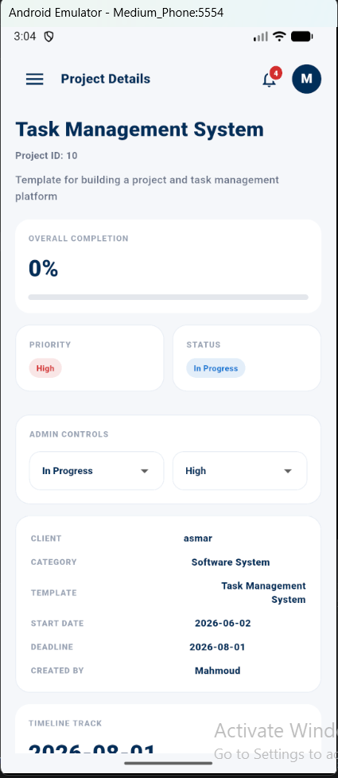
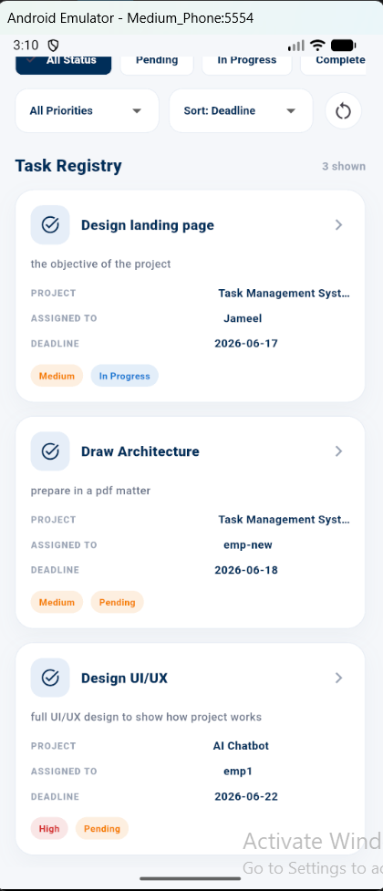
Flutter Mobile Application
Cross-platform iOS & Android — same backend, native feel
Dashboard
Projects
Project Details
Tasks
Single
codebase
iOS &
Android
Secure
JWT
Same
API
Material
Design 3
Notes:
The Flutter app connects to the same Express.js backend as the web app. JWT tokens are stored securely using flutter_secure_storage. The app uses Material Design 3 and has full feature parity with the web version.

Slide 26
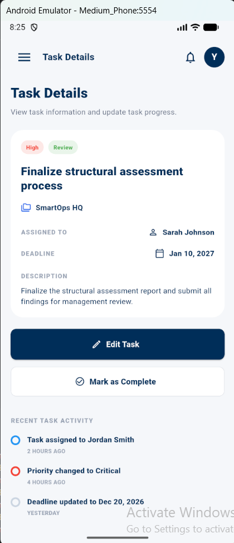
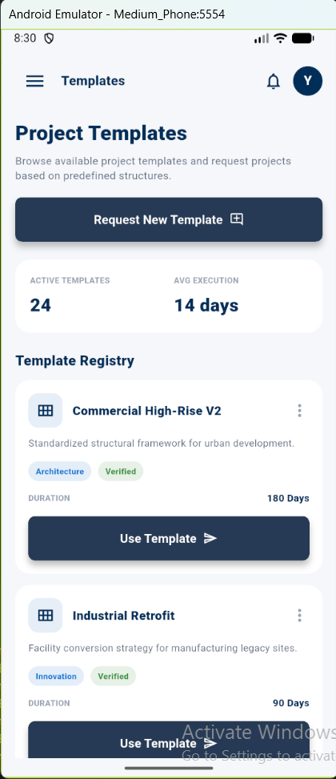
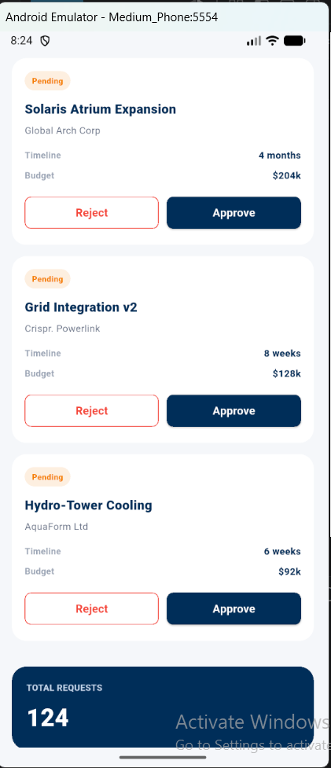
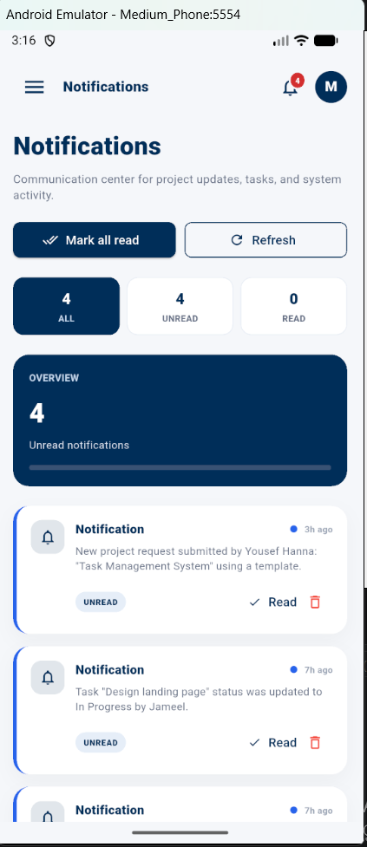
Flutter Mobile Application
Cross-platform iOS & Android — same backend, native feel
Task Details
Templates
Requests
Notifications
Single
codebase
iOS &
Android
Secure
JWT
Same
API
Material
Design 3
Notes:
The Flutter app connects to the same Express.js backend as the web app. JWT tokens are stored securely using flutter_secure_storage. The app uses Material Design 3 and has full feature parity with the web version.

Slide 27

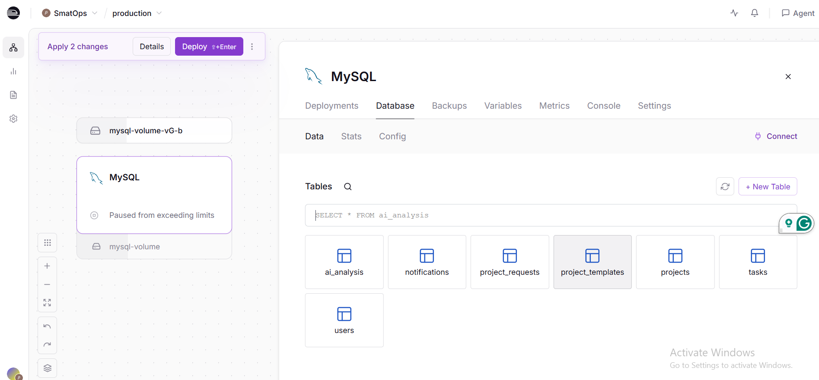




Cloud Deployment
Fully deployed on Railway — accessible from anywhere
Railway Dashboard (Live)
Zero-config Node.js deploy
Auto-detects runtime & installs deps
Managed MySQL 8
Provisioned with one click
Auto HTTPS
All API traffic encrypted by default
GitHub CI/CD
Deploy on every push to main
Private networking
MySQL only accessible to backend
Notes:
The backend and MySQL are deployed on Railway. The CI/CD pipeline triggers automatically on every GitHub push. The frontend is deployed separately on Vercel/Netlify as a static site. The Flutter app is an APK/IPA build pointing to the Railway backend URL.

Slide 28
SmartOps vs. Existing Platforms
Why SmartOps stands apart
Feature | Trello | Jira | Asana | Monday | SmartOps
RBAC (Admin/Emp/Client) | ✗ | Partial | Partial | Partial | ✓
Client project requests | ✗ | ✗ | ✗ | ✗ | ✓
Project templates catalog | ✗ | ✓ | Partial | Partial | ✓
Real-time notifications | Partial | ✓ | ✓ | ✓ | ✓
AI project health analysis | ✗ | ✗ | ✗ | ✗ | ✓
SME-focused affordability | ✓ | ✗ | ✗ | ✗ | ✓
Mobile app (native) | ✓ | ✓ | ✓ | ✓ | ✓
Notes:
Walk through the feature comparison. Highlight that SmartOps is the ONLY platform in this comparison to offer client project requests AND AI project health analysis AND RBAC with a dedicated client role — all in one system.

Slide 29

Strengths & Limitations
Strengths
Limitations
Dual-platform: web (React.js) + mobile (Flutter) from one backend
Rule-based AI (not ML) — limited by available historical data
Atomic request approval using database transactions
No persistent file storage (Railway free-tier constraint)
Dual-layer RBAC on both frontend and backend
Single-region deployment — potential latency for distant users
Real-time Socket.IO notifications without page refresh
Railway free-tier: possible cold starts after inactivity
AI health analysis with risk scoring & automated alerts
Production deployment with GitHub CI/CD on Railway
Notes:
Be honest about the limitations — this shows academic maturity. The key strength is the complete multi-platform system delivered by a two-person team in one semester. The limitations are realistic constraints (free-tier cloud, no historical ML data) not design flaws.

Slide 30


Recommendations for Future Work
ML-Based AI Enhancement
Advanced Analytics Dashboard
Train machine learning models on historical project data for more accurate delay prediction, priority recommendation, and workload forecasting
Add interactive charts (Recharts / fl_chart) for project completion trends, team workload heatmaps, and deadline forecasting
File Attachment Support
Production-grade Cloud Scaling
Integrate AWS S3 or Cloudinary to support project documents, task attachments, and profile photos
Migrate to AWS ECS or Google Cloud Run with auto-scaling to support a growing user base
Third-party Integrations
Slack / Microsoft Teams webhooks for notifications; Google Calendar sync for deadline management
Notes:
These are realistic next steps. The ML AI is the most impactful — once the system has collected enough project history it can replace the rule-based module. The file attachment feature is blocked by Railway storage but would be easy to add with S3.

Slide 31
Conclusions
SmartOps successfully delivered:
React.js web app with role-based dashboards, project management, task tracking, client portal, templates & real-time notifications
Flutter mobile app (iOS & Android) with full feature parity over the same backend
Node.js/Express.js RESTful backend with JWT, dual-layer RBAC, Zod validation, transactional operations & email OTP
MySQL schema (7 tables) with ai_analysis table prepared for future ML integration
Production deployment on Railway with GitHub CI/CD and HTTPS
All 20 user requirements (UR1–UR20) successfully delivered, tested, and deployed
Notes:
Summarize what was achieved. Emphasize the scale of the project — a two-person team delivering web + mobile + cloud in one semester. All requirements were met. Close by inviting questions.

Slide 32

SmartOps
Integrated Operations Management Platform for SMEs
Thank You — Questions?
Yousef Hanna · Mahmoud Asmar
Supervised by Dr. Amjad AbuHassan | An-Najah National University | Fall 2025/2026
Notes:
Thank the audience and invite questions. Be ready to open a live demo of the deployed system.

