Slide 1
An-Najah National University
Graduation Project
Renewable energy
Submitted to
Dr.Emad Braik
Presented by
Doha Mohammed Mansour

Slide 2
Introduction
Energy Resources
Nonrenewable Energy
Conventional and fossil fuel : coal, petroleum
Their supplies are limited and we cannot produce as much fossil fuel in a short time as we like
Most of our electricity based on nonrenewable energy
Renewable Energy
It include: biomass, geothermal energy, hydro power, solar energy, ocean energy, and wind energy
They are called renewable because they are regenerated in a short time

Slide 3
Types of Renewable Energy
Tidal energy
The energy of the ocean's waves
Tidal energy is produced by the ocean water during the rise and fall of tides

Slide 4
Wind energy
It is captured with wind turbines
Wind power is the conversion of wind energy into a useful form of energy, such as using wind turbine to make electrical power

Slide 5
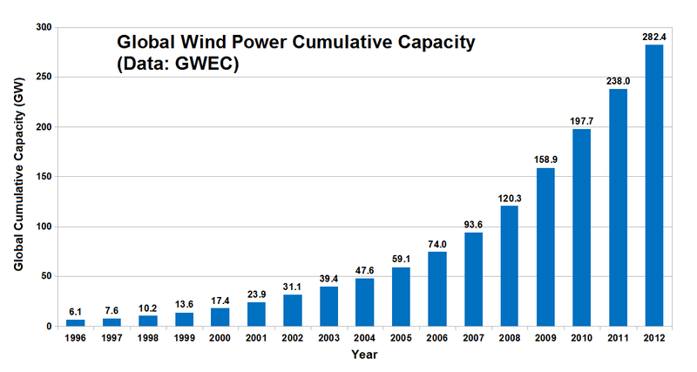

Slide 6
Advantages of renewable energy
It should not ever deplete
The fact that they are renewable. We will never run out of sources of renewable energy
Photovoltaic system are flexible, highly reliable and last long

Slide 7
Photovoltaic cell
The term photovoltaic comes from the Greek meaning light and volt
It is an electrical device that converts the energy of light directly into electricity
PV Cells are use in calculators and to power homes

Slide 8
The goals of photovoltaic cell
The main goal of PV cells is to replace fossil fuels as the main source of energy
To use the sunlight as an alternative due to its endless amounts

Slide 9
Photo voltaic are convert light to electricity
1839: Discovery of the photoelectric effect by Bequerel
1873: Discovery of the photoelectric effect of Selen
1954: First Silicon Solar Cell

Slide 10
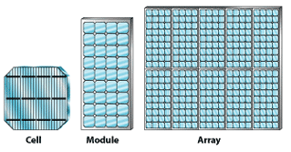
PV-System

Slide 11
How Does A Cell Become A Module?
Cell: The basic photovoltaic device for module
systems having a nominal voltage of 24-Volts and operating at about 30 Volts.
Module is the basic building block of systems
PV Module
Module: A group of PV cells connected in series and or parallel and encapsulated in an environmentally protective laminate
Polycrystalline silicon module and monocrystalline silicon module and Amorphas silicon cell

Slide 12
PV Panel
Panel: A structural group of modules that is the basic building block of a PV array
PV Array
Array: A group of panels that comprises the complete direct current PV generating unit

Slide 13
Connection of group cell
Series connection
The output current is equal to current for one cell
The output voltage is increase
V output is equal to summation to the cells

Slide 14
Parallel connection
The figure shows parallel connection of three cells
Total current is equal to the total current
I total = 3I
Total voltage is equal to voltage for one cell

Slide 15
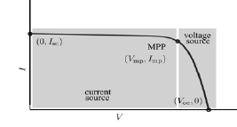
Photovoltaic cell characteristic curve
Current-Voltage curve for a solar cell

Slide 16
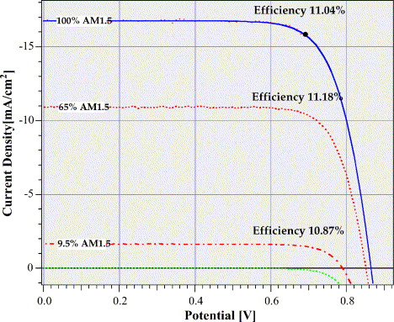
Solar cell characteristics
The fill factor (FF) of a solar-cell is the relation of electrical power generated (P_{MPP}) and the product of short current Isc and open-circuit voltage Voc
FF = P_{MPP} / Voc •Isc
FF = Vmpp Impp / Voc Isc * 100%
The efficiency η is the relation of the electrical power generated (P_{MPP)} and the light irradiance (AG₀) impinging on the solar-cell :
η = P_{MPP} / AG₀
η = PP / AG₀ *100%

Slide 17
Importance of Photovoltaic system
Produce no pollution
Protect environment
Decrease the cost of complying with existing and upcoming ecological regulations.
Conserve nature for future generations
Improve the stability of energy supplies

Slide 18
Application on Photovoltaic
Water Pumping
Commercial Lighting
Telecommunications
Residential Power

Slide 19
PV with Battery Storage
Storing electrical energy makes PV systems a reliable source of electric power day and night, rain or shine.
PV systems with battery storage are being used all over the world to power lights, sensors, recording equipment, switches, appliances, telephones, televisions, and even power tools

