Slide 1

PC Builder Application
Presented by Omar Maher Khatib and Osaid Islam Raddad
Supervisor: Dr. Amjad Abu Hassan
Notes:
1

Slide 2
Table Of Contents
1. The Problem
2. System Architecture Overview
3. Technologies
4. Other Tools
5. PC Builder Key Features
6. Future Roadmap
Notes:
2

Slide 3

The Problem
Building a PC is Complex
Users struggle with component compatibility, performance optimization, and budget planning when assembling custom computers.
Our solution simplifies the entire process.
Notes:
3

Slide 4
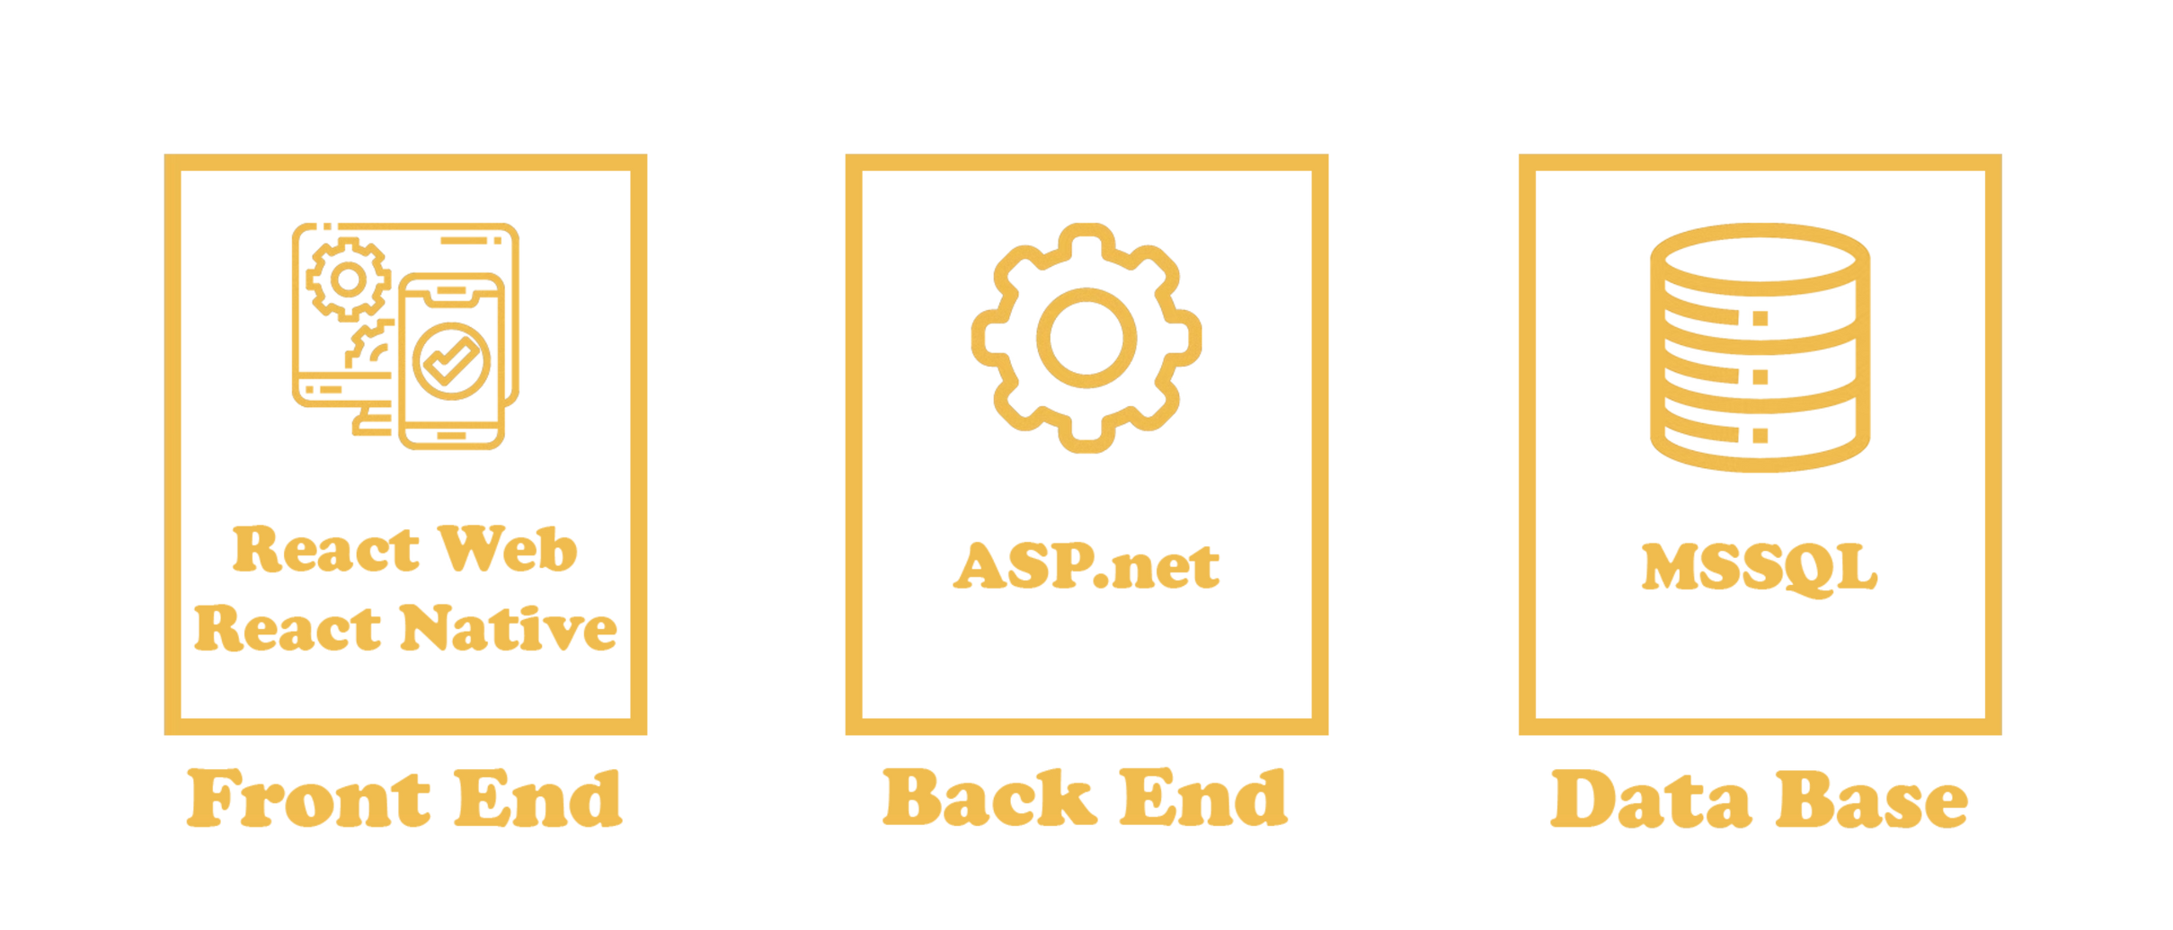
System Architecture Overview
Notes:
4

Slide 5
Technologies
Front End:
React Tailwind CSS
Prime React
Three.js
Hot Toast
React Native
Backend:
ASP.net Core
SignalR
MapSetter
My Server SQL
Entity Framework
LinQ
Notes:
4

Slide 6



Other Tools
Notes:
7

Slide 7
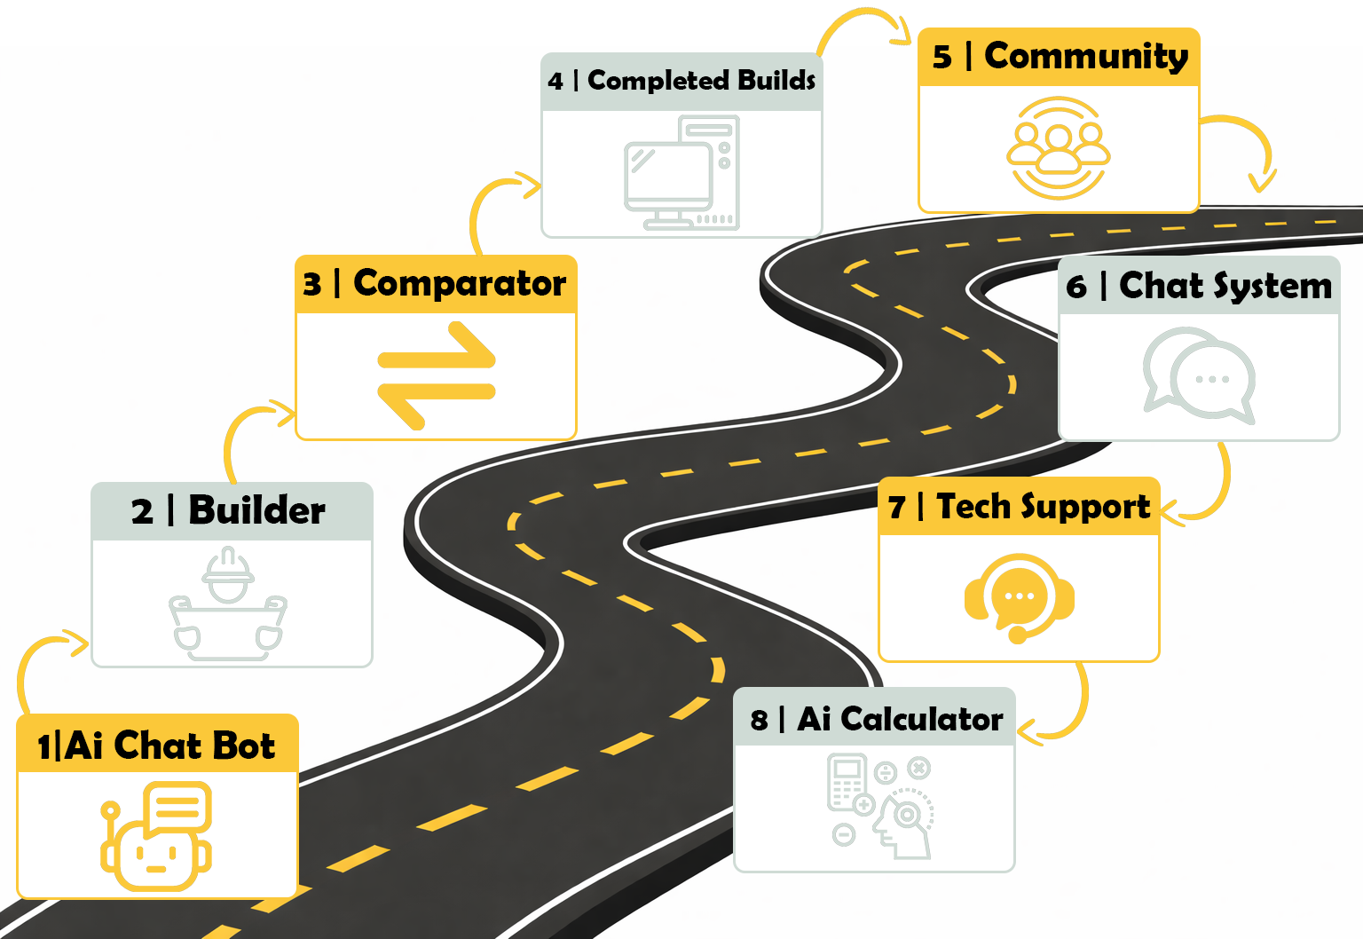
PC Builder Key Features
Notes:
8

Slide 8
Lets Get Started ..
Notes:
8

Slide 9
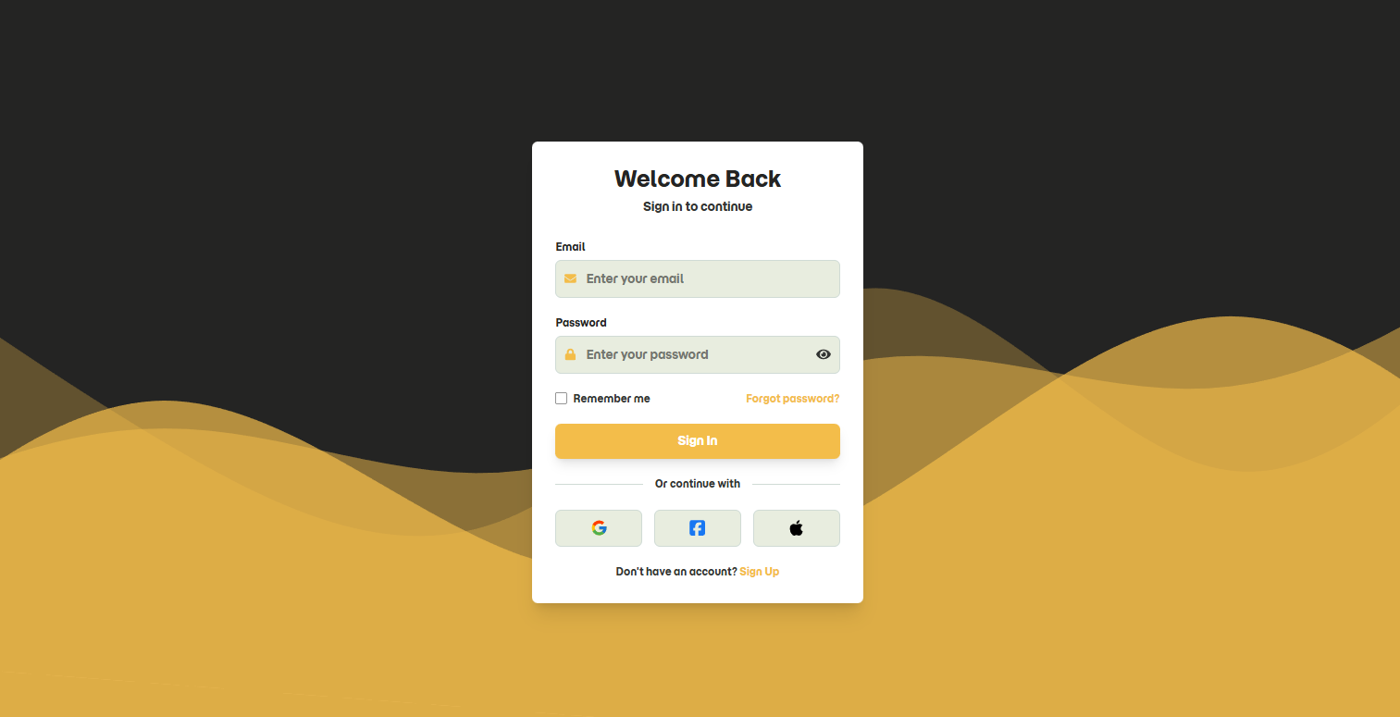

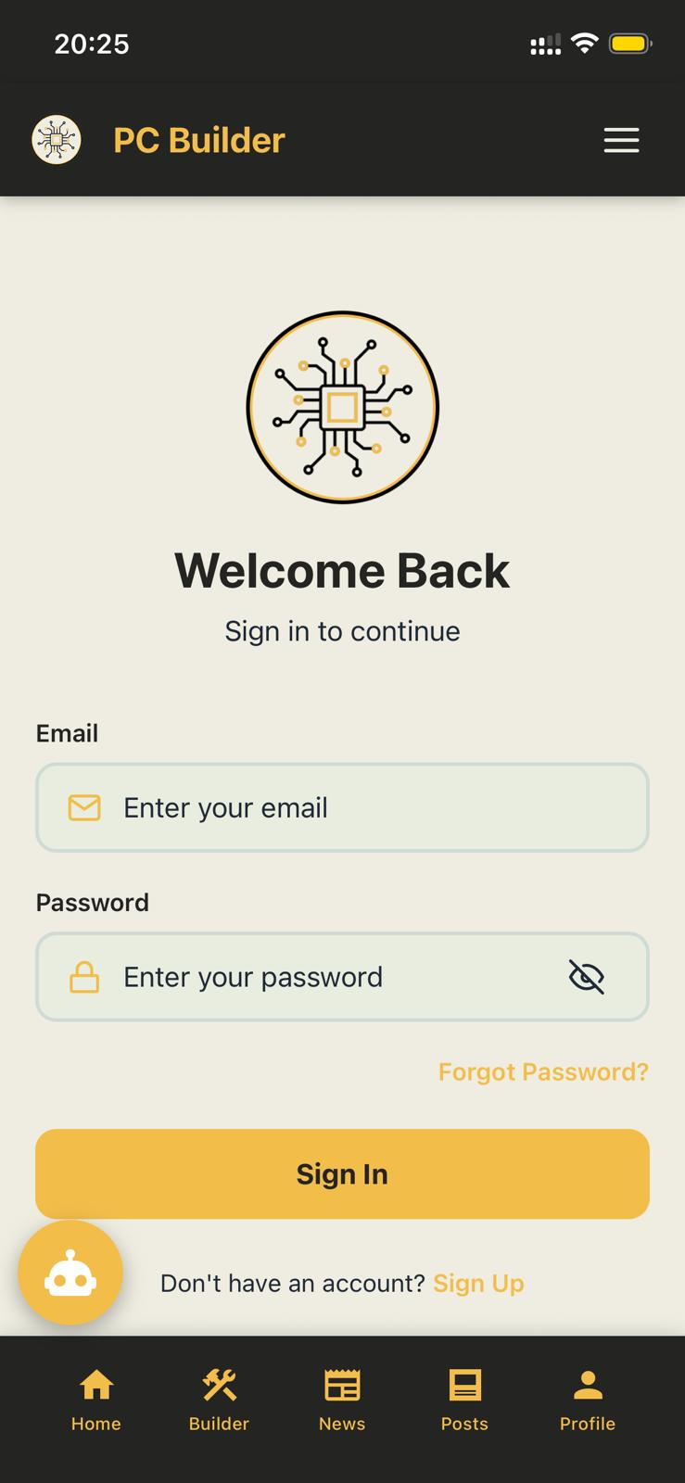
Authentication – Sign In
Notes:
8

Slide 10
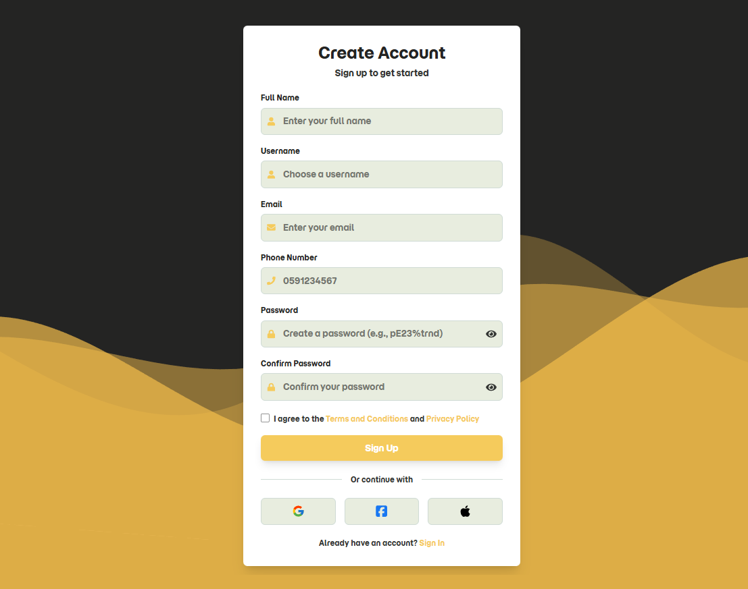
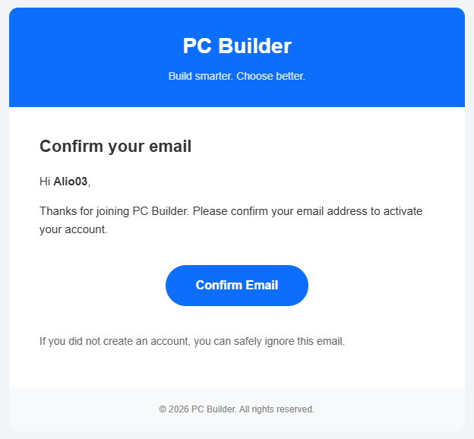

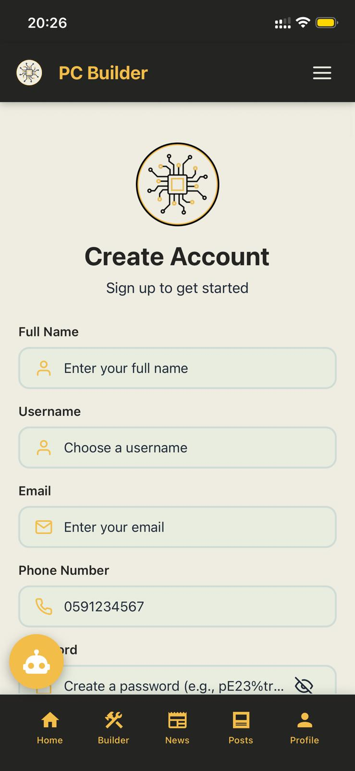
Authentication – Sign Up
Gmail Confirmation
Notes:
8

Slide 11
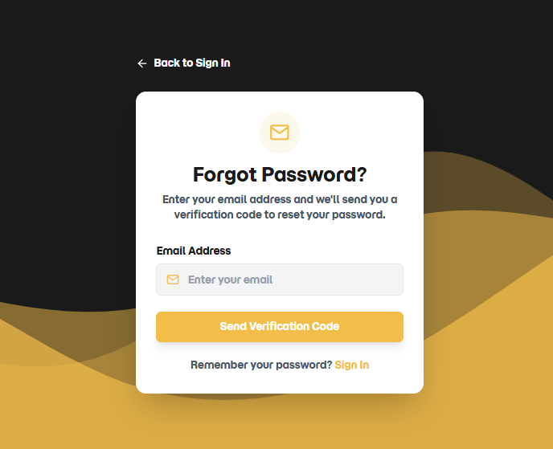

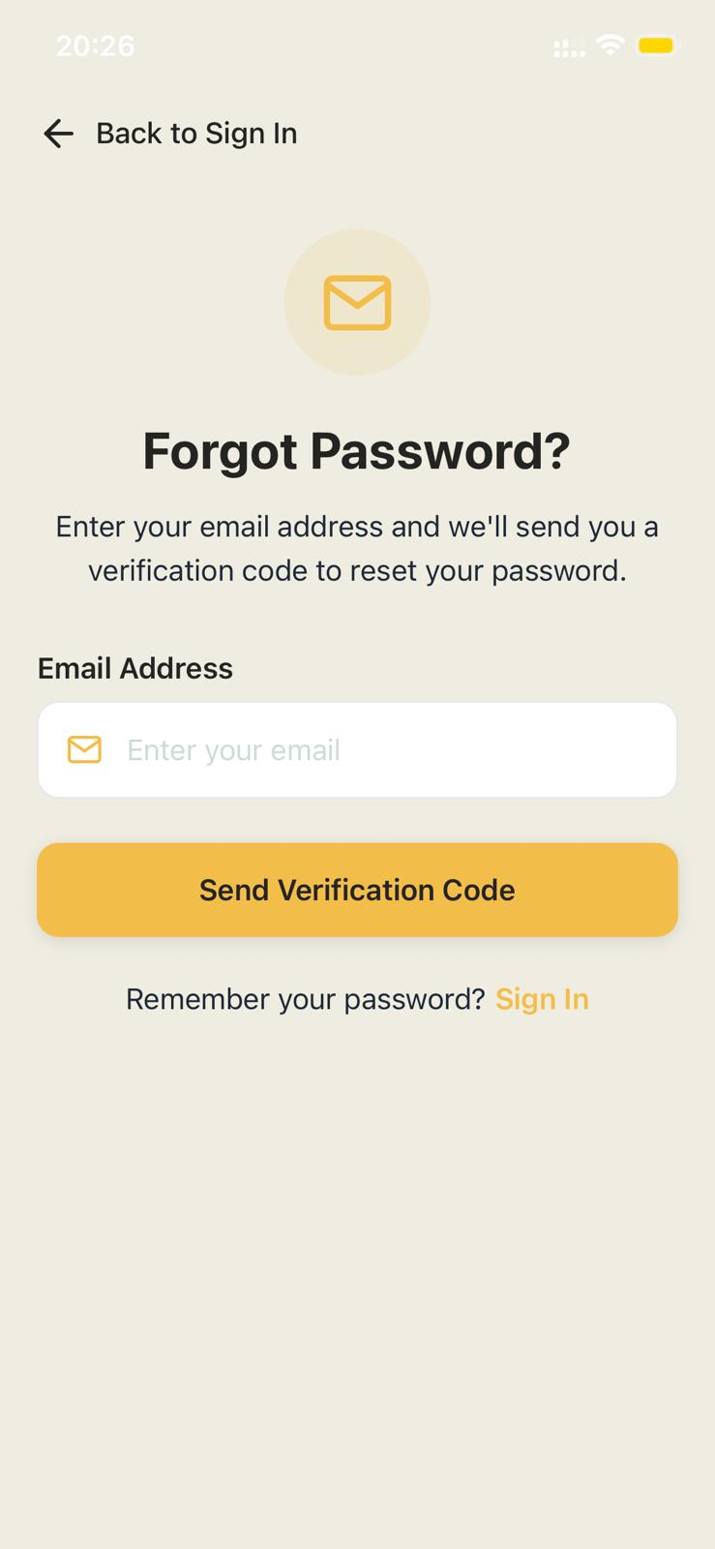
Authentication – Forgot Password
Notes:
8

Slide 12
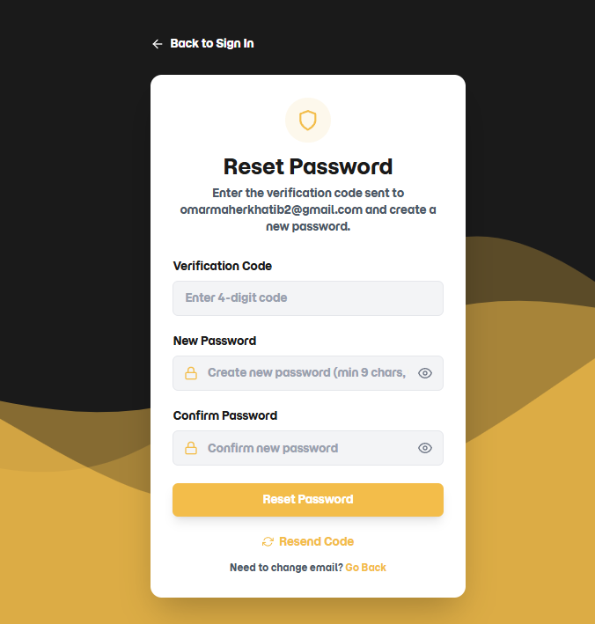
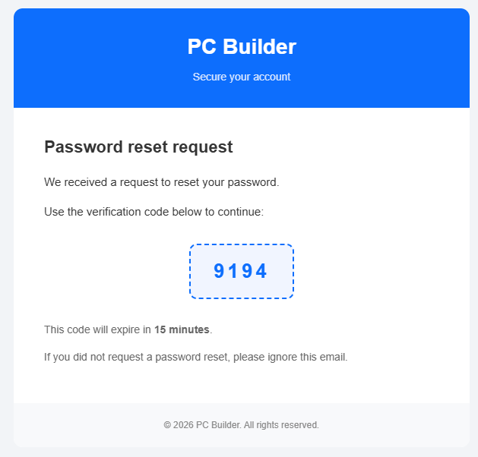
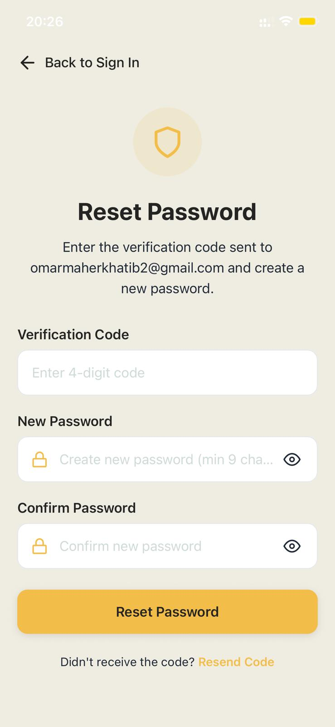
Authentication – Reset Password
Gmail
Notes:
8

Slide 13
PC Builder – Roles & Profiles
Notes:
8

Slide 14
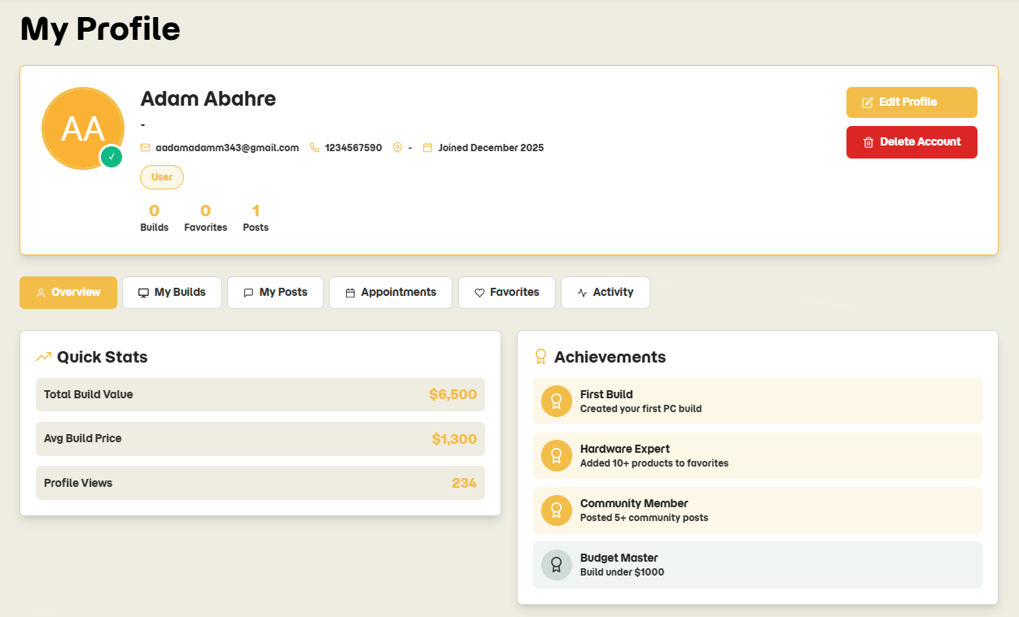
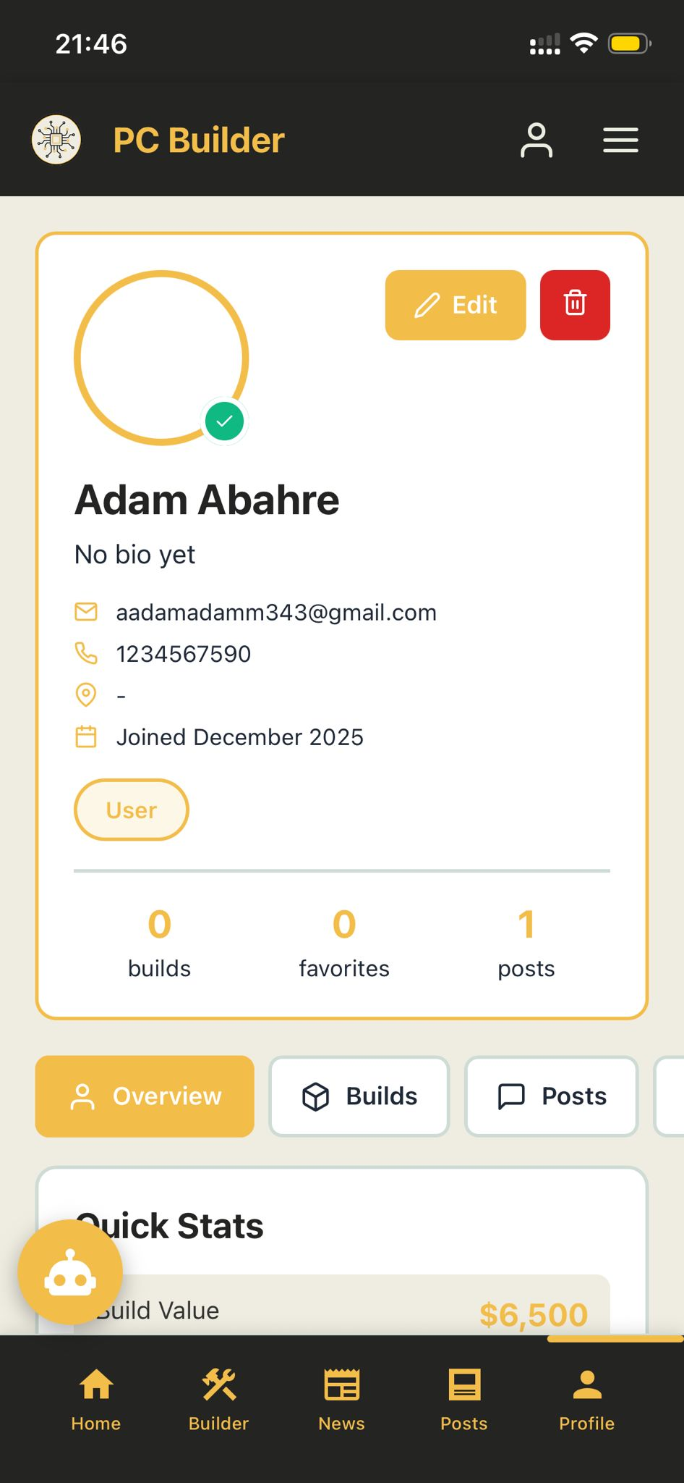
User Profile
Notes:
8

Slide 15

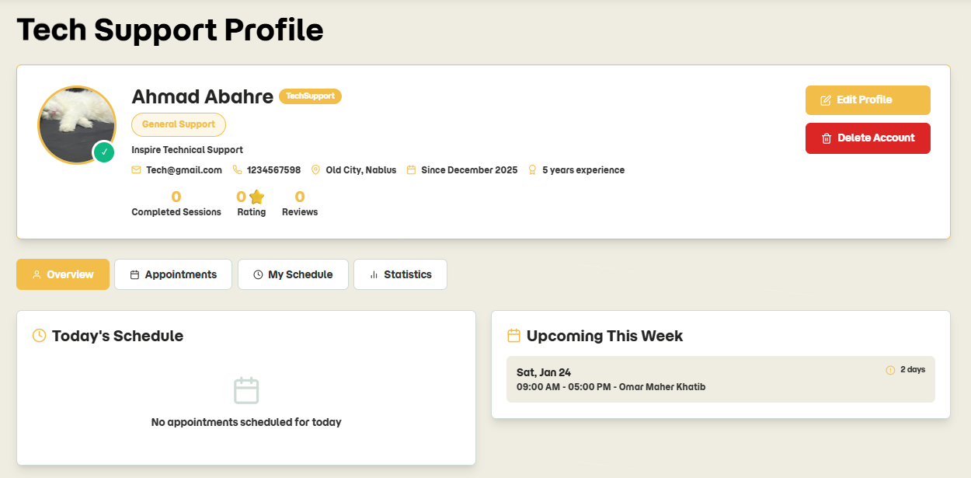
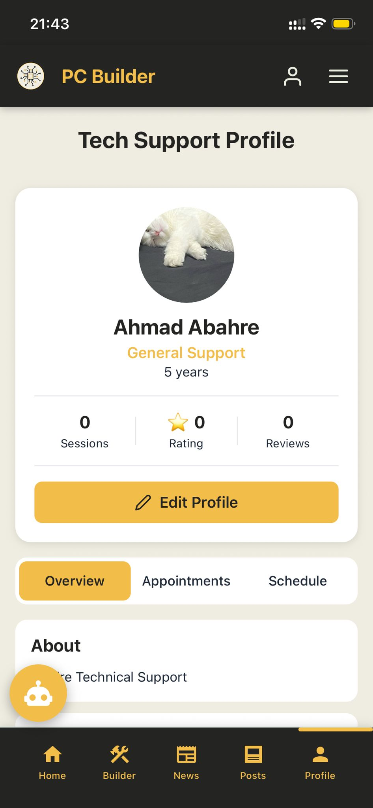
Technical Support Profile
Notes:
8

Slide 16
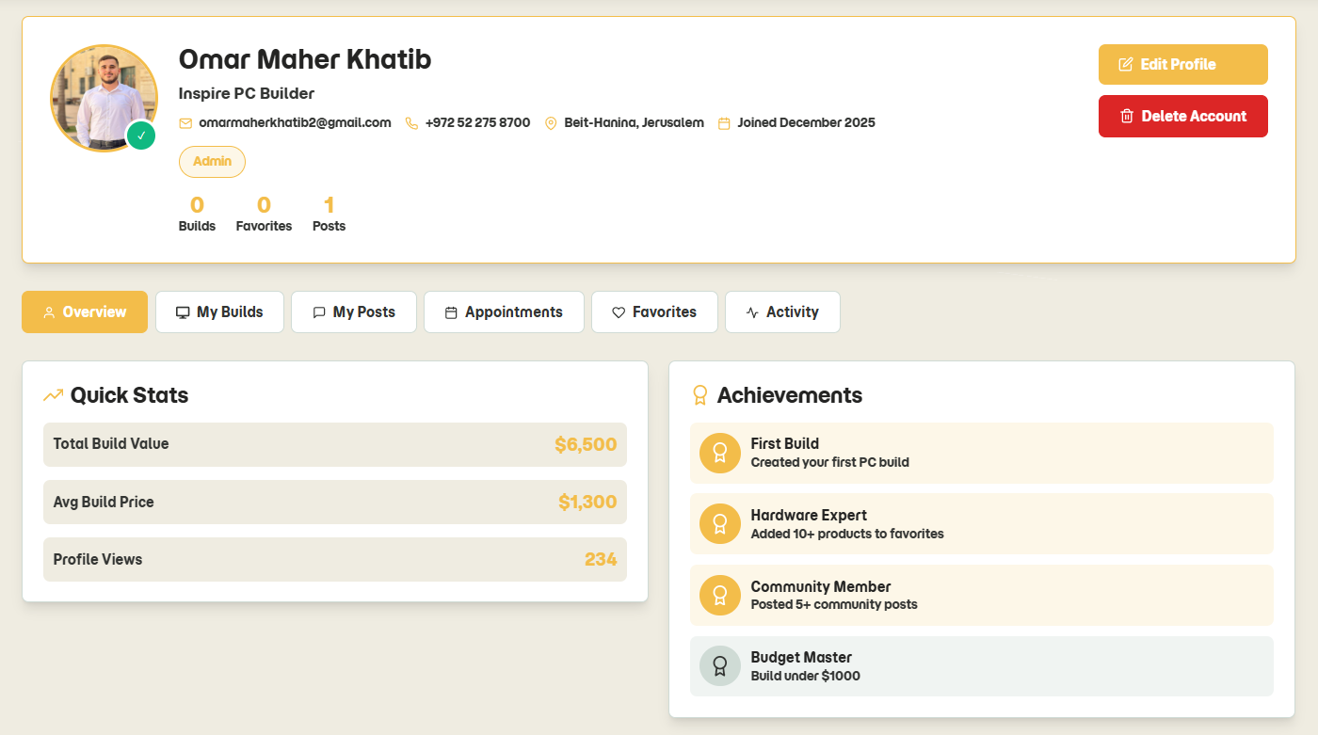

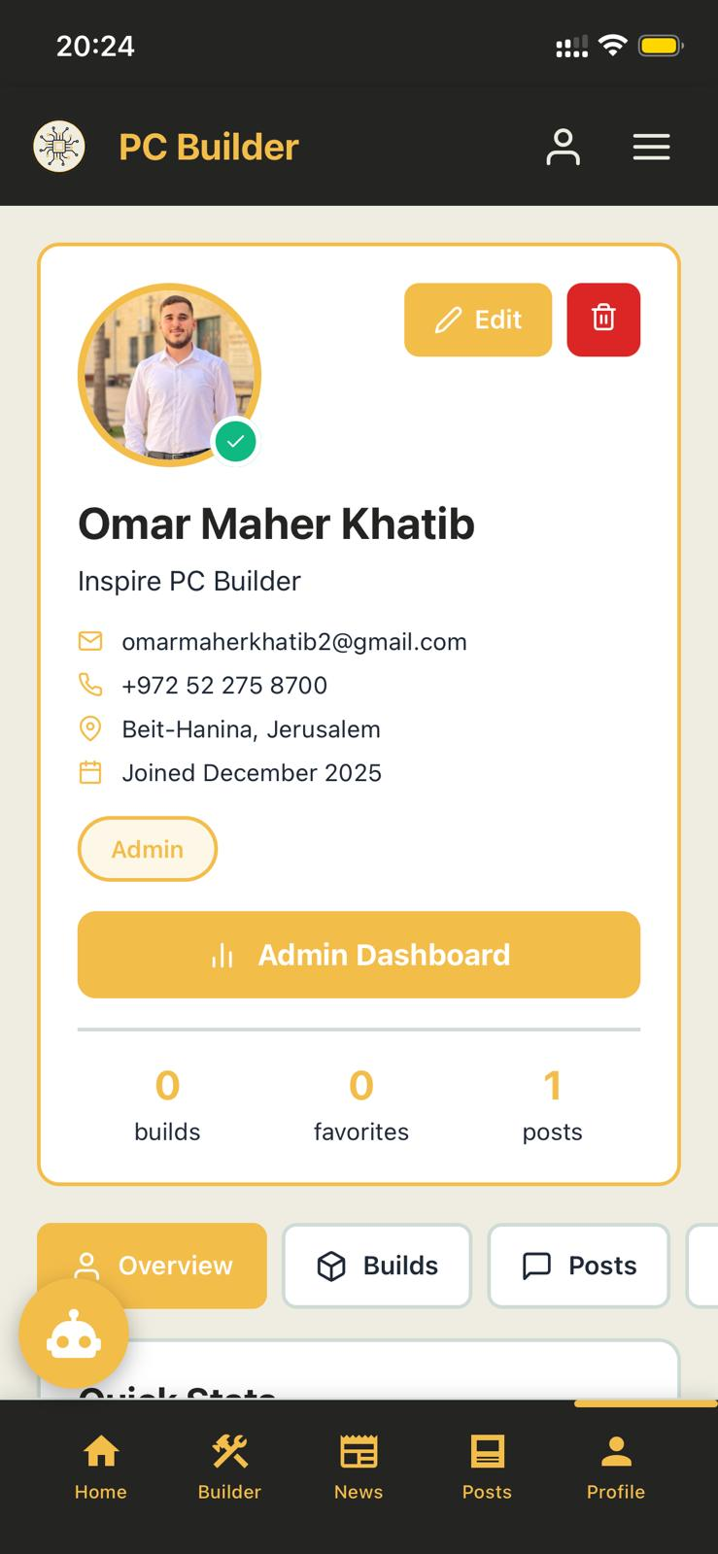
Admin Profile
Notes:
8

Slide 17
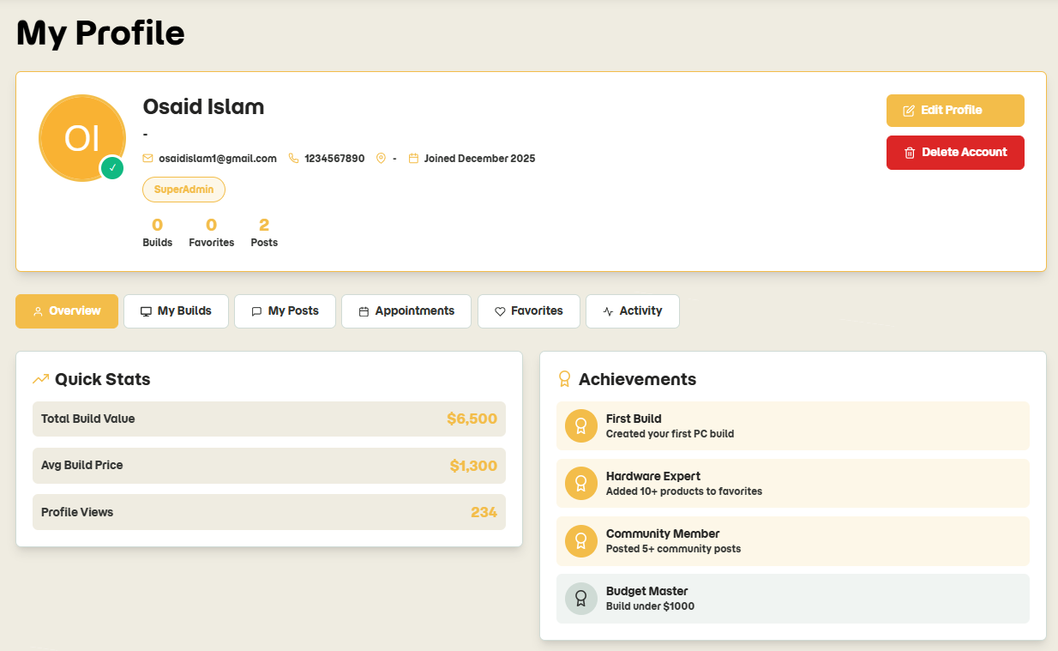

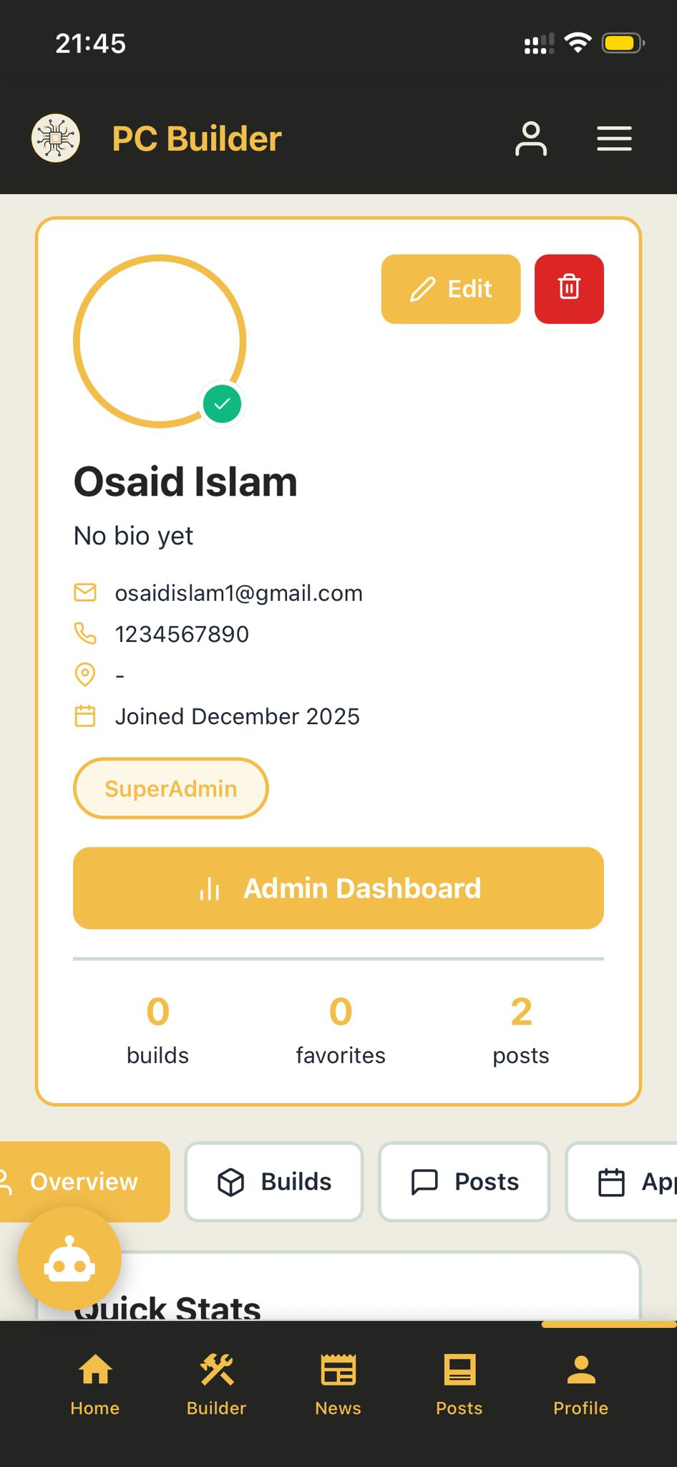
Super Admin Profile
Notes:
8

Slide 18
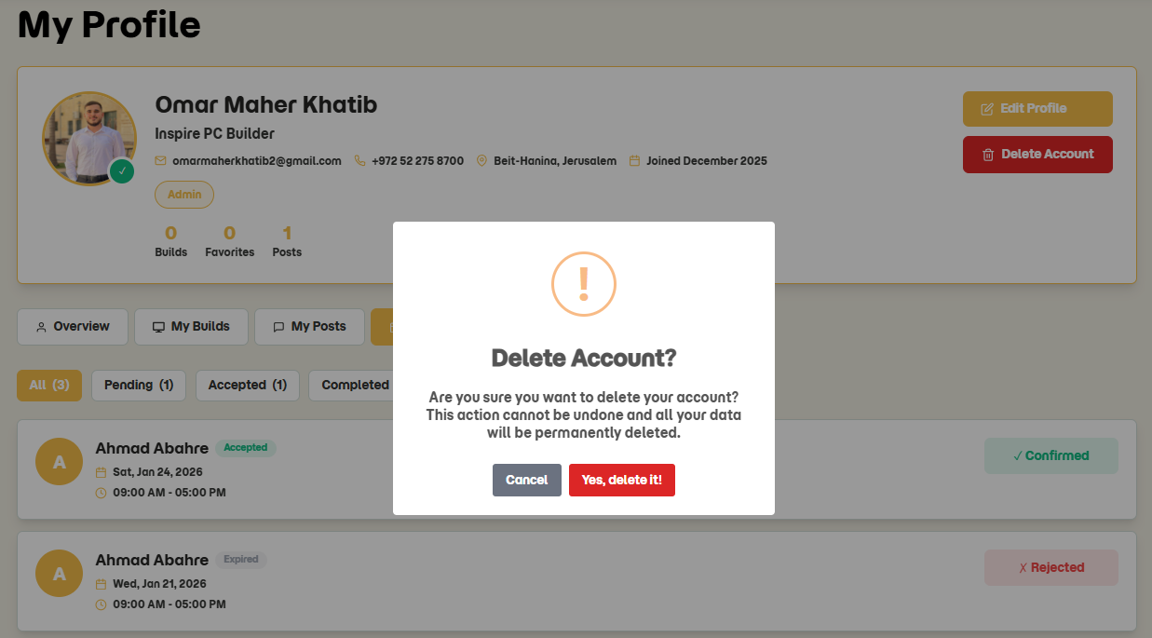
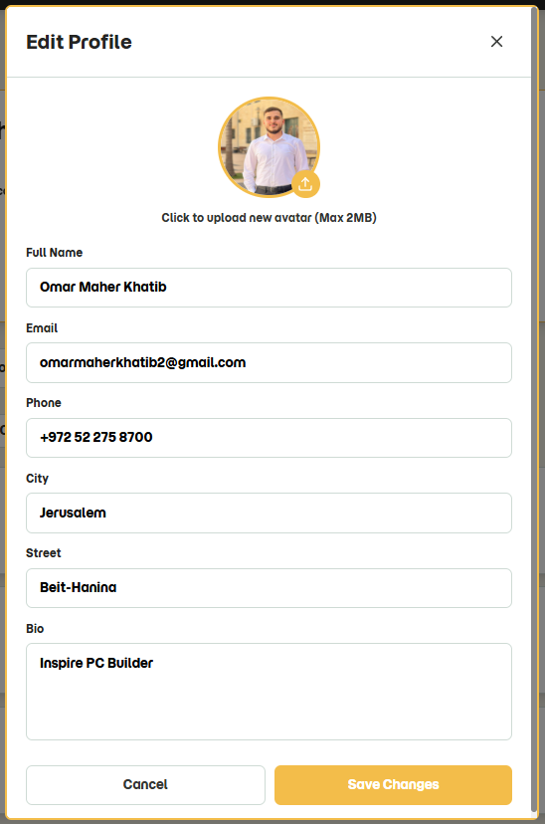
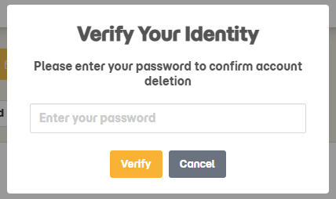
Profile Features
2
Delete Profile
1
Edit Profile
3
Verification before deletion
Notes:
8

Slide 19


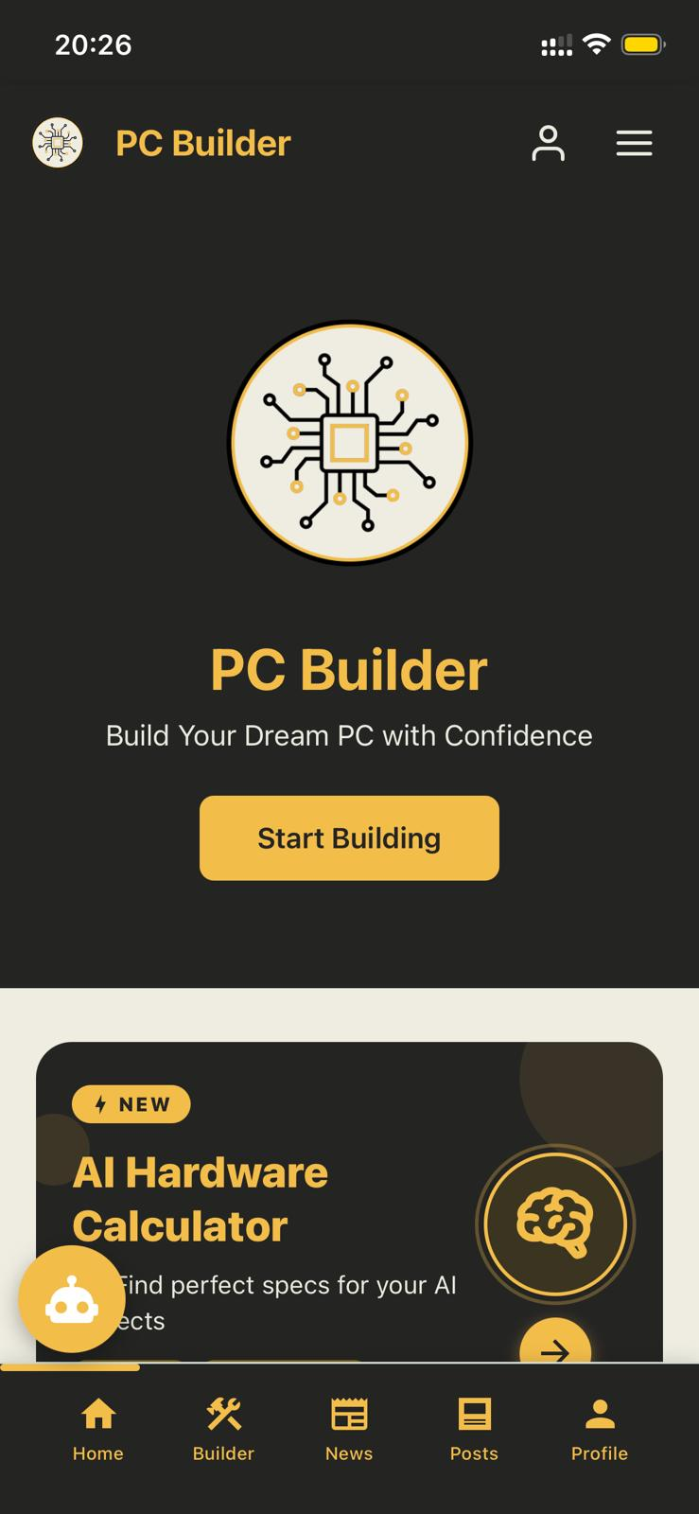
Home Page
Notes:
8

Slide 20
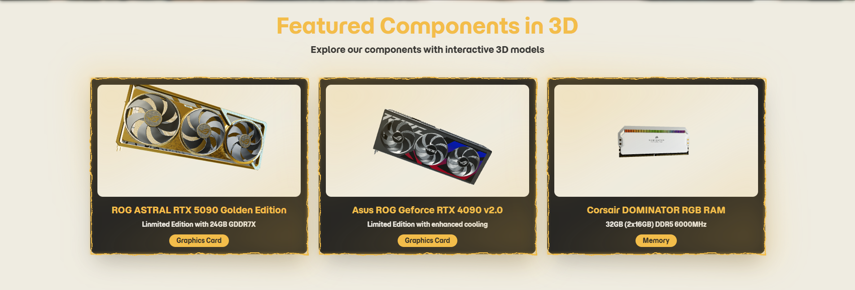
Home Page
Notes:
8

Slide 21
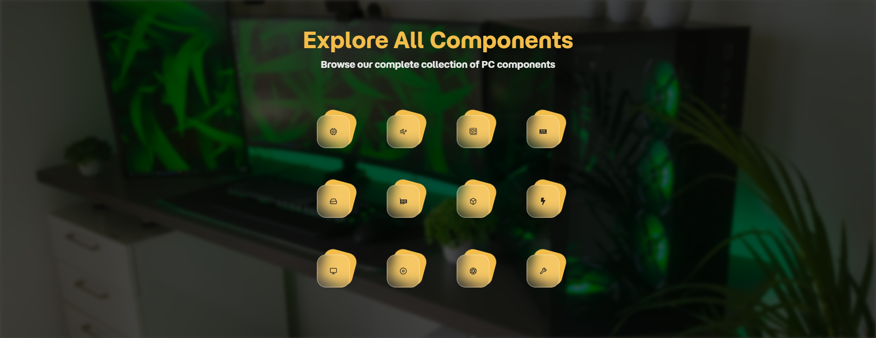

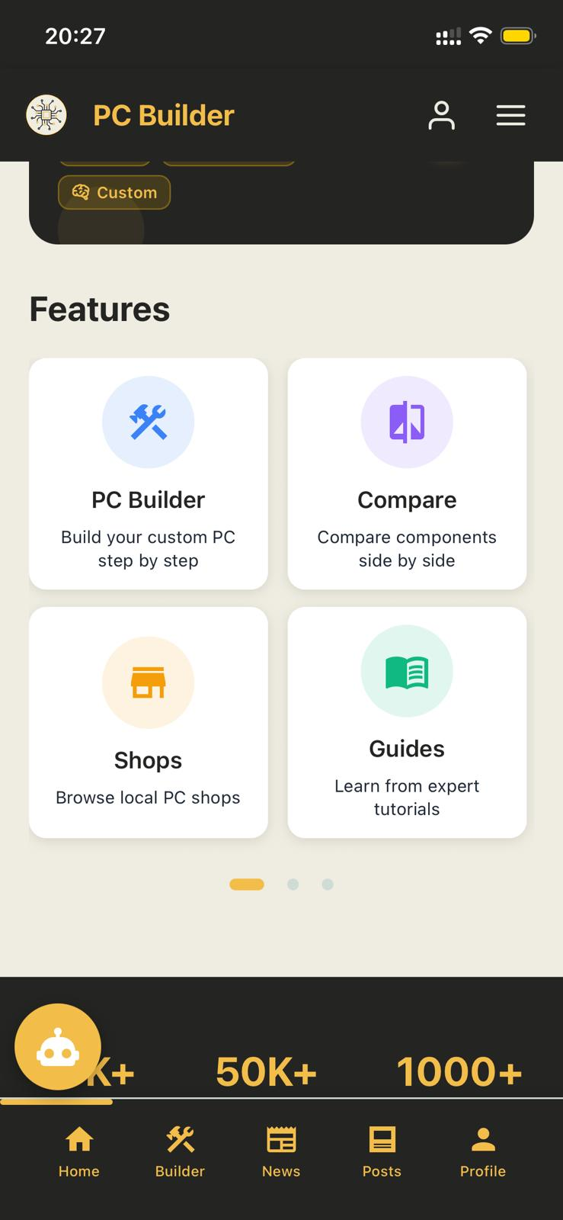
Home Page
Notes:
8

Slide 22
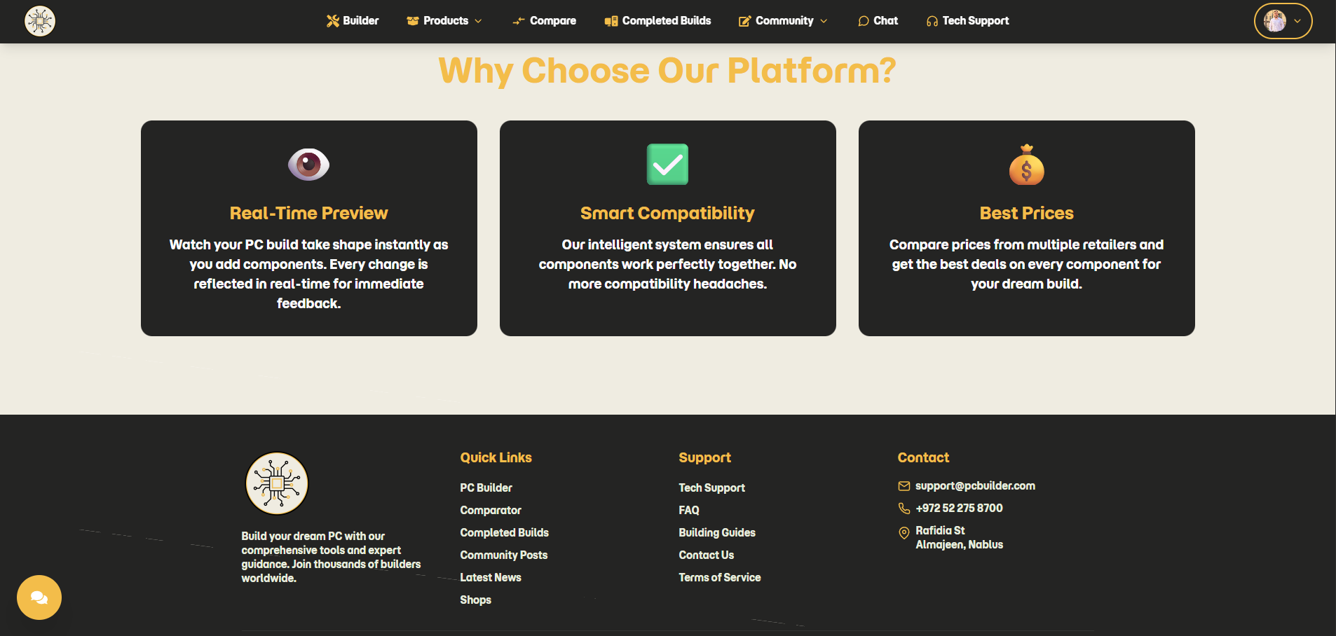
Home Page
Notes:
8

Slide 23
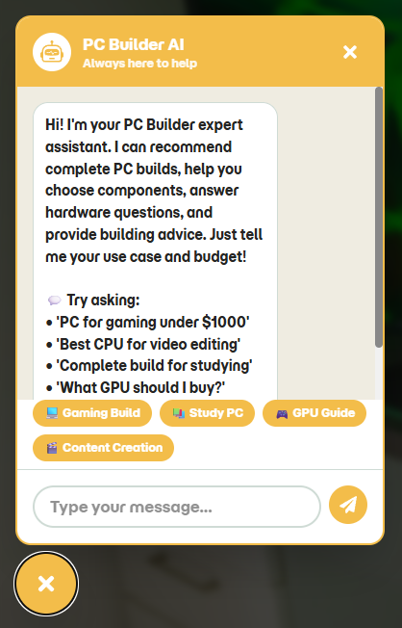
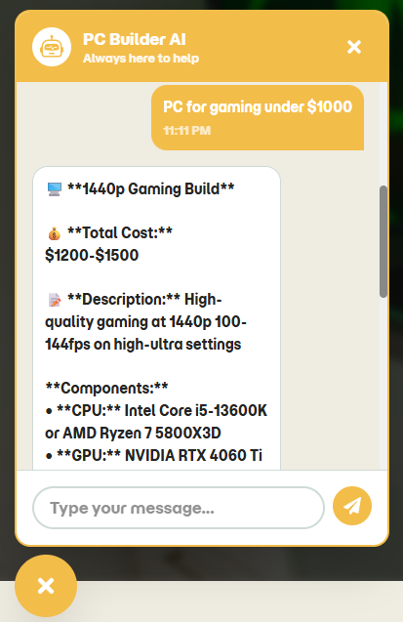
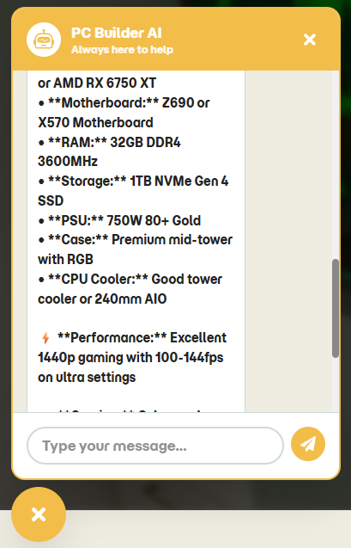
Ai Chat Bot
Notes:
8

Slide 24
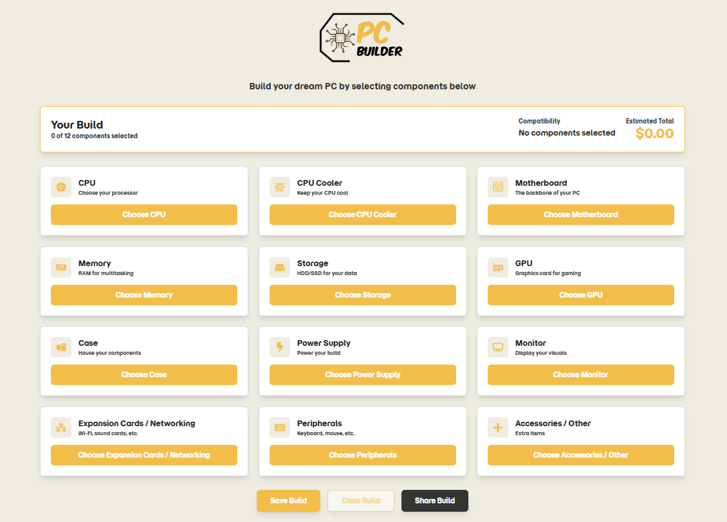

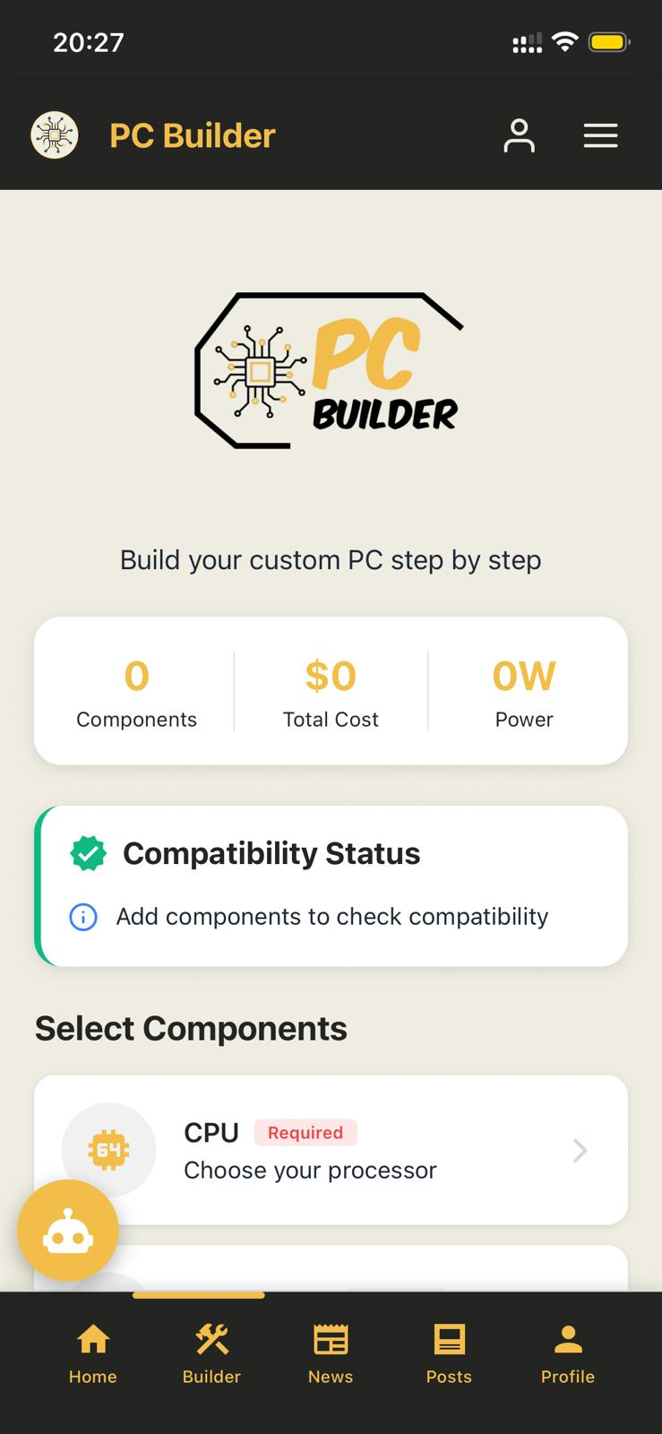
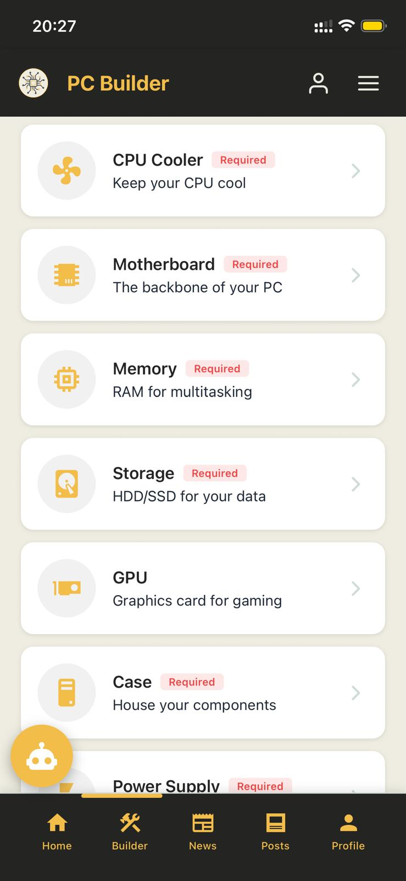
Builder Page
Notes:
8

Slide 25

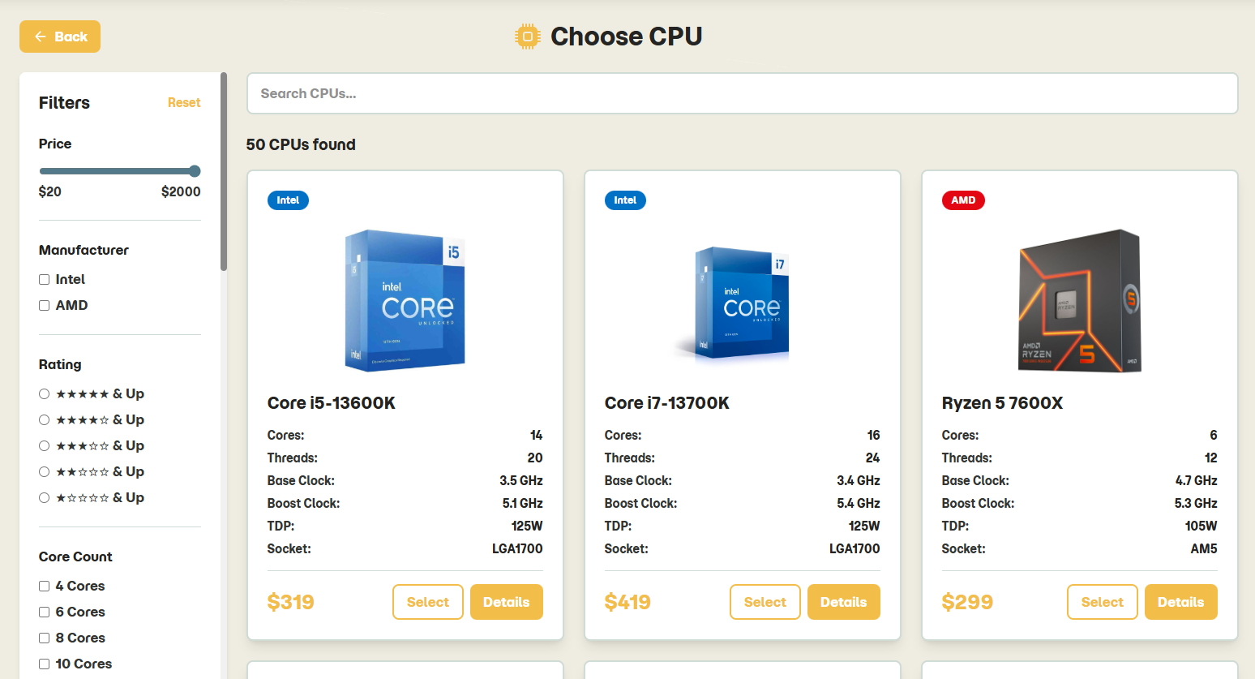
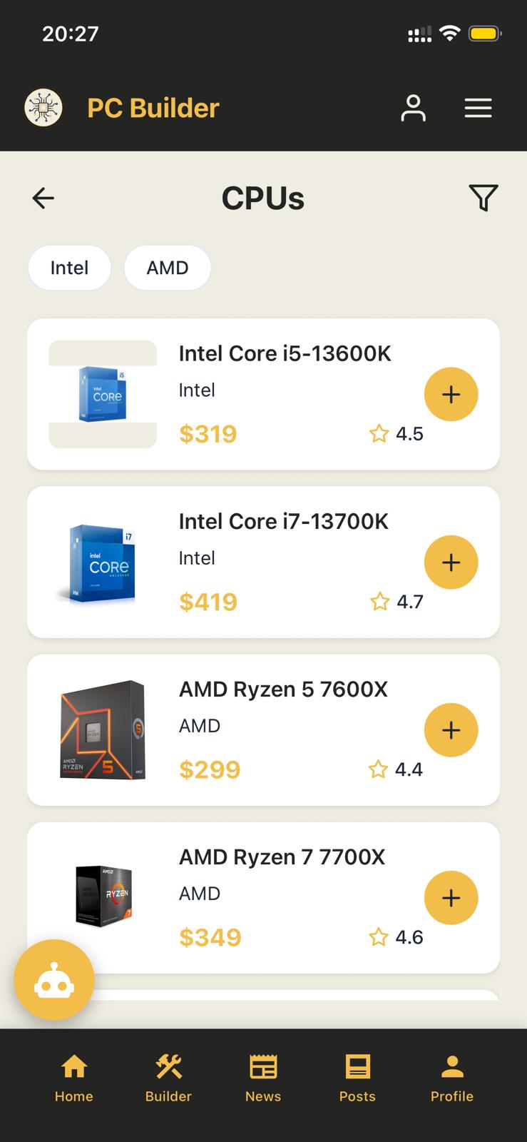
Builder Page – CPUs
Notes:
8

Slide 26

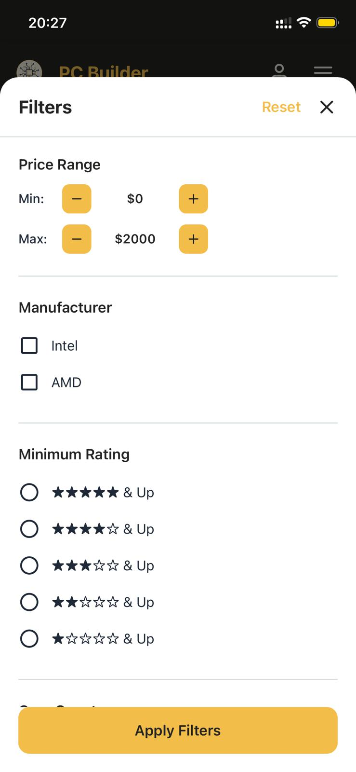
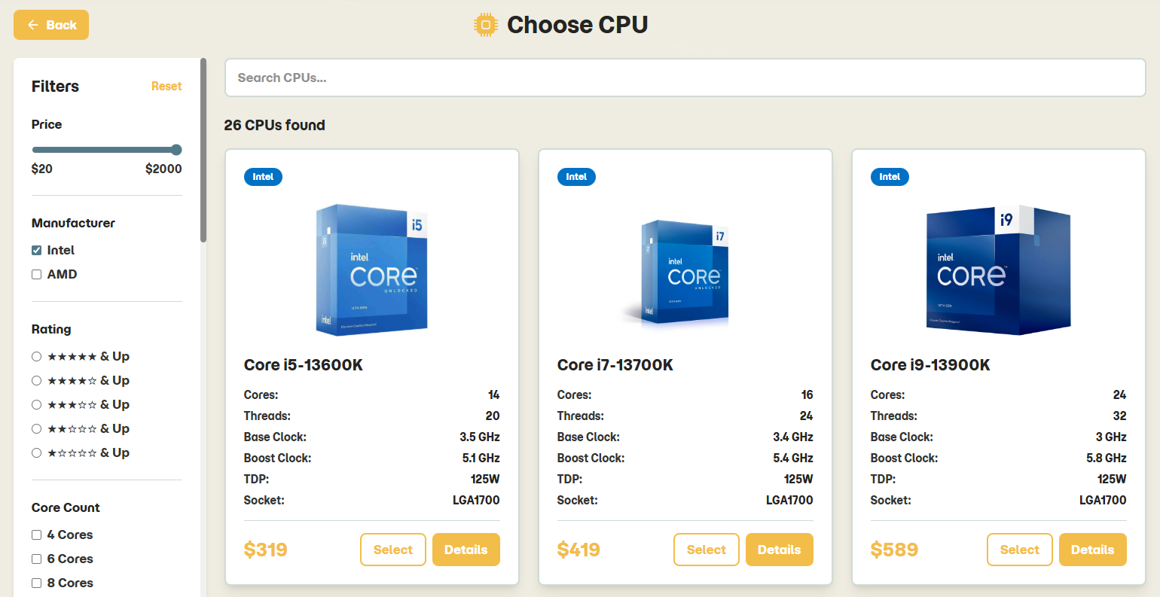
Builder Page – CPUs
Applying Filters
Notes:
8

Slide 27

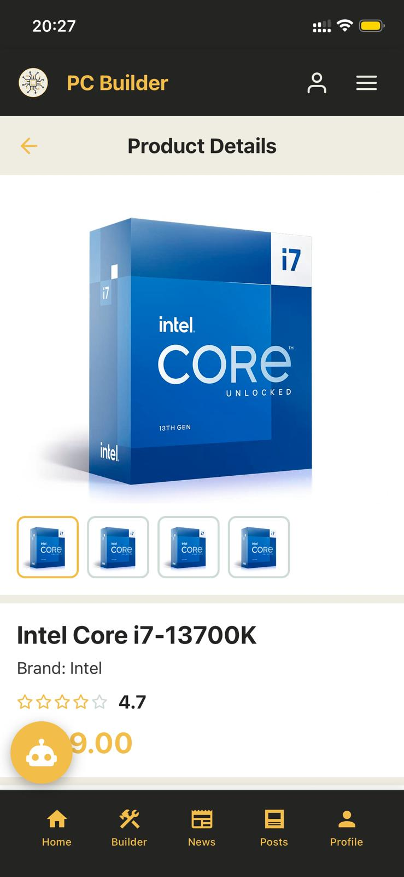
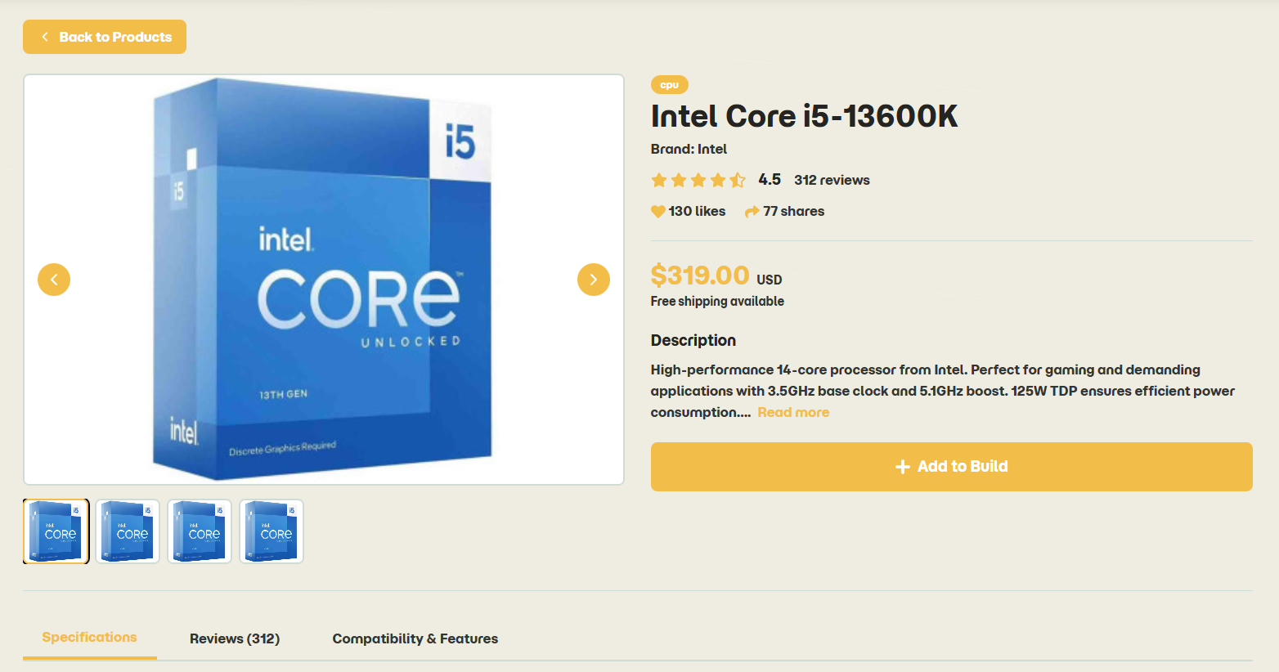
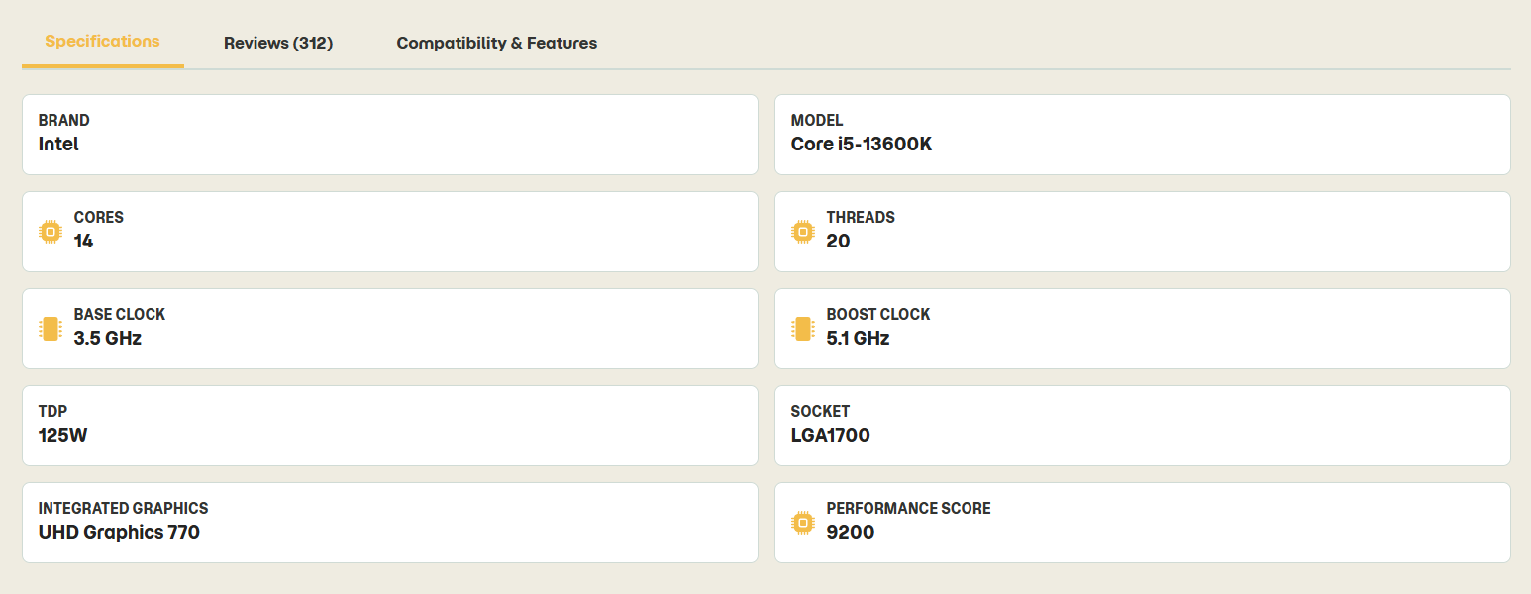
Builder Page – CPUs
Details Page for each product
Notes:
8

Slide 28

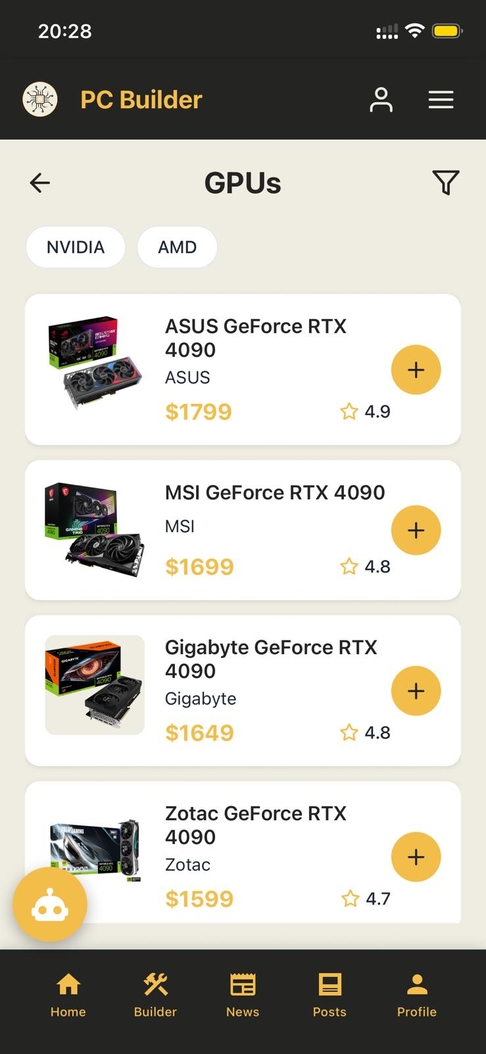
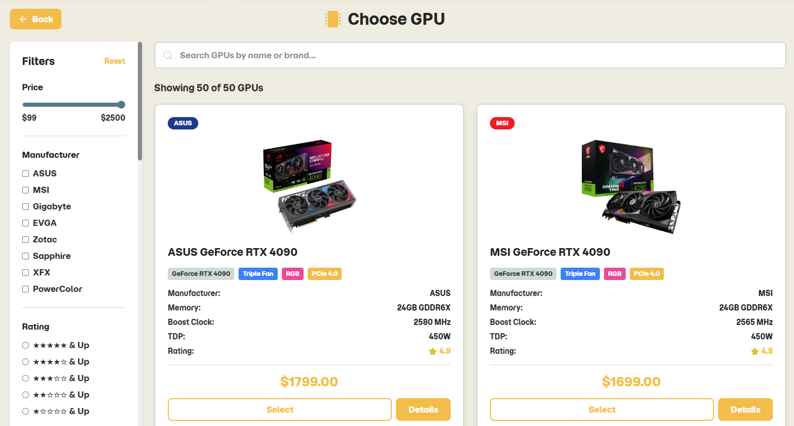
Builder Page – GPUs
Notes:
8

Slide 29

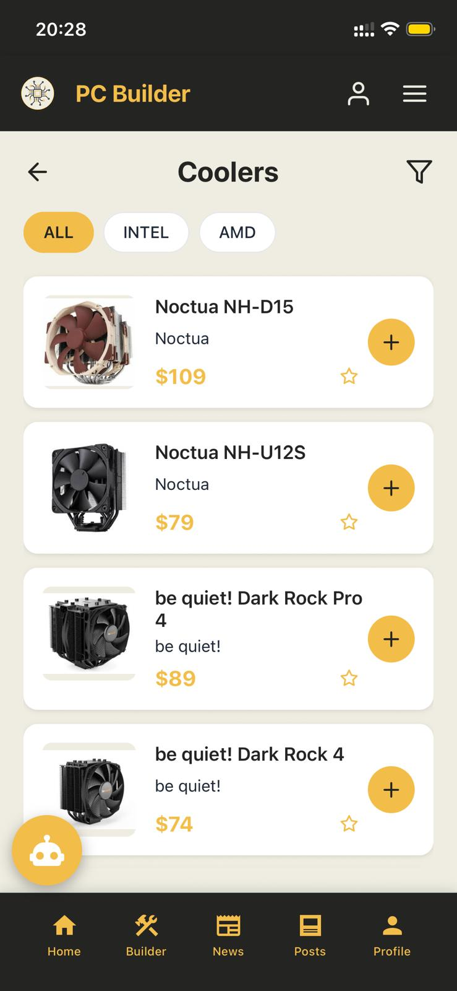
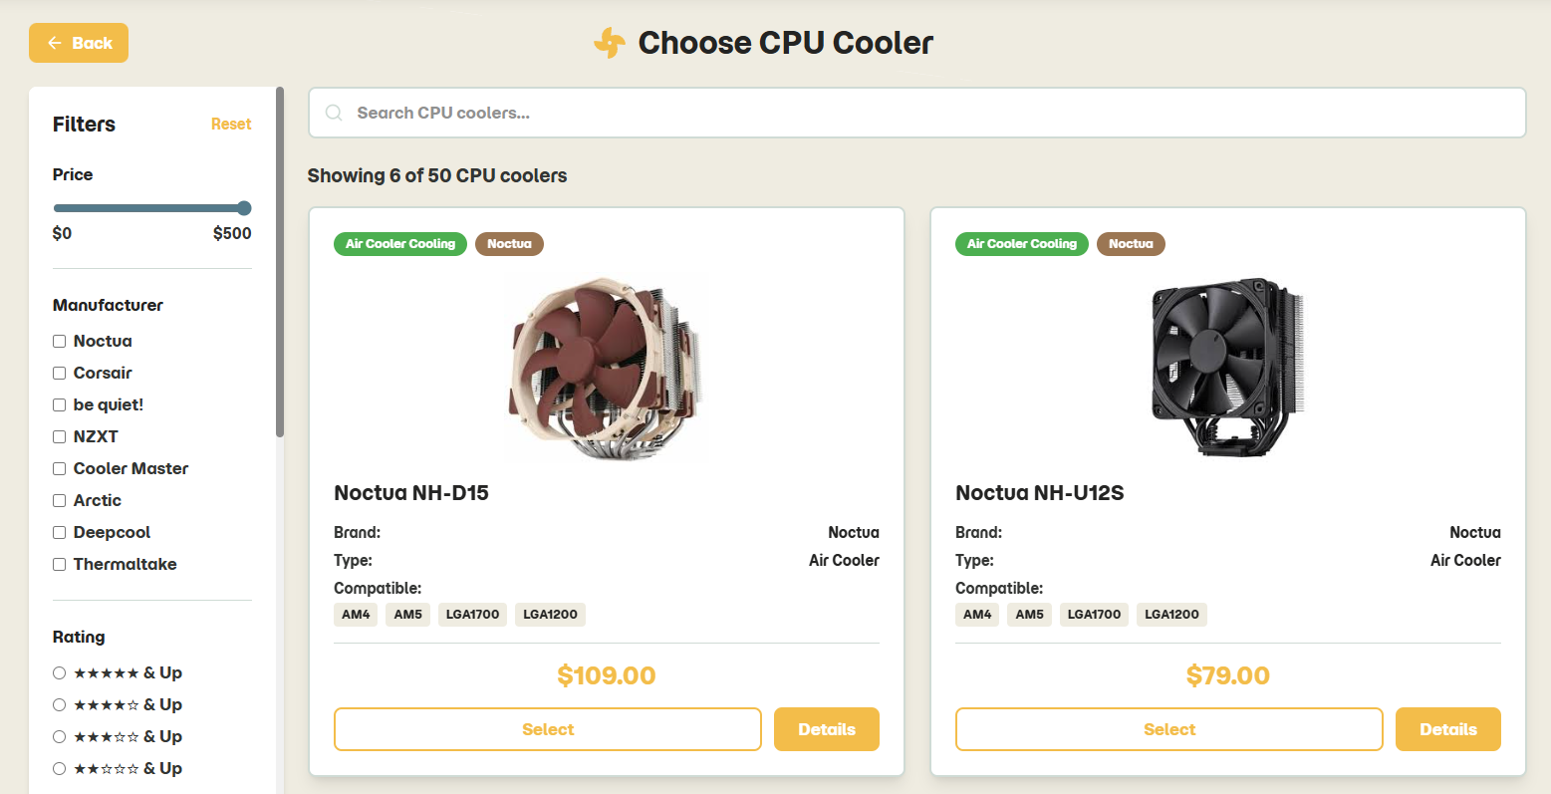
Builder Page – CPU Coolers
Notes:
8

Slide 30

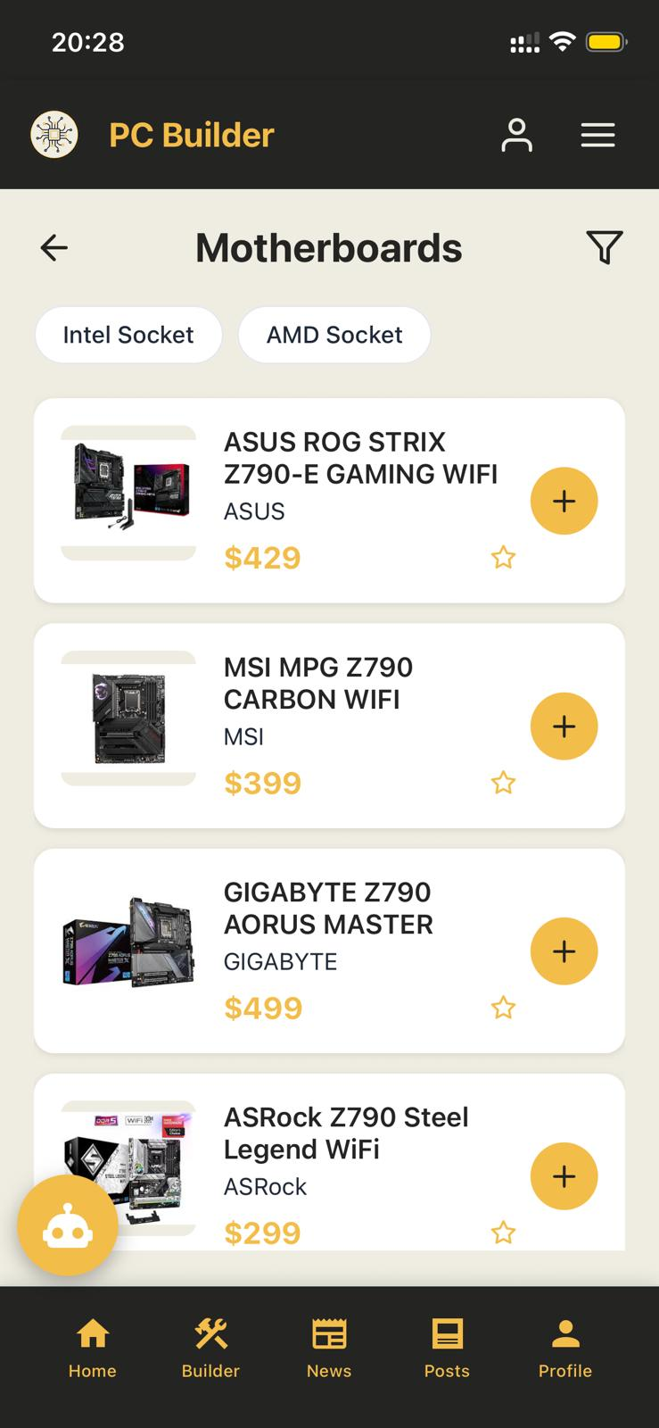
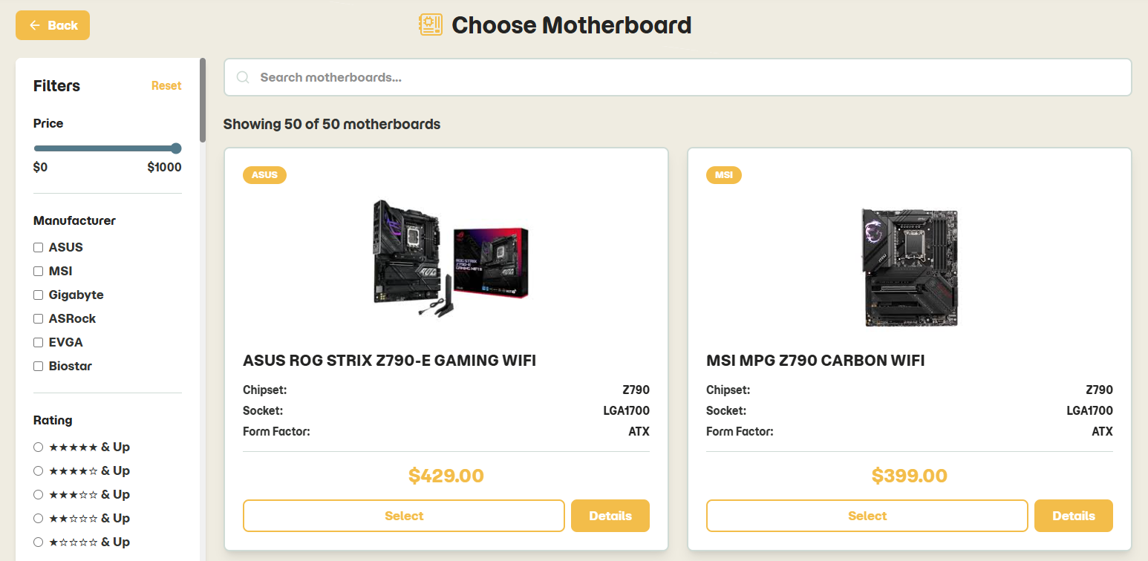
Builder Page – Motherboards
Notes:
8

Slide 31

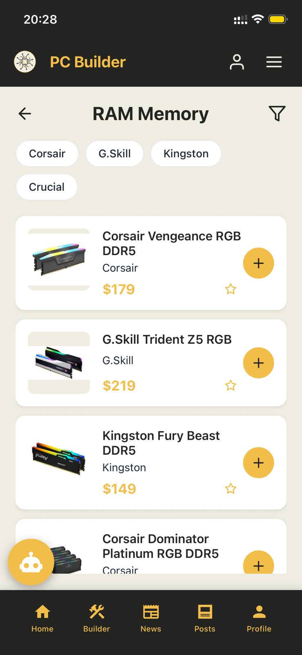
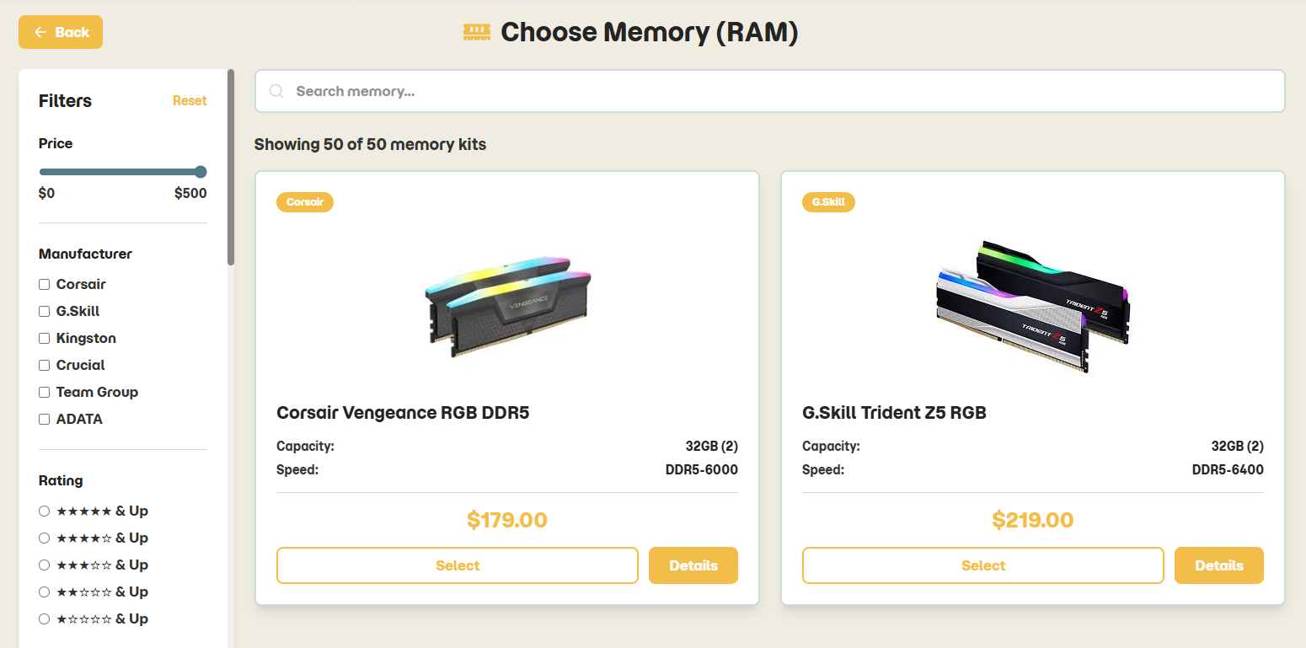
Builder Page – Memory (RAM)
Notes:
8

Slide 32

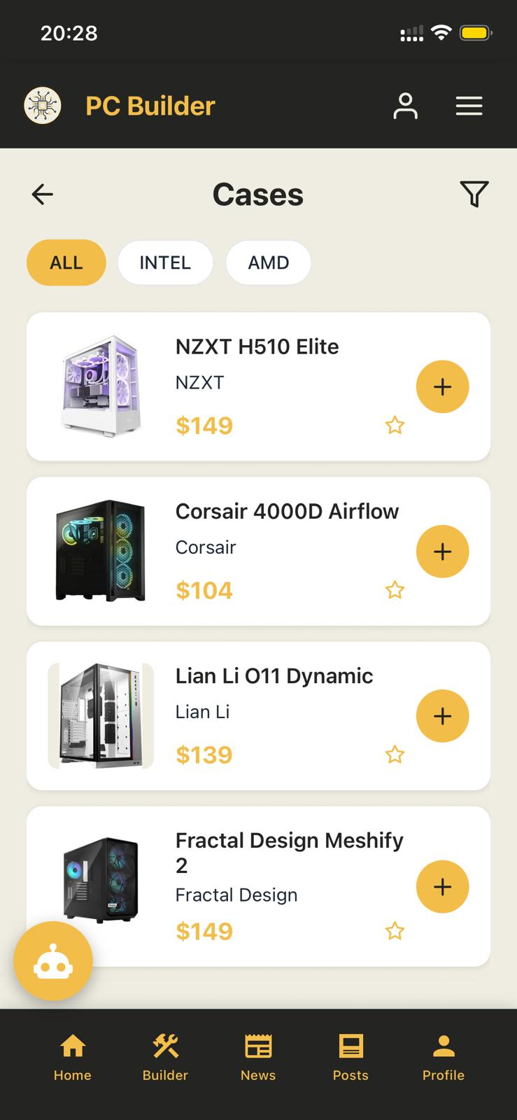

Builder Page – Cases
Notes:
8

Slide 33



Builder Page – Power Supply
Notes:
8

Slide 34



Builder Page – Monitors
Notes:
8

Slide 35



Builder Page – Expansion Cards
Notes:
8

Slide 36



Builder Page – Accessories
Notes:
8

Slide 37



Builder – In Details
Notes:
8

Slide 38


Compatibility Check – Warning
Notes:
8

Slide 39


Compatibility Check – Critical Issues
Notes:
8

Slide 40


Compatibility Check – Compatible
Notes:
8

Slide 41

Builder - Share Builds
Notes:
8

Slide 42



Comparator Page
Notes:
8

Slide 43



Comparator – In Details
New Comparing Key appears
Notes:
8

Slide 44



Comparator – Selection
Notes:
8

Slide 45


Comparator – Results
Notes:
8

Slide 46



Comparator – Results
Notes:
8

Slide 47

Comparator – Results
Final Recommendation
Notes:
8

Slide 48




Completed Builds Page
Notes:
8

Slide 49





Completed Builds Page - Submit
Notes:
8

Slide 50


Community
Notes:
8

Slide 51



Community - Posts
Notes:
8

Slide 52


Community – Posts (Create)
Notes:
8

Slide 53



Community – Posts (In Profile)
Notes:
8

Slide 54



Community - News
Notes:
8

Slide 55


Community – News (Filters)
Notes:
8

Slide 56



Community – Shops
Notes:
8

Slide 57


Community – Shops (Filters)
Notes:
8

Slide 58

Community – Shops (Submit)
Notes:
8

Slide 59



Community – Shops (Submit)
Notes:
8

Slide 60






Community – Quantum Computing
Notes:
8

Slide 61



Chat System Page
Notes:
8

Slide 62


Chat System Page
Notes:
8

Slide 63



Contact Us Page
Notes:
8

Slide 64



Technical Support Page
Notes:
8

Slide 65





Technical Support Page (Submit)
Gmail
Notes:
8

Slide 66



Technical Support Page (Appointment)
Notes:
8

Slide 67



Technical Support Page (Appointment)
Notes:
8

Slide 68



Technical Support Page (Appointment)
Notes:
8

Slide 69

Technical Support Page (Appointment)
1
2
3
Notes:
8

Slide 70



Technical Support Page (Appointment)
Notes:
8

Slide 71



Technical Support Page
Notes:
8

Slide 72


AI Hardware Calculator Page
Notes:
8

Slide 73



AI Hardware Calculator Page
Notes:
8

Slide 74



AI Hardware Calculator Page
Notes:
8

Slide 75



AI Hardware Calculator Page
Notes:
8

Slide 76



AI Hardware Calculator Page
Notes:
8

Slide 77


AI Hardware Calculator Page
Notes:
8

Slide 78


Admin Dashboard
Notes:
8

Slide 79


Admin Dashboard - Security
Notes:
8

Slide 80




Admin Dashboard - Overview
Notes:
8

Slide 81


Admin Dashboard - Shops
Notes:
8

Slide 82


Admin Dashboard - Posts
Notes:
8

Slide 83


Admin Dashboard - Users
Notes:
8

Slide 84


Admin Dashboard - Products
Notes:
8

Slide 85


Super Admin Dashboard – Tech Support
Notes:
8

Slide 86


Super Admin Dashboard – Tech Support
Notes:
8

Slide 87
Future Roadmap
Phase 1: Enhanced Features
1
100% AI-powered build recommendations
3D component visualization
Add More Than 1000 Product for each type
2
Phase 2: Community Growth
Build showcases and competitions
Rank and Prizes
Phase 3: Scale & Performance
3
Global price comparison integration
Enhanced caching and CDN deployment
Thank You
Notes:
9

