Slide 1
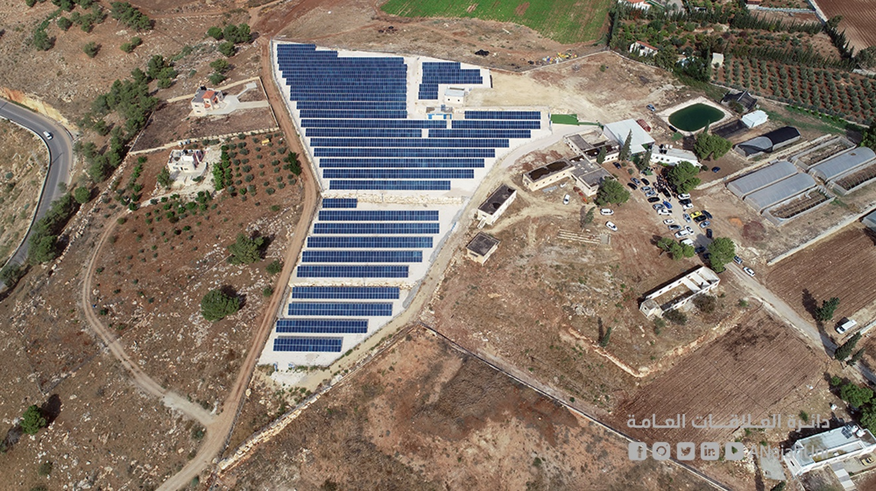

An-Najah National University
Faculty of Engineering and Information Technology
Electrical Engineering Department
Graduation Project 2
The impact of photovoltaic system on electrical grid analyses
Prepared By
Waleed Dweikat
Bara Safa
Supervised By
Dr. Imad Ibrik
This project was submitted in partial fulfillment of the requirement for the Bachelor degree in Electrical Engineering

Slide 2
Introduction
In the first project, a study was made on the effect of adding a solar cell system on the Badan network using the Etab program, where the network were studied and a set of results were obtained from changes voltage, current, PF, real power and reactive power , etap program performs static analysis, AS a result digsilent software was used as it performs dynamic analysis.
Then PVsol program was used in order to see the theoretical results from the project and compare them with the real results, where a number of parameters were calculated, including PR and the yield

Slide 3
Project-2
After studying the PV project impact using ETAP in project-1, which depends on static instantons data, our work in project -2 includes the following:
1. Study the implemented PV system using:
Real data
PVsol software
Then compare both result
2. Study the performance of PV system using:
PR
CuF
3. Study the impact of interconnection of PV system on grid using period of time (dynamic data) on:
Voltage
PF
THD (voltage & current)

Slide 4
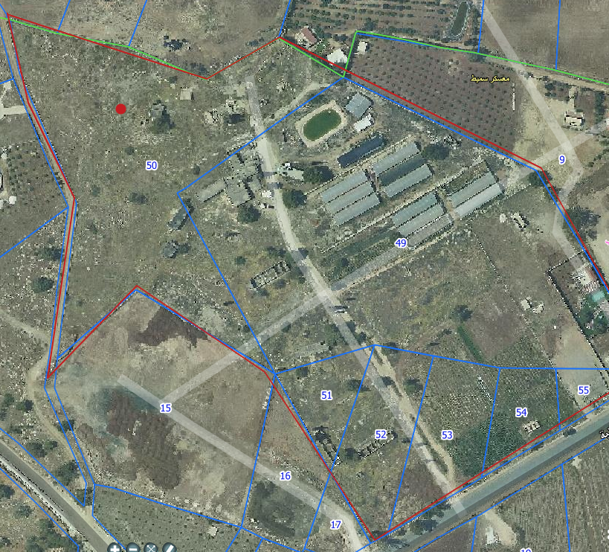
Overview of Al-Nassariah land:
The land of project is located in Nablus Governorate with coordination Lat: 32.261025 N, Long: 35.361429 E. An-Najah National University would like to install solar PV system in order to reduce the consumption and total bill of ANNU buildings.
The figure below show the map of target land
Fig.1: Project location

Slide 5
project parameters
The system is ground mounted with tilt angle 30 degree, and the installation consist of the following elements:
PV Modules CSG330WS2 (330W)
DC MCB (4P,16A) 1000V
DC cable
Inverter SMA America, Inc (50KW)
AC cable 25mm^2
AC MCCB 80A
SPD
AC MCCB (4P 100A)
C.B (3P)(1000A)

Slide 6
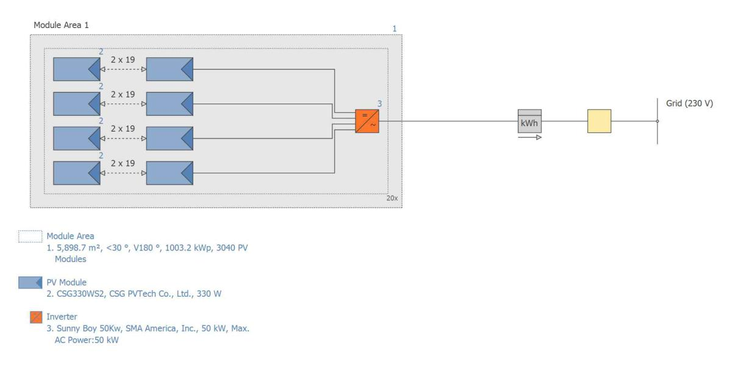
How The PV System Build/implemented?
the system was connected as follow:
3040 solar panel with a capacity of 330 watts were used, and then they were distributed on 20 inverters with a capacity of 50 kilowatts per inverter.
160 strings were connected; in each string, 19 solar panel were connected series. As shown in fig.2
Then, each two strings were connected in parallel with each other and then connected to the inverter.
At the end, all inverters were connected to the main switch and from it to a transformer 0.4/33KV.
Fig. 2: distribution of PV panels on inverter

Slide 7
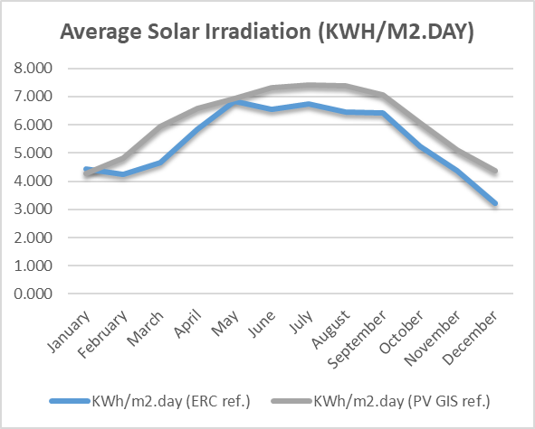
Solar Radiation on the Location:
The solar radiation on site of project as follow:
month | KWh/m2.day (ERC ref.)
January | 4.429
February | 4.236
March | 4.660
April | 5.831
May | 6.845
June | 6.552
July | 6.733
August | 6.447
September | 6.425
October | 5.236
November | 4.376
December | 3.209
AVERAGE= | 5.415

Slide 8
PVSOL
PVSOL is a dynamic simulation program for photovoltaic systems that can be used to plan and optimize a roof- or a ground-mounted, a grid-connected or a stand-alone PV system.
Meteonorm 7.1, an integrated database, provides monthly climatic data from over 8000 global data sets with averaging period 1991-2010. An interactive map let the user select the climate data, new climate data is also can be created by interpolation from existing measurement values of global horizontal and diffused horizontal irradiance and ambient temperature or by applying own monthly mean values.
PVSOL has an extensive built-in database comprising over 7500 modules and over 1500 inverters. Module configuration in optimization process might be done automatically by the program according to individual strings or defined by the user considering shading effect. The number of modules can also be automatically defined by the software based on the available area or manually set by the user. Optionally, a power optimizer can be added to a yield simulation of the system. Prior to yield simulation detailed circuit diagram in a standardized form can be drawn and exported, and dimensioning of AC and DC cabling and its losses can be defined.
PVSOL can also perform financial analysis based on user-defined cost of modules, inverters and mounting systems. Financial analysis allows the user to take into account loans, depreciations, discounts, tax payments and operational time of the system.
PVSOL provides calculation for capital value, electricity production costs and amortization period. Results of the analysis are summarized in a table in the balance of the costs.
The system parameters of nassariah project was inserted into software in order to calculate the solar yield accurately.

Slide 9
Grid Connected PV System - Full Feed-in
Climate Data | Badhan (1986 - 2005)
PV Generator Output | 1003.2 kWp
PV Generator Surface | 5,898.7 m²
Number of PV Modules | 3040
Number of Inverters | 20

Slide 10
Nassariah pv project simulation result-PVSol
The yield
PV Generator Power (AC grid) | 1,765,151 kWh
Spec. Annual Yield | 1,759.52 kWh/kWp
Performance Ratio (PR) | 79.7 %
CO₂ Emissions avoided | 1,059,050 kg / year
PV Generator Module Area
Name | Module Area 1
PV Modules* | 3040 x CSG330WS2
Manufacturer | CSG PVTech Co., Ltd.
Inclination | 30 °
Orientation | South (180 °)
Installation Type | Mounted - Open Space
PV Generator Surface | 5,898.7 m²

Slide 11
Inverter
Module Area | Module Area 1
Inverter 1* | 20 x Sunny Boy 50Kw
Manufacturer | SMA America, Inc.
Configuration | MPP 1: 2 x 19 | MPP 2: 2 x 19 | MPP 3: 2 x 19 | MPP 4: 2 x 19 | MPP 5: free | MPP 6: free
AC Mains
Number of Phases | 3
Mains Voltage (1-phase) | 230 V
Displacement Power Factor (cos phi) | +/- 1
Cable
Total Loss | 0.03 %

Slide 12
PV System
PV Generator Output | 1003.2 kWp
Spec. Annual Yield | 1,759.52 kWh/kWp
Performance Ratio (PR) | 79.7 %
Grid Feed-in | 1,765,151 kWh/year
Grid Feed-in in the first year (incl. module degradation) | 1,765,151 kWh/year
Stand-by Consumption | 68 kWh/year
CO₂ Emissions avoided | 1,059,050 kg / year

Slide 13
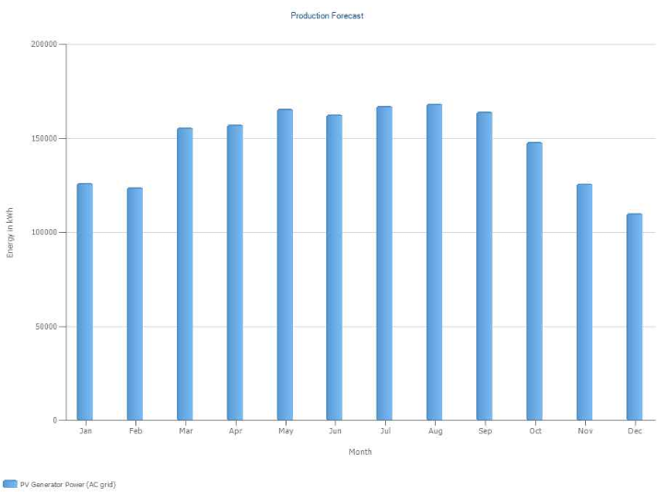
Expected Energy Output:
month | E output-Calculated (KWh)
January | 126383.3295
February | 119546.8686
March | 156443.6912
April | 158289.1913
May | 161883.4604
June | 159624.1116
July | 163937.1482
August | 169401.4886
September | 163391.8403
October | 144597.3474
November | 121273.5009
December | 114315.93559
AVERAGE= | 146590.66
Fig. 3: forecast production KWh-PVSol

Slide 14
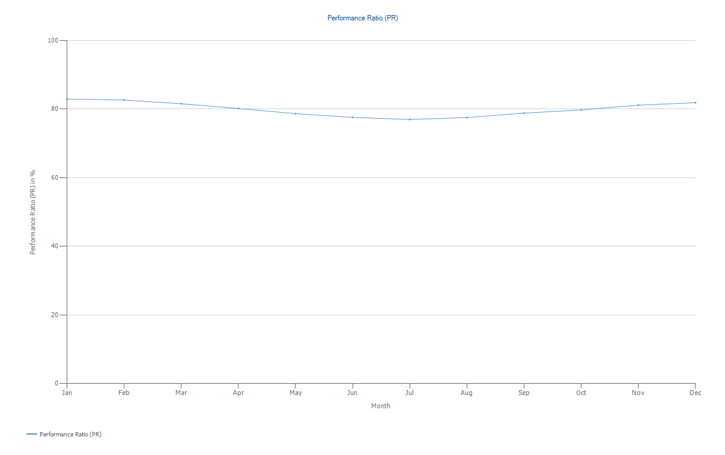
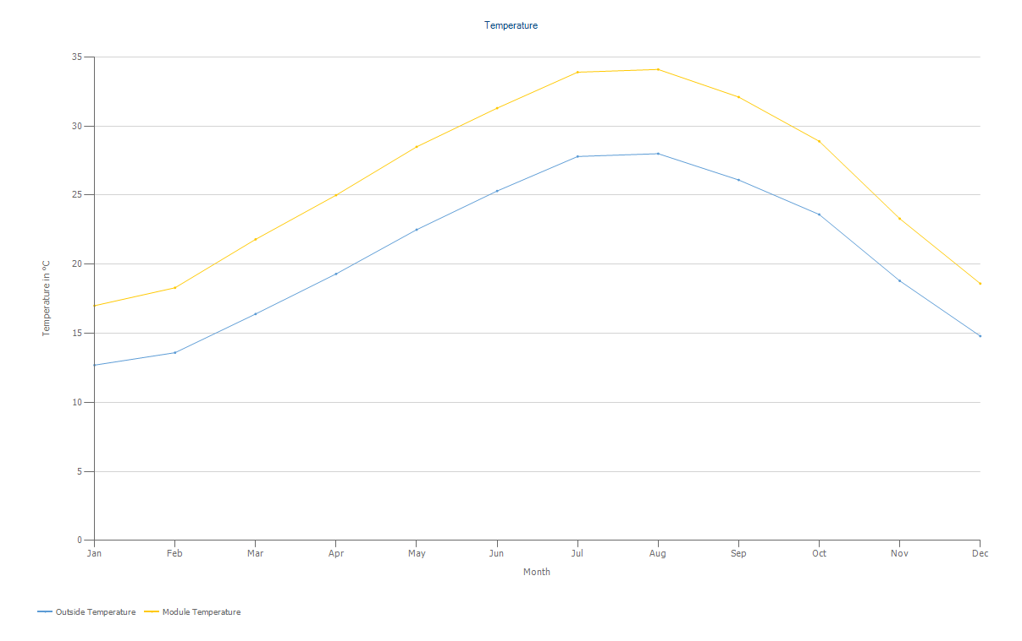
Fig. 4: Performance Ratio-PVSol
Fig. 5: Ambient (outside) vs. Module Temperature-PVSol

Slide 15
Real energy output-Nassariah project
The system was operated on 5th September 2020 and result was as follow:
Month | real data KWh
Sep | 92379.01
Oct | 125641.08
Nov | 102688.26
Fig. 11: Real energy yield-nassariah project
The data was gathered using remote monitoring system which connected to the inverter at Nassariah project sites

Slide 16
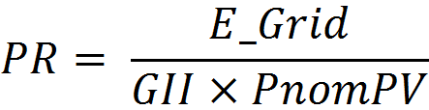
Performance Ratio (PR) FROM ACTUAL DATA
Standard definition
Ratio of Effective Produced Energy to Ideal Energy Yield at STC Condition.
Unit-Less, Represented as (%).
Usually the Effective produced Energy at The Available Useable Energy Delivered to the end user
PR Includes Optical Losses, PV array losses, DC to AC Conversion Loss and Other System losses
Formula the PR:
E_Grid = useable energy at user end (kwh/ month)
GII= global inclined irradiation (kwh /m2/month)
PnomPV =PV module installed (kwp)

Slide 17
Calculate PR
After using Excel to calculate PR we found:
Energy Generation at the end of 3 months of Operation
Month | Irradiation in Inclined Plane (GII) (kWh/m2) | Generated Energy (KWh)
September | 167.18 | 92,379.01
October | 162.44 | 125,641.08
November | 131.4 | 102,688.26
Total | 461.02 | 320708.35
September Irradiance on Inclined Plane @ STC (kW/m²) | 167.18 | (GII)
Installed PV Array Capacity (kWp) | 1003 | (P_{nom}PV)
Performance Ratio | 55% | (PR)
October Irradiance on Inclined Plane @ STC (kW/m²) | 162.44 | (GII)
Installed PV Array Capacity (kWp) | 1003 | (P_{nom}PV)
Performance Ratio | 77% | (PR)

Slide 18
November Irradiance on Inclined Plane @ STC (kW/m²) | 131.4 | (GII)
Installed PV Array Capacity (kWp) | 1003 | (P_{nom}PV)
Performance Ratio | 78% | (PR)
3 Months Irradiance on Inclined Plane @ STC (kW/m²) | 461.02 | (GII)
Installed PV Array Capacity (kWp) | 1003 | (P_{nom}PV)
Annual Performance Ratio | 69% | (PR)
From previous result, we note the following:
In September the panel was not clean and PR was little below the acceptable range of PR
after the system was cleaned, PR was risen and this is good indicator
The typical PR value is 60-90%, so the system operates well

Slide 19

Capacity utilization factor (CUF)
The CUF is a factor which measures the actual energy output against the nominal energy output of the installed power at a speciﬁc period
P_{ins}: rated capacity of solar power plant (Wp).
h: hours in speciﬁc period “during year/month/day
The CUF was calculated for the system on monthly bases and the result as follow:
Month | CUF
Sep | 27%
Oct | 22%
Nov | 18%
CUF has nothing to do with efficiency of the panel but it is average sunshine hours available throughout the year.

Slide 20
Benefits of CUF method of performance evaluation
The simplicity of evaluation and direct correlation of CUF with revenue makes it more favourable option for the investors
CUF does not truly represent the potential of the solar-PV technology itself because it does not factor in the following:
Solar PV systems do not work at night because there is no sunshine
Solar irradiation changes during the seasons
Plant output depends on temperature of the location too

Slide 21
Technical impactOf Integration Of PV system :
Load Flow Analysis:
We analyzing the system network using Dig Silent power factory software program for both cases, before installing and after installing PV system,
the results were as the following:
Voltage Level At Substation
Power Factor Profile
Voltage And Current Quality At Feeder (

Slide 22
Voltage Level At Substation
The voltage level at the MV side of the Askar substation is analyzed and studied before installing PV system for data measured during (1/1/2018 -20/11/2019 ) and also after adding the PV. The voltage variations are limited to approximately less than 10%, which is within the acceptable range.
Supplying feeder from Askar substation :
Voltage(KV) | Before PV | After PV
V max | 34.06 | 34.07
V min | 29.96 | 29.98

Slide 23
The voltage level at the MV side of the Tubas substation is analyzed and studied before installing PV system for data measured during (14/3 -14/11/2019 ) and also after adding the PV. The voltage variations are limited to approximately less than 10%, which is within the acceptable range.
Supplying feeder from Tubas :
Voltage(KV) | Before PV | After PV
V max | 34.44 | 34.45
V min | 29.26 | 29.27

Slide 24
Power Factor Profile
We found that the optimum setting of inverters is to be fixed on 0.92, the fig. 13 and 14, shows the power factor profile on Al-Badan feeder supplying from Askar and Tubas respectively,
before and after installing solar PV systems. The power factor within the range 0.92, therefore we recommend to keep the setting of all inverters in the ranges of 0.92.

Slide 25
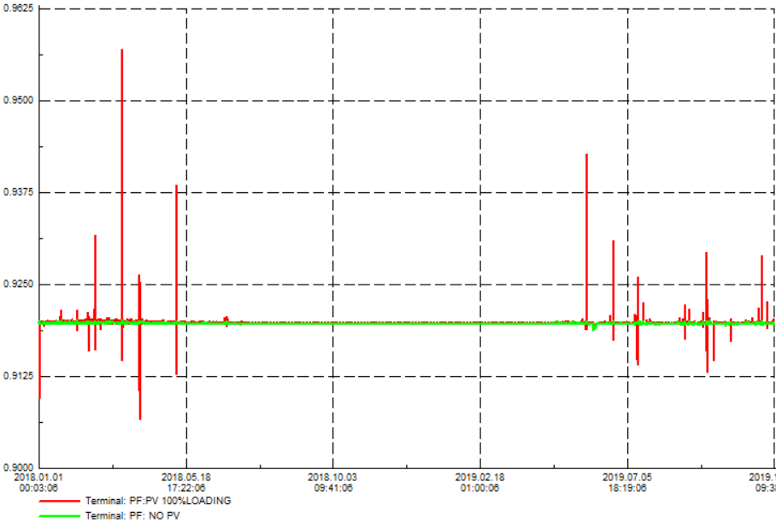
Supplying feeder from Askar substation :
PF(%) | Before PV | After PV
PF max | 92% | 95.70%
PF min | 91.80% | 90.67%
Fig.13: power factor at feeder, supplying from Askar point

Slide 26
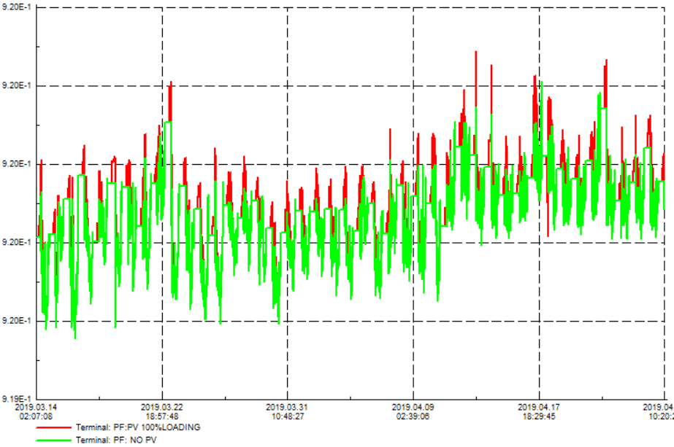
Supplying feeder from Tubas :
PF(%) | Before PV | After PV
PF max | 92% | 92.30%
PF min | 89.30% | 90.90%
Fig.14: power factor at feeder, supplying from Tubas point
Its clear that all the power factor data are within the suitable ranges and its a little improved happened after installing solar PV system at p.f.= 0.92.

Slide 27
Voltage And Current Quality At Feeder (IEc 61000)
All THD for currents and voltages are within the acceptable ranges.
The result show low THD from pv system which mean low distortion from pv on signal of grid in comparative with fundamental signal

Slide 28
economical calculation
 | Remuneration and Savings
Total Payment from Utility in First Year |  | 229,469.63 $
Remuneration of Electricity sold to Third Party
Price of Electricity sold to Third Party |  | 0.13 $/kWh
Remuneration of Electricity sold to Third Party |  | 229,469.63 $/year
Economic Parameters
Return on Assets | 14.08 %
Accrued Cash Flow (Cash Balance) | 2,807,281.63 $
Amortization Period | 6.9 Years

Slide 29
Conclusions
In September the panel was not clean and PR was little below the acceptable range of PR
after the system was cleaned, PR was risen and this is good indicator
The typical PR value is 60-90%, so the system operates well
CUF technically doesn’t paint a highly accurate picture of the plant’s performance and it cannot be used as a measure of control especially for intermittent sources of energy like solar/wind
After adding PV system, The voltage variations are limited to approximately less than 10%, which is within the acceptable range.
Its clear that all the power factor data are within the suitable ranges and its a little improved happened after installing solar PV system at p.f.= 0.92.
All THD for currents and voltages are within the acceptable ranges.
The result show low THD from pv system which mean low distortion from pv on signal of grid in comparative with fundamental signal

