Slide 1

Redesign The Directorate of Education in "Hiwarra" –Southern Nablus.
An-Najah National University
Faculty of Engineering & Information Technology
Building Engineering Department
Prepared by:
Taher Eid
Akram Sha'er
Husny Khasati
Supervisor:
Eng. Narmin Al-Barq.
Nablus – Palestine 2018.

Slide 2
LAYOUT
Introduction
Methodology
Architectural Aspects
Structural Aspects
Environmental Aspects
Electrical Aspects
Mechanical Aspects

Slide 3
Introduction
After studying the plans of the Directorate of Education and our selection of the Directorate of Huwara we discovered that the building of the Directorate contains several functions and needs of spaces so it was the beginning of our thinking is creating spaces suitable for each section and on the other hand we tried to create an interactive environment inside the building and give the building a sense of stability as a government building

Slide 4
Literature review
METHODOLOGY
Mechanical Aspects
Environmental Aspects
Electrical Aspects
Structural Aspects
Architectural Aspects
Water Supply & Drainage
HVAC
Dialux Evo
Standards & codes
Standards & codes
Standards & codes
Design Builder
Solar Systems
daylight
Acoustical
Design Builder
Dialux Evo
Ecotect
INSUL

Slide 5
Architectural Design

Slide 6
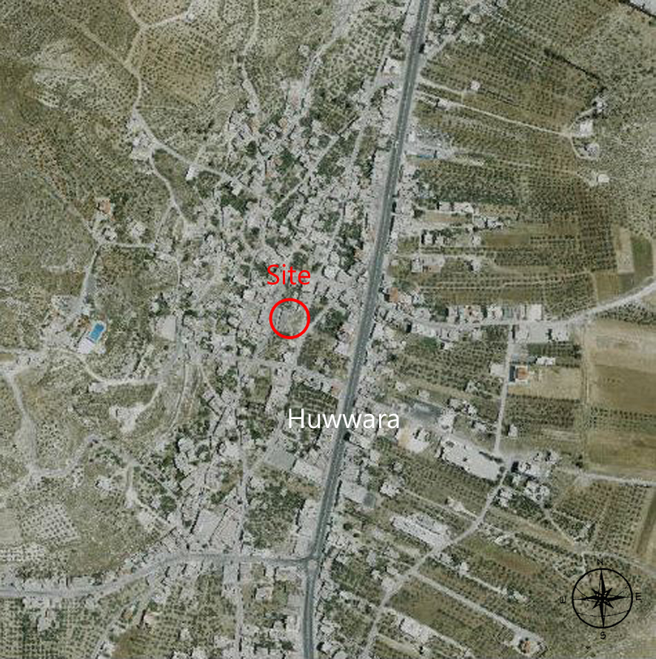
Site analysis
The site is located in Huwwara village in the south of Nablus city which is located on latitude of 32.2 north and longitude of 35.3 east.
Figure: Site location from GeoMOLG.

Slide 7
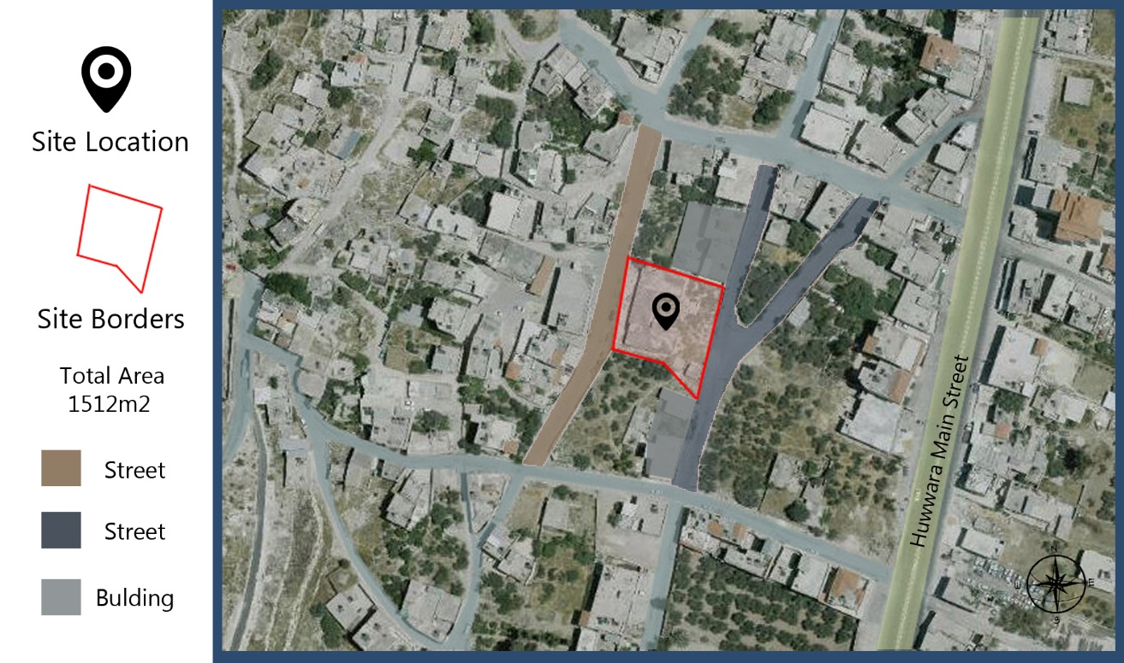
The area of the land is (1512 m2), the contour lines are in that area from 509 m which is the highest region to 500m, so the slope in the site is (20%), As shown in the Figure
Figure: Site location and Area

Slide 8
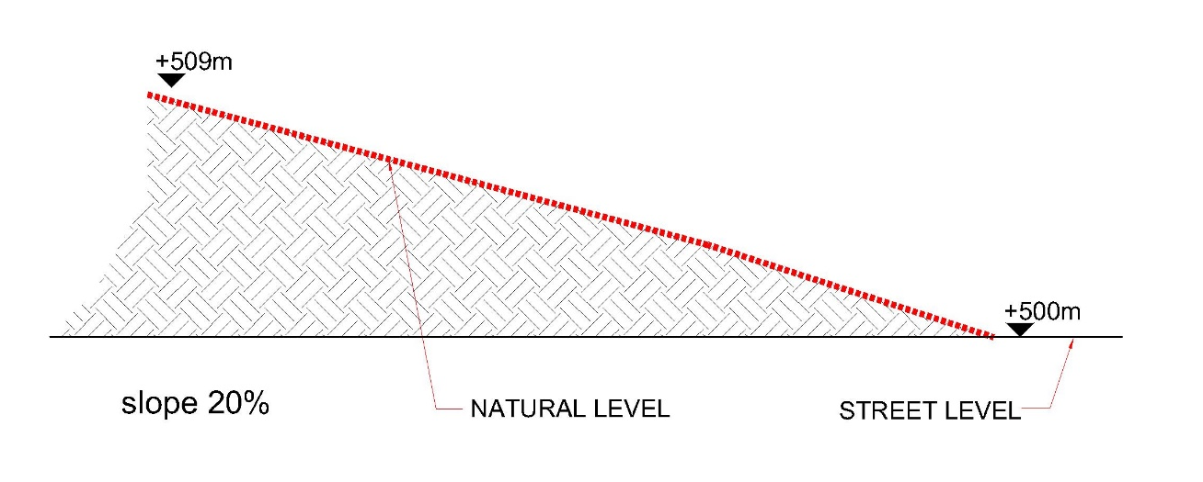
Figure: Section of site.

Slide 9
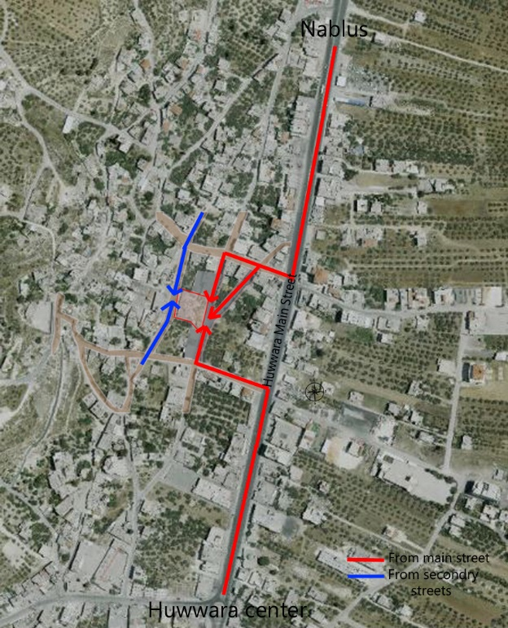
It’s bordered from the west by (Albaladeh) street, (Alaeen) street from east and building with open spaces(green areas) from north and south, and it is located in an area within the government, it is also free from sources of environmental pollution that is making it a health-friendly, and adequate ventilation.
The time needed to reach the site from Huwwara city center is nearly 5 minutes. The previous Figures and the next Figure explain how to access to the site.
Figure: How to access to the site

Slide 10
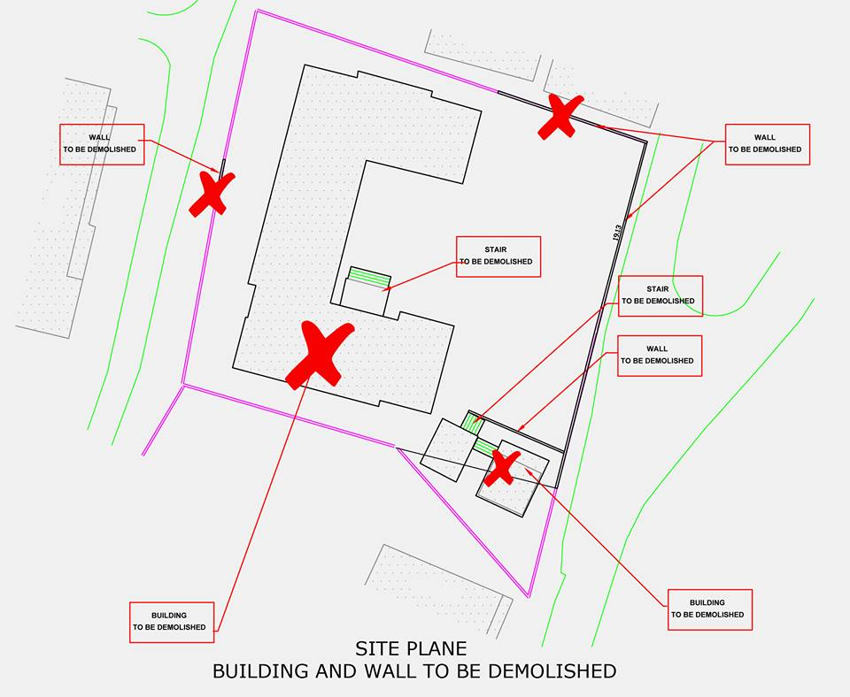

Slide 11
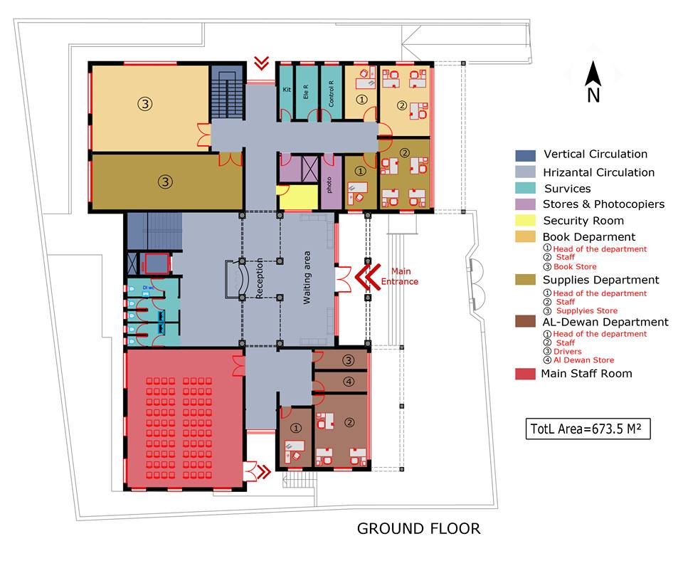
Plans

Slide 12
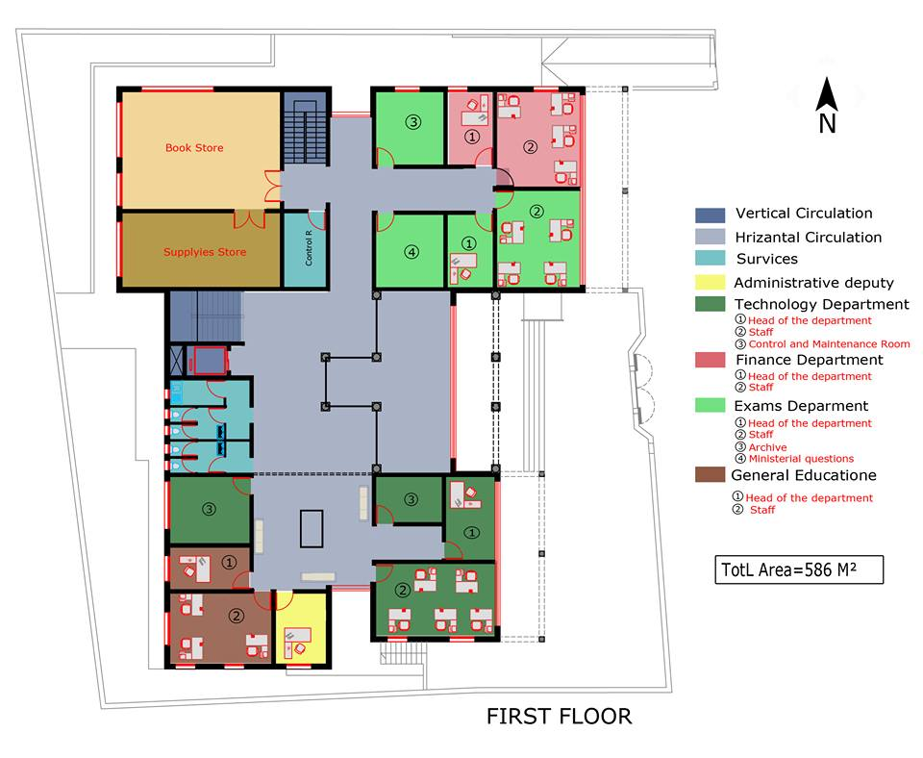

Slide 13
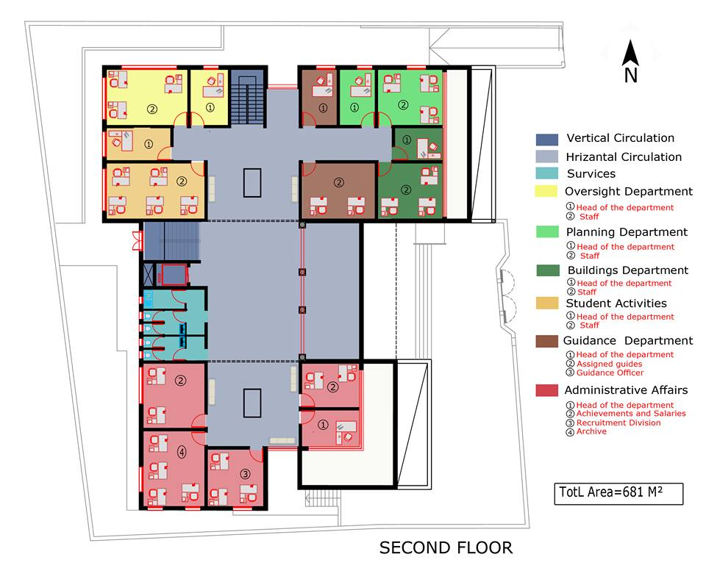

Slide 14
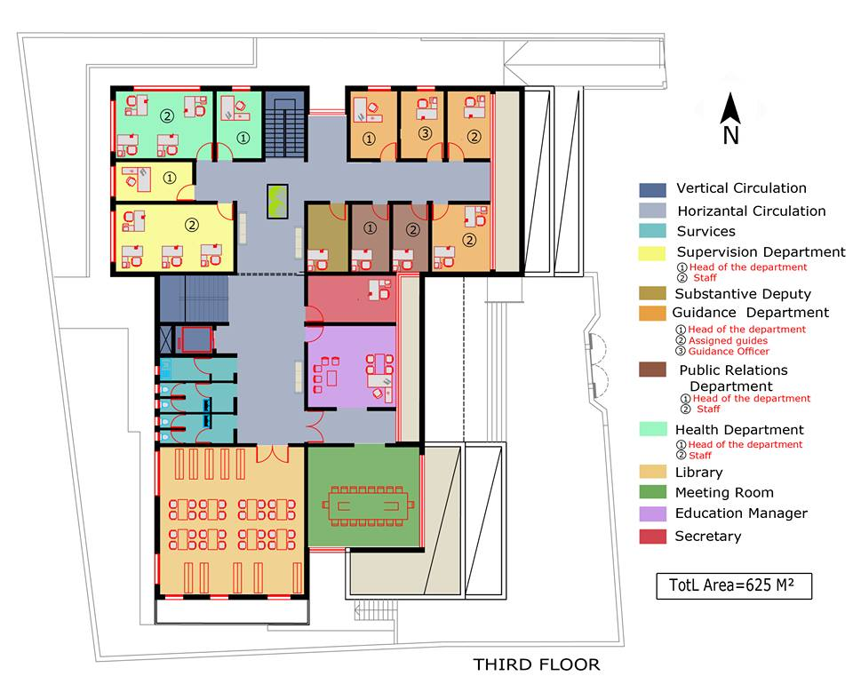

Slide 15
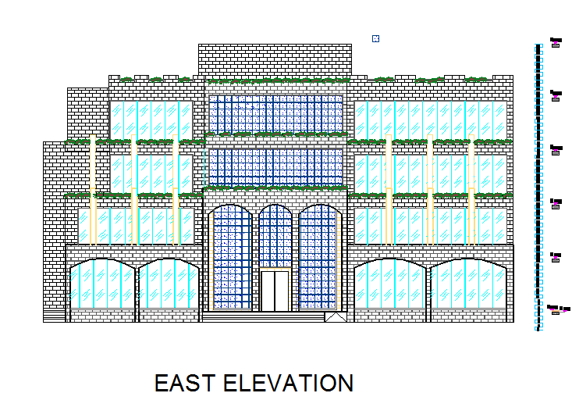
elevation

Slide 16
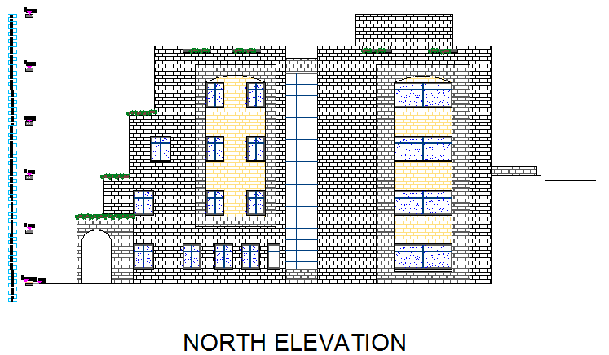

Slide 17
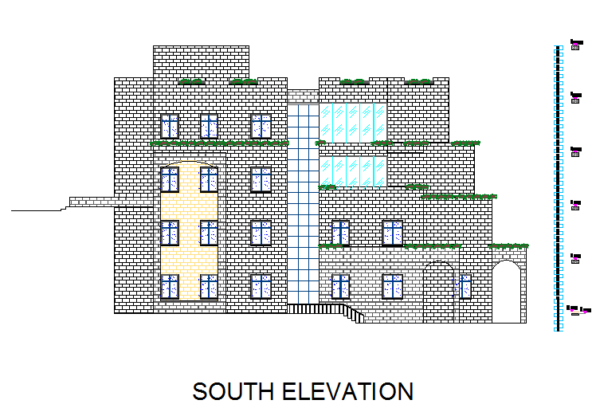

Slide 18
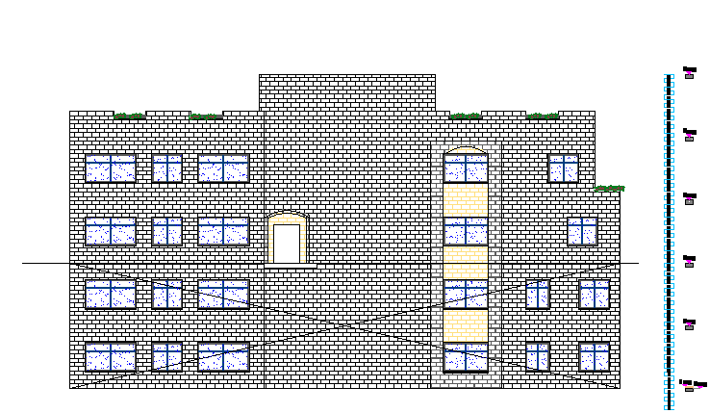
West elevation

Slide 19
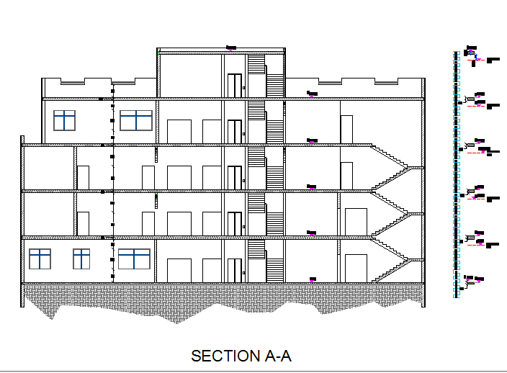
section

Slide 20
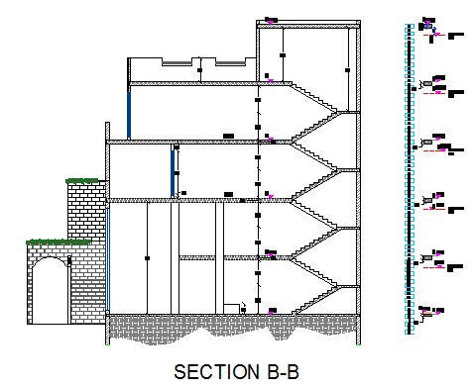

Slide 21
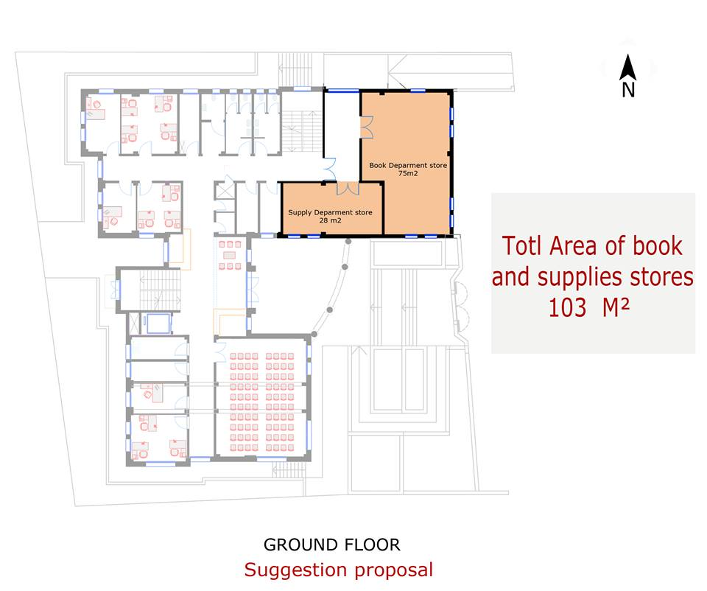
Problems and solution
The area of book and requirement stories not enough.

Slide 22
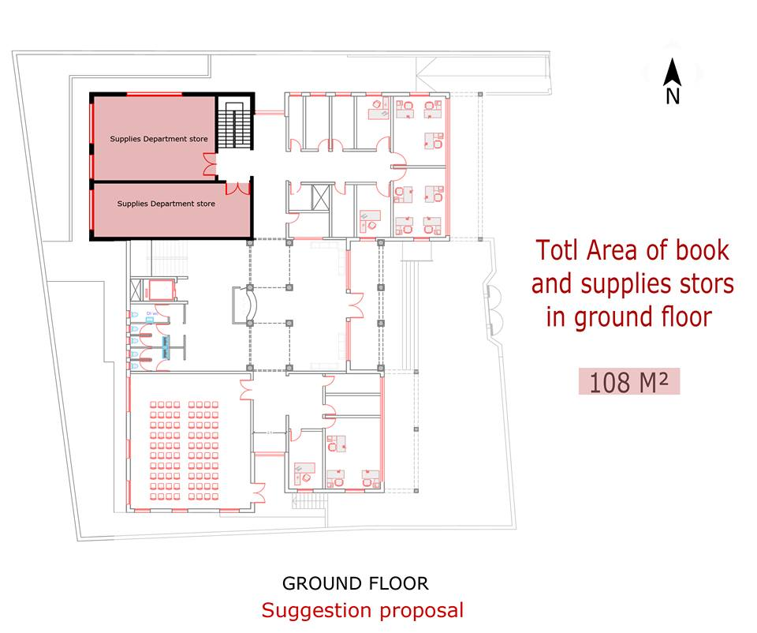

Slide 23
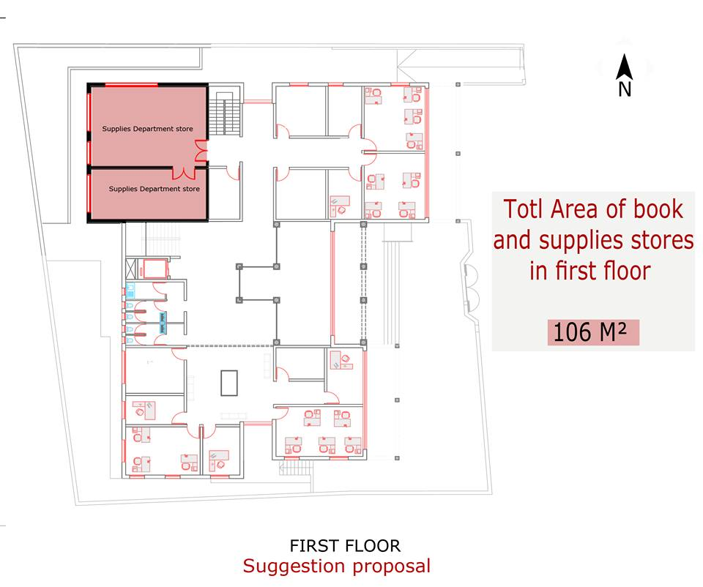
The total area for book & supplies stores in new plans is 214 m2

Slide 24
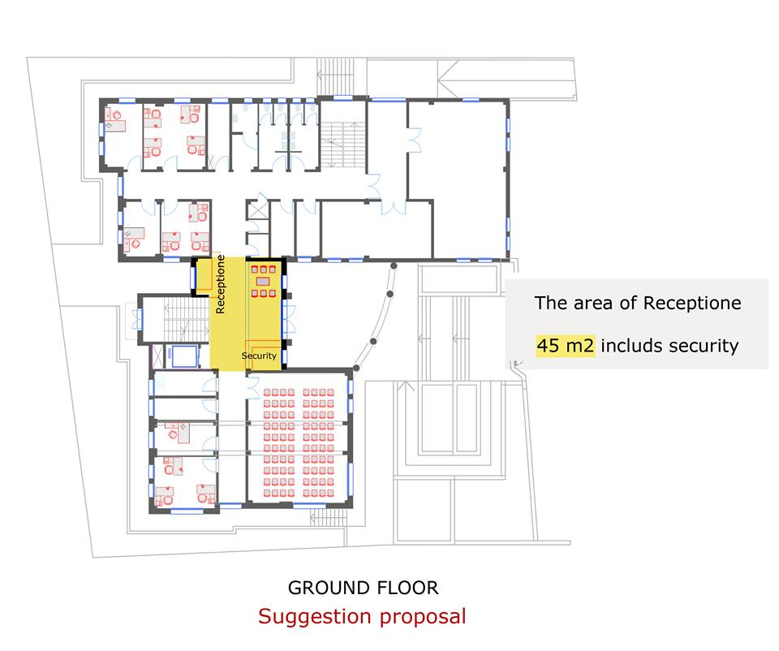
The reception area is very small

Slide 25
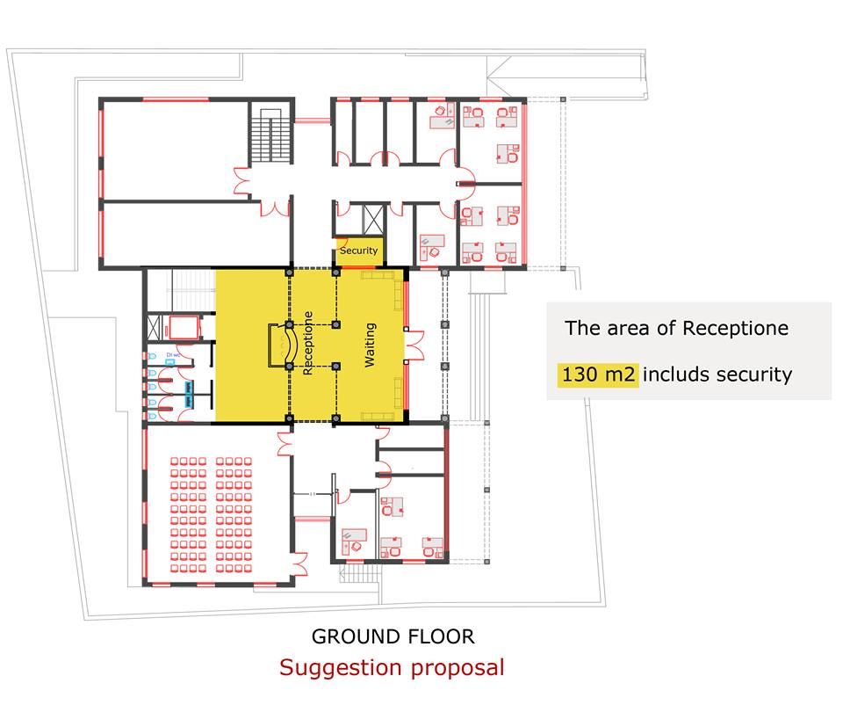

Slide 26
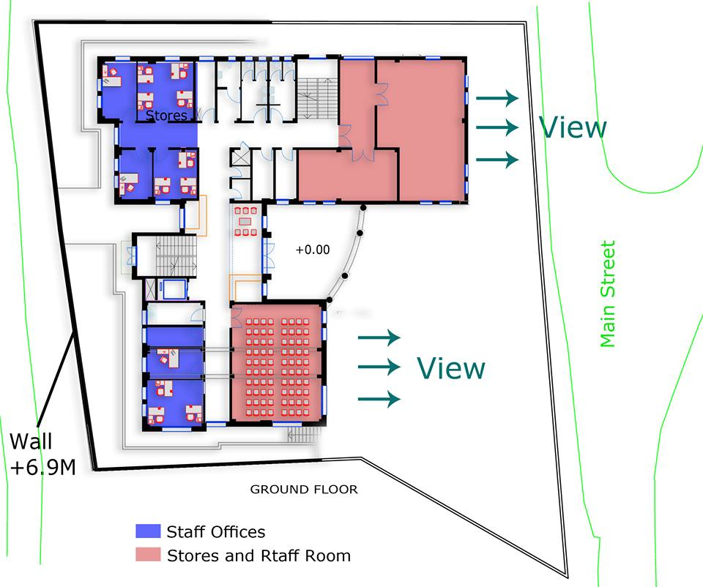
The location of the stores in the main façade and not taking into account the places of staff offices from the environmental side

Slide 27
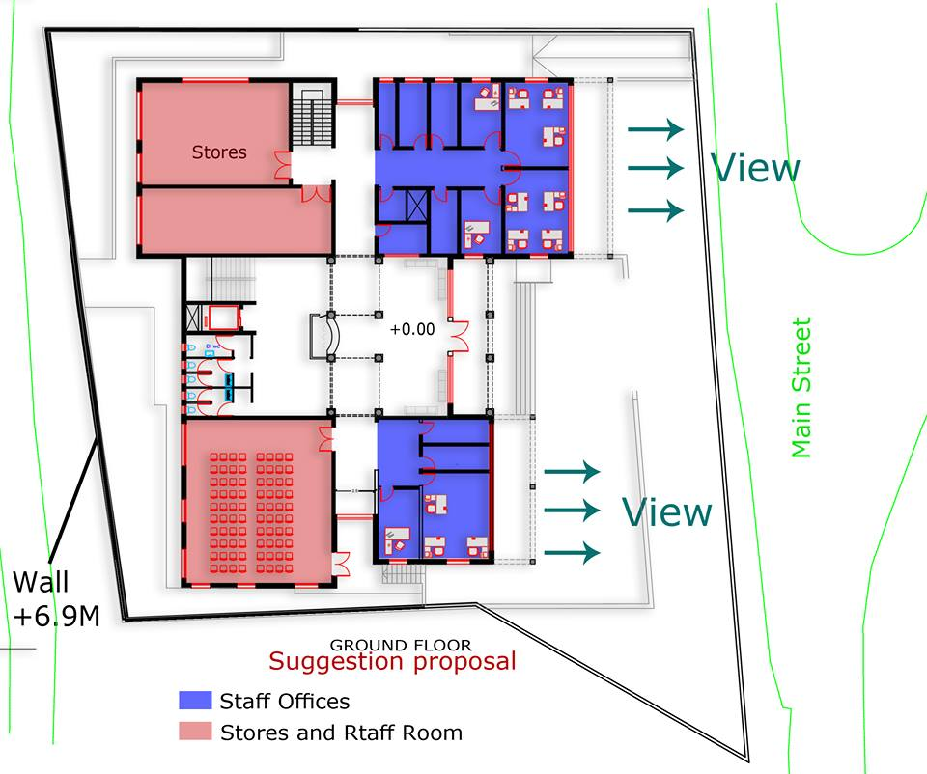

Slide 28
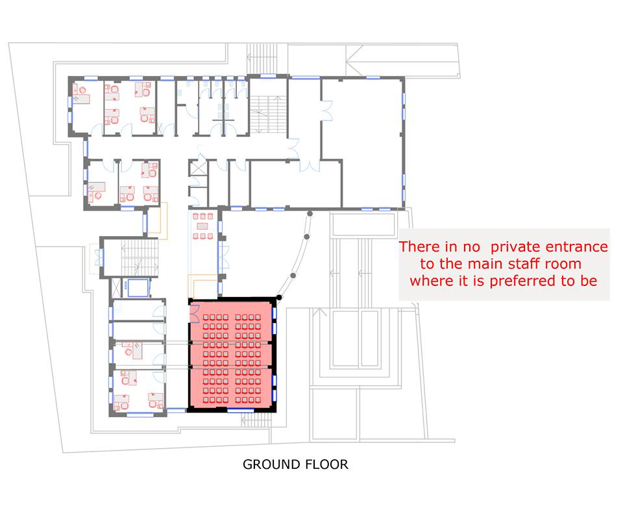
main staff room

Slide 29
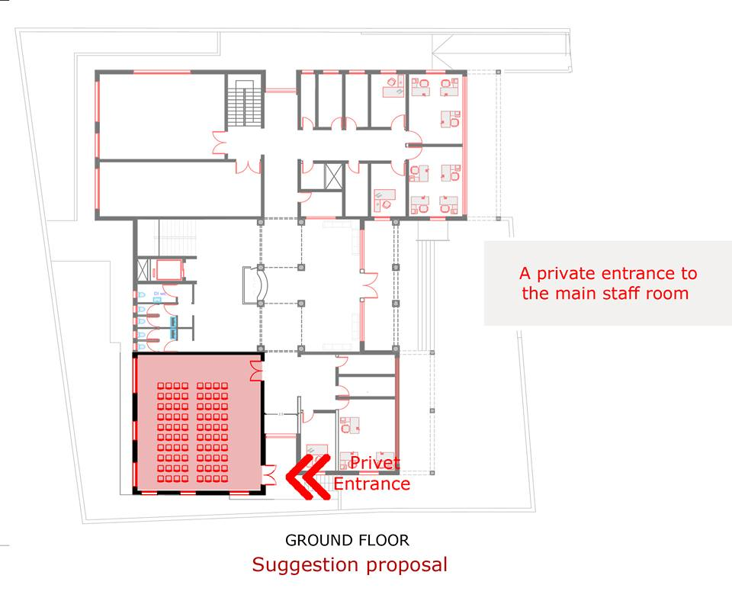

Slide 30
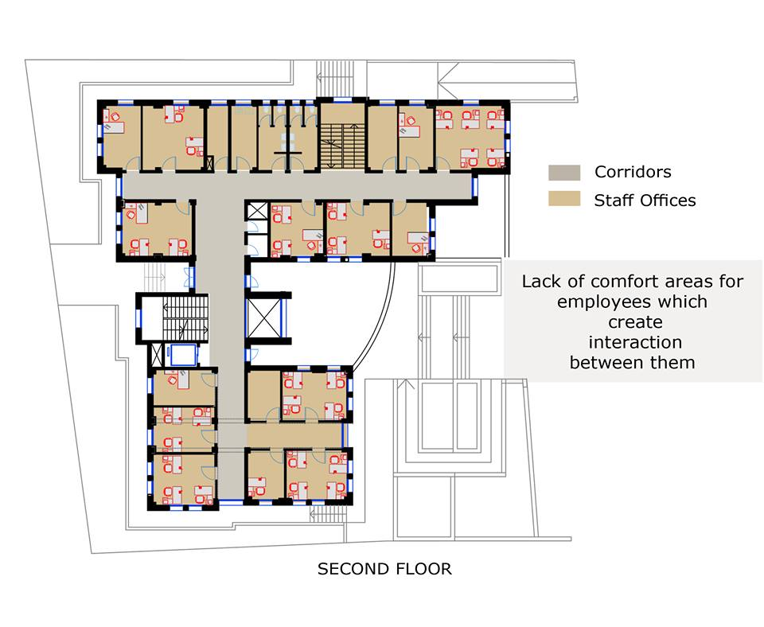
Rest area and privacy

Slide 31
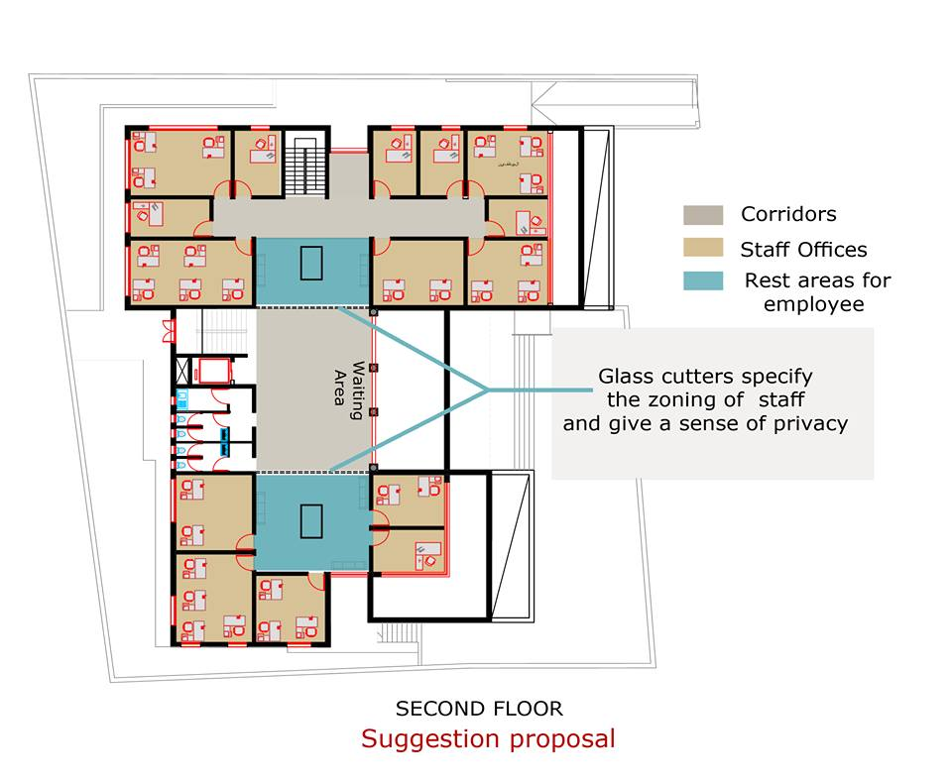

Slide 32
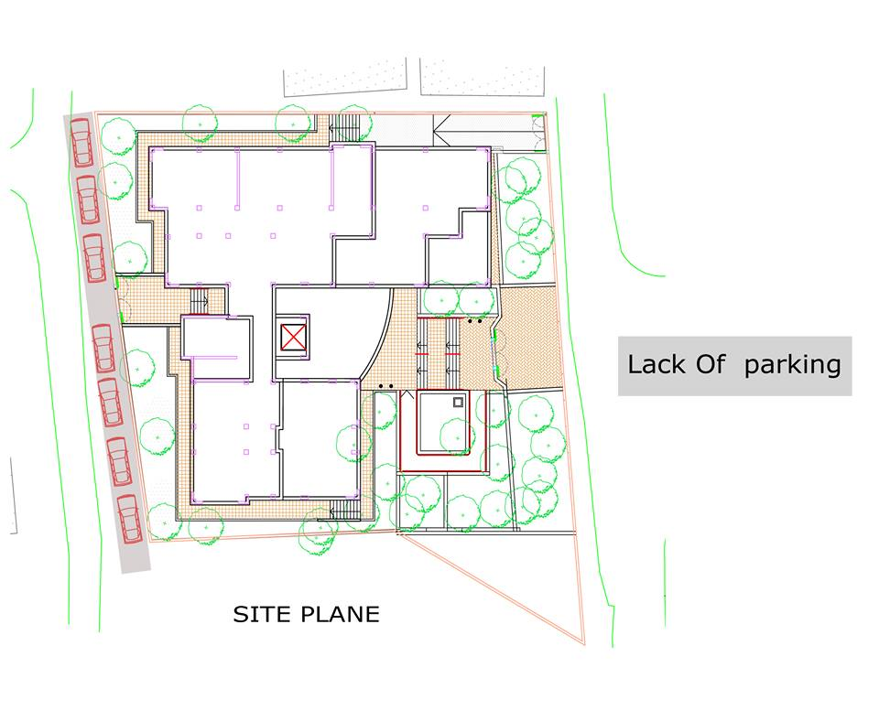
parking

Slide 33
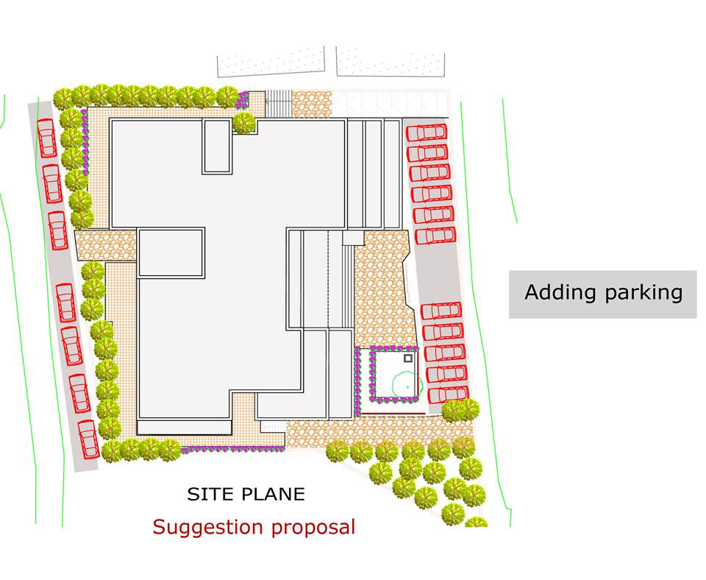

Slide 34
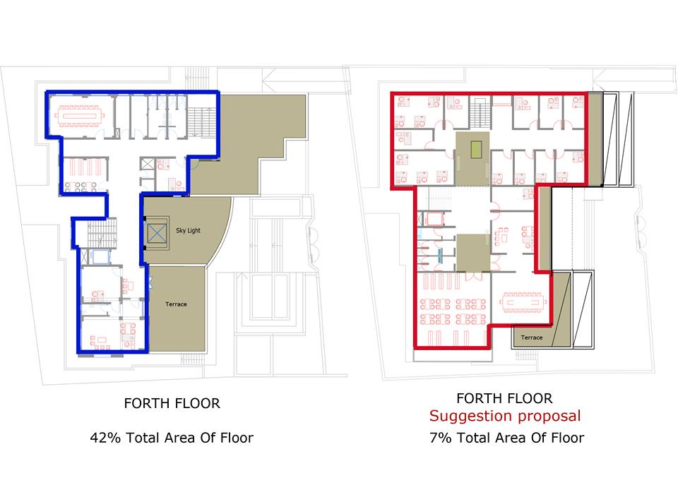
Un useless area

Slide 35
Structural Design
.

Slide 36
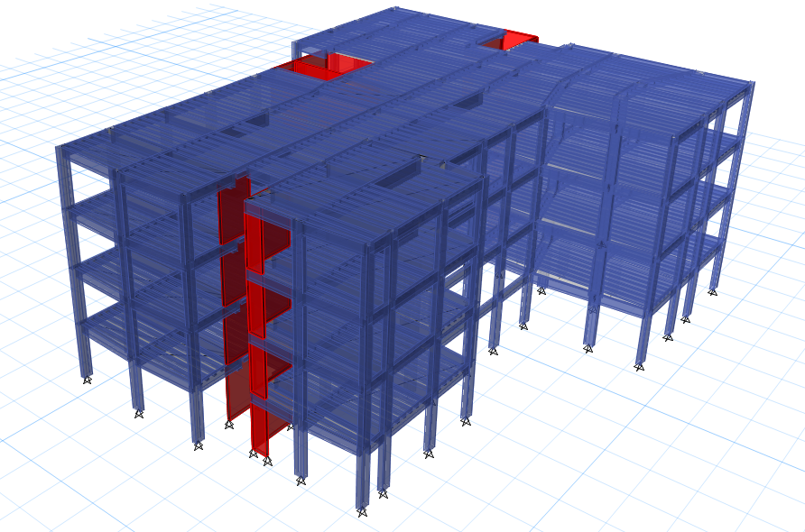
Modeling

Slide 37
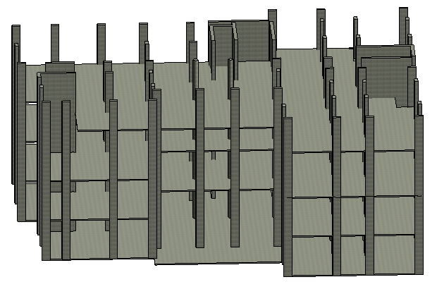
the Directorate of Education has 4 floor

Slide 38
Structural Design
Codes and Standards:
ACI -318-11 for reinforced concrete structural design.
UBC -97 for earthquake design.
ASCE 7 2010 for load combinations
For the design of the structure and its elements ETABS , SAP and hand calculations were used .

Slide 39
Structural Design
Design data:
Concrete strength, f’_{c}=28 MPa for column.
Concrete strength, f’_{c}=24 MPa for slab and beams .
Steel yield strength f_{y}=420 MPa.
Bearing capacity for soil = 220 kN/m²

Slide 40
Structural Design
Vertical Loads:
Load Type | spaces
Live Load (kN/m² ) | 5 kN / m²
SID ( kN /m² ) | 3.5 kN / m²

Slide 41
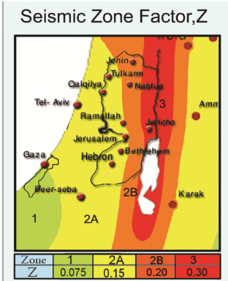
Structural Design
Seismic Design data :
The city of structure is Nablus.
The seismic zone factor. Z=0.2.
The soil profile is type SB.
The acceleration seismic coefficient Ca=0.2
The velocity seismic coefficient Cv=0.2.
The Seismic importance factor is 1.
The structural design type is intermediate, R=5.5

Slide 42
Sections Dimensions
Structural Element | Dimensions
Ribbed Slab | 25 cm thickness
Columns | (60X40) , ( 45 X 45 )
Beams | ( 70X25) , ( 50 X 25 ) , ( 35 X 70 )

Slide 43
Verification of the model
Compatibility check
Equilibrium check
Internal force check

Slide 44
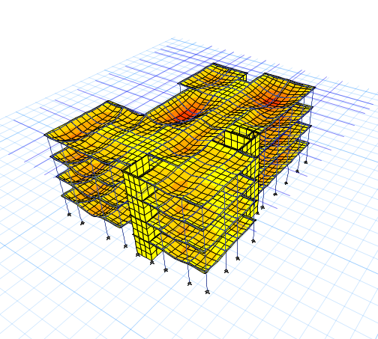
Verification of the model
Compatibility check

Slide 45
Verification of the model
Equilibrium Check
 | Live load ( kN) | SID (kN) | Dead load (kN)
Manual | 13390 | 16603.6 | 21628.76
By ETABS | 13119.7 | 16490.9 | 21192.2
% Error | 2.018671% | 0.678768% | 2.018424%

Slide 46
Verification of the model
Internal force check
 | Manual | By ETABS | %Error
Column | 3745 kN | 3769.7 kN | 0.6%
beam | 1115.2 kN.m | 1072.6 kN.m | 3.9%
Span of the slab | 110.4 kN.m | 102kN.m | 7.8%

Slide 47
Design checks
Period Check
0.49 < 0.56 sec
Drift Check
33mm < 36 mm
Deflection check
20mm < 40mm
Modal participating mass ratio check
0.93 > 0.90
Base shear check
3964kN > 3723kN
3818kN > 3723kN

Slide 48
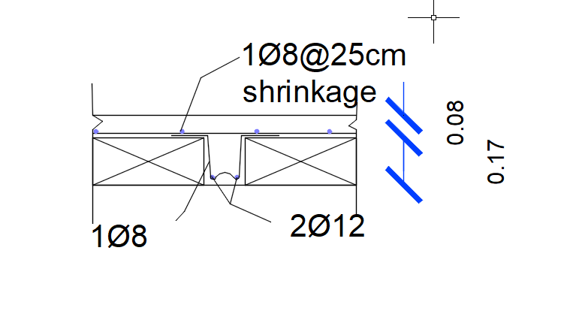
Slab Reinforcement

Slide 49
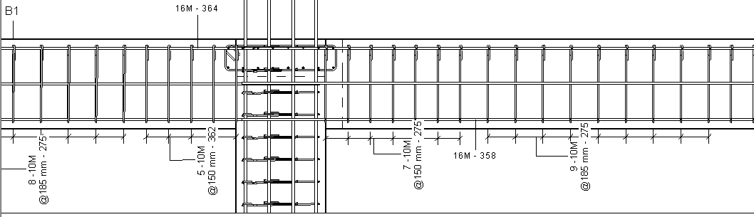
Beams Reinforcement

Slide 50
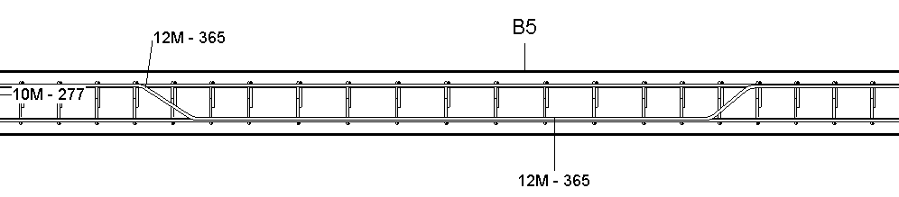

Slide 51
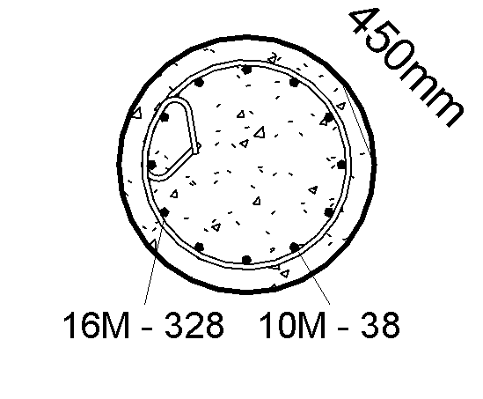
Columns Reinforcement

Slide 52
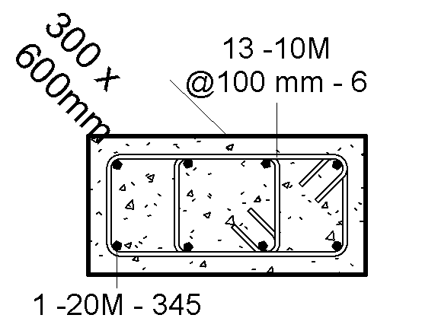

Slide 53
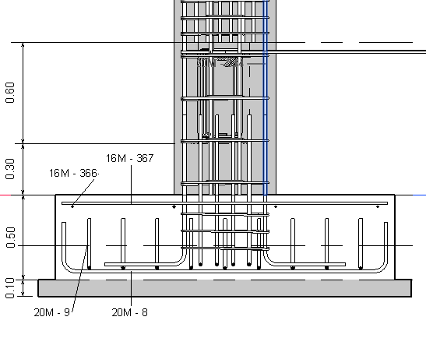
Footing Reinforcement

Slide 54
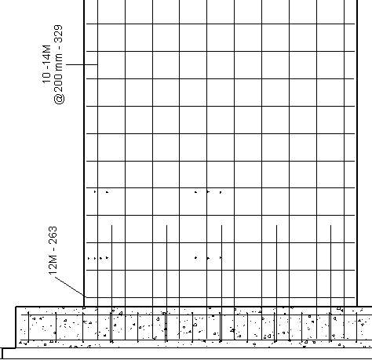
Shear Wall Reinforcement

Slide 55
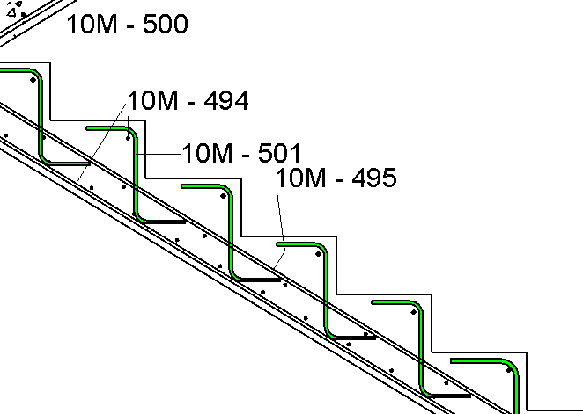
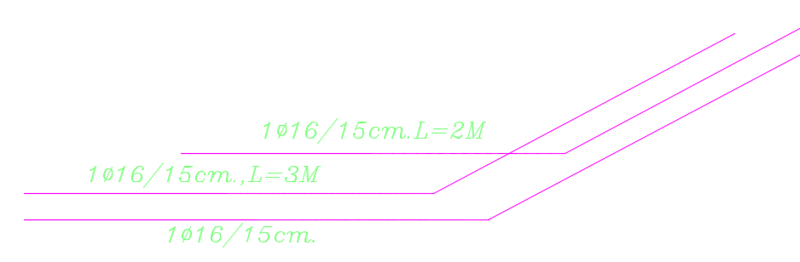
Stair Reinforcement

Slide 56
Environmental Aspects

Slide 57
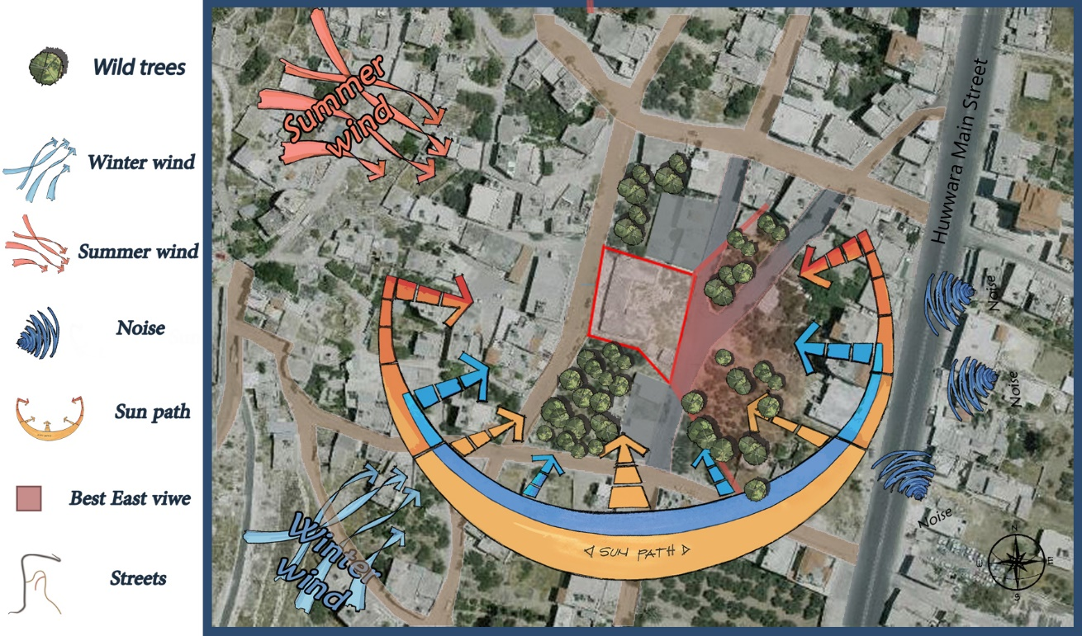
Environmental Aspects
Environment & Orientation

Slide 58
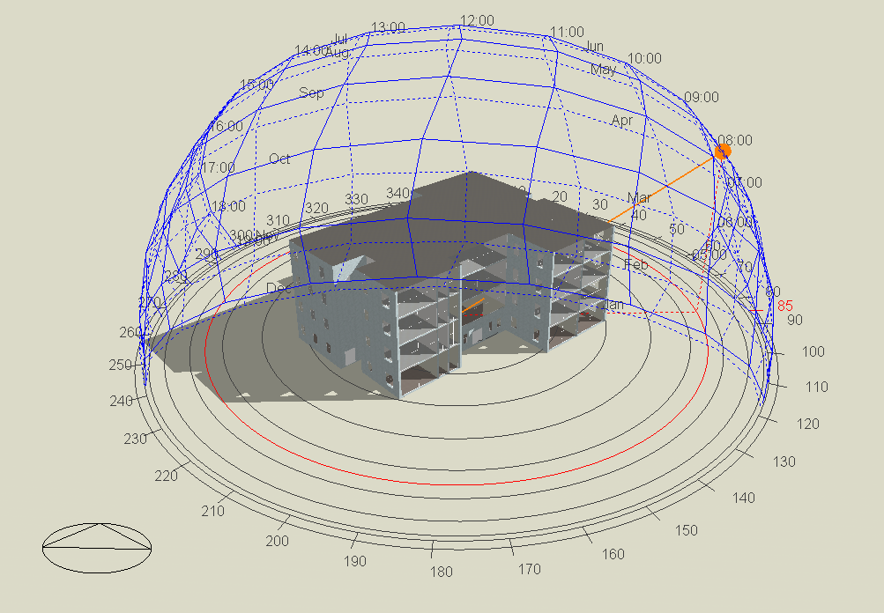
Shading at 8:00 in 15th Jul .

Slide 59
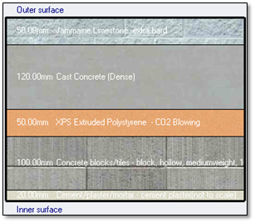
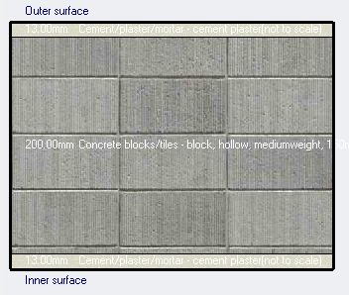


Thermal
Exterior Wall
Interior Wall
U-Value = 0.52 W/$m^{2}$.K
U-Value = 1.6 W/$m^{2}$.K

Slide 60
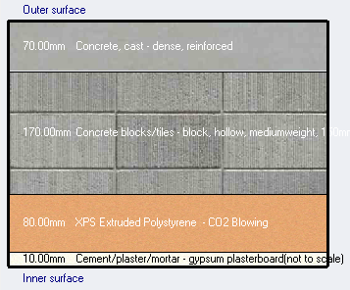


Thermal
Roof
Glazing
Double grey 3mm/13mm argon LOE (low emittance glass).
U-Value = 1.49 W/$m^{2}$.K
U-Value = 0.368 W/$m^{2}$.K

Slide 61
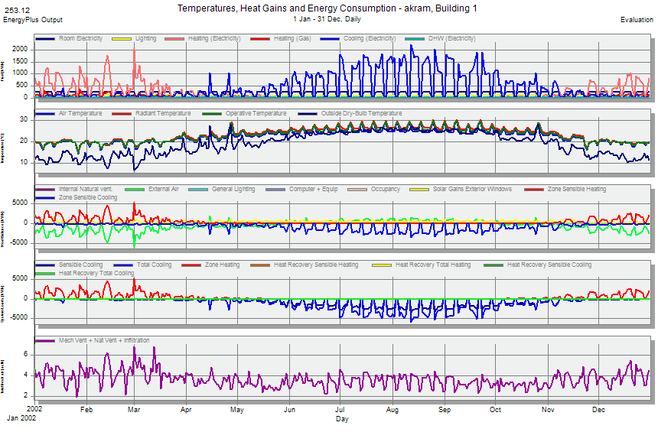
Comfort Analysis

Slide 62
Energy capacity in the building
 | Total Energy [kWh] | Energy Per Total Building Area [kWh/m2] | Energy Per Conditioned Building Area [kWh/m2]
Total Site Energy | 406208.48 | 267.76 | 273.40
Net Site Energy | 406208.48 | 267.76 | 273.40
Total Source Energy | 1004393.79 | 554.35 | 566.03
Net Source Energy | 1004393.79 | 554.35 | 566.03

Slide 63
Heating & Cooling
 | District Cooling [kWh] | District Heating [kWh]
Heating | 0 | 188169.69
Cooling | 396693.13 | 0
Interior Lighting | 0 | 0
Exterior Lighting | 0 | 0
Interior Equipment | 0 | 0
Exterior Equipment | 0 | 0
Fans | 0 | 0
Pumps | 0 | 0
Heat Rejection | 0 | 0
Humidification | 0 | 0
Heat Recovery | 0 | 0
Water Systems | 0 | 3506.23
Refrigeration | 0 | 0
Generators | 0 | 0
Total End Uses | 396693.13 | 191675.92

Slide 64
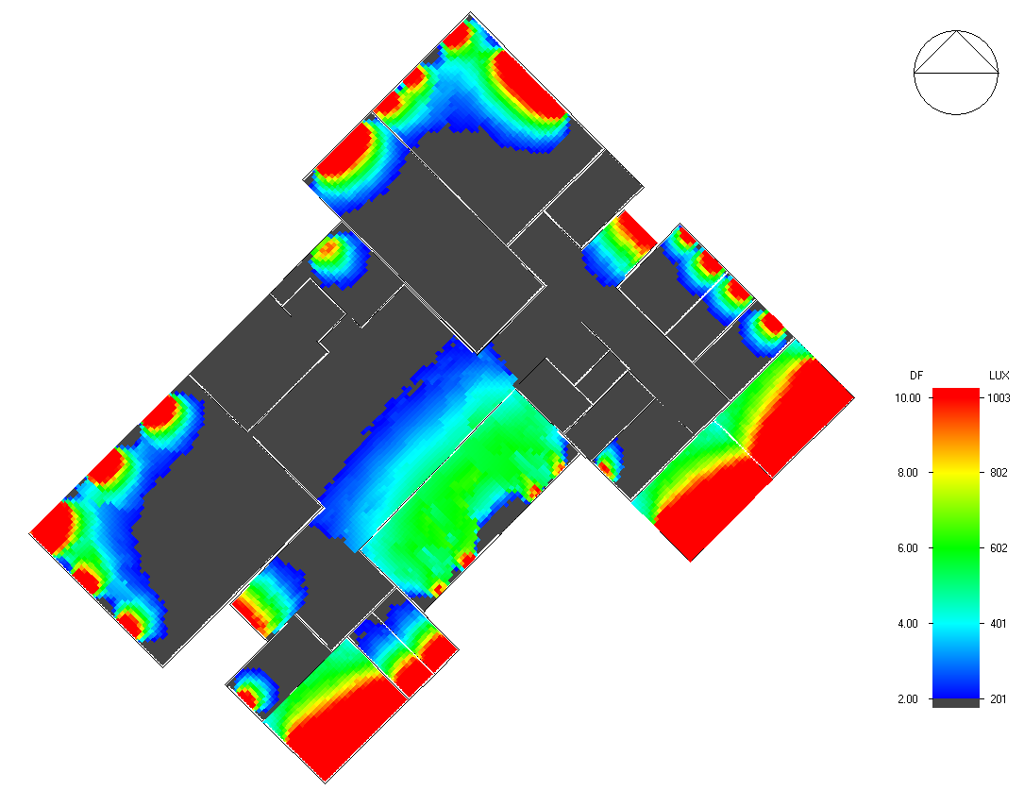
Daylight

Slide 65
Electrical Aspects

Slide 66
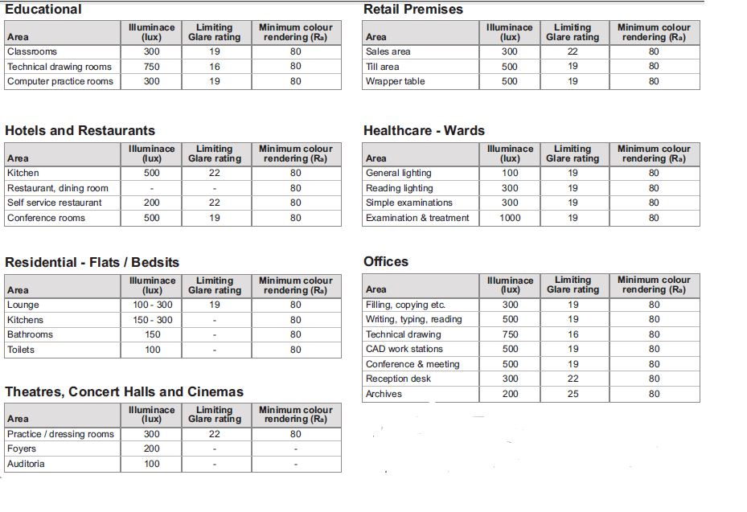
lighting aspect
The table below shows the recommended lux for different spaces:
The CIBSE (Charted red Institute of Building Engineers)

Slide 67

Two simulated spaces in the ground floor.

Slide 68


Luminaire selection :

Slide 69


Plans
Meeting hall plan.
office plan.

Slide 70


simulation Results for the office

Slide 71


simulation Results for the Meeting hall

Slide 72




Glare check

Slide 73


Slide 74


Slide 75

Power and sockets distribution

Slide 76

Distribution board for ground floor

Slide 77
MECHANICAL ASPECTS

Slide 78
Mechanical design
H-VAC System
Firefighting system
Water Supply System
Drainage System

Slide 79


HVAC System.
VRF system selection units:
Spilt and cassette indoor units
Outdoor units

Slide 80
Cooling load calculation
Floor | Load as designed(KW)
G.F | 95.21
1st floor | 98.61
2nd floor | 100.74
3rd floor | 102.2

Slide 81
The required pipe diameter and length for the ground floor.

Slide 82

HVAC system
Variable Refrigerant Flow (VRF) system

Slide 83

Return and mechanical ventilation.

Slide 84

Safety & Fire Fighting system

Slide 85

Water supply design

Slide 86

Drainage roof design

Slide 87
Elevators
Car capacity is 1250kg and its speed 2m/s
RT = 90 sec.
One car
I =RT/N =90/1 =90 sec

Slide 88

Acoustics Design
The STC for partition must =45 dB or more.

Slide 89

The value of STC for external wall with window

Slide 90

The IIC for ceiling

Slide 91
Reverberation time
Note : RT60 range for offices is (0.6 – 1.2)
STATISTICAL ACOUSTICS - Zone 1
 | TOTAL | SABINE | NOR-ER | MIL-SE
FREQ. | ABSPT. | RT(60) | RT(60) | RT(60)
------- | ------- | ------- | ------- | -------
63Hz: | 17.341 | 0.54 | 0.39 | 0.47
125Hz: | 13.708 | 0.67 | 0.47 | 0.6
250Hz: | 6.231 | 1.21 | 0.71 | 1.16
500Hz: | 3.641 | 1.5 | 1.02 | 1.47
1kHz: | 3.164 | 0.7 | 0.61 | 0.7
2kHz: | 4.276 | 0.42 | 0.4 | 0.42
4kHz: | 6.442 | 0.3 | 0.3 | 0.3
8kHz: | 6.004 | 0.13 | 0.13 | 0.13
16kHz: | 6.947 | 0.14 | 0.14 | 0.14

Slide 92
Quantities and Survey
stage | Price
Architectural work | 1469275 NIS
structure work | 1743950 NIS
mechanical work | 484800 NIS
electrical work | 320600 NIS
total cost | 4018625 NIS
cost per m2 | 1497.81 NIS

Slide 93


