Slide 1
Energy efficiency for Jawwal’s TBSs by using Photovoltaic system
By :
Hamsa Khaled
Leemara sawafta
Supervisor :
Dr.Tamer Khatib

Slide 2
Introduction
The correct power supply for telecommunications base stations (TBS), is a handicap for operators to expand their clientele.
The growing of energy consumption of Jawwal's TBS has required an energy saving and another efficient method to be used.

Slide 3
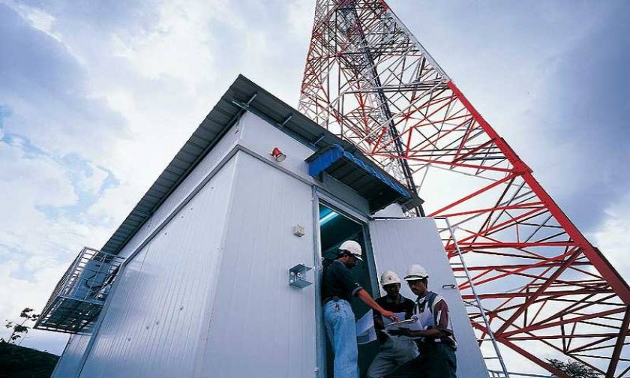

Slide 5
Field investigation:
Climate conditions in Palestine:
latitude 31⁰ 57ʹN and longitude 35⁰13ʹE .
Palestine has a Mediterranean climate.
The relative humidity is about (51% - 83%).

Slide 6
Field investigation:
Jawwal’s TBS Specifications:
Shelter dimensions is 2.2m (W) x 2.2m (L) x 2.2m (H) where cabin constructed from PU panels with plywood sandwiched in between and fully insulated.
Based on the collected data, the load of the shelters varies between 135W (Minimum) to 2.000W (Maximum).

Slide 7
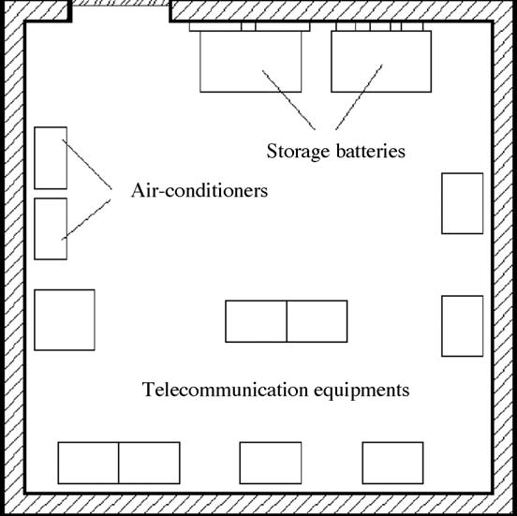

Slide 8
Methods :
Free cooling:
Free cooling is a good opportunity for energy saving in air conditioning systems.
sensors are used for monitoring outside and inside air conditions and temperatures.

Slide 9
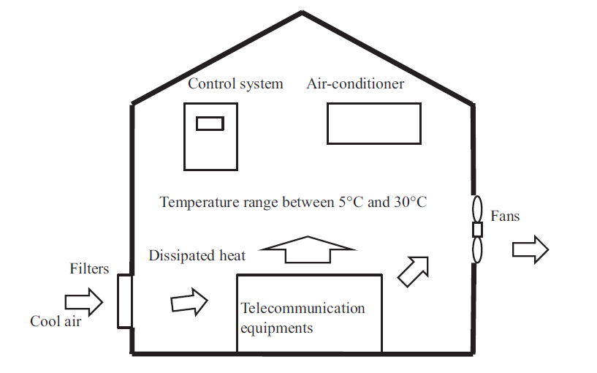

Slide 10

Free Cooling Capacity:
Δt = t internal - t ambient
Q (watt) = $\dot{m}$ cp Δt
$\dot{m}= \frac{Q (watt)}{cp Δt }$

Slide 11
Considerations When Selecting Free Cooling:
Shelter design and location.
The installation location of the fans and openings.
humidity disturbance.
unwanted particulates, and gaseous contaminants.

Slide 12
Control strategy:

Slide 13
Results and discussion:

Slide 14
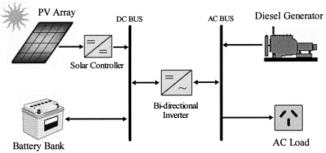
Hybrid PV-Diesel system:

Slide 15
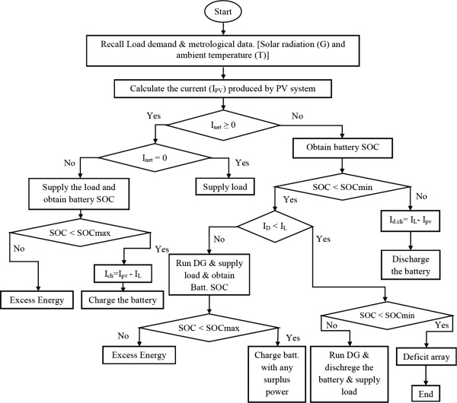
System operational control:
Cycle charging strategy:

Slide 16
Hybrid PV-Diesel system design methodology:
PV Sizing:
PV module specification
Type | JKM340PP-72-V Polycrystalline
Maximum power (P max) | 340 Wp
Maximum voltage (V max) | 38.2 V
Maximum current (I max) | 8.91 A
Short circuit current (I s.c) | 9.22 A
Open circuit voltage (V o.c) | 47.5 V
Efficiency | 17.52%
Number of cells | 72 (6*12)
Dimensions (L*W*H) | 1956×992×40mm
.

Slide 17
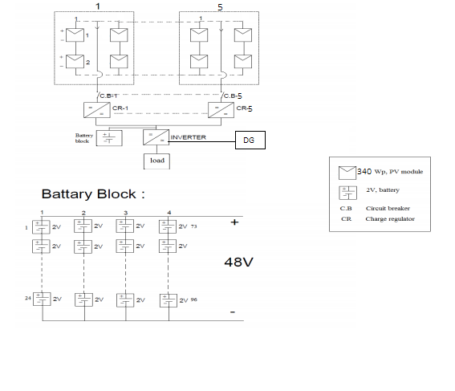
Electrical diagram for the system.

Slide 18
Economic analysis of powering telecommunication base station using Hybrid Photovoltaic system
Table 9: PV system economic analysis.
 | Quantity | Unit Price USD | Life Time | Price USD
PV Module(340W_{p}) | 40*340= 13600 | .35$/W_{p} | 20 | 4760
Batteries (1670 Ah/2V) | 48 | 630.65 | 10 | 30271.2
DG | 5KW | 1428.57 | 10 | 1428.57
Charge Controller 4KW | 5 | 832.8 | 20 | 4164
Inverter 5KW | 1 | 4948.8 | 20 | 4948.8
Total |  |  |  | 45572.57
Operating and maintenance | =3%*capital cost |  |  | 1367.17
Salvage value | = 3.5%*capital cost |  |  | 1595.04
 | Quantity | Unit Price USD | Life Time | Price USD
PV Module(340W_{p}) | 40*340= 13600 | .35$/W_{p} | 20 | 4760
Batteries (1670 Ah/2V) | 48 | 630.65 | 10 | 30271.2
DG | 5KW | 1428.57 | 10 | 1428.57
Charge Controller 4KW | 5 | 832.8 | 20 | 4164
Inverter 5KW | 1 | 4948.8 | 20 | 4948.8
Total |  |  |  | 45572.57
Operating and maintenance | =3%*capital cost |  |  | 1367.17
Salvage value | = 3.5%*capital cost |  |  | 1595.04

Slide 19
Cash Flow for TBS:

Slide 20
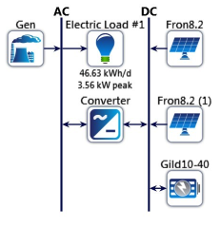
Results and discussion for homer:
one line diagram for PV/diesel/Battery:

Slide 21
Conclusion:
Expansion of the number of telecommunication networks brings a great challenge to energy saving. Free cooling of data centers is a technology that utilizes natural cold source, making it possible to not only save the energy consumption of data centers but also achieve the purpose of cooling in a renewable and sustainable way.

