Slide 1
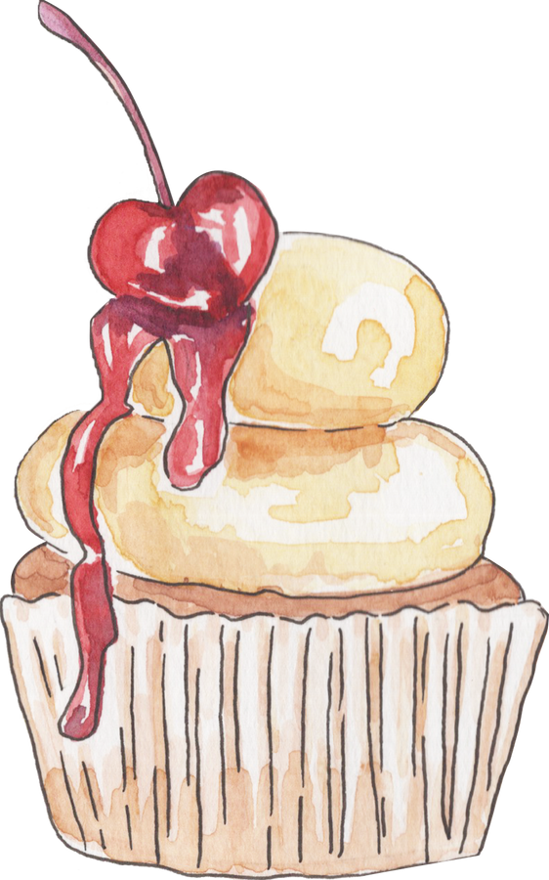

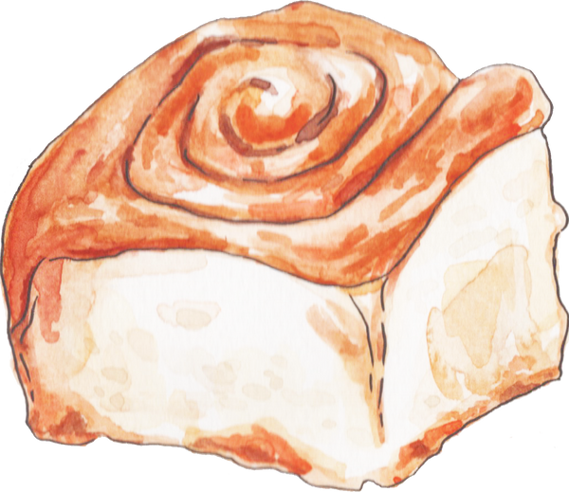

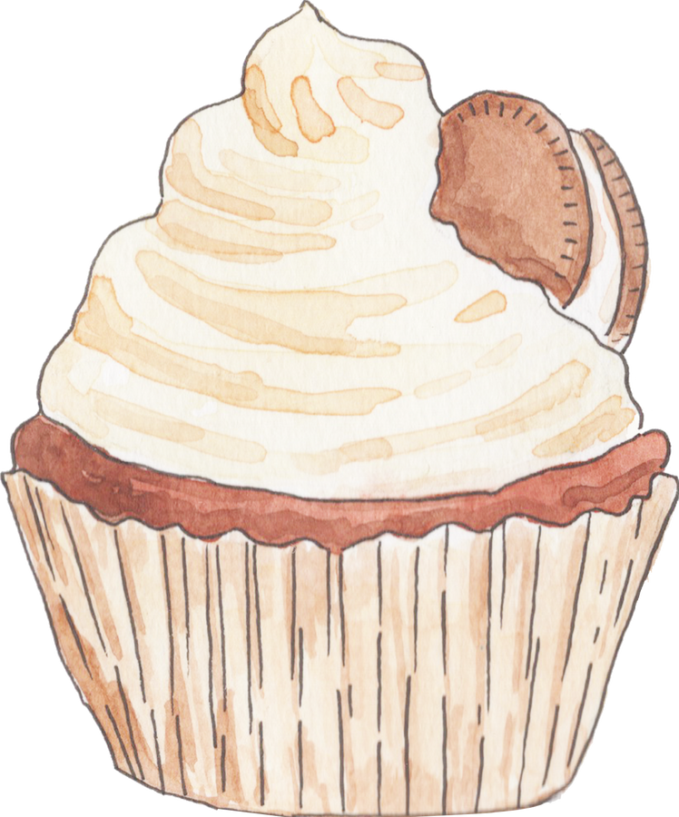
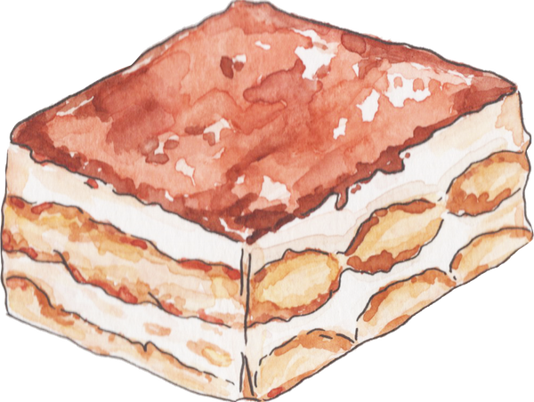

SweetCup Zone

Slide 2

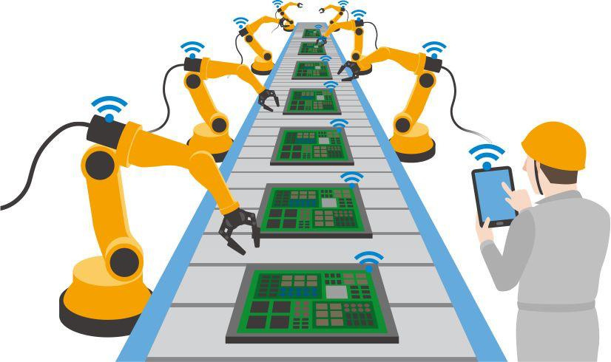


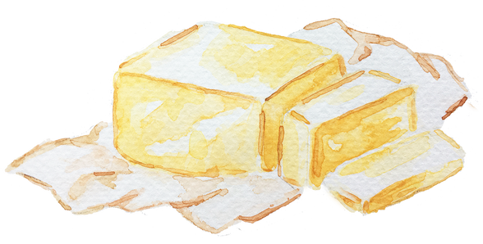
The Motivation
Automated food
High demand
Fresh and customized

Slide 3

The problem
  Premade options
  Limited Variety
  High cost and waiting time for customization

Slide 4
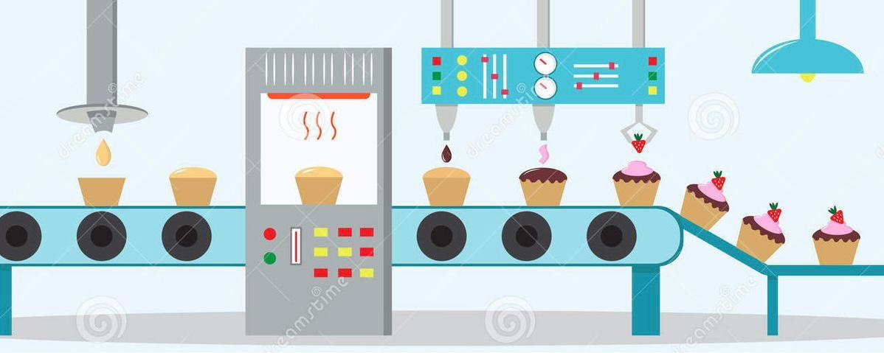
The Solution
Automated , customized cheesecake cup machine

Slide 5
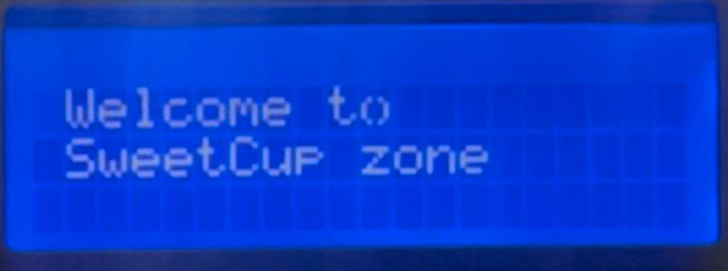
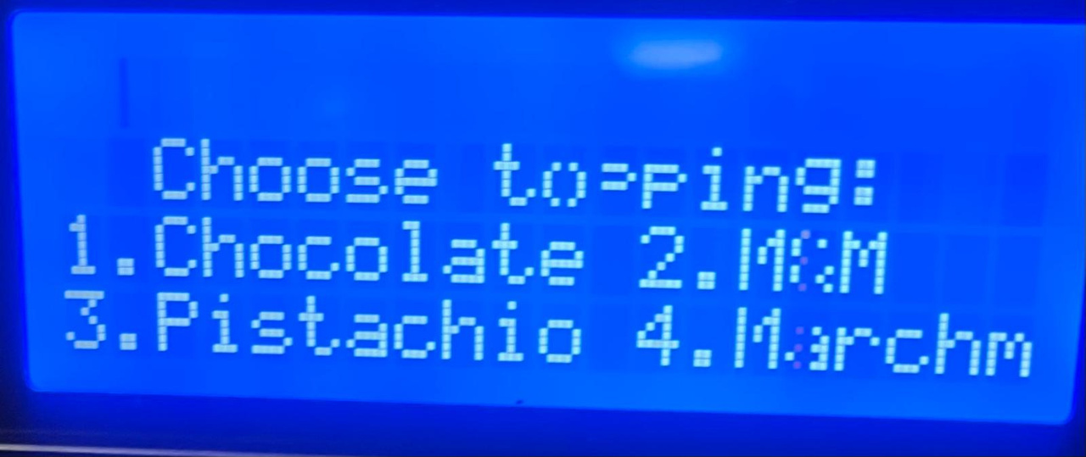
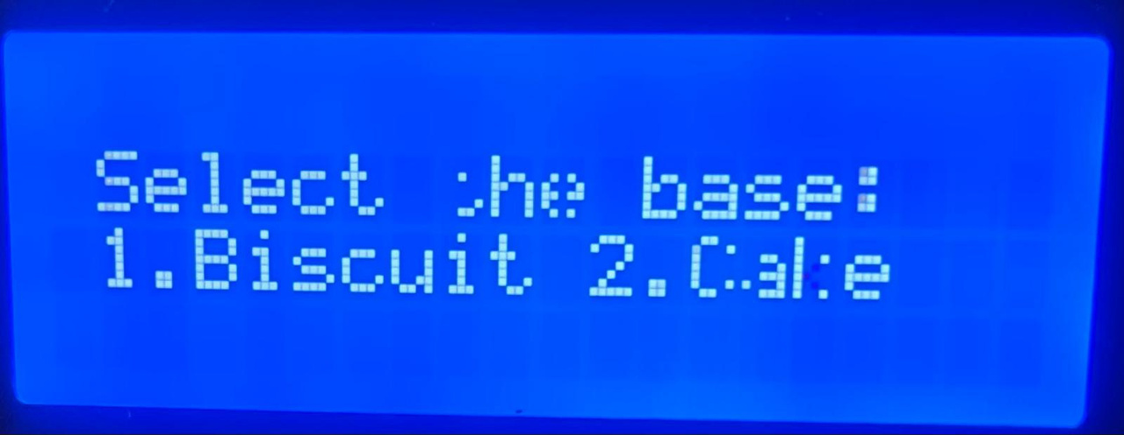
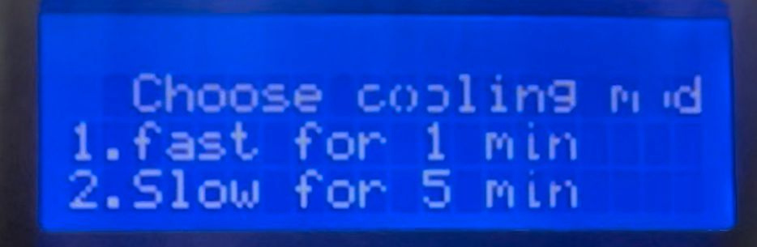
Stages
input / output unit

Slide 6
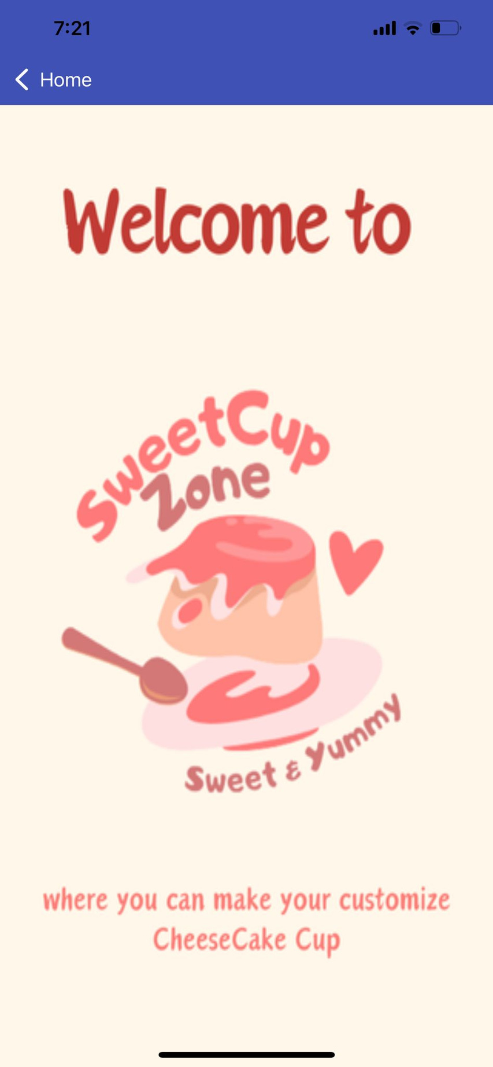
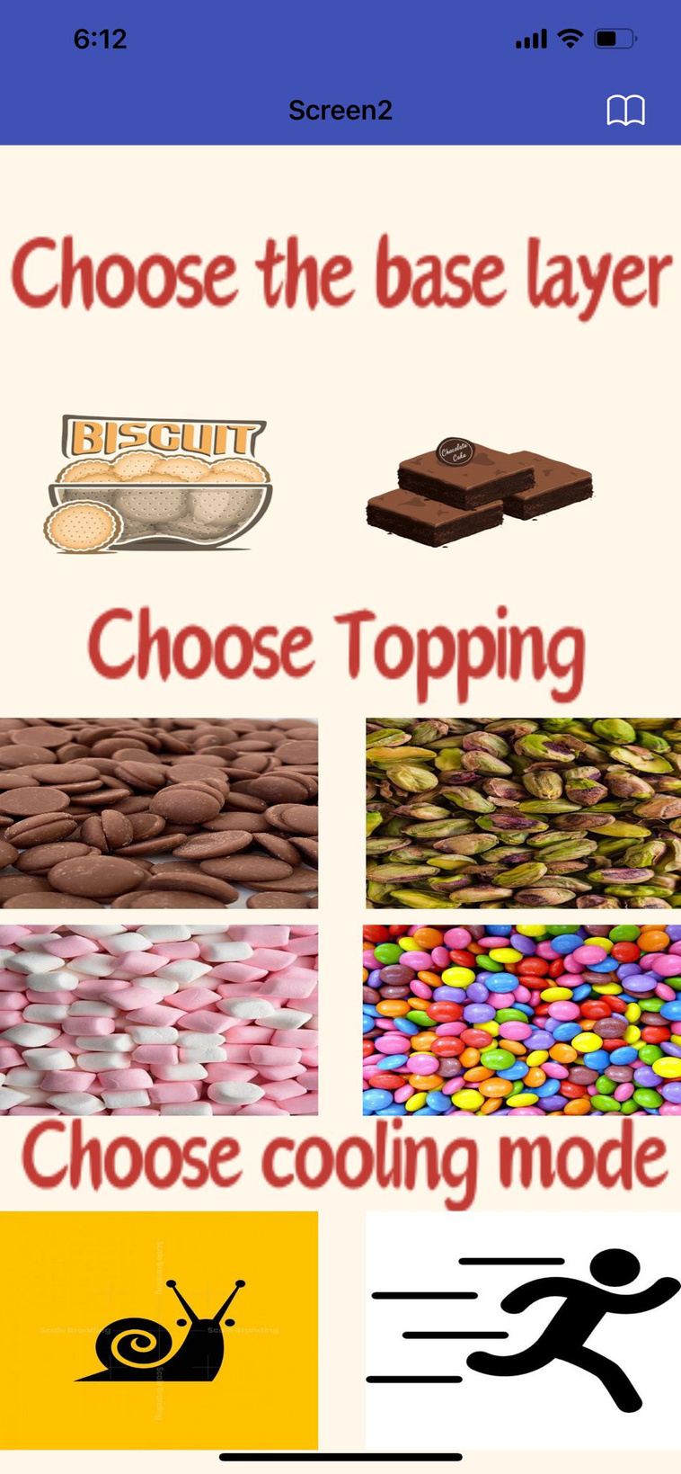
Application

Slide 7

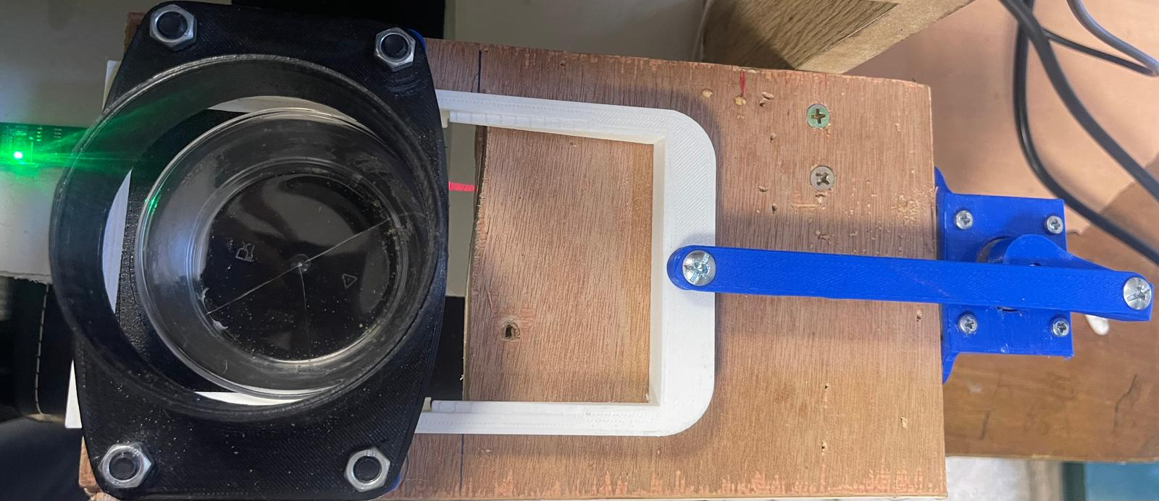
Stages
  Cup dispensing
After entering all inputs cup will dispense
and when LDR detected it the system will start

Slide 8
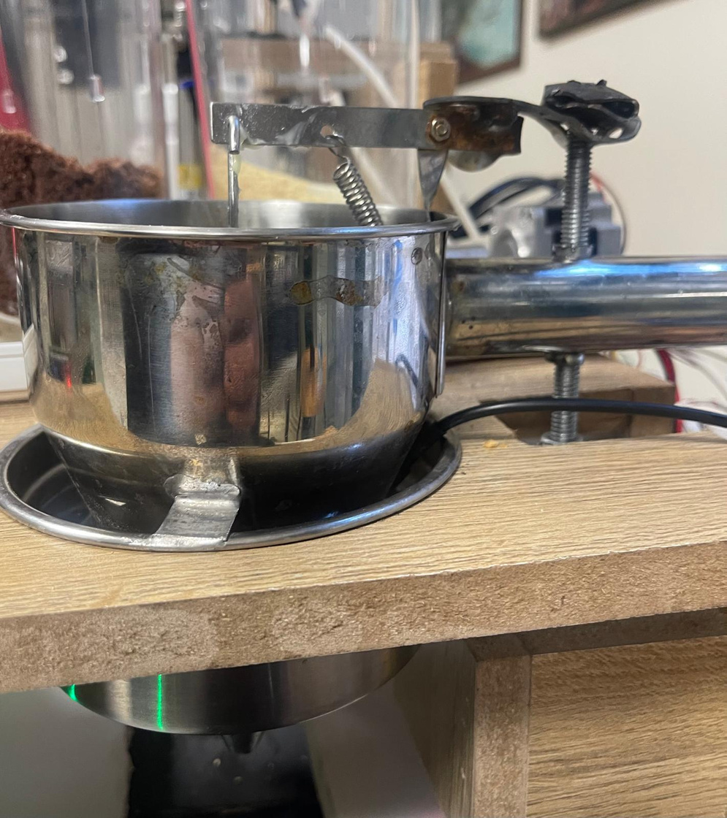
Stages
2.Butter stage
Heating butter in water path
Heater will open for 4 minutes
Then butter will stay in the hot water for other 2 minutes
Then the dispenser will open

Slide 9
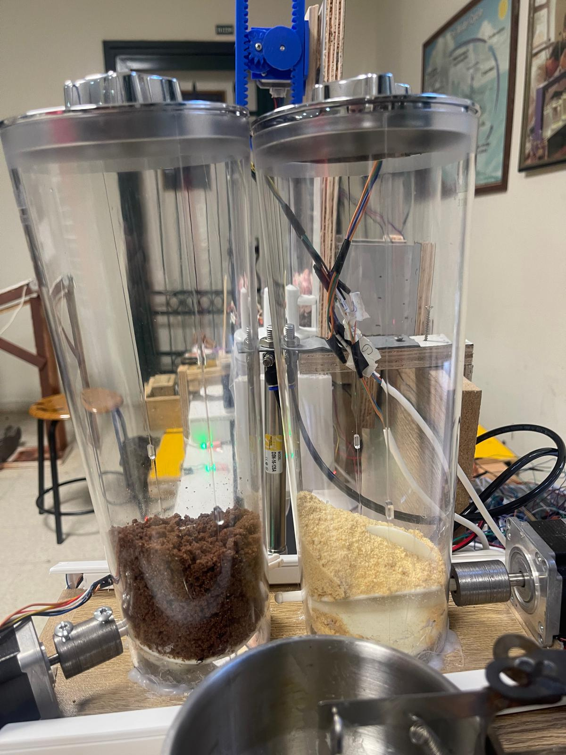
Stages
3.Base layer stage
Pour biscuit or cake according user choice

Slide 10
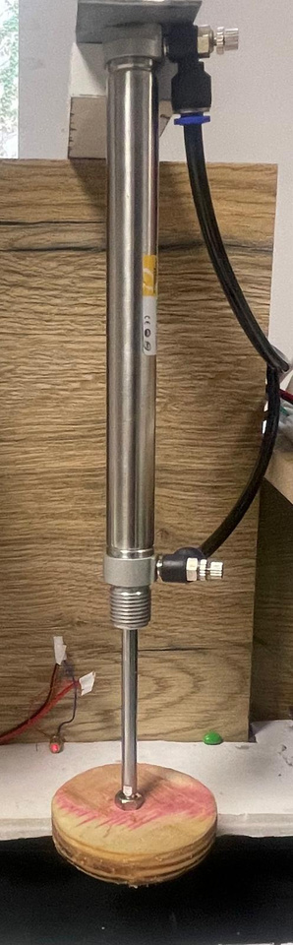
Stages
4.Piston stage
Pneumatic Piston will mixed butter and biscuit, and make them one layer

Slide 11
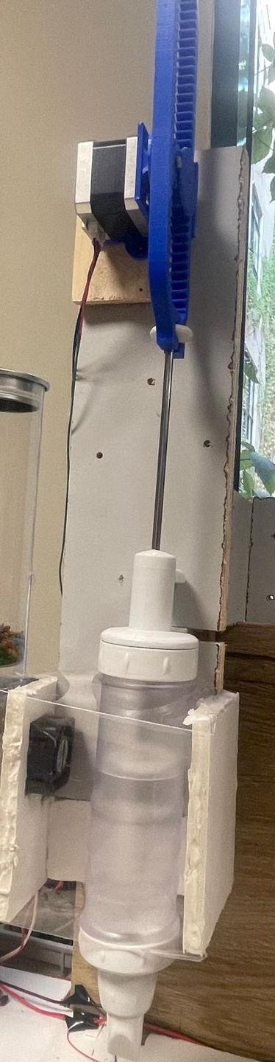
Stages
5.Whipped cream stage
Pour amount of whipped cream
simple cooling system around to keep its cold tempreture

Slide 12
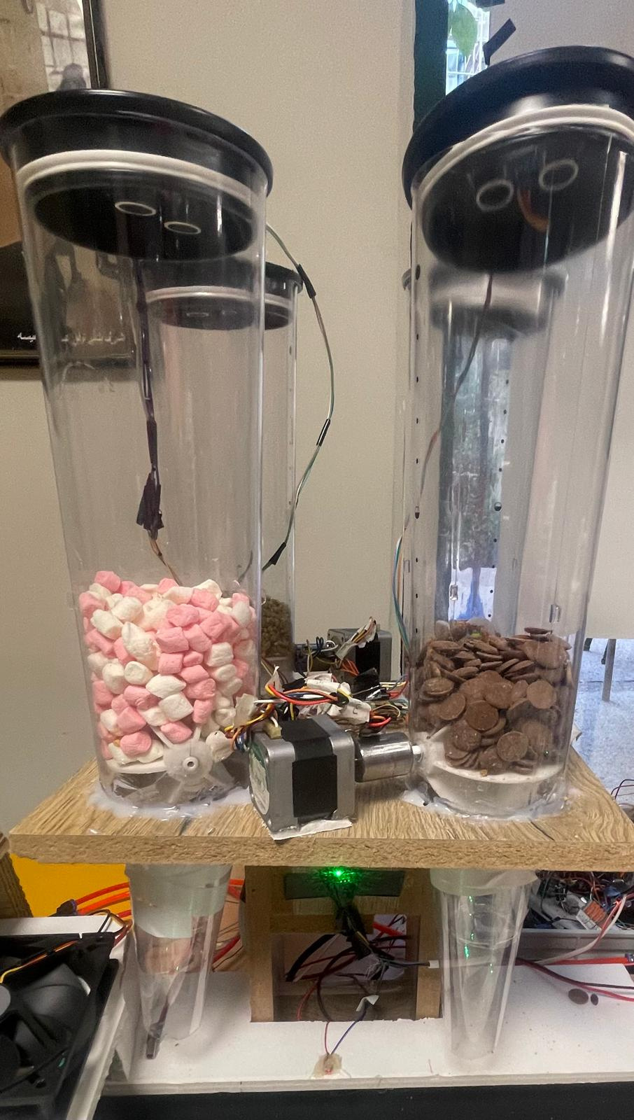
Stages
6. Topping stage
one of four choices will be pour as a topping (chocolate, m&m , Marchmelo and pisachio)

Slide 13
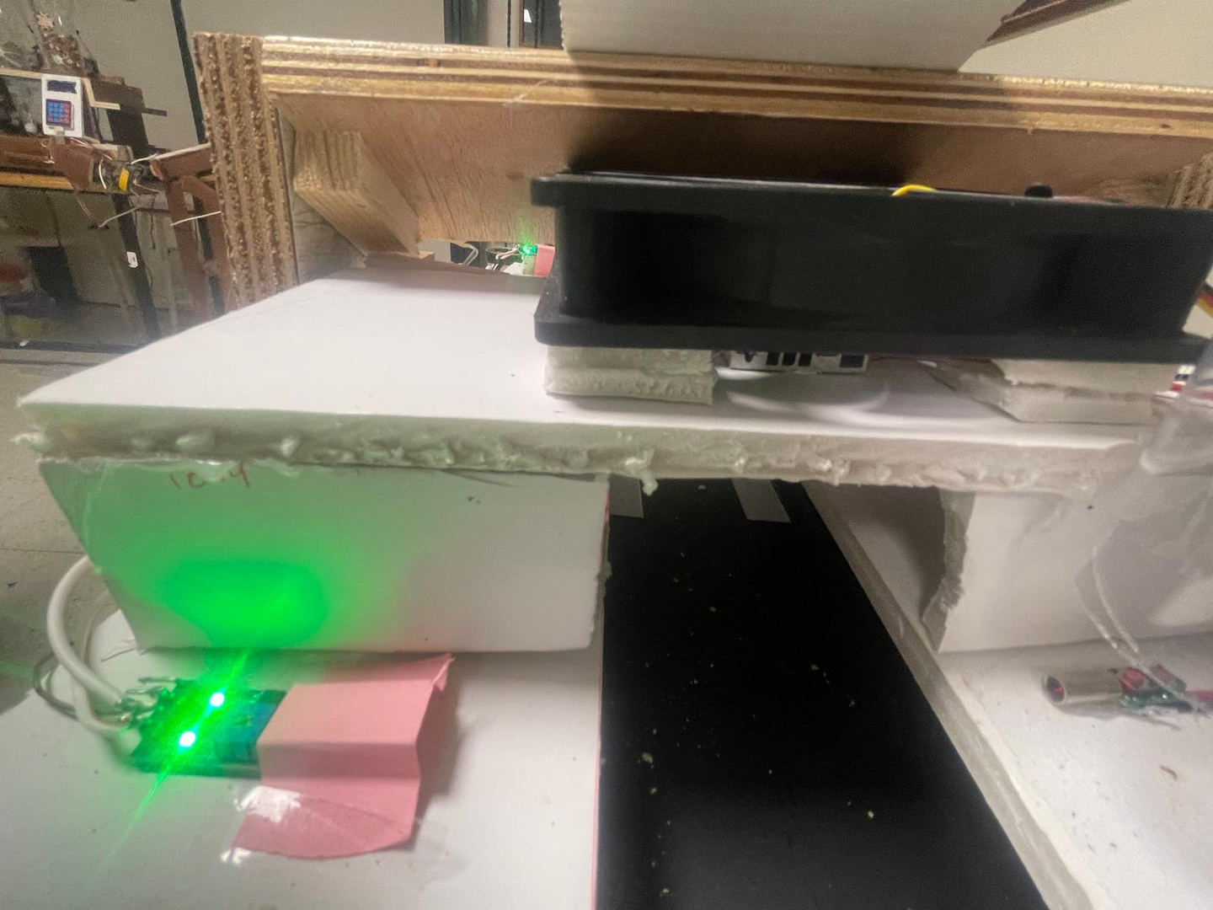
Stages
7. cooling system
simple cooling system using Peltier, heating sink and fan
It will stay in it according the mode that user enter
  Fast for 1 min
  Slow for 5 min

Slide 14
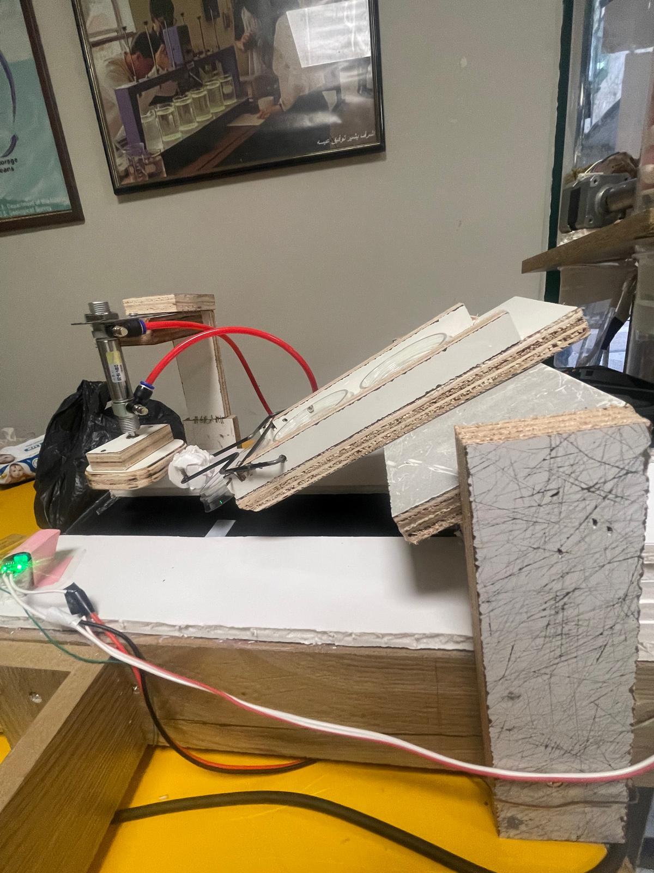
Stages
8. Closing stage
First part the cup will pull the lid
Second part piston will close it carefully

Slide 15
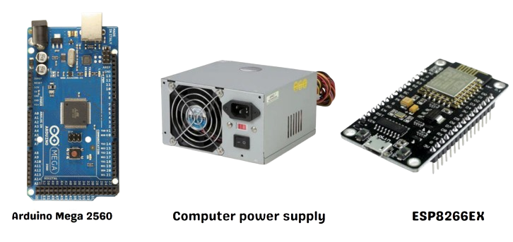
Components

Slide 16
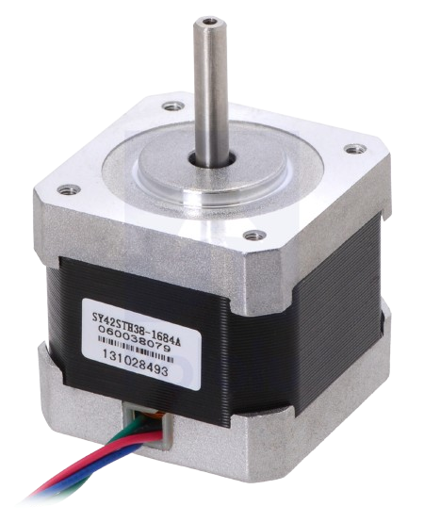
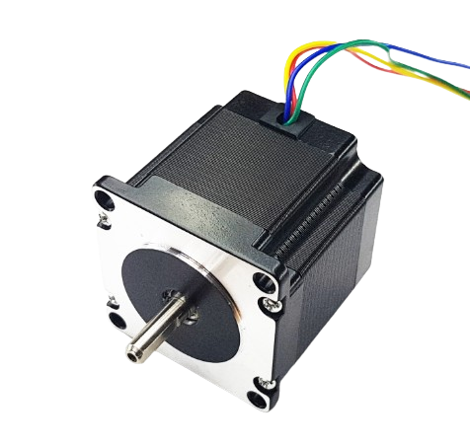
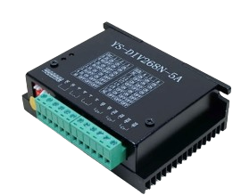
Components
Driver YS-DIV268N-5A
Stepper motor NEma23
Stepper motor NEma17

Slide 17
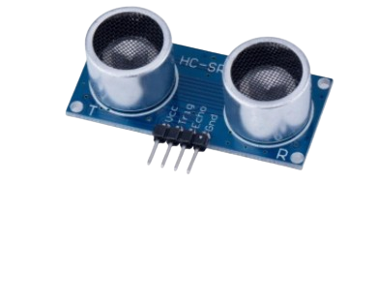
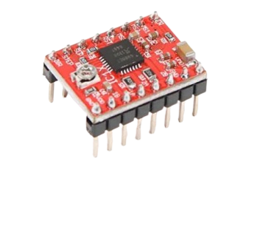
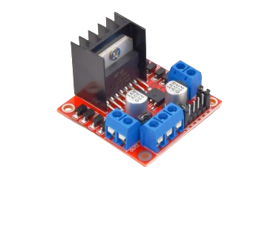
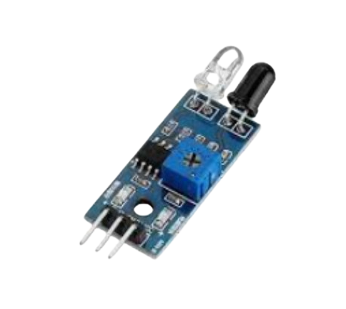
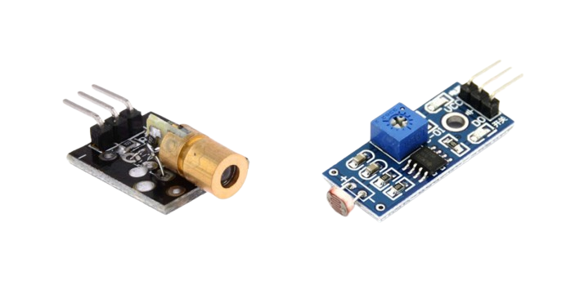
Components
Ultrasonic
Driver A4988
H Bridge L298
InfraRed( IR )Sensor module
Laser
LDR module

Slide 18
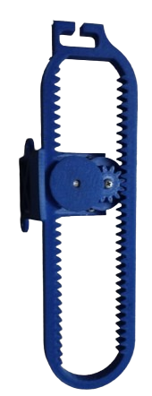
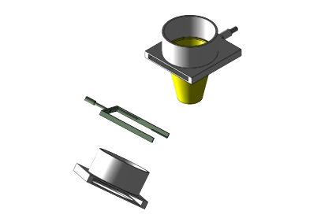
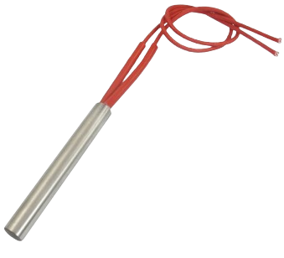
Components
Catridge Heater 220V
3D printed
Cups dispenser
3D printed
Gears

Slide 19
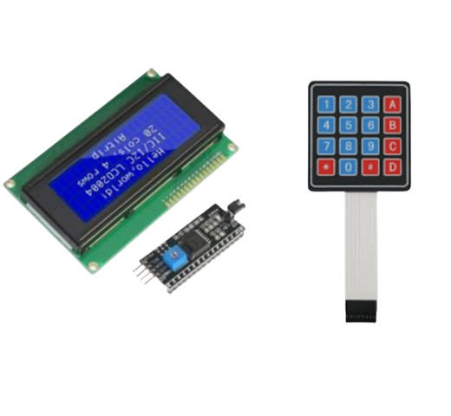

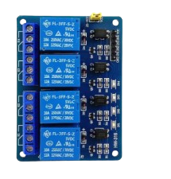
Components
20*4 LCD
Keypad
12v LED strip
4 channel relay

Slide 20
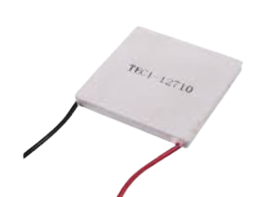
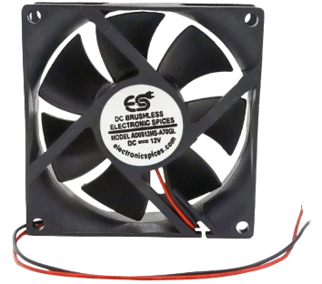
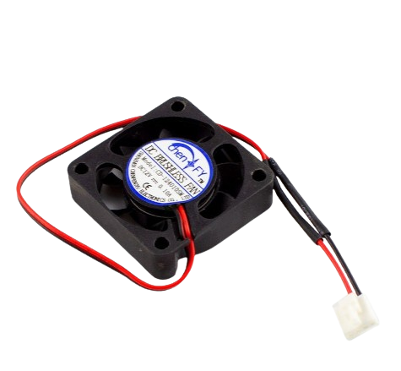
Components
Peltier
12V fans

Slide 21
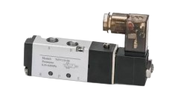
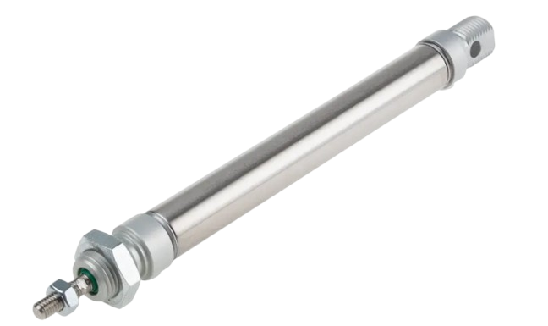
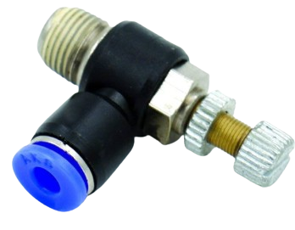
Components
air solenoid valve
air regulater
pneumatic piston

Slide 22

Challenges
  Melting the butter efficiently
  Controlling precise amounts of ingredients
  Handling different consistencies of the ingredients.
  Ensuring proper storage conditions for each ingredient.

Slide 23
Future Work
-Adding more effective cooling system
-Upgrade butter storage
-grinding mechanism to prepare fresh biscuits instead of relying on pre-powdered one
-Adding more cream ,topping and biscuit flavours ,to provide more customization

Slide 24
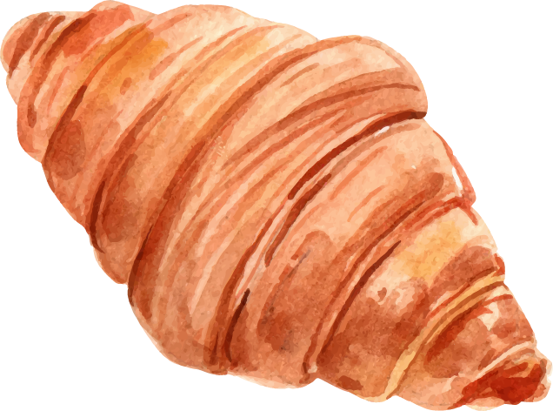
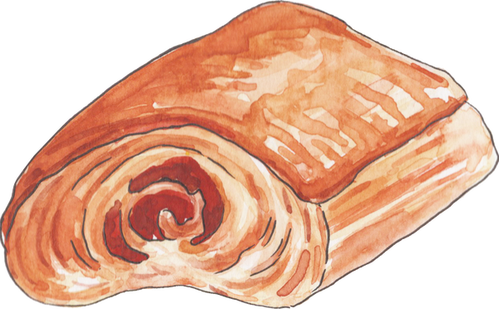
Thank you for your attention

