Slide 1
Energy efficiency for Jawwal’s TBSs by using Photovoltaic system
By :
Hamsa Khaled
Leemara sawafta
Supervisor :
Dr.Tamer Khatib

Slide 2
Introduction
The correct power supply for telecommunications base stations (TBS), is a handicap for operators to expand their clientele.
The growing of energy consumption of Jawwal's TBS has required an energy saving and another efficient method to be used.

Slide 3
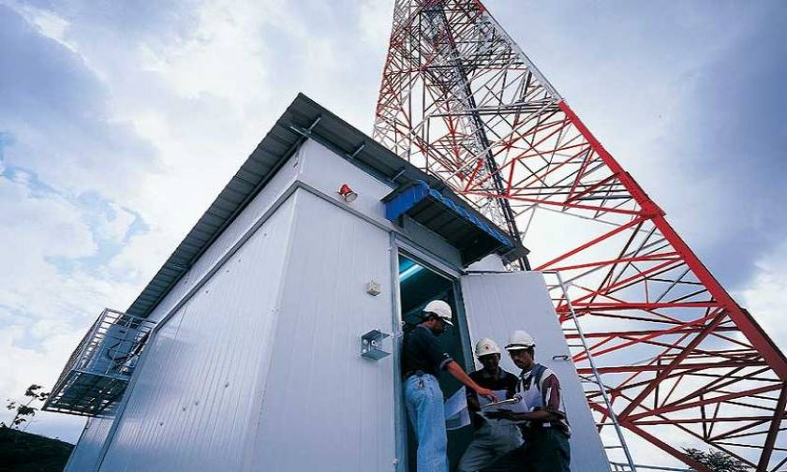

Slide 5
Field investigation:
Climate conditions in Palestine:
latitude 31⁰ 57ʹN and longitude 35⁰13ʹE .
Palestine has a Mediterranean climate.
The relative humidity is about (51% - 83%).

Slide 6
Field investigation:
Jawwal’s TBS Specifications:
Shelter dimensions is 2.2m (W) x 2.2m (L) x 2.2m (H) where cabin constructed from PU panels with plywood sandwiched in between and fully insulated.
Based on the collected data, the load of the shelters varies between 135W (Minimum) to 2.000W (Maximum).

Slide 7
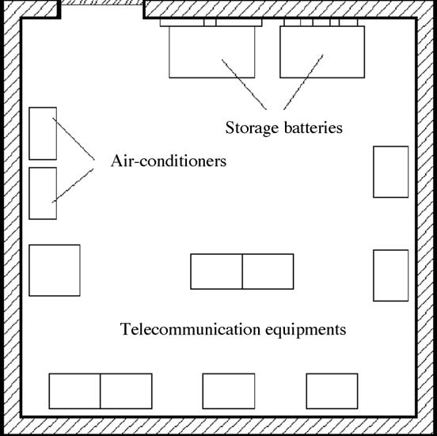

Slide 8
Methods :
Free cooling:
Free cooling is a good opportunity for energy saving in air conditioning systems.
sensors are used for monitoring outside and inside air conditions and temperatures.

Slide 9
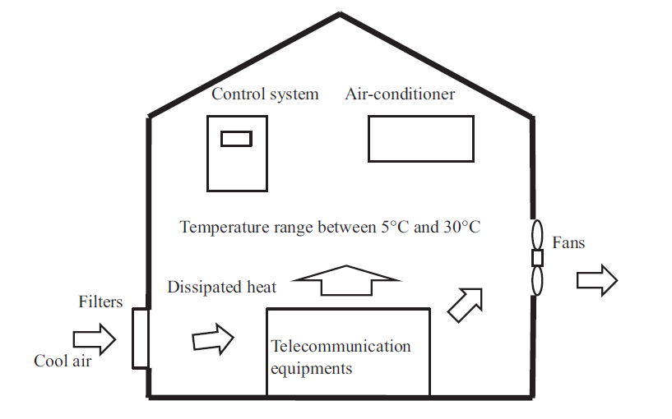

Slide 10

Free Cooling Capacity:
Δt = t internal - t ambient
Q (watt) = $\dot{m}$ cp Δt
$\dot{m}= \frac{Q (watt)}{cp Δt }$

Slide 11
Considerations When Selecting Free Cooling:
Shelter design and location.
The installation location of the fans and openings.
humidity disturbance.
unwanted particulates, and gaseous contaminants.

Slide 12
Control strategy:

Slide 13
Results and discussion:

