Slide 1
Structural Re-design Of Qeresh Building prepared by:
1. Bashar Hanoun-11642318
2. Mohammed Samaneh-11642687
3. Razan Sharqawi-11611668
Under supervision of: Dr. Riyad Abdel-karim awad

Slide 2
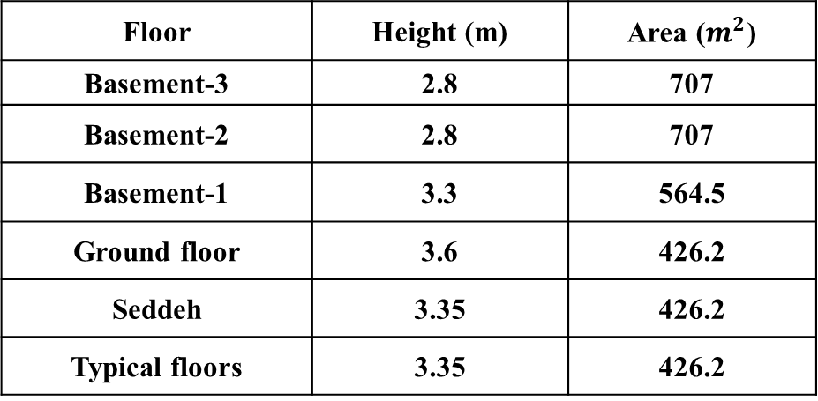
Project Description
Husam Qaresh building is commercial multi-story building in Nablus which has an area of
(5078.70) m².
Floor | Height (m) | Area ($m^{2}$)
Basement-3 | 2.8 | 707
Basement-2 | 2.8 | 707
Basement-1 | 3.3 | 564.5
Ground floor | 3.6 | 426.2
Seddeh | 3.35 | 426.2
Typical floors | 3.35 | 426.2

Slide 3
Analysis And Design Principles
Supports: assumed to be pin support.
Design method: Ultimate Load Method (ULM) .
The three-dimensions modeling (3D) using ETABS software program.

Slide 4

Geotechnical Investigation
In this project, the tests have shown that the allowable bearing capacity of the soil is equal to $160KN/m^{2}$, and according to UBC the soil site class is considered to be SD.

Slide 5
Codes And Standards
the most important codes that can be used in the design of structures are American Society of Civil Engineers (ASCE 7-10), Uniform Building Code (UBC 97), American Society for Testing Materials (ASTM), The American Concrete Institute (ACI 318-14).

Slide 6
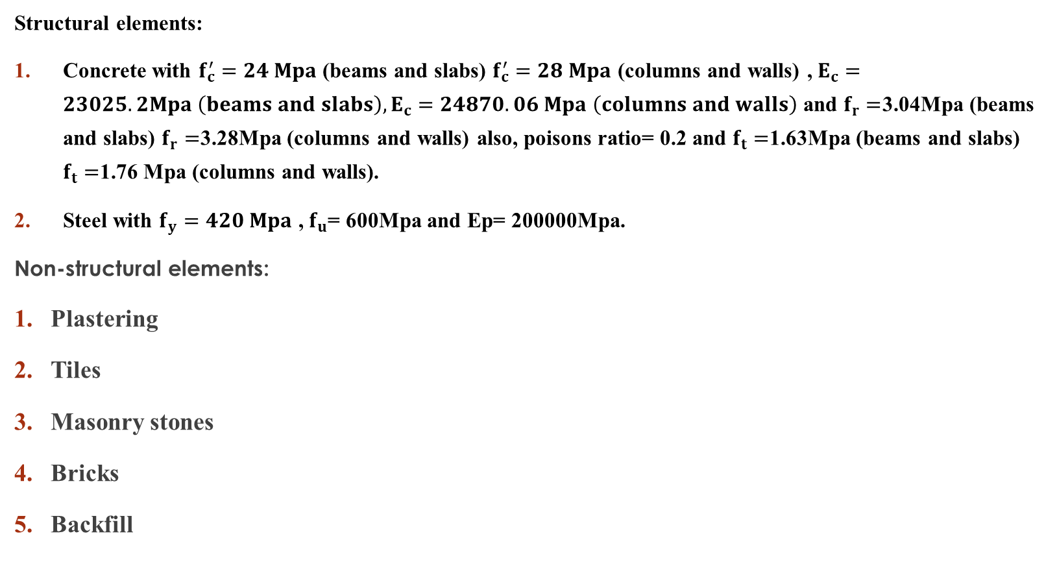
Materials
Structural elements:
Concrete with $f_{c}^{′}=24 Mpa$(beams and slabs) $f_{c}^{′}=28 Mpa$ (columns and walls) , $E_{c}=23025.2Mpa \left(beams and slabs\right),E_{c}=24870.06 Mpa \left(columns and walls\right)$ and $f_{r}=$3.04Mpa (beams and slabs) $f_{r}=$3.28Mpa (columns and walls) also, poisons ratio= 0.2 and $f_{t}=$1.63Mpa (beams and slabs) $f_{t}=$1.76 Mpa (columns and walls).
Steel with $f_{y}=420 Mpa$ , $f_{u}$= 600Mpa and Ep= 200000Mpa.
Non-structural elements:
Plastering
Tiles
Masonry stones
Bricks
Backfill

Slide 7

Loads
Gravity loads:
Dead loads
Superimposed dead loads (${SID}_{on slab}=$ 2.5$KN/m^{2}$ and ${SID}_{wall }$=6.6$KN/m^{2}$)
Live loads (shown in next slide)

Slide 8
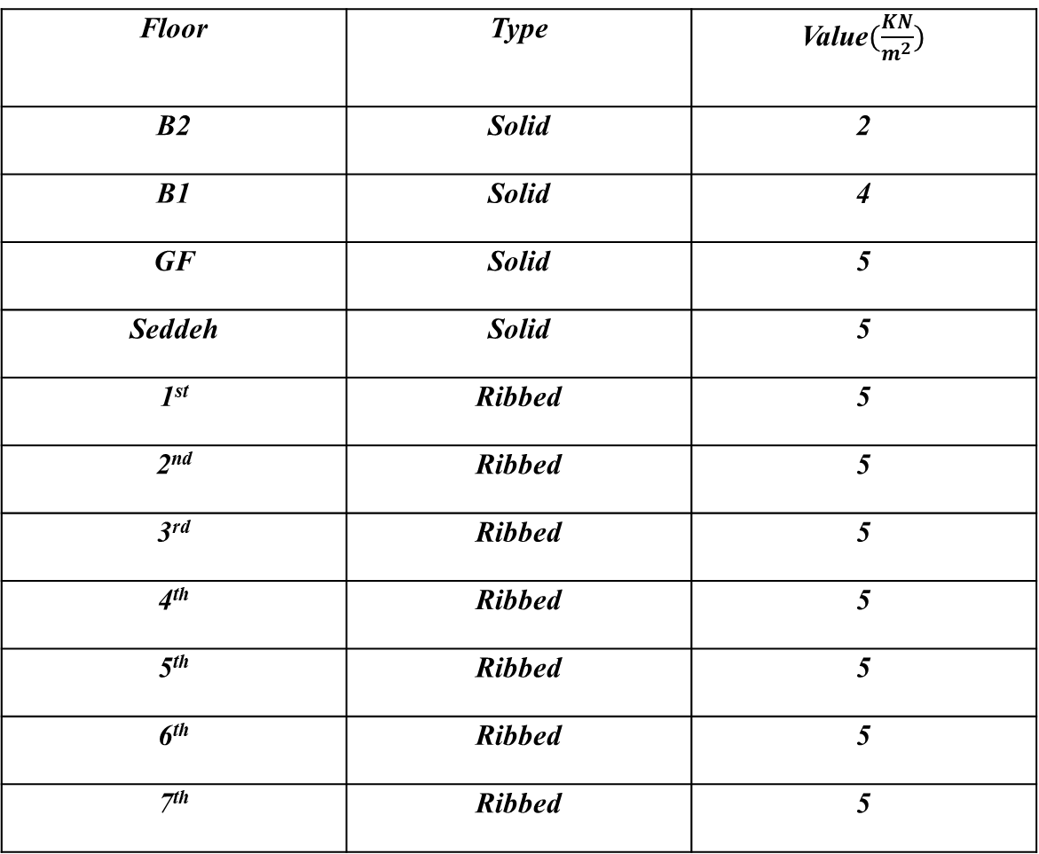
Floor | Type | Value$(\frac{KN}{m^{2}})$
B2 | Solid | 2
B1 | Solid | 4
GF | Solid | 5
Seddeh | Solid | 5
1st | Ribbed | 5
2nd | Ribbed | 5
3rd | Ribbed | 5
4th | Ribbed | 5
5th | Ribbed | 5
6th | Ribbed | 5
7th | Ribbed | 5

Slide 9
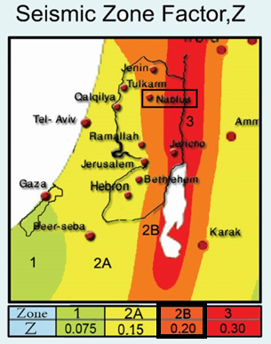
Lateral load
Seismic load: So, from this map (Earthquake Center at An-Najah National University), seismic zone for Nablus is 2B and seismic zone factor is equal to 0.2.

Slide 10
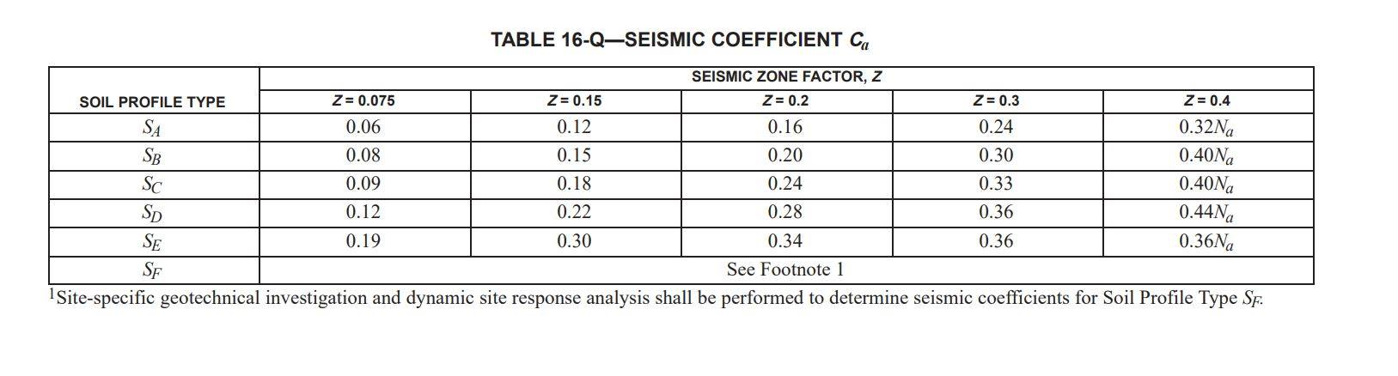
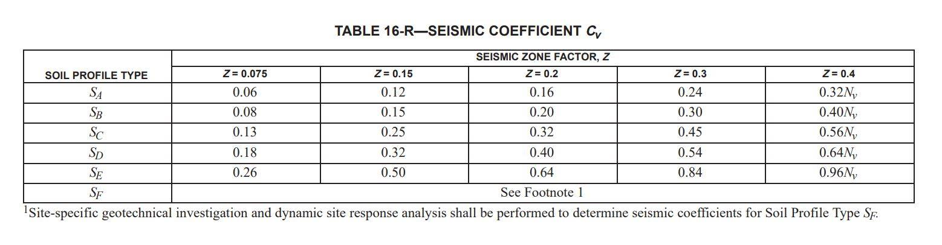

Site class: The type of the soil in the site is rock and the soil site class is assumed to be D
Seismic response coefficients ($Cv$ and $Ca$) From Tables:
$Ca=0.28$
$Cv=$0.4

Slide 11

Configuration Requirements: this project will use response spectrum analysis method.
redundancy factor $(ρ)$ = from 1 to 1.5 (use 1.3)
Importance Factor $I_{e}$= 1
Direction of applying seismic load: In this project, the principle that has been adopted of the model is to take 100 percent of the ground motion in the critical direction and 30 percent of the ground motion in the perpendicular, horizontal direction.

Slide 12
Load combinations
Service load combinations: Ultimate load combinations:

Slide 13
preliminary design
Lateral and Gravity forces resisting systems
Foundations.
Columns.
Floor beams.
Shear walls.

Slide 14
Slab Structural System
Solid slab
Ribbed slab
Based on load transformation:
One-Way Slab.
Two-Way Slab. (used in the project)

Slide 15
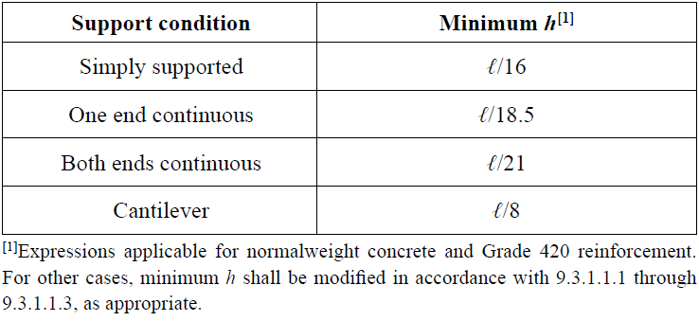

Preliminary dimensions of beams
Beams are classified according to their depths into two main categories which are:
Drop beams
Hidden beams
Where the width is $b_{w}=\frac{l}{20}$ = $\frac{8.4}{20}$ = 0.42m take it 0.5m
Depth is according to the table:
So, one end continuous has the largest depth so, h=0.45m but let’s take it h= 0.5m

Slide 16
Preliminary slab thickness
Preliminary thickness of slab is 200mm.

Slide 17
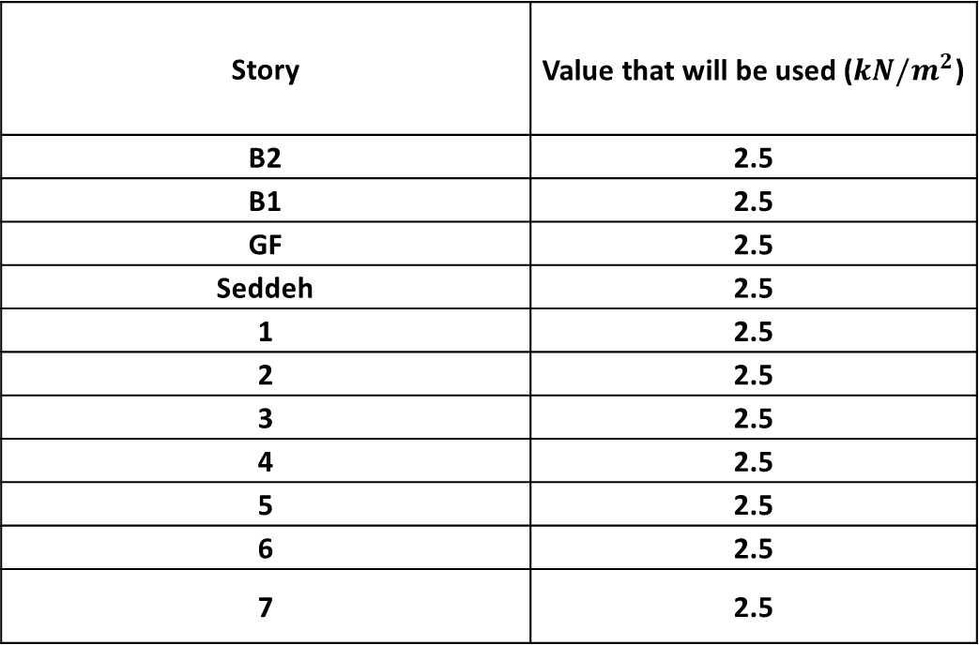
Loads on slab
Superimposed Dead loads:
Story | Value that will be used ($kN/m^{2}$)
B2 | 2.5
B1 | 2.5
GF | 2.5
Seddeh | 2.5
1 | 2.5
2 | 2.5
3 | 2.5
4 | 2.5
5 | 2.5
6 | 2.5
7 | 2.5

Slide 18
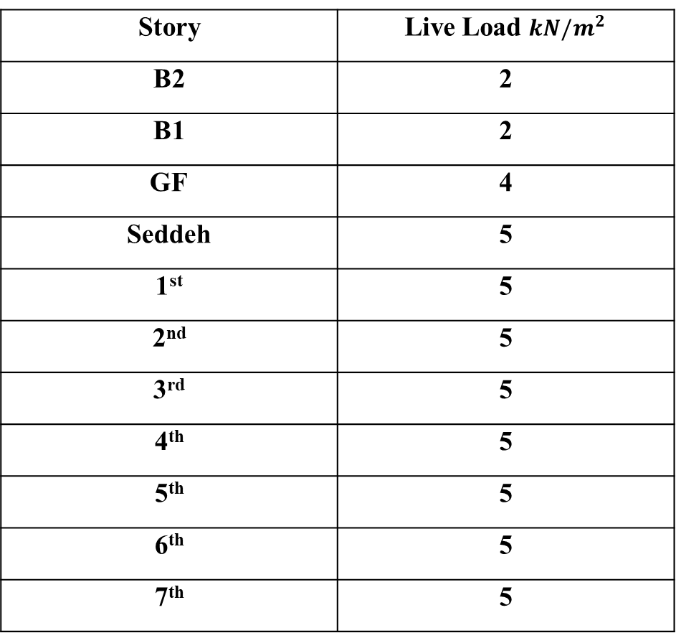
Live Loads:
Story | Live Load $kN/m^{2}$
B2 | 2
B1 | 2
GF | 4
Seddeh | 5
1st | 5
2nd | 5
3rd | 5
4th | 5
5th | 5
6th | 5
7th | 5

Slide 19
Columns
In this project, the dimensions and distribution of columns will be used as stated in architectural plans(1000*400).

Slide 20
Preliminary dimensions of walls
The preliminary dimensions of walls that will be used are:
Walls with 300mm thickness.
Walls of 200mm thickness.

Slide 21
three-dimensional analysis and design

Slide 22
Story data
Story | Height (m) | Elevation (m)
Basement 3 | 2.8 | -8.3
Basement 2 | 2.8 | -5.5
Basement 1 | 3.3 | -2.7
Ground floor | 3.6 | 0.6
Seddeh | 3.35 | 4.2
1st | 3.35 | 7.55
2nd | 3.65 | 11.2
3rd | 3.65 | 14.85
4th | 3.35 | 18.2
5th | 3.35 | 21.55
6th | 3.35 | 24.9
7th | 3.35 | 28.25

Slide 23
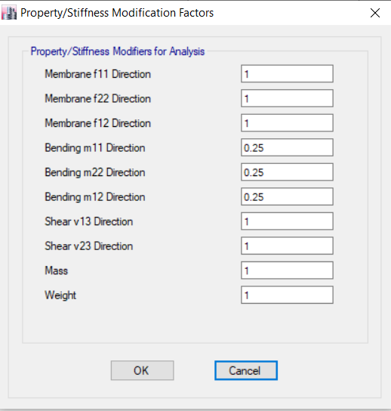
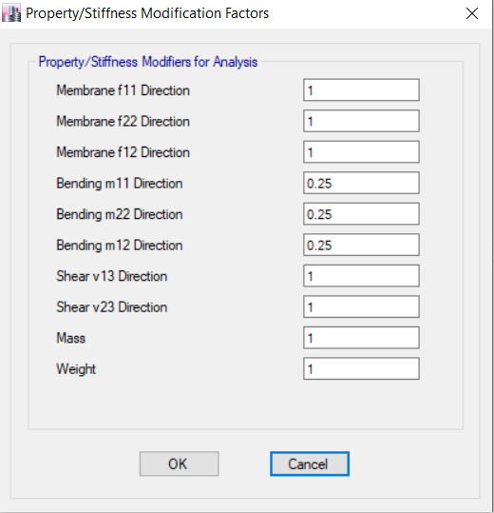
Section modifiers
The ramp modifiers
The ribbed slab modifiers
The solid slab modifiers

Slide 24
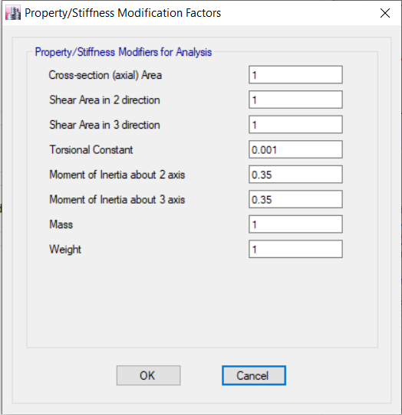
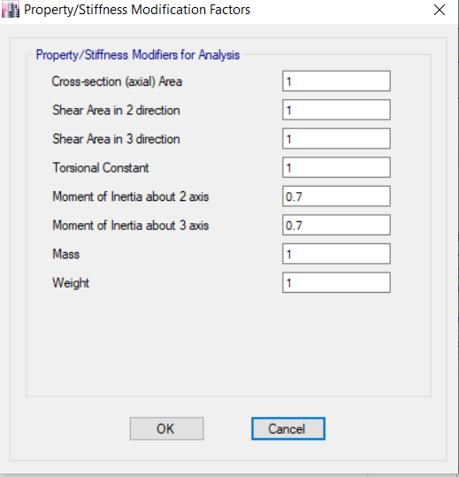
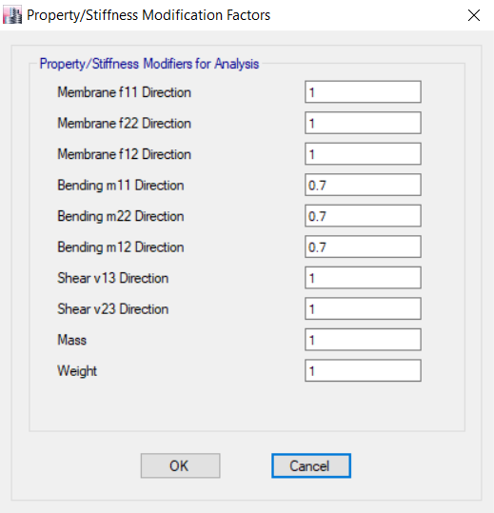
The beam modifiers
The column modifiers
The wall modifiers

Slide 25
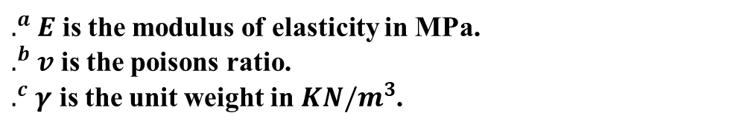
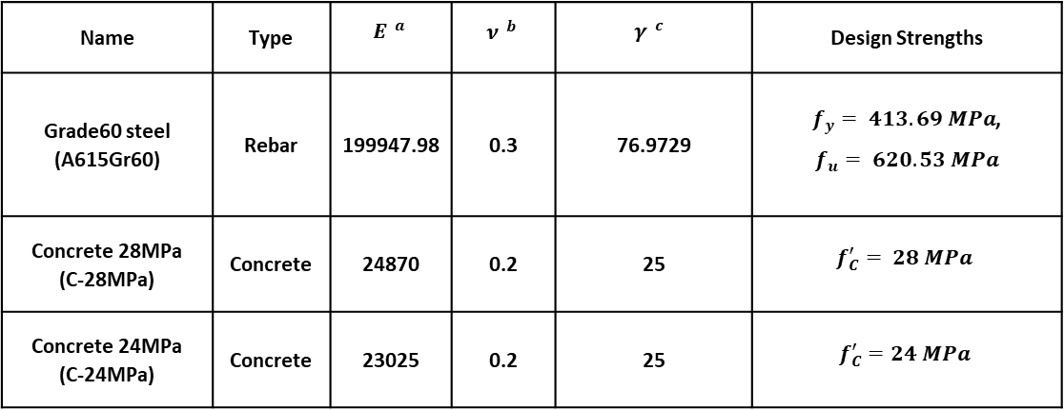
Material
Name | Type | $$E^{ a}$$ | $$ν^{ b}$$ | $$γ^{ c}$$ | Design Strengths
Grade60 steel (A615Gr60) | Rebar | 199947.98 | 0.3 | 76.9729 | $f_{y}= 413.69 MPa$, $$f_{u}= 620.53 MPa$$
Concrete 28MPa (C-28MPa) | Concrete | 24870 | 0.2 | 25 | $$f_{C}^{′}= 28 MPa$$
Concrete 24MPa (C-24MPa) | Concrete | 23025 | 0.2 | 25 | $$f_{C}^{′}=24 MPa$$
$.^{a}$ $E$ is the modulus of elasticity in MPa.
$.^{b}$ $v$ is the poisons ratio.
$.^{c}$ $γ$ is the unit weight in $KN/m^{3}$.

Slide 26
Section properties
No. | Section Name | Property Name | Material | Section Type | Dimensions (mm) | Flexural Modifier | Torsional Modifier
1 | Frame sections | B-500X700 | C-24MPa | Rectangular Beam | 500X700 | 0.35 | 0.001
2 |  | B-500X800 | C-24MPa | Rectangular Beam | 500X800 | 0.35 | 0.001
3 |  | B-700X800 | C-24MPa | Rectangular Beam | 700X800 | 0.35 | 0.001
4 |  | C-400X1000 | C-28MPa | Rectangular Column | 400X1000 | 0.7 | 1
5 | Shell sections | Ribbed | C-28MPa | Slab | t = 300 | 0.25 | 0.25
6 |  | Solid | C-28MPa | Slab | t = 200 | 0.25 | 0.25
7 |  | WALL-200 | C-28MPa | Wall | t=200 | 0.7 | 0.7
8 |  | WALL-300 | C-28MPa | Wall | t = 300 | 0.7 | 0.7

Slide 27
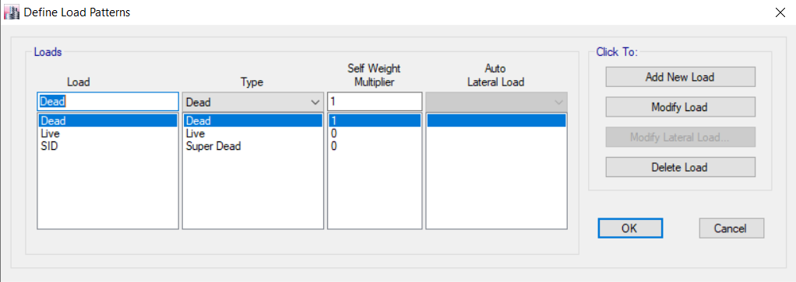
Load patterns

Slide 28
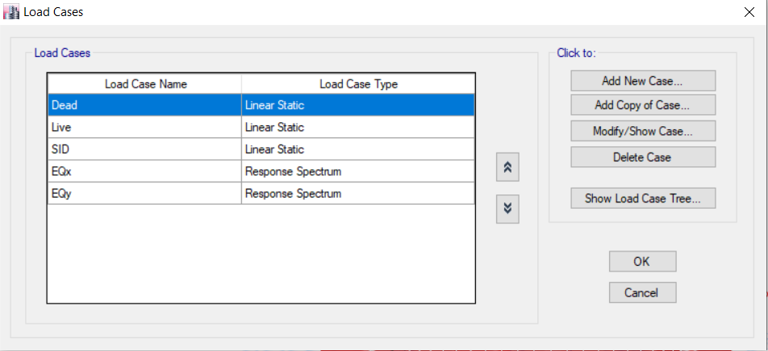


Load cases

Slide 29
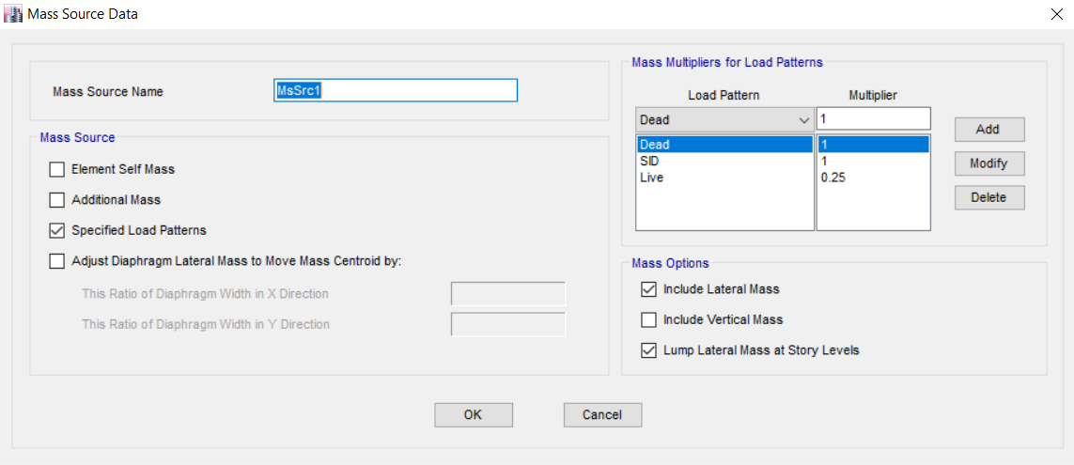
Masses

Slide 30
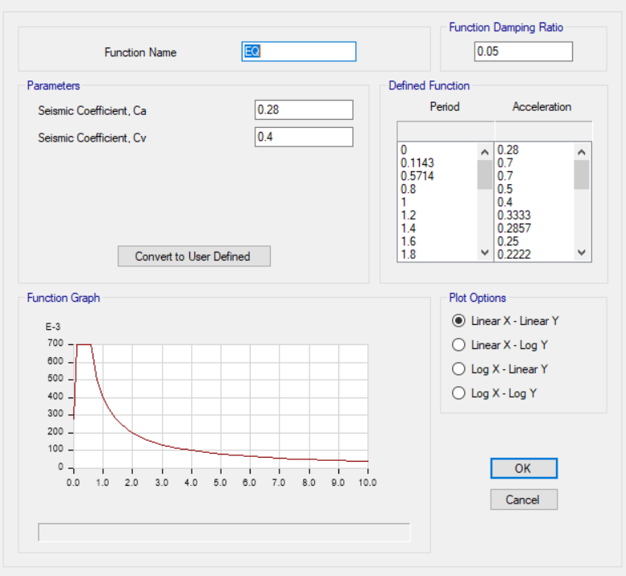
Functions

Slide 31
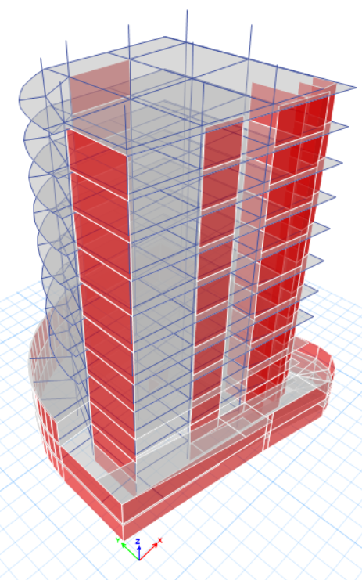
Three-dimensional modelling

Slide 32
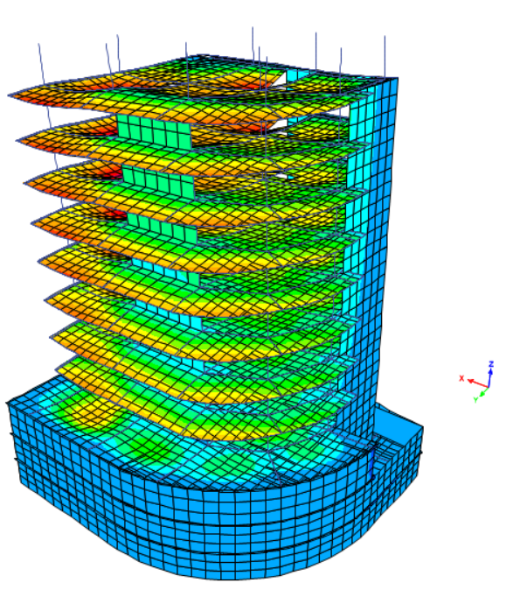
Compatibility of the structure

Slide 33
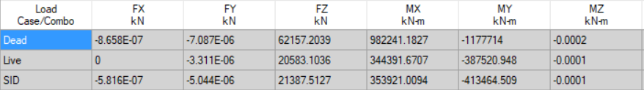
Gravity loads

Slide 34
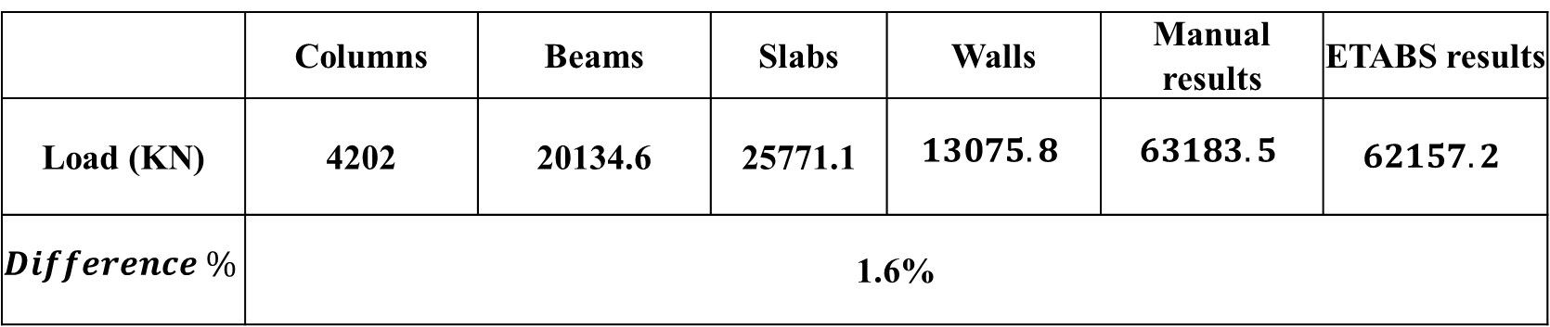
Check equilibrium for dead loads
 | Columns | Beams | Slabs | Walls | Manual results | ETABS results
Load (KN) | 4202 | 20134.6 | 25771.1 | $$13075.8$$ | $$63183.5$$ | $$62157.2$$
$$Difference \%$$ | 1.6%

Slide 35
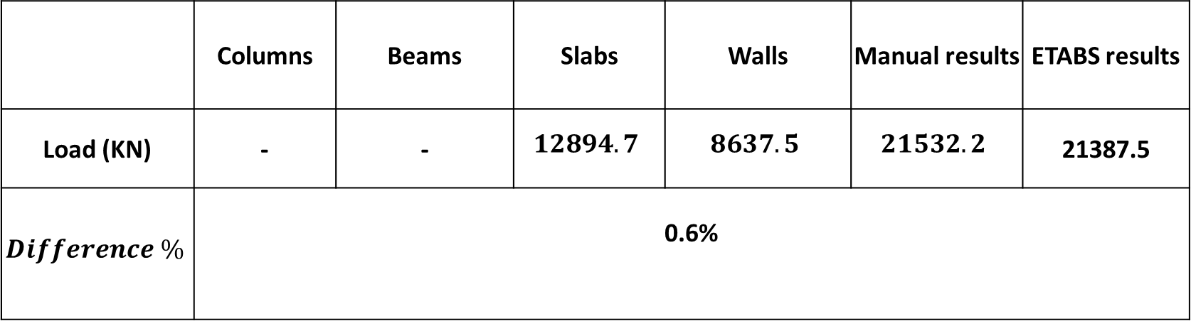
Check equilibrium for superimposed dead loads
 | Columns | Beams | Slabs | Walls | Manual results | ETABS results
Load (KN) | - | - | $$12894.7$$ | $$8637.5$$ | $$21532.2$$ | 21387.5
$$Difference \%$$ | 0.6%

Slide 36
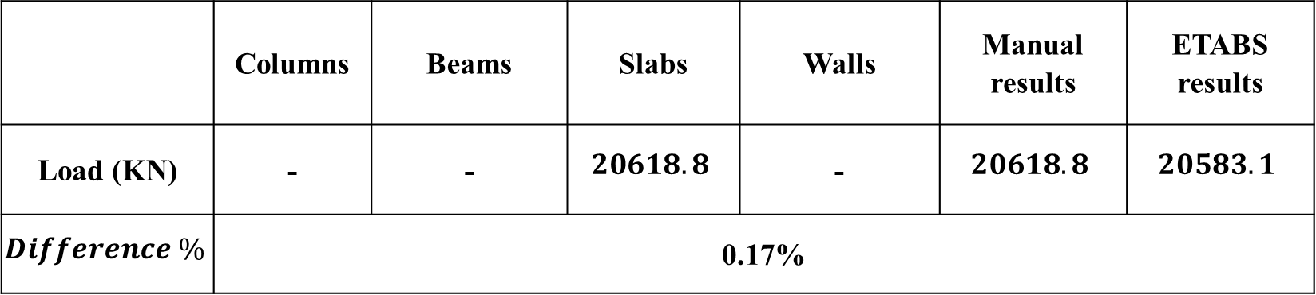
Check equilibrium for live loads
 | Columns | Beams | Slabs | Walls | Manual results | ETABS results
Load (KN) | - | - | $$20618.8$$ | - | $$20618.8$$ | $$20583.1$$
$$Difference \%$$ | 0.17%

Slide 37
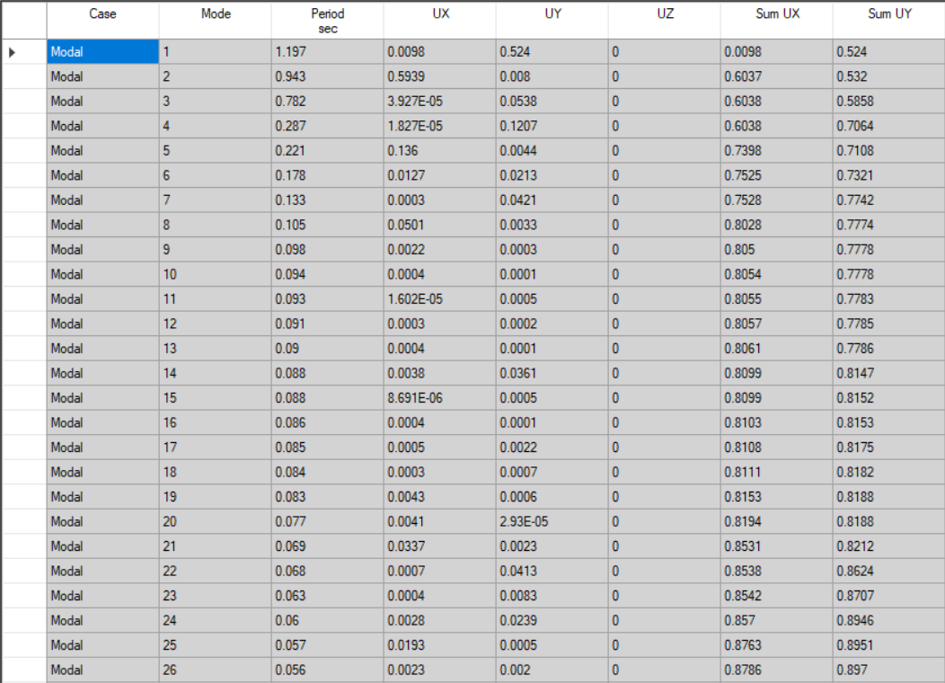
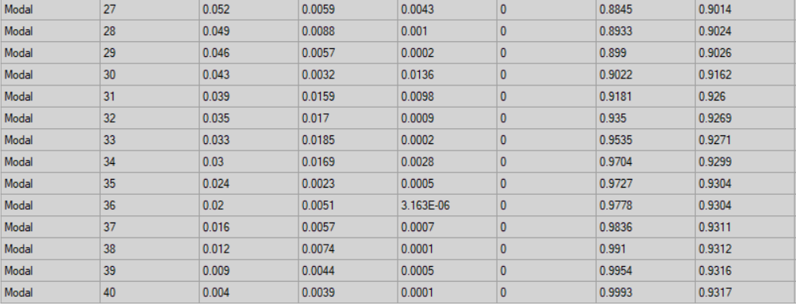
Seismic forces
Mass participation ratio for modal analysis

Slide 38
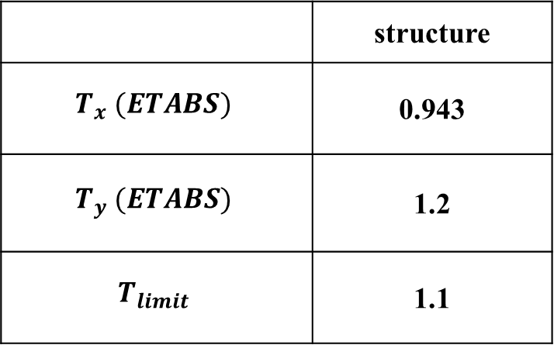
Period
 | structure
$$T_{x} (ETABS)$$ | 0.943
$$T_{y} (ETABS)$$ | 1.2
$$T_{limit}$$ | 1.1

Slide 39


Check equilibrium for base shear
Manual base shear= 6694.2KN
From ETAB= 4365.2KN
So some changes were made on the scale factor
scale factor values in X-direction
scale factor values Y-direction

Slide 40
Verification of internal forces

Slide 41
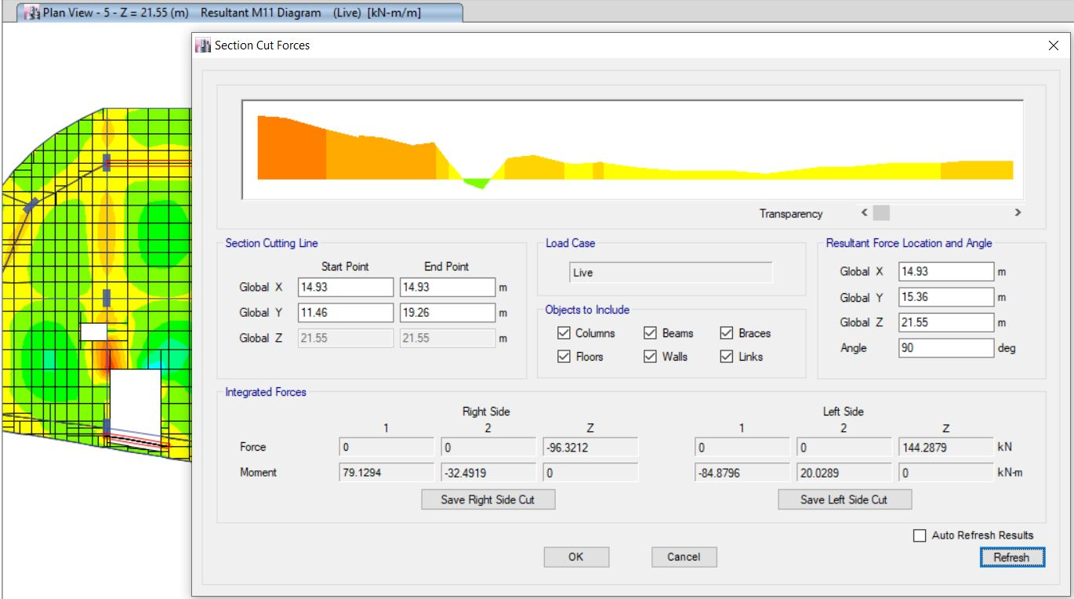
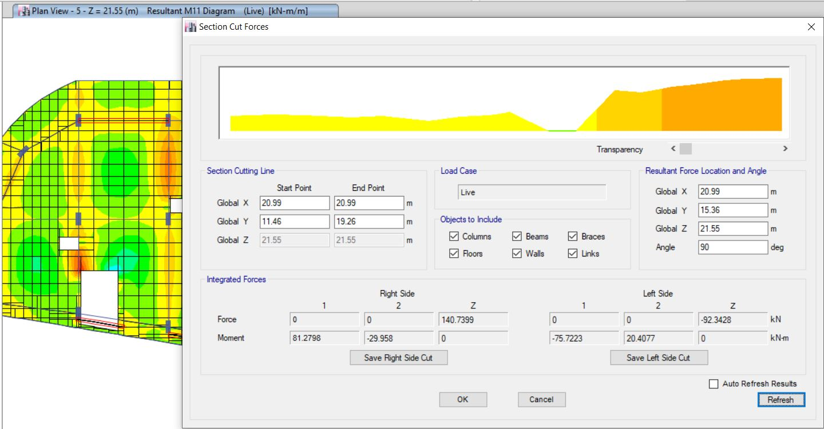
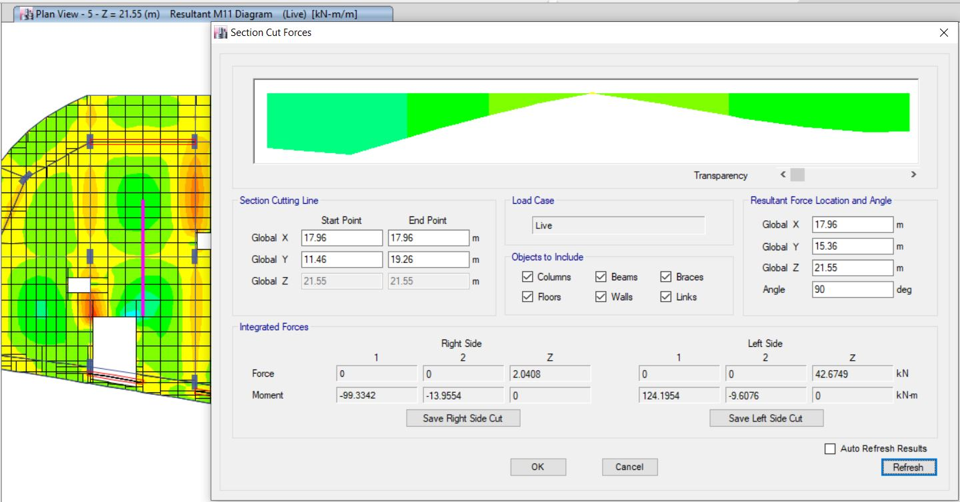
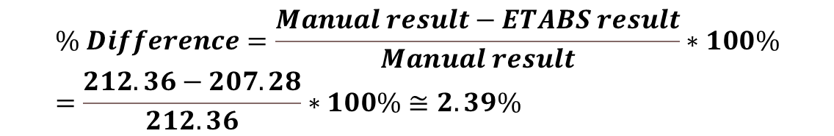
Frame(X-direction)
Frame moment (M1)
Frame moment (M2)
Frame moment (M3)
$$\% Difference=\frac{Manual result−ETABS result}{Manual result}∗100\%=\frac{212.36−207.28}{212.36}∗100\%≅2.39\%$$

Slide 42
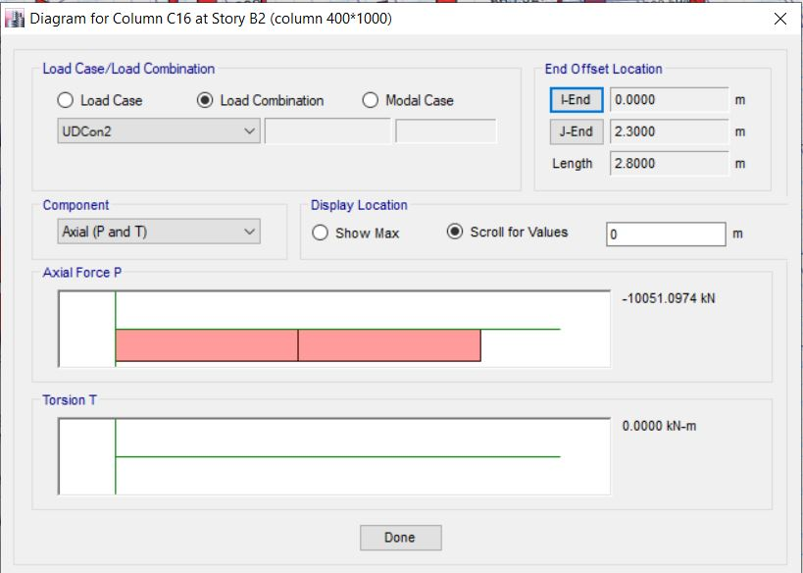

Columns
Manual result= 11188.2 $KN$
ETAB result= $10051.1KN$

Slide 43

deflections for slab systems
${comb}_{service}$= 1D + 1L + 1SID
From ETABS: $∆=33.8mm$
$∆=\frac{L}{240}=\frac{8400}{240}=35mm>33.8 mm So OK$

Slide 44
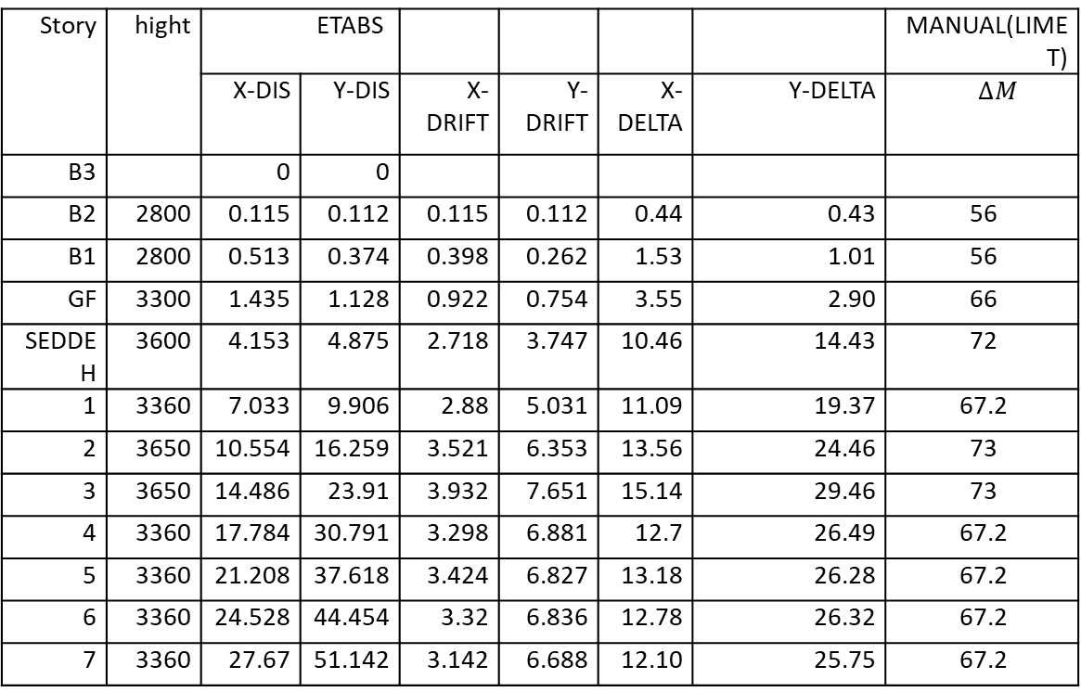
Story drift
Story | hight | ETABS |  |  |  |  |  | MANUAL(LIMET)
 |  | X-DIS | Y-DIS | X-DRIFT | Y-DRIFT | X-DELTA | Y-DELTA | $$∆M$$
B3 |  | 0 | 0
B2 | 2800 | 0.115 | 0.112 | 0.115 | 0.112 | 0.44 | 0.43 | 56
B1 | 2800 | 0.513 | 0.374 | 0.398 | 0.262 | 1.53 | 1.01 | 56
GF | 3300 | 1.435 | 1.128 | 0.922 | 0.754 | 3.55 | 2.90 | 66
SEDDEH | 3600 | 4.153 | 4.875 | 2.718 | 3.747 | 10.46 | 14.43 | 72
1 | 3360 | 7.033 | 9.906 | 2.88 | 5.031 | 11.09 | 19.37 | 67.2
2 | 3650 | 10.554 | 16.259 | 3.521 | 6.353 | 13.56 | 24.46 | 73
3 | 3650 | 14.486 | 23.91 | 3.932 | 7.651 | 15.14 | 29.46 | 73
4 | 3360 | 17.784 | 30.791 | 3.298 | 6.881 | 12.7 | 26.49 | 67.2
5 | 3360 | 21.208 | 37.618 | 3.424 | 6.827 | 13.18 | 26.28 | 67.2
6 | 3360 | 24.528 | 44.454 | 3.32 | 6.836 | 12.78 | 26.32 | 67.2
7 | 3360 | 27.67 | 51.142 | 3.142 | 6.688 | 12.10 | 25.75 | 67.2
According to results from tables, the drift in each story is less than the allowable value.

Slide 45
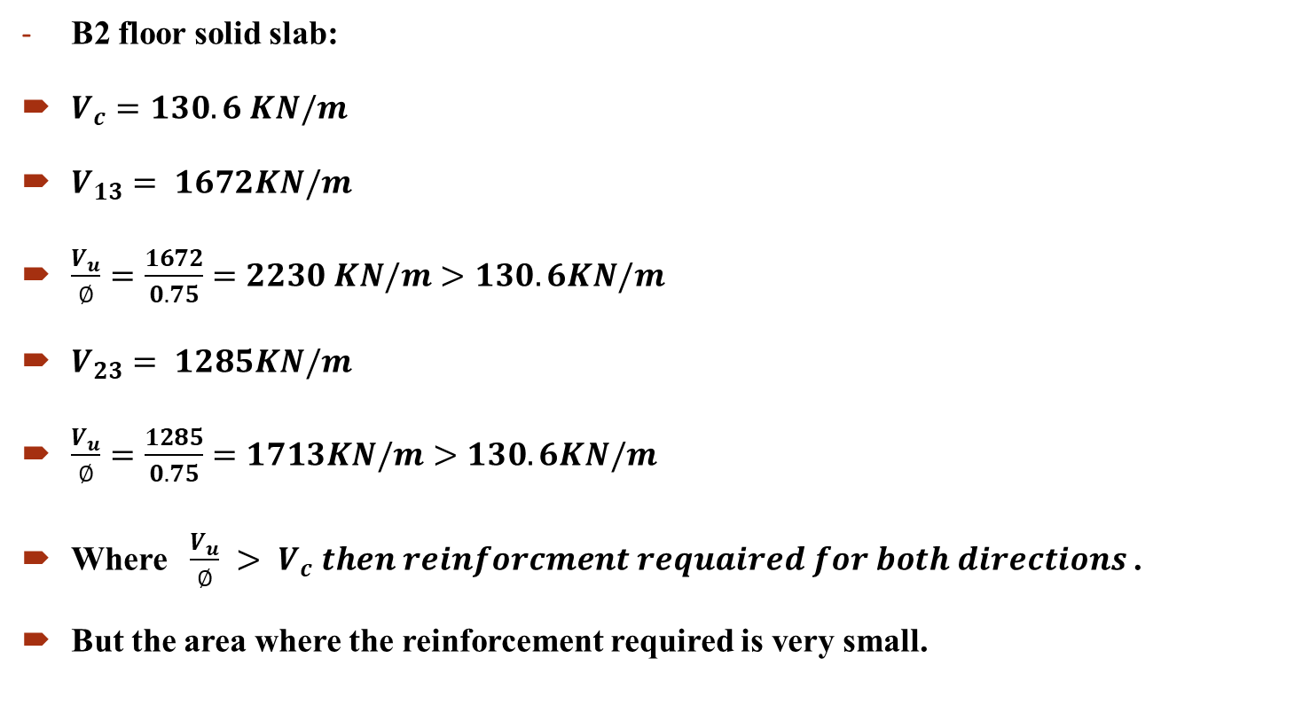
Design of slabs
B2 floor solid slab:
$V_{c}=130.6 KN/m$
$V_{13}= 1672KN/m$
$\frac{V_{u}}{∅}=\frac{1672}{0.75}=2230 KN/m>130.6KN/m$
$V_{23}= 1285KN/m$
$\frac{V_{u}}{∅}=\frac{1285}{0.75}=1713KN/m>130.6KN/m$
Where $\frac{V_{u}}{∅} > V_{c} then reinforcment requaired for both directions$.
But the area where the reinforcement required is very small.

Slide 46
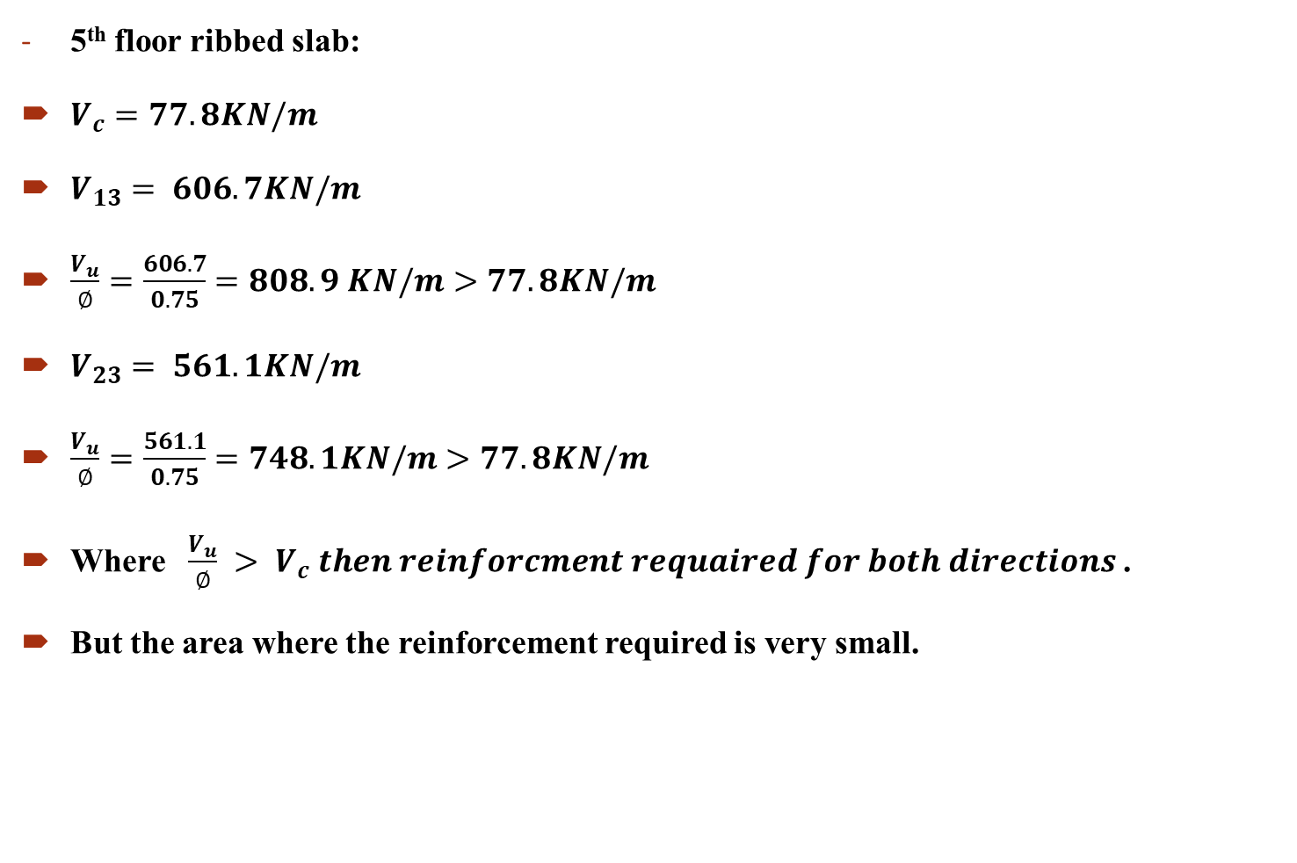
5th floor ribbed slab:
$V_{c}=77.8KN/m$
$V_{13}= 606.7KN/m$
$\frac{V_{u}}{∅}=\frac{606.7}{0.75}=808.9 KN/m>77.8KN/m$
$V_{23}= 561.1KN/m$
$\frac{V_{u}}{∅}=\frac{561.1}{0.75}=748.1KN/m>77.8KN/m$
Where $\frac{V_{u}}{∅} > V_{c} then reinforcment requaired for both directions$.
But the area where the reinforcement required is very small.

Slide 47

Flexural design
Solid slab (B2-B1-GF)
For $M_{u}^{+} in x−direction =27.3KN.m$
$A_{s}=ρ_{min}bd=0.00291∗160∗1000=465.6 {mm}^{2}$
So, use $5∅12mm of steel bars$.

Slide 48
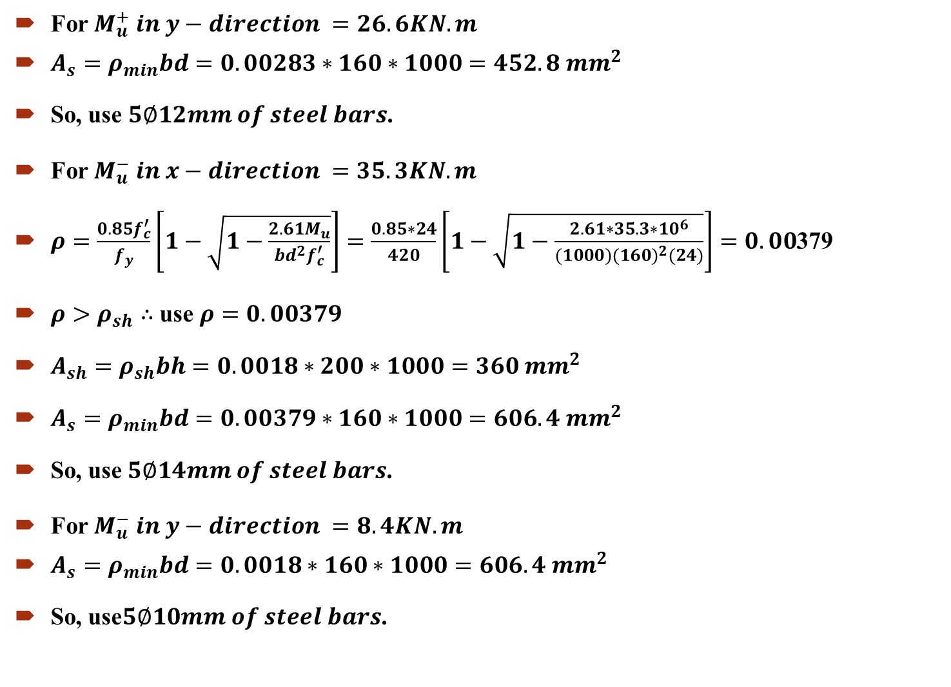
For $M_{u}^{+} in y−direction =26.6KN.m$
$A_{s}=ρ_{min}bd=0.00283∗160∗1000=452.8 {mm}^{2}$
So, use $5∅12mm of steel bars$.
For $M_{u}^{−} in x−direction =35.3KN.m$
$ρ=\frac{0.85f_{c}^{′}}{f_{y}}\left[1−\sqrt{1−\frac{2.61M_{u}}{bd^{2}f_{c}^{′}}}\right]=\frac{0.85∗24}{420}\left[1−\sqrt{1−\frac{2.61∗35.3∗{10}^{6}}{(1000)(160)^{2}(24)}}\right]=0.00$379
$ρ>ρ_{sh}∴$ use $ρ=0.00379$
$A_{sh}=ρ_{sh}bh=0.0018∗200∗1000=360 {mm}^{2}$
$A_{s}=ρ_{min}bd=0.00379∗160∗1000=606.4 {mm}^{2}$
So, use$5∅14mm of steel bars$.
For $M_{u}^{−} in y−direction =8.4KN.m$
$A_{s}=ρ_{min}bd=0.0018∗160∗1000=606.4 {mm}^{2}$
So, use$5∅10mm of steel bars$.

Slide 49
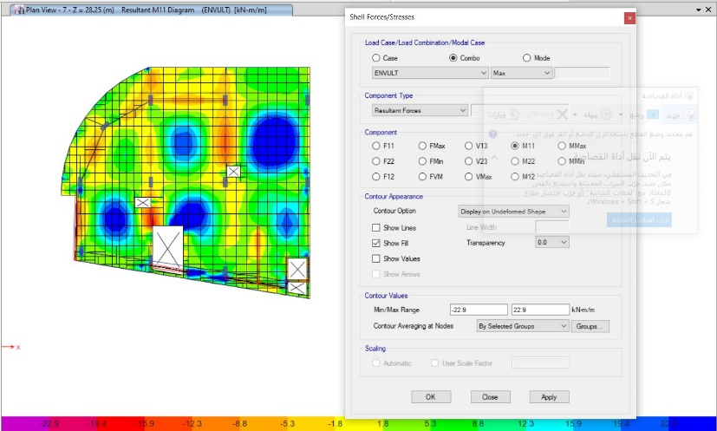

2. Ribbed slab (seddeh-1-2-3-4-5-6-7)
$ρ_{min}=0.0018$
Mn $=22.9 kn.m/m$
$M_{u}^{+} in x−direction$
Use $2∅10mm$except the dark blue area
Use $2∅14 mm$ in dark blue area
Mn $=44 kn.m/m$

Slide 50
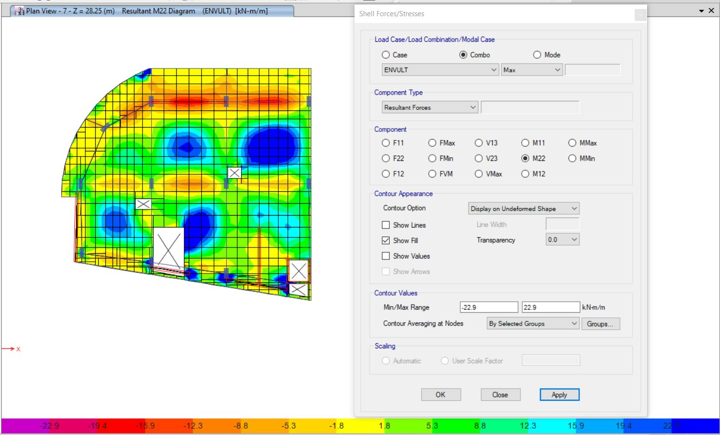
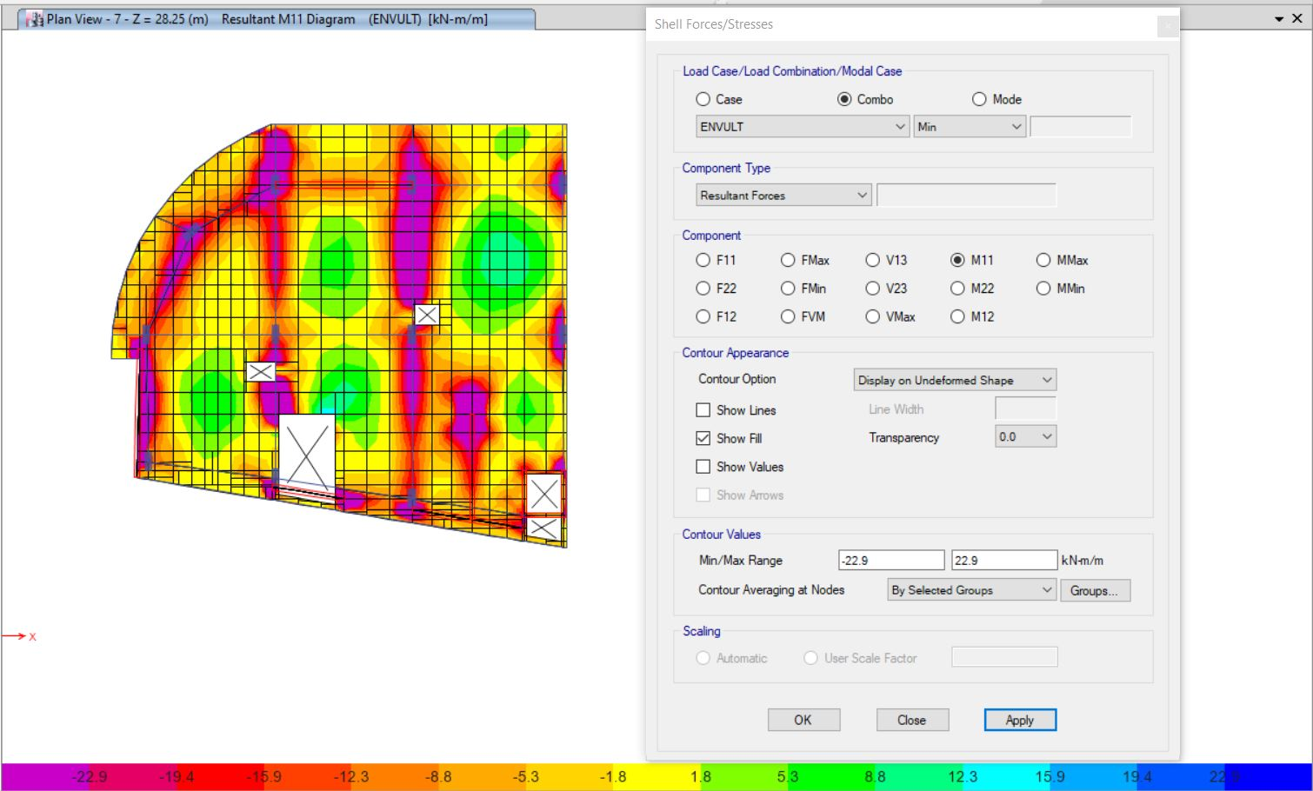

$M_{u}^{+} in y−direction$
Use $2∅10mm e$xcept the dark blue area
Use $2∅16 mm$ in dark blue area
Mn =$55.5 kn.m/m$
$M_{u}^{−} in x−direction$
Use $2∅10mm e$xcept the Purple area
Use $2∅16 mm$ in Purple area
Mn =$55.5 kn.m/m$

Slide 51


$M_{u}^{−} in y−direction$
Use $2∅10mm$except the Purple area
Use $2∅16 mm$ in Purple area
Mn =$55.5 kn.m/m$

Slide 52

Design of Beams
longitudinal reinforcement to resist flexure:
$A_{s}^{−}=2271{ mm}^{2} A_{s}^{+}=1233{ mm}^{2}$
$A_{s}^{−}$:-No. of steel bars =$\frac{2271}{\frac{π}{4}∗{20}^{2}}=7 ∴use 7∅20$
$A_{s}^{+}$:- No. of steel bars =$\frac{1233}{\frac{π}{4}∗{20}^{2}}=$4 $∴use 4∅20$
Shear reinforcement:
$\frac{A_{v}}{s}=23.63$
Use $∅20$S=$\frac{4∗{25}^{2}∗π}{23.63}=212.6mm$
$S_{max}$: $S_{max}=\frac{760}{2}=380 mm$
$S<S_{max} ∴use S=215$ mm
Use 4$∅20/200mm$

Slide 53




Design of shear wall
Design of piers:
A sample calculation will be done for P1

Slide 54



Design of columns
For longitudinal bars use 18$∅20$
For shear use 3$∅12/120mm$

Slide 55
Design of Footings
Thickness of mat footing = 1300 mm
Bunching shear: All values are less than 1 that’s mean bunching shear is Ok. Thus, mat thickness is sufficient
maximum soil pressure was less than allowable bearing capacity
maximum displacement = 7.46 mm which was acceptable
Bottom bars In X-direction Use Ø 18 @150 mm Top bars In X-direction Use Ø 18 @150 mm
Bottom bars In Y-direction Use Ø 25@150 mm Top bars In Y-direction Use Ø 18 @150 mm

Slide 56
REFERANCES
Building Code Requirements for Structural Concrete (ACI 318M-14) and Commentary (ACI 318RM-14).
American Society of Civil Engineers (ASCE 7-10)
Uniform Building Code (UBC 97).
American Society for Testing Materials (ASTM).
The American Concrete Institute (ACI 318-14).

