Slide 1

An - Najah National University
“Environmentally School
In Asira ash Shamaliya village ”
Supervisor : Eng. Abdulhakeem Al- Jawhari
Prepared By :
Hareth Jepara
Ahmad Barqawe
Mohammad lahlouh
Asa‘d Jamil

Slide 2


Slide 3

Architectural Design
3

Slide 4
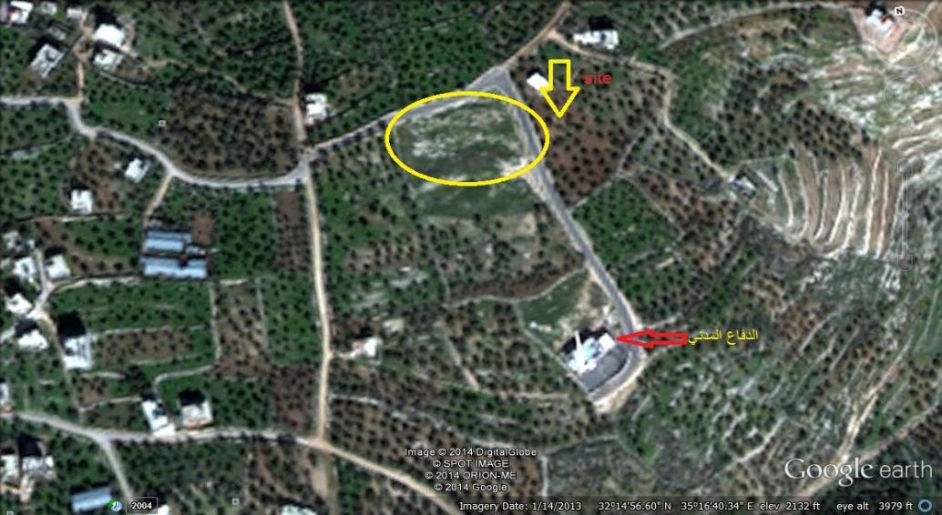
Site Description and Analysis:

Slide 5
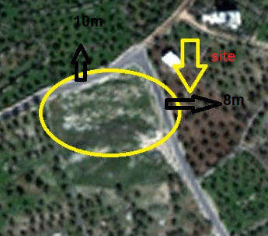
The site is surrounded by 10 -m Street on the north, 8 m Street on the east, and a green area to the south and west of the land

Slide 6
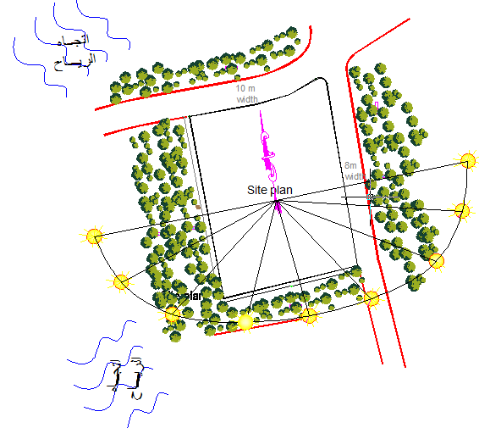

Slide 7
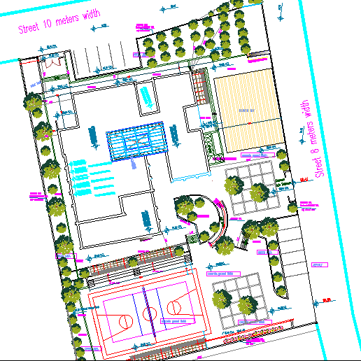
Design School Concept

Slide 8
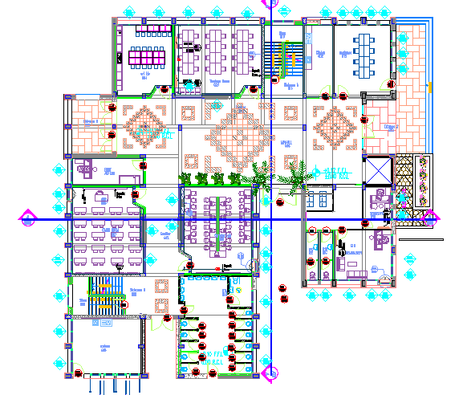
GF

Slide 9
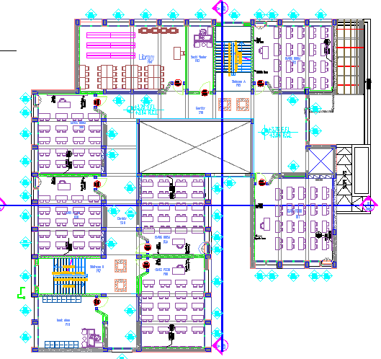
1st

Slide 10
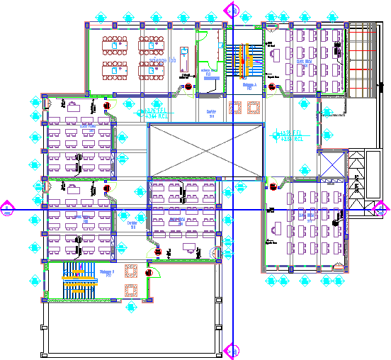
2nd

Slide 11
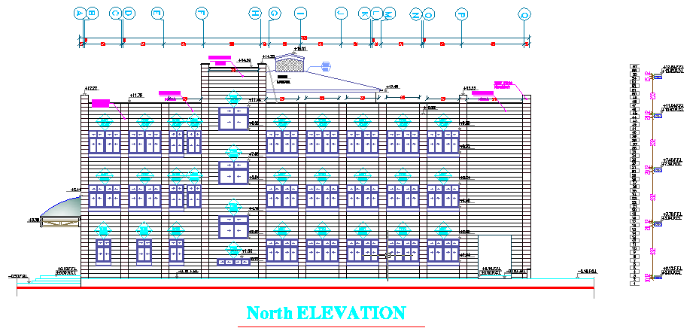
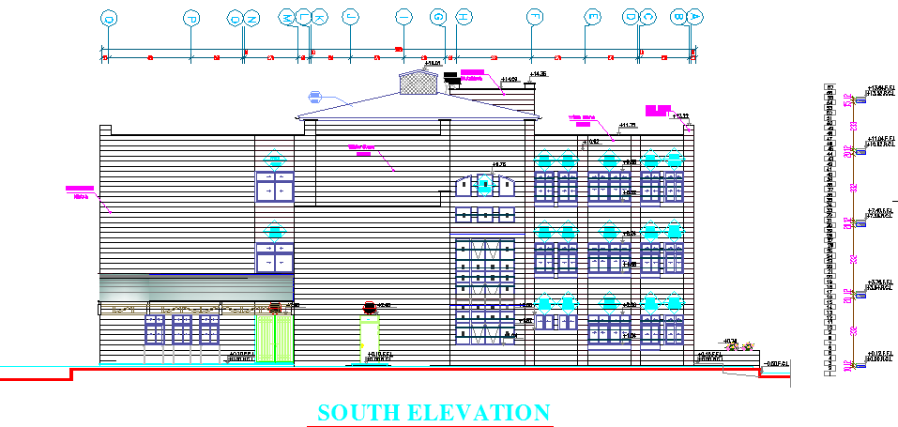

Slide 12
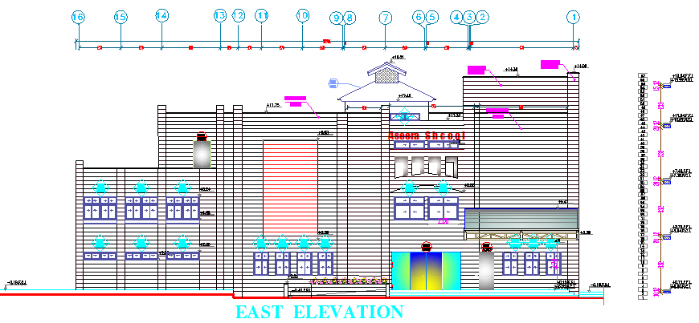
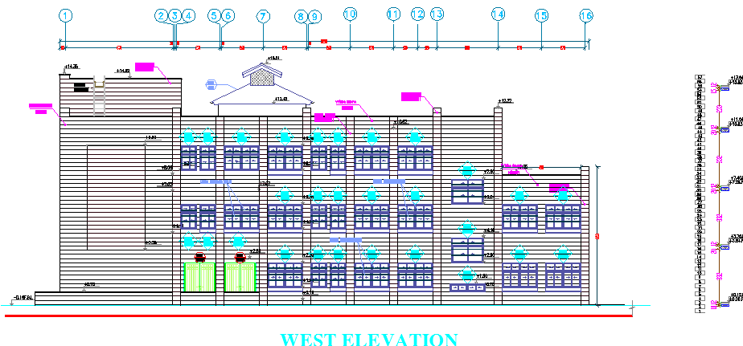

Slide 13
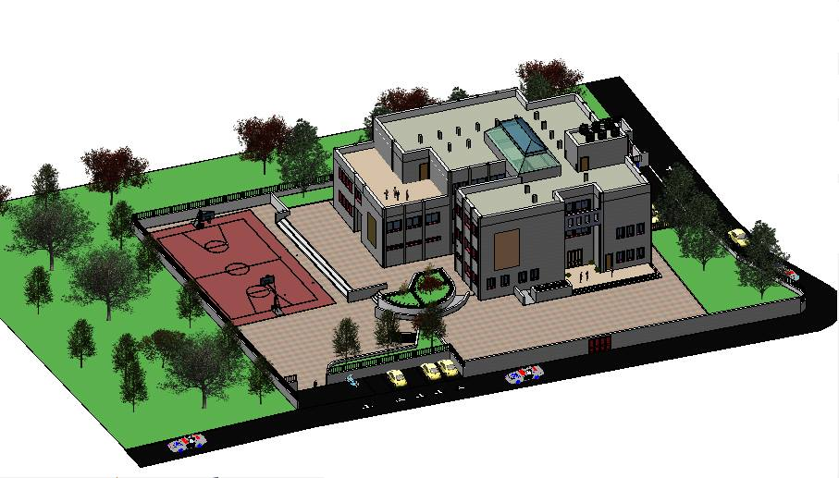

Slide 14
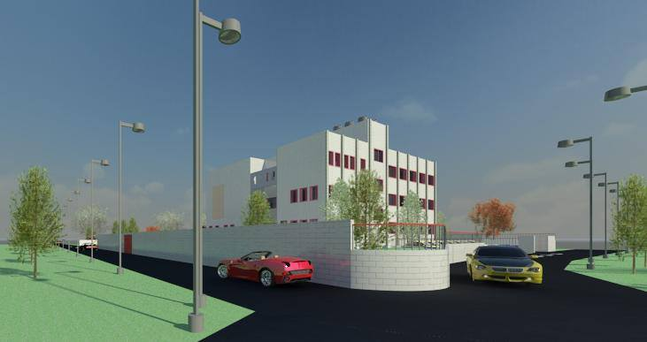

Slide 15
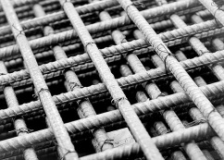
Structural Design

Slide 16
Structural Design
Design Data
Concrete Fc=24 for slabs
Concrete Fc=28 for beams and footing
Bearing Capacity of soil = 400KN/m²
Slabs System used = One way Ribed slab

Slide 17
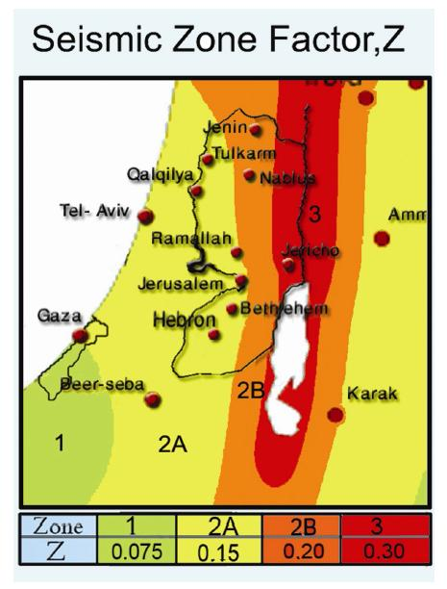
Seismic Design Data :
soil type S_{B}
Location → Nablus
zone =2B → Z=0.3
C_{V} = 0.2 , C_{a} = 0.2
I= 1.5 ( essential building )

Slide 18
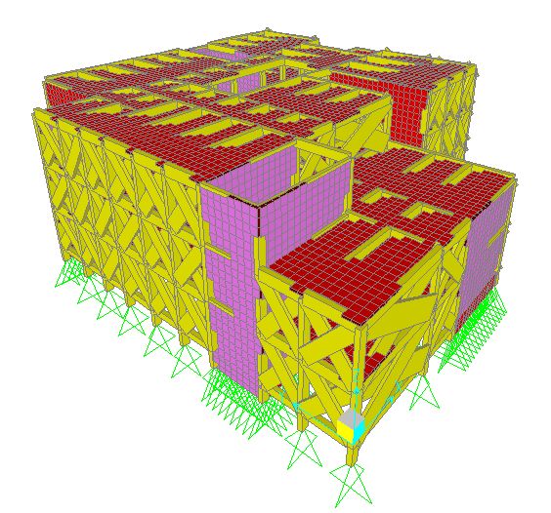
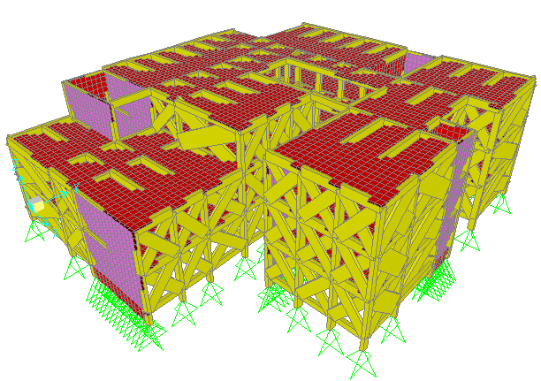
Sap
Model

Slide 19

Model Validation
Total weight of the building = 40384.9 KN.
Total Dead load from sap = 39901.1 KN
The percentage of difference = 1.19 % < 5% ---> OK
Total live load of the building = 9680.8 KN.
Total live load from sap = 9677.1 KN.
The percentage of difference = 0.03% < 5% ---> OK

Slide 20
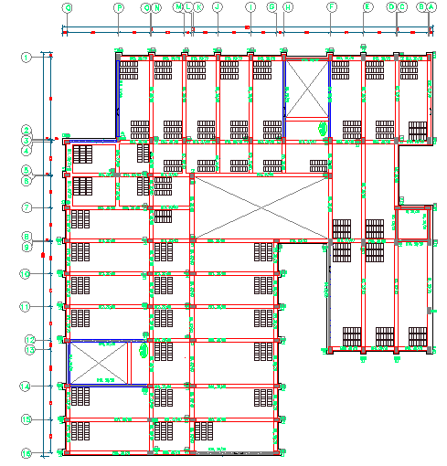
Structural-Elements

Slide 21
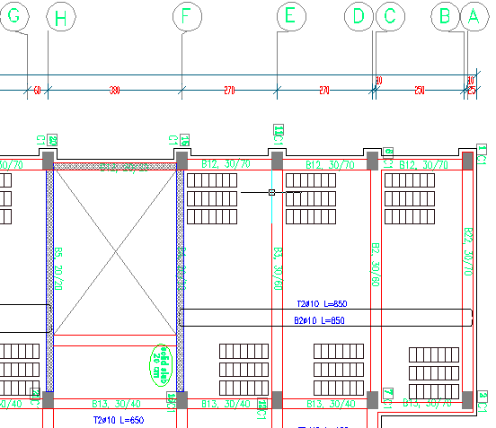
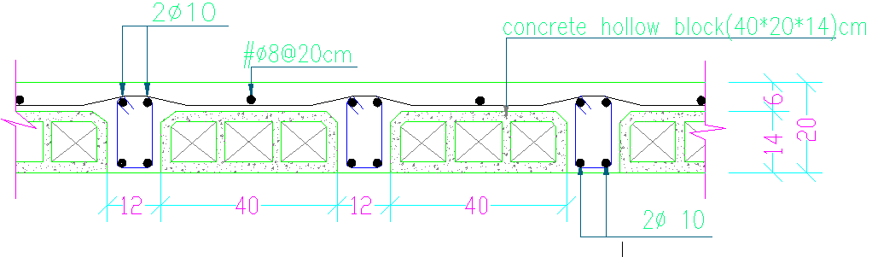
Slab
Systems

Slide 22
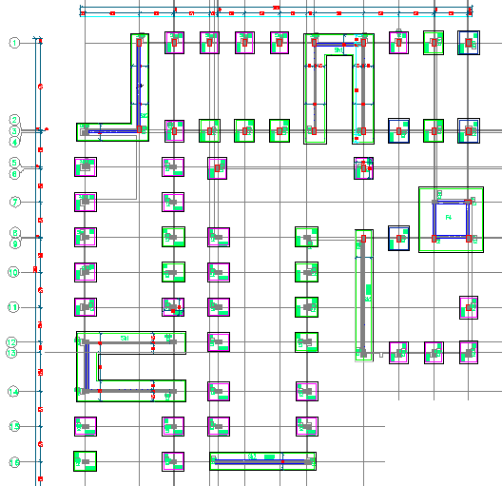
Footing Plan :

Slide 23
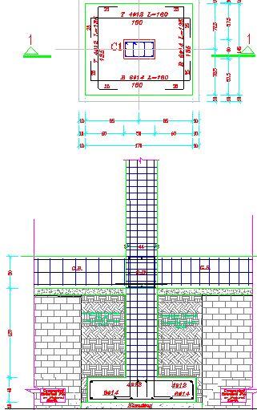
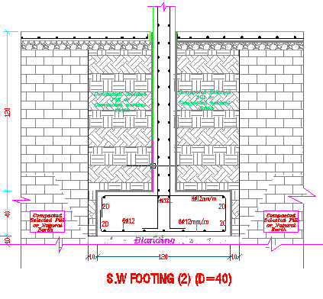
Types of footing :
Single Footing
S.W Footing

Slide 24
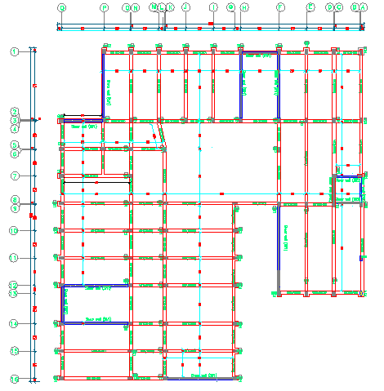
Tie Beam Plan

Slide 25
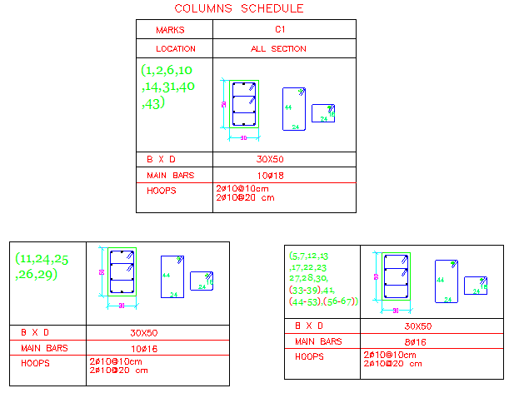
Column Design

Slide 26
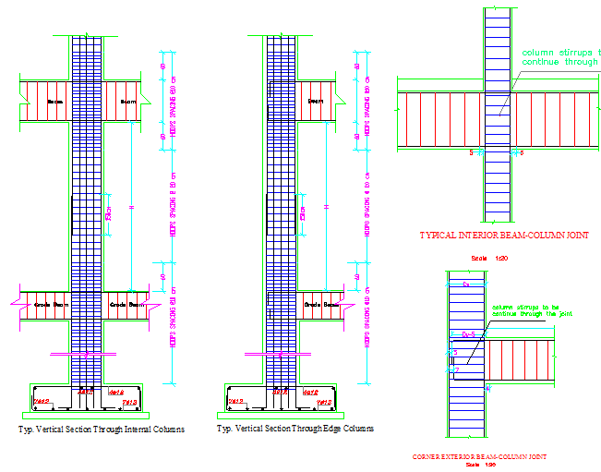
Longitudinal Column Sections :

Slide 27
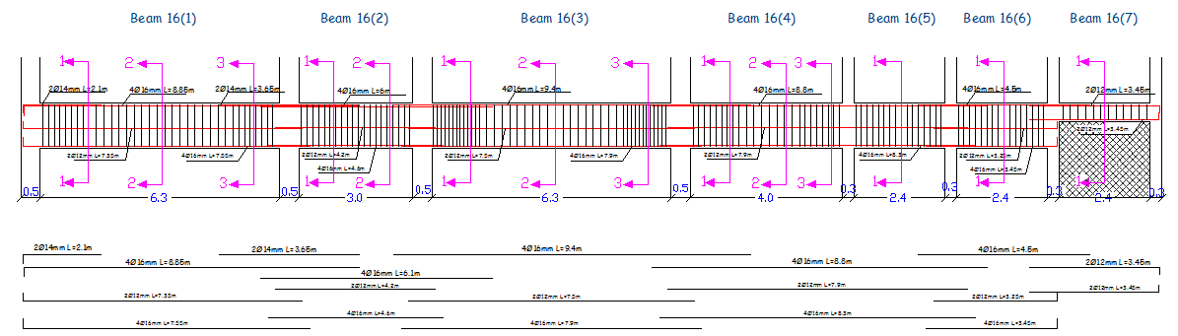
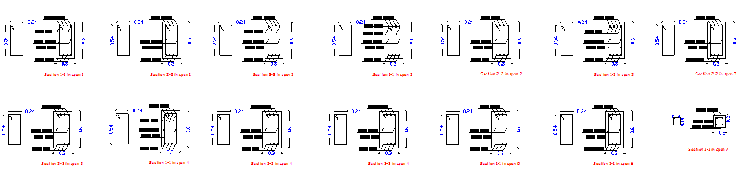
Beam Reinforcement :

Slide 28
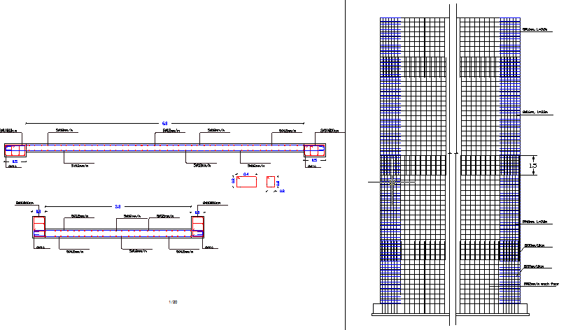
Shear Wall Reinforcement

Slide 29
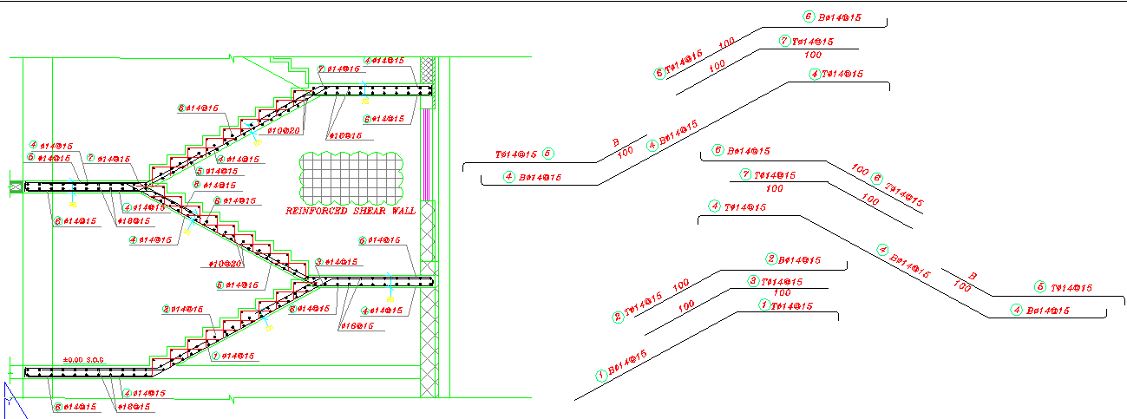
Stair Case Reinforcement

Slide 30
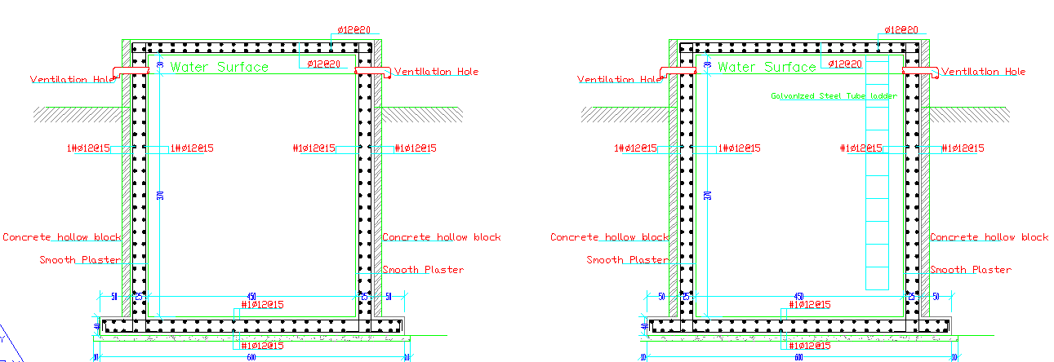
Tank Case Reinforcement

Slide 31
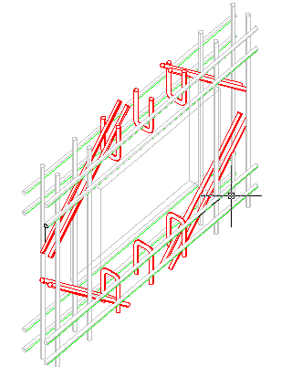
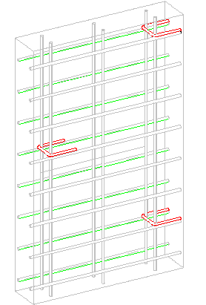
Reinforcement around windows and doors

Slide 32
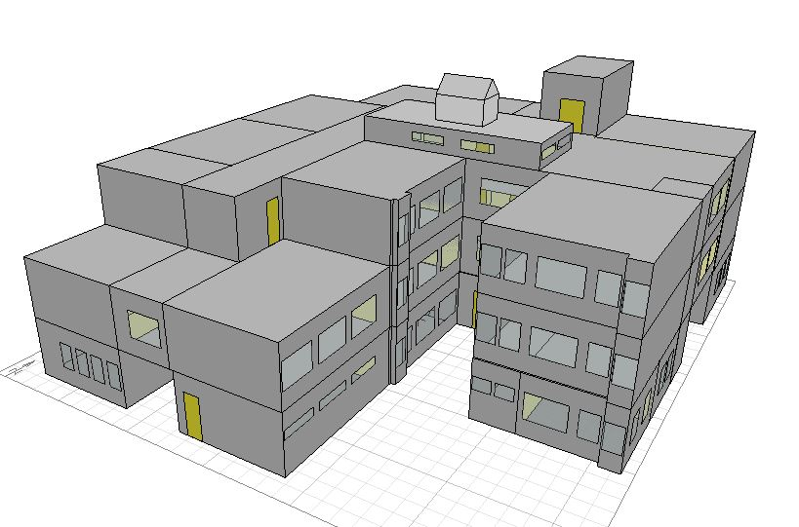
Environmental analysis

Slide 33
U value for each element :
 | U value (W/m².K)
External wall | 0.51
Ground floor | 0.31
Ceiling | 0.56
roof | 0.37
Partition | 0.54
Window | 2.7

Slide 34


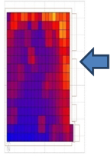
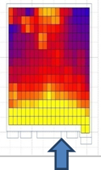
Natural Day light analysis
Activity | Floor | Orientation | Value |  | Picture
 |  |  | D.F | Lux
Classroom 2 | first | North | 4.75% | 411
Classrooms 3 | first | South | 5.02% | 455
Classroom 11 | second | East | 4.7% | 448
Classroom 12 | second | South | 4.13% | 375

Slide 35
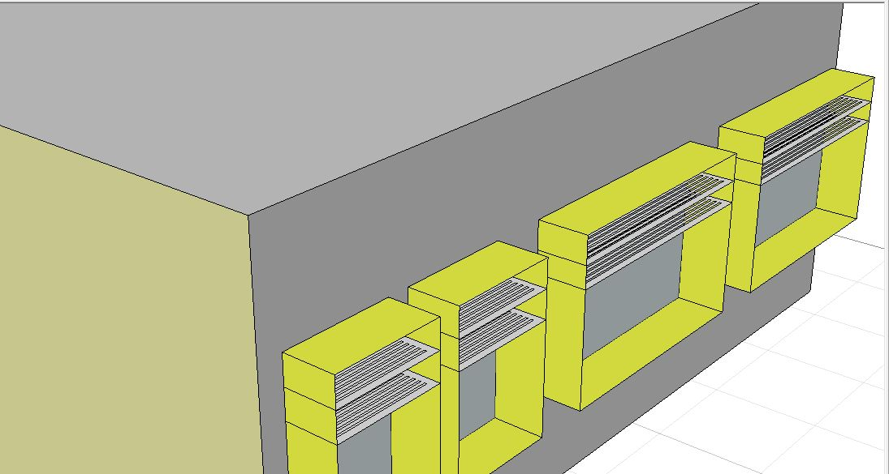
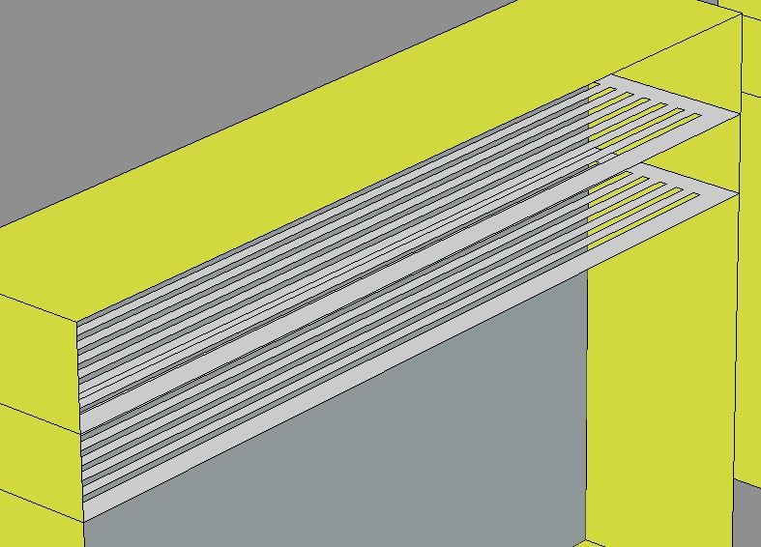

Slide 36
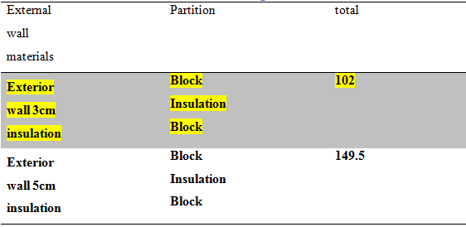
Thermal analysis.

Slide 37
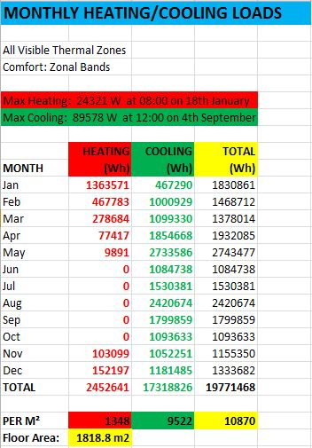
Heating and cooling results

Slide 38
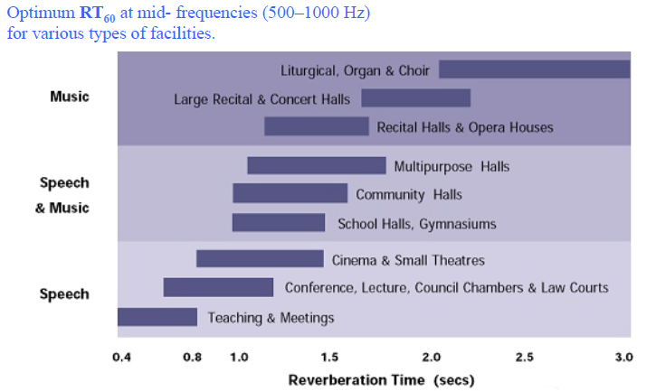
Acoustical design :
RT60 for classroom.
(RT₆₀) = 1.36 sec which it is not in the range of ( 0.4 – 0.8 ).
So that we need to do some modifications to decrease RT₆₀ to be in the range by using :
Page board.
Decorative sound absorption material.
Then RT₆₀ = 0.76 sec which is good.

Slide 39
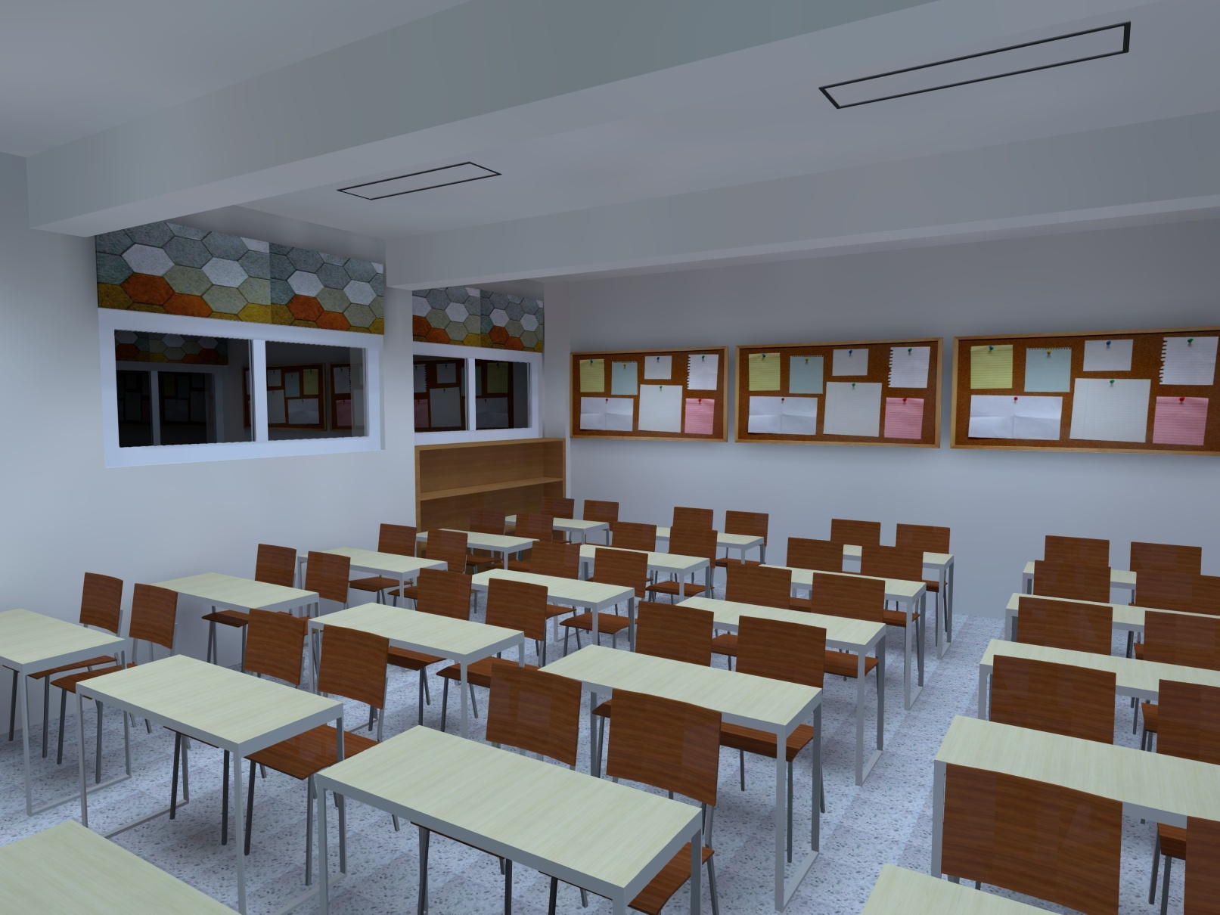
Treatment

Slide 40
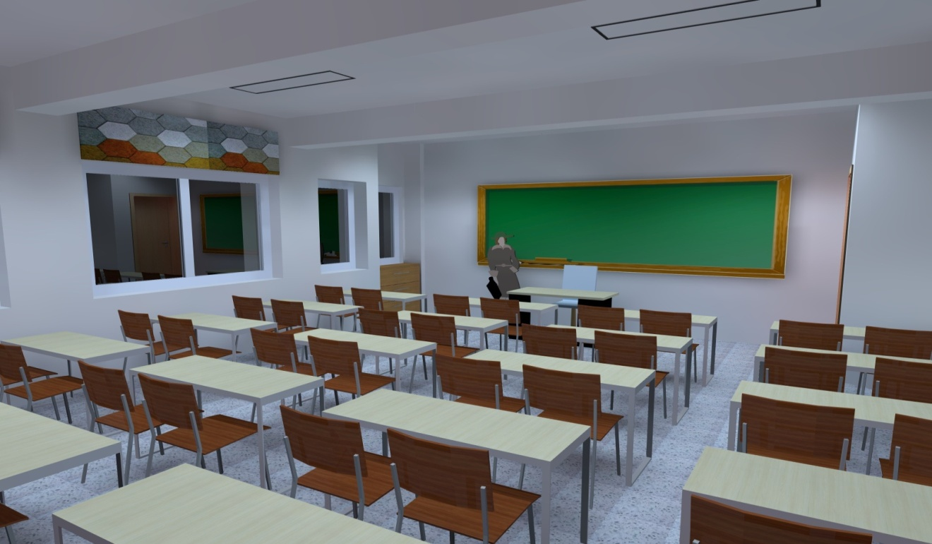
STC & IIC for rooms .
Ceiling IIC=47dB
Exterior wall
TLc=53dB
Interior wall
TLc= 37 dB

Slide 41
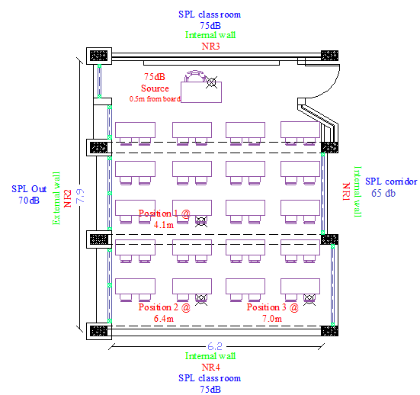
Background noise calculation.
Layers | STC
External wall | 93 dB
Windows | 30 dB
TLc | 53 dB
Sound Noise Ratio (S/N) in classroom shall be between (10-30 dB), Thus the value calculated it is good.
Percentage Articulation loss of Consonants = 6.5% between (7-15%), Thus the value calculated it is good.

Slide 42

Electrical Design

Slide 43
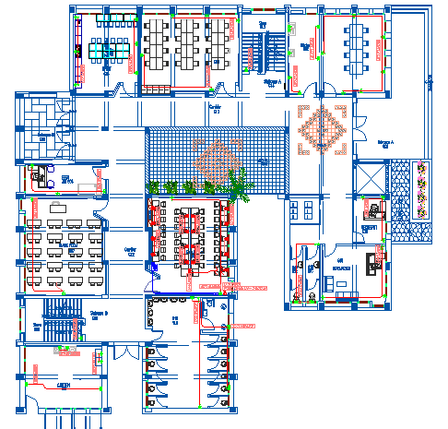
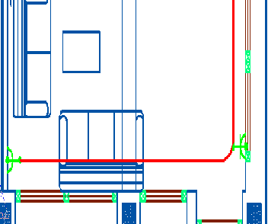
Socket Arrangement

Slide 44
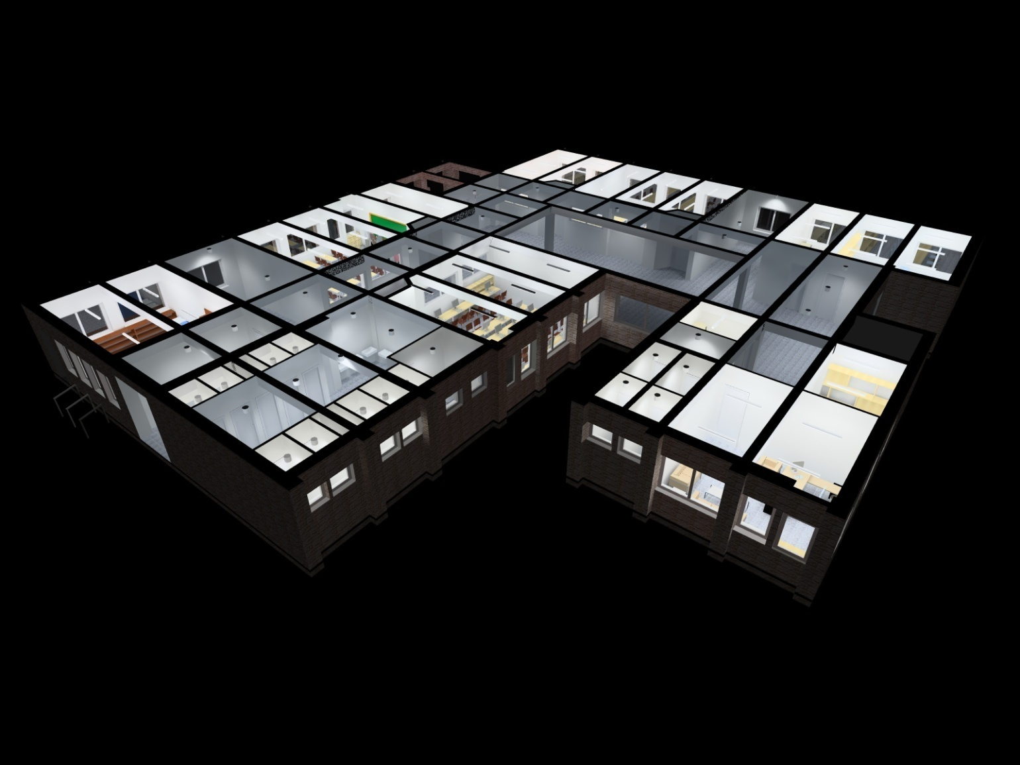
Artificial Lighting :
1- Ground Floor

Slide 45
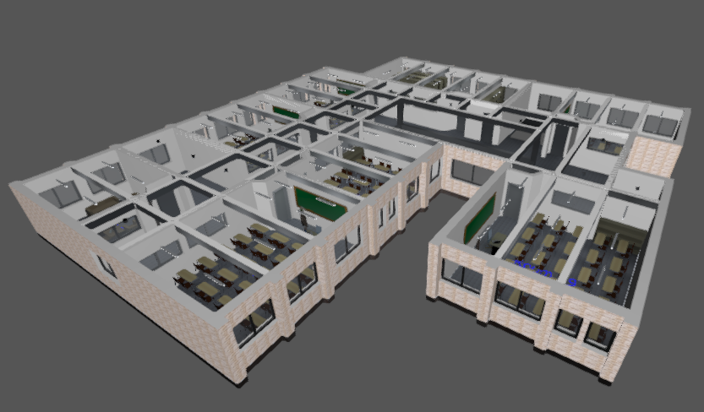
2- First Floor

Slide 46
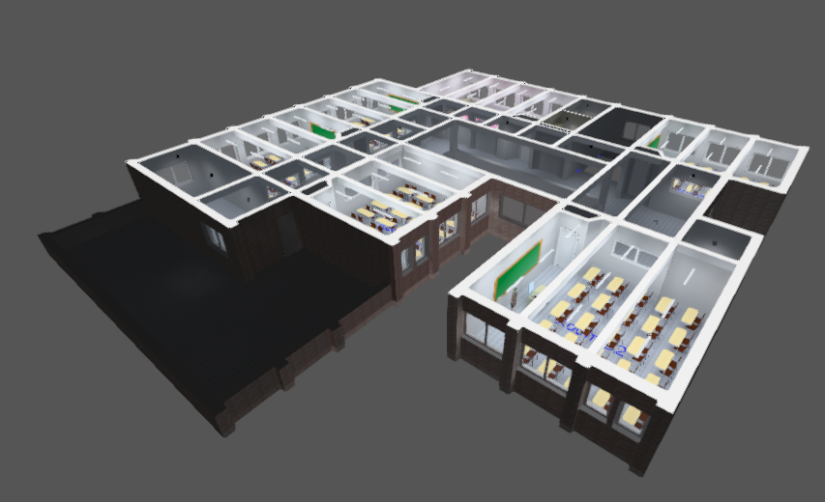
3- Second Floor

Slide 47
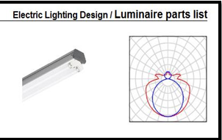



Slide 48



Slide 49





Slide 50

Mechanical Design

Slide 51
Mechanical design consists of :
Water Supplying System.
Drainage System.
Rain Water Drain System.

Slide 52


Water supplying for school
The system used is Flush Tank
The main vertical feeder has a load of 72 gpm, with 47.54 feet
The main horizontal feeder has a load of 57gpm, with 72 feet (ground floor)
The branch feeder has a load of 5gpm, with 36 feet (ground floor)

Slide 53



Slide 54

Water DRAINAGE

Slide 55

Rain Water harvesting

Slide 56


FIRE Fighting system

Slide 57

Quantity surveying

Slide 58

Quantity surveying calculation
The total cost of the school is about 3.7 million shekel.
The total cost per meter square for the school is about 2100 shekel

Slide 59


