Slide 1

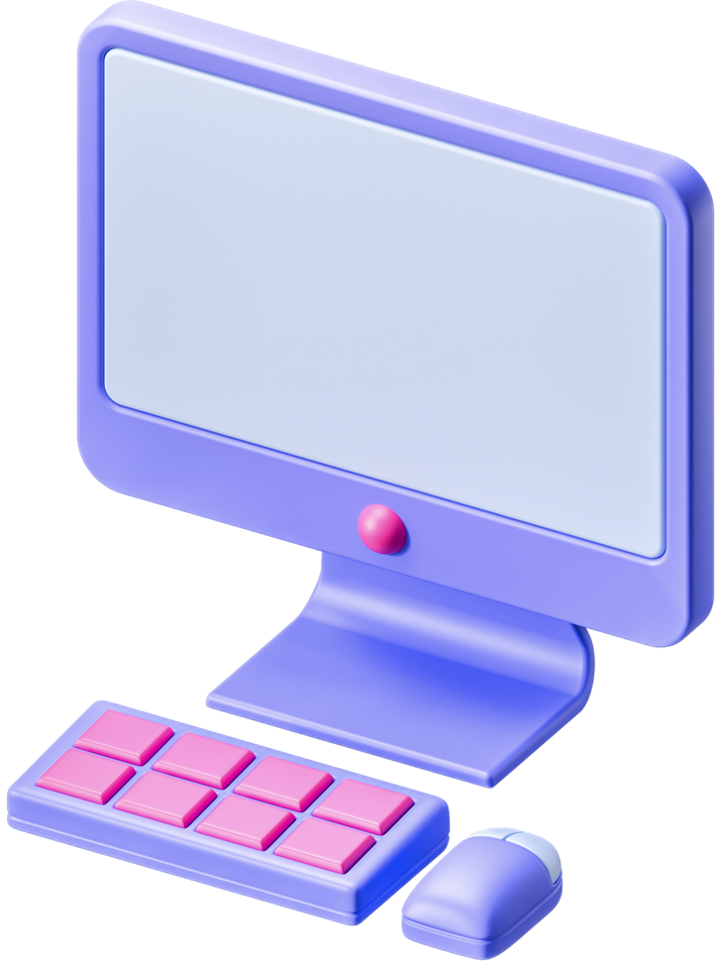


CUP FILLER
Yaser kharouf
Hamza fattouh
supervisor :
Dr. Saad Tarapieh

Slide 2

OUTLINE
1-introduction
2-motivation
3-project details
4-feature work
5-constrainst

Slide 3


INTRODUCTION

Slide 4

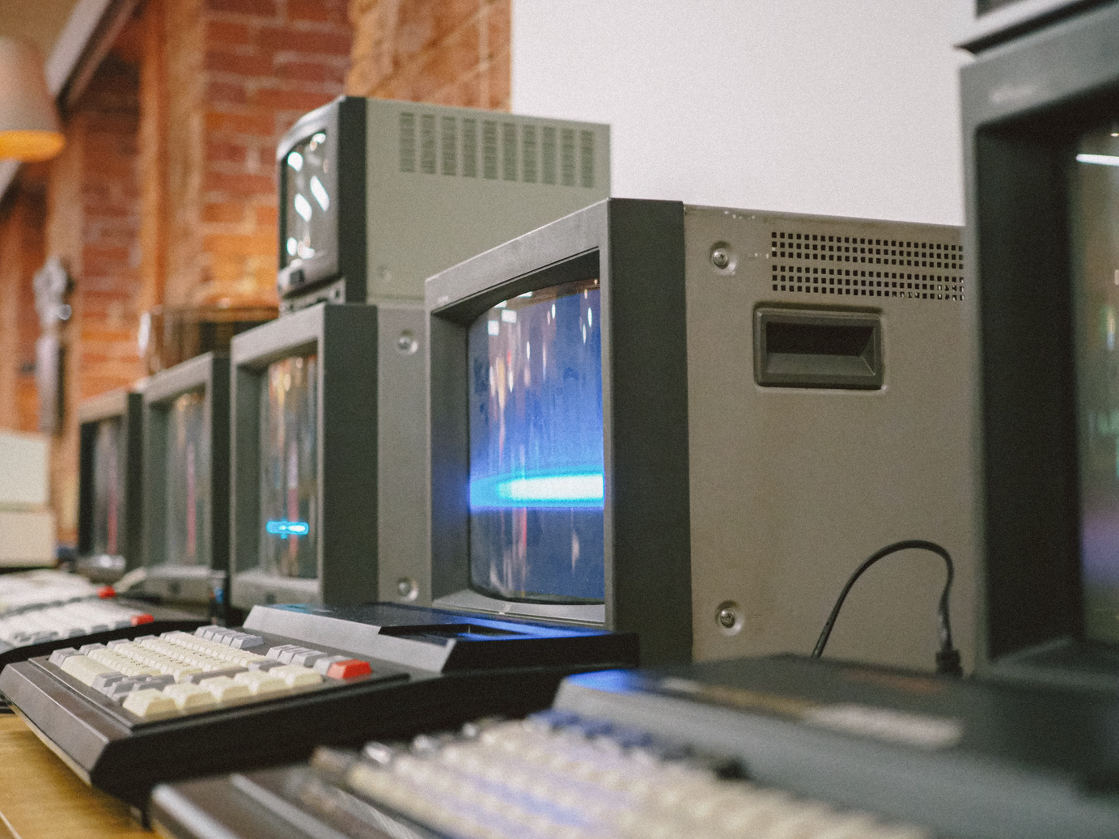

INTRODUCTION
In modern industries, manual liquid filling processes are increasingly seen as inefficient and prone to errors. The "Cup Filler" project addresses this challenge by automating the cup-filling process using advanced sensor technology, microcontrollers, and actuators. This system ensures precise liquid dispensing based on cup size, reduces waste, and enhances productivity. Designed for scalability, the project demonstrates significant potential for applications in food, beverage, pharmaceutical, and small-scale production environments.

Slide 5
MOTIVATION

Slide 6
MOTIVATION
Automation has become a cornerstone of modern engineering, driving improvements in efficiency, accuracy, and resource management. The "Cup Filler" project is motivated by the need to eliminate repetitive and error-prone manual tasks. By integrating innovative technologies, the system addresses industry demands for precision and reliability. This not only enhances operational productivity but also reduces human effort and environmental impact, aligning with the global shift toward sustainable and automated solutions.

Slide 7
HARDWARE COMPONENTS

Slide 8
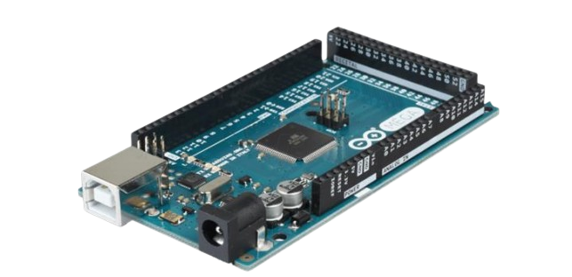
ARDUINO MEGA 2560

Slide 9
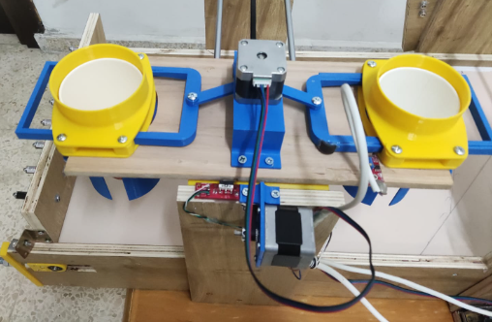
CUP EXTRACTOR

Slide 10
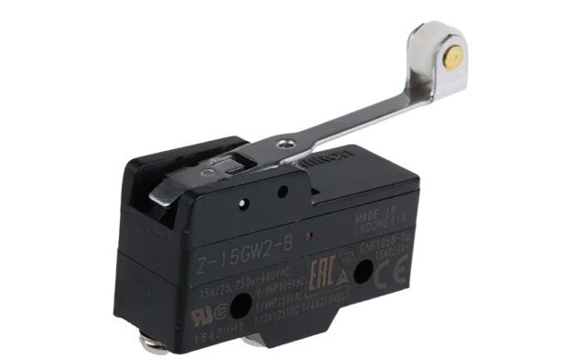
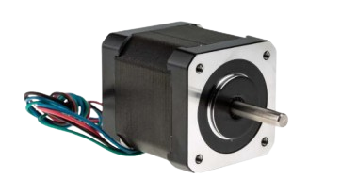
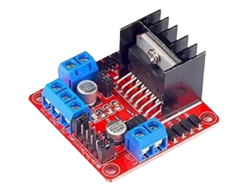
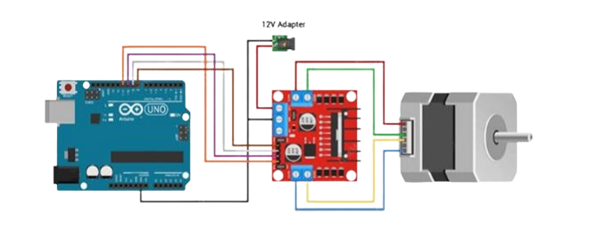
CUP EXTRACTOR PARTS

Slide 11
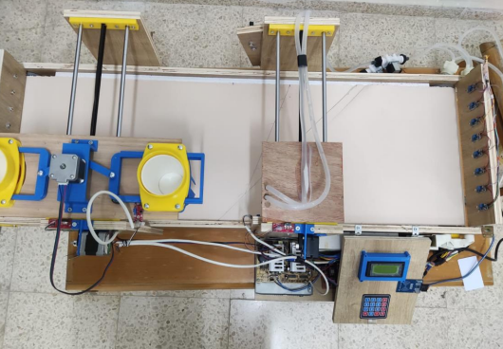
CONVEYOR BELT

Slide 12
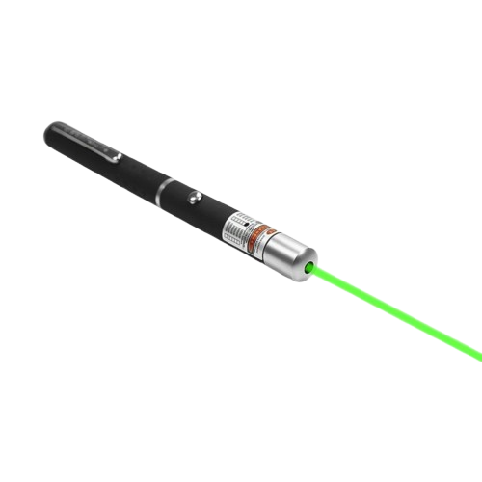
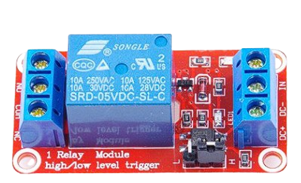
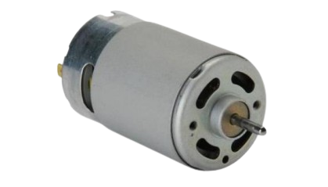
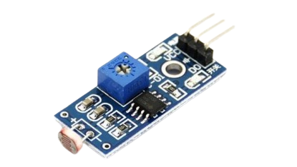
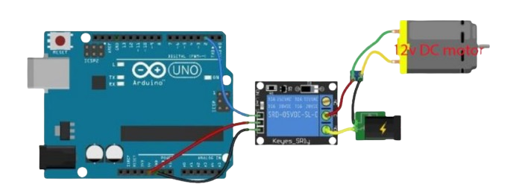
CONVEYOR BELT PARTS

Slide 13
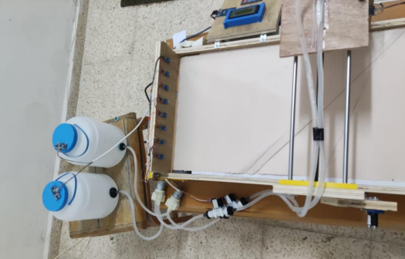
PUMP LINE

Slide 14
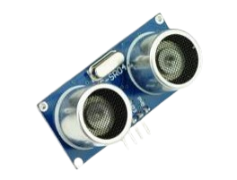
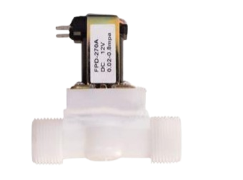
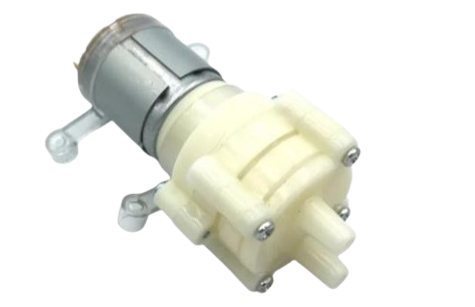
PUMP LINE PARTS

Slide 15
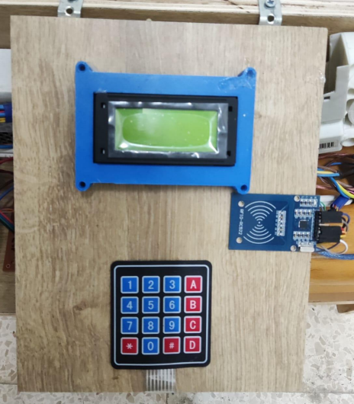
INPUT OUTPUT

Slide 16
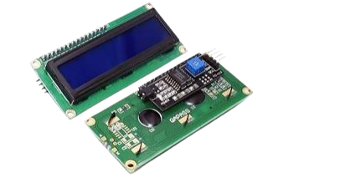
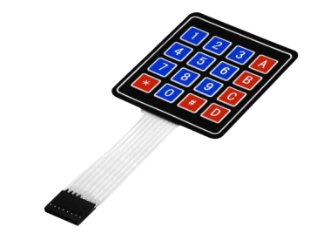
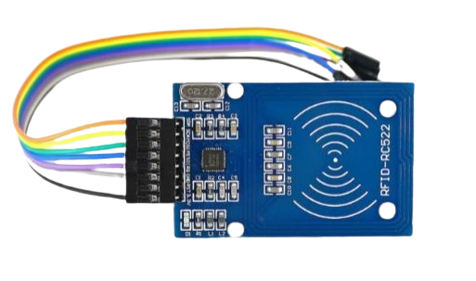
INPUT OUTPUT PARTS

Slide 17
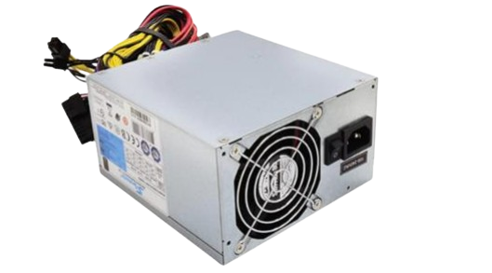
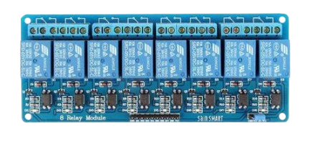
POWER DEVICES

Slide 18

FEATURE WORKS
1-Add a payment user interface and add other juices to make a juice vending machine .
2- Modifying the cups and adding a mechanism to close the cups to make a filling line for factories.

Slide 19

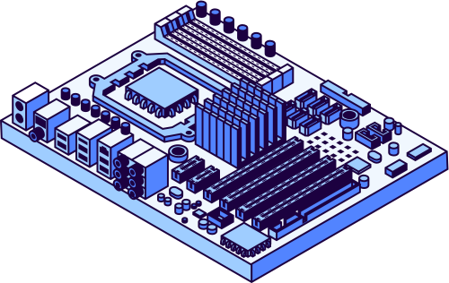
CONSTRAINTS
1- Lack of experience.
2- Lack of equipment.
3- High project cost.

Slide 20

THANK YOU

