Slide 1
The Handless Writer
Done by :
Asad Sukhon
Mahmood Jabri

Slide 2
Contents
Introduction.
What does our project do?
Project Parts.
Terms.
Progress of Work.
How does it work?
Examples.
Challenges and Constraints.
Future Work.

Slide 3
Introduction
CNC is Computer Numerical Control.
The principle of CNC plotter machines is world-wide applied principle in different fields.
    Accomplish tasks without human efforts.
    Not constrained by human limitations.
    Reduce Manpower Costs.
However, They are not easy to afford.

Slide 4
What does our project do?
Executes the voice commands.
  Shapes.
  Hand writing.
  Signature.
  Drawing.
Executes specific type of files manually .
  Gcode.

Slide 5
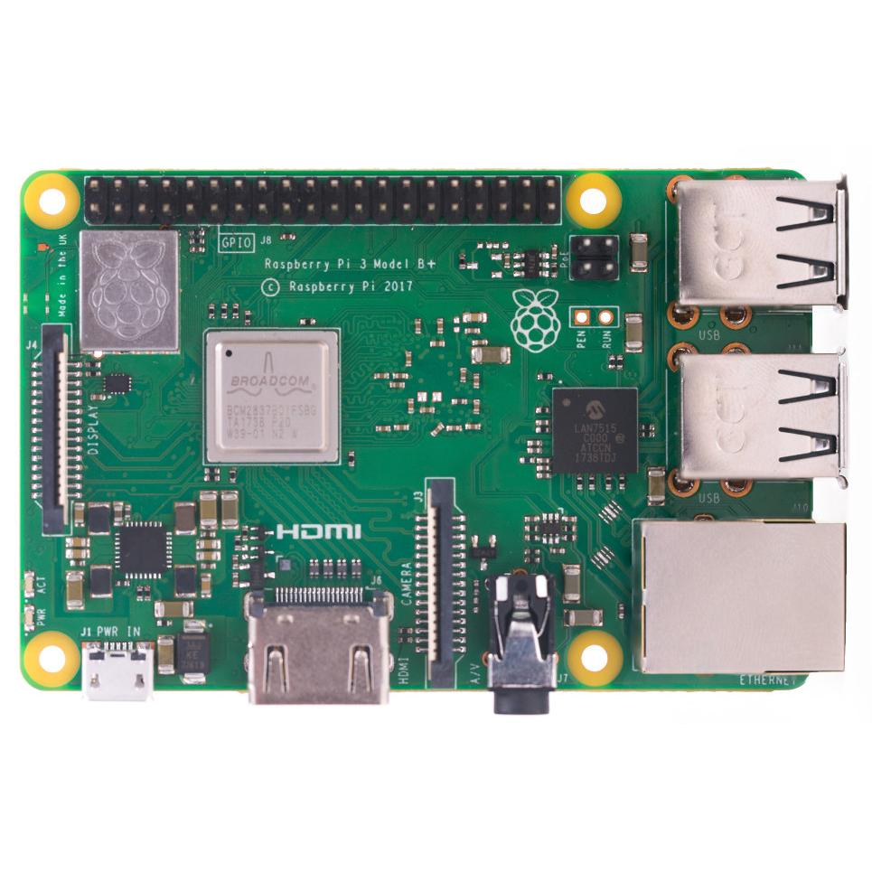
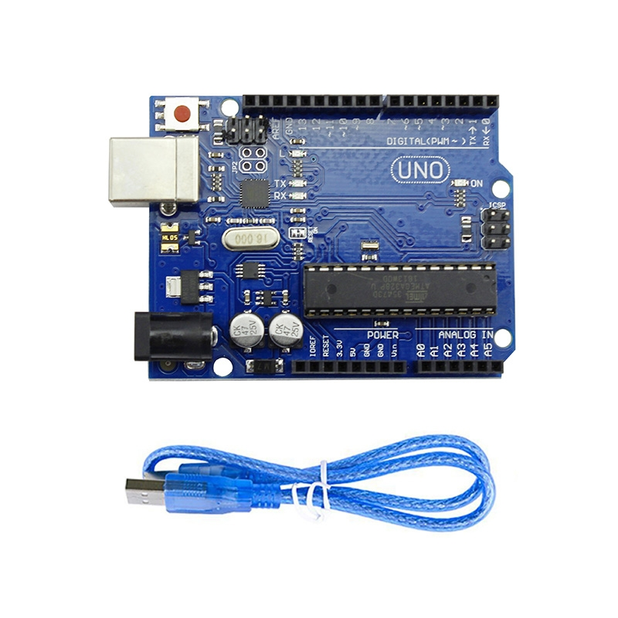
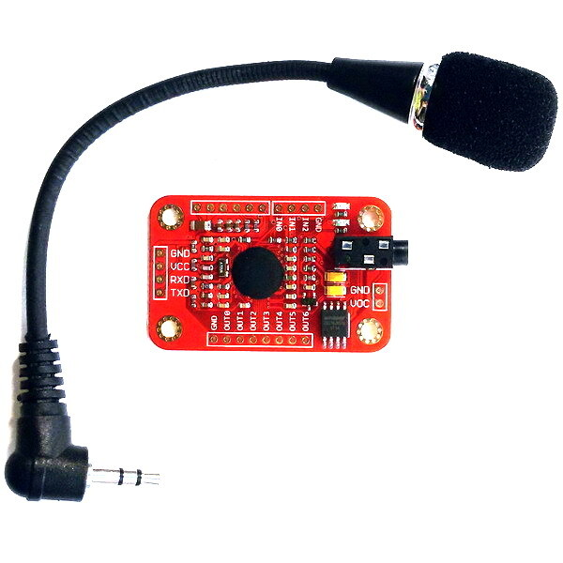
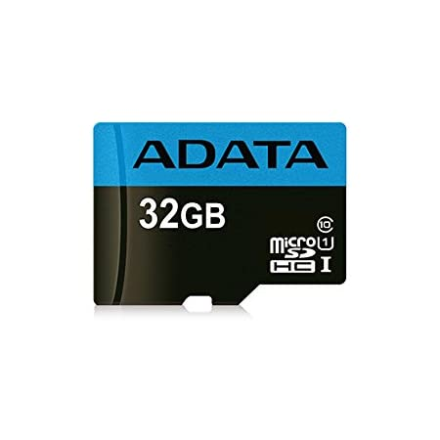
Project Parts
..

Slide 6
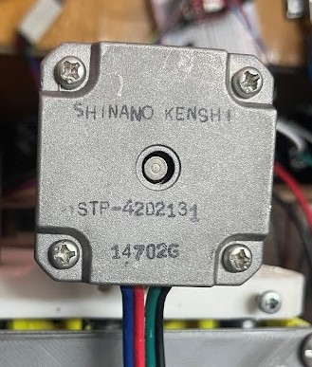
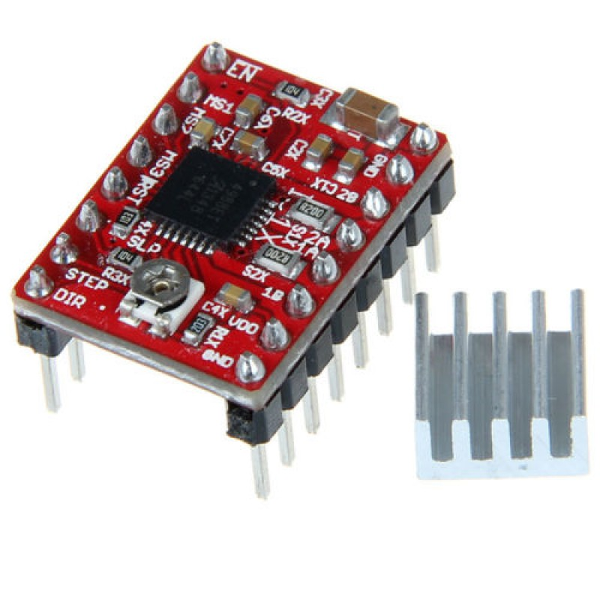
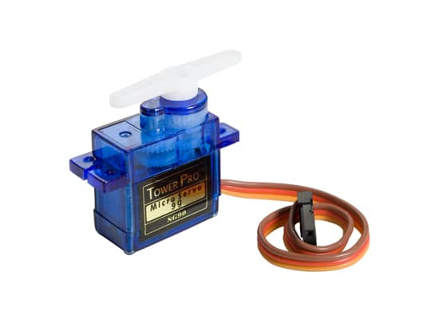
Project Parts
..

Slide 7
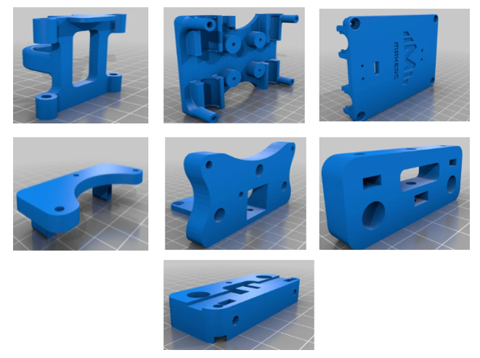
Project Parts

Slide 8
Terms
Gcode
GRBL
Universal Gcode Sender

Slide 9
Progress of Work
Printing and buying the needed parts.
Assembling and testing the CNC Machine.
Testing the voice recognition module.
Writing code for voice recognition module.
Testing the serial communication between Arduino and Raspberry pi.
Combining.

Slide 10
How does it work?
Voice recognition mode:
Voice recognition module.
Voice recognition Arduino Uno.
Raspberry pi.
GRBL Arduino Uno.
CNC Machine.

Slide 11
How does it work?
Manual Mode:
Gcode File.
Raspberry pi.
GRBL Arduino Uno.
CNC Machine.

Slide 12
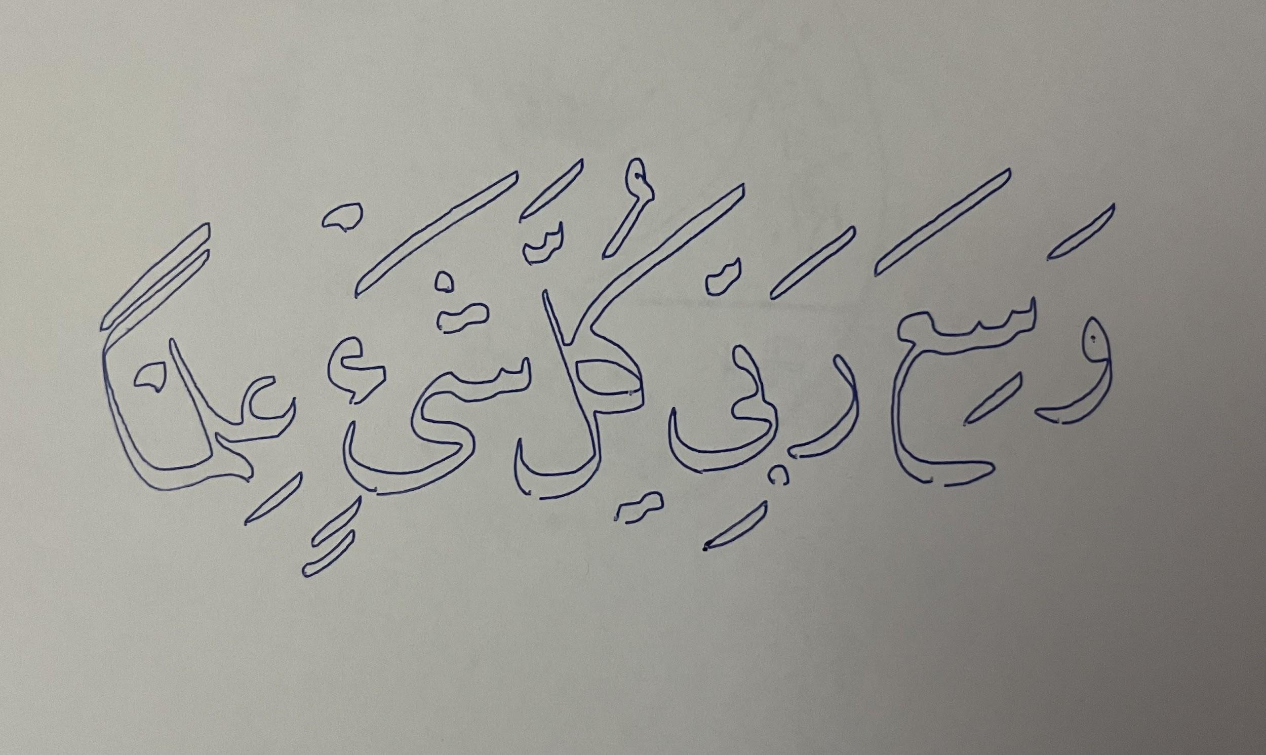
Examples

Slide 13

Examples

Slide 14
Challenges and Constraints
Cost of materials.
Printing plastic parts.
The sensitivity of parts.

Slide 15
Future Work
Navigating across the paper.
Process and execute any spoken word.

Slide 16
Thank you!
Any Questions?

