Slide 1

MY ARM
Prepared by : Supervisor:
Razan Balatiah Dr. Mona Dmaidi
Sara Mahmoud

Slide 2
Outline
Motivation
Objectives
Hardware Tools
How the project work ?
Hand Gestures
Demo
Constraints
Future work

Slide 3
Motivation
Remote control has become very widespread these days!
Hand gestures are an effective and very easy method

Slide 4
Objectives
A robot that is fully controlled by hand gestures.
Barriers Avoidance.
Record & Repeat the path.
Control the speed of car .
An educational game .

Slide 5
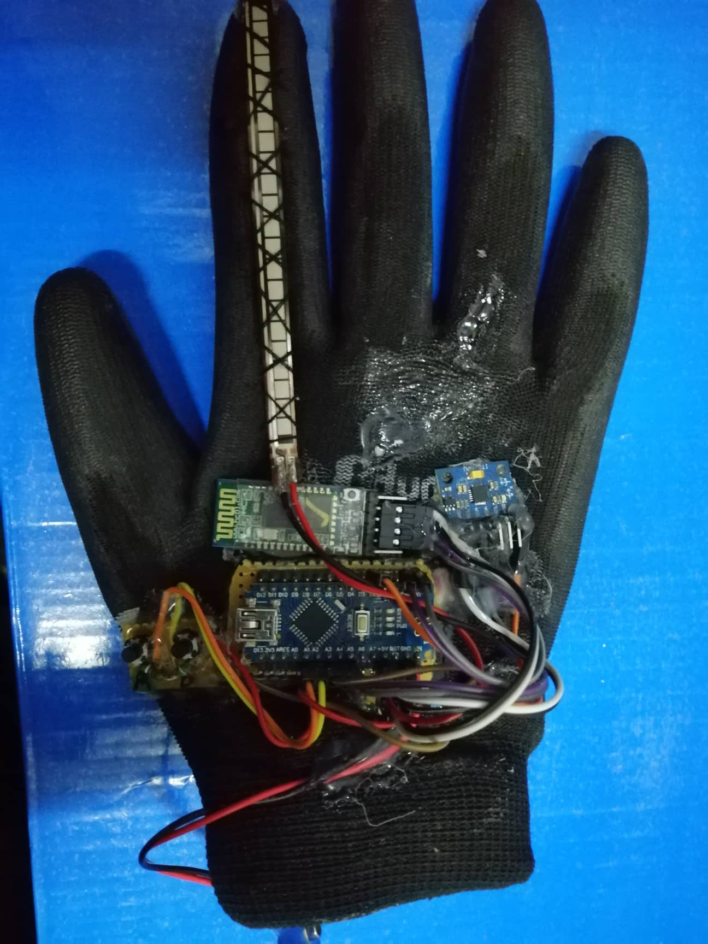
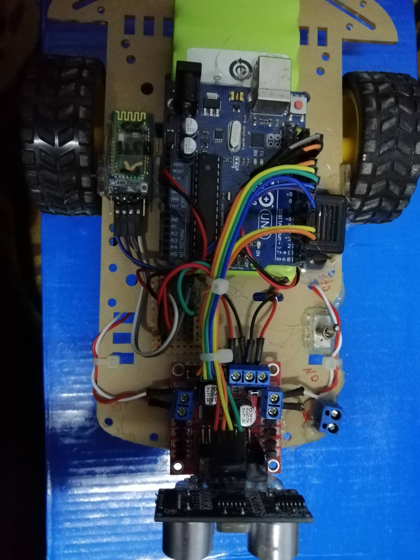
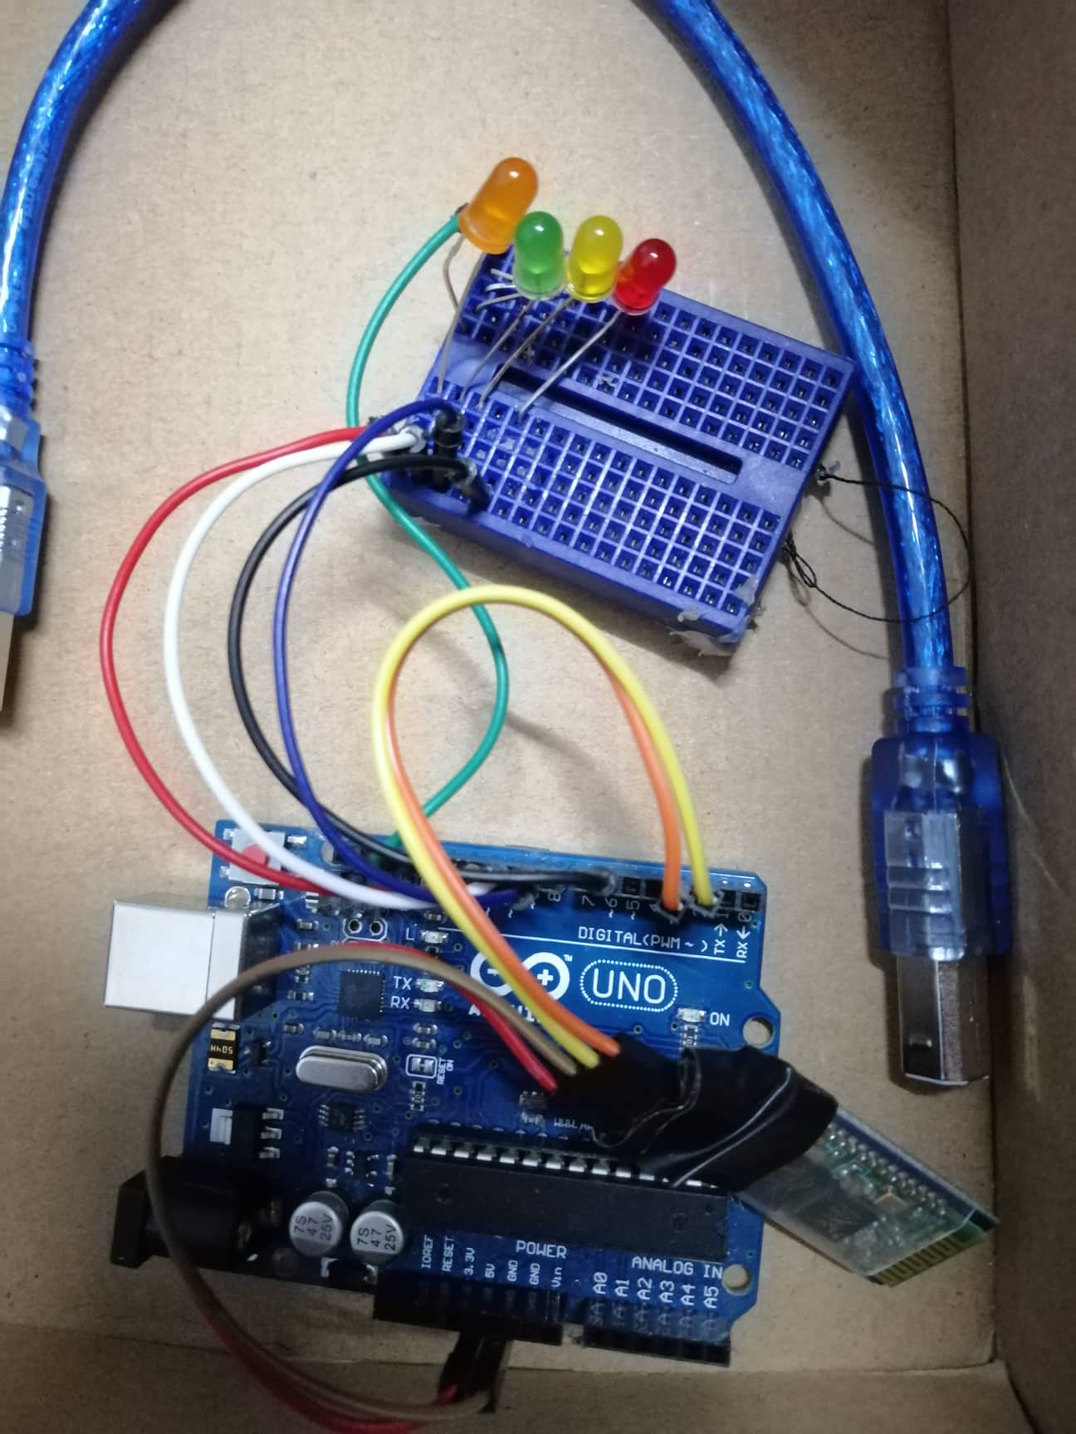
Project Parts
Transmitter & Receiver

Slide 6
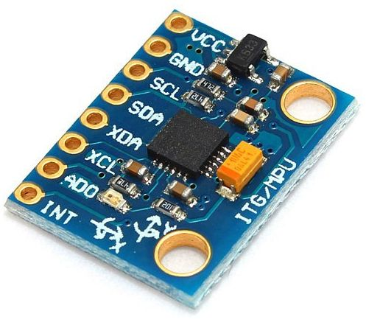
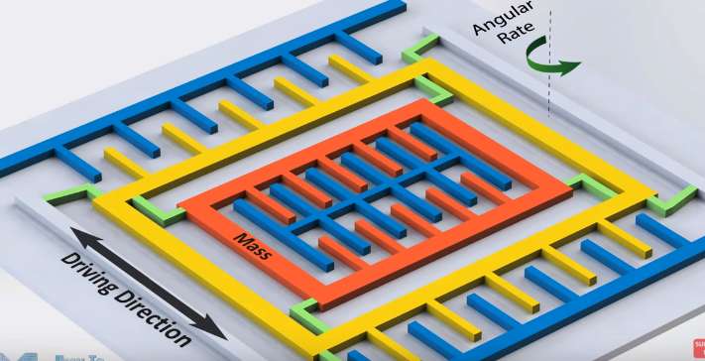
Hardware Tools
Transmitter Circuit:
1. ITG/ MPU 6050 GYROSCOPE
To know the movement of hand.

Slide 7
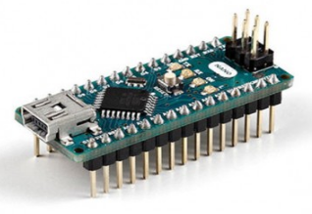
Hardware Tools
Transmitter Circuit:
2. Arduino NANO
A microcontroller board

Slide 8
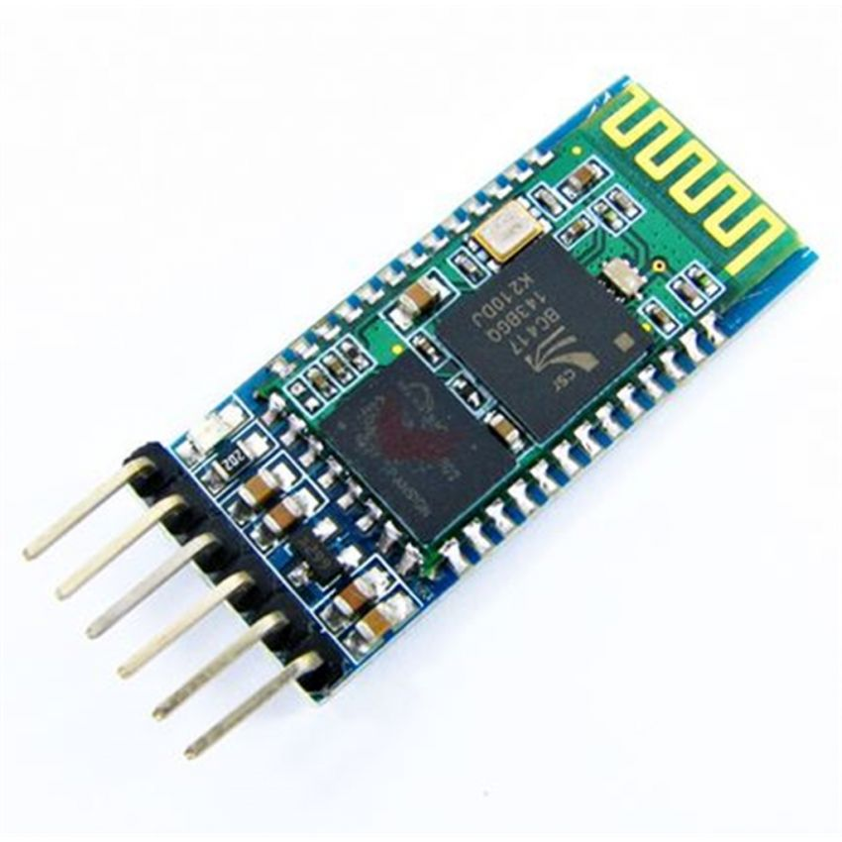
Hardware Tools
Transmitter Circuit:
3. HC-05 Bluetooth
It used to send and receive the signals .

Slide 9
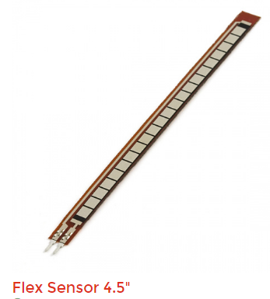
Hardware Tools
Transmitter Circuit:
4. Flex Sensor .
To Control the speed of car .

Slide 10
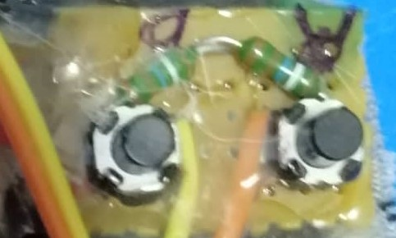
Hardware Tools
Transmitter Circuit:
5. Buttons .
It used to record the path and repeat it .

Slide 11
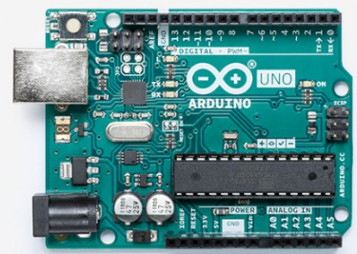
Hardware Tools
Receiver Circuit:
1. Arduino UNO
A microcontroller board

Slide 12
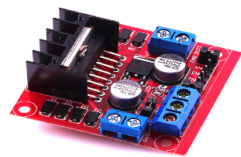
Hardware Tools
Receiver Circuit:
2. L298N H-Bridge Motor Driver.
Used to control two DC motors at the same time.

Slide 13
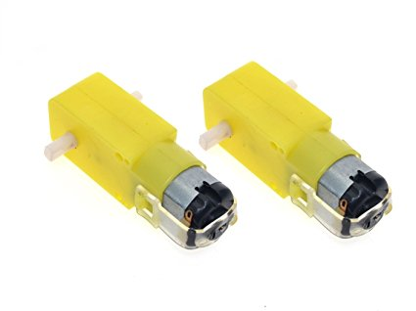
Hardware Tools
Receiver Circuit:
3. DC motors

Slide 14
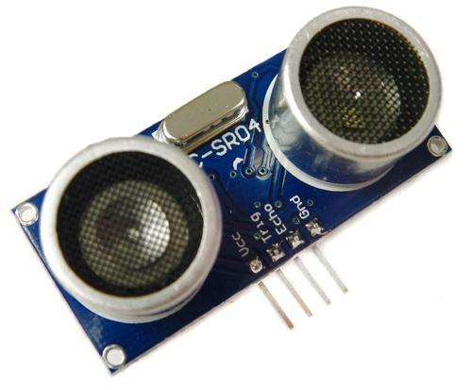
Hardware Tools
Receiver Circuit:
4. Ultrasonic sensors
It used to detect obstacles .

Slide 15
Hardware Tools
Receiver Circuit:
5. HC-05 Bluetooth
It used to send and receive the signals .

Slide 16
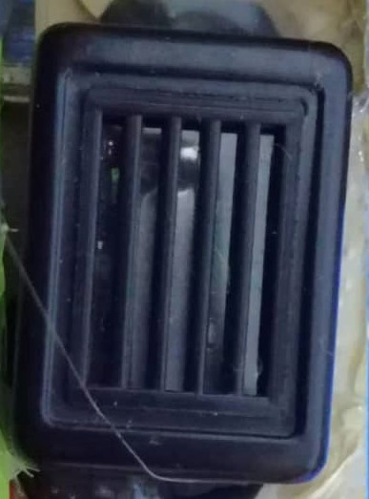
Hardware Tools
Receiver Circuit:
6. Buzzer
It used to issuing a sound .

Slide 17
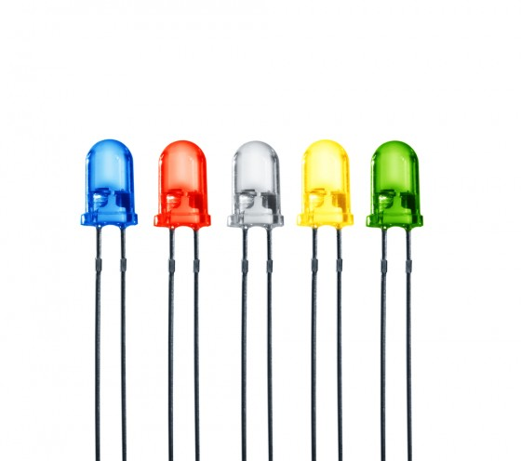
Hardware Tools
Receiver Circuit:
7. LEDS .

Slide 18
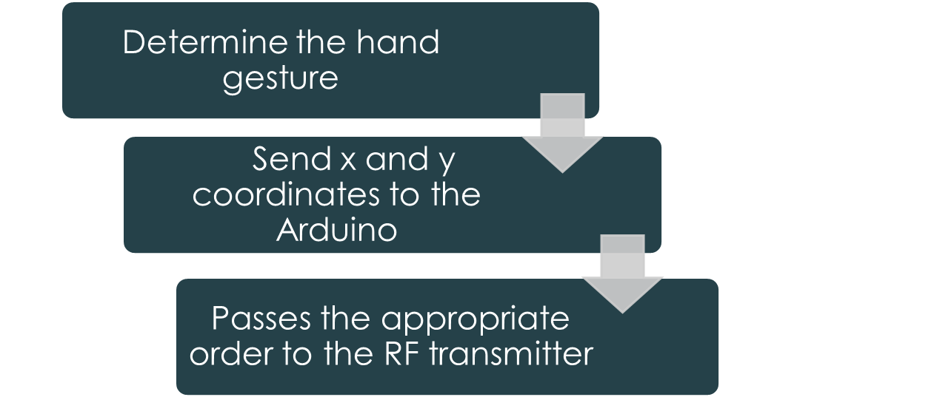
How the project work ?
The transmitter part:
Passes the appropriate order to Bluetooth

Slide 19
How the project work ?
The receiver part:
Receive the data from transmitter part
Move it to the Arduino
Arduino passes it to the motor driver
Motor driver decided how to turn the two motors

Slide 20
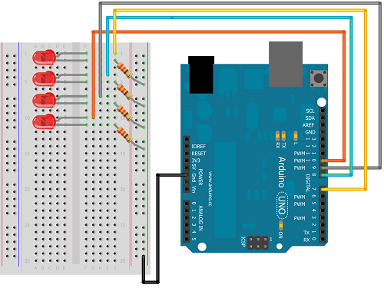
Receiver CCT

Slide 21
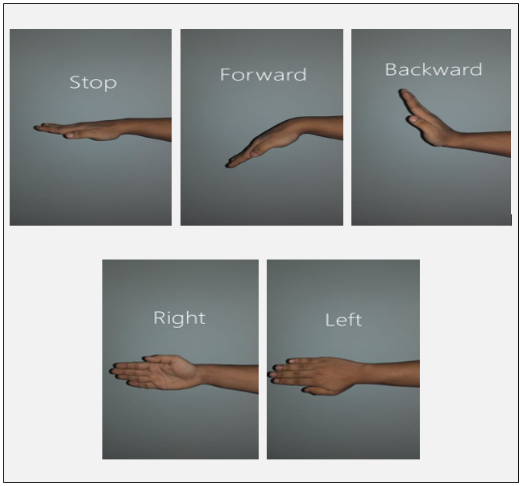
Hand Gestures

Slide 22
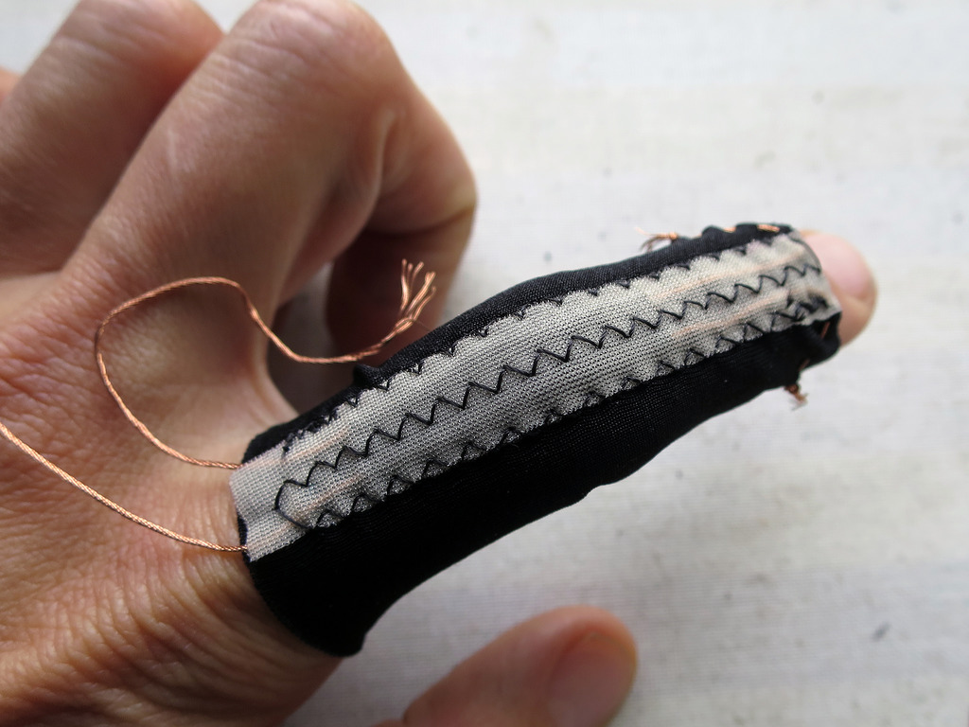
Hand Gestures

Slide 23
Demo

Slide 24
Constraints
Limitation of hand movements .
DC Motor inaccuracy in save path .

Slide 25
Future work
Providing a camera and use it to reach small and dangerous places.
Insert robotic-arm to move small things.
Glove could be used in multiple uses such as in smart homes.

