Slide 1

Operations analysis and improvement in packaging factory utilizing DMAIC approach
Prepared By:
Tareq Saymeh
Mosab Shuqqo
Anas Yaqoob
Mohammad Azzam
Industrial and Mechanical Engineering Department
Supervisor: Dr.Basheer Shaheen

Slide 2


Table of contents
Introduction
Define
Measure
Analyze
Improve
Control
Conclusion and recommendations
2

Slide 3

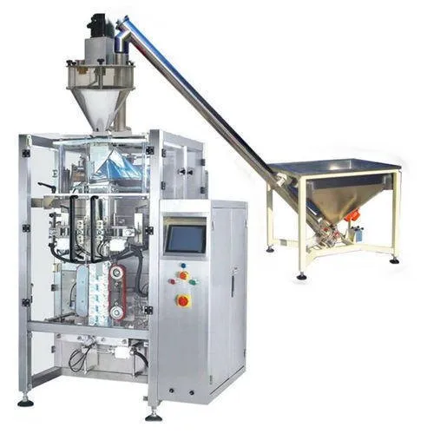

Introduction
In the previous project:
  we introduced key concepts in industrial engineering, focusing on process improvement and waste reduction using Lean six sigma and the DMAIC methodology.
  Building on that foundation, this second phase applies those principles in a practical case study at Al-Shilleh Packaging Factory, aiming to enhance the salt packaging line and address major operational challenges.
3

Slide 4







DMAIC PHASES
01.
03.
05.
D
M
A
I
C
DEFINE
MEASURE
ANALYZE
IMPROVE
CONTROL
02.
04.
4

Slide 5


DEFINE
5

Slide 6
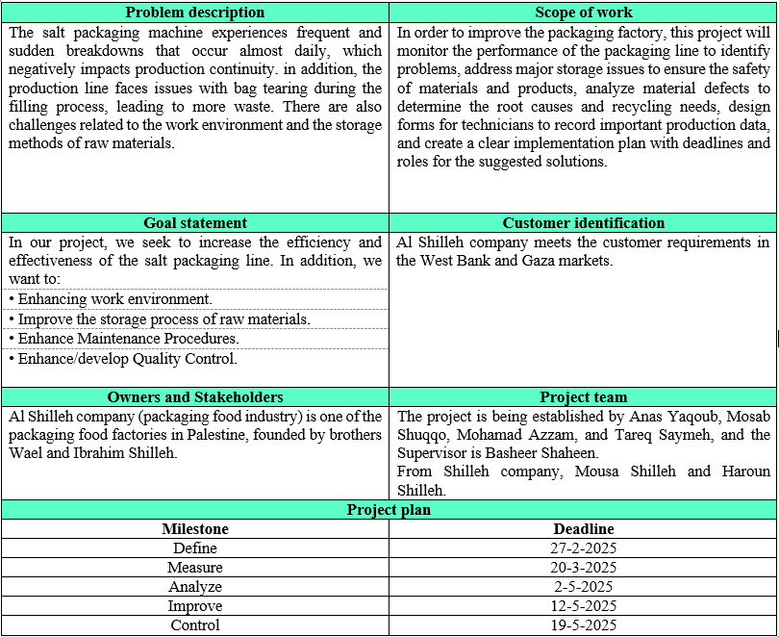
PROJECT CHARTER
6

Slide 7
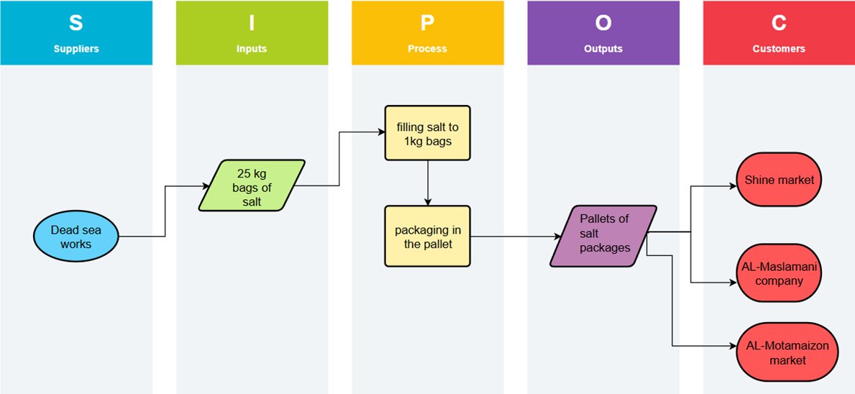

SIPOC
7

Slide 8
MEASURE
8

Slide 9
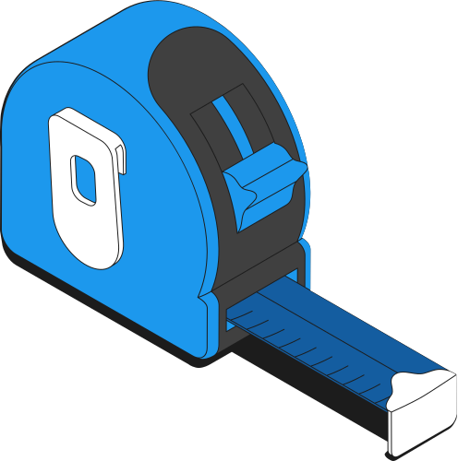
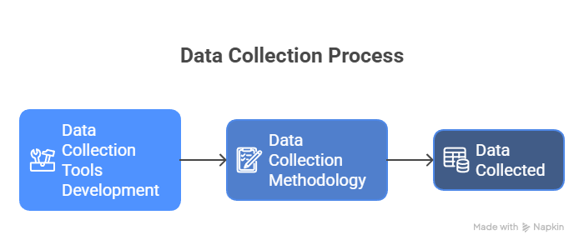
During the Measure phase, we created data collection forms and used a stopwatch to record the time spent on operations. The results were then presented in tables.
9

Slide 10
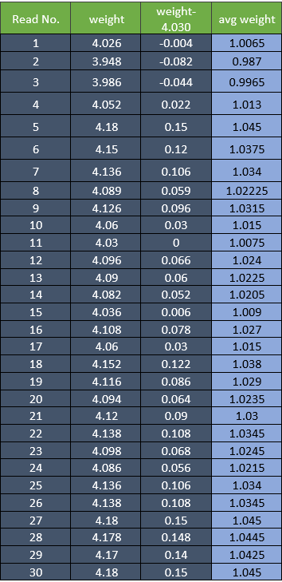
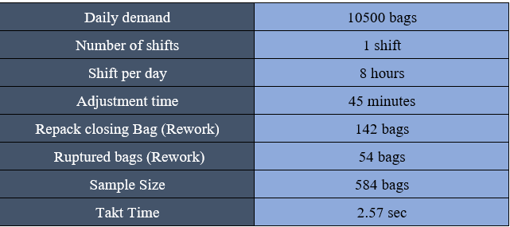
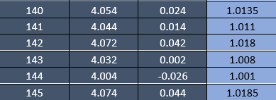
Data collected tables
Salt bags weight table
General Information table
10

Slide 11
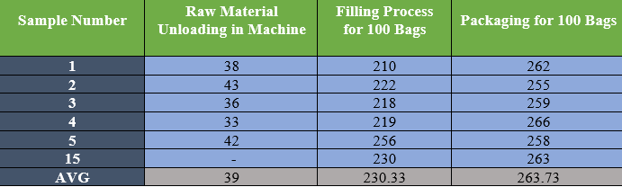
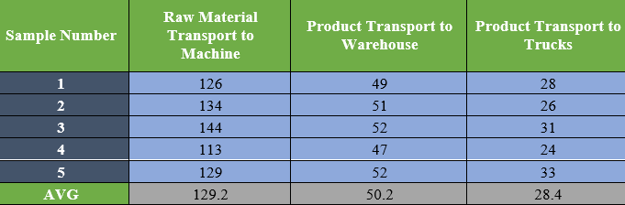
Data collected tables
Operating Times (In SECONDS) 100 bags
Time for Transportation (In SECONDS)
11

Slide 12
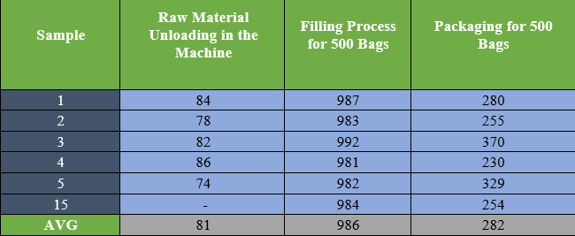
Data collected tables
Operating Times (In SECONDS) 500 bags
12

Slide 13
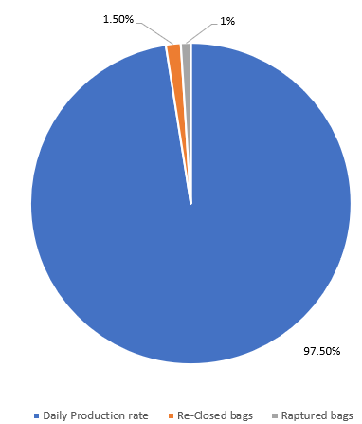


Pie Chart
🔹 Daily Production Rate
Reclosed Bags
Raptured Bags
13

Slide 14
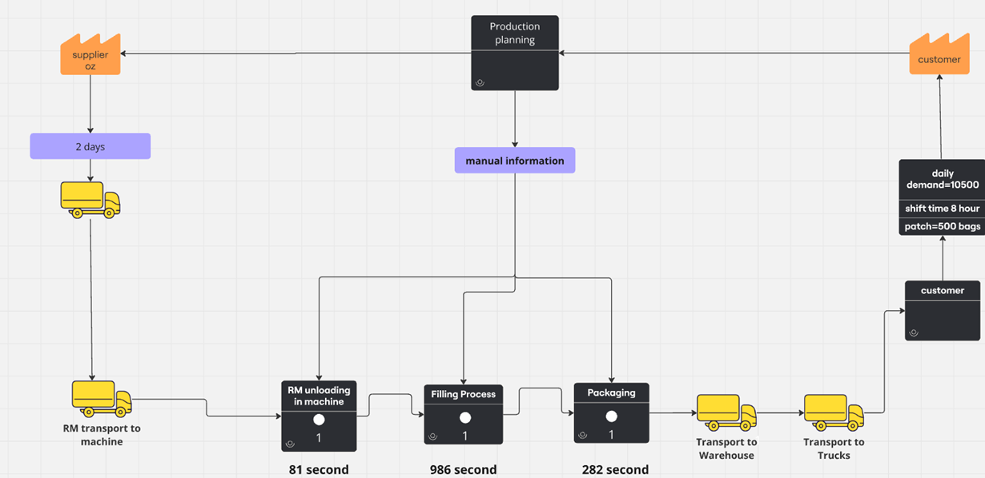
Value Stream Map
14

Slide 15
ANALYZE
15

Slide 16
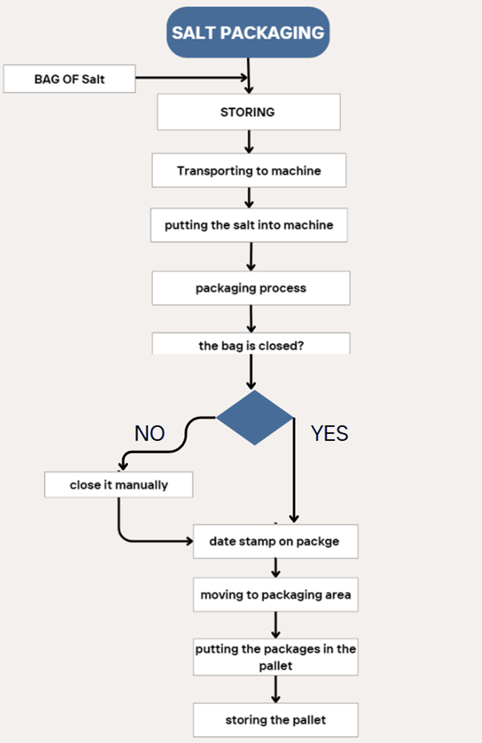

Process Flow Chart
16

Slide 17

Breakdown analysis in the Salt Packaging Line:
We used a cause and effect diagram (fishbone diagram) to analyze and categorize the root causes of waste, which helped us better understand and address it.
The types of waste that exist are:
Defect
Waiting
Transportation
17

Slide 18
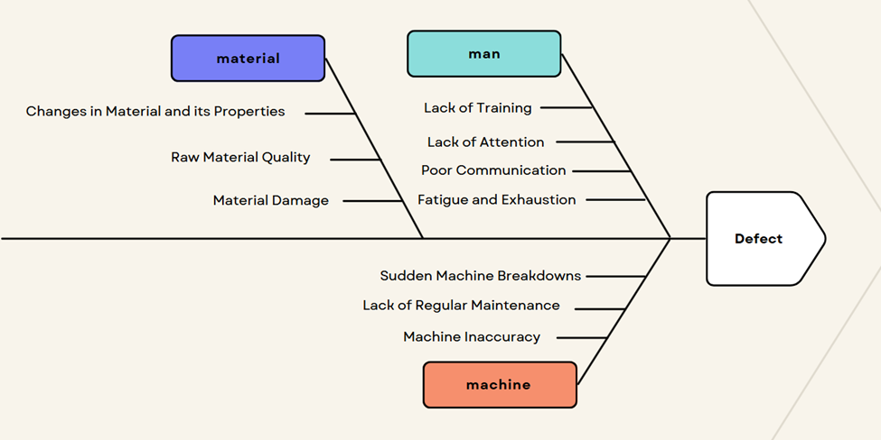
18

Slide 19
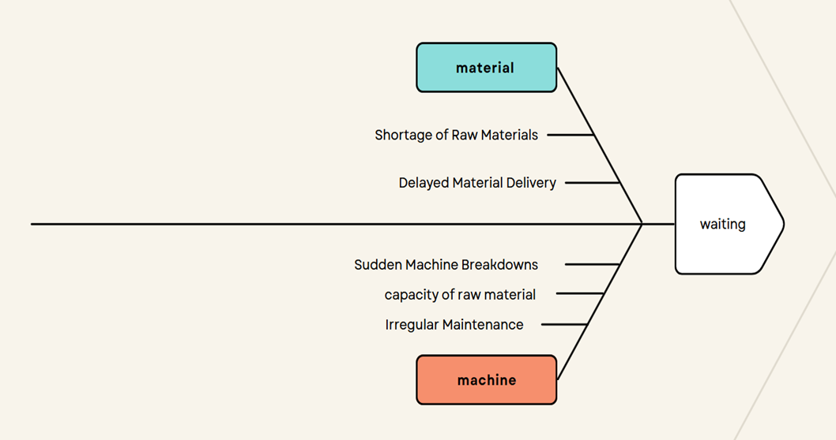
19

Slide 20
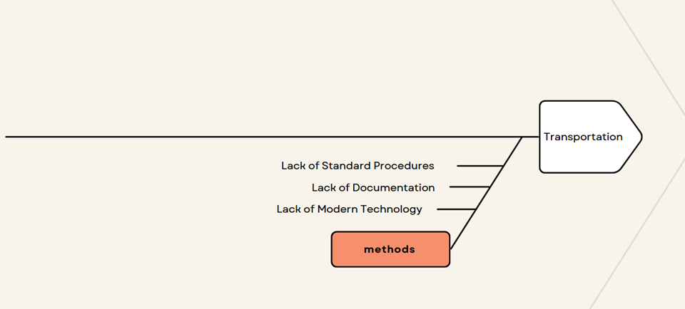
20

Slide 21

Quality control in the salt process
After collecting the data, we applied several quality control tools to analyze the process:
  Normality test – to check data distribution
  X̄-R chart – to monitor process averages and ranges
  Attribute control charts – to track defect rates and stability
21

Slide 22
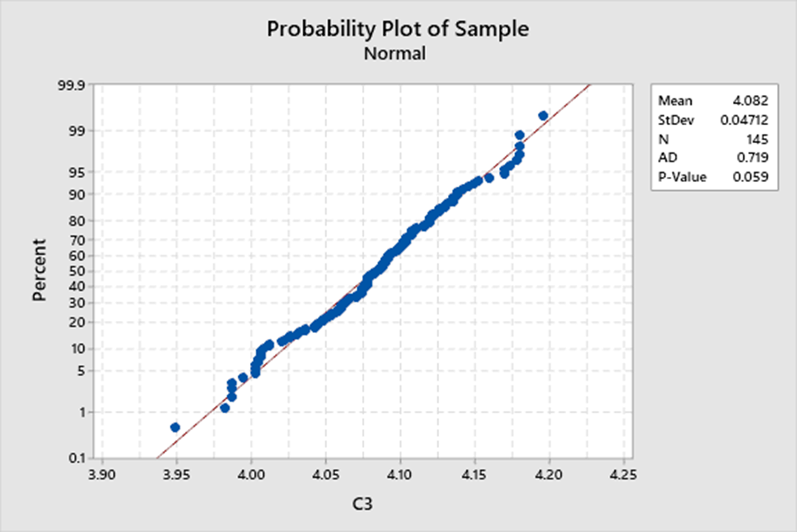
Normality test
22

Slide 23
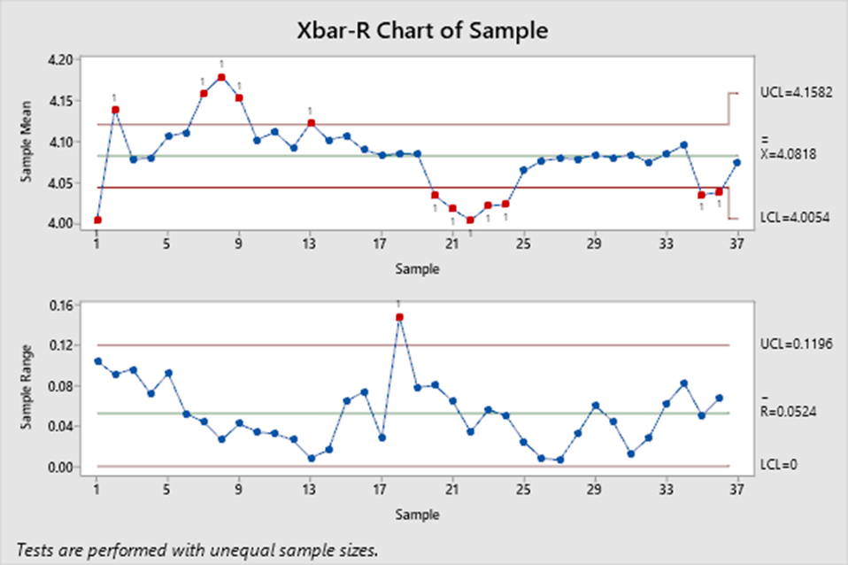
X-bar-R chart
23

Slide 24
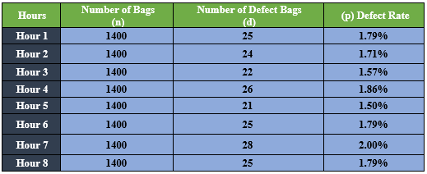
Attribute control charts
24

Slide 25
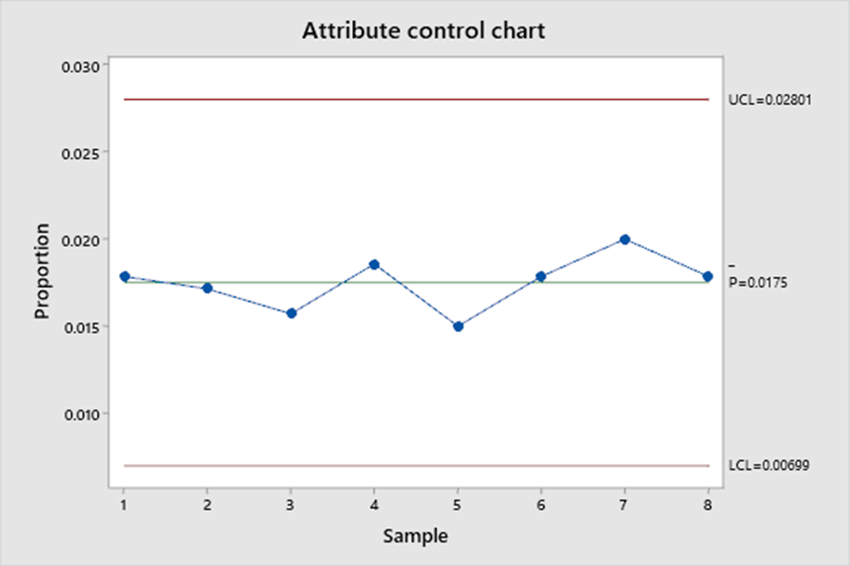
Attribute control charts
25

Slide 26

Failure Modes, Effects, and Criticality Analysis
  We first created a functional breakdown structure to understand the machine and clearly define all its components. This helped us determine how each part contributes to the overall function and identify potential failures.
  We then conducted a Failure Mode, Effect, and Severity Analysis (FMECA) to analyze potential failure modes, their effects, and their severity. This analysis allowed us to prioritize risks and propose preventative measures to enhance reliability and mitigate the effects of failure.
26

Slide 27
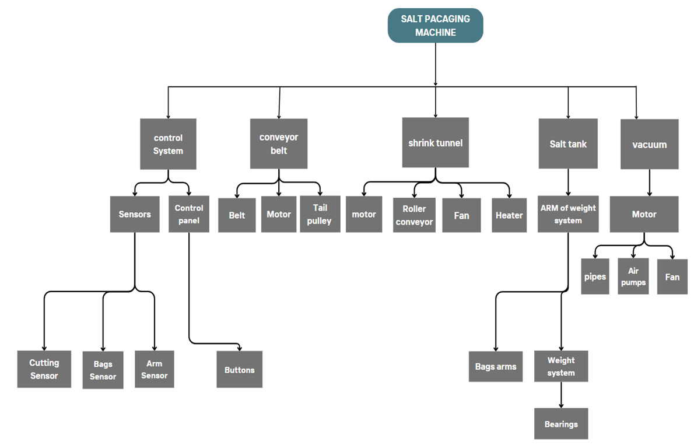
27

Slide 28
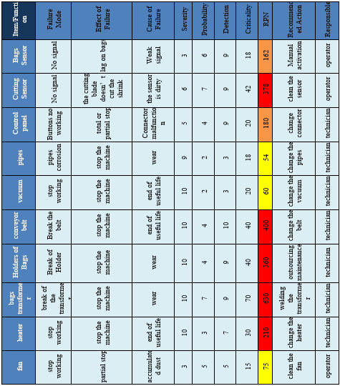
28

Slide 29
IMPROVE
29

Slide 30

Improve
01
Brainstorming sessions
The Improve phase focused on reducing waste and enhancing efficiency through practical and low-cost improvements.
02
Adding a maintenance department
03
Adding a quality control department
30

Slide 31

Brainstorming
we applied brainstorming as a structured method to generate ideas and practical solutions to key operational problems. Brainstorming allowed our team to think creatively, which encouraged a wide range of suggestions from different perspectives.
Through this method, we focused on addressing three major types of waste in the salt packaging process:
  Defects
  Waiting
  Transportation
To tackle these issues, brainstorming sessions were conducted with workers and supervisors, allowing us to gather insights based on their direct experience. These sessions led to practical, low-cost improvement ideas that were quickly implemented.
31

Slide 32

Maintenance Department
One of the critical issues identified was the frequent and unpredictable machine breakdowns. This was mainly due to the absence of a preventive maintenance plan and a structured maintenance department.
🧩 Proposed Maintenance Strategy
  Corrective Maintenance: Data will be recorded to support future improvements.
  Preventive Maintenance: Performed on a regular schedule, Helps build structure even without full operational data.
  Opportunity Maintenance: Conducted during planned or unplanned production stops.
32

Slide 33

Quality Control Department
A quality policy and strategy are developed to monitor production and ensure standards are applied at all stages, with coordination between all departments to achieve quality compliance.
Objectives:
🔹 Reduce waste from defective products
🔹 Improve customer satisfaction
🔹 Comply with local & international standards
Analytical tools such as the Pareto chart, the Ishikawa diagram, and the SPC are used to analyze data and identify opportunities for improvement.
33

Slide 34

Practical Solutions suggested
practical solutions were developed and instituted to address the lack of organized data and to improve decision-making within the factory. These were:
1. Daily production and working hours.
2. Machine downtime.
3. Bag weight check.
4. Operation time record.
These forms served to organize basic operational information and build a more systematic monitoring system.
34

Slide 35
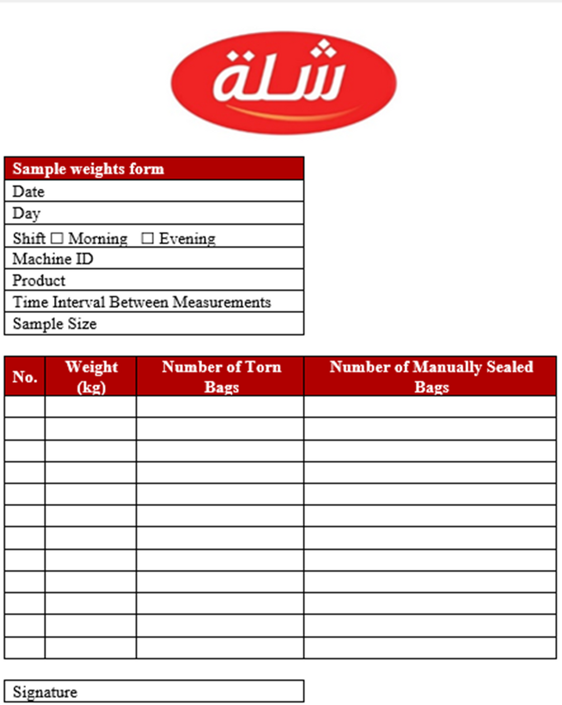
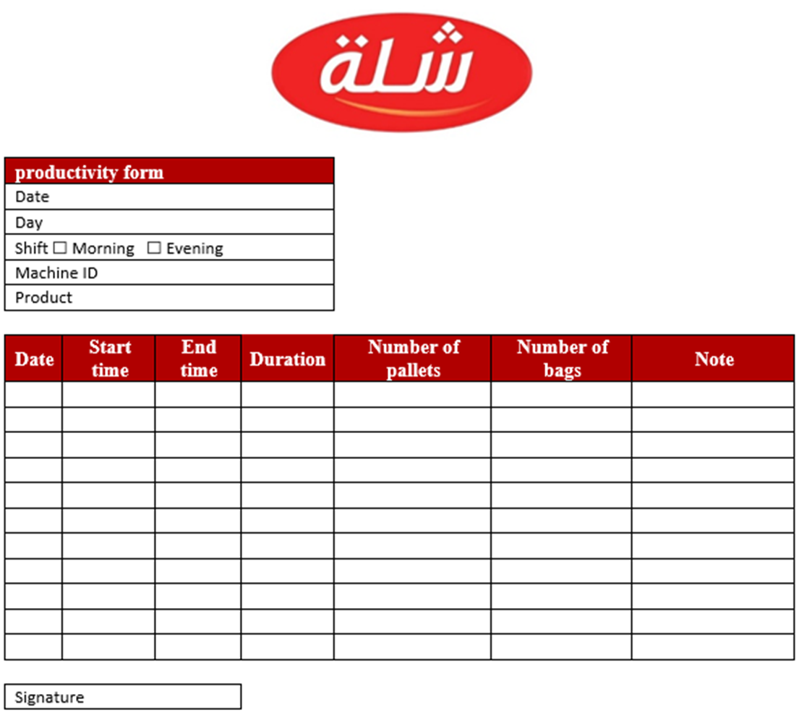
35

Slide 36
CONTROL
36

Slide 37
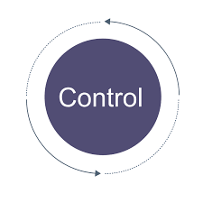
Control
Monitoring of operations is done regularly and systematically.
Data is recorded formally to evaluate process performance and enhance transparency.
Key performance metrics are used to:
  Measure efficiency and reliability
  Detect deviations and correct issues
  Guide focused improvement plans
37

Slide 38


Conclusion and recommendations
  Addressed key issues:
• Frequent machine breakdowns
• Poor production documentation
  recommended improvements
• New documentation forms
• Better maintenance procedures
• Enhanced quality control
  Sustainability plan includes:
• Ongoing monitoring
• Employee training
  • Use of control tools
38

Slide 39
THANK YOU!

