Slide 1
Mishwar
Presented by: Ibraheem Bsharat
Ehab Afaneh
Supervisor : Dr. Abdullah Rashed

Slide 2
Outlines
Introduction.
Features.
Technologies.
Methods and Techniques.
Constrains.
Future work and Recommendation.

Slide 3
What is Mishwar ?
Mishwar is a website that helps tourists choose their tourist destinations, prepare a complete plan for their trip, book travel tickets and book hotels, and makes it easy for them to travel in the country they are visiting.
The project is the idea of a Ceyac company for digital marketing and software engineering.

Slide 4
Motivation
Having a large percentage of tourists prefer to travel alone without coordination with a tourist company.
The problem of hotel reservation in the visited country.
Having trouble moving around the country.
Not knowing the tourist places, restaurants, and ways to go there.
Difficulty finding a taxi to travel or to bring supplies from the market.

Slide 5
Features
Book a plane ticket online.
Book a hotel in advance.
Display the weather conditions in the country or country you are traveling to.
Show nearby taxi offices with their numbers and distance.
Show restaurants and tourist places and show the path leading to it.
Draw a complete travel plan that includes the days the traveler will spend and draw his plan on the map.
Navigate online.
Cash Back.
Cash Back Offers(gifts).

Slide 6

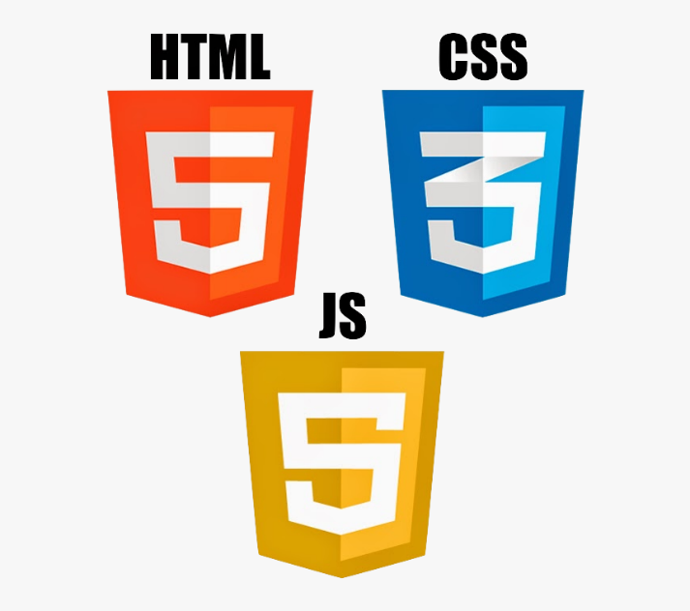


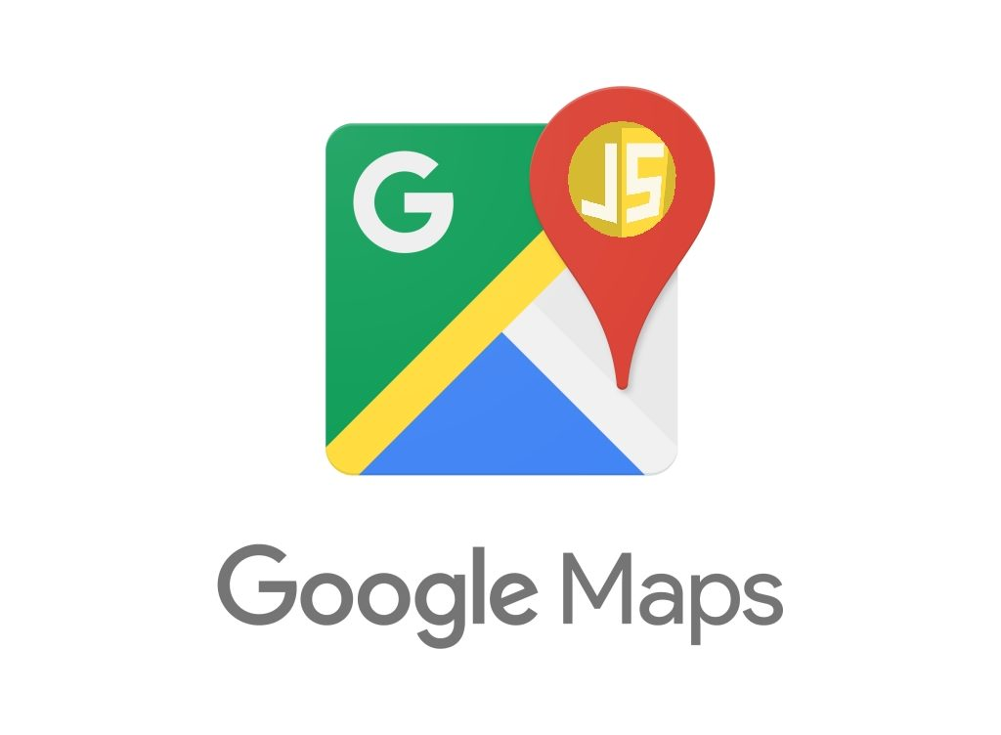


Technologies

Slide 7
Methods and Techniques
Sign Up
Login
Guest page
Main page
Flights
Hotels
Show Direction
Weather
Find a Taxi
Popular Destination
Recommended Hotels
The opinions of users on site
Contact
Plan
Restaurants
Tourist places
Online navigation
Booked items
Confirm
User Profile
Cash Back
Offers
Favourites
Admin page
User information
Recharge cash back
Editing
Add offers
Messages

Slide 8
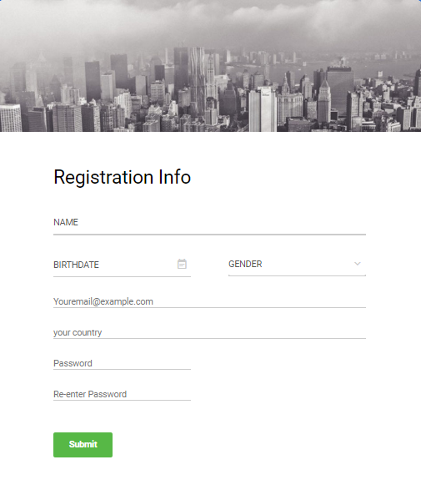
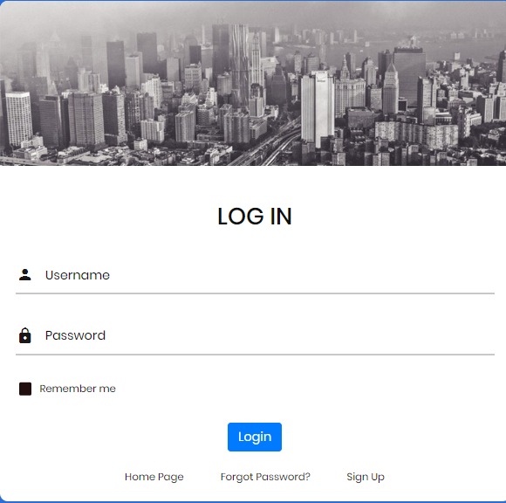
Sign Up/Login

Slide 9
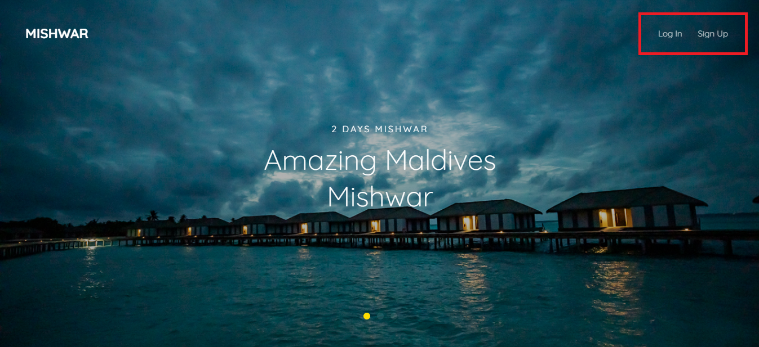
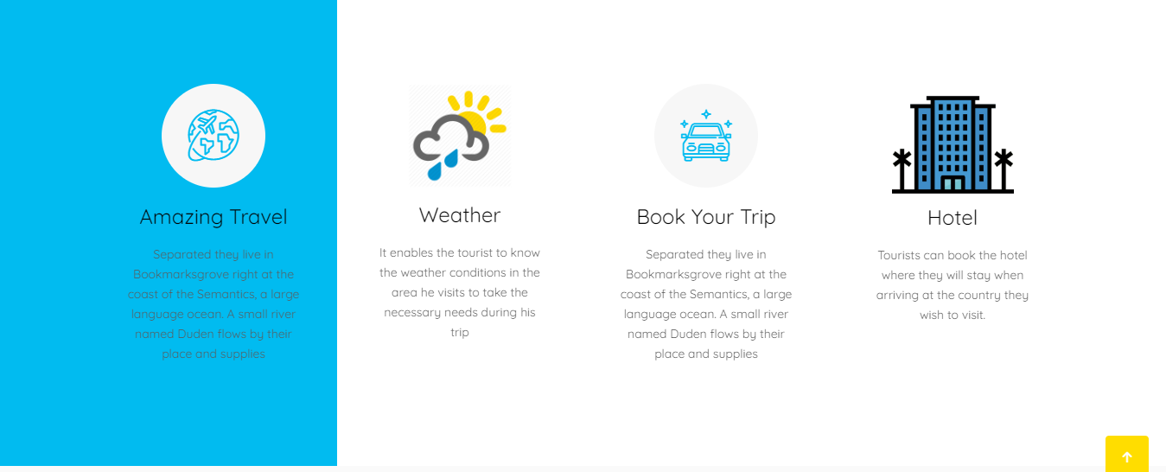
Guest page

Slide 10
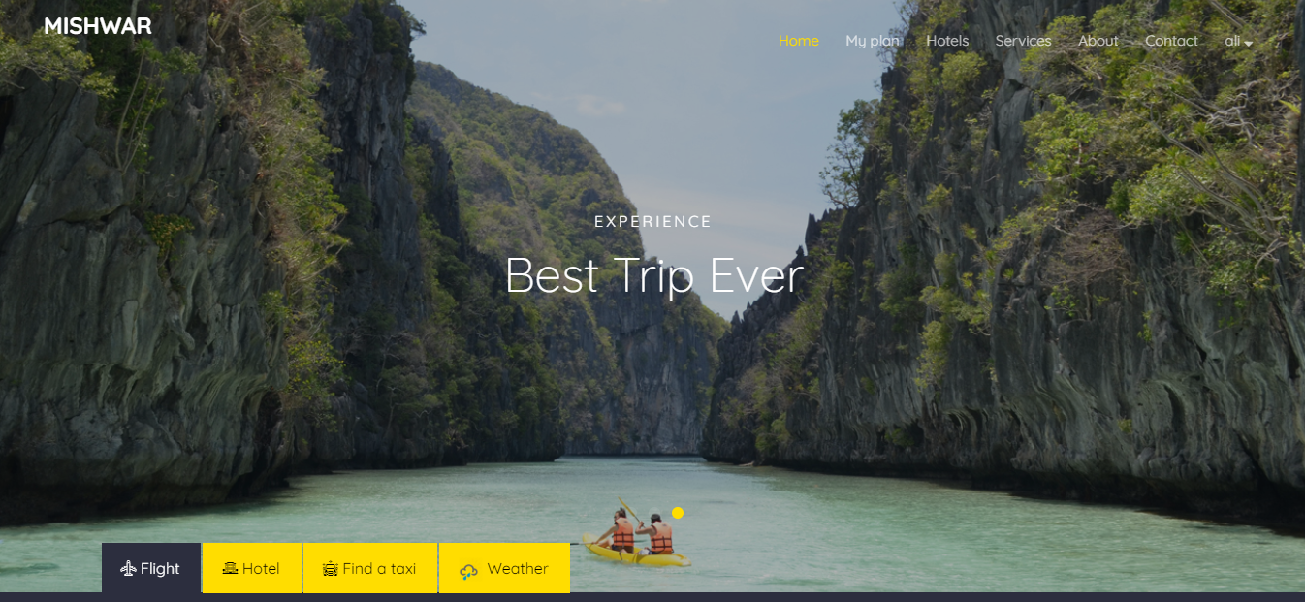
Main page

Slide 11
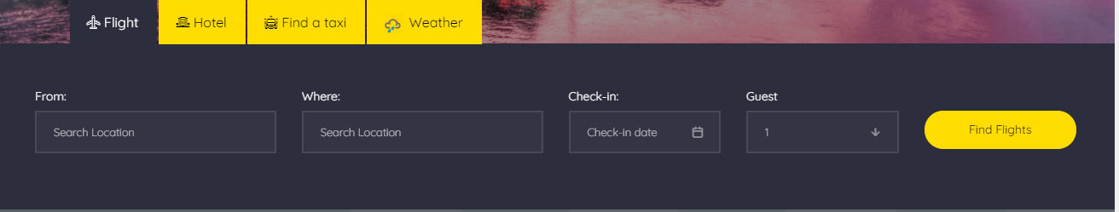
Main page
Flights

Slide 12
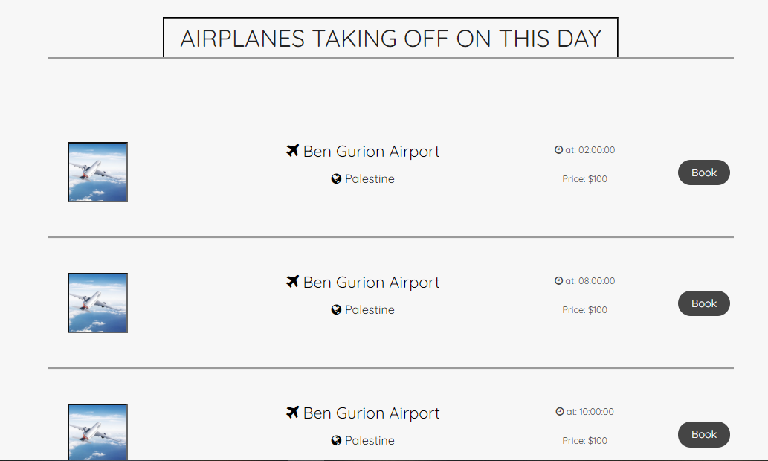
Flights

Slide 13
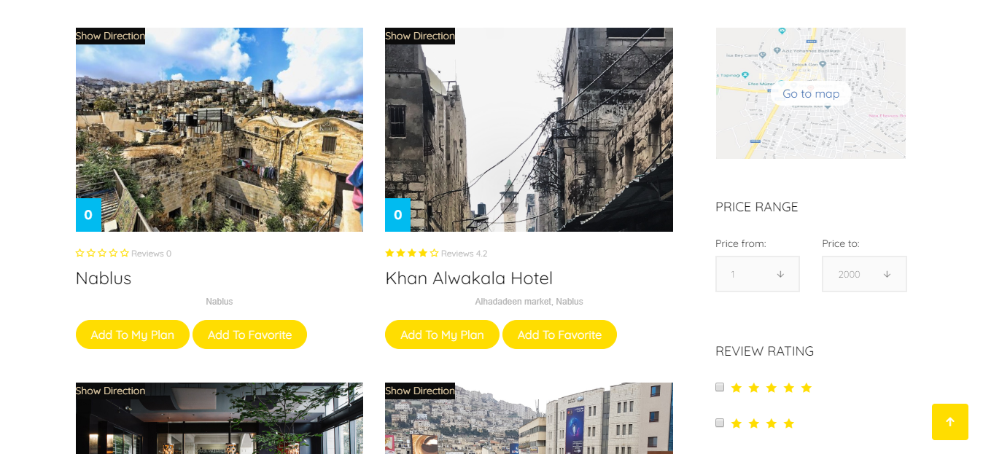
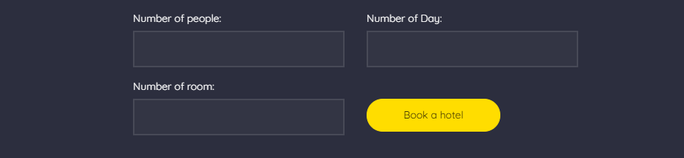
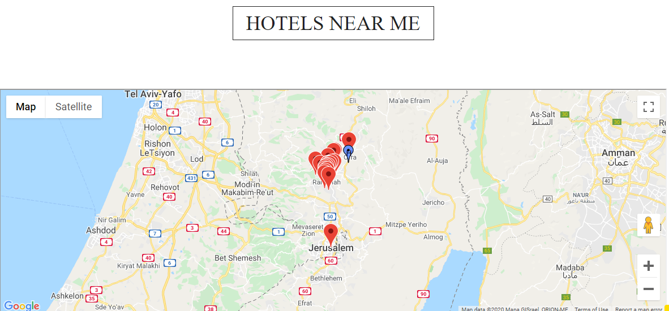
Hotels

Slide 14
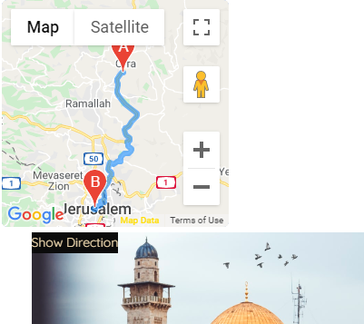
Show Direction

Slide 15
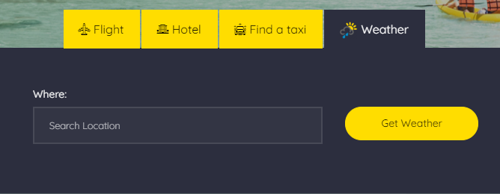
Weather

Slide 16
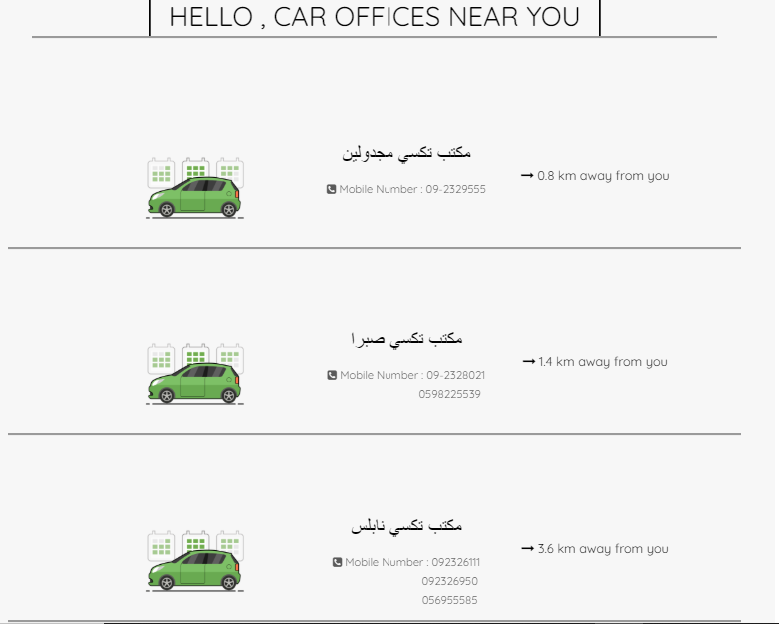
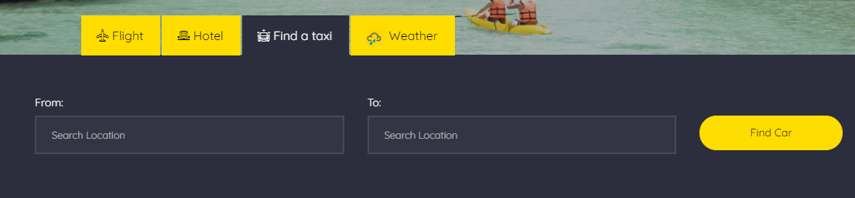
Find a Taxi

Slide 17
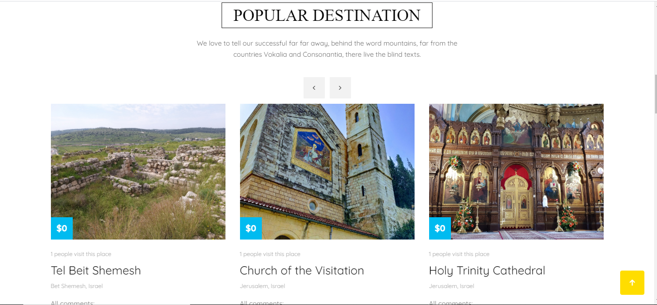
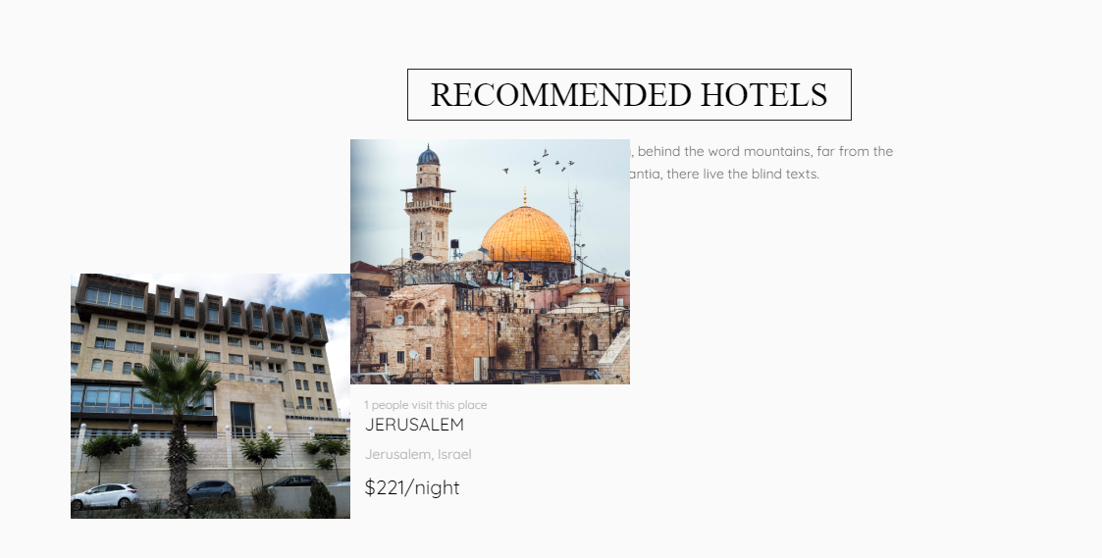
Popular Destination/Recommended Hotels

Slide 18
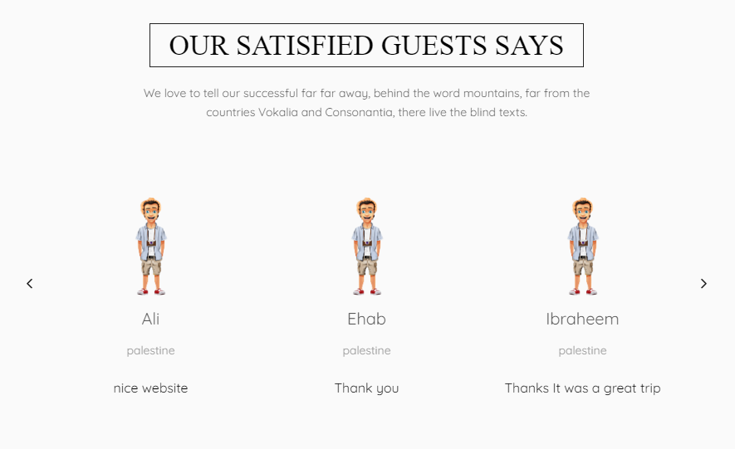
The opinions of users on site

Slide 19
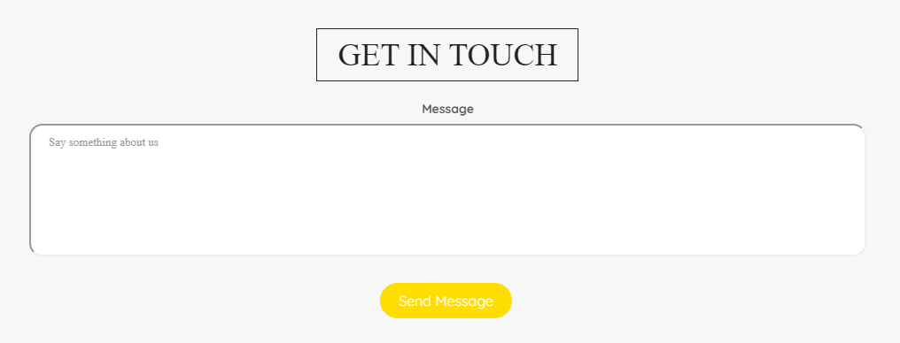
Contact

Slide 20
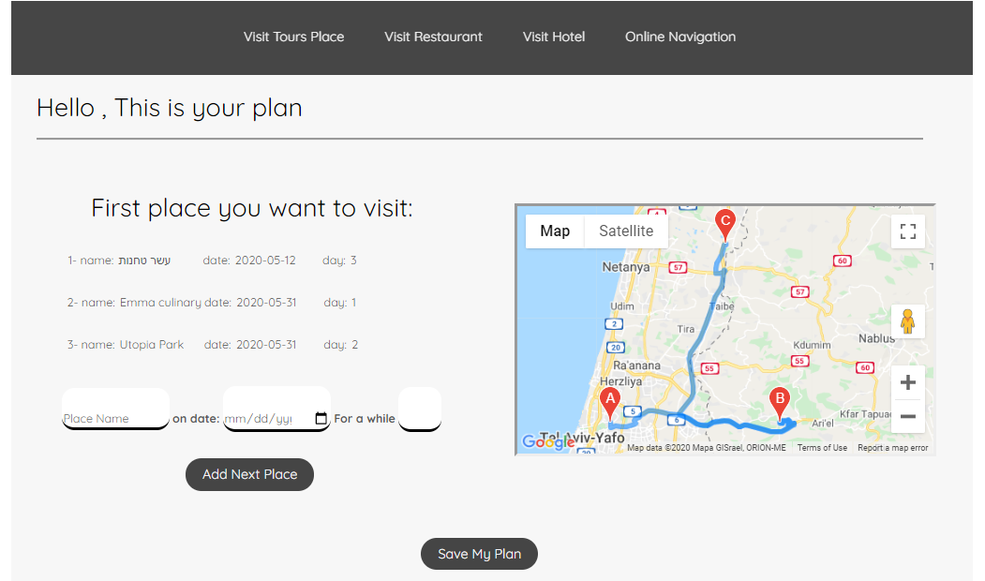
Plan

Slide 21
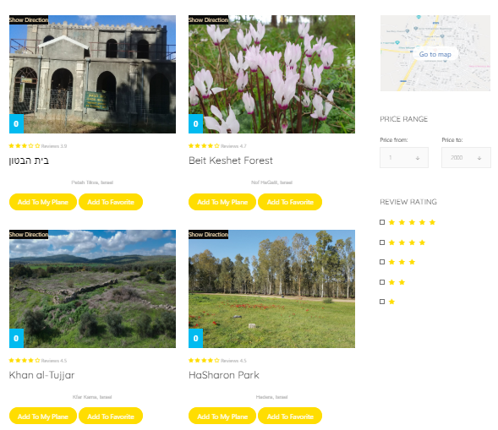
Tourist places

Slide 22
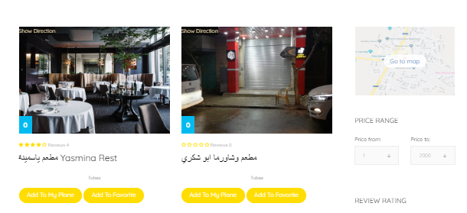
Restaurants

Slide 23
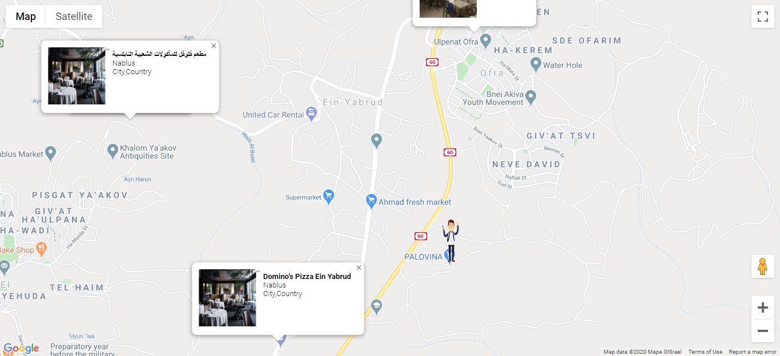
Online Navigation

Slide 24
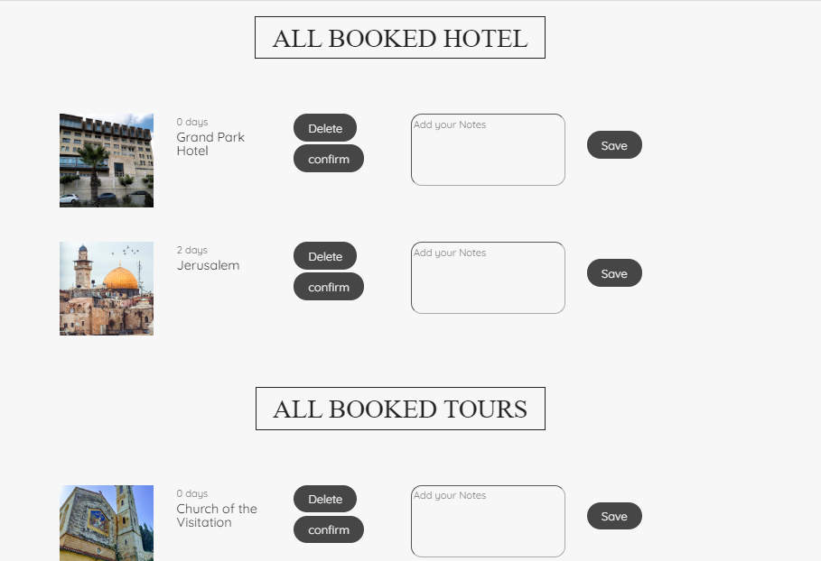
Booked items

Slide 25
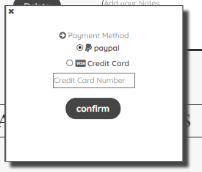
Booked items
Confirm

Slide 26
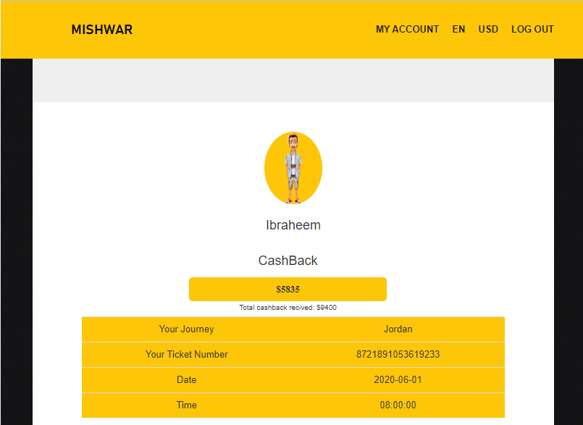
User Profile
Cash Back/Ticket details

Slide 27
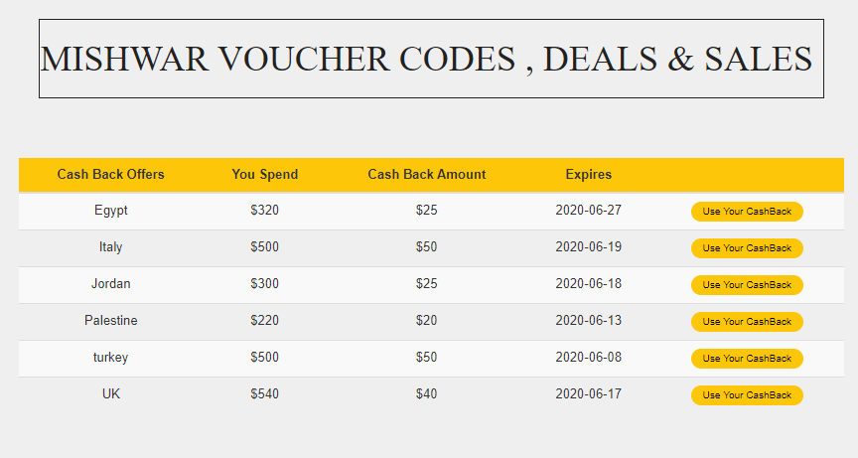
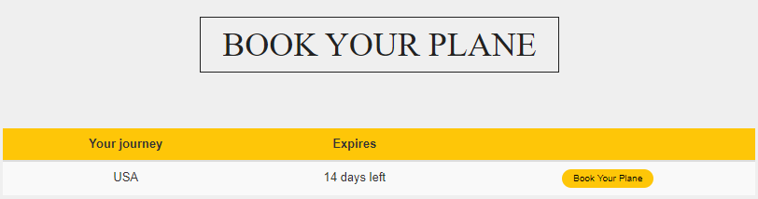
Offers

Slide 28
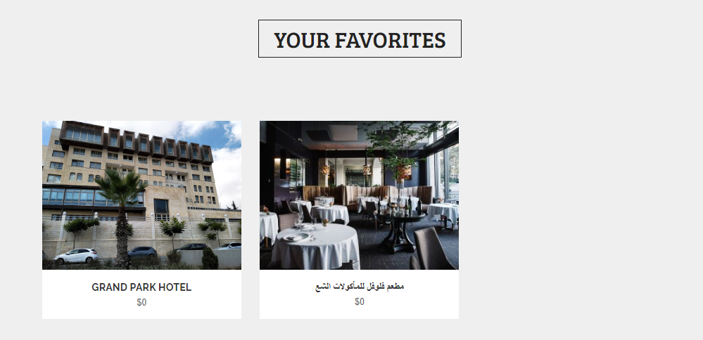
Favourites

Slide 29
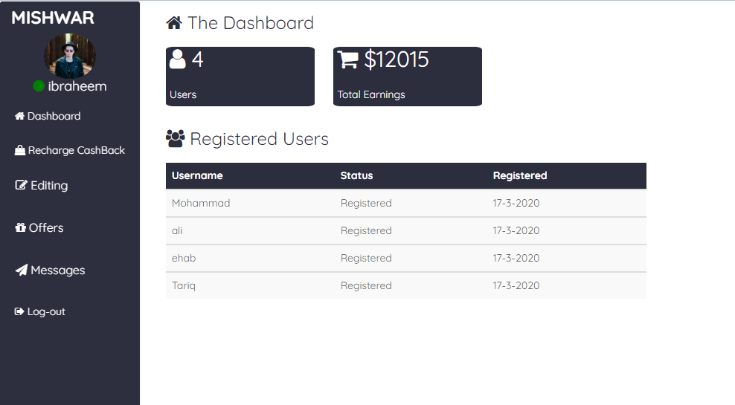
Admin page
Dashboard

Slide 30
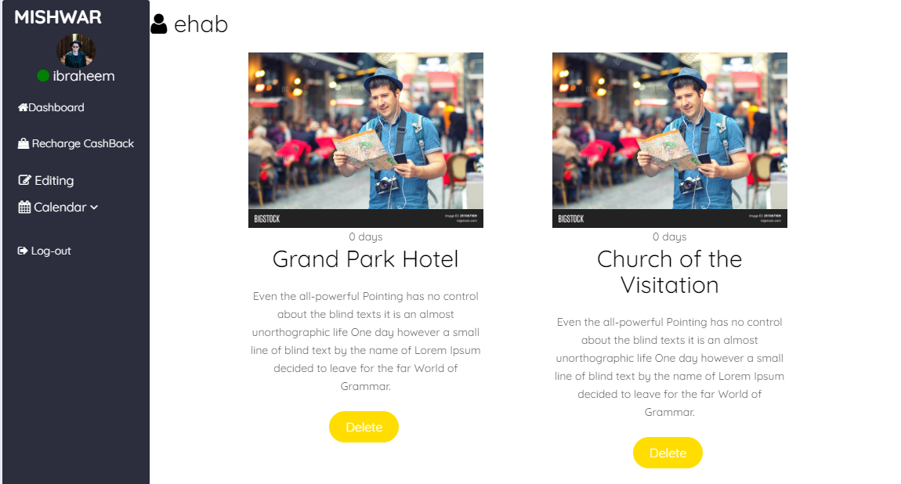
User information

Slide 31
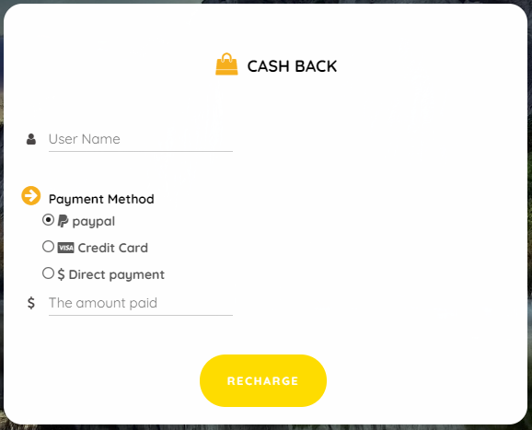
Recharge cash back

Slide 32
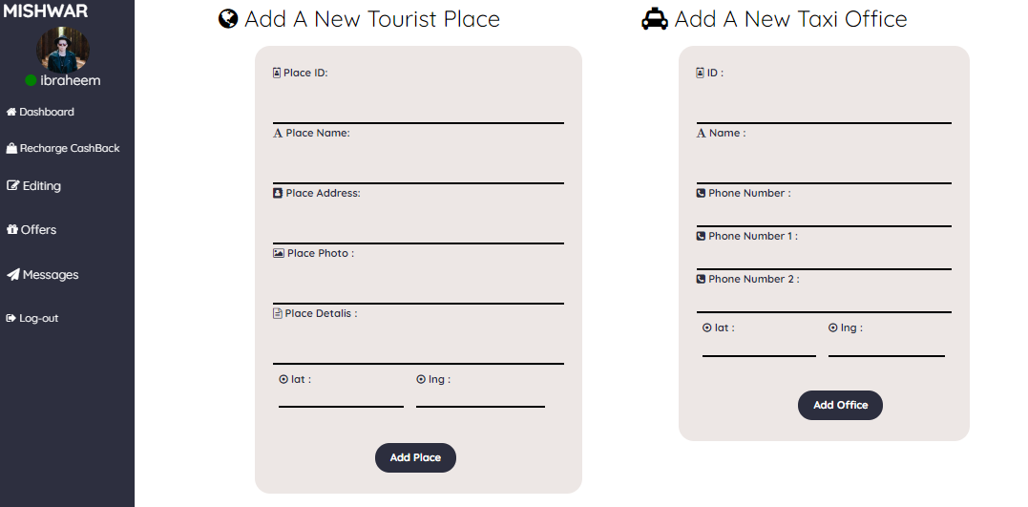
Editing

Slide 33
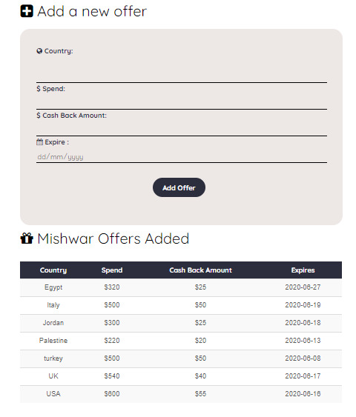
Add offers

Slide 34
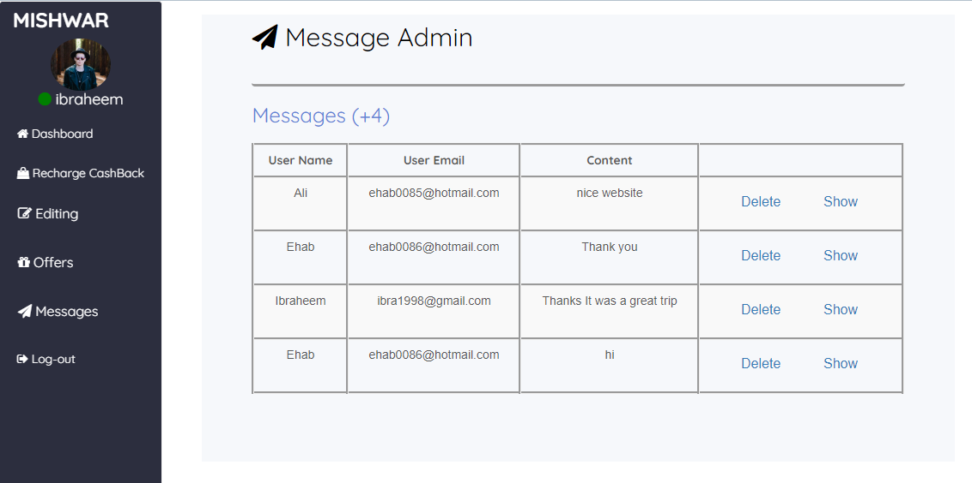
Messages

Slide 35
Constrains
Getting a license to use Google Maps took time.
Not all tourist destinations in Palestine are shown on the map.
Learning new things.
Health conditions in the country (COVID-19).

Slide 36
Future work
Creating an application for this project to facilitate the user browsing from the phone.
Offline navigation.
Organizing the trip plan according to a specific budget.
Currency Converter.
Language conversion within the site.
Invoice translation scanner.

Slide 37
The End
Thank You

