Slide 1






ChocoCup
Tamara AbuAisheh
Raya Break

Slide 2



Overview
01 Introduction
02 The Motivation
03 The Problem & The Solution
04 Stages & Components
05 Challenges
06 Future Work

Slide 3

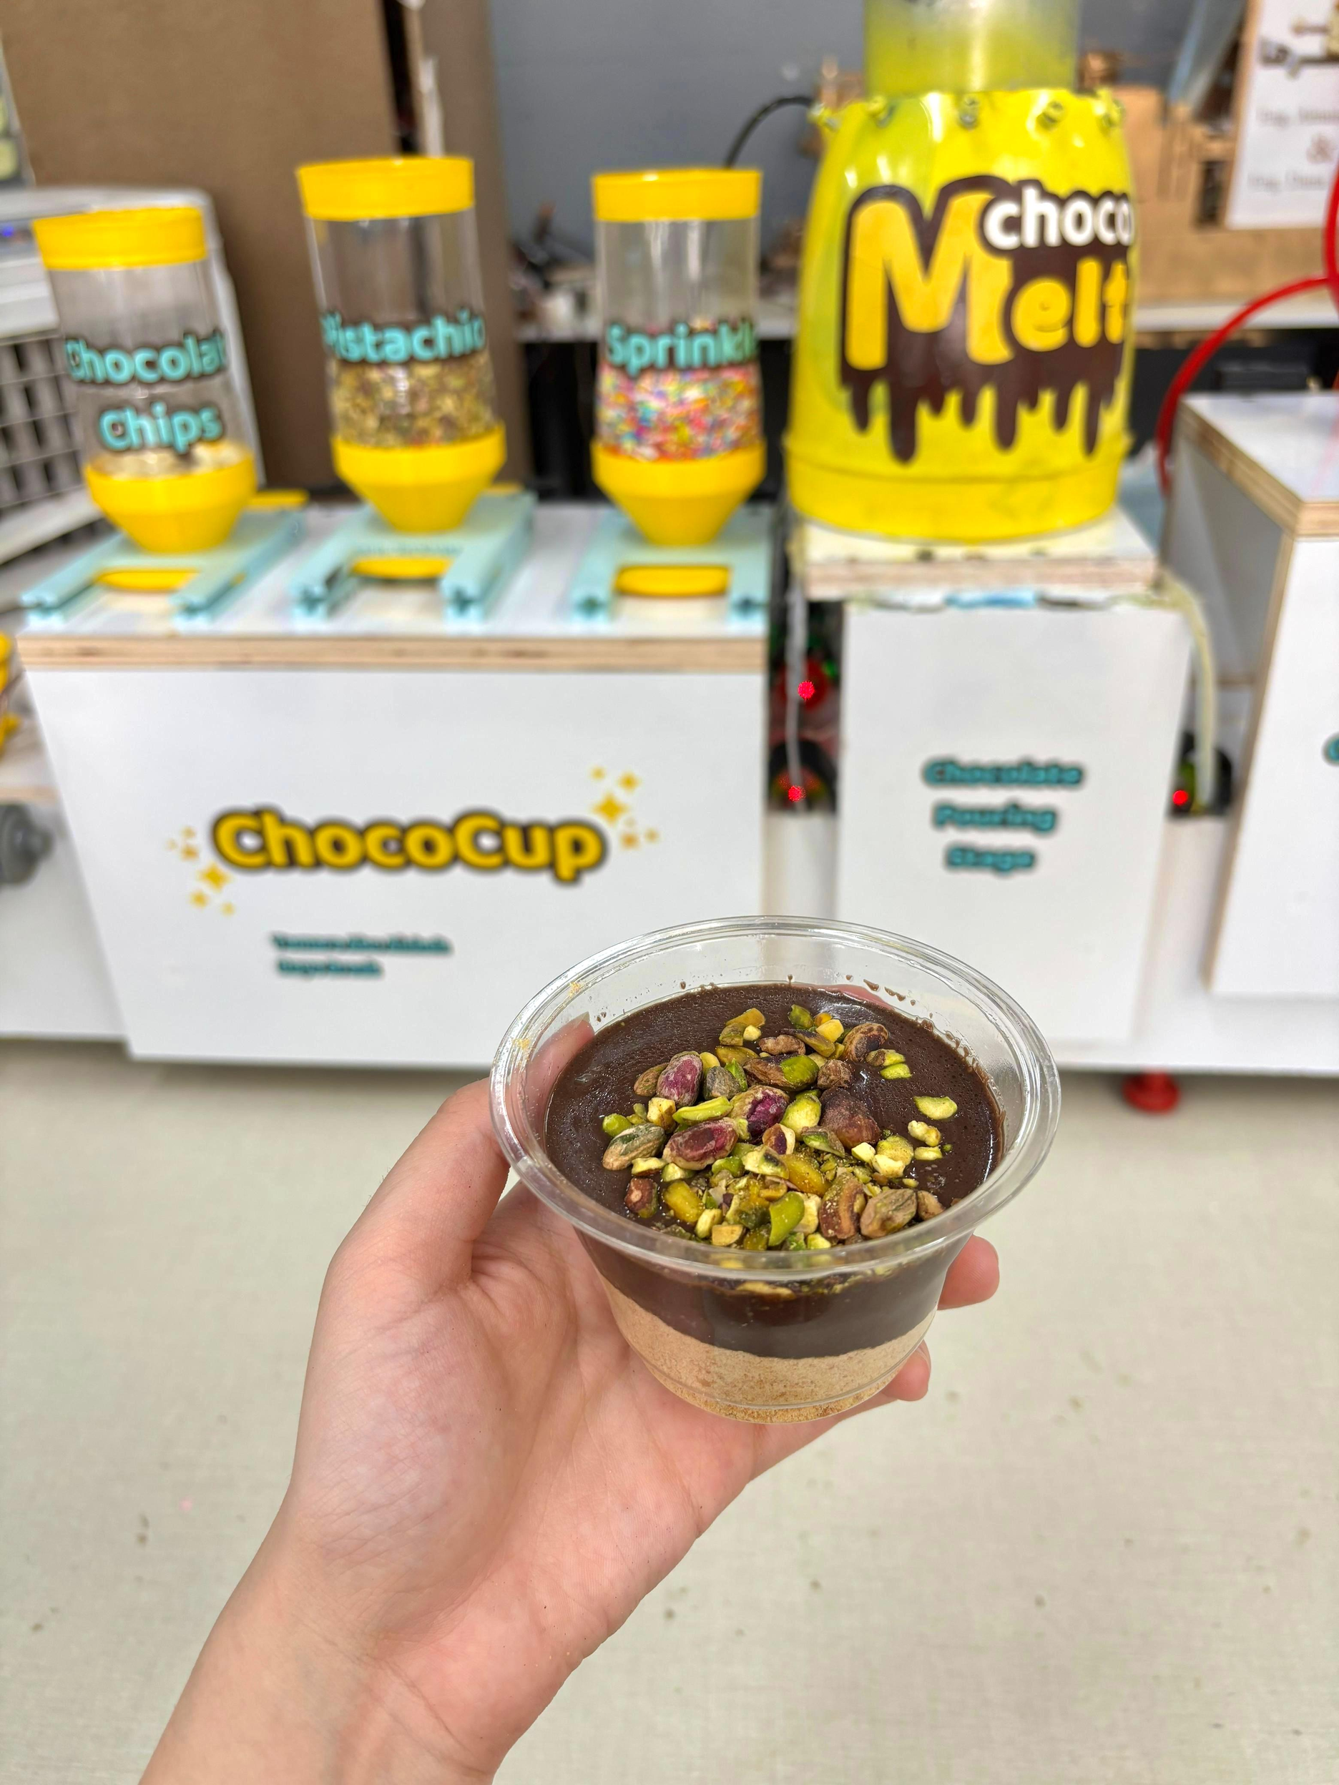
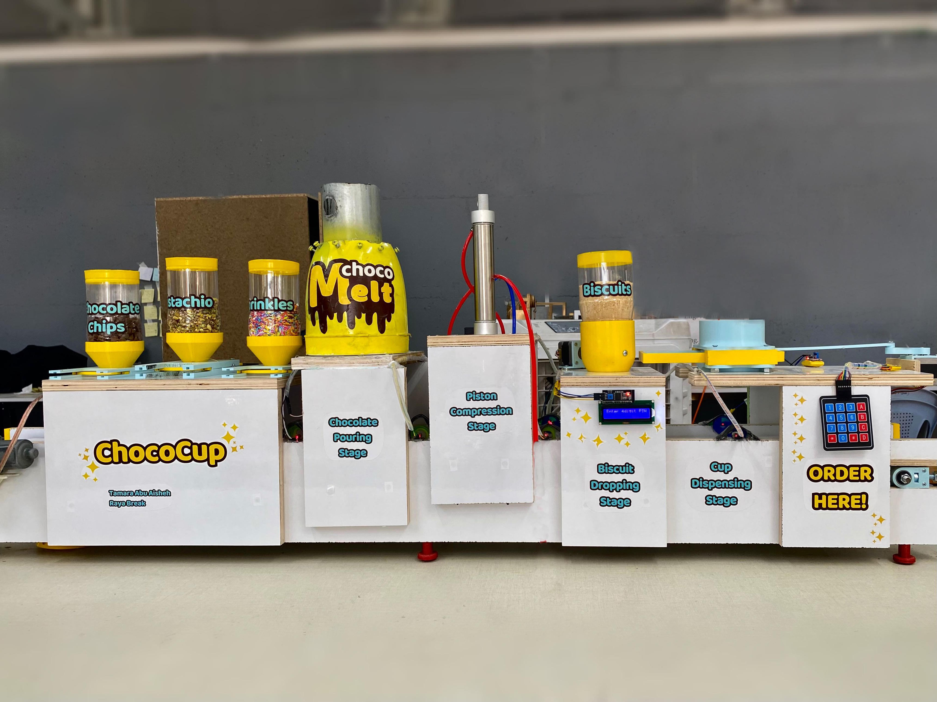
Introduction

Slide 4

The Motivation
Automatic Process
Fast
& Fresh
Hygienic
& Clean
Smart
System

Slide 5
The Problem
1. Manual work is Slow and Tiring
2. No quick Fresh Options
3. High Cost and Waiting Time
for Customization

Slide 6
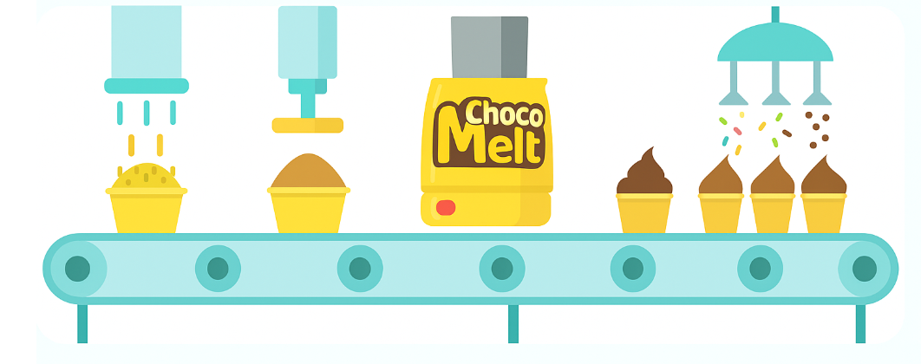
The Solution
Automated, Customized ChocoCup Machine

Slide 7
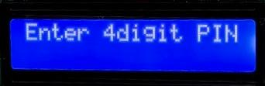
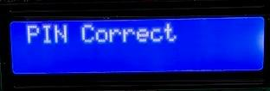
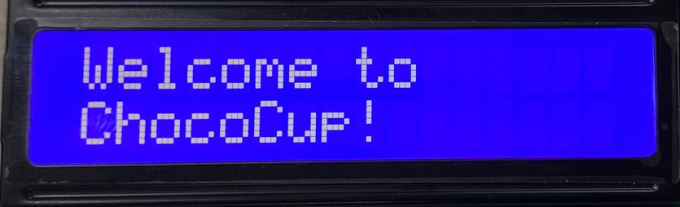

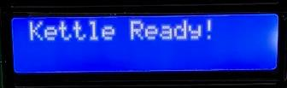
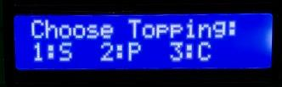

Stages
Input/Output Unit

Slide 8


Website

Slide 9
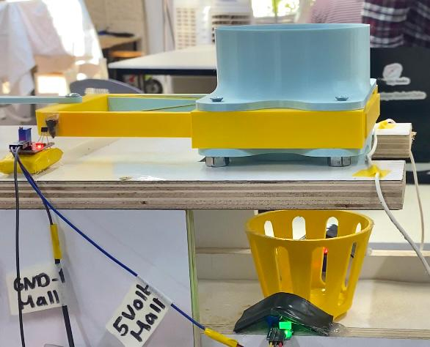
Stages
1. Cup Dispensing
The Hall Effect Sensor resets the System to the Home Position.
Then, the LDR detects the Cup Holder.
After that, the Cup is Dispensed.

Slide 10
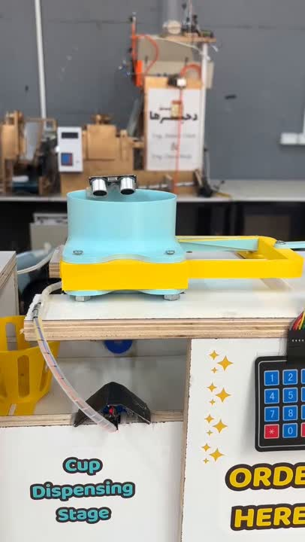

Slide 11
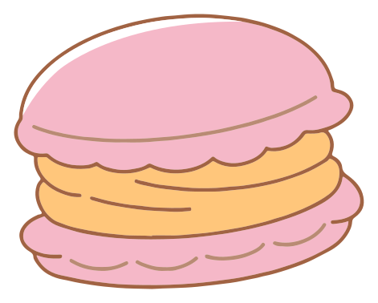
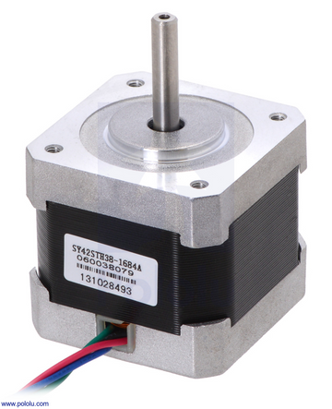
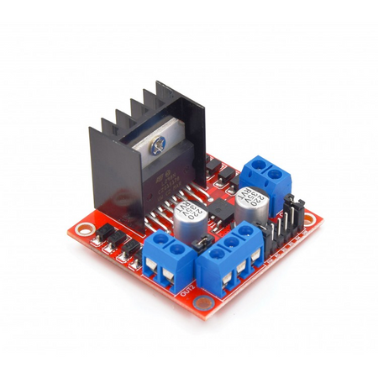
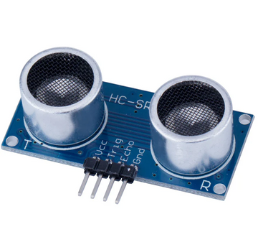
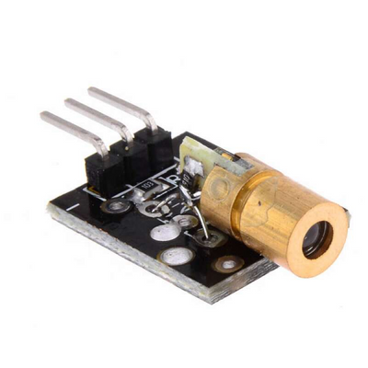
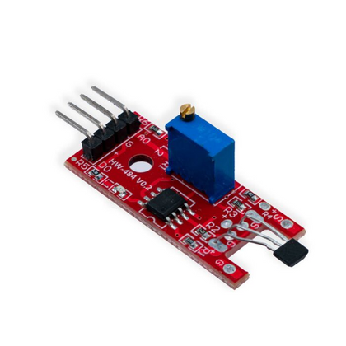
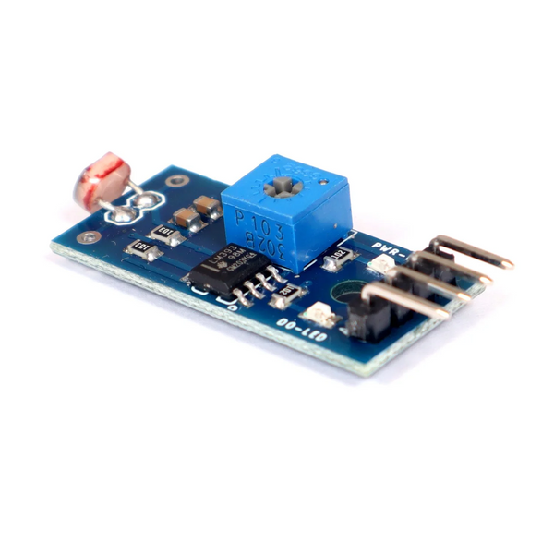
Components
Ultrasonic Sensor
Stepper Motor
Nema 17
H-Bridge L298N
Laser
LDR Module
Hall Effect Sensor

Slide 12
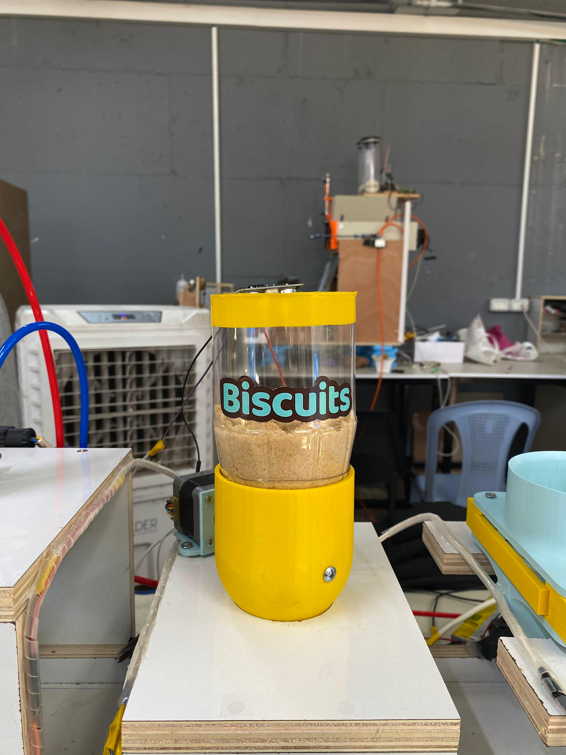
Stages
2. Biscuits Layer Stage
The Biscuit is Dropped Directly into the Cup

Slide 13
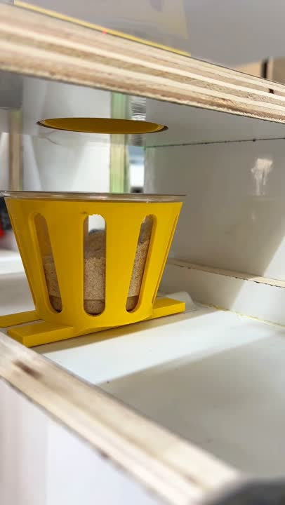

Slide 14
Components
Stepper Motor
Nema 17
H-Bridge L298N
Laser
LDR Module

Slide 15
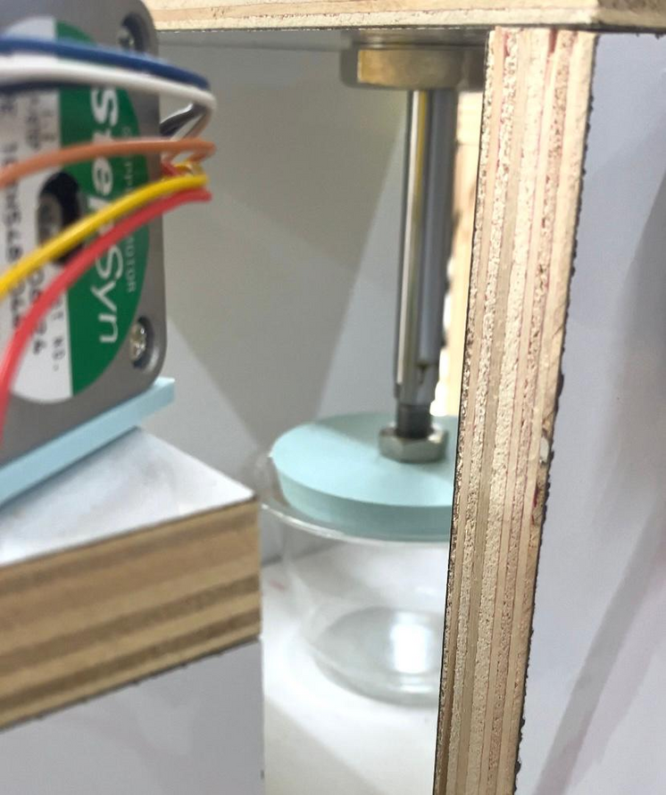
Stages
3. Piston Stage
The Pneumatic Piston will press the Biscuit into one Flat Layer

Slide 16
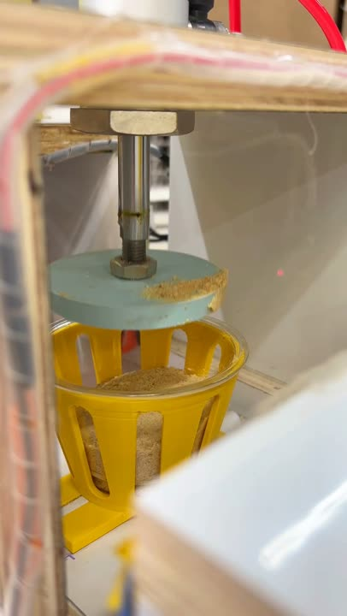

Slide 17
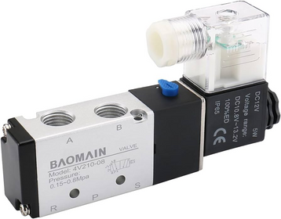
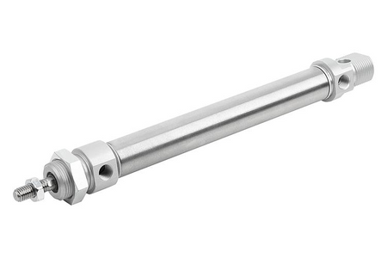
Components
Air Solenoid Valve
Pneumatic Piston
Laser
LDR Module

Slide 18
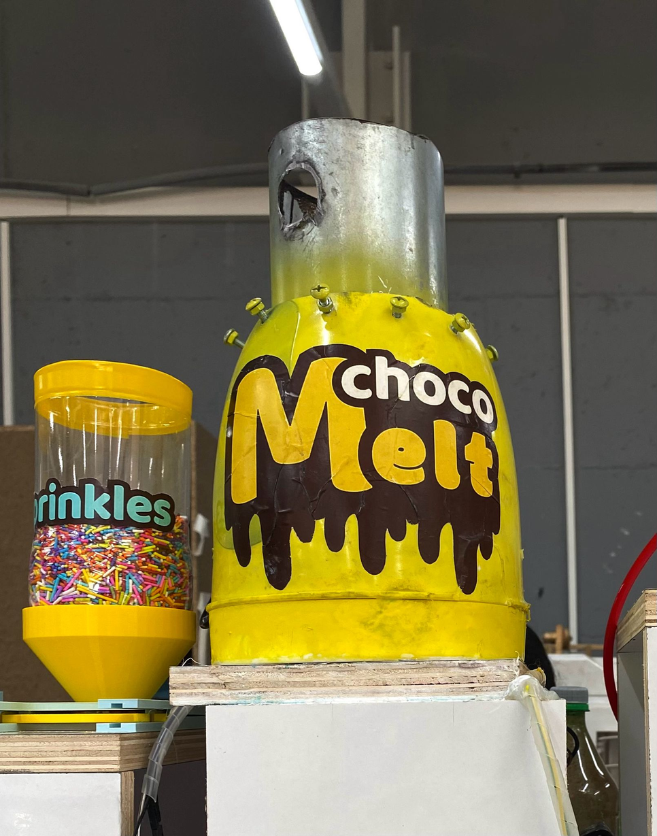
Stages
4. Melted Chocolate Stage
Chocolate is Melted using a Water Bath to stay Smooth and Shiny

Slide 19
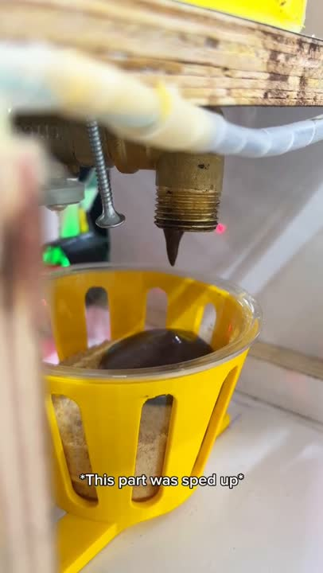

Slide 20
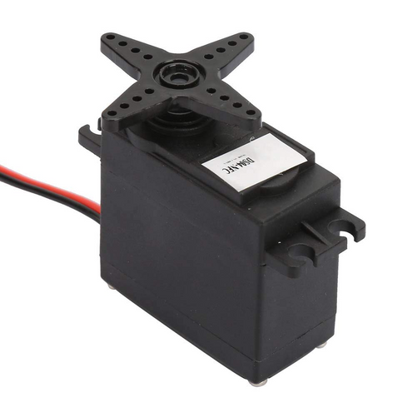
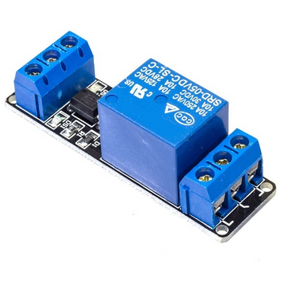
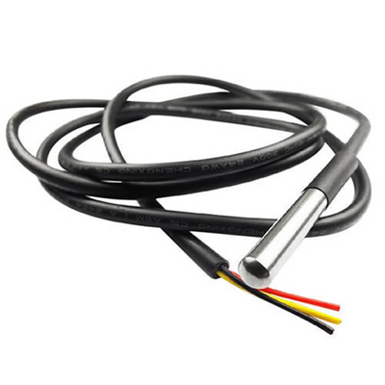
Components
Temperature
Sensor DS18B20
Servo Motor
1-Channel Relay
Laser
LDR Module

Slide 21
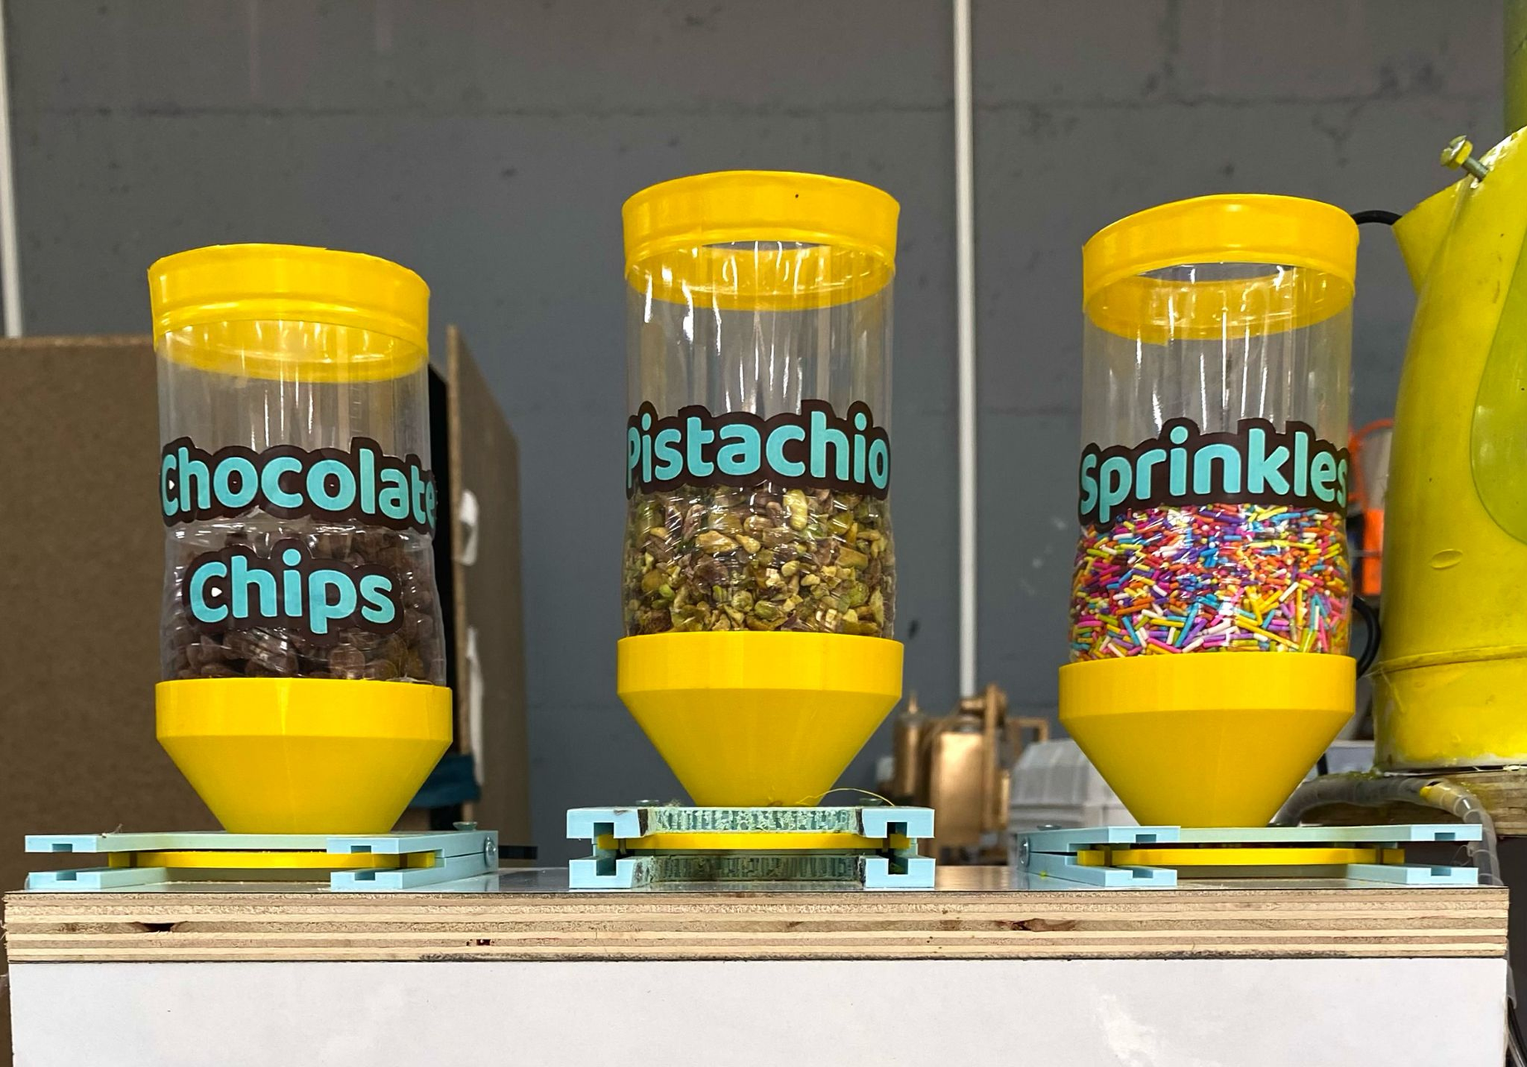
Stages
5. Topping Stage
One of three Toppings will be Added:
Sprinkles, Pistachios or Chocolate Chips

Slide 22
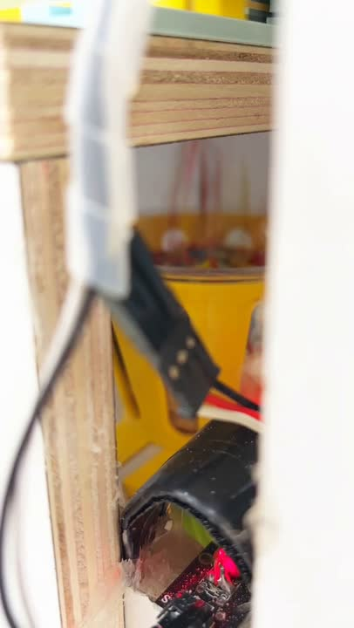

Slide 23
Components
3 Servo Motors
Laser
LDR Module

Slide 24
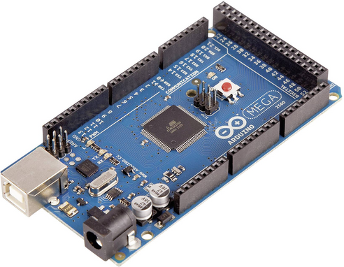
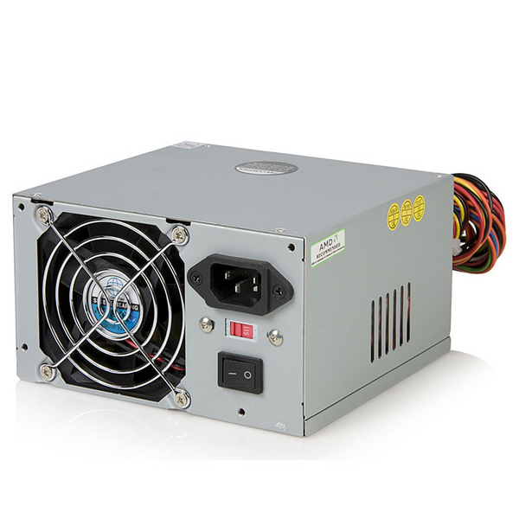
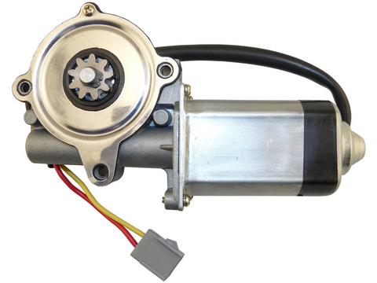
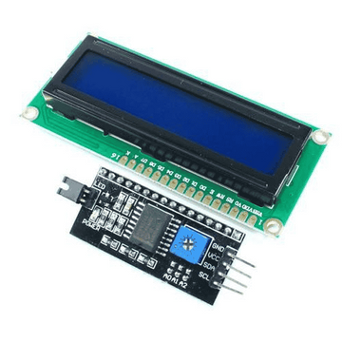
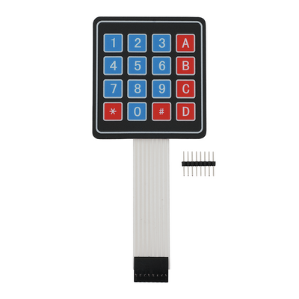
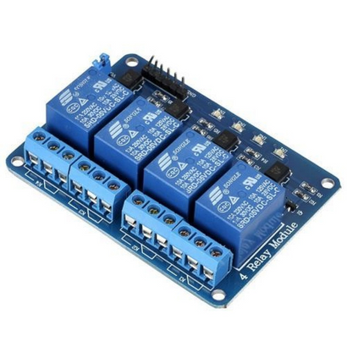
Components
Arduino Mega 2560
Power Supply
Car Window Motor
20x2 LCD
I2C
4-Channel Relay
4x4 Keypad

Slide 25


Challenges
1. Melting the Chocolate at the Right Temperature
2. Adding the Right amount of each Ingredient
3. Designing a Special 3D-Mechanism for the Topping
stage to Deal with Different Sizes
4. Making sure each step works at the Right Time
without Delays or Overlaps

Slide 26
Future Work
Implement Automatic Cleaning System for better hygiene and faster reset
Add more Flavor options for Biscuit, Chocolate and Toppings
Include a Grinding Mechanism to prepare Fresh Biscuits instead of using pre-powdered ones

Slide 27
Thank You For Your Attention

