Slide 1
Cobra
Aysar Mosallam & Saleh Sawafta
supervisor: Dr.Hanal Abu Zant

Slide 2
Outlines
What is Cobra Robot ? ​
Problems.​
Solution.
​Tools.
​Design.
Control
Constrains.​
Future Work.​​​

Slide 3
What is Cobra?​
Nowadays, robots are increasingly being integrated into working tasks to replace humans especially to perform the repetitive task.therefore a robot can be replaced human to do work . this robot designed for handicapped people to help them in their life.

Slide 4
Problems?​
Building a robot with abilities of moving around and carrying objects from place to another using mobile application. And it aims to help disabled people.

Slide 5
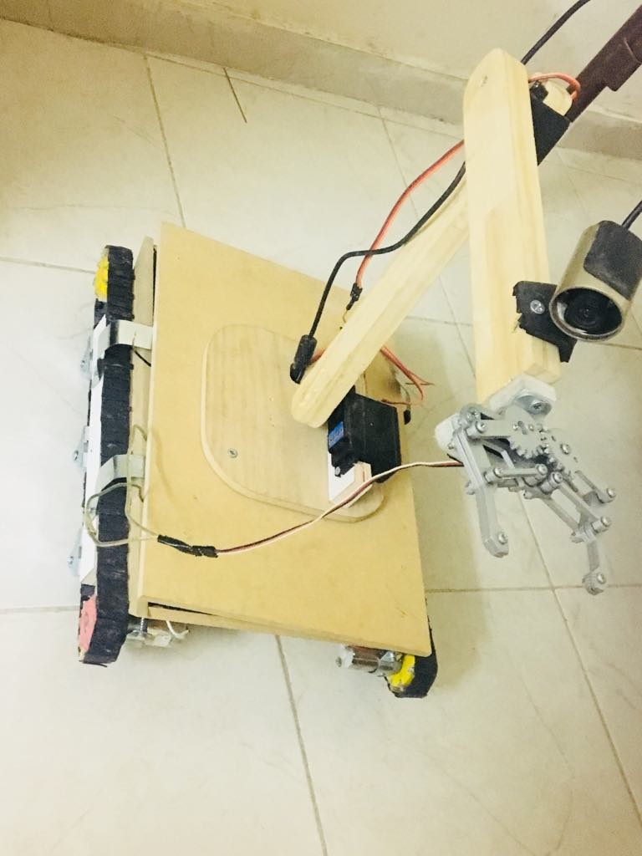
Solution

Slide 6
Tools
Raspberry pi
Arduino uno
Web Cam
StepDown Voltage
H-bridge
Ultra-sonic

Slide 7
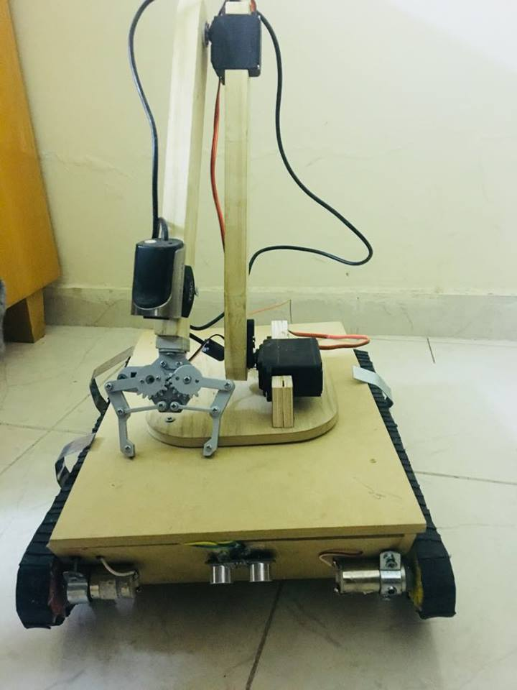
Design

Slide 8
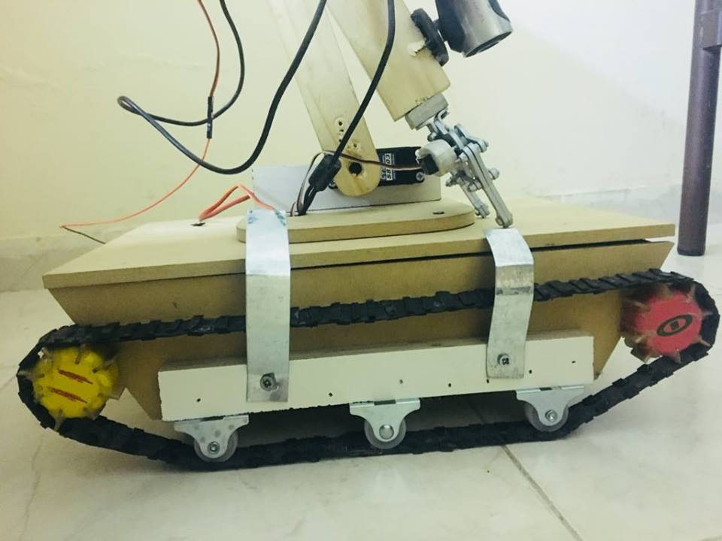
Design

Slide 9
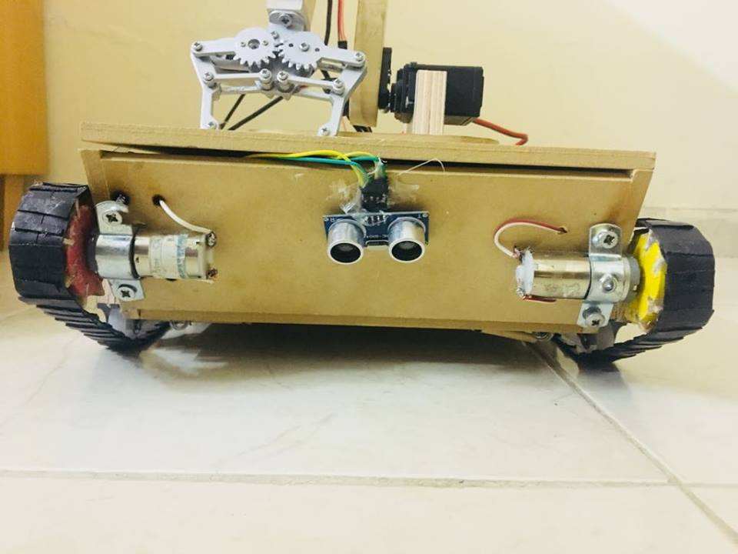
Design

Slide 10
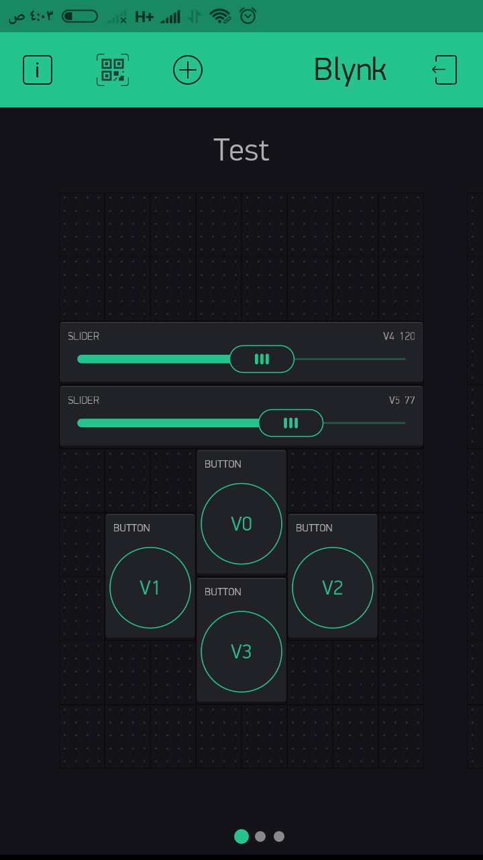
Control
it is an user interface application runs on mobile platform , used to control the whole robots such as car and arm movement based on wi-fi connection.

Slide 11
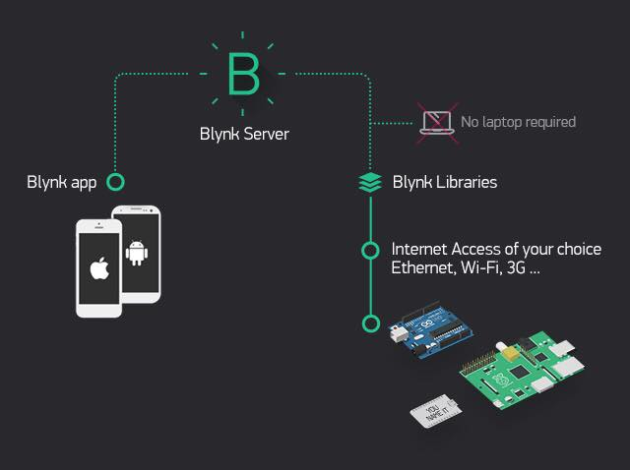
Blynk

Slide 12
Constrains​
Design
Tools
Time

Slide 13
Future Work
Enhance the design.
Artificial intelligence (AI) could be added .
Internet Connection .
Camera.

