Slide 1
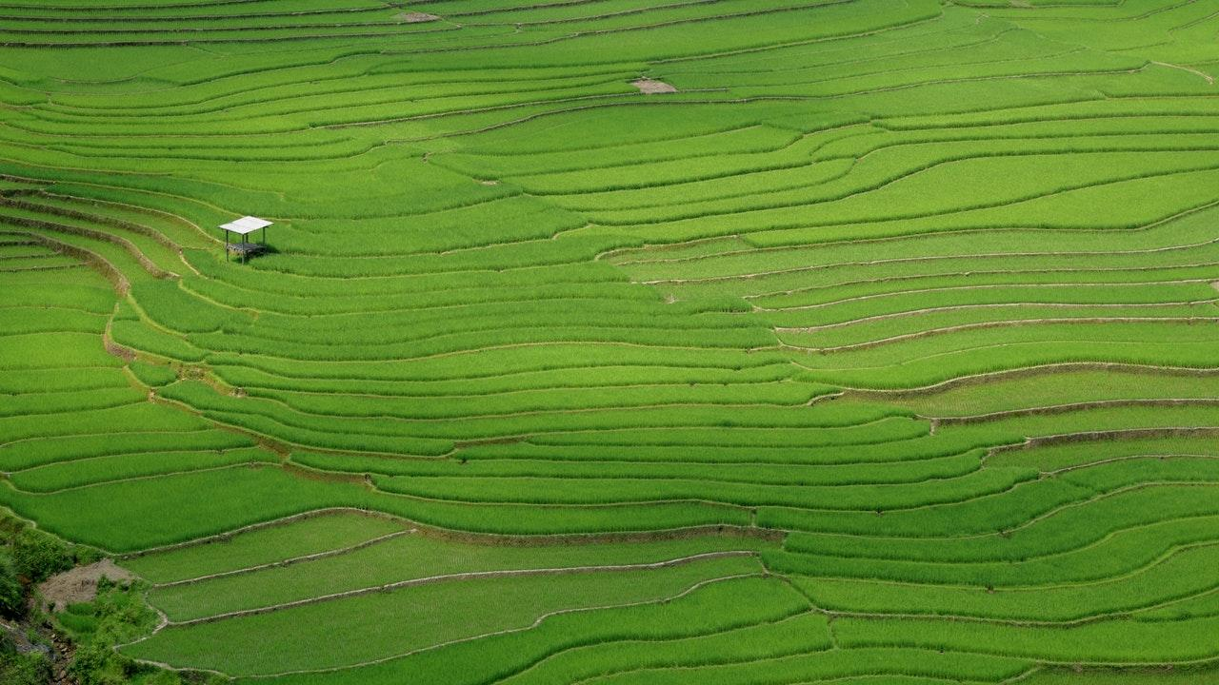
Lawn Mower
Presented by:
Maram Mayaleh
Dalia Ratrout
Supervised by:
Eng. Asma Afeefy

Slide 2

Outline:
Overview and Objectives
Tools and Technologies
Features
Constraints
Conclusion and Future work
Demo

Slide 3
Overview
Lawn Mower machine uses one or more blades to cut the grass at a specific height without human intervention in order to reduce time and efforts.
It’s used to keep the grass short, soft and equals for yard care.

Slide 4
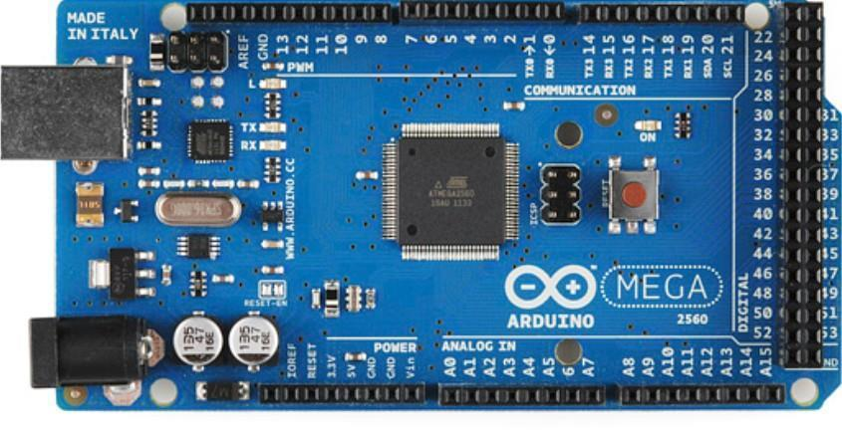
Tools and Technologies:
Arduino Mega:

Slide 5
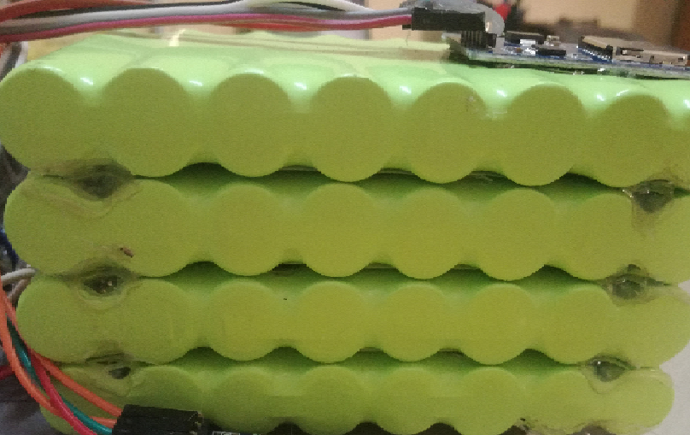
Tools and Technologies:
Charging batteries:

Slide 6

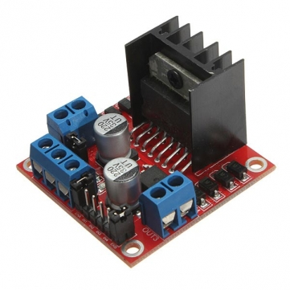
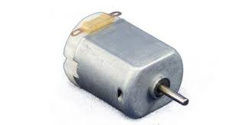
Tools and Technologies:
DC Motors
Motor Driver

Slide 7
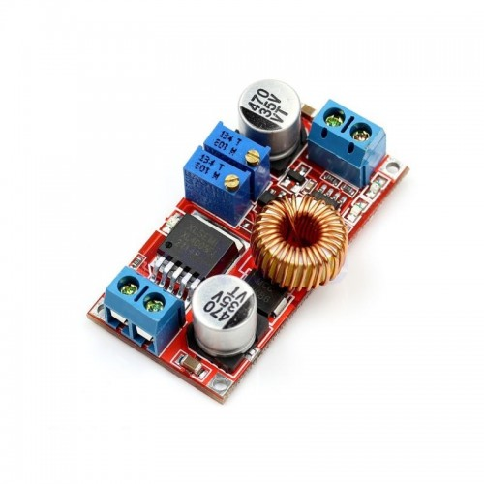
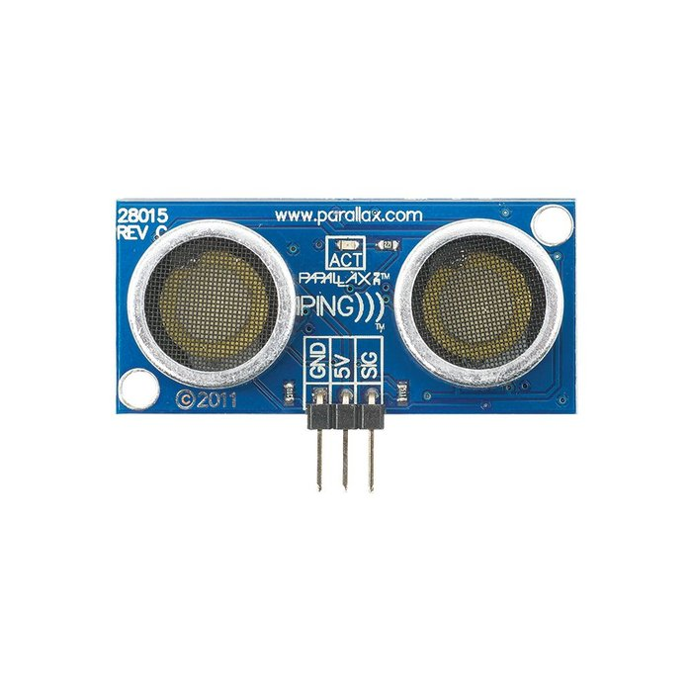
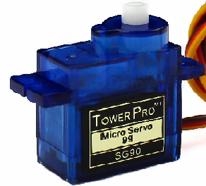
Tools and Technologies:
Voltage regulator
Ultrasonic
Servo Motor

Slide 8
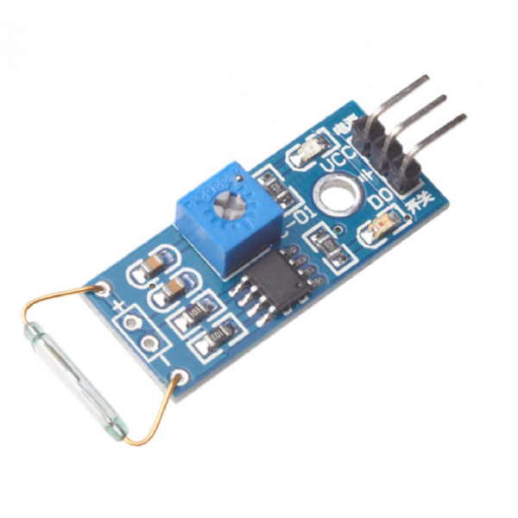
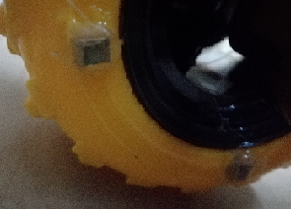
Tools and Technologies:
Reed Switch Module
Magnets

Slide 9
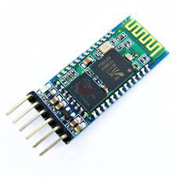
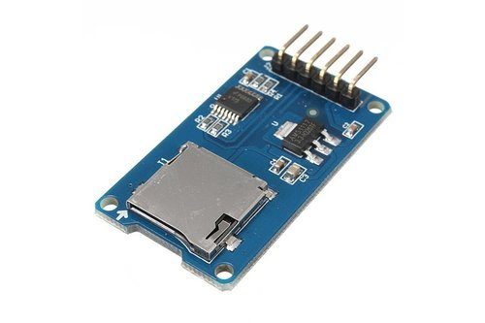
Tools and Technologies:
Bluetooth Module:
SD Card:

Slide 10
Features:
We used two methods to achieve our goal :
Algorithm way for regular areas.
Bluetooth way for irregular and regular shape areas.

Slide 11

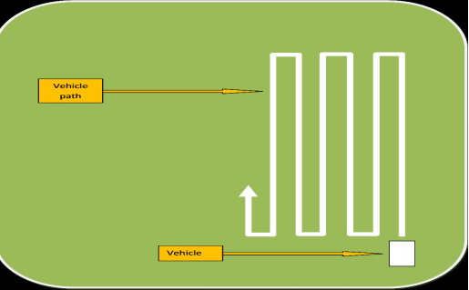
Algorithm way:

Slide 12

Bluetooth way:

Slide 13
Bluetooth way:
Via the Bluetooth, we move the car for the first time as Recording .
Then the ability of Repeating that movements at any time you need is possible .
The SD Card actually save two arrays, one for the movements and the other for the number of rolls that the wheels walked.

Slide 14
Constraints:
Structure of the car:
DC motor
recognize the lawn :
Solved by using ultrasonic sensor.

Slide 15
Future work:
Mulching or collecting the clippings.
Scanning the ground with a camera from the top.
Recharging.

Slide 16
Demo

Slide 17
Thanks !

