Slide 1
Hardware Graduation Project
Homer
By: Abdurrahman Abu-Hijleh & Amr Younis
Supervisor: Dr. Hanal Abu-Znt.
20-5-2018

Slide 2
Contents
1. Introduction
2. Components
3. Blynk
4. Mobile Application and available features
5. Conclusion

Slide 3
Introduction
Homer is a robot that brings entertainment, safety and security into its user home. It work over internet with a mobile application to control it .
Homer has many features like playing music and videos wirelessly any where inside the house, offering a live camera feed, providing sensory information about the house and detecting unseal activity.

Slide 4
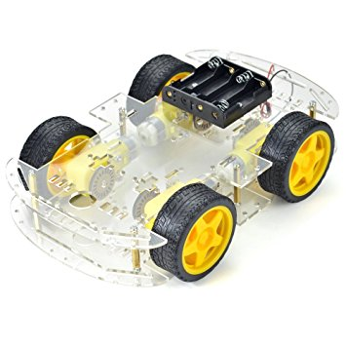
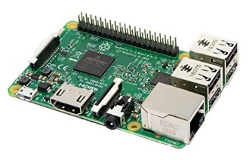
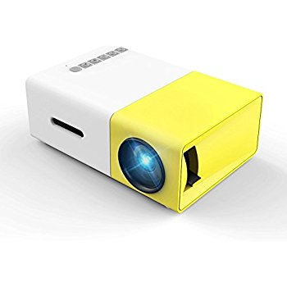
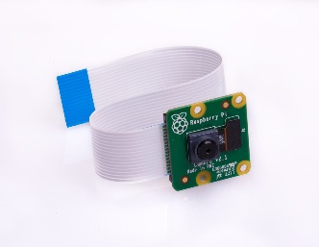
Components
1.The Vehicle Skeleton
2.Raspberry Pi 3 b
3.Portable Projector with speakers
4.Raspberry Camera Module

Slide 5
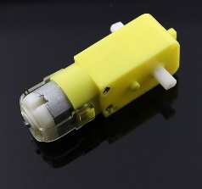
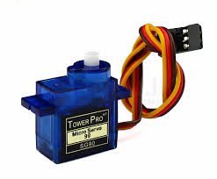
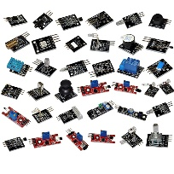

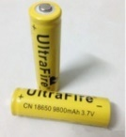
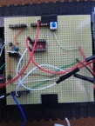
Components
5.Motors :
DC motors
Servo motor
6.Sensors:
Humidity and Temperature Sensor
Propane Gas Sensor
7. Power bank, Lithium batteries
8.Wires, Breadboard

Slide 6
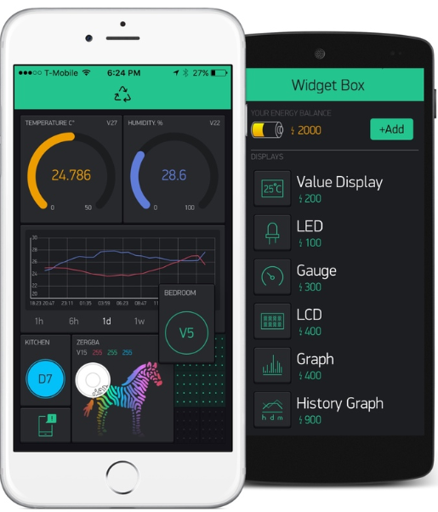
Blynk
Blynk is an IOT Platform which lets you control monitor interact with your IOT devices (Arduino , Raspberry Pi ) over internet.
Blynk was used in making this project because it provides a powerful and straightforward way of controlling and interacting with Homer.
The project’s code is mainly at Raspberry Pi side written in node.js and uses the Blynk Libraries and various other node packages like node-onoff and node-openvc.

Slide 7
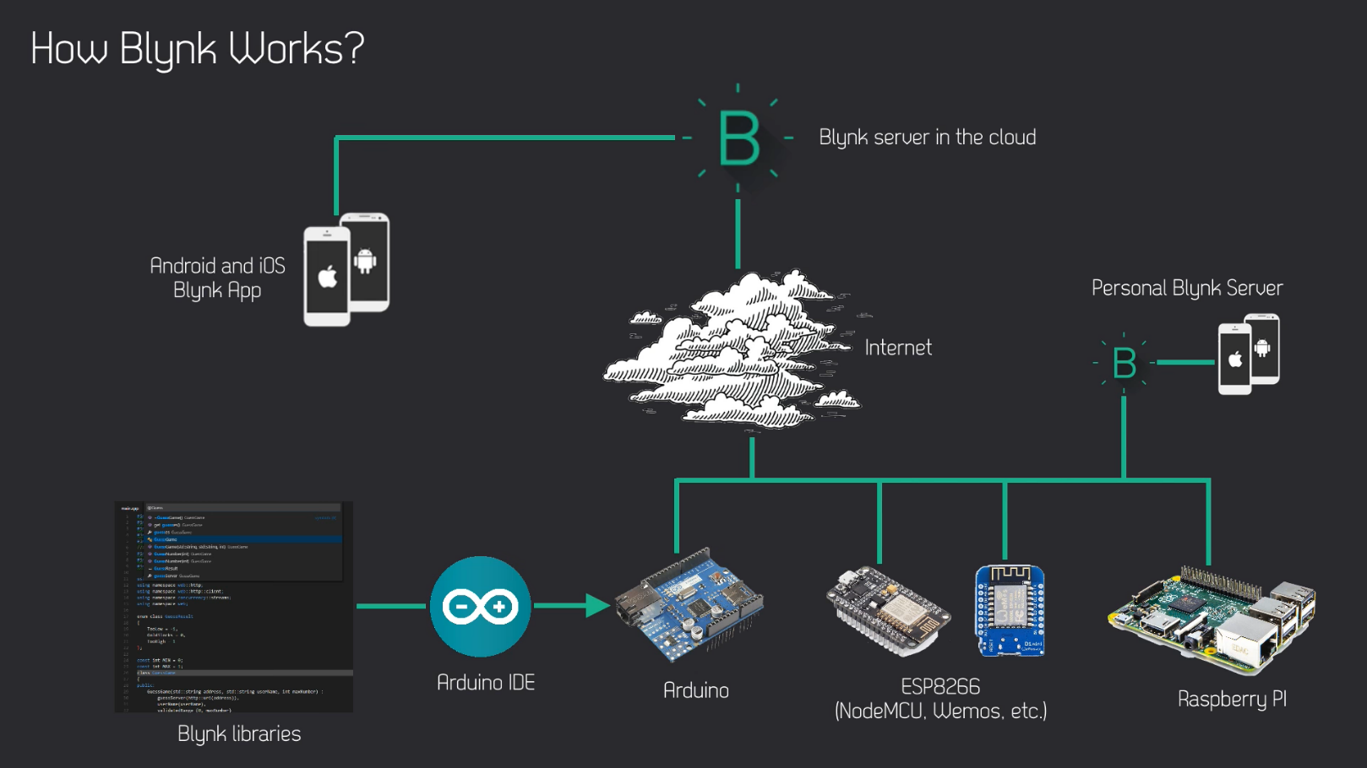
Blynk

Slide 8
Mobile Application
There are four available sections in the mobile app:
Control Area: In this section, the user can move Homer as required. Homer livestreams the camera’s feed so the user can see what is in front of the robot. Also, the user can place Homer in security mode where it will stay still and monitor the house for any suspicious movement or unusual event. In addition, the user can rotate the projector vertically up and down using a slider.
Media Center: In this section, the user can play any movie or song that is stored on a flash drive that is connected with the Raspberry Pi.
Home Analytics: In this section, the user can see the overview of the various sensor readings and information about the state of the house.
Rooms: In this section, the user can choose the room for Homer to move to automatically.

Slide 9
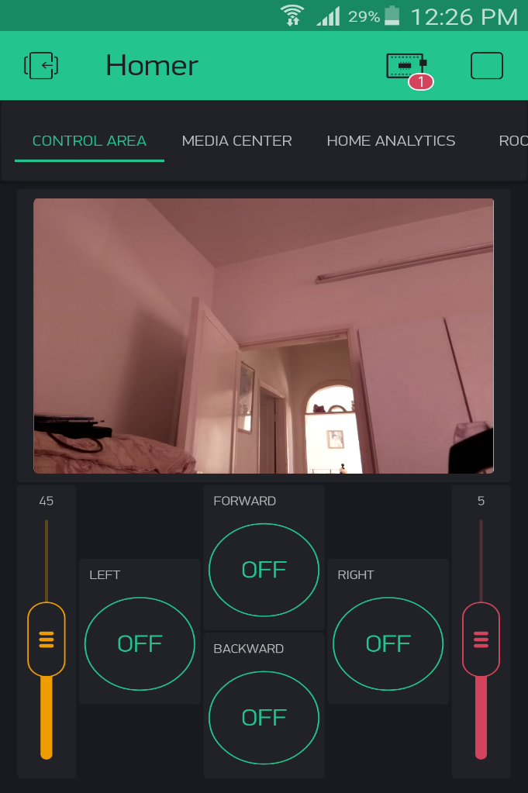
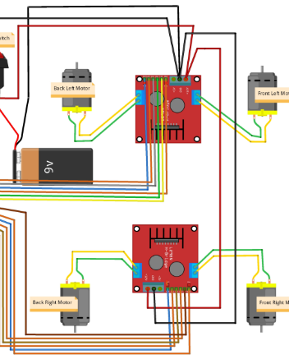
Mobile Application – Control Area
Movement and Camera feed:
We used four DC motors, and two H-birdges to control direction and speed of motors.

Slide 10
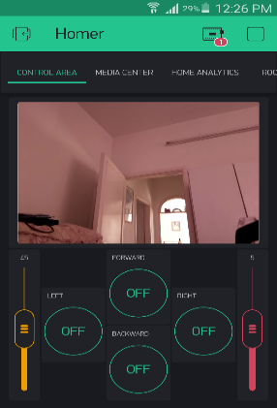
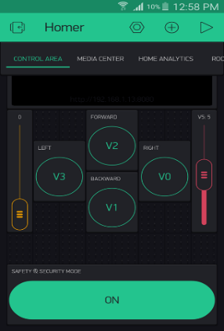

Mobile Application – Control Area
Movement and Camera feed:
We used 4 buttons to control 4 direction (FORWARD, BACKWARD, LEFT ,RIGHT).
When a button is pressed (a write event is fired) and a function is executed at the raspberry pi side which writes to GPIO pins as necessary to move in the appropriate direction.
We used a slider to control the speed of robot.
And another slider for controlling the servo motor which rotates the projector.
A live video feed of what Homer sees is shown to the user using the Raspberry Pi camera module.

Slide 11
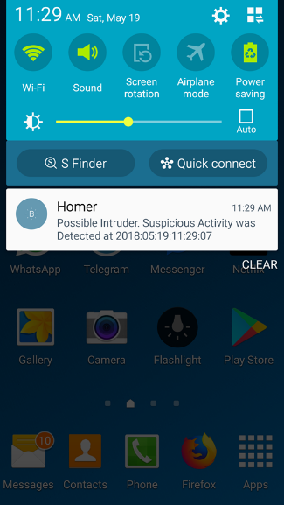
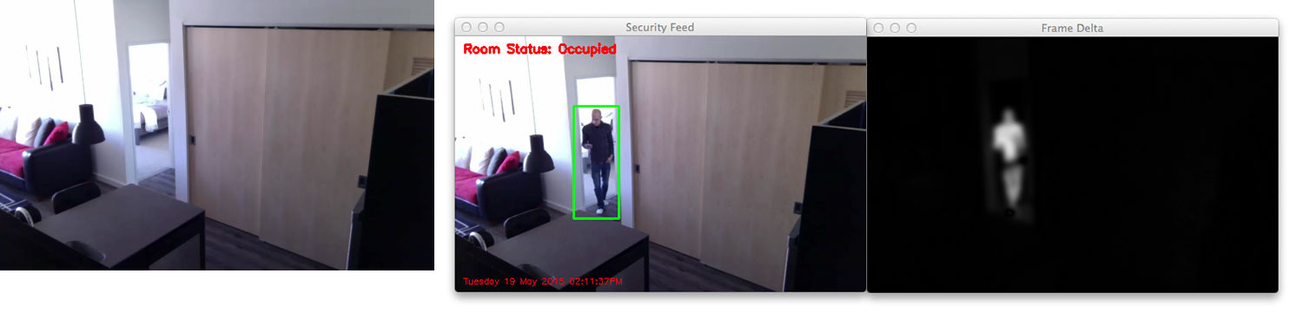
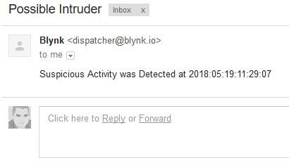
Mobile Application – Control Area
Security Mode:
While in this mode, Homer stays put while keeping the camera and the sensor readings active.
Homer sends a push notification as well as an email when an unusual event occurs. For example, if motion is detected (using image processing) or the temperature sensor reads a really high value.

Slide 12
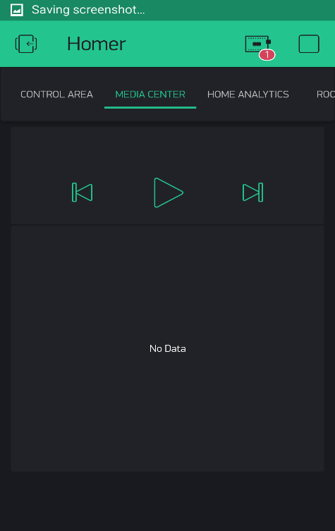
Mobile Application – Media Center
We read audio files (mp3s) and video files (mp4s for example) that are available on the flash drive connected to the Pi.
We send that information to the mobile application
The user can click on the media to be played.
The media will be displayed using Homer’s portable projector.

Slide 13
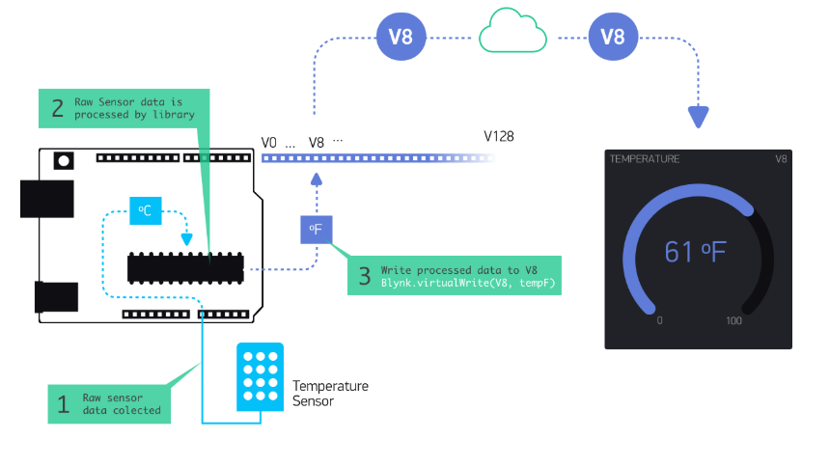
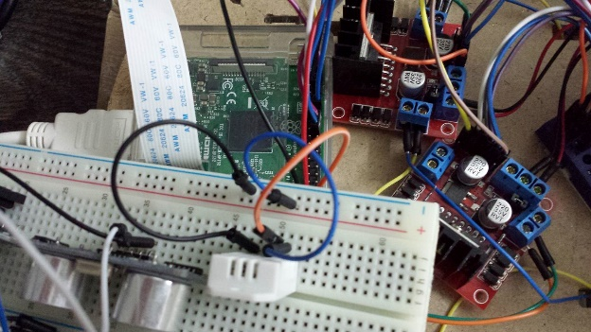
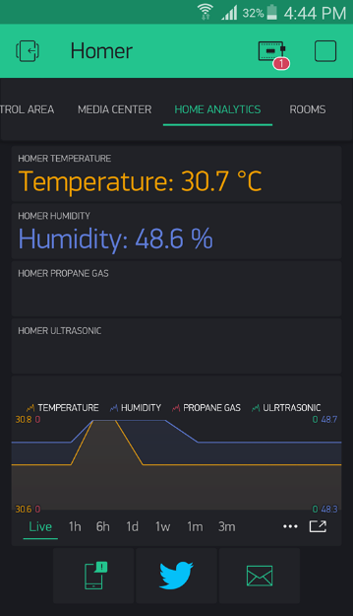
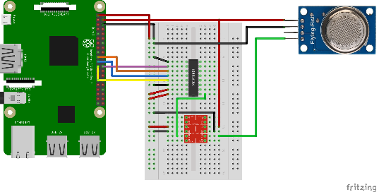
Mobile Application – Home Analytics
Sensory data such as temperature and humidity that Homer measures using sensors connected to its GPIOs is sent to the mobile application in order for the user to review.
In addition, sensory data that is available on the smartphone itself is also displayed in comparison if the mobile device supports it.

Slide 14
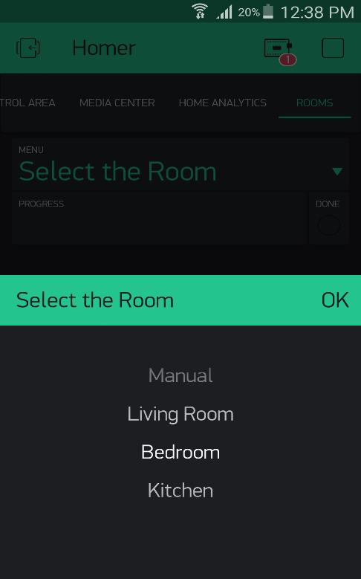
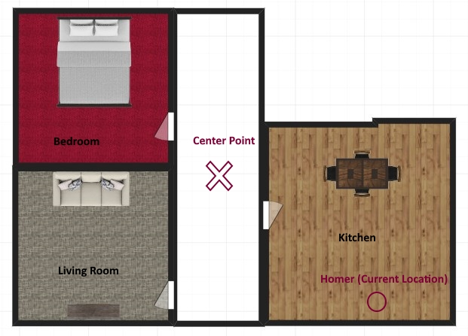
Mobile Application – Rooms (Automatic Pathing using image processing)
The User chooses the room which Homer is supposed to go to.
Homer tries to find the required path and move to a specific room on its own.
Decisions are made based on camera frame analyzation using image processing.
We helped Homer by putting markers in the house for which Homer can recognize and move as planned.

Slide 15
Conclusion
At the end of this project, the creation of the Homer robot has been completed, where the robot can serve the user without the need of wires and the ability to turn any room into a movie theater using a video projector as well as many features that provide safety and security to the house.
This project has allowed us to learn about many things, in terms of dealing with different types of devices and integrate them efficiently to make a working product and also to learn about hardware limitations and constraints . In addition to relying on a large number of previous courses which gave us an opportunity to consolidate information in our minds.

