Slide 1

GRADUATION PROJECT 2
SMART TRAFFIC CONGESTION CONTROL
PREPARED BY:
MAY THAHER [11525094]
JAMILA AHMAD [11611931]
RAWAN HASSAN[11526781]
NOUR SUWAN [11525281]
SUPERVISOR:
DR. FALAH MOHAMMAD

Slide 2
01
Introduction
02
Solving Traffic Congestion Using Different Methods
03
A description of our project
2020
04
Results
05
The problems that we faced during the project
06
Conclusion
07
Recommendation

Slide 3
Introduction
Our cities and the world population are getting bigger and bigger, our roads become larger, so that traffic congestion become one of the biggest problems facing cities around the world, and perhaps the most important factors that led to it.
Among the problems facing us in Palestine is the presence of the Israeli occupation, which works to hinder the development and prevent drilling in many areas of infrastructure development, in addition to the lack of advanced radio communication networks such as the fifth generation.
So we tried to manage traffic in our project because it can play a role in reducing traffic congestion, improving safety, and reducing gases produced by cars. It also reduces human control of the Vehicle.

Slide 4
Solving Traffic Congestion Using Different Methods
Solve traffic congestion by image processing:
This method is used to track vehicles, counting, the average speed of each vehicle, analysis of traffic targets and vehicle classification. Image tracking for moving vehicles can provide us with a description Quantification of Traffic Flow.
Computer Vision Based Vehicle Detection and Counting System in MATLAB
Vehicle detection and counting system plays an important role in the intelligent transportation system, especially for traffic management. This introduces video-based method for vehicle detection and counting system based on computer vision technology. The proposed method uses the background subtraction technique to find the forward compounds in the video sequence. In order to detect moving vehicles with high accuracy and explained.

Slide 5
Solve traffic congestion by Video processing in Python
Vehicle counting process provides appropriate information about traffic flow, vehicle crash occurrences and traffic peak times in roadways. An acceptable technique to achieve these goals is using image processing methods on roadway camera video outputs.
The accuracy from video is very high as compared to other technologies. such that video infrared, magnetic, radar, ultrasonic, acoustic, and video imaging sensors.
However, the image processing is time consuming and requires some automation to save the time for image count and classification. in current era of python type programming language has much addition of image processing and time saving for vehicle detection and counting.

Slide 6
A description of our project
Ultimately, we choose Video Processing using both MATLAB and Python in order to count cars, traffic light will open or not depending on the number of counted cars.

Slide 7
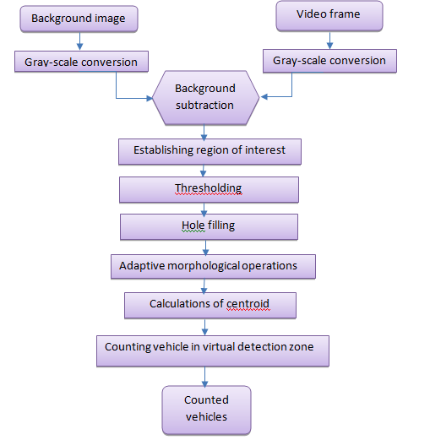
Flowchart to describe video processing by MATLAB.

Slide 8
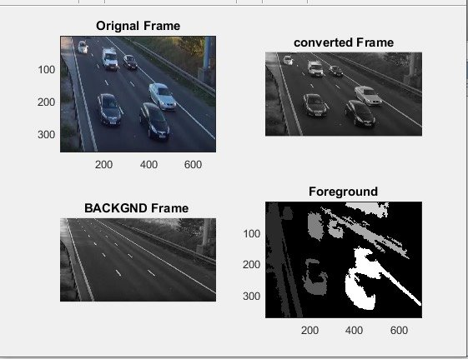
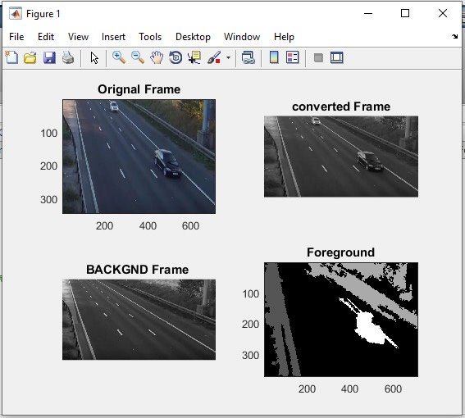
Results
By MATLAB
Six cars detected
6
Two cars detected
2

Slide 9
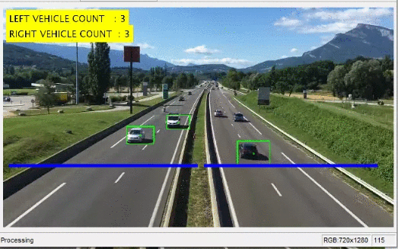
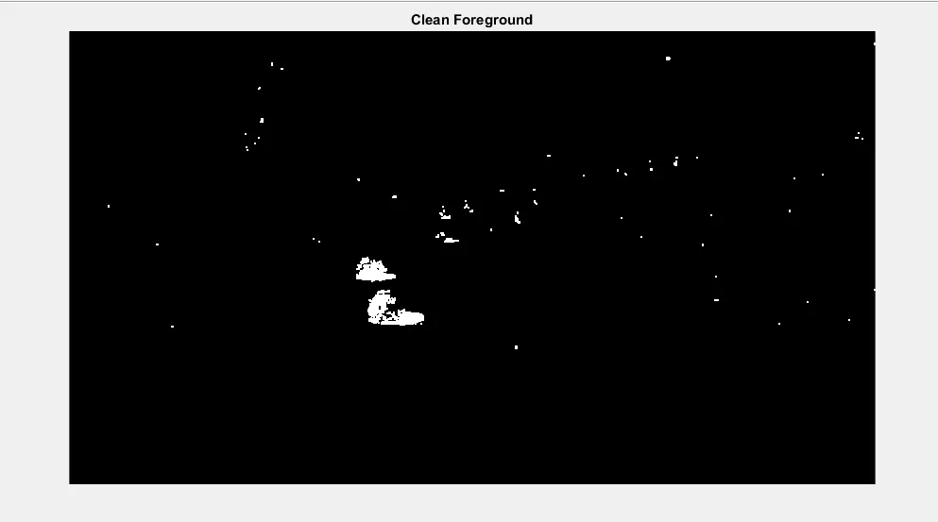
Video Processing By MATLAB
Counting cars in
RGB
Counting cars in gray scale

Slide 10
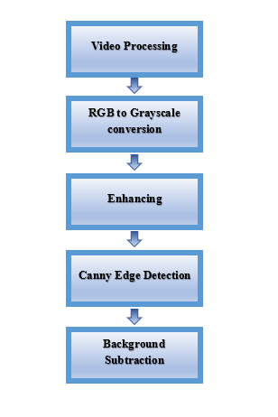
Flowchart to describe video processing by python

Slide 11
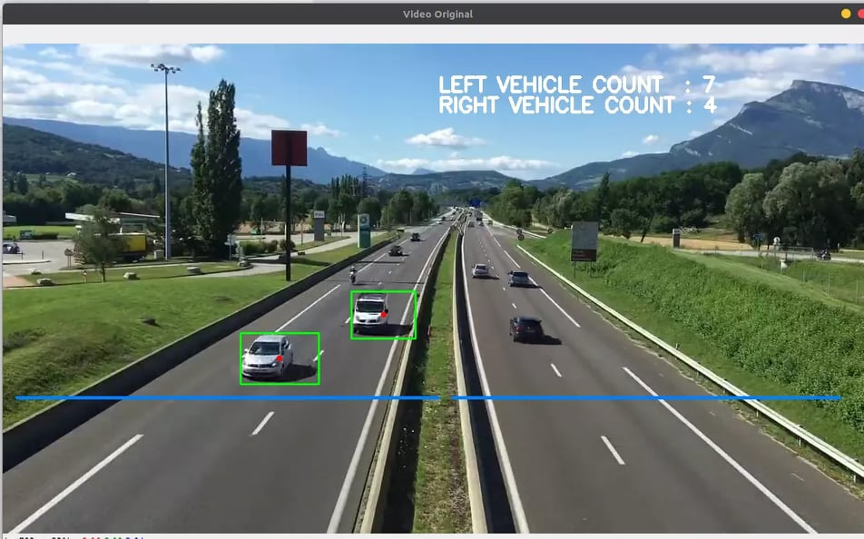
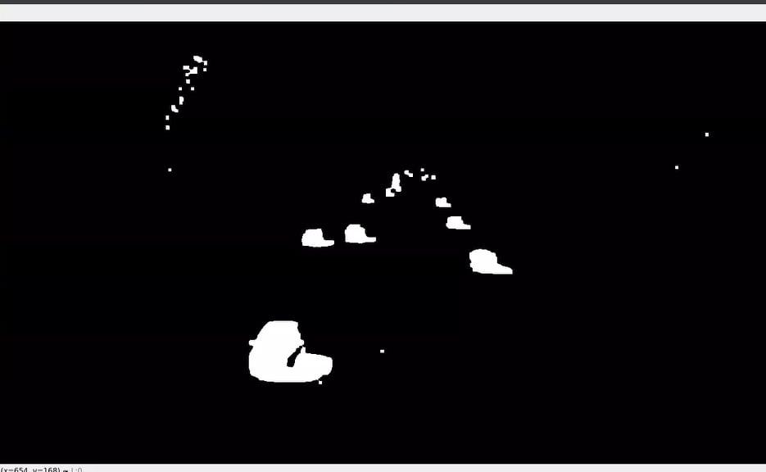
Video Processing By Python
Counting cars in
RGB
Counting cars in gray scale

Slide 12
The problems that we faced during the project
When implementing any project, we may face several problems, some of which may have a simple solution and the other that you must work hard to solve.
In our project, the problem was different for the first time in the world. Our project coincided with the appearance of the Corona virus and the curfew. This made it difficult for us to take video .
The location of the camera is also one of the biggest problems that we have faced, so in order to shoot the video, the camera must be in a high and stable place in a relation to the cars.

Slide 13
Conclusion
Using video processing, which is the most effective way, we were able to control traffic and reduce the traffic crisis, away from traditional techniques.
This technique is effective nowadays and easier because we do not need to break the road surface in order to install a camera, also, the frames carried in the video have much information than which obtained from a conventional method. The code we used shows the results of the success counted cars.

Slide 14
Recommendation
At first by despite to the conditions in our country, Palestine, we recommend to this project to our government. Also, we hope in the future it will be implemented due to its simplicity, efficiency and low cost. Moreover, we recommend to develop and apply it in a way that ameliorates and serves citizens.

Slide 15


GRADUATION PROJECT 2 DONE

