Slide 1
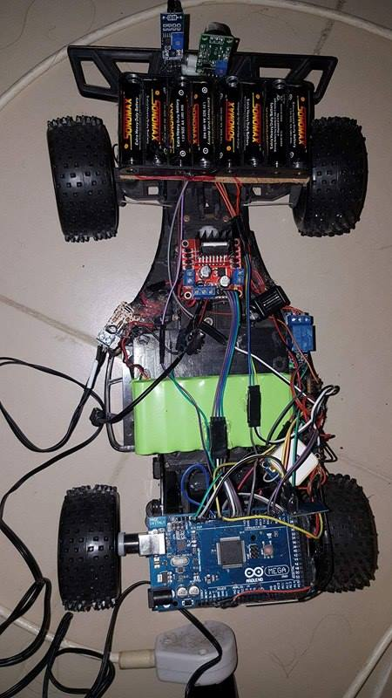
Automated Fire Man

Slide 2
Al-Najah University
Computer Engineering Department.
Automated Fire Man
Supervised by:
Dr.Raed Al-Qadi & Eng.Asma Afeefi
Prepared by:
Enas Awwad & Ahmad Mansour
Apr 19,2016

Slide 3
Outline
Objective
What is Automate Fireman??
Constraints
Component Used
Software Part
Image processing using raspberry
Flow Chart OF System
Conclusion
Future work
Demo

Slide 4
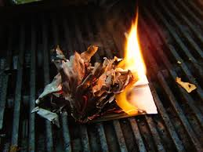
Objective
Education is not the filling of a pail, but the lighting of a fire.
William Butler Yeats
Automate Fireman was Build to reduce the damage of the fire ,our goal was in this project employed modern technology to protect person life from damage in different way

Slide 5
What is Automate Fireman??
Automated Fire Man facilitating the traditional ways of fight fire. It composed of a Flame sensor, Raspberry Pi camera to detect smoke using grayscale , Motion and Color detection by using image processing to switch the pump on to destroy fire.
Automate Fire Man stream video from the Raspberry Pi using MJPG-Streamer in case an object was on the road to give user ability to see everything and control the car and the pump remotely a Wi-Fi component used.
Also GPS component used to send the location of the fire to both fire station and owner of the home via SMS Message and a loud noise issued if there are people around to protect their life.

Slide 6
Constraints
Time constraints
Software Constraints:
Image Processing
WIFI Configurations
Hardware Components

Slide 7
Flame Sensor
Charging Battery
Car Module
Smoke Detector
Pump Module
Raspberry Pi 3
Component Used
    Raspberry Pi camera:
GSM module
Arduino Mega
GPS Module
    WIFI Module

Slide 8
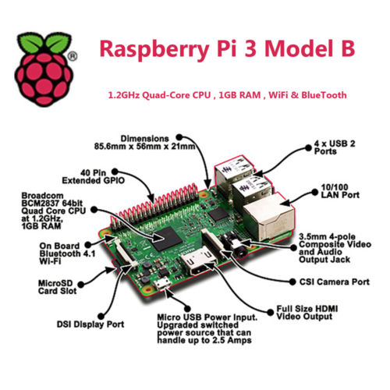
Raspberry Pi 3
boasts improved performance, connectivity and power management with a 64-bit CPU and onboard Wi-Fi and Bluetooth.
Notes:
If not have a google account he or she can create an new one and continue enjoy our application
After that the user should select which account want to log in with and will see his information and the profile picture on his google plus acount

Slide 9
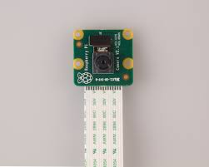
Raspberry Pi camera
It used to take high-definition video, as well as stills photographs.
It’s easy to use for beginners.

Slide 10
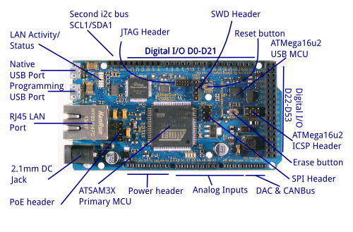
Arduino Mega(2560)
54 digital input/output pins.
16 analog inputs.
4 UARTs (hardware serial ports).
The Arduino IDE(1.6.7 v).

Slide 11
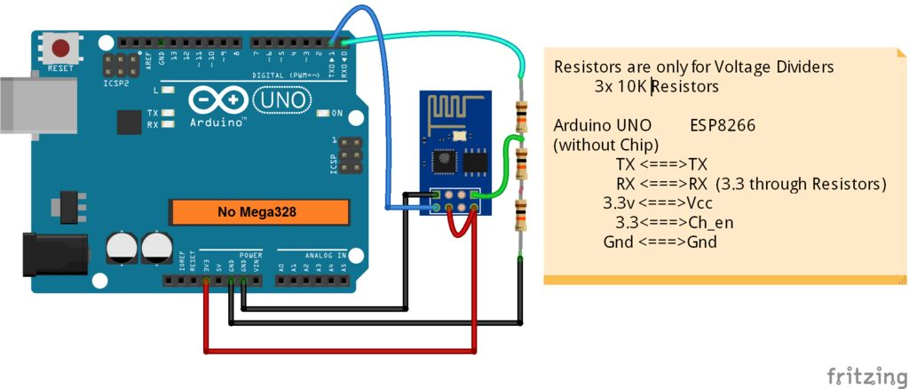
Wi-Fi Module ESP8266
* Its is a self-contained SOC with integrated TCP/IP protocol stack that can give any microcontroller access to your Wi-Fi network.
* Its capable of either hosting an application or offloading all Wi-Fi networking functions from another application processor.

Slide 12
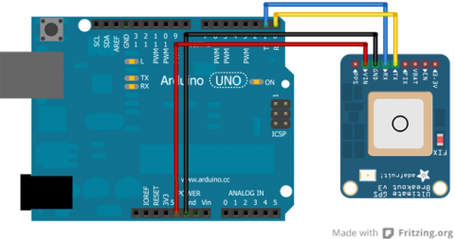
GY-NEO6MV2 GPS Module with antenna:
We Choose GPS module NEO-6M with:
3V-5V power supply Universal
LED signal indicator with data backup battery
default baud rate: 9600

Slide 13
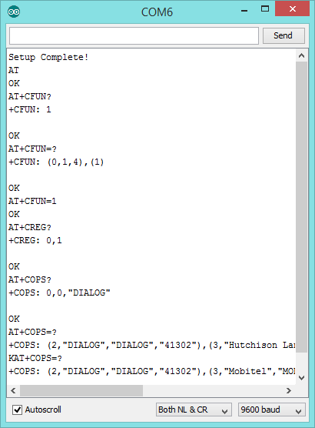
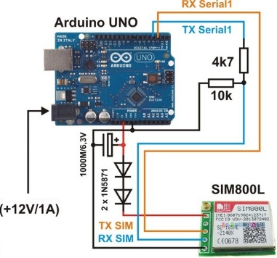
    GSM module (SIM800L)
SIM800 is one of the most commonly used GSM module among Arduino community

Slide 14
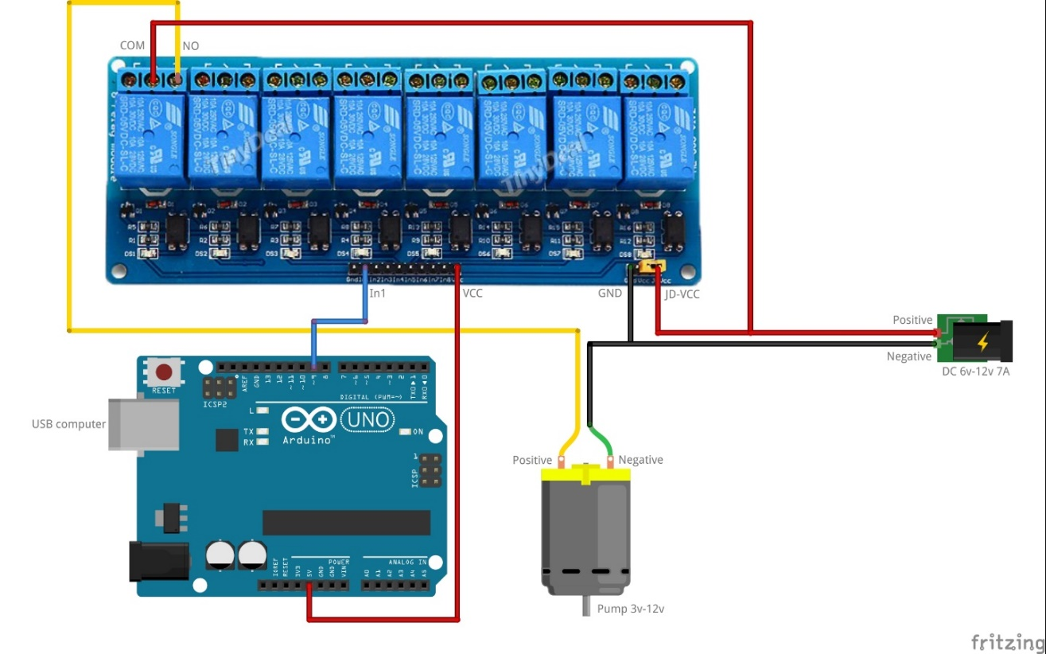
Pump Module: 12V Diaphragm Pump for Water

Slide 15
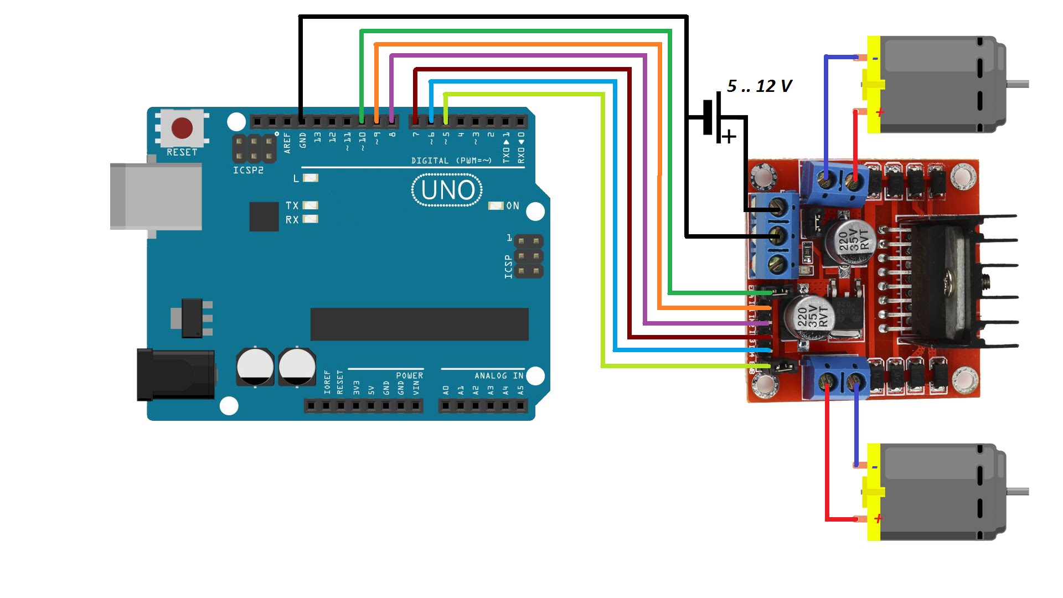
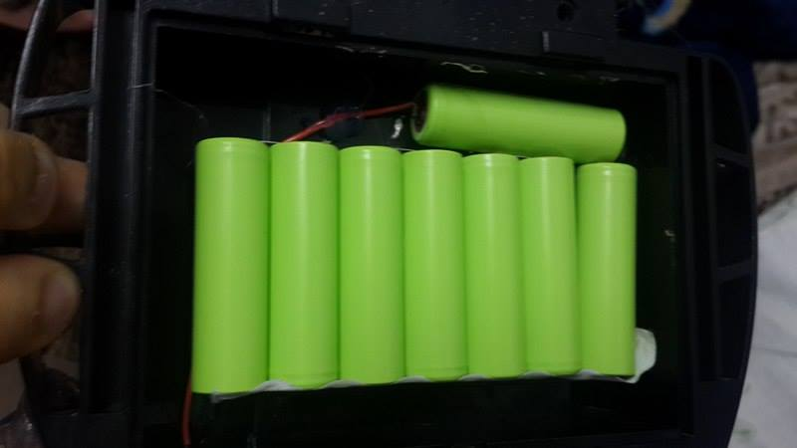
      Car Module and Battery Charging

Slide 16
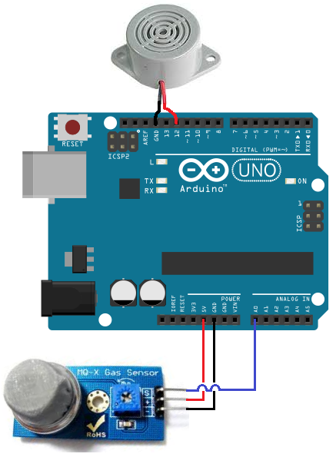
    Smoke Detector: MQ-2 Detector
connect the smoke sensor to the 5V terminal of the Arduino and terminal 3 to the GND terminal of the Arduino.
The output of the sensor goes into analog pin A0 of the Arduino.

Slide 17
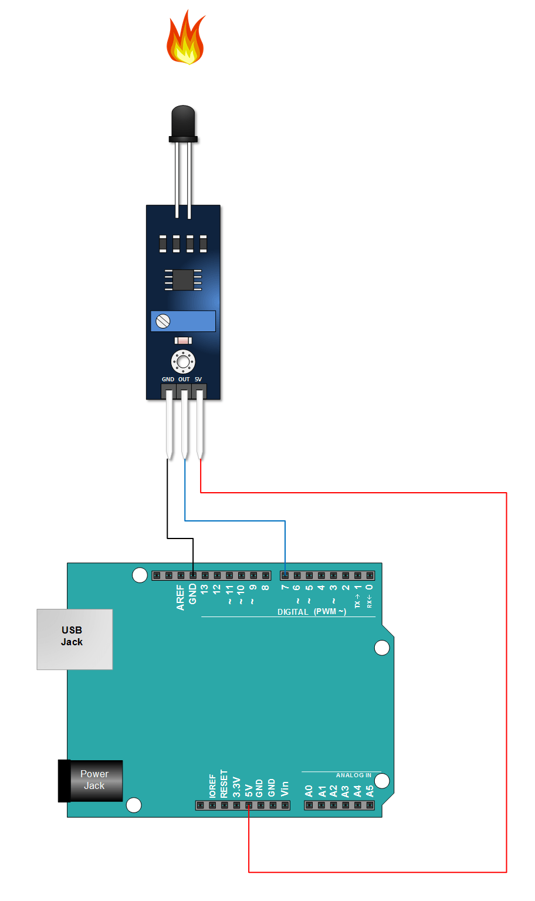
Flame Sensor
We used to detect fire source or other light sources of the wavelength in the range of 760nm - 1100 nm.

Slide 18
Software Part
Image Processing
Software
Streaming Video
Website

Slide 19
Image processing using raspberry
Motion Detection
Edge Detection
Color Detection

Slide 20
Motion Detection
Start
Start Video Input
Consecutive frame Subtraction
End
Thresholding
Contour Detection of object
Filtering
Object detection

Slide 21
Color Detection
Start
Video Input in RGB form
Convert RGB to HSV
Apply Threshold of HSV Range for Fire
End
Display Result

Slide 22
Detection of fire
Get Frames from Raspberry camera
Start Video Streaming
Perform Motion Algorithm
Start
No
Yes
Check Flags of Algorithm
perform Color and edge algorithm
End
No
Check Flags of Algorithm
Send 1 to Arduino
Yes

Slide 23
Flow Chart OF System
Yes
Check movement of car
Yes
Check Values of Flags and Sensor
Move car ,turn on pump
No
Start
Send to user to notify them
No
Move car using website and video streaming
End

Slide 24
Conclusion
In Automatic fireman Raspberry pi helped a lot in fire deduction and image processing
Wi-Fi component facilitate doing stuff remotely and locating the damage location,
Flame and smoke sensors facilitate finding fire, the combination of all those components beside the software technologies and algorithms emerge Automatic fireman

Slide 25
Future work
Add more features to make it more reliable and secure.
Add more algorithm to get more accurate result of detect fire using image processing

Slide 26


