Slide 1
Pharmacy Automation system
-PAS-

Slide 2
Outline
Introduction .
What problem does PAS solve.
Parts.
Project Timeline.
How does PAS Work.
Final Product.
Future Work.

Slide 3
1.
Introduction

Slide 4
PAS It is a system for a fully smart pharmacy that works to provide any type of medication-drug- available in that pharmacy by just searching for the name of the drug on the mobile or laptop. Then the arm with the basket, which moves in a movement x,y, in front of all the shelves, where this arm moves to take the drug and bring it to the origin point.
As well as the pharmacist can the insertion-input- of drug on the existing shelves.

Slide 5
What problem does PAS solve

Slide 6
What problem does PAS solve
-Employees in general pharmacies, which makes it easier for them to work and produce quickly and accurately.
-Huge pharmaceutical companies, which makes it easier for them to classify and arrange products in warehouses properly, correctly and without complication.

Slide 7
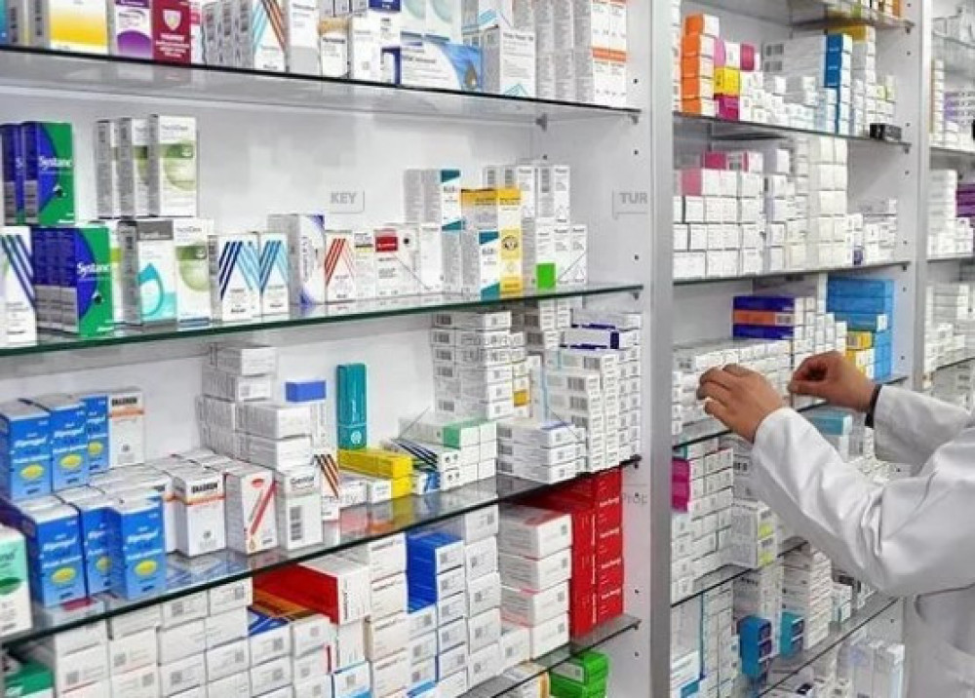
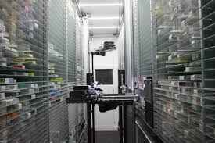
What problem does PAS solve
Befor solution
After solution

Slide 8
Parts
-Mechanical
-Electric

Slide 9
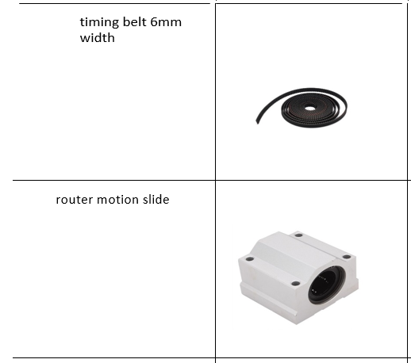
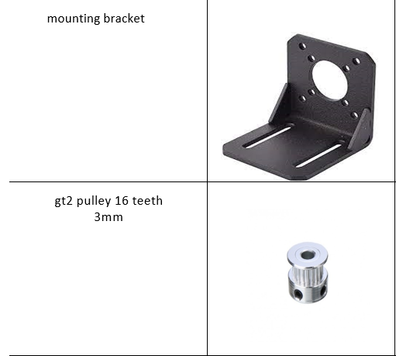
Mechanical Part

Slide 10
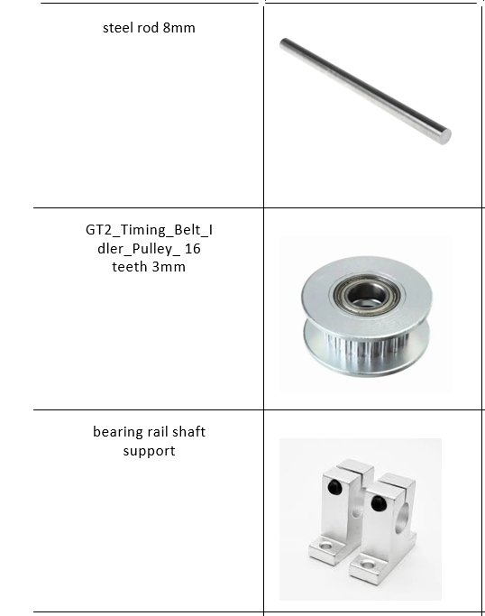
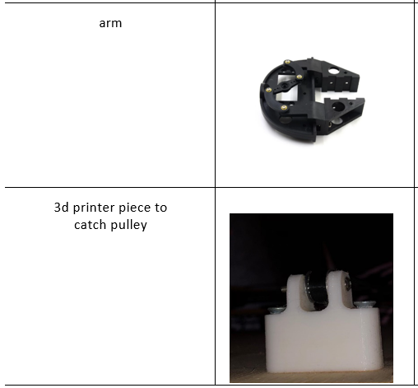
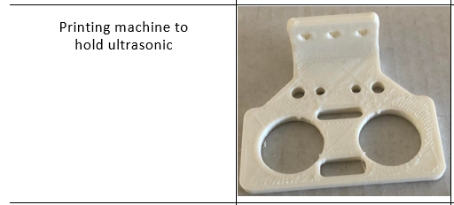
Mechanical Part

Slide 11
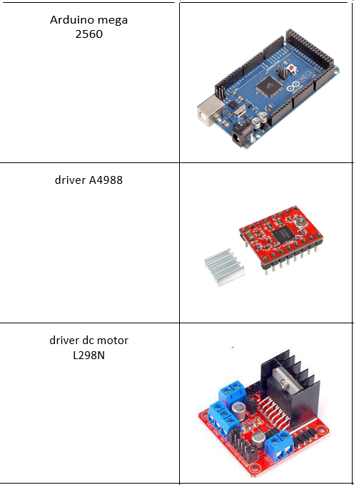
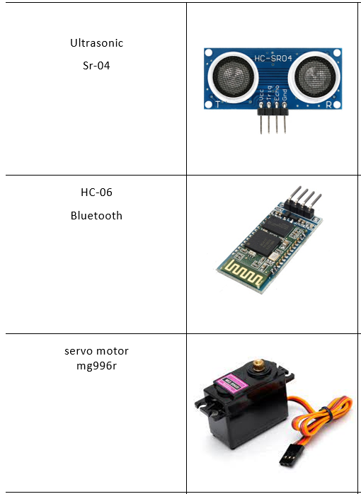
Electric Part

Slide 12
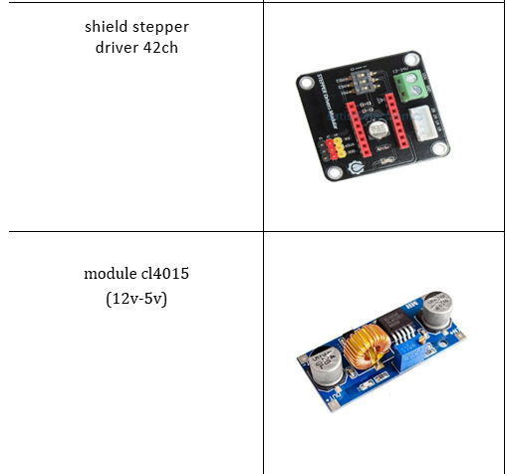
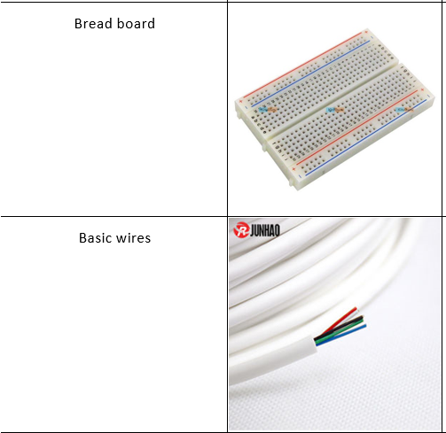
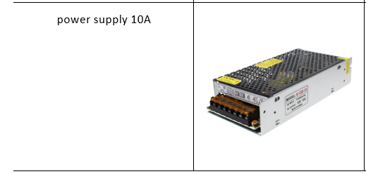
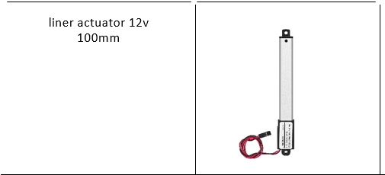
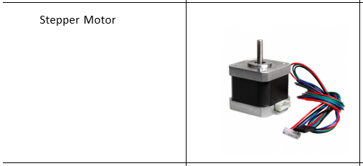
Electric Part

Slide 13
Project Timeline
buy parts
Connecting electrical parts to the project
Confirm the idea
1
3
5
2
4
6
Planning how to implement the idea
Building the project structure
Testing

Slide 14
How does PAS Work.

Slide 15


How does PAS Work.
-Initially run the system.
-Here you are given two options to use the system, either from your laptop or your phone

Slide 16
How does PAS Work.
-The serial screen will appear in front of you.
حفظ الترجمة
-As shown. It requires you to choose the process either output ,Input.

Slide 17
How does PAS Work.
-If operation is Output
-It shows you a list of the existing drugs along with their count.
-It requires you to search of drug you want.

Slide 18
How does PAS Work.
-The arm goes with the cart to the shelf for the medicine you ordered and catch it, if it is found, and returns it to the point of origin at which the drug is taken.

Slide 19
How does PAS Work.
-If operation is Input.
-It shows you a list of the existing drugs with their count.
-It requires you to write the name of drug you want to put it in right shelf.
-If the shelf is not full,the arm open then require from you to put the drug in the designated place in the arm. Then he goes to his shelf and inserts it, and return the point of origin.

Slide 20
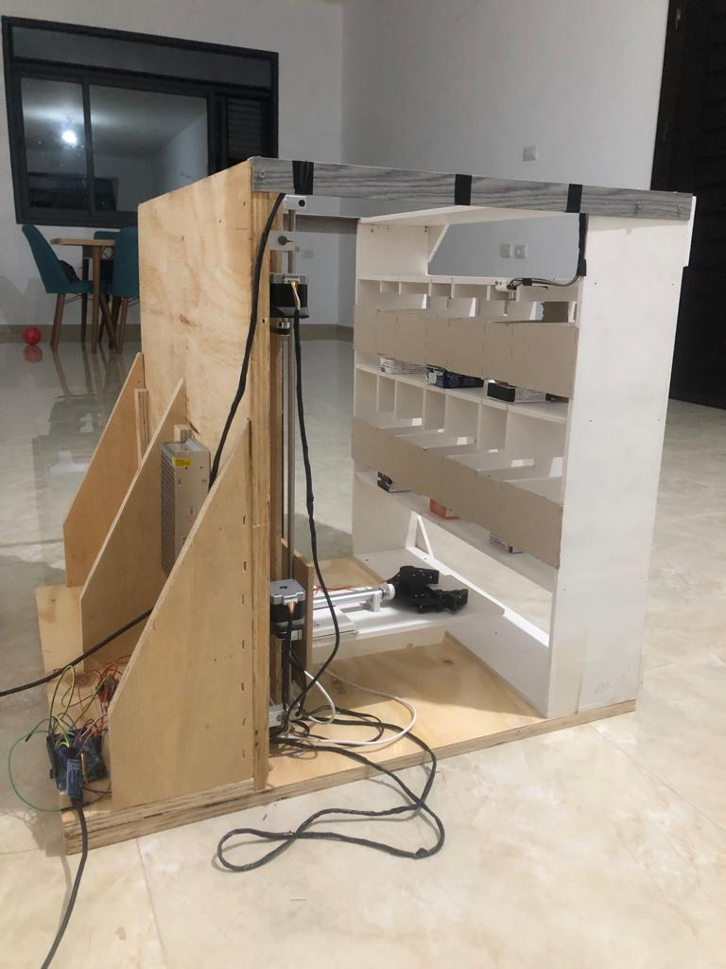
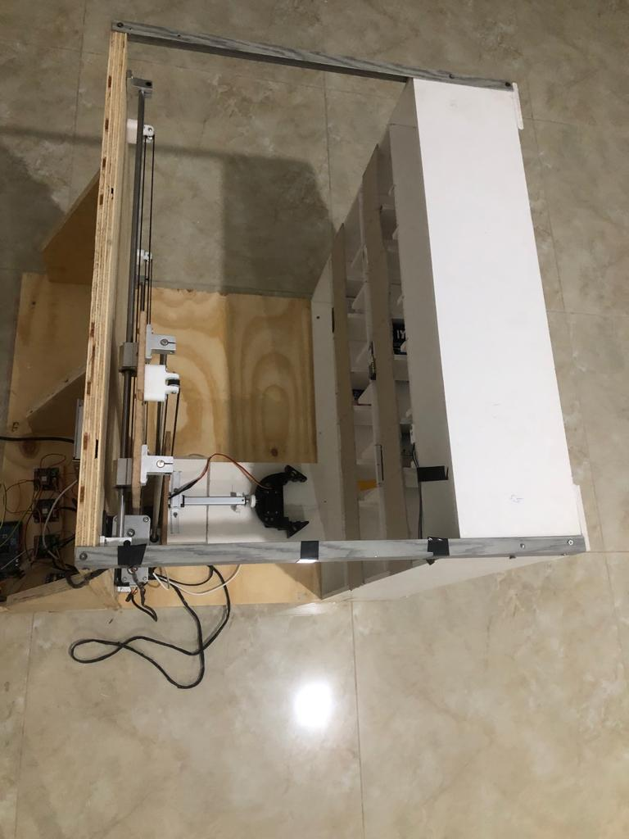
Final Product

Slide 21
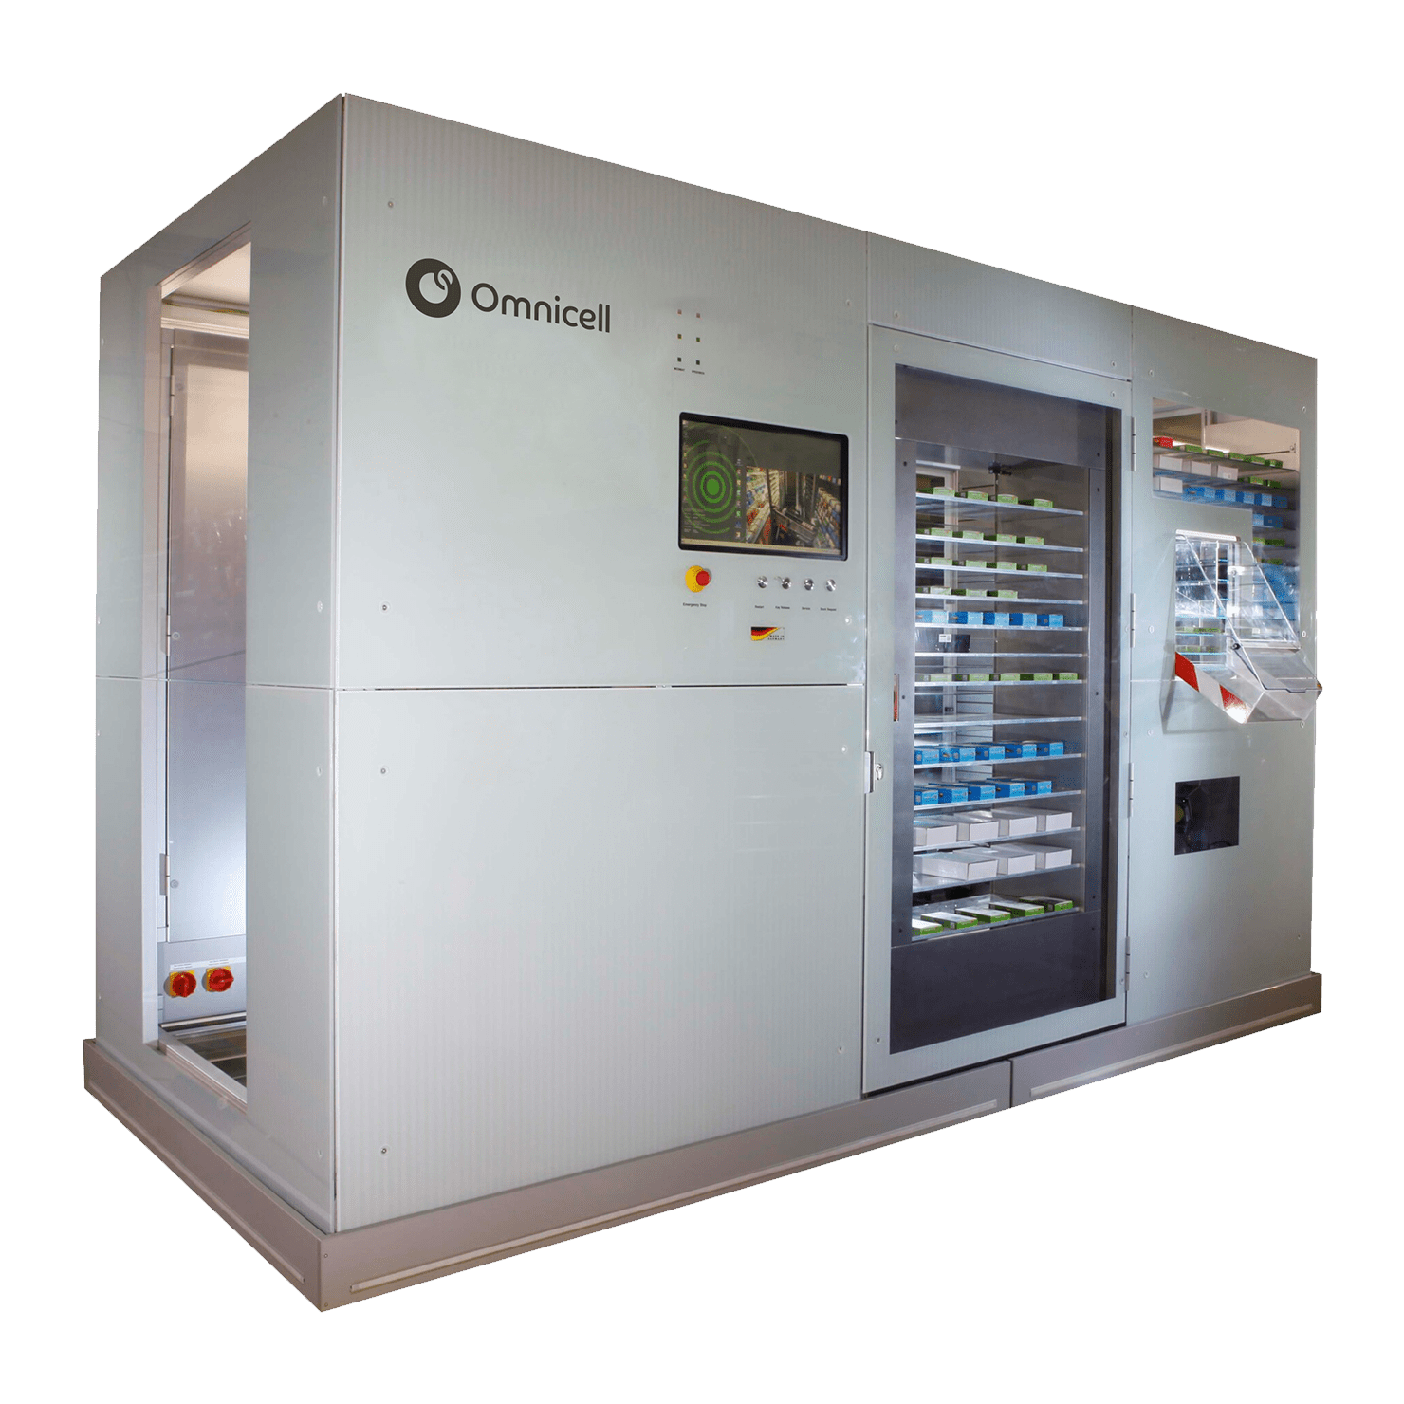
Future work
-You can also provide pharmacies in public places in the form of a closed room without the need for employees

Slide 22


Team Presentation
Hosny Ishtaya
Hamza Khaleel

Slide 23
THANKS!
Any questions?

